Slide 1
Module 2: Safety & Input/Output Devices
PLC Tabletop Training Program · Lecture + Lab · 2.5 h
v1.0 (April 2026)

Slide 2
Learning objectives
Identify the main input device types and describe the signal each sends to the PLC
Identify the main output device types and describe how the PLC drives each
Understand the difference between standard I/O and safety I/O (dual-channel, OSSD)
Recognize additional field devices: photoelectric sensors, encoders, solenoid valves, VFDs

Slide 3
Overview
Input devices (sensors, switches, safety devices) and output devices (motors, relays, valves) — how they work and how they connect to the PLC.

Slide 4
Lesson: Input Devices — Sensors & Switches
Proximity sensors, limit switches, photoelectric sensors, push buttons

Slide 5
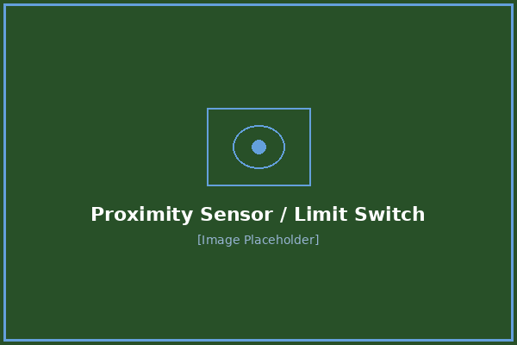
Proximity Sensors
An inductive proximity sensor detects metal objects without physical contact. It sends a 24VDC signal to the PLC digital input when a metal target enters its sensing range. Available in NPN (sinking) and PNP (sourcing) output types.

Slide 6
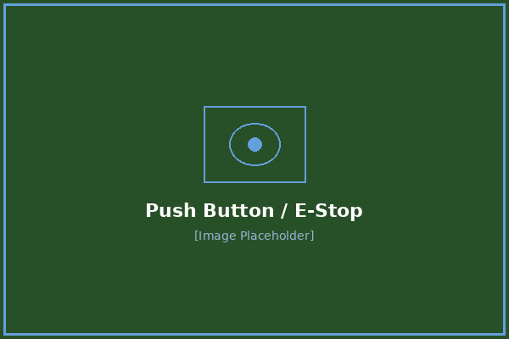
Limit Switches
A limit switch is a mechanical contact sensor that triggers when an actuator (lever, roller, plunger) reaches its end-of-travel position. Provides either Normally Open (N/O) or Normally Closed (N/C) dry contacts.

Slide 7
Photoelectric Sensors
Photoelectric sensors use light beams for detection. Three main types are used in manufacturing:
Table: Type | Configuration | Range | Best For
Through-beam | Separate emitter + receiver | Longest (up to 30m) | Part counting, conveyor jam detection — most reliable
Retroreflective | Emitter/receiver in one housing + reflector | Medium (up to 10m) | Presence detection where mounting space is limited on one side
Diffuse | Emitter/receiver in one housing, detects object directly | Short (up to 1m) | Close-range part detection, color/contrast sensing
[TIP] Maintenance Tip: Dirty lenses are the #1 cause of photoelectric sensor failures. Regular cleaning with a lint-free cloth can prevent most false triggers and missed detections.

Slide 8
Push Buttons
Push buttons provide operator input to the PLC. Can be N/O (closes when pressed) or N/C (opens when pressed), momentary (spring-return) or maintained (latching). E-stop buttons are always N/C — they open the safety circuit when pressed and must be physically reset.
[Figure] Emergency stop — wired as normally closed (N/C) in the safety circuit

Slide 9
Lesson: Safety Devices
Area scanners, light curtains, safety relays, and OSSD concepts

Slide 10

Area Scanners
An area scanner uses a rotating laser to scan a defined area of space. If it detects a person or obstruction within its configured safety zone, it sends a signal to the PLC to stop or de-energize connected equipment.
Configurable warning and protective fields
OSSD (Output Signal Switching Device) safety outputs to PLC
Common brands: SICK S300/S3000, Omron OS32C
Programmed via USB using manufacturer software

Slide 11

Light Curtains
A light curtain is an infrared safety barrier consisting of an emitter and receiver pair. If any beam is broken (e.g., a hand reaches through), the OSSD outputs drop and the machine stops. Used to guard press brakes, palletizers, and robotic cells.

Slide 12
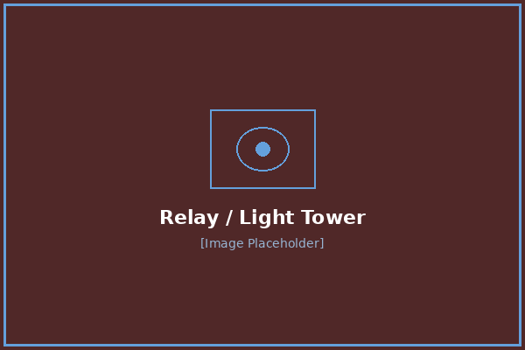
Safety Relays
Safety relays monitor safety circuits using dual-channel inputs with forced-guided contacts. They verify that both OSSD channels from a safety device agree before allowing machine operation. If the channels disagree (indicating a fault), the relay locks out and requires manual reset.

Slide 13
What is OSSD?
[INFO] OSSD — Output Signal Switching Device: Safety-rated devices use two independent output channels (OSSD1 and OSSD2). Both must be ON for the machine to run. This dual-channel design means a single component failure cannot defeat the safety function. Standard single-channel sensors cannot be used for safety-rated applications.

Slide 14
Lesson: Output Devices
Light towers, motors, drives, relays, solenoid valves, and VFDs

Slide 15
Light Tower (Stack Light)
Stack lights indicate machine status: Green = running, Red = fault/stopped, Amber = warning/attention needed, Blue = operator call. Each color is driven by a separate PLC digital output.

Slide 16
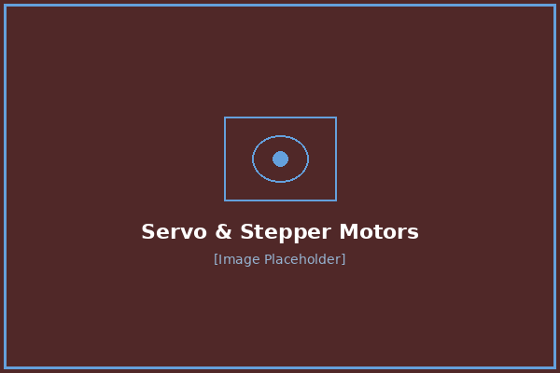
Servo Motors & Drives
Servo motors provide precise position, speed, and torque control. The servo drive receives commands from the PLC (typically via EtherCAT or EtherNet/IP) and controls the motor accordingly. Used for CNC positioning, robotic joints, and precise material handling.
[Figure] Servo drive (amplifier) — executes motion commands from the PLC over the fieldbus

Slide 17
Stepper Motors
Stepper motors provide open-loop position control using discrete step pulses. Simpler and less expensive than servos but limited in torque and speed. Used for lower-precision positioning applications.

Slide 18
Relays
Relays are electrically-operated switches that isolate PLC outputs from high-voltage or high-current loads. The PLC energizes the relay coil (24VDC), and the relay contacts switch the load circuit (which may be 120VAC, 240VAC, or higher).

Slide 19
Solenoid Valves
Solenoid valves control pneumatic or hydraulic flow. The PLC digital output energizes the solenoid coil, which shifts a spool to direct air or fluid to cylinders, actuators, or clamps.
Table: Type | Action | Application
5/2 single-solenoid | Spring return — de-energize returns to home | Single-acting cylinders, simple extend/retract
5/2 double-solenoid | Detented — stays in last position | Double-acting cylinders where position must hold on power loss
5/3 center-closed | Center position blocks all ports | Holding position under load with no air flow

Slide 20
Variable Frequency Drives (VFDs)
VFDs control AC motor speed by varying output frequency and voltage. Found on conveyors, pumps, fans, and mixers. Control methods:
Hardwired: PLC digital output for run/stop, analog output (4–20mA) for speed reference
Network: PLC sends commands and reads feedback over EtherNet/IP, EtherCAT, or Modbus — start/stop, speed setpoint, actual speed, current draw, and fault codes all in one connection
[WARNING] VFD Safety Note: VFD DC bus capacitors retain dangerous voltage (up to 800VDC) after the drive is powered off. Wait for the DC bus voltage to decay to zero (check the drive display or measure with a meter) before working on VFD wiring.

Slide 21
Motor Contactors & Starters
For motors without VFDs, contactors switch motor power on/off. A motor starter = contactor + overload relay. The PLC energizes the contactor coil (usually through an interposing relay), and the overload relay's auxiliary contacts feed back to a PLC input for trip monitoring.

Slide 22
Encoders
Encoders provide position and speed feedback. Incremental encoders output A/B pulses proportional to rotation (connect to PLC high-speed counter inputs). Absolute encoders output a unique position value even after power loss (connect via SSI, BiSS, or EtherCAT).

Slide 23
Lab: Input Device Activation
After: Input Devices — Sensors & Switches
Duration: 10 min
At the bench, activate each input device: trigger the proximity sensor with a metal target, actuate the limit switch, press push buttons.
Each student activates each input device and observes both the device's own LED and the I/O module channel LED light up. First time seeing the full input signal chain.

Slide 24
Lab: Output Device Observation
After: Output Devices
Duration: 10 min
Force outputs to energize the light tower (cycle colors), click the relay, and command a servo motor move. Point out I/O module output LEDs.
Students observe outputs and match each physical action to its module LED. Listen for the relay click, watch the servo shaft move, see the light tower cycle.

Slide 25
Lab: Area Scanner OSSD Demo
After: Safety Devices
Duration: 10 min
Show the OS32C area scanner. Have someone walk into the detection zone. Show the scanner LED change, OSSD drop, and downstream effect.
Students observe the full safety chain: intrusion → scanner response → OSSD state change → device de-energization. Ask: 'What just stopped and why?'

Slide 26
Quiz
What are the three types of photoelectric sensors?
Inductive, capacitive, ultrasonic | Through-beam, retroreflective, diffuse | NPN, PNP, relay output | Analog, digital, safety

Slide 27
Quiz
A proximity sensor has its LED lit but the PLC doesn't see the signal. The I/O module channel LED is also dark. What is the most likely cause?
The sensor is broken | Bad wiring between the sensor and the I/O module | The PLC program has a bug | The HMI is misconfigured

Slide 28
Quiz
Why do safety devices use two OSSD channels instead of one?
To double the signal strength | To provide redundancy — a single component failure cannot defeat the safety function | To allow two machines to share one sensor | To reduce wiring costs

Slide 29
Quiz
A VFD has been powered off. Is it immediately safe to touch the wiring?
Yes — power is off | No — DC bus capacitors can retain dangerous voltage | Only if you wait 30 seconds | Only if the motor has stopped spinning

Slide 30
Quiz
What controls the speed of an AC motor connected to a VFD?
The PLC changes the motor's winding configuration | The VFD varies the output frequency and voltage to the motor | A mechanical gearbox inside the VFD | The power supply voltage is adjusted

