Slide 1


ResMap: Exploiting Sparse Residual Feature Map for Accelerating Cross-Edge Video Analytics
Ning Chen, Shuai Zhang, Sheng Zhang, Yuting Yan, Yu Chen, and Sanglu Lu
State Key Laboratory for Novel Software Technology, Nanjing University

Slide 2
Outline
Problem Scenario
Cross-Edge Video Analytics
Model Partition, Intermediate Feature Map Transmission
Challenges
Data-Bandwidth Trade-Off, Information Revealed after Decisions
Related Works
Motivations
System Model
ResMap: Optimizing Model Partition to Accelerate Inference
Experiments

Slide 3





Cross-Edge Video Analytics
Edge Collaboration for Neural Inference
Input
Output
$$⋱$$
$$⋱$$
Cat:${ p}_{1}$
Dog: $p_{2}$
Rabbit: $p_{3}$
Edge 1
Edge 2
Edge 3

Slide 4



Cross-Edge Video Analytics
Edge Collaboration for Neural Inference
Model Partition: Each Edge Runs a DNN Slice
Input
Output
$$⋱$$
$$⋱$$
Cat:${ p}_{1}$
Dog: $p_{2}$
Rabbit: $p_{3}$
Edge 1
Edge 2
Edge 3
Slice 1: $\left(L_{0},L_{i}\right)$
Slice 2: $\left(L_{i+1},L_{j}\right)$
Slice 3: $\left(L_{j+1},L_{k}\right)$

Slide 5


Cross-Edge Video Analytics
Edge Collaboration for Neural Inference
Model Partition: Each Edge Runs a DNN Slice
Data Transfer: Send Feature Map to the Next Edge
Feature Map
Feature Map
00101
01101
$$⋯$$
00111
01100
0101
$$⋯$$
01011
Input
Output
$$⋱$$
$$⋱$$
Cat:${ p}_{1}$
Dog: $p_{2}$
Rabbit: $p_{3}$
Edge 1
Edge 2
Edge 3
Slice 1: $\left(L_{0},L_{i}\right)$
Slice 2: $\left(L_{i+1},L_{j}\right)$
Slice 3: $\left(L_{j+1},L_{k}\right)$

Slide 6

Cross-Edge Video Analytics
Edge Collaboration for Neural Inference
Model Partition → Edge Inference Delay $T_{i}^{inf}$
Data Transfer → Feature Map Transfer Delay $T_{i}^{tr}$
Feature Map
Feature Map
00101
01101
$$⋯$$
00111
01100
0101
$$⋯$$
01011
Input
Output
$$⋱$$
$$⋱$$
Cat:${ p}_{1}$
Dog: $p_{2}$
Rabbit: $p_{3}$
Edge 1
Edge 2
Edge 3
Slice 1: $\left(L_{0},L_{i}\right)$
Slice 2: $\left(L_{i+1},L_{j}\right)$
Slice 3: $\left(L_{j+1},L_{k}\right)$

Slide 7


Cross-Edge Video Analytics
Edge Collaboration for Neural Inference
Goal: Minimize Completion Time $\sum_{i}^{N}{{(T}_{i}^{inf}+T_{i}^{tr})}$
$T= T_{1}^{inf}$ + $T_{1}^{tr}$ + ${ T}_{2}^{inf}$ +${ T}_{2}^{tr}$ +${ T}_{1}^{inf}$
Completion
00101
01101
$$⋯$$
00111
01100
0101
$$⋯$$
01011
Input
Output
Feature Map
Feature Map
$$⋱$$
$$⋱$$
Cat:${ p}_{1}$
Dog: $p_{2}$
Rabbit: $p_{3}$
Edge 1
Edge 2
Edge 3
Slice 1: $\left(L_{0},L_{i}\right)$
Slice 2: $\left(L_{i+1},L_{j}\right)$
Slice 3: $\left(L_{j+1},L_{k}\right)$

Slide 8
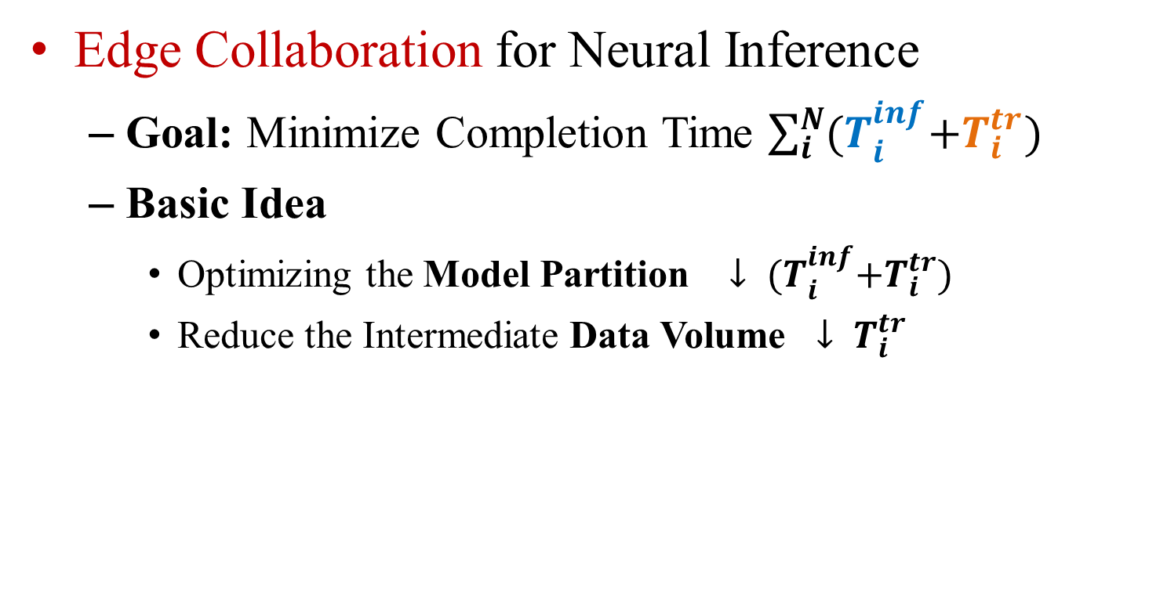
Cross-Edge Video Analytics
Edge Collaboration for Neural Inference
Goal: Minimize Completion Time $\sum_{i}^{N}{{(T}_{i}^{inf}+T_{i}^{tr})}$
Basic Idea
Optimizing the Model Partition $↓ {(T}_{i}^{inf}+T_{i}^{tr})$
Reduce the Intermediate Data Volume $↓ T_{i}^{tr}$

Slide 9
Related Works
Edge Resource and Bandwidth-based Model Partitioning
AVSS 18 Jong Hwan Ko et al.; IoT 20 He et al.
Fail to Reduce the Feature Map Volume
Feature Map Pruning Techniques
IoTDI 20 Hu et al.; ICCAD 17 Mao et al.; ToN 21 Zeng et al
Fail to Maintain the Analytical Accuracy
Iteratively Searching the Optimal Model Partitioning
IoT 21 Tang et al.; SEC 19 Hsu et al.
Fail to Reduce the Data Volume

Slide 10
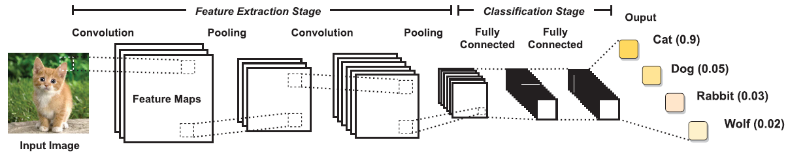
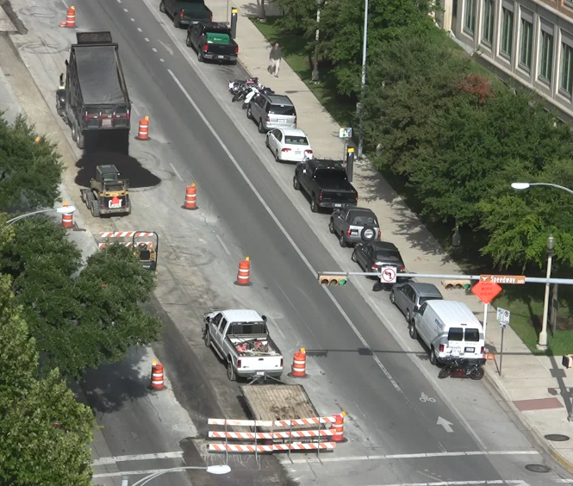
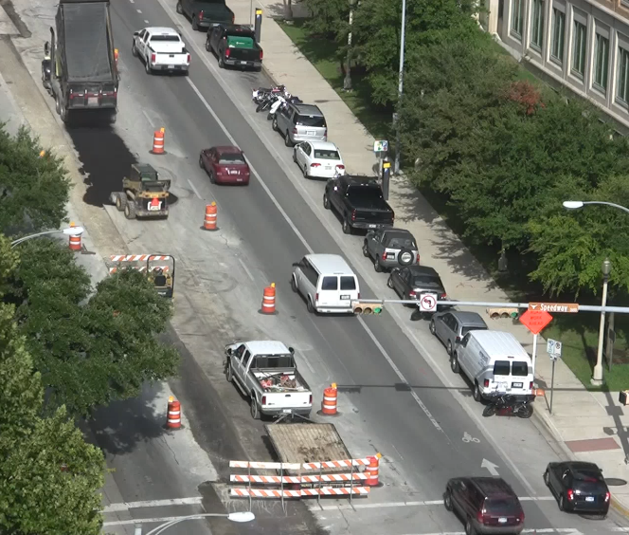









Motivation: Sparsity
Video Codec→Inter- and Intra-frame Redundancy
FM Codec→Inter- and Intra-FM Sparsity ?
$${FM}_{1,1}$$
$${FM}_{1,2}$$
$${FM}_{1,3}$$
Frame 1
$${FM}_{1,1}≈{FM}_{2,1} ?$$
$${FM}_{1,2}≈{FM}_{2,2} ?$$
$${FM}_{1,3}≈{FM}_{2,3} ?$$
Frame 2
$${FM}_{2,1}$$
$${FM}_{2,2}$$
$${FM}_{2,3}$$

Slide 11
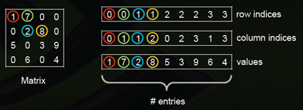
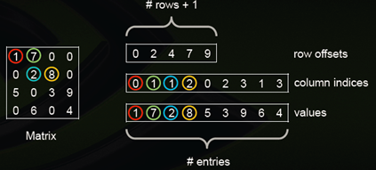

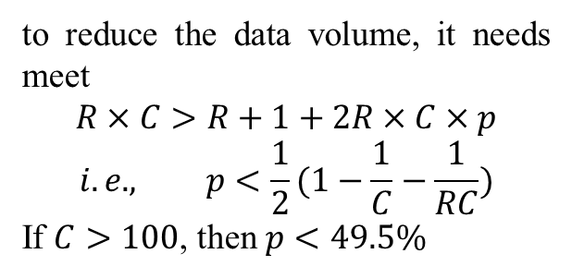
Motivation: Sparsity
FM Codec → Matrix Sparsity Encoding
Coordinate (COO)
Compressed Sparse Row (CSR)
For matrix $M$, assume the number of rows, columns, and sparsity is $R, C$ and $p$ respectively, then to reduce the data volume, it needs meet
$R×C>3R×C×p→p<\frac{1}{3}$
to reduce the data volume, it needs meet
$$R×C>R+1+2R×C×p$$
$$i.e., p<\frac{1}{2}(1−\frac{1}{C}−\frac{1}{RC})$$
If $C>100$, then $p<49.5\%$

Slide 12
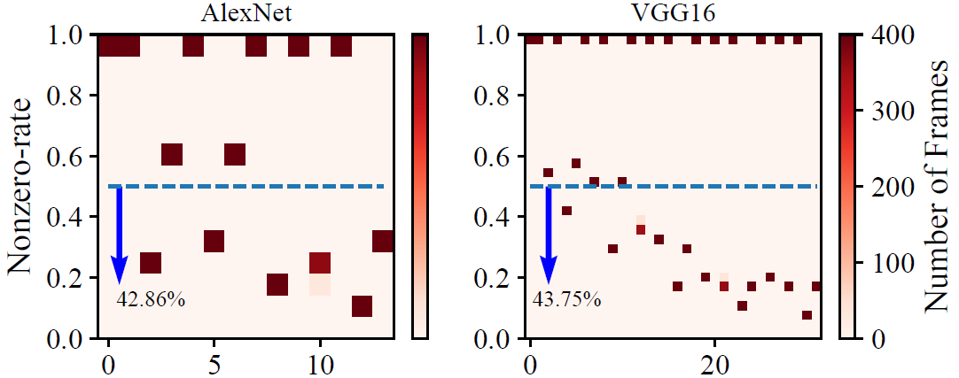
Motivation: Sparsity
Sparsity → Non-Zero Rate (NZR)
Raw Feature Map

Slide 13
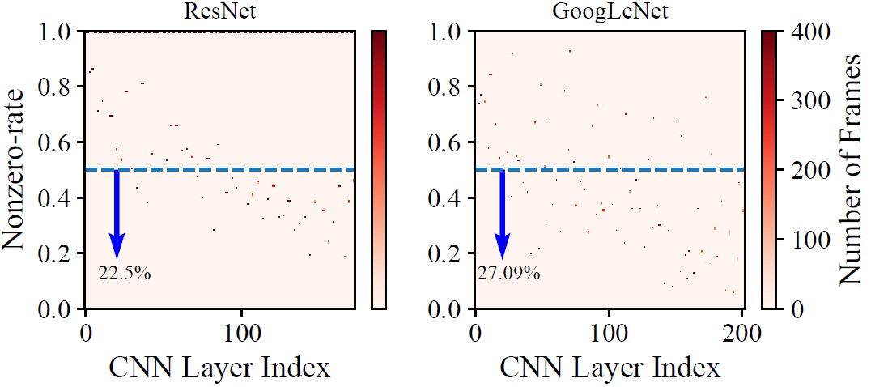
Motivation: Sparsity
Sparsity → Non-Zero Rate (NZR)
Raw Feature Map

Slide 14









Motivation: Sparsity
Sparsity → Non-Zero Rate (NZR)
Residual Feature Map
e.g., ${FM}_{2,1}−{FM}_{1,1}$, ${ FM}_{2,2}−{FM}_{1,2}$, ${FM}_{2,3}−{FM}_{1,3}$
$${FM}_{1,1}$$
$${FM}_{1,2}$$
$${FM}_{1,3}$$
$${FM}_{1,1}≈{FM}_{2,1} ?$$
$${FM}_{1,2}≈{FM}_{2,2} ?$$
$${FM}_{1,3}≈{FM}_{2,3} ?$$
Frame 2
$${FM}_{2,1}$$
$${FM}_{2,2}$$
$${FM}_{2,3}$$

Slide 15
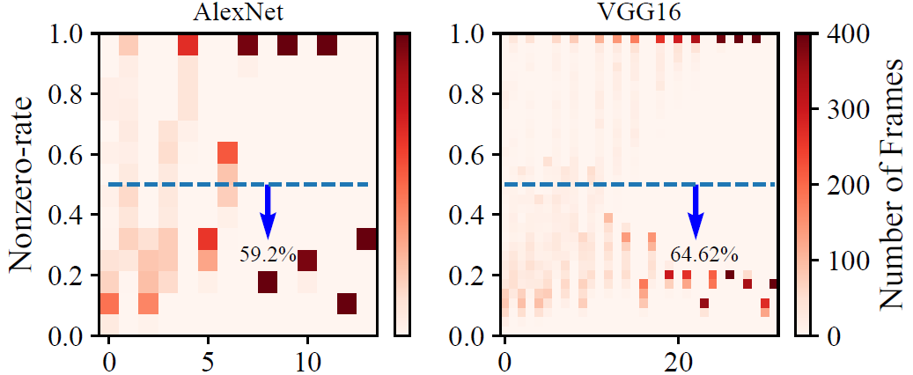
Motivation: Sparsity
Sparsity → Non-Zero Rate (NZR)
Residual Feature Map

Slide 16

Motivation: Sparsity
Sparsity → Non-Zero Rate (NZR)
Residual Feature Map
It makes sense to use feature map sparsity encoding !

Slide 17


System: ResMap
General System (Without Sparse Encoding)
Optimal match
Operations of DNN layers
Compute resource of Edge device
Scheduler for DNN partitioning
Output volume of DNN layers
Bandwidth of inter-edge
Optimal match
Known Fixed value
3 channels input
Filter x4
Map x4
$$\left(320,320,3\right)$$
$$\left(318,318,4\right)$$
Convolution

Slide 18








System: ResMap
General System (With Sparse Encoding)
Optimal match
Operations of DNN layers
Compute resource of Edge device
Scheduler for DNN partitioning
Output volume of DNN layers
Bandwidth of inter-edge
Optimal match
Unknown value
Frame 1
Nonzero rate ${NZR}_{1}$
Feature map volume $D_{1}$
Frame 2
Nonzero rate ${NZR}_{2}$
Feature map volume $D_{2}$
Frame 3
Nonzero rate ${NZR}_{3}$
Feature map volume $D_{3}$
Is Unknown and varies with frames, ${NZR}_{1}≠{NZR}_{2}≠{NZR}_{3}$

Slide 19
System: ResMap
Feature Map NZR predictor
Run Each Layer to Obtain NZR → Impractical

Slide 20
System: ResMap
Feature Map NZR predictor
Run Each Layer to Obtain NZR → Impractical

Slide 21
System: ResMap
Feature Map NZR predictor
Run Each Layer to Obtain NZR → Impractical
NZR of Origin Frame or First Layer → Derive NZR of Each Layer ?

Slide 22
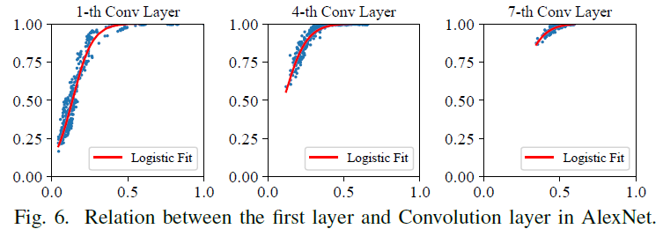
System: ResMap
Feature Map NZR predictor
Convolution Layer

Slide 23
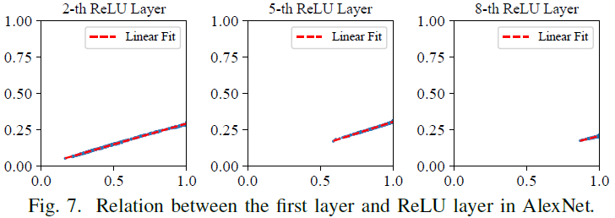
System: ResMap
Feature Map NZR predictor
ReLU Layer

Slide 24
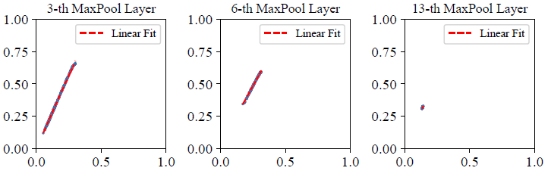
System: ResMap
Feature Map NZR predictor
MaxPool Layer
Relation between the first layer and MaxPool layer in AlexNet

Slide 25






System: ResMap
Feature Map NZR predictor
NZR of Residual Frame → NZRs of Each Layer
frame
Conv: Logistic
$$Z_{1}$$
$$Z_{2}$$
$$⋯$$
$$Z_{N}$$
$$D_{1}$$
$$D_{2}$$
$$⋯$$
$$D_{N}$$
$$i$$
CSR
$$Z_{0}$$
$$i+1$$
ReLU: Linear
$${O_{i+1,0}−O}_{i,0}$$
MaxPool: Linear

Slide 26
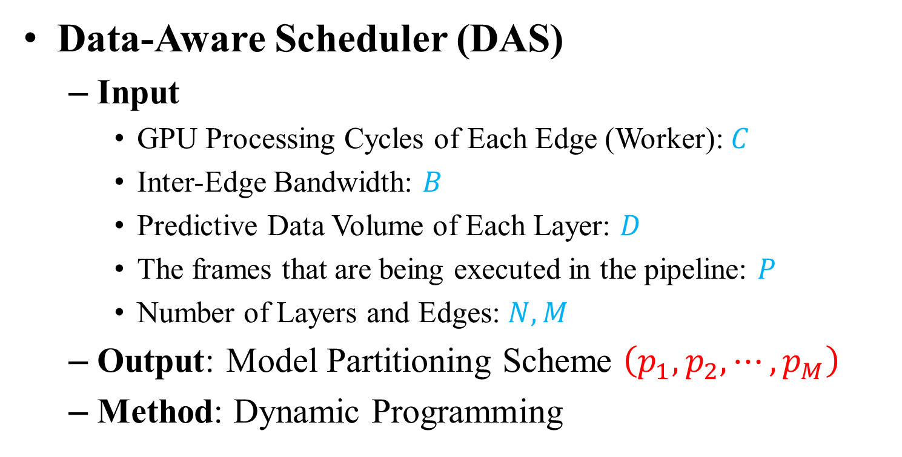
System: ResMap
Data-Aware Scheduler (DAS)
Input
GPU Processing Cycles of Each Edge (Worker):$C$
Inter-Edge Bandwidth: $B$
Predictive Data Volume of Each Layer: $D$
The frames that are being executed in the pipeline: $P$
Number of Layers and Edges: $N,M$
Output: Model Partitioning Scheme $\left(p_{1},p_{2},⋯,p_{M}\right)$
Method: Dynamic Programming

Slide 27






System: ResMap
ResMap Workflow
Master
Worker 0
Worker N
$$⋯$$
$$⋱$$
Data-Aware Scheduler
$$⋯$$
ItgJob
$$⋯$$
ItgJob
Video
chunk
IFR Queue
Executor
Executor
Nonzero Rate Info.
$$⋯$$
Pre-train
State Update
DifJob
result
Sparsity
Predictor
State
Tracker
Monitor
Monitor
$$⋯$$
data
CNNs
Device Info. Update
control

Slide 28
Experiments
Experimental Setup
CNN Models
AlexNet (14 layers), VGG16 (32 layers)
GoogLeNet (173 layers), ResNet (203 layers)
Video Data
Road Video and Parking Video from VIRAT
Edge Device
Three 4B Raspberry Pi’s
Baseline Policy
Load-Balanced Scheduler (LBS)

Slide 29
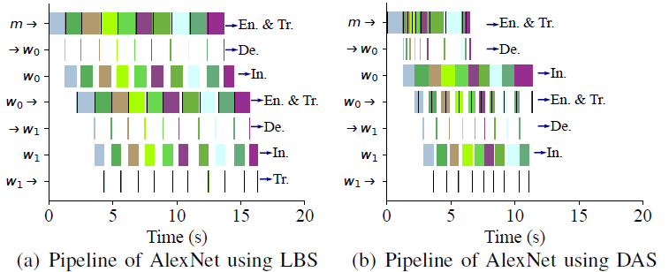
Experiments
Pipeline Execution

Slide 30
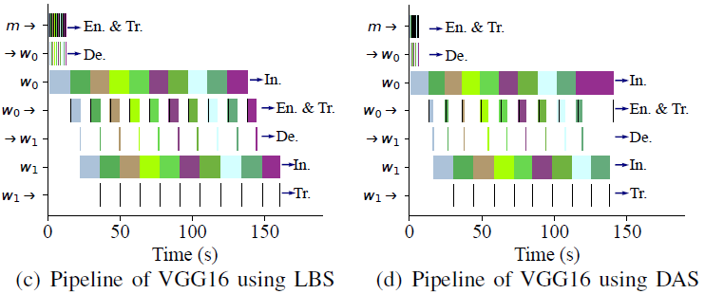
Experiments
Pipeline Execution

Slide 31
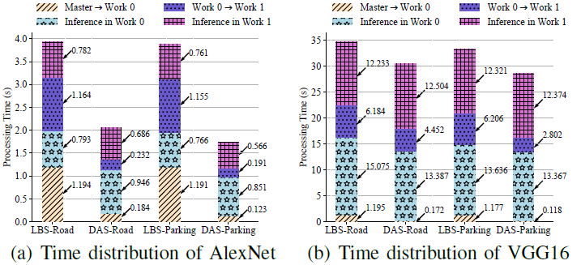
Experiments
Average Processing Time Reduction

Slide 32
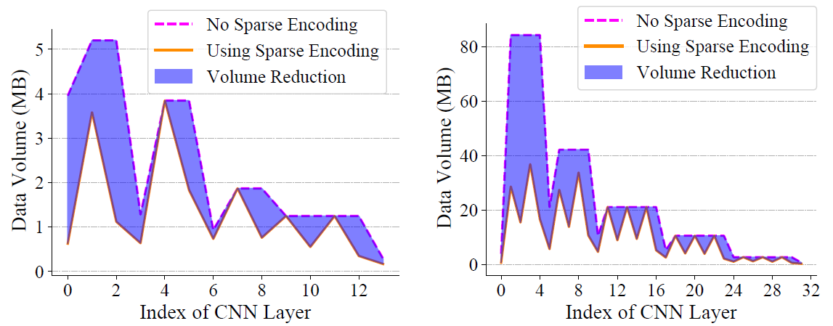
Experiments
Feature Map Volume Reduction

Slide 33
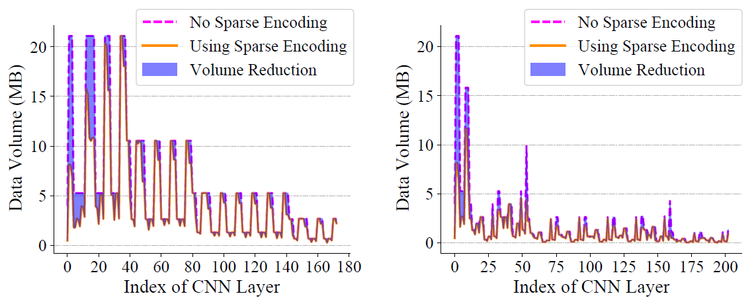
Experiments
Feature Map Volume Reduction

Slide 34
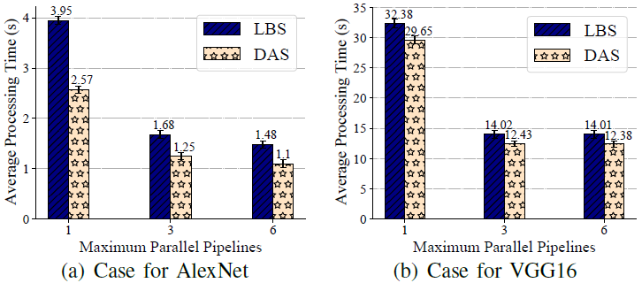
Experiments
Maximum Parallel Pipelines

Slide 35
Conclusion
Cross-Edge Video Analytics Optimization
Feature Map NZR Prediction
NZR of Origin Frame → NZR of Each Layer
Data-Aware Scheduler for Model Partitioning
Dynamic Programming
Experiment Evaluation
Outperforms LBS in data volume and processing time

Slide 36
Future Work
Model Partitioning for DAG-like CNNs
Other Strategies to Predict NZR
Other Strategies to Schedule the DNN slices

Slide 37
Thank You !
Q & A
Ning Chen
Nanjing University

