Slide 1

TileSR: Accelerate On-Device Super-Resolution with Parallel Offloading in Tile Granularity
Ning Chen, Sheng Zhang, Yu Liang, Jie Wu, Yu Chen, Yuting Yan, Zhuzhong Qian and Sanglu Lu
Notes:
Hello, everyone, my name is Ning Chen, from Nanjing University. Today I will introduce the paper titled “TileSR: Accelerate On-Device Super-Resolution with Parallel Offloading in Tile Granularity”

Slide 2
Outline
Problem Background
Edge Collaborative SR with Parallel Offloading
Key steps: image dividing, tile-based offloading
Challenges
SR difficulty, device priori information
Related Works
Motivations
System Model
TileSR: Parallel Offloading Tiles to Accelerate Inference
Experiments
Notes:
Here is the outline, I will first introduce the problem background, and simplify the related works. Then, based on the key observations, we propose our system TileSR, which uses parallel offloading to accelerate image super resolution. Finally, we do lots of experiments to evaluate the system performance.

Slide 3







Background: Single-Device SR
On-device video super-resolution
Unreliable network leads to low-quality video
Local SR to enhance the video quality
360P
1080P
720P
1080P
CDNs
360P
Media server
1080P
User
Notes:
Let's start with the background. We often watch some live videos in the internet, however, because the unreliable network in the downstream, the video we received can hardly maintain the high-quality for a long time. A nature idea is to perform local super-resolution to enhance the video quality.

Slide 4
Background: Single-Device SR
On-device video super-resolution
Challenges: local resource constrained
Computation → long inference delay
Memory → hard to store intermediate data
Energy → hard to support long-term inference
SR model | 270p (s) | 360p (s) | 540p (s) | 720p (s)
MSRN X2 | 0.075 | 0.167 | 0.302 | 0.922
MSRN X3 | 0.083 | 0.182 | 0.321 | 1.003
MSRN X4 | 0.091 | 0.237 | 0.404 | 1.118
RCAN X2 | 0.269 | 0.595 | 1.057 | 3.191
RCAN X3 | 0.277 | 0.610 | 1.085 | 3.261
RCAN X4 | 0.287 | 0.632 | 1.149 | 3.356
Notes:
However, on-device super-resolution poses significant challenges as the local resources are constrained. For example, the limited computation leads to long inference delay, the limited memory can hardly to store the intermediate data, and the limited energy cannot support long-term CNN inference.

Slide 5
Background: Multi-Device SR
Multi-device inference for image/video SR
Model downloading from cloud
SR Model Zoo
Local Device
Access Point
Cloud
Base Station
Model Update
Device 1
Device 2
Device 3
Notes:
In such dilemma, multi-device collaboration for video super-resolution is proposed. It contains two key steps: firstly, each device downloads the proper SR models from remote cloud

Slide 6
Background: Multi-Device SR
Multi-device inference for image/video SR
Model downloading from cloud
Image dividing → multiple tiles
Images
Tiles
SR Model Zoo
Local Device
Access Point
Cloud
Base Station
Model Update
Device 1
Device 2
Device 3
Notes:
Then, the local device partitions the incoming image into multiple tiles,

Slide 7
Background: Multi-Device SR
Multi-device collaboration for image/video SR
Model downloading from cloud
Image dividing → multiple tiles
Parallel offloading → tile inference
Images
Tiles
SR Model Zoo
Local Device
Access Point
Cloud
Base Station
Tile Offloading
Model Update
Device 1
Device 2
Device 3
Notes:
and offloads the tiles to the collaborative devices. Finally, the collaborative devices returns the SR results to the local devices

Slide 8
Background: Multi-Device SR
Multi-device collaboration for image/video SR
Challenges
How to divide? even or uneven?
How to offload? without prior offload reward
Notes:
This collaborative framework faces two key challenges. Firstly, how to divide the images, even dividing or uneven dividing? Second, without the prior knowledge, such as the system-side information of each device. Next, I introduce two previous works.

Slide 9
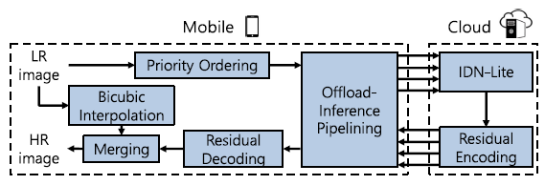
Related Works
Supremo TMC 2022
Layer: edge-cloud collaboration
Methods: based on the “edge” feature
Notes:
The first work is Supremo, which uses edge-cloud collaboration rather than multi-edge device to run CNN super-resolution. It first divides the image into multiple tiles based on the image “edge” feature, then, it offloads the tiles with more edges to cloud for CNN inference, but do interpolation for the remaining tiles. Thought it uses residual encoding to reduce the data volume, the cloud-assisted method incurs large transmission delay.

Slide 10
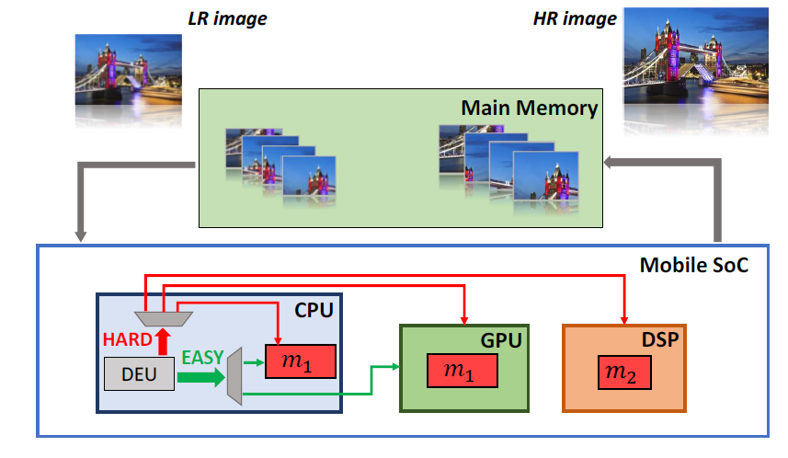
Related Works
MobiSR MobiCom 2019
Methods: dispatch images to diverse processors
Notes:
The second work is MobiSR, it does not have the image dividing process, it dispatches the incoming images to diverse processors, such as CPU, GPU and DSP. However, the CPU capacity in common mobile device is so weak that it incurs long inference delay, thereby hardly meeting the requirement of real-time.

Slide 11
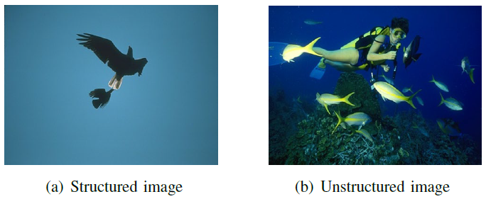
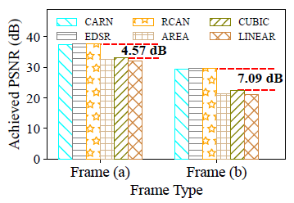
Motivation: Difficulty Analysis
Visual structural complexity
Utilize two methods, interpolation and CNN-based
Higher structure, higher upscale quality (PSNR)
Higher structure, it benefits less from CNN inference
How to measure the structure information?
Notes:
To make efficient image dividing and tile offloading , we first discuss the relationship between super-resolution difficulty and the enhanced quality. We first consider the visual structural complexity. For two images, image a is structured and image b is unstructured, we use interpolation-based and CNN-based method to upscale them. We find that higher structure leads to high upscale quality, but compared lower structure, it benefits less from CNN inference. Now, we transform the problem to measure the structure information.

Slide 12

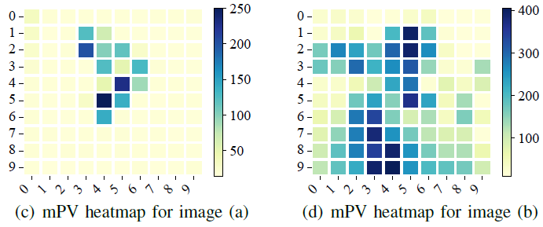

Motivation: Difficulty Analysis
Pixel Variant Matrix ${PV}_{f}$ for image $f$,
Mean Pixel Variant
This definition applies to tile as well
Notes:
Hence, we next analysis the relationship between the pixel feature and the SR difficulty. Specifically, we define the pixel variant matrix PV_f for image f, and each item represent the summed pixel variant with surrounding 8 pixel points.

Slide 13
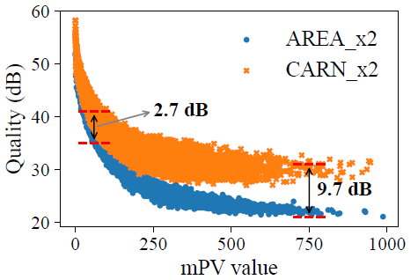
Motivation: Difficulty Analysis
Mean Pixel Variant
Motivative insights
Tiles with low-mPV achieve high and similar PSNR using CNN-based and interpolation-based methods;
Tiles with high-mPV get significant higher PSNR using CNN-based method than interpolation.
Dataset | DIV2K
Interpolation method | AREA_x2
CNN model | CARN_x2
Dividing method | 20 x 20

Slide 14
Tiles Generation
Mean Pixel Variant
Key Idea: only offload high-mPV tiles
Calculate the upscaling difficulties for each tile;
Select the Top-K tiles with highest mPV;
Parallel offload the selected tiles to involved devices for CNN-based inference;
Locally upscale other tiles via interpolation.
Next we consider the parallel offloading policy!

Slide 15
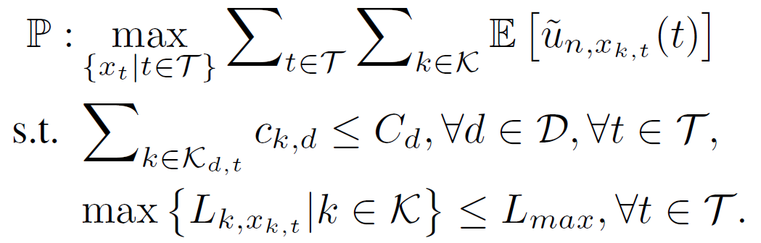

Parallel Offloading: System Model
Multi-device parallel offloading problem
Decision: $x_{t}=(x_{1,t},⋯,x_{K,t})$
Maximize the overall offload reward
Subject to the resource and latency constraints
No System-side info.
i.i.d random reward
Resource constraint
Latency constraint

Slide 16
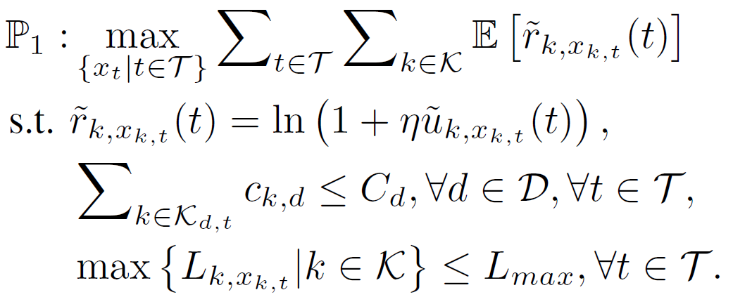

Parallel Offloading: System Model
Multi-device parallel offloading problem
Decision: $x_{t}=(x_{1,t},⋯,x_{K,t})$
Proportional fairness maximization
No System-side info.
i.i.d random reward
Fair reward distribution
Resource constraint
Latency constraint

Slide 17

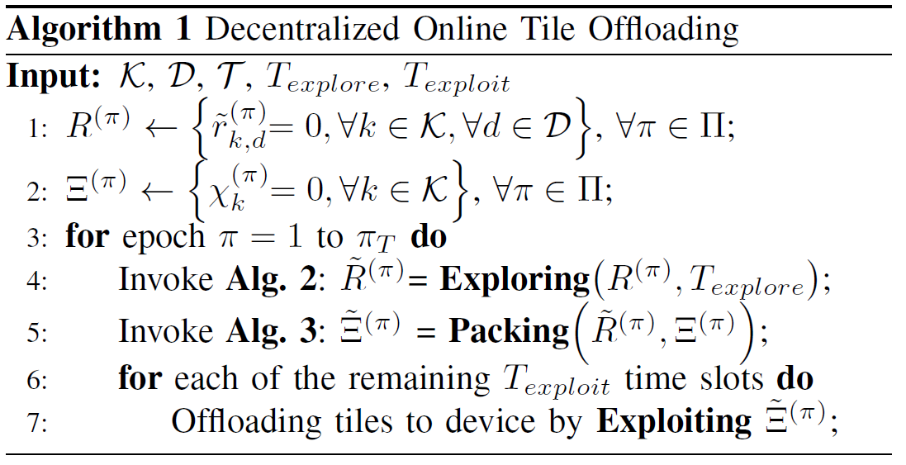
Parallel Offloading: Algorithm
Reward is uncertain but bounded
Decentralized multi-agent multi-armed bandit
Exploration: obtain the offloading reward mapping
Packing: get the final tile offloading scheme
Exploitation: utilize the packing result

Slide 18

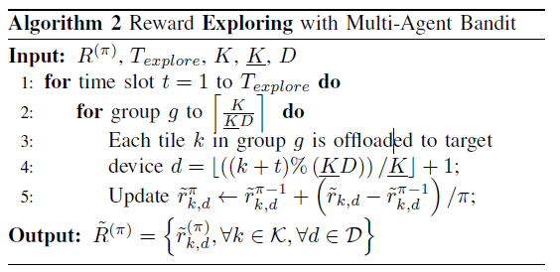
Parallel Offloading: Algorithm
Reward Exploration and Exploitation
Group-based offloading in a round-robin fashion
Target device
Reward update

Slide 19
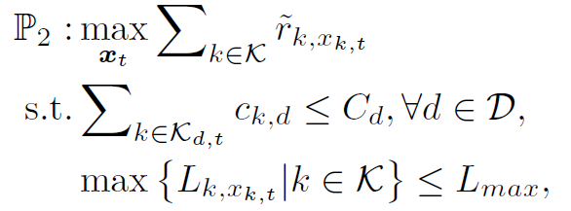

Parallel Offloading: Algorithm
Tile packing based on reward map
For each slot $t$, it can be modeled as
Value
Volume
Multi-Knapsack Problem (MKP)

Slide 20
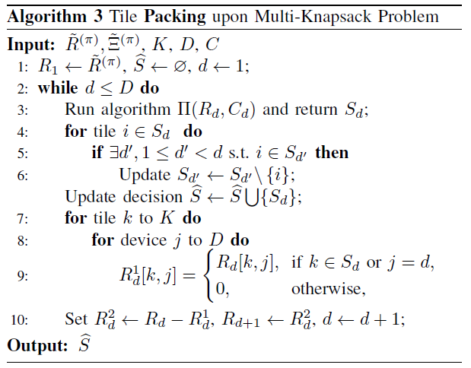
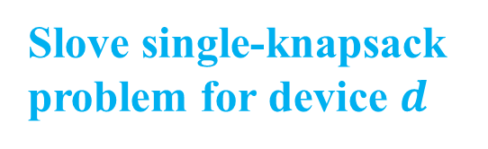
Parallel Offloading: Algorithm
Tile packing upon MKP
Iteratively update the tiles for each device
Slove single-knapsack problem for device $d$
Update the decision set
Update the profit matrix

Slide 21
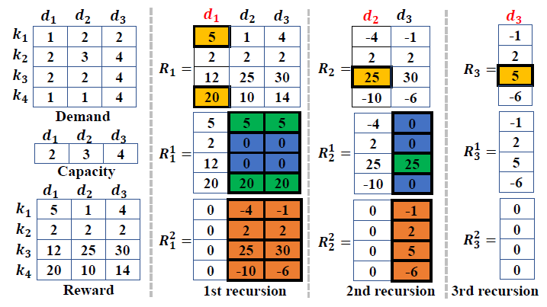
Parallel Offloading: Algorithm
Tile packing upon MKP
Example: 4 tiles, 3 devices

Slide 22
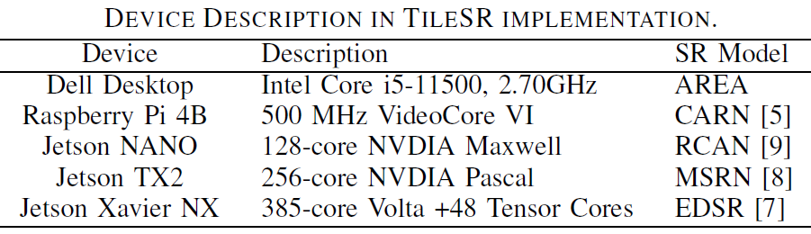
Experiments
Experimental setup
Edge device and CNN models
Datasets: DIV2K/Set5/Set13/YouTube-NBA

Slide 23
Experiments
Experimental setup
Edge device and CNN models
Datasets: DIV2K/Set5/Set13/YouTube-NBA
Comparing schemes
Supremo: offloads tiles to cloud
MobiSR: utilizes local multiple diverse processor
Strawman: utilizes CARN for local SR
RAScheduler: offloads tiles based the computation

Slide 24
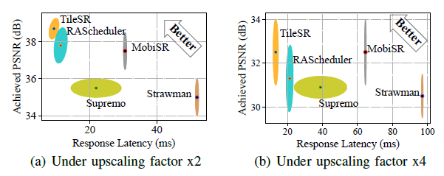
Experiments
Tradeoff between latency and quality
Latency: 17.77%, 57.63%, 69.66%, and 82.2%
SR quality: 2.38%, 9%, 3.2%, and 10.57%

Slide 25
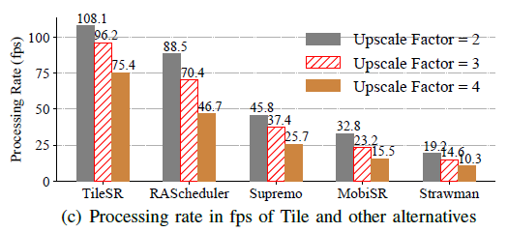
Experiments
Processing Rate (fps)
0.22x, 1.36x, 2.3x, and 4.62x

Slide 26
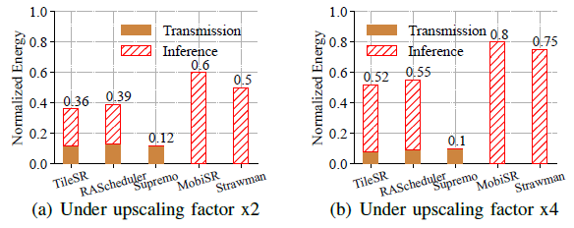
Experiments
Energy efficiency
7.6%，40%，28%

Slide 27
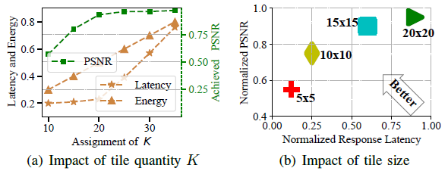
Experiments
Tile settings
Tile quantity: 20；Tile size: 15x15

Slide 28
Conclusion
Multi-device inference for image SR
SR difficulty analysis
Method: Top-K tiles are offloaded for CNN inference, others are executed locally.
Tile parallel offloading
Decentralized multi-agent multi-armed bandit
Exploration: obtain the offloading reward map
Packing (MKP): iteratively solve a single-knapsack problem for each device

Slide 29
Thank You !
Q & A
Ning Chen
Nanjing University

