Slide 1
DeepLENS: Deep Learning for Entity Summarization
Qingxia Liu, Gong Cheng, and Yuzhong Qu
National Key Laboratory for Novel Software Technology, Nanjing University, China

Slide 2
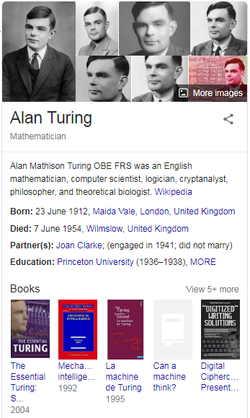
Entity Summarization (ES)
RDF Graph: T
triple t∈T: <subj, pred, obj>
Entity Description: Desc(e)
Desc(e) = {t∈T: subj(t)=e or obj(t)=e}
triple t∈Desc(e): <e, property, value>
Entity Summarization: S(e, k)
S⊆Desc(e) , |S|≤k
Person
TYPE
TYPE
TYPE
field
Logic
field
TYPE
Alan Turing
Alonzo Church
doctoralAdvisor
Scientist
almaMater
Philosopher
thesisTitle
doctoralStudent
almaMater
“Systems of Logic based on Ordinals”
Princeton University
TYPE
influences
Michael O. Rabin
knownFor
knows
Donald Knuth
almaMater
Noam Chomsky
prizes
Award
TYPE
prizes
Turing Award

Slide 3
Existing Solutions
Frequency of Property
Frequency of Value
Un-Supervised Methods^{[1]}
Frequency and Centrality
Centrality of Value
LDA
FCA
Generic
Features
Informativeness
Statistical
RELIN
DIVERSUM
FACES
FACES-E
CD
LinkSUM
BAFREC
KAFCA
MPSUM
...
Ontological
Discrete Similarity
Diversity and Coverage
Textual Similarity (BoW, edit-distance)
Semantic Similarity (numerical, logical)
Simple Frameworks
Union of Top-Ranked Results
Feature Aggregation
Random Surfer Model
Weighted PageRank
Session Relevance
Frameworks
Grouping-based Selection
Group by Property
Group by Word Similarity
MMR-like Re-Ranking
Quadratic Knapsack Model
Combinatorial Optimization
Quadratic Multidimensional Knapsack Model
[1] Liu, Q., Cheng, G., Gunaratna, K., Qu, Y.: Entity summarization: state of the art and future challenges. CoRR abs/1910.08252 (2019)

Slide 4
Existing Solutions
Un-Supervised Methods^{[1]}
RELIN
DIVERSUM
FACES
FACES-E
CD
LinkSUM
BAFREC
KAFCA
MPSUM
...
Can deep learning summarize better?
[1] Liu, Q., Cheng, G., Gunaratna, K., Qu, Y.: Entity summarization: state of the art and future challenges. CoRR abs/1910.08252 (2019)

Slide 5
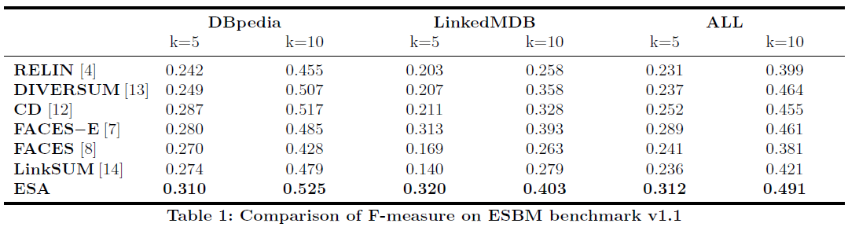
Existing Solutions
Un-Supervised Methods
Supervised Methods
RELIN
DIVERSUM
FACES
FACES-E
CD
LinkSUM
BAFREC
KAFCA
MPSUM
...
ESA^{[12]}
graph embedding (TransE), BiLSTM
[12] Wei, D., Liu, Y., Zhu, F., Zang, L., Zhou, W., Han, J., Hu, S.: ESA: Entity summarization with attention. In: EYRE 2019. pp. 40-44 (2019)

Slide 6
Existing Solutions
Un-Supervised Methods
Supervised Methods
RELIN
DIVERSUM
FACES
FACES-E
CD
LinkSUM
BAFREC
KAFCA
MPSUM
...
ESA^{[12]}
graph embedding (TransE), BiLSTM
small improvement
+7% compared with unsupervised FACES-E
[12] Wei, D., Liu, Y., Zhu, F., Zang, L., Zhou, W., Han, J., Hu, S.: ESA: Entity summarization with attention. In: EYRE 2019. pp. 40-44 (2019)

Slide 7
Our Idea
Deisgn a novel Deep Learning based approach to Entity Summarization: DeepLENS
Entity summary presented as short text: textual semantics
Entity description as a triple set: permutation invariant
 | ESA | DeepLENS
Triple Encoding | Graph Embedding | Word Embedding
Triple Set Encoding | Sequence Model | Aggregation-based Model

Slide 8
Our Solution
DeepLENS
Triple Encoding
Entity Description Encoding
Triple Scoring
score(t|Desc(e))
Triple Scoring
MLP_{S}
[h; d]
d
Entity Description
Encoding
a
Triple Encoding
h
g₁, g₂,..., g_{n}
...
MLP_{C}
MLP_{D}
t
t₁, t₂,..., t_{n}
...
Word Embedding
t
Desc(e)

Slide 9

Our Solution
DeepLENS
Triple Encoding
Entity Description Encoding
Triple Scoring
score(t|Desc(e))
Triple Scoring
MLP_{S}
[h; d]
d
Entity Description
Encoding
a
Triple Encoding
h
g₁, g₂,..., g_{n}
...
textual semantics of triple
MLP_{C}
MLP_{D}
t
t₁, t₂,..., t_{n}
...
Word Embedding
t
Desc(e)

Slide 10



Our Solution
DeepLENS
Triple Encoding
Entity Description Encoding
Triple Scoring
score(t|Desc(e))
Triple Scoring
MLP_{S}
[h; d]
d
Entity Description
Encoding
a
permutation invariant representation
Triple Encoding
h
g₁, g₂,..., g_{n}
...
MLP_{C}
MLP_{D}
t
t₁, t₂,..., t_{n}
...
Word Embedding
t
Desc(e)

Slide 11
Our Solution
DeepLENS
Triple Encoding
Entity Description Encoding
Triple Scoring
score(t|Desc(e))
Triple Scoring
MLP_{S}
[h; d]
d
Entity Description
Encoding
a
context-based salience score
Triple Encoding
h
g₁, g₂,..., g_{n}
...
MLP_{C}
MLP_{D}
t
t₁, t₂,..., t_{n}
...
Word Embedding
t
Desc(e)

Slide 12
Evaluation
Dataset: ESBM v1.2^{[8]}
DBpedia, LinkedMDB
Metric: F1
Participating Methods
Unsupervised Methods
RELIN, DIVERSUM, FACES, FACES-E, CD, LinkSUM, BAFREC, KAFCA, MPSUM
Supervised Methods
ESA (state of the art)
DeepLENS (our method)
Oracle Method
ORACLE (best possible performance on ESBM)
Summary consisting of k triples that most frequently appear in ground-truth summaries
[8] Liu, Q., Cheng, G., Gunaratna, K., Qu, Y.: ESBM: An entity summarization benchmark. In: ESWC 2020 (2020)

Slide 13
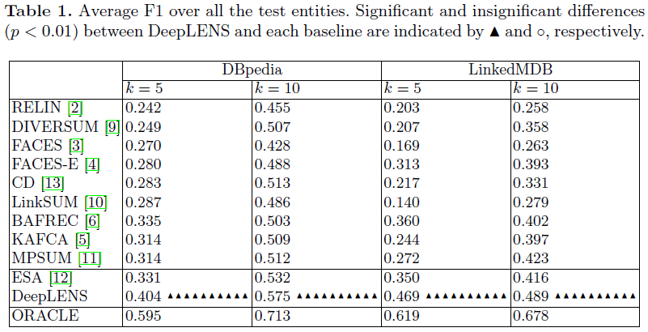
Overall Result
Results
supervised > unsupervised
DeepLENS > all baselines
ORACLE > DeepLENS
suggesting room for improvement
Notes:
+30% compared with unsupervised FACES-E
+20% compared with unsupervised BAFREC

Slide 14
Conclusion
Presented a simple yet effective deep learning model for ES.
textual semantics
permutation invariance
Achieved new state-of-the-art results on the ESBM benchmark.
ES can be effectively solved with properly designed deep learning models.
Future Work
ontological semantics
structural semantics

Slide 15
Main Conference Papers
Entity Summarization with User Feedback
Qingxia Liu, Yue Chen, Gong Cheng, Evgeny Kharlamov, Junyou Li and Yuzhong Qu
Session 3: Extraction and Recommendation 2
Thursday, June 4, 10:20-10:40
ESBM: An Entity Summarization Benchmark
Qingxia Liu, Gong Cheng, Kalpa Gunaratna and Yuzhong Qu
Session 9: Benchmarking
Thursday, June 4, 11:50-12:10

Slide 16
Thank you !
Questions ?

