Slide 1
ESSTER at the EYRE 2020 Entity Summarization Task
Qingxia Liu, Gong Cheng, and Yuzhong Qu
State Key Laboratory for Novel Software Technology, Nanjing University, China

Slide 2
Outline
Introduction
ESSTER
Structural Importance
Textual Readability
Information Redundancy
Combinatorial Optimization
Evaluation
Conclusion

Slide 3
Introduction
RDF Graph
Entity Description
Entity Summary
Place
Location
“1918”
type
United States
“Paris Public School”
built
type
Building
type
country
Paris Public School
type: Building
location: Paris, Idaho
built: “1918”
architect: Richard C. Watkins
architectural style: Prairie School
type
elevation
“1818.13”
name
label
Paris Public School
location
Paris, Idaho
area land
“9.01e+06”
“Paris Public School”
type
type
area total
“9.09e+06”
NRHP Reference Number
Thing
Person
name
“820002990”
“Paris, Idaho”
MPS
architect
type
type
architectural style
Prairie School
Paris MRA
Richard C. Watkins
gender
“male”
architect
Noyes Building
property
value

Slide 4
Introduction
Entity Description Desc(e)
Desc(e) = {<e, prop(t), val(t)>}
a set of triples in T, where e as subject or object
Entity Summarization Summ(e)
Summ(e) ⊆ Desc(e) , |Summ(e)| ≤ k
Provide key information & compact
For human users
Paris Public School
MPS: Paris MRA
locmapin: “ldaho”
NRHP Reference Number: “82000290”
coord format: “dms”
latitude: “42.2284”
Paris Public School
type: Thing
type: Place
type: Building
label: “Paris Public School”
name: “Paris Public School”
Paris Public School
type: Building
location: Paris, Idaho
built: “1918”
architect: Richard C. Watkins
architectural style: Prairie School
Reading Experience

Slide 5
ESSTER
Generating entity summaries of structural importance, high readability, and low redundancy.
ESSTER
Structural Importance
global/local structure, popularity
Information Redundancy
logical, numerical, textual redundancy
Combinatorial Optimization
0-1 quadratic knapsack problem
Desc(e)
Summ(e)
Textual Readability
familiarity, N-gram
√
Paris Public School
MPS: Paris MRA
locmapin: “ldaho”
NRHP Reference Number: “82000290”
coord format: “dms”
latitude: “42.2284”
Paris Public School
type: Thing
type: Place
type: Building
label: “Paris Public School”
name: “Paris Public School”
Paris Public School
type: Building
location: Paris, Idaho
built: “1918”
architect: Richard C. Watkins
architectural style: Prairie School

Slide 6
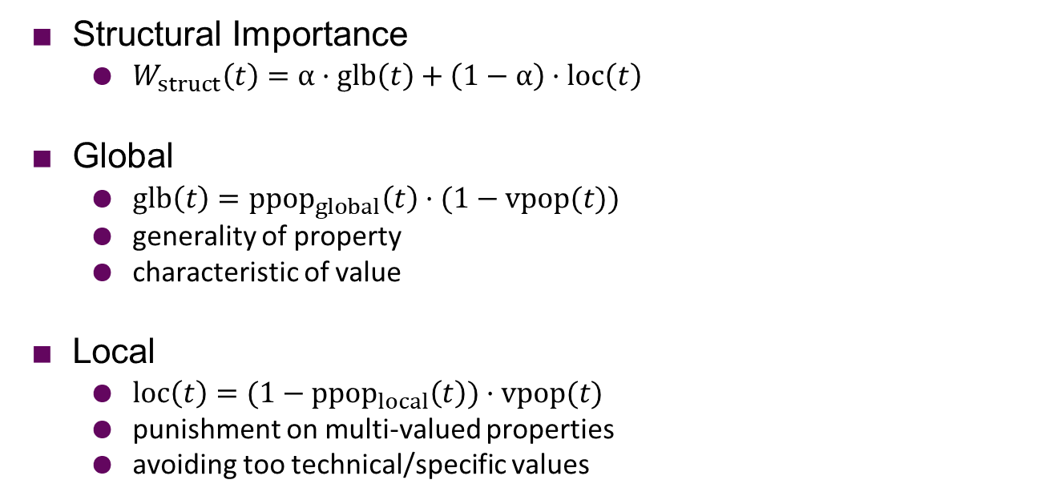
Structural Importance
Structural Importance
$W_{struct}\left(t\right)=α·glb\left(t\right)+\left(1−α\right)·loc\left(t\right)$
Global
$glb\left(t\right)={ppop}_{global}\left(t\right)·(1−vpop(t))$
generality of property
characteristic of value
Local
$loc\left(t\right)={(1−ppop}_{local}\left(t\right))·vpop(t)$
punishment on multi-valued properties
avoiding too technical/specific values
type: Thing
type: Architect
hypernym: Architect
√
subject: American architects
subject: NRHP architects
birth year: “1858”
wiki page ID: “34981613”
√

Slide 7
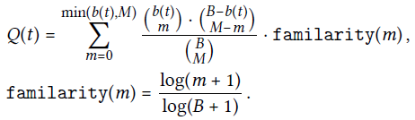


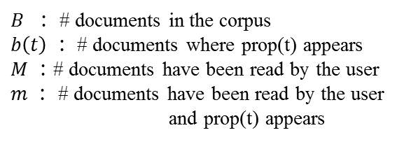
Textual Readability
Familiarity
Textual Readability
location
√
NRHP Reference Number
？
birth date
√
coord format
？
A property is familiar to users if
it is often used in an open-domain corpus
country
√
locmapin
？
architectural style
√
MPS
？
$B$ $：$ # documents in the corpus
$b\left(t\right) ：$ # documents where prop(t) appears
$M ：$# documents have been read by the user
$m ：$ # documents have been read by the user
and prop(t) appears

Slide 8

Information Redundancy
Redundancy
$sim(t_{i},$ $t_{j})$
Logical Redundancy
Numerical Redundancy
Textual Redundancy

Slide 9
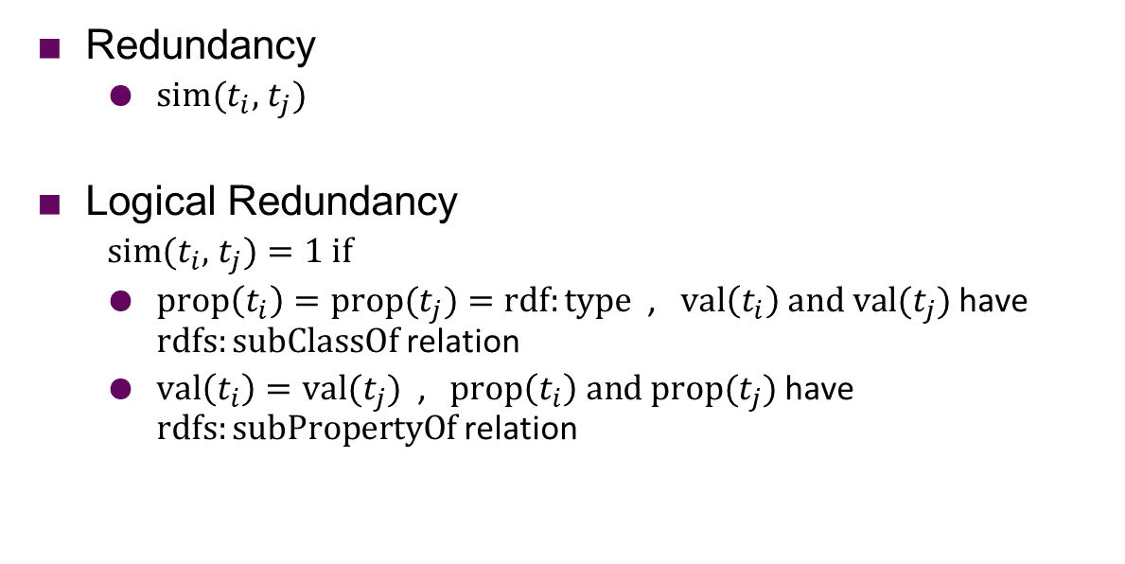
Information Redundancy
Redundancy
$sim(t_{i},$ $t_{j})$
Logical Redundancy
$sim(t_{i},$ $t_{j})=1 if$
$prop\left(t_{i}\right)=prop(t_{j})=rdf:type$ , $val\left(t_{i}\right) and val(t_{j})$ have $rdfs:subClassOf$relation
$val\left(t_{i}\right)=val(t_{j})$ , $prop\left(t_{i}\right) and prop(t_{j})$ have $rdfs:subPropertyOf$relation
type: Thing
type: Place
type: Building
label: “Paris Public School”
name: “Paris Public School”

Slide 10
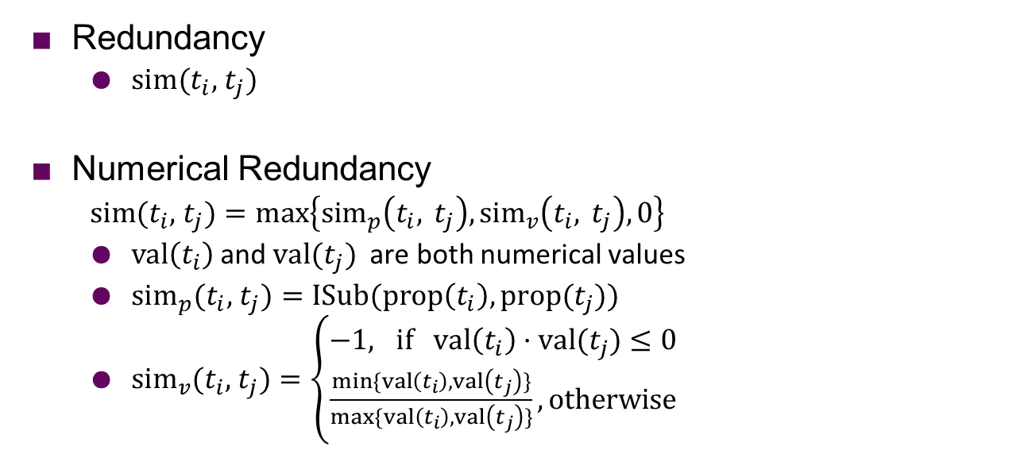
Information Redundancy
Redundancy
$sim(t_{i},$ $t_{j})$
Numerical Redundancy
$sim(t_{i},$ $t_{j})=max\left\{{sim}_{p}\left(t_{i}, t_{j}\right),{sim}_{v}\left(t_{i}, t_{j}\right),0\right\}$
$val\left(t_{i}\right)$and $val(t_{j})$ are both numerical values
${sim}_{p}(t_{i},$ $t_{j})=ISub(prop\left(t_{i}\right), prop(t_{j}))$
${sim}_{v}(t_{i},$ $t_{j})=\left\{\begin{aligned}−1, if val\left(t_{i}\right)·val(t_{j})≤0 \\ \frac{min⁡\{val\left(t_{i}\right),val\left(t_{j}\right)\}}{max⁡\{val\left(t_{i}\right),val\left(t_{j}\right)\}},otherwise\end{aligned}\right.$
area land: “9.01e+06”
area total: “9.09e+06”
elevation: “1818.13”
sim=0.9019
sim=0.0002
Notes:
ISub=[-1,1]

Slide 11
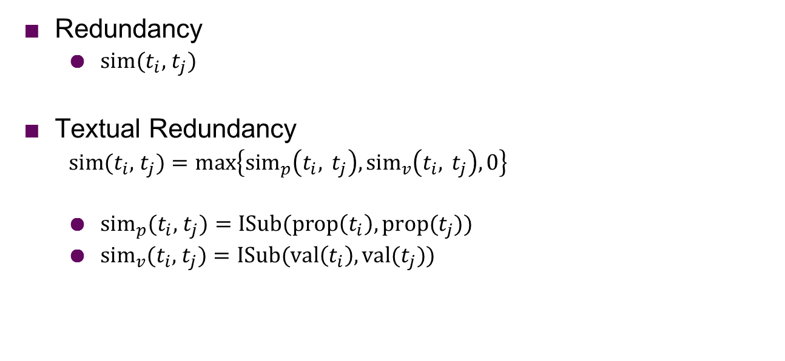
Information Redundancy
Redundancy
$sim(t_{i},$ $t_{j})$
Textual Redundancy
$sim(t_{i},$ $t_{j})=max\left\{{sim}_{p}\left(t_{i}, t_{j}\right),{sim}_{v}\left(t_{i}, t_{j}\right),0\right\}$
${sim}_{p}(t_{i},$ $t_{j})=ISub(prop\left(t_{i}\right),prop(t_{j}))$
${sim}_{v}(t_{i},$ $t_{j})=ISub(val\left(t_{i}\right),val(t_{j}))$
given name: “Richard”
name: “Richard C. Watkins”
gender: “male”
sim=0.78
sim=0
Notes:
ISub(name, given name)=0.6154
ISub(Ric, Rich)=0.781818
ISub(name, gender)=-1
ISub(Richard, male)=-1

Slide 12
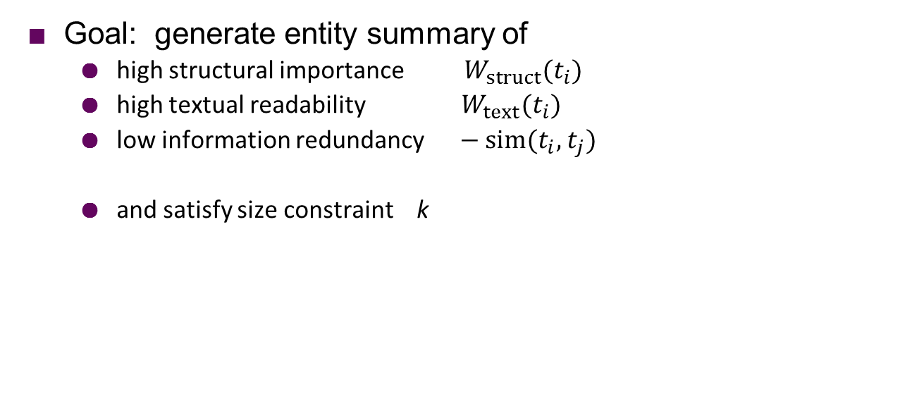
Combinatorial Optimization
Goal: generate entity summary of
high structural importance $W_{struct}{(t}_{i})$
high textual readability $W_{text}{(t}_{i})$
low information redundancy $− sim(t_{i},$ $t_{j})$
and satisfy size constraint k

Slide 13
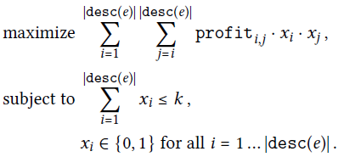
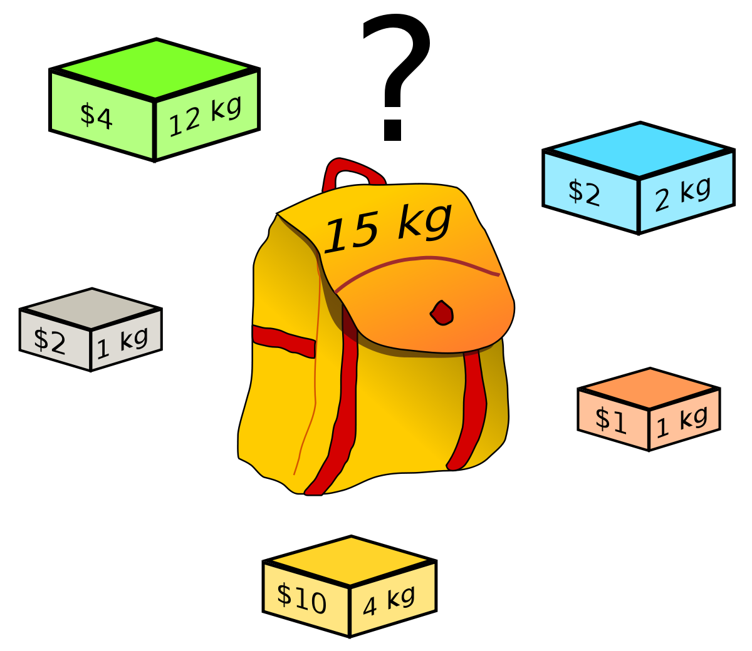

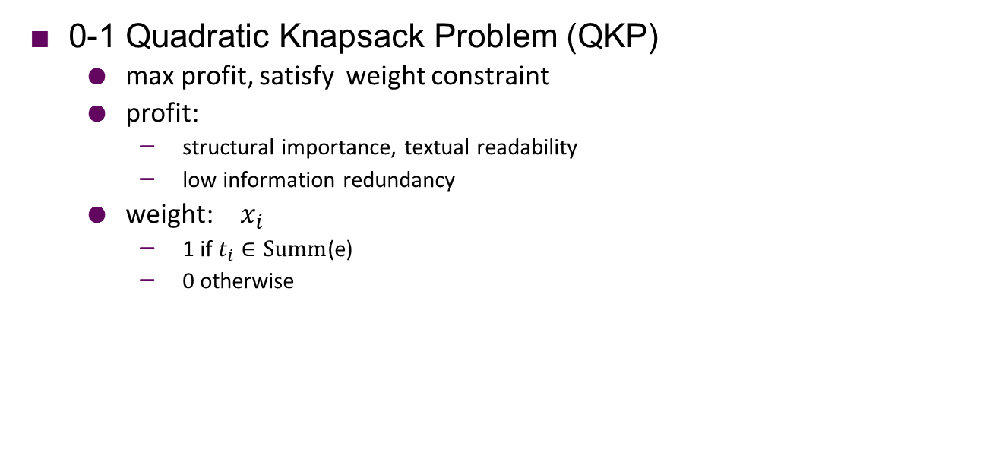
Combinatorial Optimization
0-1 Quadratic Knapsack Problem (QKP)
max profit, satisfy weight constraint
profit:
structural importance, textual readability
low information redundancy
weight: $x_{i}$
1 if $t_{i}∈Summ$(e)
0 otherwise

Slide 14
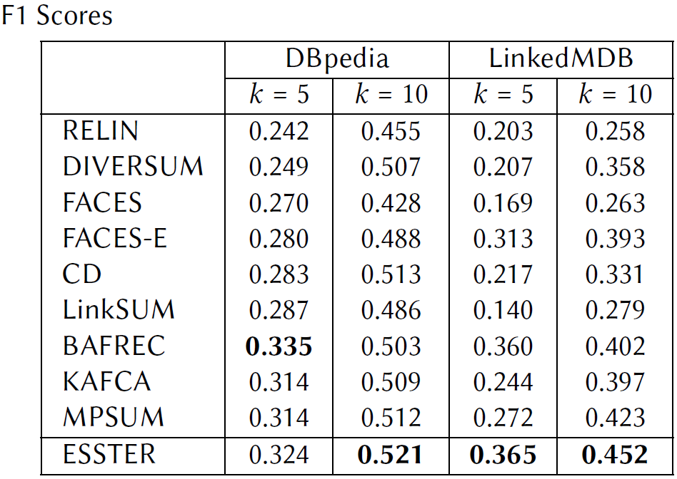
Evaluation
Data
ESBM v1.2
Baselines
9 unsupervised methods
Results
top-2 on DBpedia under k=5
best in all the other three settings

Slide 15
Conclusion
ESSTER: generating entity summaries by integrating
structural importance,
textual readability,
and information redundancy
via combinatorial optimization
ESSTER achieves SOTA among unsupervised entity summarizers on ESBM v1.2
Future Work
more powerful measures of readability and redundancy
incorporate these features into a neural network model

Slide 16
Thank you !
Questions ?

