Slide 1




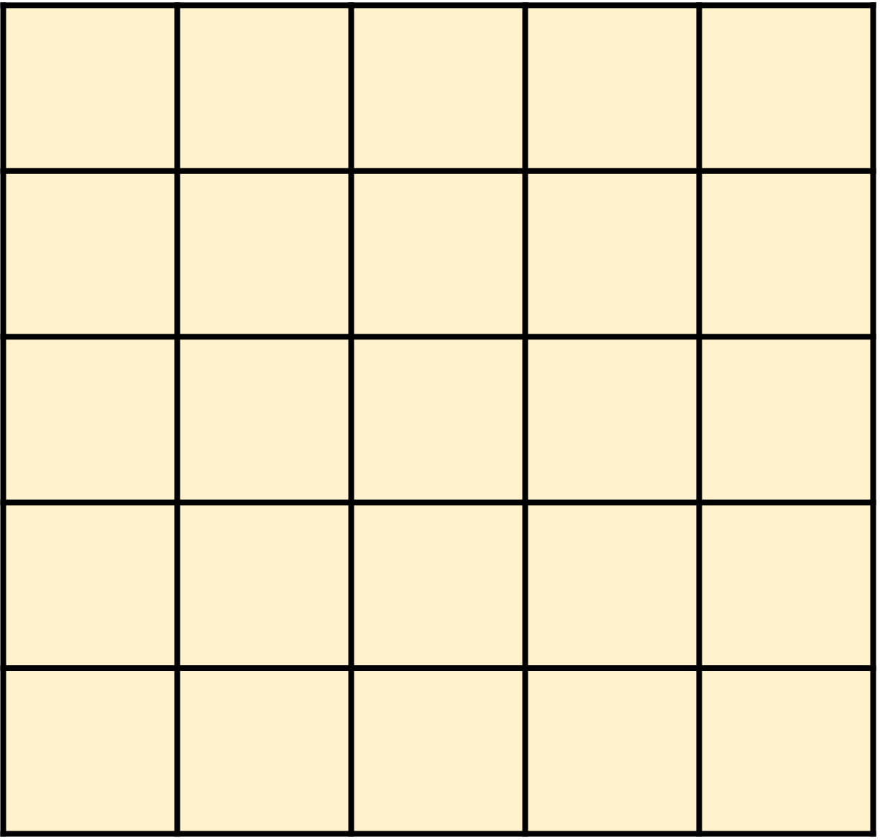


Graph Construction
Participant Role Identification
Cross-role Pattern
A temporal, weighted, homogeneous and directed multi-graph $G=\left(\tilde{V},\tilde{E}\right)$
ChainVoteRank
A Self-supervised GAT-based Method
Network Motif
[out-voting score, in-voting score]
Node Embedding Module
Self-supervised Learning Module
1
1.58, t₁₄
MSF
Evolved GAT Layer
NSF
1.46, t₁₉
1.23, t₇
2.64, t₁₅
0.87, t₁₃
Aggregate
HDBSCAN
9.26, t₁
2
2.45, t₅
0.62, t₁₁
2
3
0.34, t₄
0.87, t₁₇
5.13, t₂
1
1.43, t₈
Linear
Attention
(transaction
amount)
Concatenation
Joint learning
$$L_{Total}=L_{EGAT}+{α∙L}_{EGAT}+β∙L_{SSL}$$
1.27, t₁₂
3
0.78, t₁₀
2.99, t₁₆
2
7.89, t₃
0.84, t₆
TEF
2.56, t₉
0.78, t₁₈
Listing Agents
[t₁, t₂, -t₃, …, t_{n})]
Airdrop Promotors
t₁
TLSTM
Disguised Gamblers
t_{n}
Transaction/Transfer
-t₄
t₂
Funding Sponsors
Casino stakeholder
Betting address
Amount
-t₃
Real gamblers
Unknown address
…
Timestamp
Exchange
Arbitrageurs

