Slide 1
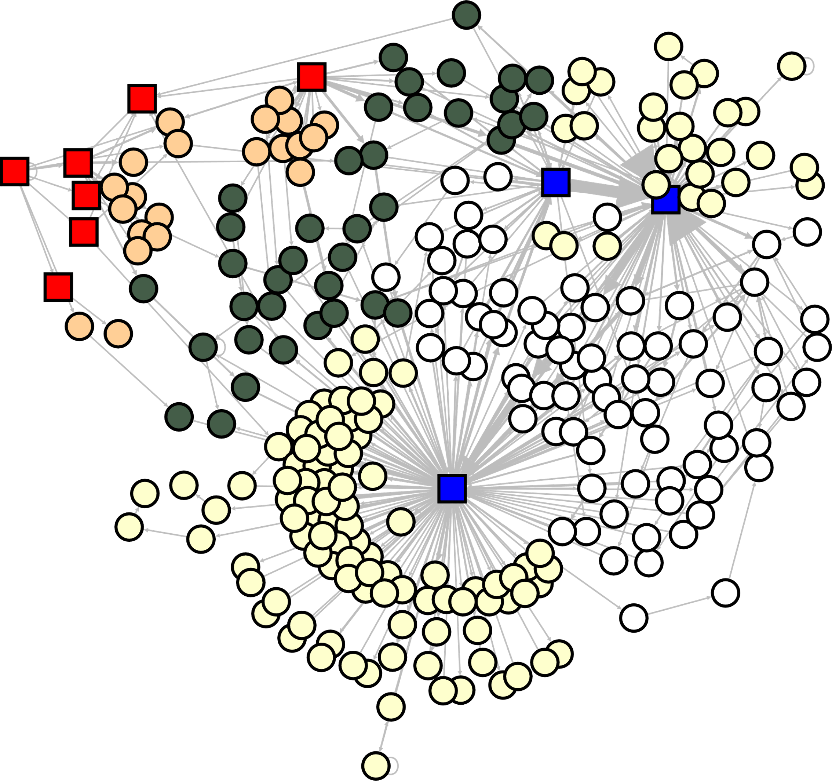
Cross-role Motifs
|z-score|=5.82
|z-score|=5.45
|z-score|=3.01
|z-score|=2.91
|z-score|=2.16
|z-score|=2.13
|z-score|=2.06
|z-score|=2.04
|z-score|=2.01
|z-score|=3.15
|z-score|=3.02
|z-score|=2.58
Casino stakeholders
Exchanges or services
Listing agents
Airdrop promotors
Arbitrageurs
Real Gamblers

