Slide 1
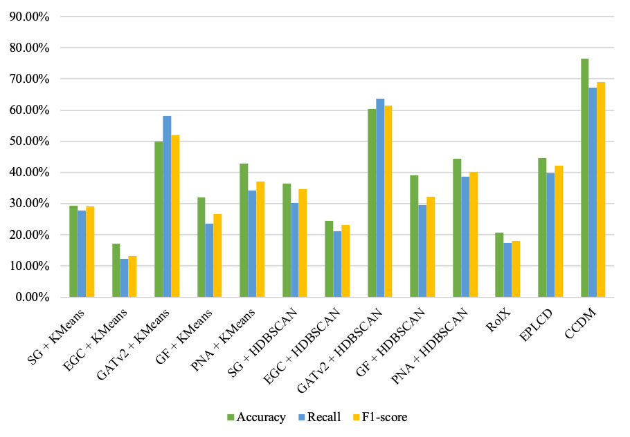
GF + KMeans
SG + KMeans
PNA + KMeans
EGC + AHC
CCDM(Ours)
SG + AHC
RolX
EGC + KMeans
EPLCD
GATv2+ KMeans
GATv2 + AHC
GF + AHC
PNA + AHC
Accuracy
Recall
F1-score

