Slide 1
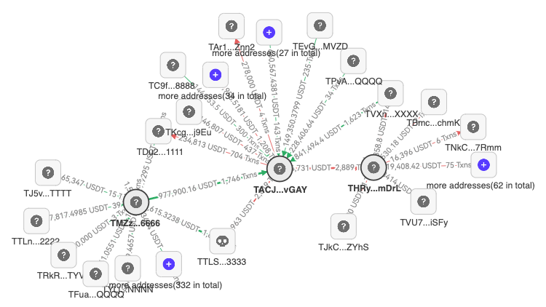


Bonus payer addresses
Disguised gamblers
Other addresses
A collection of addresses
not shown

