Slide 1
Machine Learning in Computational Chemistry:
Classification Models, Tree Models,
Introduction to Neural Networks
Jun Chen
Fujian Institute of Research on the Structure of Matter,
Chinese Academy of Sciences
July 14, 2025

Slide 2
Classification Models

Slide 3
Origin of classification models?
Brief History:
1950s: Founding of statistics: Fisher’s Linear Discriminant Analysis.
1980s-1990s:Pattern recognition emerges: Decision trees, KNN, Support Vector Machines(SVM).
2000s: Integration of Materials Science and AI: Materials Genome Initiative (High-throughput Data-Driven).
2010s: Research on reshaping the classification model of deep learning.
Classification models start with statistics(discriminant analysis) and pattern recognition(early AI)
Key milestones: Logistic Regression and Naive Bayes.

Slide 4
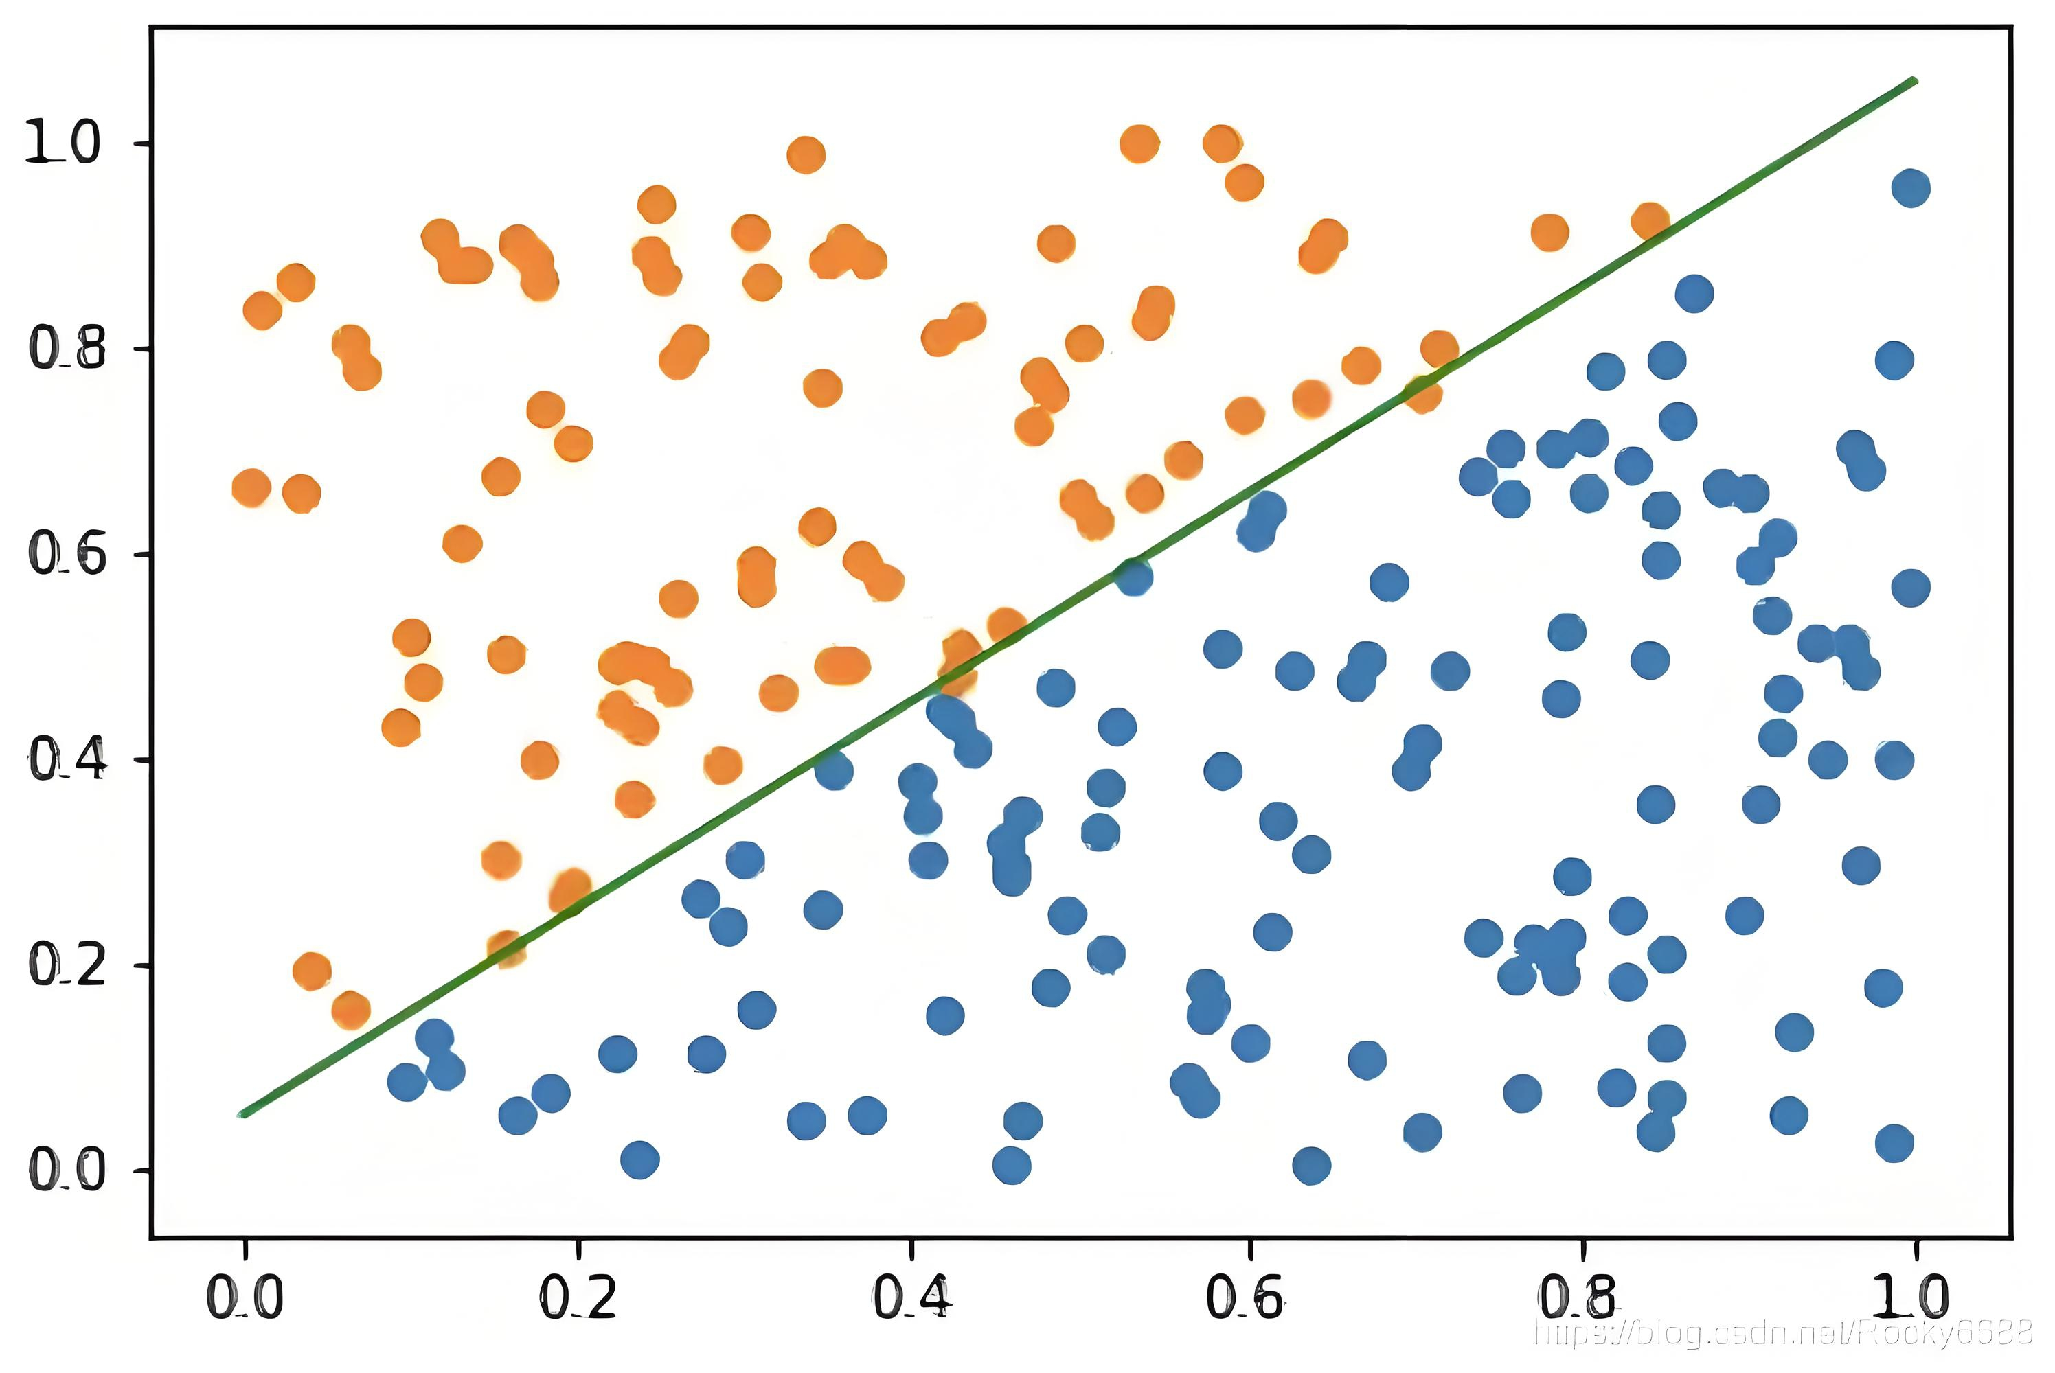
What is Classification Models?
Definition: a supervised learning method used to classify data points into categories.
Output: Categorical(e.g., ’active’/’inactive’, ’metal’/’insulator’, ’stable’/’unstable’)
Contrast with Regression:Regression predicts a continuous value (e.g., binding affinity, band gap energy).
Figure:Illustration of Binary Classification
(Imagine separating red and blue points with a line)
Core idea: By optimizing algorithms (such as minimizing the loss function), the model parameters are adjusted so that the decision boundary can best distinguish between different types of sample points.

Slide 5
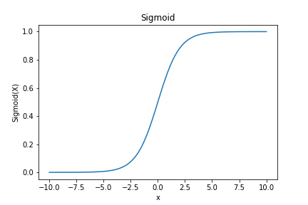
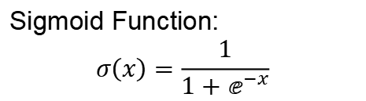
Common Algorithms: Logistic Regression
Sigmoid Function:
$$σ\left(x\right)=\frac{1}{1+ⅇ^{−x}}$$
Logistic regression is suitable for predicting binary categorical variables.
It maps the output of a linear function to a probability between 0 and 1 through the sigmoid function.
Figure:Sigmoid Function Plot
(S-shaped curve from 0 to 1)

Slide 6
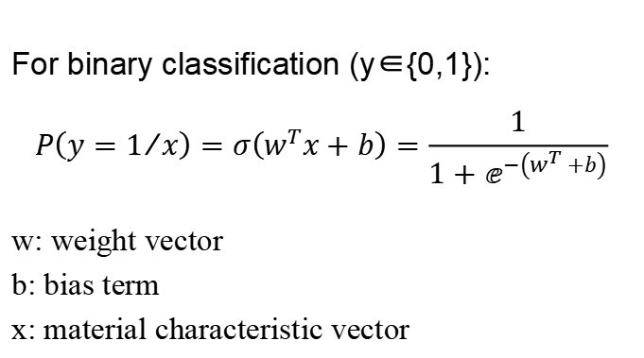
Prediction Equation
For binary classification (y∈{0,1}):
$$P\left(y=1/x\right)=σ\left(w^{T}x+b\right)=\frac{1}{1+ⅇ^{−\left(w^{T}+b\right)}}$$
w: weight vector
b: bias term
x: material characteristic vector
Advantages:
The computational cost is low, and it is
easy to understand and implement.
Disadvantage:
It is prone to underfitting and the
classification accuracy may not be high.
Applicable data types:
Numeric Data and Nominal Data

Slide 7
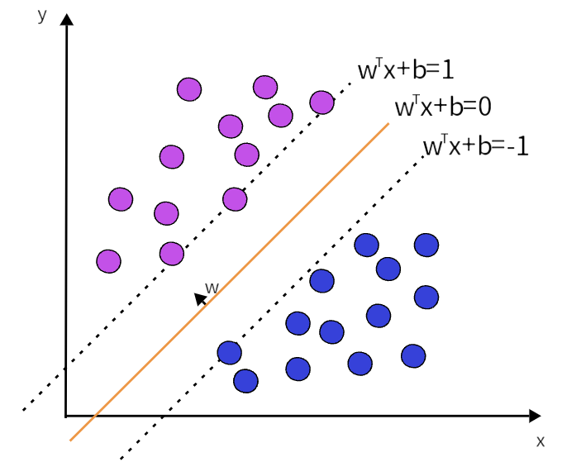
Common Algorithms: Support Vector Machines(SVM)
Finds the optimal hyperplane that best separates data points into different classes.
Key: Maximize the margin between the decision boundary and the nearest training data points (support vectors).
Handles both linearly separable and non-linearly separable data (using kernel trick).
Figure:SVM: Maximizing the Margin
(Imagine two classes of points, a separating line, and parallel lines defining the margin)

Slide 8
Key Concepts
Hyperplane: w^{T}x + b = 0
Support Vectors: Data points closest to the hyperplane.
Kernel Trick: Implicitly maps data into higher-dimensional space where it might be linearly separable (e.g., Radial Basis Function(RBF).)
Advantages:
Low generalization error rate, low computational cost, and easily interpretable results.
Disadvantages:
Sensitive to parameter adjustment and choice of kernel function. The original classifier,
without modification, is only applicable for handling binary problems.
Applicable data types:
Numeric Data and Nominal Data

Slide 9
Evaluation Metrics for Classification
Key Performance Indicators
Indicators | Formulas | Scientific significance | Ideal value
Accuracy | (TP+TN)/(TP+FP+FN+TN) | Overall prediction accuracy rate | Nearly 1
Precision | TP/(TP+FP) | The proportion of true stable materials in the predicted stable materials | Nearly 1
Recall | TP/(TP+FN) | The proportion of truly stable materials that are correctly identified | Nearly 1
TP (True Positive) TN (True Negative)
FP (False Positive) FN (False Negative)

Slide 10
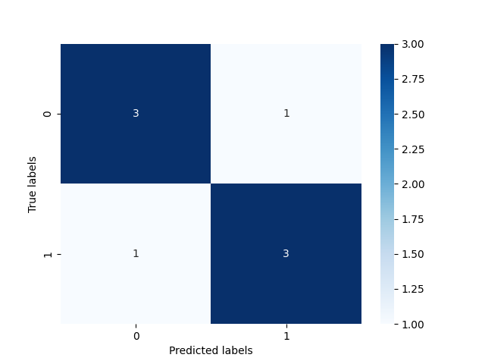
Evaluation Metrics for Classification
The confusion matrix is a tool used to evaluate the performance of classification models. The confusion matrix compares the classification results with the actual labels to illustrate the prediction performance of the model.
Figure:Confusion Matrix

Slide 11
Application fields
High-Throughput Virtual Screening (HTVS)
e.g. Lithium battery electrolyte
Input: Ion conductivity + Electrochemical window
Output: Safe/Unstable Classification → Experimental Verification Efficiency Increased by 5 Times
Structural Classification
e.g. Molecular dynamics trajectory analysis
Input: Local atomic coordinates
Output: Identification of amorphous/crystalline regions (SVM accuracy > 92%)
Performance Prediction
e.g. Classification of catalyst activity levels
Input: Surface adsorption energy + d-band center
Output: High/Middle/Low Activity → Guide Experimental Synthesis
Synthetic Path Optimization
e.g. Prediction of MOF Synthesis Conditions
Input: Solvent polarity + Reaction temperature
Output: Probability of success/failure → Reduction of trial-and-error costs

Slide 12
Tree Models

Slide 13
Origin of tree models?
1960s: The basic idea of decision tree is proposed.
1975: ID3: The use of the information gain criterion to select the splitting attribute marked the official birth of the decision tree classification algorithm.
1980s-1990s: C4.5, CART and the seeds of the idea of ensemble learning began to germinate.
1995: Random Forest: Improve the performance of tree ensemble, significantly enhancing the performance of classification and regression tasks.
2007: Gradient Boosting Machines (GBM) : The Boosting tree model framework based on gradient descent to optimize the loss function has significantly improved the accuracy.
2010s: The rise of XGBoost.
After 2016: LightGBM and CatBoost were released, improving training speed and accuracy. LightGBM innovatively adopted an efficient splitting algorithm based on histograms, while CatBoost addressed the bias of categorical features.
Definition: The tree model is a supervised learning algorithm based on a tree structure. It predicts by recursively dividing the feature space into mutually exclusive regions.

Slide 14
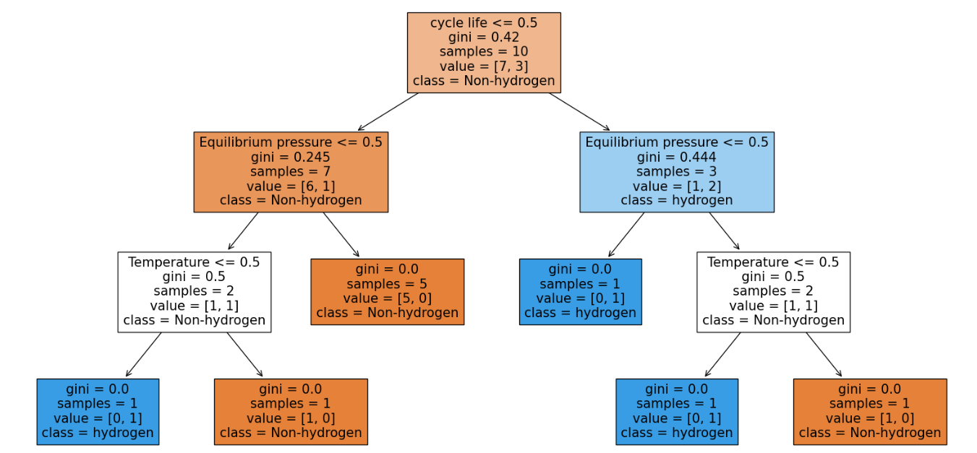
Decision Trees- The Basics
A flowchart-like structure where each internal node represents a ”test” on an attribute (feature).
Each branch represents an outcome of the test.
Each leaf node represents a class label (decision).
Works by recursively splitting the data based on features to maximize homogeneity (purity) within each child node.
Figure:Decision Tree for Material Classification
Pros: Highly interpretable, easy to understand.
Cons: Prone to overfitting, sensitive
Pros & Cons

Slide 15

Building a Decision Tree: Gini Impurity
At each node, we select the feature and split point that best divides the data.
Gini Impurity is a common metric to quantify the “purity” or “mixed-up-ness” of a node.
A node is pure if all its samples belong to the same class (Gini=0).
For a node p with C classes, where p_{k} is the proportion of samples belonging to class k:
Gini Impurity Formula
$$G\left(p\right)=1−\sum_{k=1}^{c}{{\left(p_{k}\right)}^{2}}$$
Example Calculation
Consider a node with 10 samples: 7 are Class A, 3 are Class B.
p_{A} = 7/10 = 0.7, p_{B} = 3/10 = 0.3
G = 1 − ((0.7)²+(0.3)²) = 1 − (0.49+0.09) = 1 − 0.58 = 0.42

Slide 16
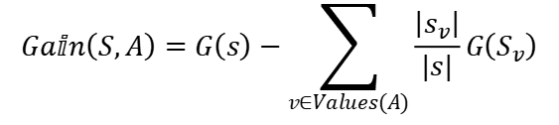
Building a Decision Tree: Information Gain (Gini Gain)
We want to find the split that maximizes the reduction in impurity.
This reduction is called Information Gain or Gini Gain.
The algorithm iterates through all possible features and split points to find the best one.
For a parent node S split into m child nodes S_{v} based on attribute A:
Information Gain Formula for a Split
$$Gaⅈn\left(S,A\right)=G\left(s\right)−\sum_{v∈Values(A)}{\frac{\left|s_{v}\right|}{|s|}G\left(S_{v}\right)}$$
Where |S_{v}| is the number of samples in child node S_{v}, and |S| is the number of samples in the parent node S.

Slide 17
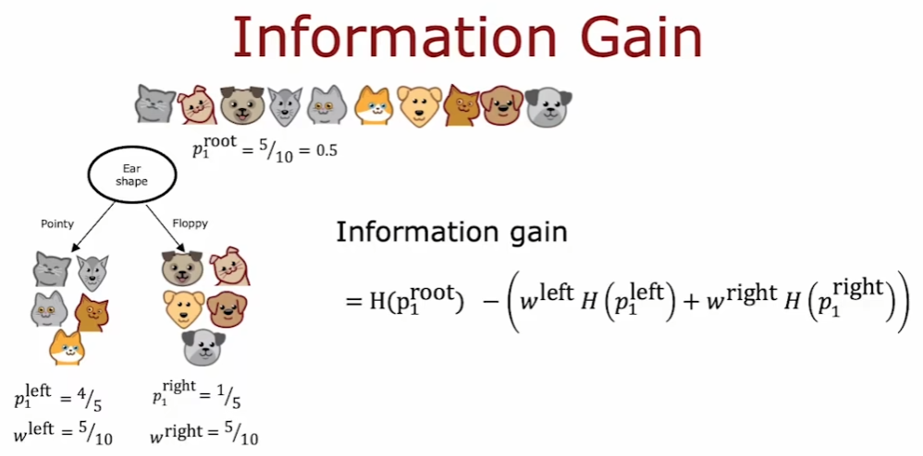
Building a Decision Tree: Information Gain (Gini Gain)
Figure:Information Gain

Slide 18
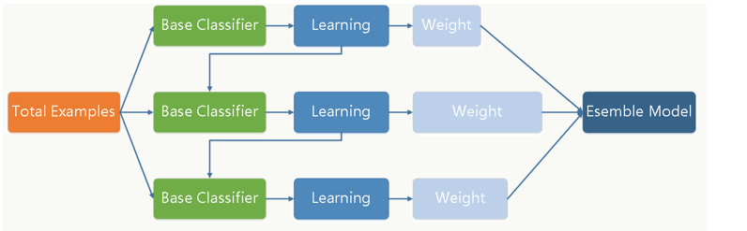
Ensemble Methods: Beyond Single Trees
Single decision trees are often prone to overfitting and can be unstable.
Ensemble methods combine the predictions of multiple individual models (often ”weak learners”) to produce a more robust and accurate model.
Two main types:
Bagging (Bootstrap Aggregating): Build multiple models independently and average their predictions (e.g., Random Forests).
Boosting: Build models sequentially, where each new model corrects the errors of the previous ones (e.g., Gradient Boosting).
Figure:Ensemble Learning Concept (Imagine multiple decision trees contributing to a final decision)

Slide 19
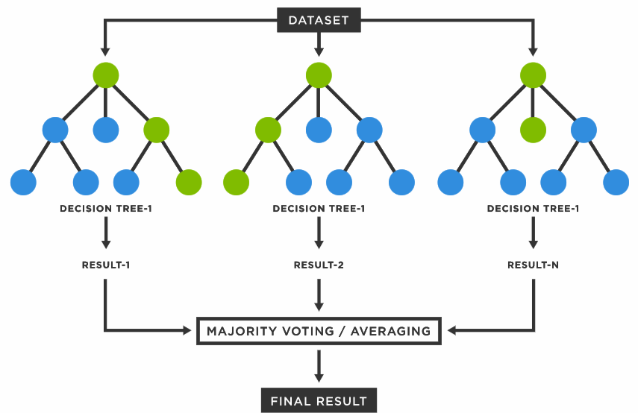
Random Forests
An ensemble learning method for both classification and regression. Builds multiple decision trees and merges their predictions to get a more accurate and stable prediction.
Two key randomization techniques:
1. Bagging (Bootstrap Aggregating): Each tree is trained on a different random subset (with replacement) of the training data.
2. Feature Randomness: At each split in a tree, only a random subset of features is considered.
Figure:Random Forests

Slide 20
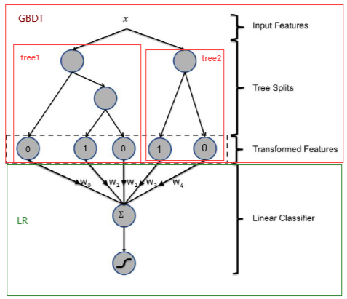
Gradient Boosting (e.g., XGBoost, LightGBM)
An ensemble method where new models are added to sequentially correct the errors made by previous models.
Builds trees one at a time, where each new tree tries to minimize the loss function of the previous model by learning from the “residuals” (errors).
How it works (intuition):
Start with an initial simple model (e.g., a single leaf predicting the average).
Calculate the “residuals” (errors) of this model.
Train a new weak learner (decision tree) to predict these residuals.
Add the predictions of this new tree to the previous model’s predictions, scaled by a learning rate.
Repeat steps 2-4 for many iterations

Slide 21
XGBoost vs LightGBM vs Random Forest Performance Comparison
Characteristic | XGBoost | LightGBM | Random Forest
Training Speed | Medium | Fast | Slow
Prediction Accuracy | High | Medium-High | Medium
Memory Usage | Medium | Low | High
Overfitting Risk | Medium-Low | Medium | Low
Interpretability | Medium | Medium | High
GPU Support | Excellent | Excellent | Limited
High-Dim Data Handling | Excellent | Excellent | Good

Slide 22
Application fields
1. Perovskite solar cell screening
Method: XGBoost classifier.
Input: Tolerance factor + Octahedral factor Output: Stable / Unstable.
Result: 142 viable experimental materials were selected from 120,000 candidates.
2. Classification of semiconductor point defects
Input: Defect formation energy + Charge transfer quantity.
Output: Reorganization center / Non-radiation center.
Key finding: The SHAP values reveal that the S impurity is the main recombination center.
3. Prediction of MOF synthesis success rate
Characteristics: Solvent polarity + Reaction temperature + Ligand length.
Model: LightGBM classifier (AUC = 0.91).
Application: Reduces failed experiments by 63%.
4. Classification of Molecular Dynamics Trajectories
(1) MD simulation
(2) Extract local atomic environment
(3) Random forest classification
(4) Identify BCC/HCP/Amorphous regions
The accuracy rate is 98.7%, which is 17 times faster than SVM.

Slide 23
Neural Networks

Slide 24
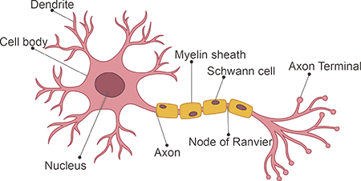
Biological Inspiration & History
Brief History:
1943: McCulloch and Pitts propose the first computational model of a neuron.
1957: Frank Rosenblatt creates the Perceptron, the first functional artificial neural network.
1969: Minsky and Papert’s
”Perceptrons” highlights
limitations (e.g., XOR problem),
leading to ”AI Winter”.
1980s: Backpropagation algorithm
rediscovered/popularized, enabling
training of multi-layer networks
Figure: A Biological Neuron
Biological Neurons:
Receive signals from dendrites.
Process signals in the cell body.
Transmit signals via axon to other neurons.
Synapses adjust strength of connections.

Slide 25
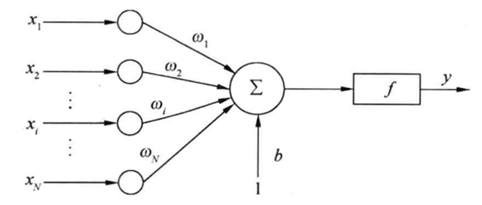
The Artificial Neuron (Perceptron)
The fundamental building block
of a Neural Network.
Mimics the biological neuron’s
function:
Receives multiple numerical
inputs (x_{i}).
Each input is multiplied by a
corresponding weight (w_{i}).
A bias (b) term is added.
The sum is passed through an
activation function (f ).
Produces a single output.
Figure: Artificial Neuron (Perceptron)
Weighted Sum:
Output (Activation): a = f (z)
Mathematical Formulation

Slide 26
Activation Functions
Introduce non-linearity into the network, allowing it to learn complex patterns.
Without them, a neural network would just be a series of linear operations, equivalent to a single linear model.
Sigmoid (Logistic)
Rectified Linear Unit (ReLU)
Formula:
Range: (0, 1)
Pros: Historically important,
provides probabilities.
Cons: Vanishing gradient
problem for very large or very
small z.
Formula: f (z) = max(0, z)
Range: [0, ∞)
Pros: Computationally efficient,
helps mitigate vanishing gradient.
Cons: ”Dying ReLU” problem
(neurons can become inactive).
Others: Tanh ( ), Leaky ReLU, ELU, Swish.

Slide 27
Common activation functions and their derivatives
Activation Functions | Functions | derivatives
Logistic Functions
Tanh Functions
ReLU Functions
ELU Functions
SoftPlus Functions

Slide 28
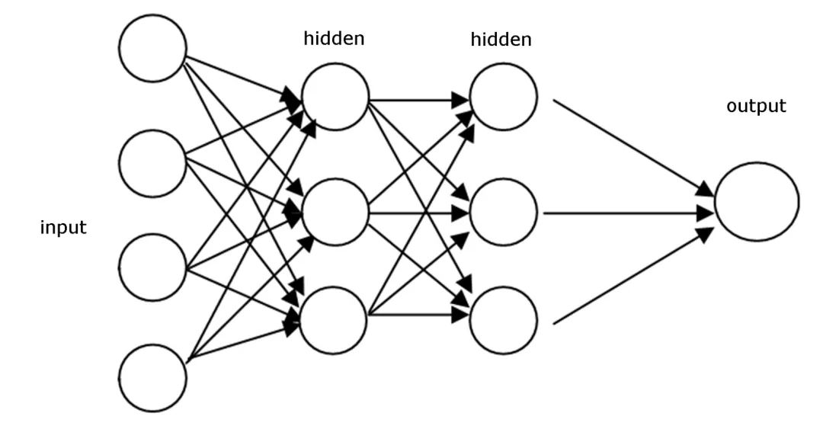
Feedforward Neural Networks (Multilayer Perceptrons - MLP)
Neurons are organized into layers.
Input Layer: Receives raw data. No computation performed.
Hidden Layers: One or more layers between input and output.
Perform computations, learning increasingly complex representations.
Output Layer: Produces the final prediction (e.g., class probabilities
for classification, a single value for regression).
Feedforward: Information flows in one direction, from input to
output, without loops.

Slide 29
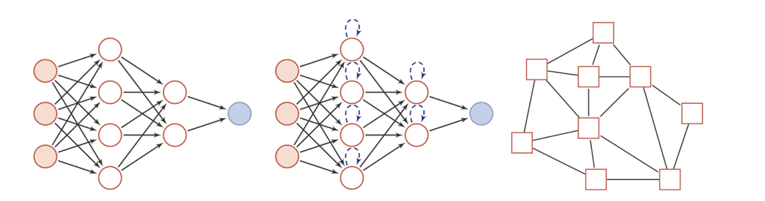
Memory networks and networks with graphs
Memory networks, also known as feedback networks, are networks in which neurons not only receive delicate bits of information from other neurons, but also from their own histories.
Graph networks are neural networks defined on graph-structured data, where each node in the graph consists of a neuron or a set of neurons, the connections between nodes can be directed or undirected, and each node can receive information from neighboring nodes or from itself. Graph neural networks are a generalization of feedforward and memory neural networks.

Slide 30
Neural Network Implementation Core Components
subassemblies | Calculate network output | Realization points
forward propagation | Calculate network output | Matrix multiplication and activation functions
loss function | Quantifying prediction error | Numerical stability needs to be considered
backward propagation | Calculate the parameter gradient | Recursive applications of the chain rule
Parameter update | Optimization weight | Optimizer Selection

Slide 31
Universal Approximation Theroem
Feedforward neural networks have a strong fitting ability, and common continuous nonlinear functions can be approximated by feedforward neural networks
approximation

Slide 32
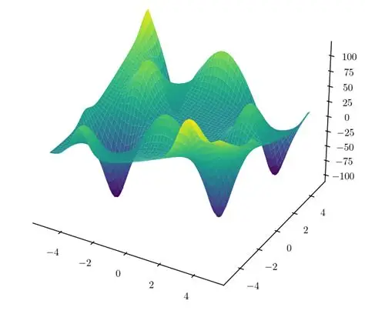
Training a Neural Network: Backpropagation (Intuition)
The goal of training is to find the optimal weights and biases that minimize the difference between predicted and actual outputs.
This difference is quantified by a Loss Function (or Cost Function).
Gradient Descent: An iterative optimization algorithm that adjustsweights and biases in the direction that most steeply reduces the loss function.
Regression: Mean Squared Error (MSE):
Classification: Cross-Entropy Loss (for probabilities).
Figure: Gradient Descent: Finding the Minimum of a Loss Function
(Imagine a ball rolling down a hill to the lowest point)

Slide 33
Training a Neural Network: Backpropagation (Algorithm)
Backpropagation is the core algorithm for training ANNs. It uses the chain rule of calculus to efficiently compute the gradients of the loss function with respect to every weight and bias in the network.
Two Phases:
Forward Pass: Input data flows through the network, layer by layer, to compute the output and the loss.
Backward Pass: The error (difference between predicted and actual) is propagated backward through the network. Gradients are calculated for each weight and bias, indicating how much they contributed to the error.

Slide 34
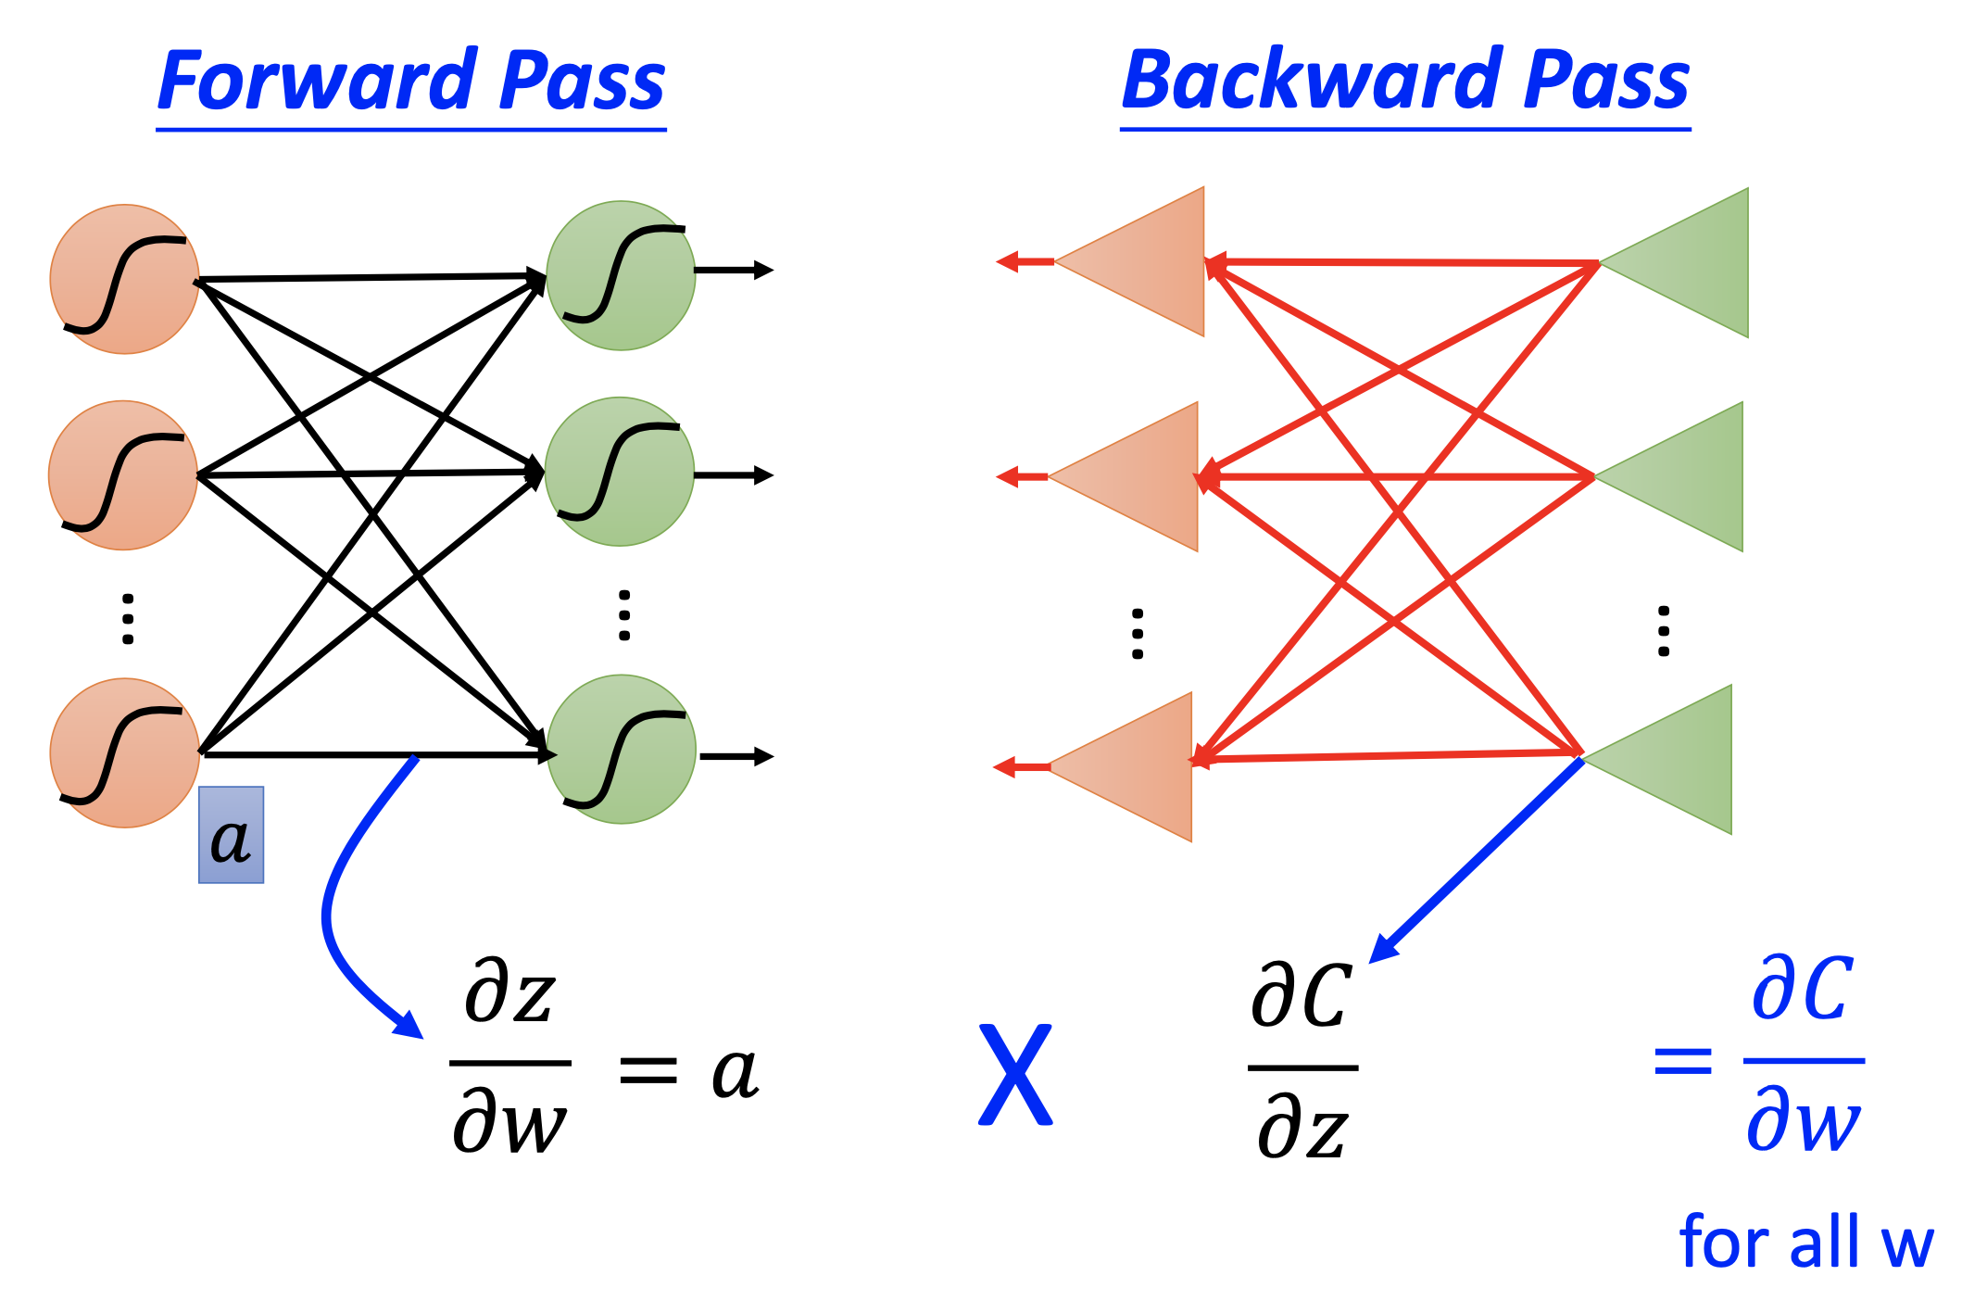
Training a Neural Network: Backpropagation (Algorithm)
Weight Update: Weights and biases are then adjusted using the calculated gradients and a learning rate (α):
This process is repeated over many ”epochs” (passes through the entire dataset)
Figure: Forward and Backward Pass in Backpropagation

Slide 35
Key Hyperparameters in Neural Networks
Learning Rate (α): Determines the step size at each iteration while moving toward a minimum of the loss function. (Too high:overshoot; Too low: slow convergence).
Number of Hidden Layers: Depth of the network. More layers enable learning more complex hierarchical features.
Number of Neurons per Layer (Width): Capacity of the layer to learn representations.
Activation Functions: (Discussed previously: ReLU, Sigmoid, Tanh, etc.). Chosen based on task and layer.
Epochs: Number of times the entire training dataset is passed
through the neural network.
Batch Size: Number of training examples utilized in one iteration. (Larger batches: stable gradients, less frequent updates; Smaller batches: noisy gradients, more frequent updates).
Optimizers: Algorithms (e.g., Adam, SGD, RMSprop) that control how weights and biases are adjusted based on gradients.

Slide 36
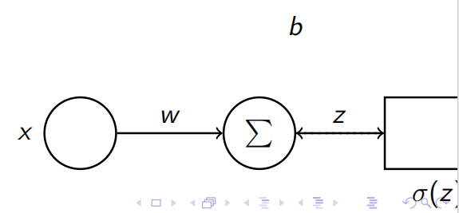
Training a Neural Network: Backpropagation (Cont.) -
Error FunctionDerivation
A Simplified Example: Single-Layer Network
Let’s walk through the weight update process using backpropagation with a simple single-layer neural network.
Network Structure:
Single input x
Single neuron with weight w and bias b
Activation function σ(z) (e.g., Sigmoid)
Output
Target output y
Error Function (Loss Function):
We’ll use a simple Mean Squared
Error (MSE) as our loss function L:

Slide 37
Applications of Neural Networks
Molecular Property Prediction and Virtual Screening
Neural networks can rapidly predict physicochemical properties (e.g., solubility, logP value) and biological activities (e.g., IC50 value) of tens of thousands of compounds by directly learning the relationship between molecular structure (e.g., SMILES string, molecular diagram, or 3D conformation) and properties.
Chemical reaction prediction and synthetic route design
Transformer-based neural networks (e.g., Molecular Transformer) can predict the product distribution and optimal reaction conditions of chemical reactions with an accuracy of over 90%.
Molecular Dynamics Simulation Acceleration
Conventional molecular dynamics (MD) simulations are limited by computational cost, making it difficult to study millisecond-scale processes. Neural Network Potential (NNP) can realize nanosecond simulations with DFT-level accuracy by fitting quantum mechanical calculations.

Slide 38
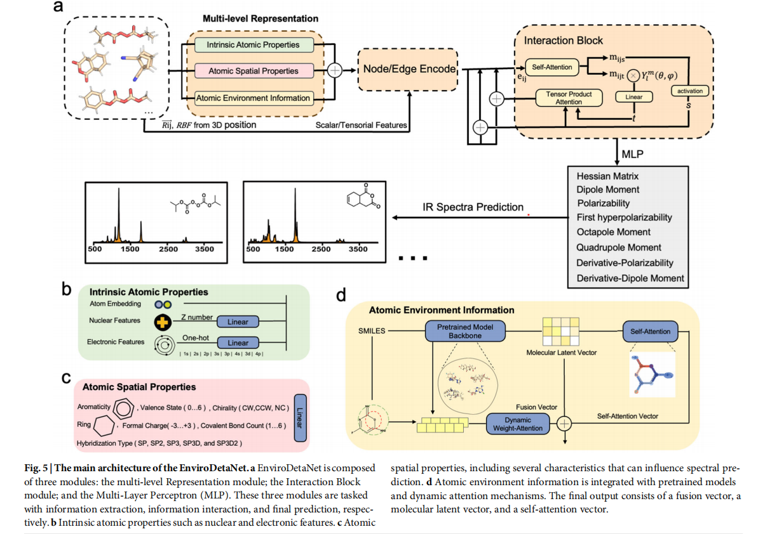
Related Literature
In this paper, we propose an equivariant, fast, and robust model, named EnviroDetaNet, which integrates molecular environment information. EnviroDetaNet employs an E(3)-equivariant message-passing neural network combining intrinsic atomic properties, spatial features,
and environmental information, allowing it to comprehensively capture both local and global molecular information.
Xu, Yuzhi, et al. "Pretrained E(3)-Equivariant Message-Passing Neural Networks with Multi-Level Representations for Organic Molecule Spectra Prediction." npj Computational Materials, vol. 11, 2025

Slide 39
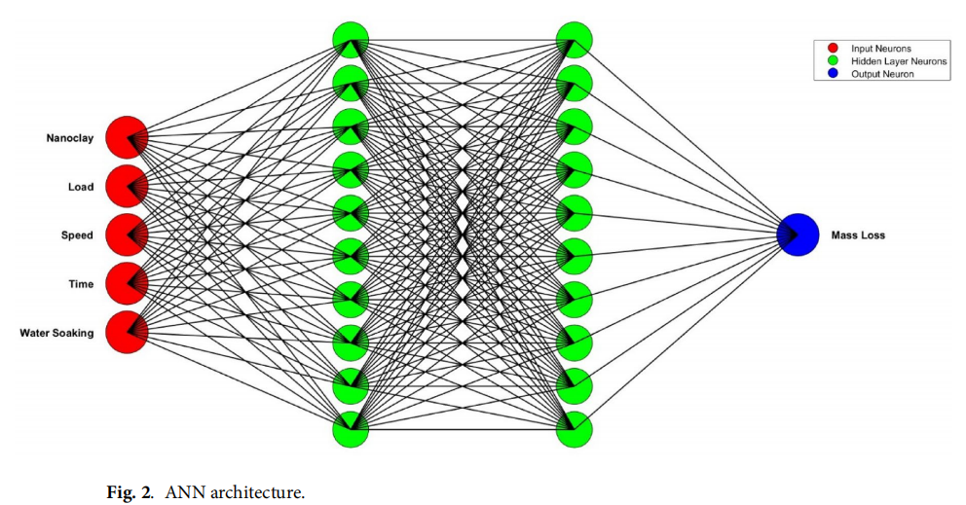
Related Literature
This study aims to measure mass loss under wear conditions by studying critical parameters like nanoclay wt%, load, speed, time, and water soaking time. Experimental runs are planned based on the Box-Behnken design of RSM to create a regression model, which is then validated by ANOVA analysis.
Shettar, Manjunath, et al. "Estimation of Mass Loss Under Wear Test of Nanoclay-Epoxy Nanocomposite Using Response Surface Methodology and Artificial Neural Networks." Scientific Reports, vol. 15, 2025

Slide 40
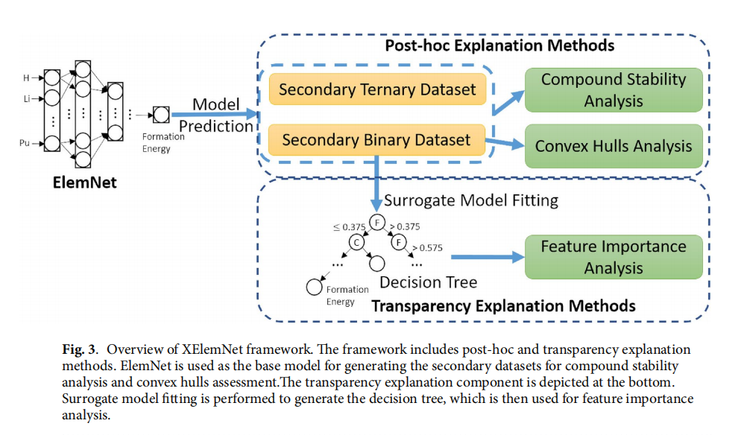
Related Literature
In this study, we propose XElemNet to explore the interpretability of ElemNet by applying a series of explainable artificial intelligence (XAI) techniques, focusing on post_x0002_hoc analysis and model transparency. The experiments with artificial binary datasets reveal ElemNet’s effectiveness in predicting convex hulls of element-pair systems across periodic table groups, indicating its capability to effectively discern elemental interactions in most cases.
Wang, Kewei, et al. "XElemNet: Towards Explainable AI for Deep Neural Networks in Materials Science." Scientific Reports, vol. 14, 2024

Slide 41
Thank You!

