Slide 1
What is this course all about?
The fundamental of Digital Logic
Binary numbers and relate number systems
Digital circuit building block
How to design
Combinational logic circuits
Sequential logic circuits

Slide 2
Course Management

Slide 3
Introduction to Digital Systems

Slide 4
Digital Technology
The term digital is derived from the way computer perform operations → by counting digits.
Today, digital tech is applied in a wide range of areas.
The tech has progressed from vacuum-tube to discrete transistors to complex ICs.

Slide 5
Digital and Analog Quantities
2 categories of electronic circuits:
Analog
Digital
Analog quantity = continuous values
Digital quantity = a discrete set of values

Slide 6
Analog Quantity
Most things in nature → analog form
Temperature, pressure, distance, etc
Smooth, continuous curve like this:
Temp
Time

Slide 7
Digital Quantity
Sampled-value representation (quantization)
Each dot can be digitized as a digital code (consists of 1s and 0s)
Temp
Time

Slide 8
Digital Advantages
Digital data can be processed and transmitted more efficiently and reliably than analog data.
Digital data has a great advantage when storage is necessary.
Let’s talk about digital music…

Slide 9
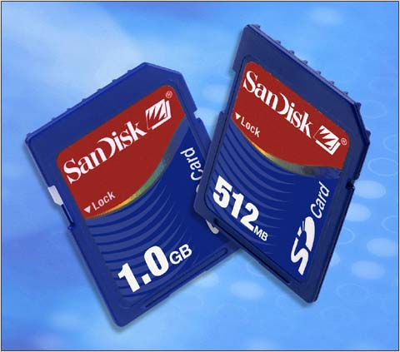
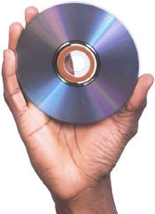
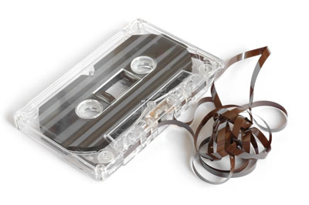
Digital Music
The media is very compact but higher-density (and counting):
CDs
Memory cards
No more bulky and noise-prone media like cassette tape
http://www.dpreview.com/news/0303/sandisk512mb1gbsdcard.jpg
http://www.wwwk.co.uk/images/homepage/compact-disc.jpg
http://www.cricketsoda.com/images/music/cassette_tape.jpg

Slide 10
Digital systems are everywhere!!!

Slide 11
Binary Digits,
Logic Levels, &
Digital Waveforms

Slide 12
Binary Digits
Binary system (either 0 or 1)
Bit (comes from binary digit)
Digital circuits:
1 represents HIGH voltage
0 represents LOW voltage
Groups of bits (combinations of 0s and 1s) are called codes
Being used to represent numbers, letters, symbols, (i.e. ASCII code), instructions, and etc.

Slide 13
Logic Levels
The voltages used to represent a 1 and 0 are called logic levels.
Ideally, there is only HIGH (1) and LOW (0).
Practically, there must be thresholds to determine which one is HIGH or LOW or neither of them.
CMOS
(2V to 3.3V → HIGH)
(0V. To 0.8V → LOW)
V_{H(max)}
HIGH
(binary 1)
V_{H(min)}
Not allowed
V_{L(max)}
LOW
(binary 0)
V_{L(min)}

Slide 14
Digital Waveforms
Voltage levels that are changing back and forth between HIGH and LOW
(Ideal) pulse
At t₀ → leading edge, at t₁ → trailing edge
HIGH
HIGH
LOW
LOW
t₀
t₁
t₀
t₁
Positive-going pulse
Negative-going pulse

Slide 15
Non-Ideal Pulse
90%
t_{w}
Amplitude
50%
Pulse width
10%
t_{r}
t_{f}
Rise time
Fall time

Slide 16
Waveform Characteristics
Waveforms = series of pulses (called pulse train)
Periodic
Period (T) = T₁ = T₂ = T₃ = … = T_{n}
Frequency (f) = 1/T
Nonperiodic
T₁
T₂
T₃

Slide 17
Duty Cycle
Ratio of the pulse width (t_{w}) to the period (T)
Duty cycle = ( t_{w} / T ) x 100%

Slide 18
Example
From a portion of a periodic waveform (as shown) determine:
Period
Frequency
Duty cycle
T
t_{w}
0
1
10
11
t (ms)

Slide 19
Waveform & Binary Information
Bit time
1
clock
0
1
A
0
Bit sequence represented by waveform A
1
0
1
0
0
1
1
0
0
1
0
1

Slide 20
Data Transfer
Binary data are transferred in two ways:
Serial – bits are sent one bit at a time
Parallel – all the bits in a group are sent out on separate lines at the same time (one line for each bit)
Serial over Parallel
Advantage: less transmission line
Disadvantage: takes more time

