Slide 1
The Digital Codes

Slide 2
Binary Coded Decimal (BCD)
Would it be easy for you if you can replace a decimal number with an individual binary code?
Such as 00011001 = 19₁₀
The 8421 code is a type of BCD to do that.
BCD code provides an excellent interface to binary systems:
Keypad inputs
Digital readouts

Slide 3
Binary Coded Decimal
Decimal Digit | 0 | 1 | 2 | 3 | 4 | 5 | 6 | 7 | 8 | 9
BCD | 0000 | 0001 | 0010 | 0011 | 0100 | 0101 | 0110 | 0111 | 1000 | 1001
Note: 1010, 1011, 1100, 1101, 1110, and 1111 are INVALID CODE!
Let’s crack these…
ex1: dec-to-BCD
35
98
170
2469
ex2: BCD-to-dec
10000110
001101010001
1001010001110000

Slide 4
BCD Addition
BCD is a numerical code and can be used in arithmetic operations. Here is how to add two BCD numbers:
Add the two BCD numbers, using the rules for basic binary addition.
If a 4-bit sum is equal to or less than 9, it is a valid BCD number.
If a 4-bit sum > 9, or if a carry out of the 4-bit group is generated it is an invalid result. Add 6 (0110) to a 4-bit sum in order to skip the six the invalid states and return the code to 8421. If a carry results when 6 is added, simply add the carry to the next 4-bit group.

Slide 5
BCD Addition
Try these:
ex: Add the following numbers
(a) 0011+0100
(b) 00100011 + 00010101
(c) 10000110 + 00010011
(d) 010001010000 + 010000010111
(e) 1001 + 0100
(f) 1001 + 1001
(g) 00010110 + 00010101
(h) 01100111 + 01010011

Slide 6
The Gray Code
The Gray code is unweighted and is not an arithmetic code.
There are no specific weights assigned to the bit positions.
Important: the Gray code exhibits only a single bit change from one code word to the next in sequence.
This property is important in many applications, such as shaft position encoders.

Slide 7
The Gray Code
Decimal | Binary | Gray Code
0 | 0000 | 0000
1 | 0001 | 0001
2 | 0010 | 0011
3 | 0011 | 0010
4 | 0100 | 0110
5 | 0101 | 0111
6 | 0110 | 0101
7 | 0111 | 0100
Decimal | Binary | Gray Code
8 | 1000 | 1100
9 | 1001 | 1101
10 | 1010 | 1111
11 | 1011 | 1110
12 | 1100 | 1010
13 | 1101 | 1011
14 | 1110 | 1001
15 | 1111 | 1000

Slide 8
The Gray Code
Binary-to-Gray code conversion
The MSB in the Gray code is the same as corresponding MSB in the binary number.
Going from left to right, add each adjacent pair of binary code bits to get the next Gray code bit. Discard carries.
ex: convert 10110₂ to Gray code
1 + 0 + 1 + 1 + 0 binary
1 1 1 0 1 Gray

Slide 9
The Gray Code
Gray-to-Binary Conversion
The MSB in the binary code is the same as the corresponding bit in the Gray code.
Add each binary code bit generated to the Gray code bit in the next adjacent position. Discard carries.
ex: convert the Gray code word 11011 to binary
1 1 0 1 1 Gray
+ + + +
1 0 0 1 0 Binary

Slide 10
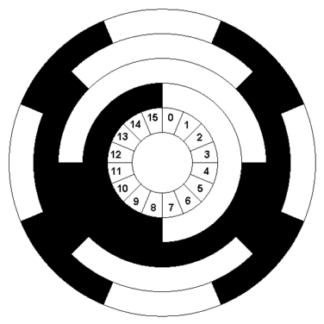
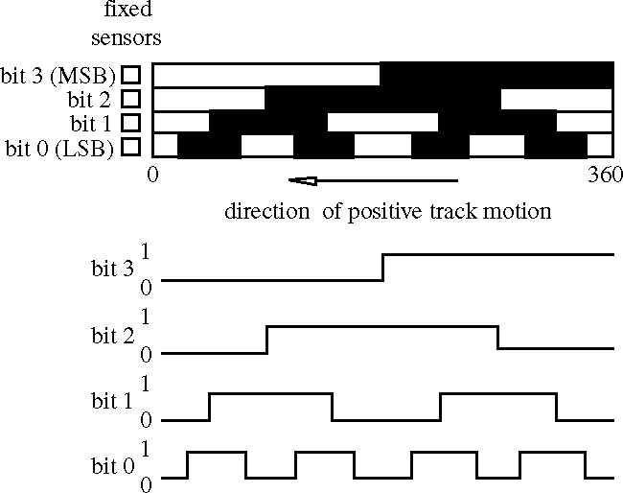
The Gray Code - Application
Bit 0
Bit 1
Bit 2
Bit 3
http://www.mipraso.de/enzyklopaedie/g/gray-code-scheibe.gif
http://www.engr.colostate.edu/~dga/mechatronics/figures/9-11.gif

Slide 11
Alphanumeric Codes
Represent numbers and alphabetic characters.
Also represent other characters such as symbols and various instructions necessary for conveying information.
The ASCII is the most common alphanumeric code.
ASCII = American Standard Code for Information Interchange

Slide 12
ASCII
ASCII has 128 characters and symbols represented by a 7-bit binary code.
It can be considered an 8-bit code with the MSB always 0. (00h-7Fh)
00h-1Fh (the first 32) – control characters
20h-7Fh – graphics symbols (can be printed or displayed)

Slide 13
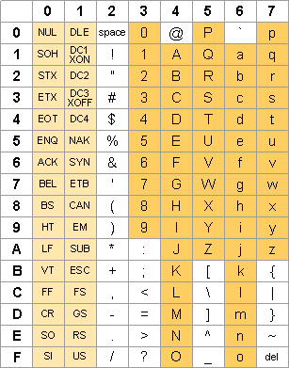
ASCII Table
http://ascii-table.com/img/table.gif

Slide 14
Extended ASCII
There are an additional 128 characters that were adopted by IBM for use in their PCs. It’s popular and is used in applications other than PCs → unofficial standard.
The extended ASCII characters are represented by an 8-bit code series from 80h-FFh

Slide 15
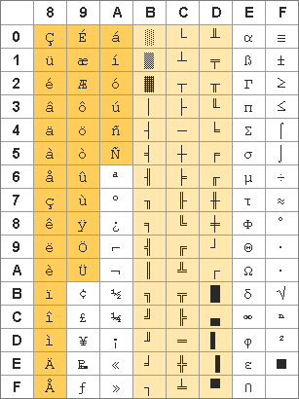
Extended ASCII Table
http://ascii-table.com/img/table-pc.gif

