Slide 1
EAZZYNET DIAGRAM TOOL
JOE W NGETHE
SCIJ/01103/2014
B.TECH COMMUNICATION AND COMPUTER NETWORKS

Slide 2
What is EazzyNet
A diagramming tool
A learning aid system
An online subnetting tool

Slide 3
IP Adresses
Numeric identifier to each device connected to a network
Uses the internet protocol for communication
Location addressing
Serves the host or network identification
Class | Range from | Range to
Class A | 0.0.0.0 | 127.255.255.255
Class B | 128.0.0.0 | 191.255.255.255
Class C | 192.0.0.0 | 223.255.255.255
Class D | 224.0.0.0 | 255.255.255.255

Slide 4
Problem Statement The problem the system is to tackle is the difficulty of planning a network. The number of professionals is limited thus the number of people capable of planning and creating networks is limited. Ordinary users cannot plan networks until they have acquired a certain level of networking knowledge

Slide 5
Objectives
system that will enable both ordinary and professional users to successfully plan and diagram home and small business LAN networks virtually.
Physical topology diagrams
Determine devices required based network requirements.
Recommend devices and cost and desired network
Sub-netting into subnets
Provide learning links for users

Slide 6
Literature review
A network is an interconnection of devices
Networks are not only a luxury, but have become a necessity.
Networks are classified as logical or physical
There are two ways of subnetting an IP space ; VLSM and FLSM.
Network diagrams enhance better understanding of system and ease troubleshooting.

Slide 7
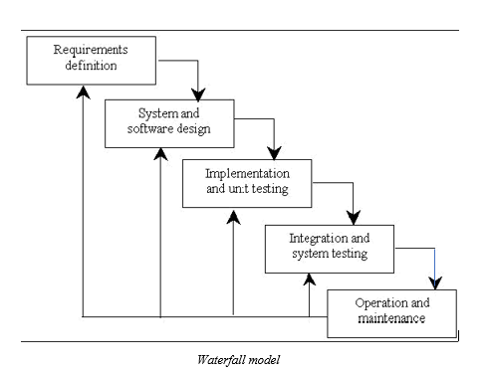
Methodology 1. structured method 2. Is simple to use 3. Task done in phases

Slide 8
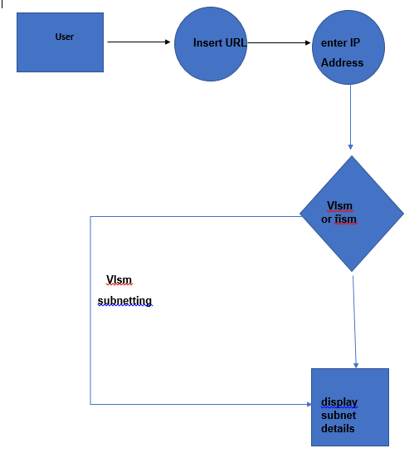
System Design
Data flow diagram for subnetting

Slide 9
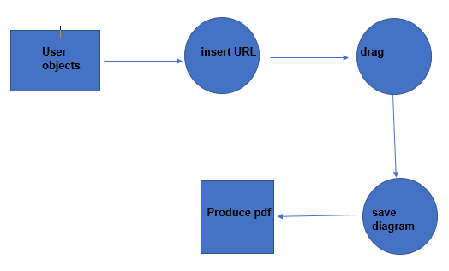
Data flow diagram for diagramming tool

Slide 10
RECOMMENDATIONS
Satisfy the needs of users who want a tool for diagramming and planning a network topology in a user friendly manner and easy to use interface

Slide 11
FURTHER WORKS
Introduction of predesigned templates.
This will then then give user wanted topology

Slide 12
CONCLUSION
I hope the system will be of help to many users, and improve learning

Slide 15
Add a Slide Title - 1

Slide 16
Two Content Layout with SmartArt
First bullet point here
Second bullet point here
Third bullet point here
Group A
Task 1
Task 2
Group B
Task 1
Task 2
Task 3
Task 4
Task 3

Slide 18
Add a Slide Title - 4

Slide 19
Add a Slide Title - 5

Slide 20
Title and Content Layout with Chart

