Slide 1
LSA, PLSI, and LDA
A Brief Introduction
Notes:
Hu Guang-Neng 2014-9-28

Slide 2
Representation
RG (Niu Li-Qiang)
LSA → word2vec → GloVec
本次
LSA→PLSA→LDA

Slide 3
Timeline & Outline
1990，LSA
Indexing by latent semantic analysis. Deerwester, Dumais et al. JASIS
1999，PLSI
Probabilistic Latent Semantic Indexing. Hofmann. SIGIR
2003，LDA
Latent Dirichlet Allocation. Blei, Ng, Jordan. JMLR
Notes:
从CFG到PCFG？

Slide 4
Two Problems in Natural Language
Synonymy
一义多词
Polysemy
一词多义
auto
engine
tyre
car
model
tyre
Markov
model
normalize
Synonymy
Poor Recall
Polysemy
Poor Precision

Slide 5
The Setting
Corpus
set of documents
D = {d_1, …, d_N}
Vocabulary
set of words
W = {w_1, …, w_M}
Term-Doc Matrix
occurrence of words in docs
A_ij = n(w_i, d_j)
Term-Doc | D_1 | D_2 | D_3
auto | 1
engine | 1
tyre | 1 | 1
car |  | 1
model |  | 1 | 1
markov |  |  | 1
normalize |  |  | 1
NOTE: Each example has its own docs and terms which are from different references.

Slide 6
I

Slide 7
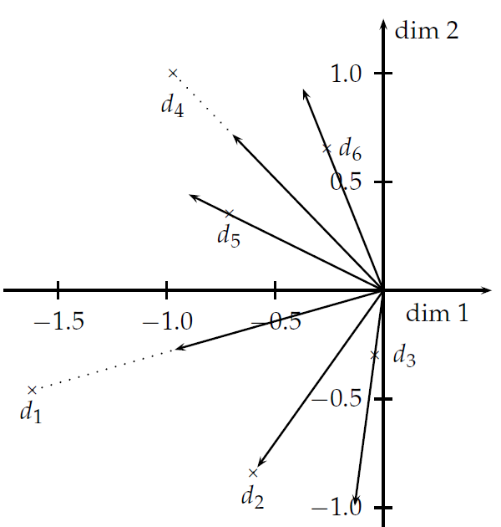
LSA: Key ideas
Mapping terms and docs into a latent semantic space
Notes:
Manning: Intro to IR，FSNLP

Slide 8
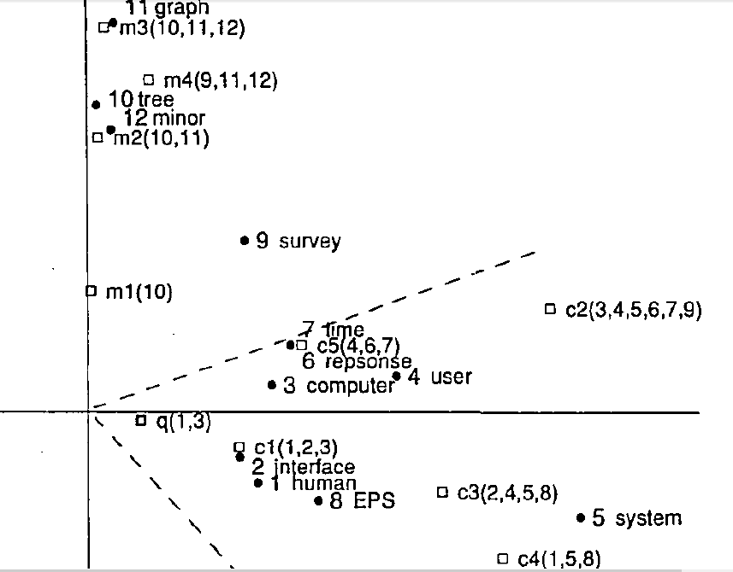
1 | Human
2 | Interface
3 | Computer
4 | User
5 | System
6 | Response
7 | Time
8 | EPS
9 | Survey
10 | Tree
11 | Graph
12 | Minor
Notes:
LSA 1990

Slide 9
LSA: Technical Details (1)
Matrix Diagonalization Theorem (Eigen Decomposition)
Symmetric Diagonalization Theorem (Spectral Theorem)
Singular Value Decomposition (SVD)
Notes:
A 是满秩的，即有n个线性独立的特征向量；
A是对称的，

Slide 10
LSA: Technical Details (2)
Eckart – Young Theorem (1936)
Keep top k singular values(Optimal in the sense of L2-norm)
Term-Term correlation: C C^T (C: term-doc matrix)
Doc-Doc correlation: C^T C
Query representation:

Slide 11
Aside: PCA and SVD
The principal components of matrix X are rows of orthogonal matrix P such that the covariance C_Y of Y≡PX is diagonal
Rows are pre-centered
Spectral Theorem provides
Principal components are the eigenvectors of covariance
Finding PCA via SVD
Construct Y
Perform SVD
Q = V
Notes:
P is a projection matrix iff P^2=P. projection matrix P is orthogonal iff P=P^T. Orthogonal matrix: QQ^T = I.
PCA: dim-trial, SVD: trial-dim; PRML：min SSE = max Var

Slide 12
From LSA to PLSI
LSA assumption on the data : normally distributed
Optimize Sum-Squares-Error (Eckart-Young 1936)
LSA have negative entries
Orthogonal, not Non-negative
Count data (e.g. Text)
Normal distribution is not appropriated; maybe multinomial better
Latent semantic space
No probabilistic interpretation
Linear algebra to Probabilistic modeling

Slide 13
II

Slide 14
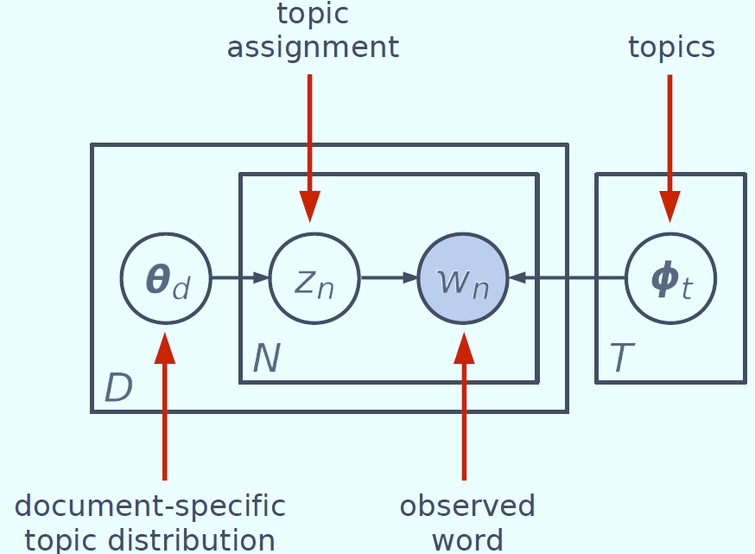
PLSI: Key Ideas
Expressing words and documents in terms of probabilistic topics
Z: latent class/aspect/topic
Generative probabilistic models of text corpora

Slide 15
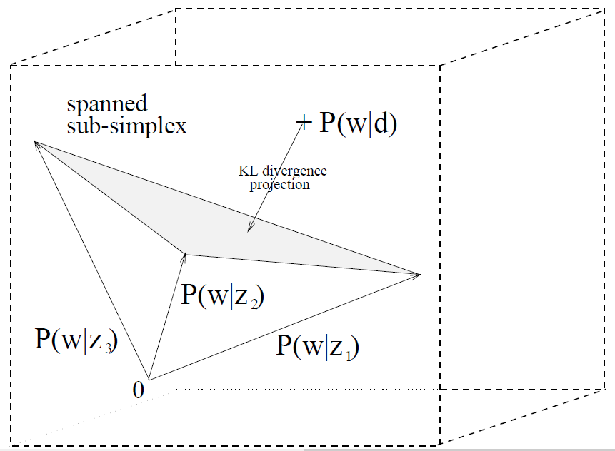
P(w|d) are approximated by a multinomial representable as a convex combination of the class-conditionals P(w|z)

Slide 16
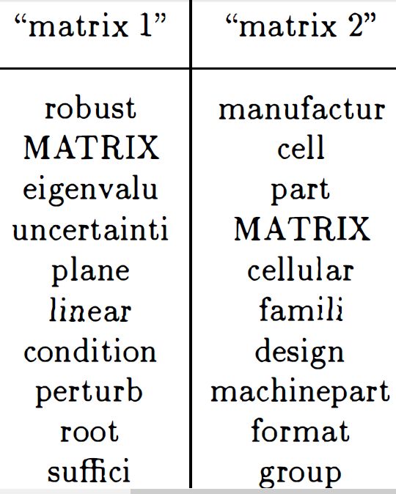
PLSI: An Example
Polysemy: matrix
Linear algebra: 矩阵
Biology cell: 基质
LSA (SVD) helplessness
Making topics for central bridge
Doc-topic
Topic-term
Notes:
电影： 黑客帝国

Slide 17
PLSI: Technical Details
Joint Probability Model
E-step
M-step
Notes:
PRML： Ch9.

Slide 18
Comparing PLSA with LSA
LSA vs. PLSA
U: P(w|z)
V: P(d|z)
Sigma: P(z)
Linear algebra (SVD) vs. Probabilistic modeling (EM)
Notes:
Weight vs. Probability

Slide 19
III

Slide 20
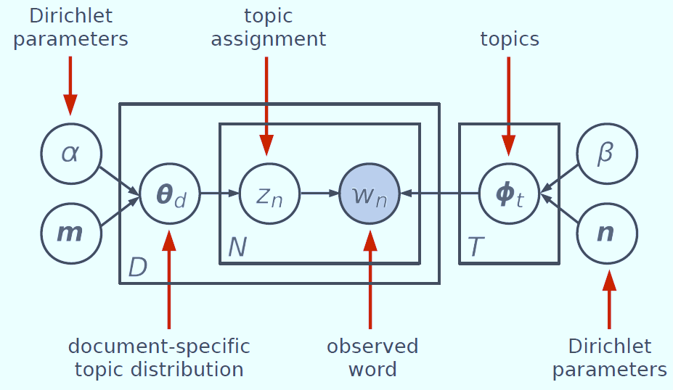
LDA: Key Ideas
Generative probabilistic models of text corpora
Same as PLSA
Three-level Pr. Model
Corpus: alpha, beta
Doc: theta
Term: z, w
Notes:
PLSA in the red circle

Slide 21
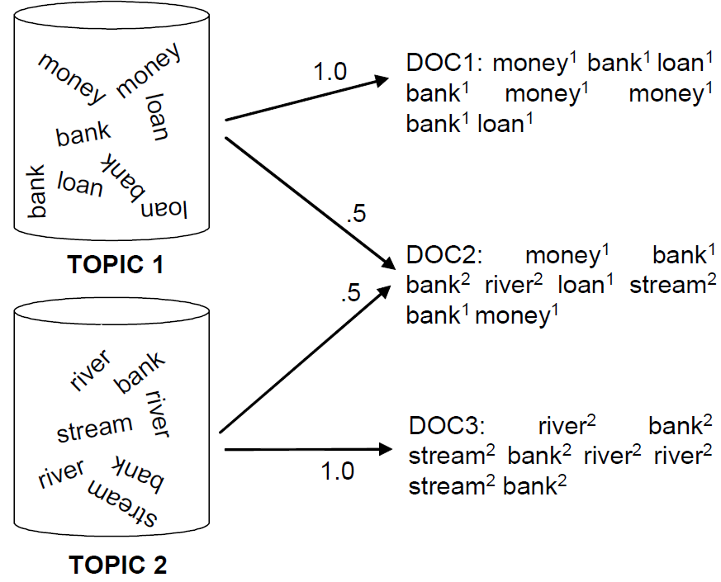
Mixture
components
Mixture
weights
Bayesian approach: use priors
Mixture weights ~ Dirichlet( α )
Mixture components ~ Dirichlet( β )

Slide 22
LDA: Technical Details (1)
The complete probability model
Gibbs Sampling
number of times that term t has been observed with topic k
number of times that topic k has been observed with doc m
Notes:
Text para est 09

Slide 23
LDA: Technical Details (2)
while not finished do
for all documents m in [1, M] do
for all words n in [1, Nm] in document m do
decrement counts and sums:
sample topic index:
increment counts and sums:
Notes:
http://www.flickering.cn/概率统计/2014/06/lda数学八卦文本建模/

Slide 24
LDA: Technical Details (3)
Multinomial parameters

Slide 25
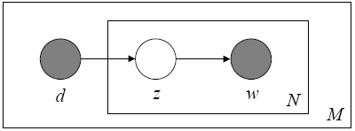
Three-level models
Unigram model
Mixture of unigrams
PLSA
LDA

