Slide 1
LSA, pLSA, and LDA
Acronyms, oh my!
Slides by me,
Thomas Huffman,
Tom Landauer and Peter Foltz,
Melanie Martin,
Hsuan-Sheng Chiu,
Haiyan Qiao,
Jonathan Huang

Slide 2
Outline
Latent Semantic Analysis/Indexing (LSA/LSI)
Probabilistic LSA/LSI (pLSA or pLSI)
  Why?
  Construction
    Aspect Model
    EM
    Tempered EM
  Comparison with LSA
Latent Dirichlet Allocation (LDA)
  Why?
  Construction
  Comparison with LSA/pLSA

Slide 3
LSA vs. LSI
But first:
What is the difference between LSI and LSA?
  LSI refers to using this technique for indexing, or information retrieval.
  LSA refers to using it for everything else.
  It’s the same technique, just different applications.

Slide 4
The Problem
Two problems that arise using the vector space model:
  synonymy: many ways to refer to the same object, e.g. car and automobile
    leads to poor recall
  polysemy: most words have more than one distinct meaning, e.g. model, python, chip
    leads to poor precision

Slide 5
The Problem
Example: Vector Space Model
  (from Lillian Lee)
auto
engine
bonnet
tyres
lorry
boot
car
emissions
hood
make
model
trunk
make
hidden
Markov
model
emissions
normalize
Synonymy
Will have small cosine
but are related
Polysemy
Will have large cosine
but not truly related

Slide 6
The Setting
Corpus, a set of N documents
  D={d_1, … ,d_N}
Vocabulary, a set of M words
  W={w_1, … ,w_M}
A matrix of size N * M to represent the occurrence of words in documents
  Called the term-document matrix

Slide 7
Latent Semantic Indexing
Latent – “present but not evident, hidden”
Semantic – “meaning”
LSI finds the “hidden meaning” of terms
based on their occurrences in documents

Slide 8
Latent Semantic Space
LSI maps terms and documents to a “latent semantic space”
Comparing terms in this space should make synonymous terms look more similar

Slide 9
LSI Method
Singular Value Decomposition (SVD)
A(n*m) = U(n*n) E(n*m) V(m*m)
Keep only k eigen values from E
  A(n*m) = U(n*k) E(k*k) V(k*m)
Convert terms and documents to points in k-dimensional space

Slide 10
A Small Example
Technical Memo Titles
c1: Human machine interface for ABC computer applications
c2: A survey of user opinion of computer system response time
c3: The EPS user interface management system
c4: System and human system engineering testing of EPS
c5: Relation of user perceived response time to error measurement
m1: The generation of random, binary, ordered trees
m2: The intersection graph of paths in trees
m3: Graph minors IV: Widths of trees and well-quasi-ordering
m4: Graph minors: A survey

Slide 11
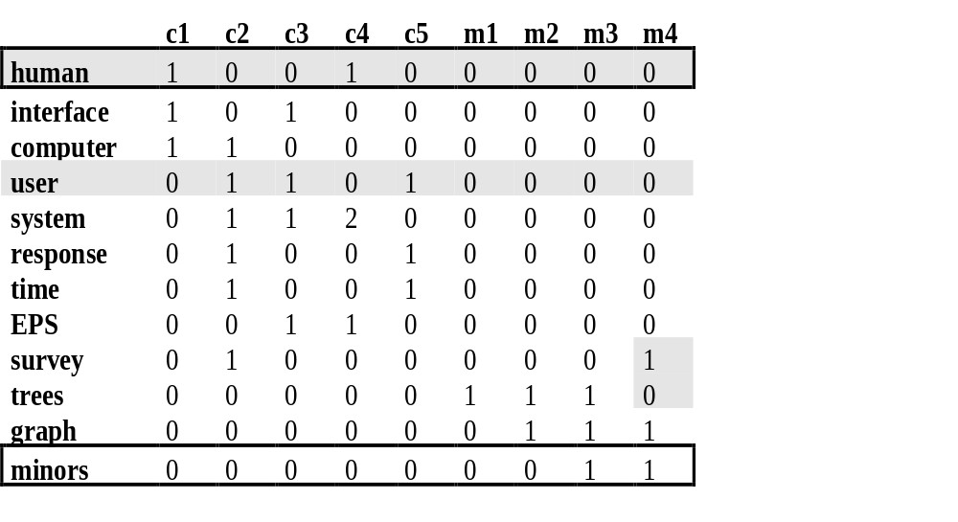
A Small Example – 2
r (human.user) = -.38 r (human.minors) = -.29

Slide 12
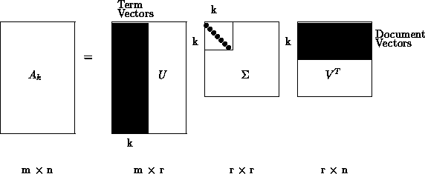
A Small Example – 3
Singular Value Decomposition
  {A}={U}{S}{V}^{T}
Dimension Reduction
  {~A}~={~U}{~S}{~V}^{T}

Slide 13
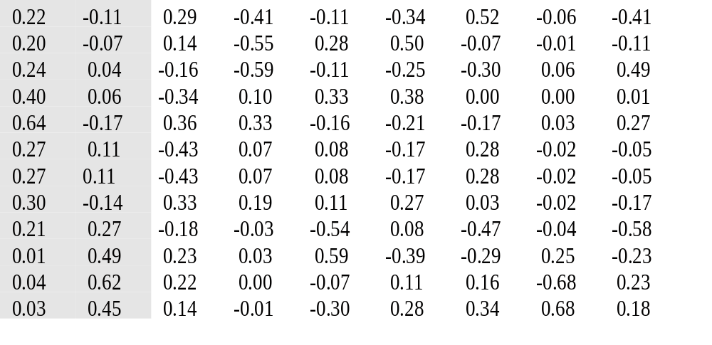
A Small Example – 4
{U} =

Slide 14
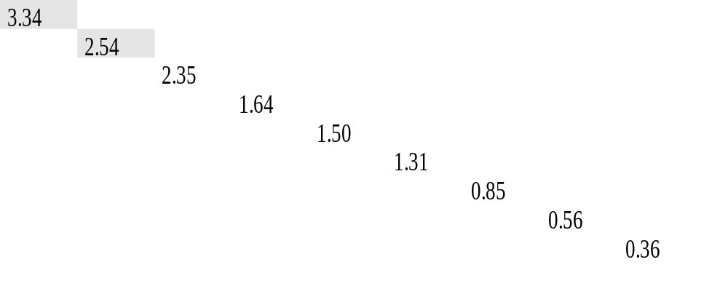
A Small Example – 5
{S} =

Slide 15
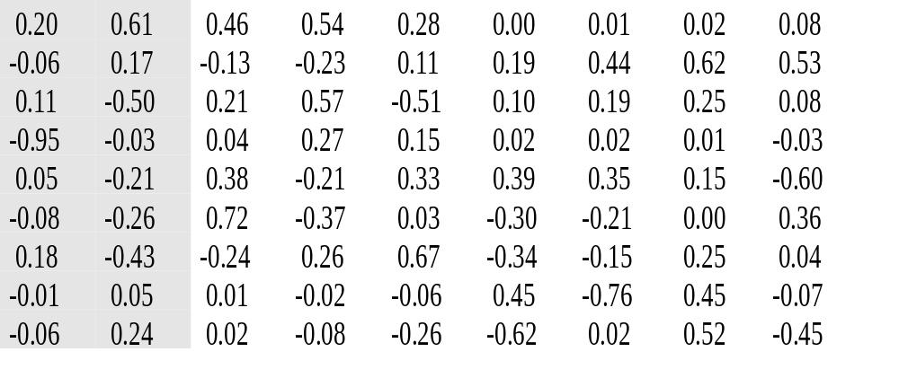
A Small Example – 6
{V} =

Slide 16
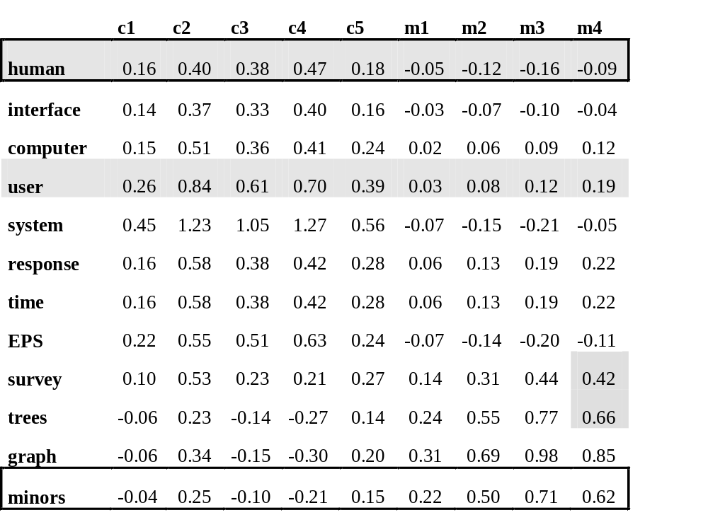
A Small Example – 7
r (human.user) = .94 r (human.minors) = -.83

Slide 17
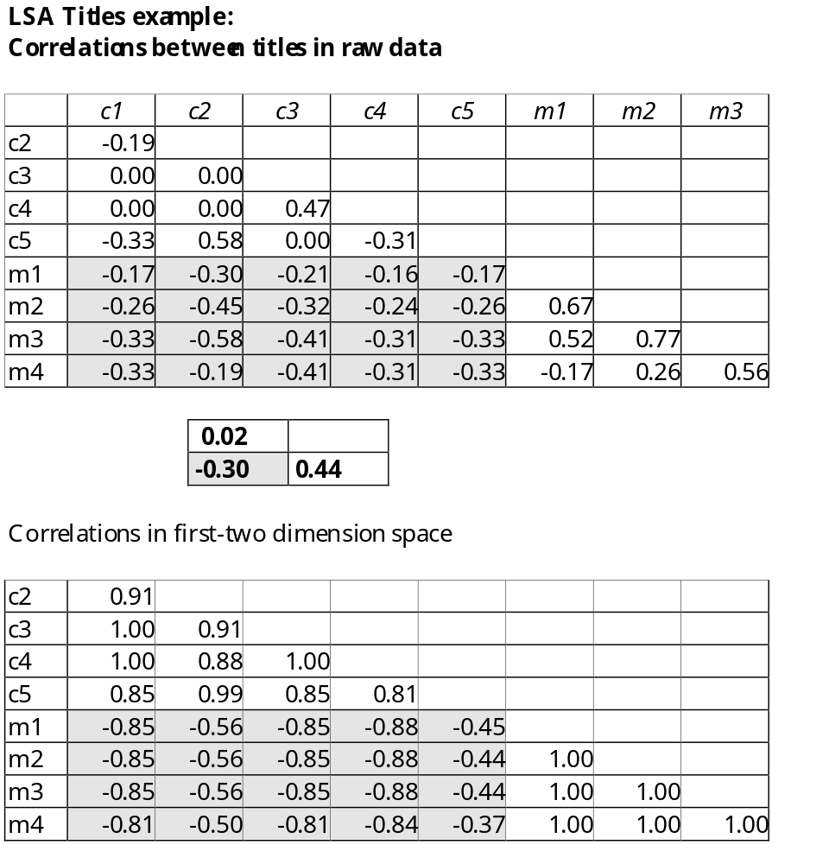
Correlation
Raw data
0.92
-0.72 1.00

Slide 18
Pros and Cons
LSI puts documents together even if they don’t have common words if
  The docs share frequently co-occurring terms
Disadvantages:
  Statistical foundation is missing

Slide 19



SVD cont’
SVD of the term-by-document matrix X:
If the singular values of S0 are ordered by size, we only keep the first k largest values and get a reduced model:
  doesn’t exactly match X and it gets closer as more and more singular values are kept
  This is what we want. We don’t want perfect fit since we think some of 0’s in X should be 1 and vice versa.
  It reflects the major associative patterns in the data, and ignores the smaller, less important influence and noise.

Slide 20
Fundamental Comparison Quantities from the SVD Model
Comparing Two Terms: the dot product between two row vectors of reflects the extent to which two terms have a similar pattern of occurrence across the set of document.
Comparing Two Documents: dot product between two column vectors of
Comparing a Term and a Document

Slide 21
Example -Technical Memo
Query: human-computer interaction
Dataset:
  c1 Human machine interface for Lab ABC computer application
  c2 A survey of user opinion of computer system response time
  c3 The EPS user interface management system
  c4 System and human system engineering testing of EPS
  c5 Relations of user-perceived response time to error measurement
  m1 The generation of random, binary, unordered trees
  m2 The intersection graph of paths in trees
  m3 Graph minors IV: Widths of trees and well-quasi-ordering
  m4 Graph minors: A survey

Slide 22
Example cont’
% 12-term by 9-document matrix
>> X=[ 1 0 0 1 0 0 0 0 0;
1 0 1 0 0 0 0 0 0;
1 1 0 0 0 0 0 0 0;
0 1 1 0 1 0 0 0 0;
0 1 1 2 0 0 0 0 0
0 1 0 0 1 0 0 0 0;
0 1 0 0 1 0 0 0 0;
0 0 1 1 0 0 0 0 0;
0 1 0 0 0 0 0 0 1;
0 0 0 0 0 1 1 1 0;
0 0 0 0 0 0 1 1 1;
0 0 0 0 0 0 0 1 1;];

Slide 23
Example cont’
% X=T0*S0*D0', T0 and D0 have orthonormal columns and So is diagonal
% T0 is the matrix of eigenvectors of the square symmetric matrix XX'
% D0 is the matrix of eigenvectors of X’X
% S0 is the matrix of eigenvalues in both cases
>> [T0, S0] = eig(X*X');
>> T0
T0 =
0.1561 -0.2700 0.1250 -0.4067 -0.0605 -0.5227 -0.3410 -0.1063 -0.4148 0.2890 -0.1132 0.2214
0.1516 0.4921 -0.1586 -0.1089 -0.0099 0.0704 0.4959 0.2818 -0.5522 0.1350 -0.0721 0.1976
-0.3077 -0.2221 0.0336 0.4924 0.0623 0.3022 -0.2550 -0.1068 -0.5950 -0.1644 0.0432 0.2405
0.3123 -0.5400 0.2500 0.0123 -0.0004 -0.0029 0.3848 0.3317 0.0991 -0.3378 0.0571 0.4036
0.3077 0.2221 -0.0336 0.2707 0.0343 0.1658 -0.2065 -0.1590 0.3335 0.3611 -0.1673 0.6445
-0.2602 0.5134 0.5307 -0.0539 -0.0161 -0.2829 -0.1697 0.0803 0.0738 -0.4260 0.1072 0.2650
-0.0521 0.0266 -0.7807 -0.0539 -0.0161 -0.2829 -0.1697 0.0803 0.0738 -0.4260 0.1072 0.2650
-0.7716 -0.1742 -0.0578 -0.1653 -0.0190 -0.0330 0.2722 0.1148 0.1881 0.3303 -0.1413 0.3008
0.0000 0.0000 0.0000 -0.5794 -0.0363 0.4669 0.0809 -0.5372 -0.0324 -0.1776 0.2736 0.2059
0.0000 0.0000 0.0000 -0.2254 0.2546 0.2883 -0.3921 0.5942 0.0248 0.2311 0.4902 0.0127
-0.0000 -0.0000 -0.0000 0.2320 -0.6811 -0.1596 0.1149 -0.0683 0.0007 0.2231 0.6228 0.0361
0.0000 -0.0000 0.0000 0.1825 0.6784 -0.3395 0.2773 -0.3005 -0.0087 0.1411 0.4505 0.0318

Slide 24
Example cont’
>> [D0, S0] = eig(X'*X);
>> D0
D0 =
0.0637 0.0144 -0.1773 0.0766 -0.0457 -0.9498 0.1103 -0.0559 0.1974
-0.2428 -0.0493 0.4330 0.2565 0.2063 -0.0286 -0.4973 0.1656 0.6060
-0.0241 -0.0088 0.2369 -0.7244 -0.3783 0.0416 0.2076 -0.1273 0.4629
0.0842 0.0195 -0.2648 0.3689 0.2056 0.2677 0.5699 -0.2318 0.5421
0.2624 0.0583 -0.6723 -0.0348 -0.3272 0.1500 -0.5054 0.1068 0.2795
0.6198 -0.4545 0.3408 0.3002 -0.3948 0.0151 0.0982 0.1928 0.0038
-0.0180 0.7615 0.1522 0.2122 -0.3495 0.0155 0.1930 0.4379 0.0146
-0.5199 -0.4496 -0.2491 -0.0001 -0.1498 0.0102 0.2529 0.6151 0.0241
0.4535 0.0696 -0.0380 -0.3622 0.6020 -0.0246 0.0793 0.5299 0.0820

Slide 25
Example cont’
>> S0=eig(X'*X)
>> S0=S0.^0.5
S0 =
0.3637
0.5601
0.8459
1.3064
1.5048
1.6445
2.3539
2.5417
3.3409
% We only keep the largest two singular values
% and the corresponding columns from the T and D

Slide 26
Example cont’
>> T=[0.2214 -0.1132;
0.1976 -0.0721;
0.2405 0.0432;
0.4036 0.0571;
0.6445 -0.1673;
0.2650 0.1072;
0.2650 0.1072;
0.3008 -0.1413;
0.2059 0.2736;
0.0127 0.4902;
0.0361 0.6228;
0.0318 0.4505;];
>> S = [ 3.3409 0; 0 2.5417 ];
>> D’ =[0.1974 0.6060 0.4629 0.5421 0.2795 0.0038 0.0146 0.0241 0.0820;
-0.0559 0.1656 -0.1273 -0.2318 0.1068 0.1928 0.4379 0.6151 0.5299;]
>> T*S*D’
0.1621 0.4006 0.3790 0.4677 0.1760 -0.0527
0.1406 0.3697 0.3289 0.4004 0.1649 -0.0328
0.1525 0.5051 0.3580 0.4101 0.2363 0.0242
0.2581 0.8412 0.6057 0.6973 0.3924 0.0331
0.4488 1.2344 1.0509 1.2658 0.5564 -0.0738
0.1595 0.5816 0.3751 0.4168 0.2766 0.0559
0.1595 0.5816 0.3751 0.4168 0.2766 0.0559
0.2185 0.5495 0.5109 0.6280 0.2425 -0.0654
0.0969 0.5320 0.2299 0.2117 0.2665 0.1367
-0.0613 0.2320 -0.1390 -0.2658 0.1449 0.2404
-0.0647 0.3352 -0.1457 -0.3016 0.2028 0.3057
-0.0430 0.2540 -0.0966 -0.2078 0.1520 0.2212

Slide 27
Summary
Some Issues
  SVD Algorithm complexity O(n^2k^3)
    n = number of terms
    k = number of dimensions in semantic space (typically small ~50 to 350)
    for stable document collection, only have to run once
    dynamic document collections: might need to rerun SVD, but can also “fold in” new documents

Slide 28
Summary
Some issues
  Finding optimal dimension for semantic space
    precision-recall improve as dimension is increased until hits optimal, then slowly decreases until it hits standard vector model
    run SVD once with big dimension, say k = 1000
      then can test dimensions <= k
    in many tasks 150-350 works well, still room for research

Slide 29
Summary
Some issues
  SVD assumes normally distributed data
    term occurrence is not normally distributed
    matrix entries are weights, not counts, which may be normally distributed even when counts are not

Slide 30
Summary
Has proved to be a valuable tool in many areas of NLP as well as IR
  summarization
  cross-language IR
  topics segmentation
  text classification
  question answering
  more

Slide 31
Summary
Ongoing research and extensions include
  Probabilistic LSA (Hofmann)
  Iterative Scaling (Ando and Lee)
  Psychology
    model of semantic knowledge representation
    model of semantic word learning

Slide 32
Probabilistic Topic Models
A probabilistic version of LSA: no spatial constraints.
Originated in domain of statistics & machine learning
  (e.g., Hoffman, 2001; Blei, Ng, Jordan, 2003)
Extracts topics from large collections of text
Topics are interpretable unlike the arbitrary dimensions of LSA

Slide 33
Model is Generative
Find parameters that “reconstruct” data
DATA
Corpus of text:
Word counts for each document
Topic Model
Notes:
To understand meaning, we need to understand how words are used to convey meaning. In communication,
It is not the words themselves that communicate meaning but it is the latent structure underlying the words that conveys meaning.
Therefore, in communication, we need to infer latent structure from the observed words.
Our model for semantic representation is phrased as a generative model –
we state how latent structures are used to convey meaning.
The idea is that when you read some text, you can understand that text in terms of the meaning when
You have a generative model for how words are put together to convey meaning. Understanding text
And understanding the meaning of text is reached by inverting the generative model.
Inverting the generative model means figuring out what the latent structures the writer could have had
in mind when producing the text.
Why is this useful?
It allows us to state an explicit causal model for the data that we are trying to explain.
Associative meaning arises by learning the causal model that generates the data such as text in a corpus.
Because the model is generative, it is easy to specify how new text can be generated and this makes
It very easy to use the model for prediction.

Slide 34
Probabilistic Topic Models
Each document is a probability distribution over topics (distribution over topics = gist)
Each topic is a probability distribution over words

Slide 35
Document generation as a probabilistic process
  for each document, choose
  a mixture of topics
  For every word slot,
  sample a topic [1..T]
  from the mixture
  sample a word from the topic
TOPICS MIXTURE
...
TOPIC
TOPIC
WORD
...
WORD

Slide 36
Example
money
money
bank
loan
DOCUMENT 1: money¹ bank¹ bank¹ loan¹ river² stream² bank¹ money¹ river² bank¹ money¹ bank¹ loan¹ money¹ stream² bank¹ money¹ bank¹ bank¹ loan¹ river² stream² bank¹ money¹ river² bank¹ money¹ bank¹ loan¹ bank¹ money¹ stream²
.8
loan
bank
bank
loan
.2
TOPIC 1
.3
DOCUMENT 2: river² stream² bank² stream² bank² money¹ loan¹ river² stream² loan¹ bank² river² bank² bank¹ stream² river² loan¹ bank² stream² bank² money¹ loan¹ river² stream² bank² stream² bank² money¹ river² stream² loan¹ bank² river² bank² money¹ bank¹ stream² river² bank² stream² bank² money¹
river
bank
river
.7
stream
river
bank
stream
TOPIC 2
Mixture
components
Mixture
weights
Bayesian approach: use priors
Mixture weights ~ Dirichlet( α )
Mixture components ~ Dirichlet( β )

Slide 37
Inverting (“fitting”) the model
?
DOCUMENT 1: money? bank? bank? loan? river? stream? bank? money? river? bank? money? bank? loan? money? stream? bank? money? bank? bank? loan? river? stream? bank? money? river? bank? money? bank? loan? bank? money? stream?
TOPIC 1
?
DOCUMENT 2: river? stream? bank? stream? bank? money? loan? river? stream? loan? bank? river? bank? bank? stream? river? loan? bank? stream? bank? money? loan? river? stream? bank? stream? bank? money? river? stream? loan? bank? river? bank? money? bank? stream? river? bank? stream? bank? money?
?
TOPIC 2
Mixture
components
Mixture
weights

Slide 38
Application to corpus data
TASA corpus: text from first grade to college
  representative sample of text
26,000+ word types (stop words removed)
37,000+ documents
6,000,000+ word tokens

Slide 39
Example: topics from an educational corpus (TASA)
37K docs, 26K words
1700 topics, e.g.:
PRINTING
PAPER
PRINT
PRINTED
TYPE
PROCESS
INK
PRESS
IMAGE
PRINTER
PRINTS
PRINTERS
COPY
COPIES
FORM
OFFSET
GRAPHIC
SURFACE
PRODUCED
CHARACTERS
PLAY
PLAYS
STAGE
AUDIENCE
THEATER
ACTORS
DRAMA
SHAKESPEARE
ACTOR
THEATRE
PLAYWRIGHT
PERFORMANCE
DRAMATIC
COSTUMES
COMEDY
TRAGEDY
CHARACTERS
SCENES
OPERA
PERFORMED
TEAM
GAME
BASKETBALL
PLAYERS
PLAYER
PLAY
PLAYING
SOCCER
PLAYED
BALL
TEAMS
BASKET
FOOTBALL
SCORE
COURT
GAMES
TRY
COACH
GYM
SHOT
JUDGE
TRIAL
COURT
CASE
JURY
ACCUSED
GUILTY
DEFENDANT
JUSTICE
EVIDENCE
WITNESSES
CRIME
LAWYER
WITNESS
ATTORNEY
HEARING
INNOCENT
DEFENSE
CHARGE
CRIMINAL
HYPOTHESIS
EXPERIMENT
SCIENTIFIC
OBSERVATIONS
SCIENTISTS
EXPERIMENTS
SCIENTIST
EXPERIMENTAL
TEST
METHOD
HYPOTHESES
TESTED
EVIDENCE
BASED
OBSERVATION
SCIENCE
FACTS
DATA
RESULTS
EXPLANATION
STUDY
TEST
STUDYING
HOMEWORK
NEED
CLASS
MATH
TRY
TEACHER
WRITE
PLAN
ARITHMETIC
ASSIGNMENT
PLACE
STUDIED
CAREFULLY
DECIDE
IMPORTANT
NOTEBOOK
REVIEW

Slide 40
Polysemy
PRINTING
PAPER
PRINT
PRINTED
TYPE
PROCESS
INK
PRESS
IMAGE
PRINTER
PRINTS
PRINTERS
COPY
COPIES
FORM
OFFSET
GRAPHIC
SURFACE
PRODUCED
CHARACTERS
PLAY
PLAYS
STAGE
AUDIENCE
THEATER
ACTORS
DRAMA
SHAKESPEARE
ACTOR
THEATRE
PLAYWRIGHT
PERFORMANCE
DRAMATIC
COSTUMES
COMEDY
TRAGEDY
CHARACTERS
SCENES
OPERA
PERFORMED
TEAM
GAME
BASKETBALL
PLAYERS
PLAYER
PLAY
PLAYING
SOCCER
PLAYED
BALL
TEAMS
BASKET
FOOTBALL
SCORE
COURT
GAMES
TRY
COACH
GYM
SHOT
JUDGE
TRIAL
COURT
CASE
JURY
ACCUSED
GUILTY
DEFENDANT
JUSTICE
EVIDENCE
WITNESSES
CRIME
LAWYER
WITNESS
ATTORNEY
HEARING
INNOCENT
DEFENSE
CHARGE
CRIMINAL
HYPOTHESIS
EXPERIMENT
SCIENTIFIC
OBSERVATIONS
SCIENTISTS
EXPERIMENTS
SCIENTIST
EXPERIMENTAL
TEST
METHOD
HYPOTHESES
TESTED
EVIDENCE
BASED
OBSERVATION
SCIENCE
FACTS
DATA
RESULTS
EXPLANATION
STUDY
TEST
STUDYING
HOMEWORK
NEED
CLASS
MATH
TRY
TEACHER
WRITE
PLAN
ARITHMETIC
ASSIGNMENT
PLACE
STUDIED
CAREFULLY
DECIDE
IMPORTANT
NOTEBOOK
REVIEW

Slide 41
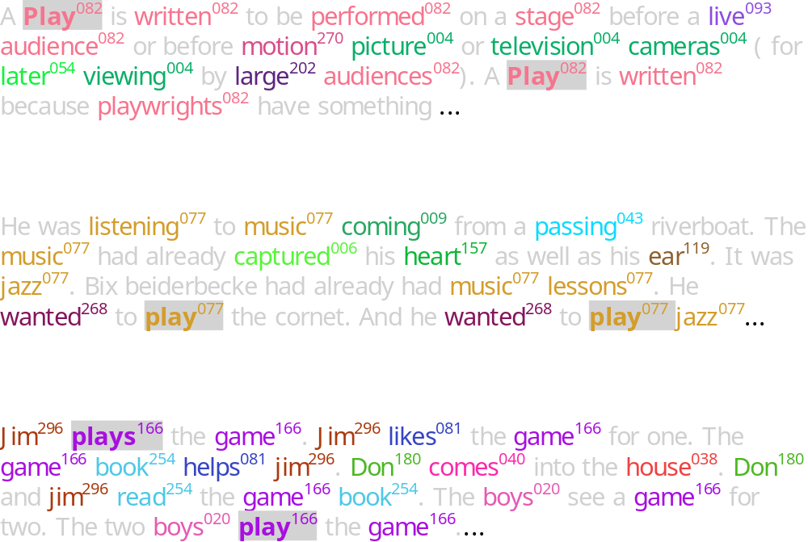
Three documents with the word “play”
(numbers & colors → topic assignments)

Slide 42
No Problem of Triangle Inequality
TOPIC 1
TOPIC 2
SOCCER
FIELD
MAGNETIC
Topic structure easily explains violations of triangle inequality

Slide 43
Applications

Slide 44

Enron email data
500,000 emails
5000 authors
1999-2002

Slide 45

Enron topics
TEXANS
WIN
FOOTBALL
FANTASY
SPORTSLINE
PLAY
TEAM
GAME
SPORTS
GAMES
GOD
LIFE
MAN
PEOPLE
CHRIST
FAITH
LORD
JESUS
SPIRITUAL
VISIT
ENVIRONMENTAL
AIR
MTBE
EMISSIONS
CLEAN
EPA
PENDING
SAFETY
WATER
GASOLINE
FERC
MARKET
ISO
COMMISSION
ORDER
FILING
COMMENTS
PRICE
CALIFORNIA
FILED
POWER
CALIFORNIA
ELECTRICITY
UTILITIES
PRICES
MARKET
PRICE
UTILITY
CUSTOMERS
ELECTRIC
STATE
PLAN
CALIFORNIA
DAVIS
RATE
BANKRUPTCY
SOCAL
POWER
BONDS
MOU
May 22, 2000
Start of California
energy crisis
TIMELINE

Slide 46
Probabilistic Latent Semantic Analysis
Automated Document Indexing and Information retrieval
Identification of Latent Classes using an Expectation Maximization (EM) Algorithm
Shown to solve
  Polysemy
    Java could mean “coffee” and also the “PL Java”
    Cricket is a “game” and also an “insect”
  Synonymy
    “computer”, “pc”, “desktop” all could mean the same
Has a better statistical foundation than LSA

Slide 47
PLSA
Aspect Model
Tempered EM
Experiment Results

Slide 48
PLSA – Aspect Model
Aspect Model
  Document is a mixture of underlying (latent) K aspects (doc-topic distr)
  Each aspect is represented by a distribution of words p(w|z) (topic-word distr)
Model fitting with Tempered EM

Slide 49
Aspect Model
Latent Variable model for general co-occurrence data
  Associate each observation (w,d) with a class variable z Є Z{z_1,…,z_K}
Generative Model
  Select a doc with probability P(d)
  Pick a latent class z with probability P(z|d)
  Generate a word w with probability p(w|z)
P(d)
P(z|d)
P(w|z)
d
z
w

Slide 50
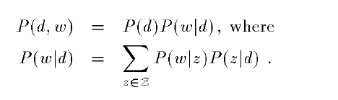
Aspect Model
To get the joint probability model
(d,w) – assumed to be independent

Slide 51

Using Bayes’ rule

Slide 52
Advantages of this model over Documents Clustering
Documents are not related to a single cluster (i.e. aspect )
  For each z, P(z|d) defines a specific mixture of factors
  This offers more flexibility, and produces effective modeling
  Now, we have to compute P(z), P(z|d), P(w|z). We are given just documents(d) and words(w).

Slide 53
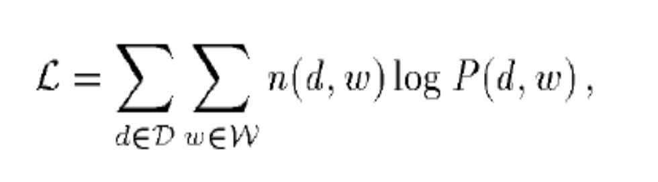
Model fitting with Tempered EM
We have the equation for log-likelihood function from the aspect model, and we need to maximize it.
Expectation Maximization ( EM) is used for this purpose
  To avoid overfitting, tempered EM is proposed

Slide 54
EM Steps
E-Step
  Expectation step where expectation of the likelihood function is calculated with the current parameter values
M-Step
  Update the parameters with the calculated posterior probabilities
  Find the parameters that maximizes the likelihood function

Slide 55
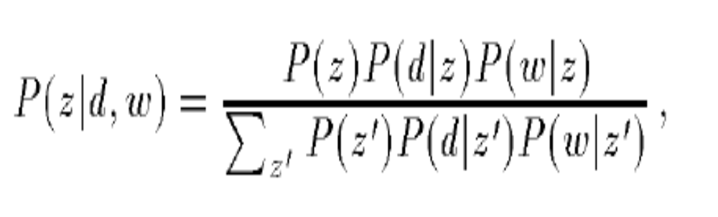
E Step
It is the probability that a word w occurring in a document d, is explained by aspect z
(based on some calculations)

Slide 56
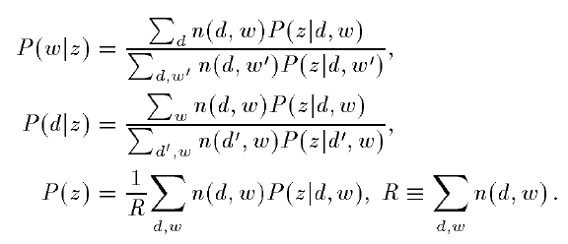
M Step
All these equations use p(z|d,w) calculated in E Step
Converges to local maximum of the likelihood function

Slide 57
Over fitting
Trade off between Predictive performance on the training data and Unseen new data
Must prevent the model to over fit the training data
Propose a change to the E-Step
Reduce the effect of fitting as we do more steps

Slide 58
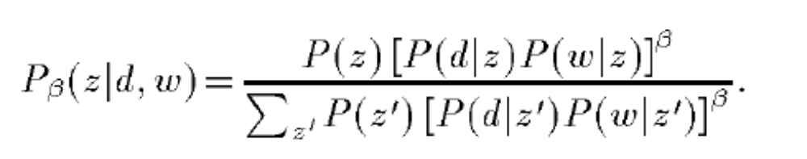
TEM (Tempered EM)
Introduce control parameter β
β starts from the value of 1, and decreases

Slide 59
Simulated Annealing
Alternate healing and cooling of materials to make them attain a minimum internal energy state – reduce defects
This process is similar to Simulated Annealing : β acts a temperature variable
As the value of β decreases, the effect of re-estimations don’t affect the expectation calculations

Slide 60
Choosing β
How to choose a proper β?
It defines
  Underfit Vs Overfit
Simple solution using held-out data (part of training data)
  Using the training data for β starting from 1
  Test the model with held-out data
  If improvement, continue with the same β
  If no improvement, β <- nβ where n<1

Slide 61
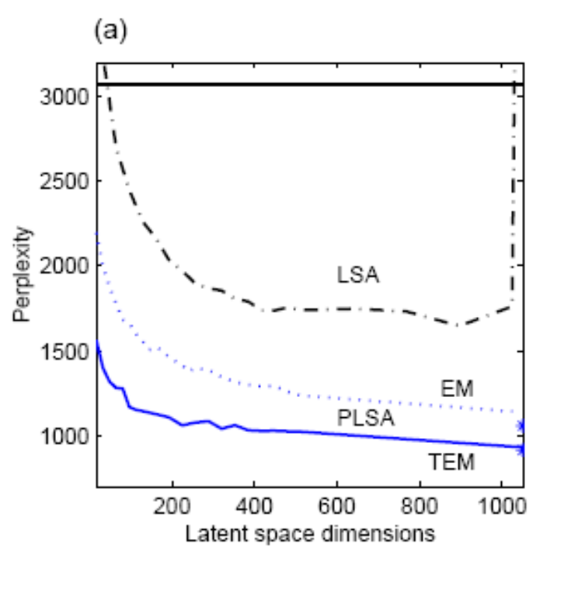
Perplexity Comparison(1/4)
Perplexity – Log-averaged inverse probability on unseen data
High probability will give lower perplexity, thus good predictions
MED data

Slide 62
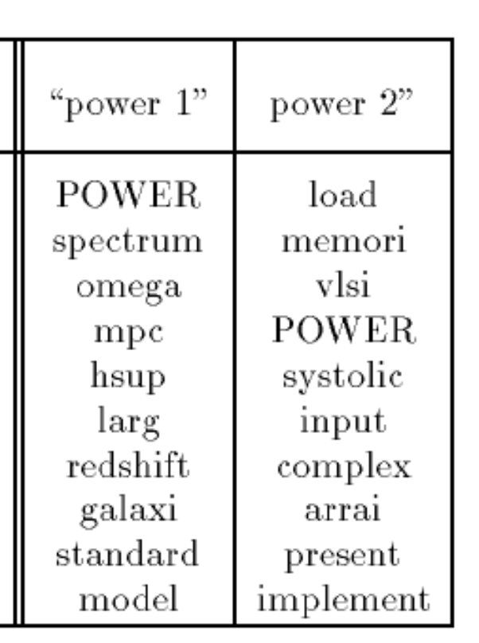
Topic Decomposition(2/4)
Abstracts of 1568 documents
Clustering 128 latent classes
Shows word stems for
the same word “power”
as p(w|z)
Power1 – Astronomy
Power2 - Electricals

Slide 63
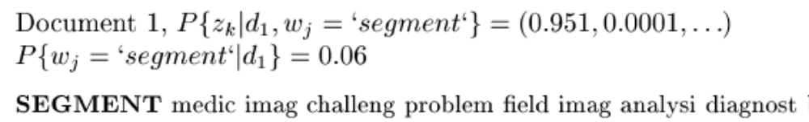
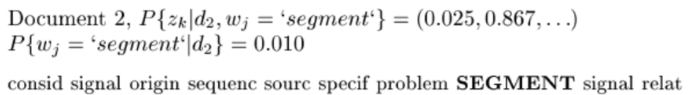
Polysemy(3/4)
“Segment” occurring in two different contexts are identified (image, sound)

Slide 64
Information Retrieval(4/4)
MED – 1033 docs
CRAN – 1400 docs
CACM – 3204 docs
CISI – 1460 docs
Reporting only the best results with K varying from 32, 48, 64, 80, 128
PLSI* model takes the average across all models at different K values

Slide 65
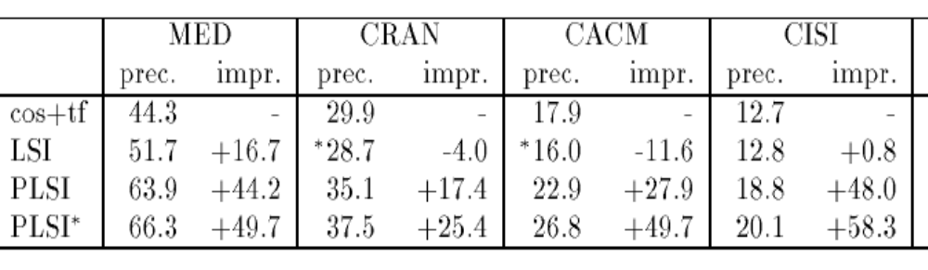
Information Retrieval (4/4)
Cosine Similarity is the baseline
In LSI, query vector(q) is multiplied to get the reduced space vector
In PLSI, p(z|d) and p(z|q). In EM iterations, only P(z|q) is adapted

Slide 66
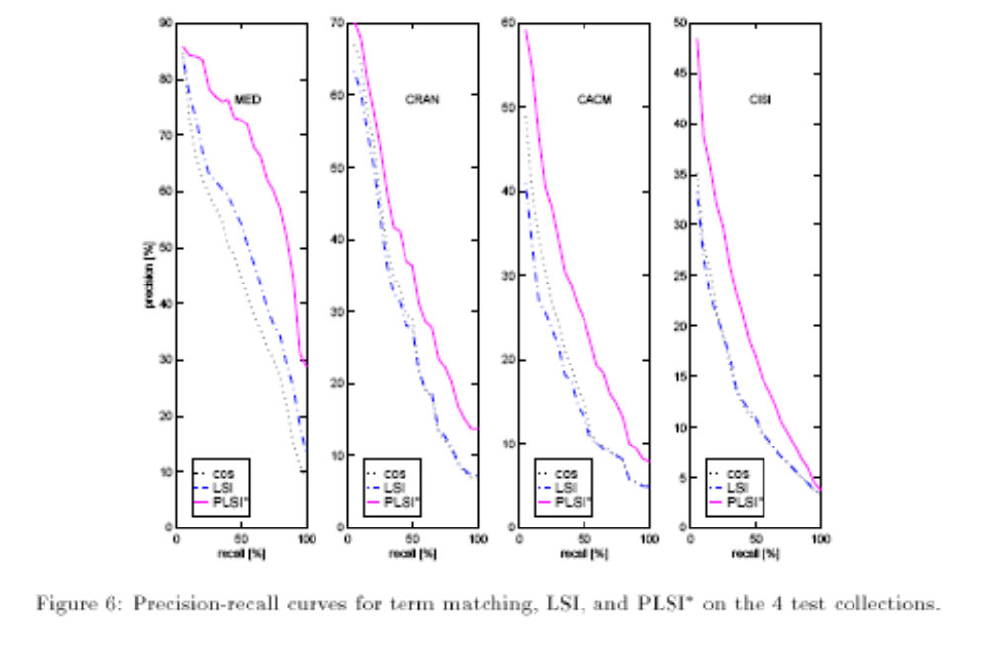
Precision-Recall results(4/4)

Slide 67
Comparing PLSA and LSA
LSA and PLSA perform dimensionality reduction
  In LSA, by keeping only K singular values
  In PLSA, by having K aspects
Comparison to SVD
  U Matrix related to P(d|z) (doc to aspect)
  V Matrix related to P(z|w) (aspect to term)
  E Matrix related to P(z) (aspect strength)
The main difference is the way the approximation is done
  PLSA generates a model (aspect model) and maximizes its predictive power
  Selecting the proper value of K is heuristic in LSA
  Model selection in statistics can determine optimal K in PLSA

Slide 68
Latent Dirichlet Allocation

Slide 69

“Bag of Words” Models
Let’s assume that all the words within a document are exchangeable.

Slide 70
Mixture of Unigrams
_{Zi}
w_{i1}
w_{2i}
w_{3i}
w_{4i}
Mixture of Unigrams Model (this is just Naïve Bayes)
For each of M documents,
Choose a topic z.
Choose N words by drawing each one independently from a multinomial conditioned on z.
In the Mixture of Unigrams model, we can only have one topic per document!
Notes:
not clear what the plates are and what N and M are, and how you relate this to a naïve bayes model/
between this slide and the previous one, add a slide introducing the naïve bayes model.
add a slide explaining why naïve bayes is not good (you are picking a single class for each document).
you need to say more precisely what the plate means, i.e., parameter sharing in the cpts

Slide 71
The pLSI Model
For each word of document d in the training set,
Choose a topic z according to a multinomial conditioned on the index d.
Generate the word by drawing from a multinomial conditioned on z.
In pLSI, documents can have multiple topics.
_{d}
z_{d1}
z_{d2}
z_{d3}
z_{d4}
w_{d1}
w_{d2}
w_{d3}
w_{d4}
Probabilistic Latent Semantic Indexing (pLSI) Model
Notes:
between this slide and the previous one, add a motivating example where you have a latent variable in naïve bayse
show an unrolled bn for this model using your running example (text classification)

Slide 72
Motivations for LDA
In pLSI, the observed variable d is an index into some training set. There is no natural way for the model to handle previously unseen documents.
The number of parameters for pLSI grows linearly with M (the number of documents in the training set).
We would like to be Bayesian about our topic mixture proportions.

Slide 73
Dirichlet Distributions
In the LDA model, we would like to say that the topic mixture proportions for each document are drawn from some distribution.
So, we want to put a distribution on multinomials. That is, k-tuples of non-negative numbers that sum to one.
The space is of all of these multinomials has a nice geometric interpretation as a (k-1)-simplex, which is just a generalization of a triangle to (k-1) dimensions.
Criteria for selecting our prior:
  It needs to be defined for a (k-1)-simplex.
  Algebraically speaking, we would like it to play nice with the multinomial distribution.

Slide 74
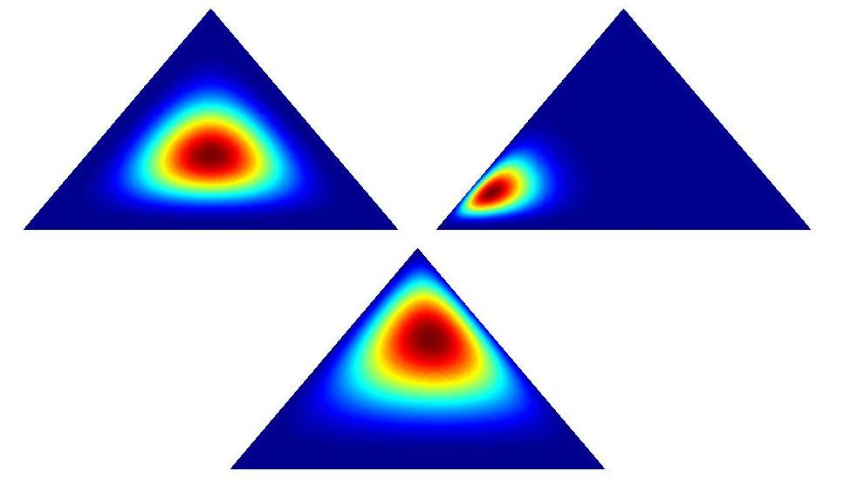
Dirichlet Examples

Slide 75
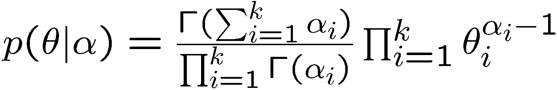
Dirichlet Distributions
Useful Facts:
  This distribution is defined over a (k-1)-simplex. That is, it takes k non-negative arguments which sum to one. Consequently it is a natural distribution to use over multinomial distributions.
  In fact, the Dirichlet distribution is the conjugate prior to the multinomial distribution. (This means that if our likelihood is multinomial with a Dirichlet prior, then the posterior is also Dirichlet!)
  The Dirichlet parameter α_{i} can be thought of as a prior count of the i^{th} class.
Notes:
you need to first motivate why we need a dirichlet distribution, i.e., we need distribution over a mixture of classes, which is distribution over weights that add up to one.
you can then show the picture in the next slide, and then show this slide last.

Slide 76
The LDA Model
α
θ
θ
θ
z₁
z₂
z₃
z₄
z₁
z₂
z₃
z₄
z₁
z₂
z₃
z₄
w₁
w₂
w₃
w₄
w₁
w₂
w₃
w₄
w₁
w₂
w₃
w₄
For each document,
Choose θ~Dirichlet(α)
For each of the N words wn:
  Choose a topic z_{n}» Multinomial(θ)
  Choose a word w_{n} from p(w_{n}|z_{n},β), a multinomial probability conditioned on the topic z_{n}.
β

Slide 77
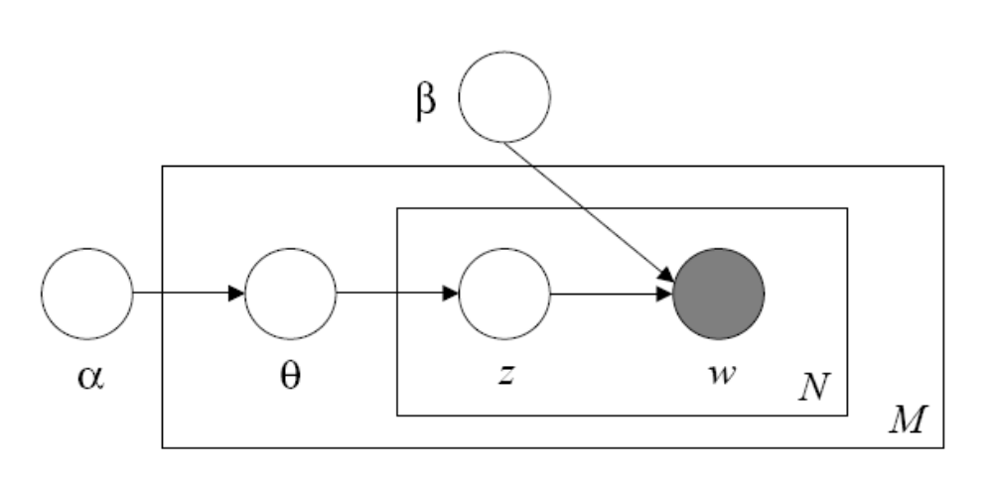
The LDA Model
For each document,
Choose θ» Dirichlet(α)
For each of the N words w_{n}:
  Choose a topic z_{n}» Multinomial(θ)
  Choose a word w_{n} from p(w_{n}|z_{n},β), a multinomial probability conditioned on the topic z_{n}.
Notes:
before this slide and the previous, say why the previous model is not good enough.
say that you need to be bayesian about the mixture between classes
show an unrolled LDA model, and explain why it’s different than the previous models
I like the generative model description. use it in the previous models, it will make the differences more clear.

Slide 78
Inference
The inference problem in LDA is to compute the posterior of the hidden variables given a document and corpus parameters α and β. That is, compute p(θ,z|w,α,β).
Unfortunately, exact inference is intractable, so we turn to alternatives…
Notes:
add a slide between this one and the previous showing what the inference task is in the context of an example.
explain that inference is hard in this graphical model, this is very hard to see in this picture.

Slide 79
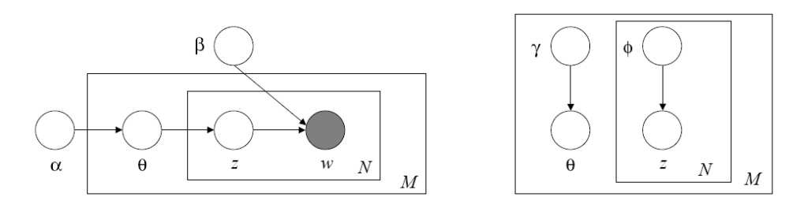
Variational Inference
  In variational inference, we consider a simplified graphical model with variational parameters γ, φ and minimize the KL Divergence between the variational and posterior distributions.
Notes:
between this slide and the previuous one, add an aside explaining variational inference in the context of a small example. you can use the intuition I wrote for you in one of our meetings.
in particular, you are picking a representation for the posterior, and trying to find a solution that is as close as possible.
once you introduced variational inference, then you can introduce this slide.
it would be nice if you showed the unrolled plates, they provide a better intuition of the approximation.

Slide 80
Parameter Estimation
Given a corpus of documents, we would like to find the parameters α and β which maximize the likelihood of the observed data.
Strategy (Variational EM):
  Lower bound log p(w|α,β) by a function L(γ,φ;α,β)
  Repeat until convergence:
    Maximize L(γ,φ;α,β) with respect to the variational parameters γ,φ.
    Maximize the bound with respect to parameters α and β.
Notes:
explain why you need to do em here. in particular, why some variables are not observed.
relate variational em to regular em. in particular, regular em requires inference in the e step, and they are using the variuational inference to approximate this step.

Slide 81
Some Results
Given a topic, LDA can return the most probable words.
For the following results, LDA was trained on 10,000 text articles posted to 20 online newsgroups with 40 iterations of EM. The number of topics was set to 50.

Slide 82
Some Results
“politics” | “sports” | “space” | “computers” | “christianity”
Political | Team | Space | Drive | God
Party | Game | NASA | Windows | Jesus
Business | Play | Research | Card | His
Convention | Year | Center | DOS | Bible
Institute | Games | Earth | SCSI | Christian
Committee | Win | Health | Disk | Christ
States | Hockey | Medical | System | Him
Rights | Season | Gov | Memory | Christians
Notes:
are there any results that are not just anecdotal, e.g., some graphs comparing performance to naïve bayes?

Slide 83
Extensions/Applications
Multimodal Dirichlet Priors
Correlated Topic Models
Hierarchical Dirichlet Processes
Abstract Tagging in Scientific Journals
Object Detection/Recognition

Slide 84
Visual Words
Idea: Given a collection of images,
  Think of each image as a document.
  Think of feature patches of each image as words.
  Apply the LDA model to extract topics.
  (J. Sivic, B. C. Russell, A. A. Efros, A. Zisserman, W. T. Freeman. Discovering object categories in image collections. MIT AI Lab Memo AIM-2005-005, February, 2005. )

Slide 85
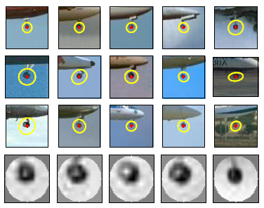
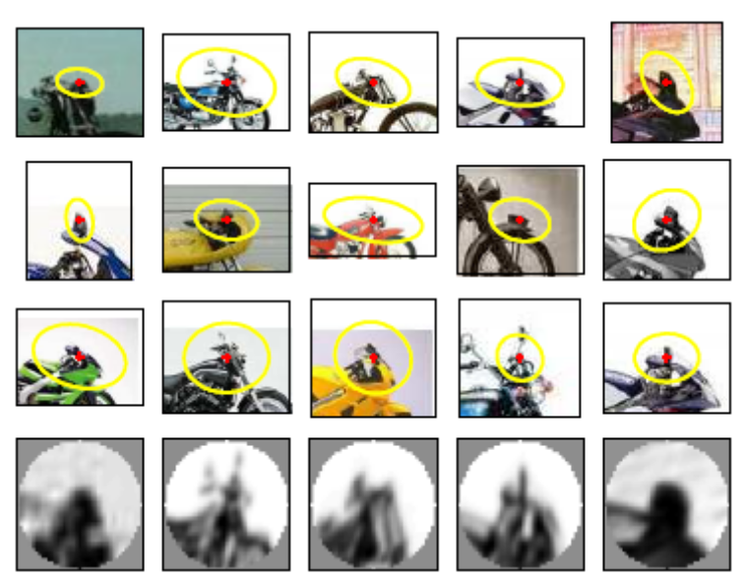
Visual Words
Examples of ‘visual words’

Slide 86
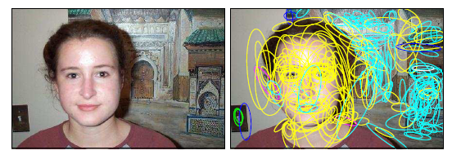
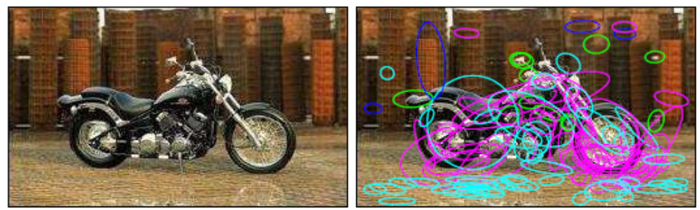
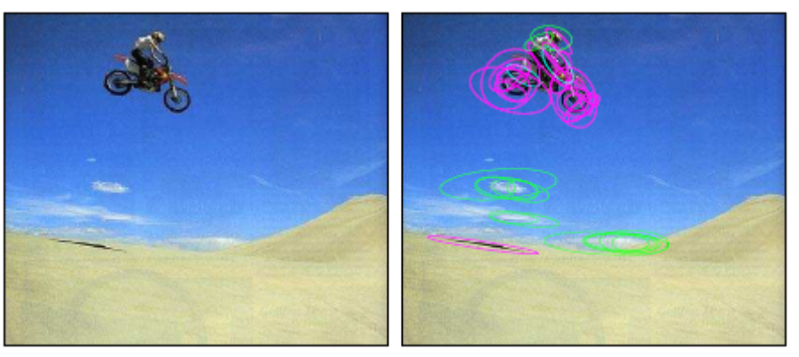
Visual Words
Notes:
can you give examples of the words that were used here?

Slide 87
References
  Latent Dirichlet allocation. D. Blei, A. Ng, and M. Jordan. Journal of Machine Learning Research, 3:993-1022, January 2003.
  Finding Scientific Topics. Griffiths, T., & Steyvers, M. (2004). Proceedings of the National Academy of Sciences, 101 (suppl. 1), 5228-5235.
  Hierarchical topic models and the nested Chinese restaurant process. D. Blei, T. Griffiths, M. Jordan, and J. Tenenbaum In S. Thrun, L. Saul, and B. Scholkopf, editors, Advances in Neural Information Processing Systems (NIPS) 16, Cambridge, MA, 2004. MIT Press.
  Discovering object categories in image collections. J. Sivic, B. C. Russell, A. A. Efros, A. Zisserman, W. T. Freeman. MIT AI Lab Memo AIM-2005-005, February, 2005.

Slide 88
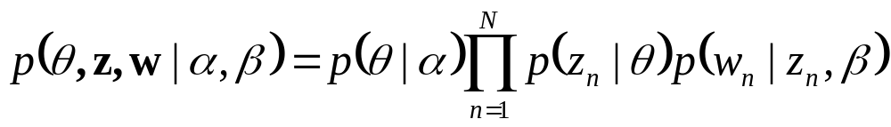
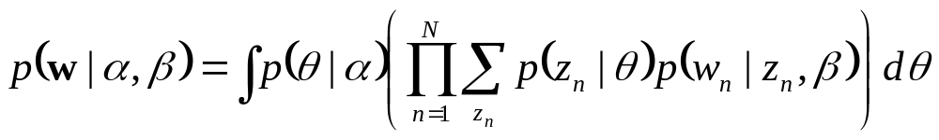
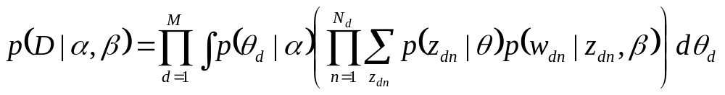
Latent Dirichlet allocation (cont.)
The joint distribution of a topic θ, and a set of N topic z, and a set of N words w:
Marginal distribution of a document:
Probability of a corpus:

Slide 89
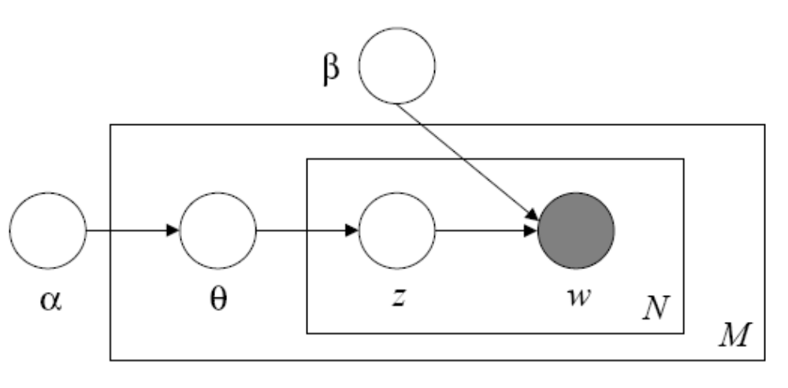
Latent Dirichlet allocation (cont.)
There are three levels to LDA representation
  α, β are corpus-level parameters
  θ_{d} are document-level variables
  z_{dn}, w_{dn} are word-level variables
document
corpus

Slide 90
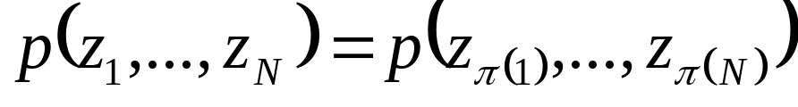
Latent Dirichlet allocation (cont.)
LDA and exchangeability
  A finite set of random variables {z₁,…,z_{N}} is said exchangeable if the joint distribution is invariant to permutation (π is a permutation)
  A infinite sequence of random variables is infinitely exchangeable if every finite subsequence is exchangeable
  De Finetti’s representation theorem states that the joint distribution of an infinitely exchangeable sequence of random variables is as if a random parameter were drawn from some distribution and then the random variables in question were independent and identically distributed, conditioned on that parameter
  http://en.wikipedia.org/wiki/De_Finetti's_theorem

Slide 91
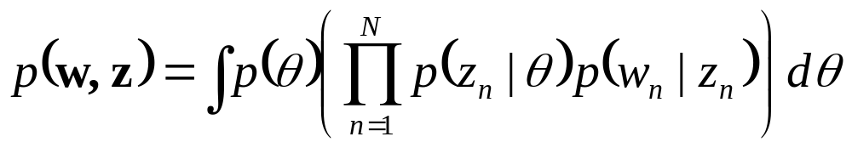
Latent Dirichlet allocation (cont.)
In LDA, we assume that words are generated by topics (by fixed conditional distributions) and that those topics are infinitely exchangeable within a document

Slide 92
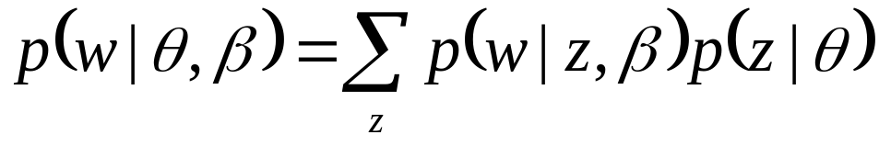
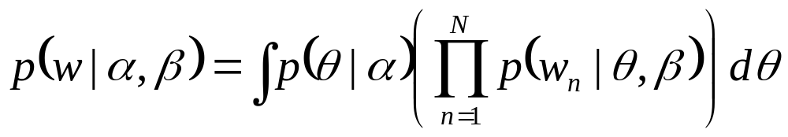
Latent Dirichlet allocation (cont.)
A continuous mixture of unigrams
  By marginalizing over the hidden topic variable z, we can understand LDA as a two-level model
Generative process for a document w
  1. choose θ~ Dir(α)
  2. For each of the N word w_{n}
    Choose a word w_{n} from p(w_{n}|θ, β)
  Marginal distribution of a document

Slide 93
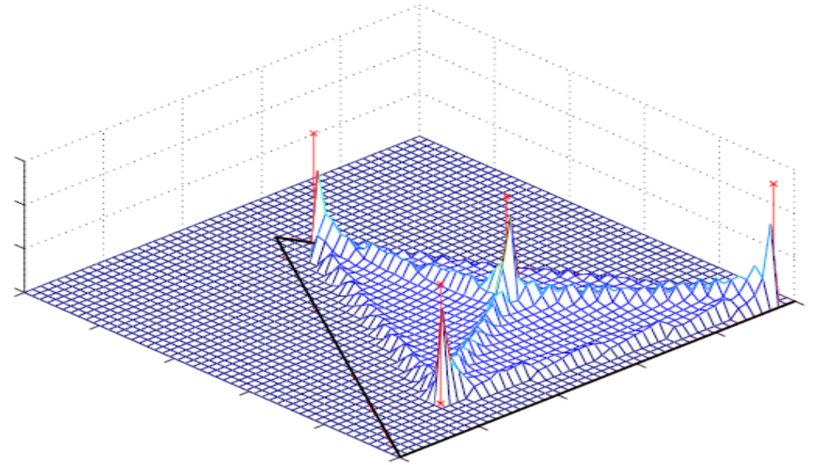
Latent Dirichlet allocation (cont.)
The distribution on the (V-1)-simplex is attained with only k+kV parameters.

Slide 94
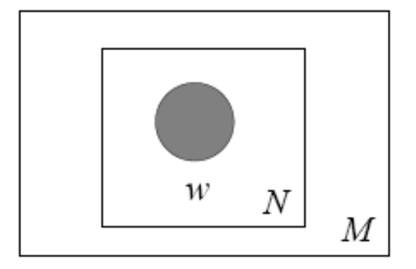
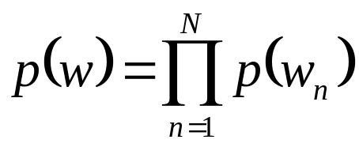
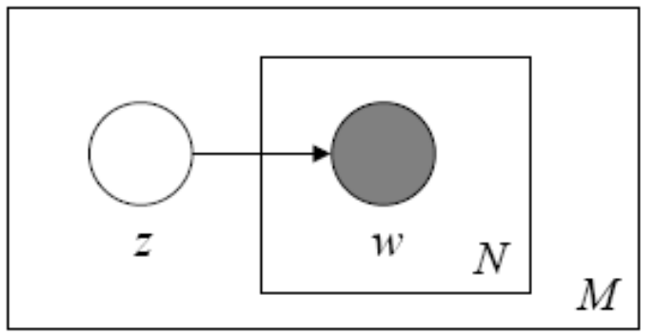
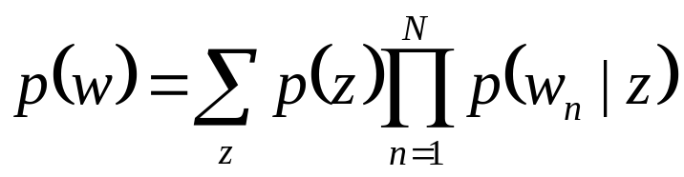
Relationship with other latent variable models
Unigram model
Mixture of unigrams
  Each document is generated by first choosing a topic z and then generating N words independently form conditional multinomial
  k-1 parameters

Slide 95
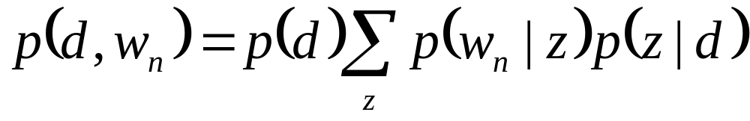
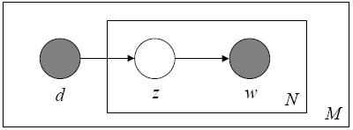
Relationship with other latent variable models (cont.)
Probabilistic latent semantic indexing
  Attempt to relax the simplifying assumption made in the mixture of unigrams models
  In a sense, it does capture the possibility that a document may contain multiple topics
  kv+kM parameters and linear growth in M

Slide 96
Relationship with other latent variable models (cont.)
Problem of PLSI
  There is no natural way to use it to assign probability to a previously unseen document
  The linear growth in parameters suggests that the model is prone to overfitting and empirically, overfitting is indeed a serious problem
LDA overcomes both of these problems by treating the topic mixture weights as a k-parameter hidden random variable
The k+kV parameters in a k-topic LDA model do not grow with the size of the training corpus.

Slide 97
Relationship with other latent variable models (cont.)
The unigram model find a single point on the word simplex and posits that all word in the corpus come from the corresponding distribution.
The mixture of unigram models posits that for each documents, one of the k points on the word simplex is chosen randomly and all the words of the document are drawn from the distribution
The pLSI model posits that each word of a training documents comes from a randomly chosen topic. The topics are themselves drawn from a document-specific distribution over topics.
LDA posits that each word of both the observed and unseen documents is generated by a randomly chosen topic which is drawn from a distribution with a randomly chosen parameter

Slide 98
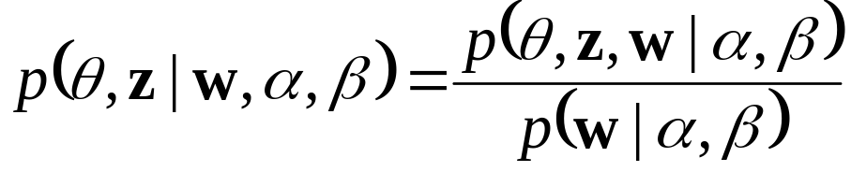
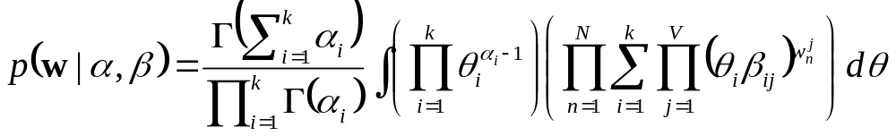
Inference and parameter estimation
The key inferential problem is that of computing the posteriori distribution of the hidden variable given a document
Unfortunately, this distribution is intractable to compute in general.
A function which is intractable due to the coupling between
θ and β in the summation over latent topics

Slide 99
Inference and parameter estimation (cont.)
The basic idea of convexity-based variational inference is to make use of Jensen’s inequality to obtain an adjustable lower bound on the log likelihood.
Essentially, one considers a family of lower bounds, indexed by a set of variational parameters.
A simple way to obtain a tractable family of lower bound is to consider simple modifications of the original graph model in which some of the edges and nodes are removed.

Slide 100
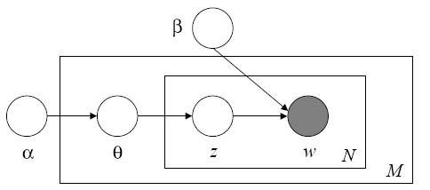
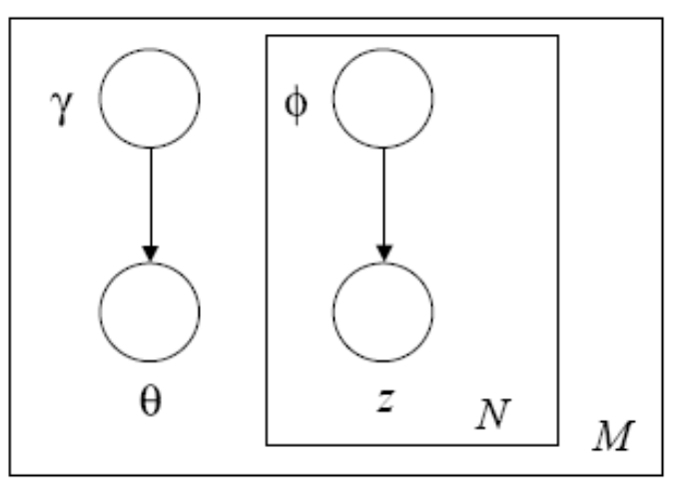
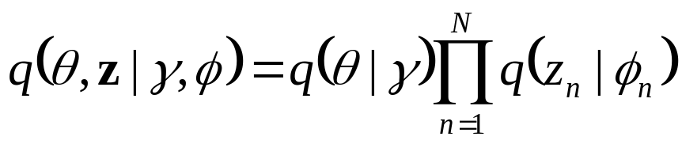
Inference and parameter estimation (cont.)
Drop some edges and the w nodes

Slide 101
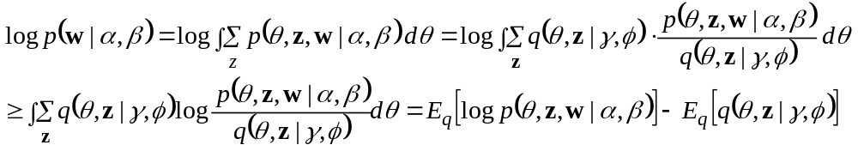
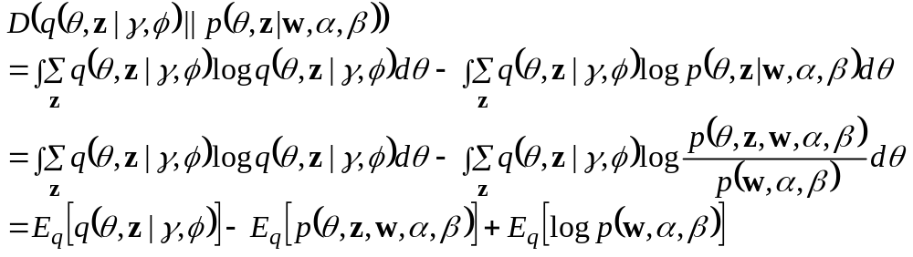
Inference and parameter estimation (cont.)
Variational distribution:
  Lower bound on Log-likelihood
  KL between variational posterior and true posterior

Slide 102


Inference and parameter estimation (cont.)
Finding a tight lower bound on the log likelihood
Maximizing the lower bound with respect to γand φ is equivalent to minimizing the KL divergence between the variational posterior probability and the true posterior probability

Slide 103

Inference and parameter estimation (cont.)
Expand the lower bound:

Slide 104

Inference and parameter estimation (cont.)
Then

Slide 105

Inference and parameter estimation (cont.)
We can get variational parameters by adding Lagrange multipliers and setting this derivative to zero:

Slide 106

Inference and parameter estimation (cont.)
Parameter estimation
  Maximize log likelihood of the data:
  Variational inference provide us with a tractable lower bound on the log likelihood, a bound which we can maximize with respect α and β
Variational EM procedure
  1. (E-step) For each document, find the optimizing values of the variational parameters {γ, φ}
  2. (M-step) Maximize the resulting lower bound on the log likelihood with respect to the model parameters α and β

Slide 107

Inference and parameter estimation (cont.)
Smoothed LDA model:

Slide 108
Discussion
LDA is a flexible generative probabilistic model for collection of discrete data.
Exact inference is intractable for LDA, but any or a large suite of approximate inference algorithms for inference and parameter estimation can be used with the LDA framework.
LDA is a simple model and is readily extended to continuous data or other non-multinomial data.

Slide 109
Relation to Text Classification and Information Retrieval

Slide 110
LSI for IR
Compute cosine similarity for document and query vectors in semantic space
  Helps combat synonymy
  Helps combat polysemy in documents, but not necessarily in queries
  (which were not part of the SVD computation)

Slide 111
pLSA/LDA for IR
Several options
  Compute cosine similarity between topic vectors for documents
  Use language model-based IR techniques
potentially very helpful for synonymy and polysemy

Slide 112
LDA/pLSA for Text Classification
Topic models are easy to incorporate into text classification:
  Train a topic model using a big corpus
  Decode the topic model (find best topic/cluster for each word) on a training set
  Train classifier using the topic/cluster as a feature
  On a test document, first decode the topic model, then make a prediction with the classifier

Slide 113
Why use a topic model for classification?
Topic models help handle polysemy and synonymy
  The count for a topic in a document can be much more informative than the count of individual words belonging to that topic.
Topic models help combat data sparsity
  You can control the number of topics
  At a reasonable choice for this number, you’ll observe the topics many times in training data
  (unlike individual words, which may be very sparse)

Slide 114
LSA for Text Classification
Trickier to do
  One option is to use the reduced-dimension document vectors for training
  At test time, what to do?
    Can recalculate the SVD (expensive)
  Another option is to combine the reduced-dimension term vectors for a given document to produce a vector for the document
  This is repeatable at test time (at least for words that were seen during training)

