Slide 1
An Introduction to Latent Semantic Analysis
Melanie Martin
October 14, 2002
NMSU CS AI Seminar

Slide 2
Acknowledgements
Peter Foltz for conversations, teaching me how to use LSA, pointing me to the important work in the field. Thanks!!!
ARL Grant for supporting this work

Slide 3
Outline
The Problem
Some History
LSA
A Small Example
Summary
Applications: October 28th, by Peter Foltz

Slide 4
The Problem
Information Retrieval in the 1980s
Given a collection of documents: retrieve documents that are relevant to a given query
Match terms in documents to terms in query
Vector space method

Slide 5
The Problem
The vector space method
  term (rows) by document (columns) matrix, based on occurrence
  translate into vectors in a vector space
    one vector for each document
  cosine to measure distance between vectors (documents)
    small angle = large cosine = similar
    large angle = small cosine = dissimilar

Slide 6
The Problem
A quick diversion
Standard measures in IR
  Precision: portion of selected items that the system got right
  Recall: portion of the target items that the system selected

Slide 7
The Problem
Two problems that arose using the vector space model:
  synonymy: many ways to refer to the same object, e.g. car and automobile
    leads to poor recall
  polysemy: most words have more than one distinct meaning, e.g.model, python, chip
    leads to poor precision

Slide 8
The Problem
Example: Vector Space Model
  (from Lillian Lee)
auto
engine
bonnet
tyres
lorry
boot
car
emissions
hood
make
model
trunk
make
hidden
Markov
model
emissions
normalize
Synonymy
Will have small cosine
but are related
Polysemy
Will have large cosine
but not truly related

Slide 9
The Problem
Latent Semantic Indexing was proposed to address these two problems with the vector space model for Information Retrieval

Slide 10
Some History
Latent Semantic Indexing was developed at Bellcore (now Telcordia) in the late 1980s (1988). It was patented in 1989.
http://lsi.argreenhouse.com/lsi/LSI.html

Slide 11
Some History
The first papers about LSI:
  Dumais, S. T., Furnas, G. W., Landauer, T. K. and Deerwester, S. (1988), "Using latent semantic analysis to improve information retrieval." In Proceedings of CHI'88: Conference on Human Factors in Computing, New York: ACM, 281-285.
  Deerwester, S., Dumais, S. T., Landauer, T. K., Furnas, G. W. and Harshman, R.A. (1990) "Indexing by latent semantic analysis." Journal of the Society for Information Science, 41(6), 391-407.
  Foltz, P. W. (1990) "Using Latent Semantic Indexing for Information Filtering". In R. B. Allen (Ed.) Proceedings of the Conference on Office Information Systems, Cambridge, MA, 40-47.

Slide 12
LSA
But first:
What is the difference between LSI and LSA???
  LSI refers to using it for indexing or information retrieval.
  LSA refers to everything else.

Slide 13
LSA
Idea (Deerwester et al):
“We would like a representation in which a set of terms, which by itself is incomplete and unreliable evidence of the relevance of a given document, is replaced by some other set of entities which are more reliable indicants. We take advantage of the implicit higher-order (or latent) structure in the association of terms and documents to reveal such relationships.”

Slide 14
LSA
Implementation: four basic steps
  term by document matrix (more generally term by context) tend to be sparce
  convert matrix entries to weights, typically:
    L(i,j) * G(i): local and global （tf-idf）
    a_ij -> log(freq(a_ij)) divided by entropy for row (-sum (p logp), over p: entries in the row)
      weight directly by estimated importance in passage
      weight inversely by degree to which knowing word occurred provides information about the passage it appeared in

Slide 15
LSA
Four basic steps
  Rank-reduced Singular Value Decomposition (SVD) performed on matrix
    all but the k highest singular values are set to 0
    produces k-dimensional approximation of the original matrix (in least-squares sense)
    this is the “semantic space”
  Compute similarities between entities in semantic space (usually with cosine)

Slide 16
LSA
SVD
  unique mathematical decomposition of a matrix into the product of three matrices:
    two with orthonormal columns
    one with singular values on the diagonal
  tool for dimension reduction
  similarity measure based on co-occurrence
  finds optimal projection into low-dimensional space

Slide 17
LSA
SVD
  can be viewed as a method for rotating the axes in n-dimensional space, so that the first axis runs along the direction of the largest variation (PCA) among the documents
    the second dimension runs along the direction with the second largest variation
    and so on
  generalized least-squares method

Slide 18
A Small Example
To see how this works let’s look at a small example
This example is taken from: Deerwester, S.,Dumais, S.T., Landauer, T.K.,Furnas, G.W. and Harshman, R.A. (1990). "Indexing by latent semantic analysis." Journal of the Society for Information Science, 41(6), 391-407.
Slides are from a presentation by Tom Landauer and Peter Foltz

Slide 19
A Small Example
Technical Memo Titles
c1: Human machine interface for ABC computer applications
c2: A survey of user opinion of computer system response time
c3: The EPS user interface management system
c4: System and human system engineering testing of EPS
c5: Relation of user perceived response time to error measurement
m1: The generation of random, binary, ordered trees
m2: The intersection graph of paths in trees
m3: Graph minors IV: Widths of trees and well-quasi-ordering
m4: Graph minors: A survey

Slide 20
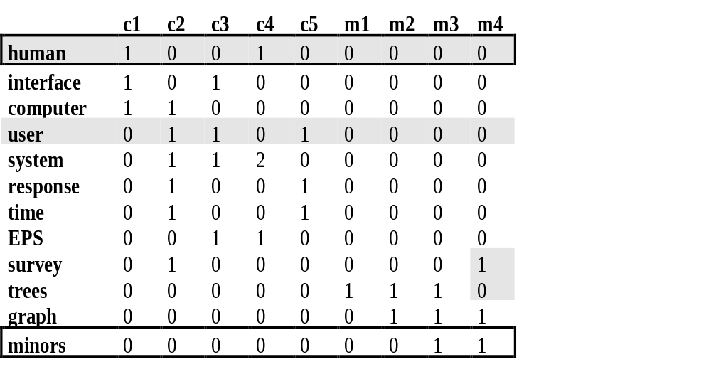
A Small Example – 2
r (human.user) = -.38 r (human.minors) = -.29

Slide 21
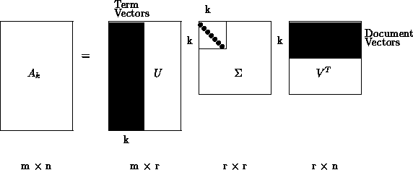
A Small Example – 3
Singular Value Decomposition
  {A}={U}{}{V}^{T}
Dimension Reduction
  {~A}~={~U}{~}{~V}^{T}

Slide 22
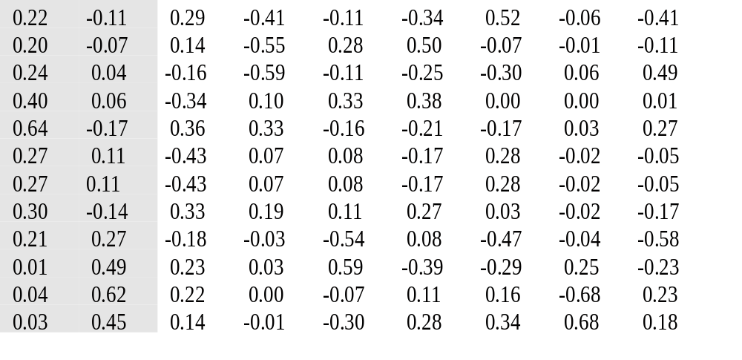
A Small Example – 4
{U} =

Slide 23
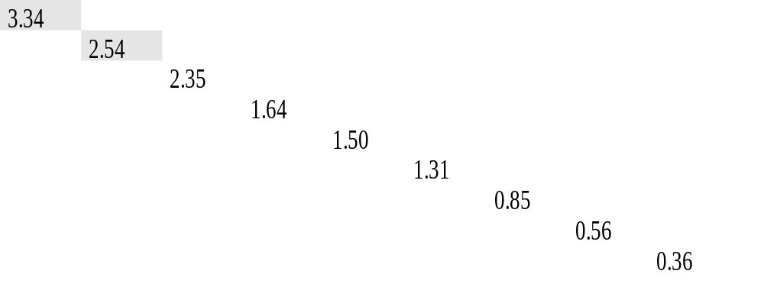
A Small Example – 5
{} =

Slide 24
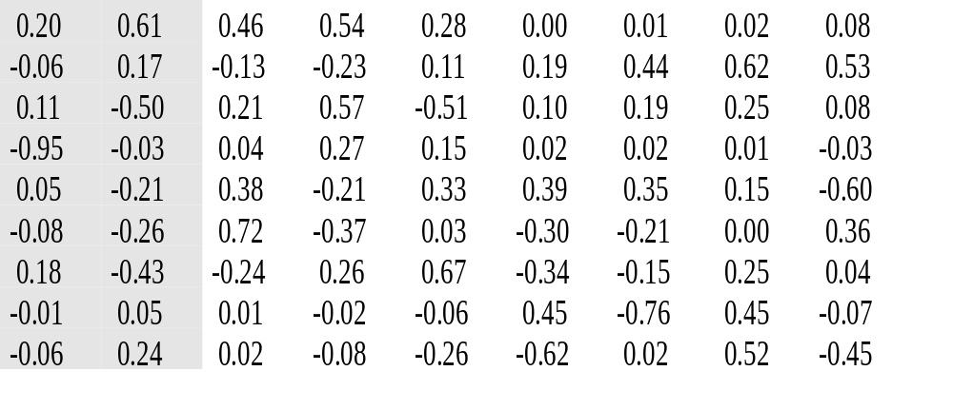
A Small Example – 6
{V} =

Slide 25
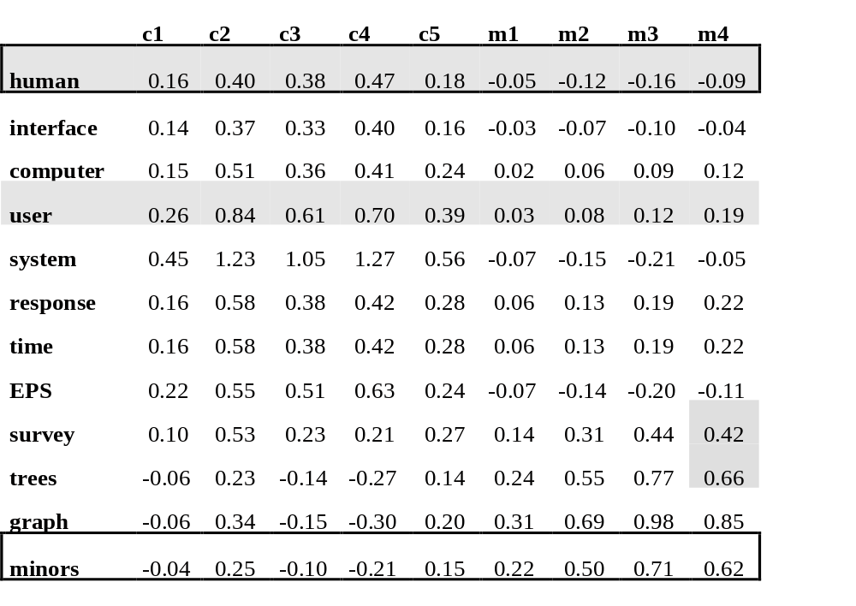
A Small Example – 7
r (human.user) = .94 r (human.minors) = -.83

Slide 26
A Small Example – 2 reprise
r (human.user) = -.38 r (human.minors) = -.29

Slide 27
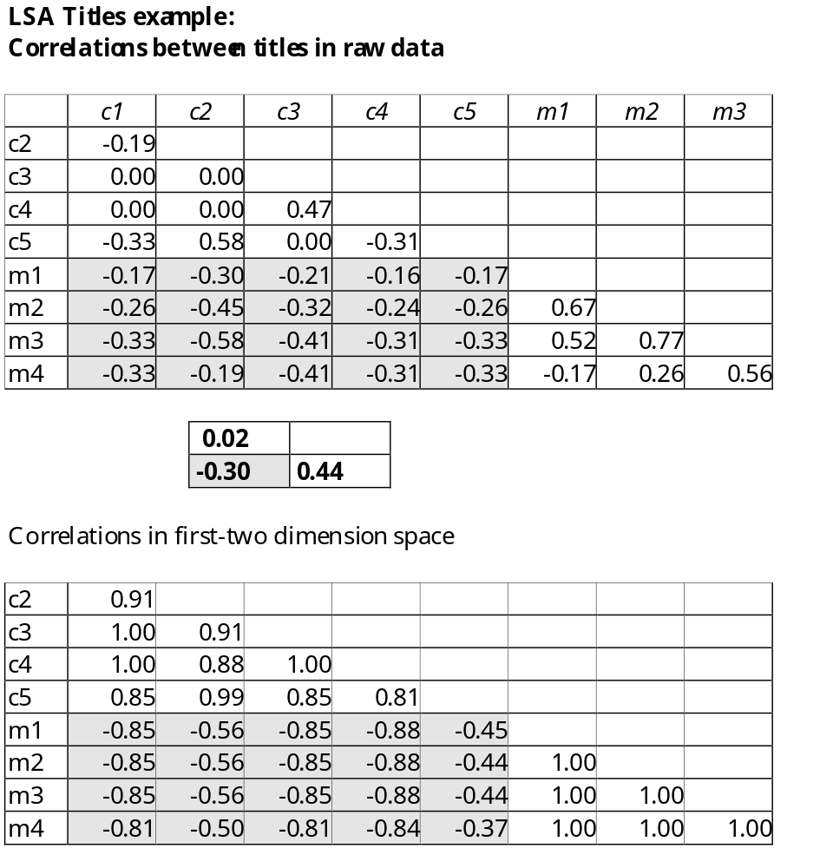
Correlation
Raw data
0.92
-0.72 1.00

Slide 28
A Small Example
A note about notation:
  Here we called our matrices
    {A}={U}{}{V}^{T}
  You may also see them called
    {W}{S}{P}^{T}
    {T}{S}{D}^{T}
  The last one is easy to remember
    T = term
    S = singular
    D = document

Slide 29
Summary
Some Issues
  SVD Algorithm complexity O(n^2k^3)
    n = number of terms
    k = number of dimensions in semantic space (typically small ~50 to 350)
    for stable document collection, only have to run once
    dynamic document collections: might need to rerun SVD, but can also “fold in” new documents

Slide 30
Summary
Some issues
  Finding optimal dimension for semantic space
    precision-recall improve as dimension is increased until hits optimal, then slowly decreases until it hits standard vector model
    run SVD once with big dimension, say k = 1000
      then can test dimensions <= k
    in many tasks 150-350 works well, still room for research

Slide 31
Summary
Some issues
  SVD assumes normally distributed data
    term occurrence is not normally distributed
    matrix entries are weights, not counts, which may be normally distributed even when counts are not

Slide 32
Summary
Has proved to be a valuable tool in many areas of NLP as well as IR
  summarization
  cross-language IR
  topics segmentation
  text classification
  question answering
  more

Slide 33
Summary
Ongoing research and extensions include
  Probabilistic LSA (Hofmann)
  Iterative Scaling (Ando and Lee)
  Psychology
    model of semantic knowledge representation
    model of semantic word learning

Slide 34
Summary
That’s the introduction, to find out about applications:
  Monday, October 28th
  same time same place
  Peter Foltz on Applications of LSA

Slide 35
Epilogue
The group at the University of Colorado at Boulder has a web site where you can try out LSA and download papers
  http://lsa.colorado.edu/
Papers are also available at:
  http://lsi.research.telcordia.com/lsi/LSI.html

