Slide 1
Effective Smart Completion for JavaScript
——Especially for Property Completion
何欣程
DZ1833010

Slide 2
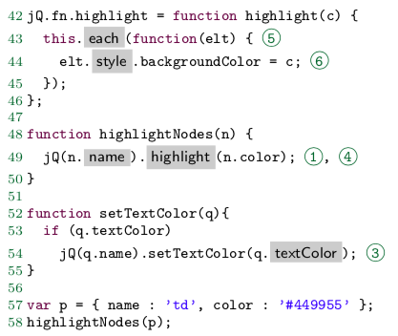
Function
When the JavaScript programmer enters an expression e followed by a dot character, the tool offers a list of properties available on e to complete the expression.
ex:

Slide 3
Four Main Challenges
(C1) JavaScript is dynamically typed, so statically determining the possible types of an expression is itself a challenging problem. Moreover, object properties can be added and removed freely at runtime, hence the set of properties of an object is not fixed.
(C2) Most JavaScript programs are built on top of complex frameworks such as jQuery , which tend to make extensive use of dynamic language constructs that are hard to analyze statically .
(C3) Typical JavaScript programs rely heavily on native libraries such as the Document Object Model (DOM) API, which is built into the browser and cannot easily be analyzed.
(C4) Smart completion should be able to deal with incomplete programs still under development. In particular, smart completion should be available in functions that are not yet called from anywhere.

Slide 4
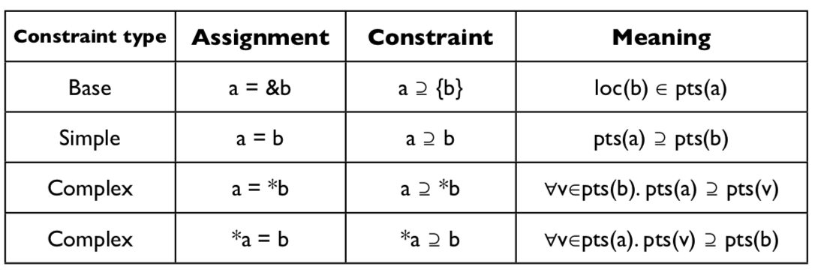
For C1
A static pointer analysis is used to approximate the set of abstract objects that may flow into a receiver expression e, and to compute which properties may be available on these objects, which takes care of (C1).
pointer analysis

Slide 5
For C2 & C3
We use a fully automatic dynamic analysis that infers an API model capturing this information. The key insight underlying this analysis is that most frameworks come with extensive unit test suites that exercise all important behaviors of its API methods. We run these test suites on an instrumented version(JS_WALA) of the framework, which observes property writes and function returns to create models for the values stored in object properties and returned from functions.
Using API models instead of the frameworks themselves and taking the DOM model into account, our pointer analysis can successfully analyze framework based JavaScript code.

Slide 6
For C4
To deal with incomplete code (C4) and missing flows due to unsoundness, we extend the basic analysis with features mimicking usage-based property inference.
we explicitly track the catalog of every abstract object, i.e., the set of properties that have been either read or written on it. If the analysis has seen reads of, but no writes to, a property f on an abstract object o, f will still be entered into o’s catalog and hence suggested as a completion for a receiver expression that may evaluate too.
we introduce dummy objects for every local variable and parameter in the program, so that even if no flow into the variable is observed, catalogs operations can still be performed on the dummy objects.
the analysis assumes that any function defined as a property of an object literal l may be invoked with l as its receiver, even if no such invocation is observed.

Slide 7
Structure
JS&HTML
Test suite API models
Completed files
extracted js
Build AST and find location of completion(e.$$)
Top k recommendation and completion
Dynamic
instrumentation
Yes
If using framework/DOM
Pointer analysis
No

Slide 8
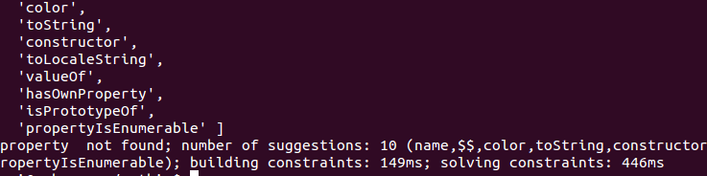
Implementation
Tool used:
Parsing: Esprima
dynamic instrumentation:JS_WALA
Location of completation:
form of: e.$$f
Result:

Slide 9
Conclusion
Challenges
In JavaScript, smart completion is much more challenging, since expressions are not statically typed and object properties may change over time. The problem is exacerbated by the common use of complex framework libraries like jQuery and native libraries like the browser DOM.
Highlights
Completions are computed using a static pointer analysis enhanced with support for usage-based property inference.
Frameworks are handled using a fully automatic dynamic analysis which infers API models based on the framework’s test suite.
Disadvantage
Flow insensitive, can’t deal with sequence in CFG

