Slide 1
IAU Division E Sun and Heliosphere
Business Meeting
2015-2018
XXX IAU GA, Vienna, Austria
August 27, 2018

Slide 2
Agenda
President's report: Division E activities during 2015-2018
Commission Reports
Commission C.E1 President's report (Natalie Krivova)
Commission C.E2 President's report (Lyndsay Fletcher)
Commission C.E3 President's report (Ingrid Mann)
Working Group Reports
Division WG: “Impact of Magnetic Activity on Solar and Stellar Environments” Chair’s Report (Dibyendu Nandi) - (Interdiv E&F)
Interdivision (C&E) WG: “Solar Eclipses” Chair’s Report (Jay M. Pasachoff ) ---Functional
Interdivision (B&E) WG: “Coordination of Synoptic Observations of the Sun” Chairs’ Report (Frederic Clette/Alexei A. Pevtsov) ---Functional
Commission C.E1 WG: “Solar Irradiance” Chairs’ Report (Greg Kopp/Alexander I. Shapiro) ---Functional
AOB

Slide 3
Division E Activities during the Past Triennial Period 2015-2018
Election of Division E Steering Committee
IAU PhD Thesis Prizes & Junior Members
IAU Web Pages
IAU meetings organized & supported
Division E Commissions
Division E and Interdivisional Working Groups (E&F, B&E, C&E)
Commission Working Group (C.E1)
IAU Resolutions & IAU Strategic Plan 2020-2030
Election Results: Incoming Division E SC

Slide 4
Division E Steering Committee for 2015-2018
Following the first ever membership-wide election of six SC members after IAU GA in Beijing, DP, DVP, and all other SC members are elected by the membership. Past DP remains advisor to the DSC.
PRESIDENT YAN, Yihua
VICE-PRESIDENT Gibson, Sarah
SECRETARY DeRosa, Marc
ADVISORS van Driel-Gesztelyi, Lidia
STEERING COMMITTEE
Choudhuri, Arnab DeRosa, Marc Fletcher, Lyndsay
Gibson, Sarah Kontar, Eduard Krivova, Natalie
Mann, Ingrid Shimizu, Toshifumi Srivastava, Nandita
van Driel-Gesztelyi, Lidia von Steiger, Rudolf YAN, Yihua
Division E has 1189 members

Slide 5
IAU Deceased Members of Division E during 2015-2018
Henry Aurass；Barbara Bell；Erika Bohm-Vitense；Andrey V. Bruns；Vaclav Bumba；Franz-Ludwig Deubner；Günther Elste；Enrique García-Berro； Sergei A. Grib； Ahmed Abdel Hady；Yunchun Jiang；Pierre Kaufmann；John K. Lawrence；Moisey A. Livshits；Leon Mestel；Patrick S. McIntosh; Lucio Paternò；Isroil Sattarov；Zhongxian Shi；Raisa Teplitskaya；Richard G. Teske；Arthur H. Vaughan；Zhiliang Yang.

Slide 6
IAU PhD Prize & Junior Members
In 2016 EC meeting Division Presidents proposed to establish IAU PhD Prize：
9 IAU Divisions award, once a year, 9 PhD Theses (defended 16/12/ previous year---15/12/this year) + 1 from developing countries
new Category of Junior Members: A junior scientist who completed the PhD studies and who is in the initial phase of the professional researcher career in some branch of astronomy may be admitted to the Union by the Executive Committee as Junior Member for a period not exceeding 6 years.

Slide 7
IAU Web Pages
IAU Web Pages providing Divisions, Commissions and WGs with dedicated web pages residing within the IAU site.
The objective is to unify all the functional web pages in one (IAU) site, therefore overcoming the issue of transferring the functionalities every triennium at the rotation of the Presidents, Chairs, etc.
At the same time the Div/Comm/WG should have the possibility of structuring the web services according to their needs and to upload documents.
It is understood that some Division already put a lot of effort in building very nice web pages and services, therefore the transition from the external to the internal web pages are provided.

Slide 8
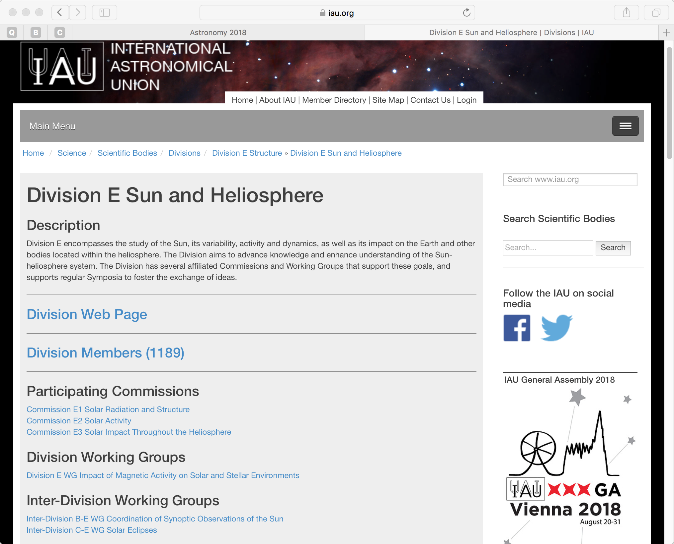
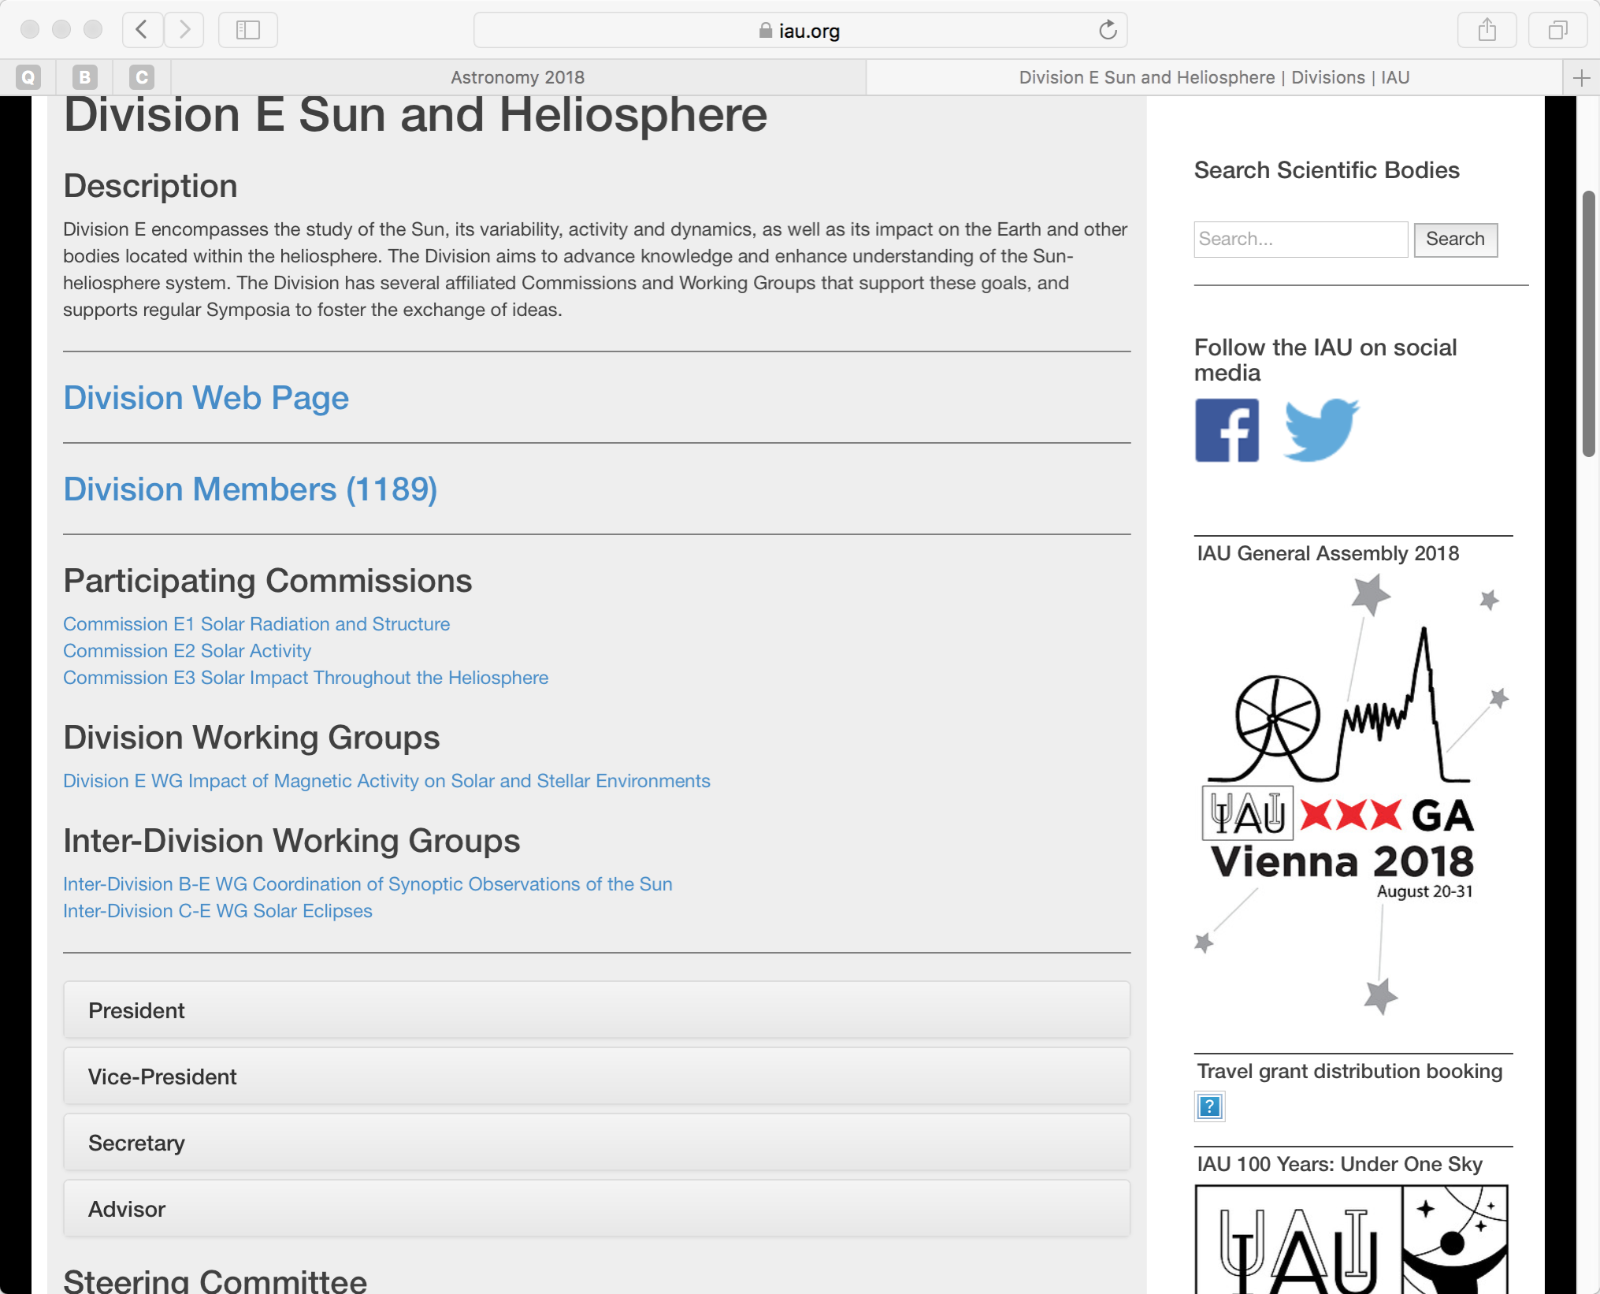

Slide 9
Division E --- Various Activities
The Division E Steering Committee:
Helped to establish IAU Division E web pages
Discussed, provided feedback and ranked IAU meeting proposals each year: 2016-2018
Evaluated and selected Division E IAU PhD Prize winner each year: 2016-2017
Organized this 2nd Division Days Meeting at IAU GA 2018 with certain supports from IAU
Approved one individual IAU membership request from non-member country

Slide 10
Division E --- Various Activities
Activities with related Societies:
UN COPUOS Thematic Priority 4: Space Weather --- “Strategy for Developing an International Framework for Space Weather Services (2018-2030)”
SCOSTEP & SCOSTEP VarSITI (Variability of the Sun and its Terrestrial Impact)
Inactive case:
Current IAU representative to ISES: International Space Environment Service is inactive and has no responses to IAU for years (once contacted Terry Onsager to propose new candidate )

Slide 11
Division E --- Various Activities
Functional Working Groups
The “functional” WGs are those that pursue a long term institutional function on behalf of the IAU, therefore they should not be automatically suppressed at every GA. They should however report about their activity at the GA and, if needed, propose amendments in their mission.
Interdivision (C&E) WG: “Solar Eclipses” ---Functional
Interdivision (B&E) WG: “Coordination of Synoptic Observations of the Sun” ---Functional
Commission C.E1 WG: “Solar Irradiance ---Functional

Slide 12
IAU meetings organized & supported
2016, IAUS 327, Fine Structure and Dynamics of the Solar Atmosphere, Cartagena de Indias, Colombia
2016, IAUS 328, Living around Active Stars, Maresias, Brazil
2017, IAUS 335, Space Weather of the Heliosphere: Processes and Forecasts, University of Exeter, UK
2018, IAUS 340, Long-term datasets for the understanding of solar and stellar magnetic cycles, Jaipur, India
2018 IAU GA Division Days & coordinating/supporting FMs, IAUS
FM9, Solar Irradiance: Physics-Based Advances
FM10, Nano Dust in Space and Astrophysics
FM5, Understanding historical observations to study transient phenomena
FM15, Astronomy for Development
IAUS349, Under One Sky: The IAU Centenary Symposium
Future 2019 IAUS during solar total eclipse, Chile

Slide 13
Division E Commissions and Working Groups
The 3 Commissions constitute distinct and interconnected parts of Division E “Sun and Heliosphere” as a whole
1 Comm E1 WG Functional
1 Div WG
2 inter-Div WG Functional

Slide 14
Division E Commissions and Working Groups Reports during 2015-2018
Comm E1 “Solar Radiation & Structure”: highlighted with 82 references
Comm E2 “Solar Activity”: highlighted with 131 references
Comm E3 “Solar Impact throughout the Heliosphere”: highlighted with 74 references
(~2200 refereed papers/year, ~5000 authors---Div II Legacy Reports)
E1 WG Solar Irradiance: Functional, TSI & SSI: long timescales with stellar-variability studies planned
WG Impact of Magnetic Activity on Solar and Stellar Environments:
B-E WG Coordination of Synoptic Observations of the Sun: Functional
C-E WG Solar Eclipses: Functional 2 total, 2 annular, 4 partial eclipses
All active and fruitful, Division E recommends to continue these Comms/WGs. (Next time all Commissions must reform!)

Slide 15
Division E progress during 2015-2018
The scientific developments on key scientific problems in a wide spectra are addressed either through theory, data-processing or observationally with stereo and close-up observations by a variety of facilities including continued space-based facilities: RHESSI, Hinode, IRIS, SDO, STEREO, SoHO; ground-based major facilities: 1m SST, NVST, 1.5m Gregor, 1.6m GST; non-solar dedicated radio facilities: ALMA, EVLA, LWA, MWA, LOFAR, GURT and solar dedicated radio facilities: MUSER, SRH, ICCON, NRH, etc. and future projects ASO-S, SKA etc.

Slide 16
IAU Strategic Plan 2020-2030
& Division E Vision
A great variety of opportunities in the coming decade through new generations of observations:
Parker Solar Probe (PSP) will approach to within ~8.5 solar radii from the Sun to solve the longstanding mysteries of solar-wind acceleration and coronal heating;
Solar Orbiter (SO) will provide close-up, high-latitude observations of the Sun to examine how the Sun creates and controls the heliosphere;
Daniel K Inouye Solar Telescope (DKIST) -- will image the surface of the Sun in unprecedented detail.

Slide 17
IAU Strategic Plan 2020-2030
Goals
Goal 1: the IAU leads the worldwide coordination of astronomy and the fostering of communication and dissemination of astronomical knowledge among professional astronomers
Goal 2: the IAU promotes the inclusive advancement of the field of astronomy in every country
Goal 3: the IAU promotes the use of astronomy as a tool for development in every country
Goal 4: the IAU engages the public in astronomy through access to astronomical information and communication of the science of astronomy
Goal 5: the IAU stimulates the use of astronomy for teaching and education at school level

Slide 18
IAU Resolutions to be voted at the XXXth General Assembly
Resolution A1: addresses the 10 year IAU Strategic Plan for the years 2020–2030.
Resolution B1: is on the Geocentric and International Terrestrial Reference Systems and Frames.
Resolution B2: is on The Third Realisation of the International Celestial Reference Frame.
Resolution B3: is on the preservation, digitisation and scientific exploration of historical astronomical data.
Resolution B4: addresses a suggested renaming of the Hubble Law
（Marcos Peñaloza-Murillo from Venezuela, an atmospheric physicist, suggests that the IAU declare the sunflower as the official flower of astronomers---Need to follow standard procedure）.

Slide 19
Incoming Division E SC 2018-2021
President: Sarah Gibson (United States)
Vice-President: Cristina H. Mandrini (Argentina)
Elected Members, First Term: Timothy S. Bastian (United States), Mingde Ding (China, Nanjing), Irina N. Kitiashvili (United States)
Second Term Members: Toshifumi Shimizu (Japan), Eduard Kontar (UK), Nandita Srivastava (India)
Ex-Officio Members (Commission Presidents): E1: Alexander Kosovichev (United States) E2: Paul Cally (Australia) E3: Nicole Vilmer (France)
Advisor (Past President): Yihua Yan (China Nanjing)
[---- 4421 votes (average 21%) by all Divisions Members, the participation is quite uniform across Divisions]
Thanks are due to the SC members, who served the last triennium and stepped down: Lidia van Driel-Gesztelyi, Arnab Choudhuri, Marc DeRosa, Lyndsay Fletcher, Natalie Krivova, Ingrid Mann, Rudolf von Steiger.

