Slide 1
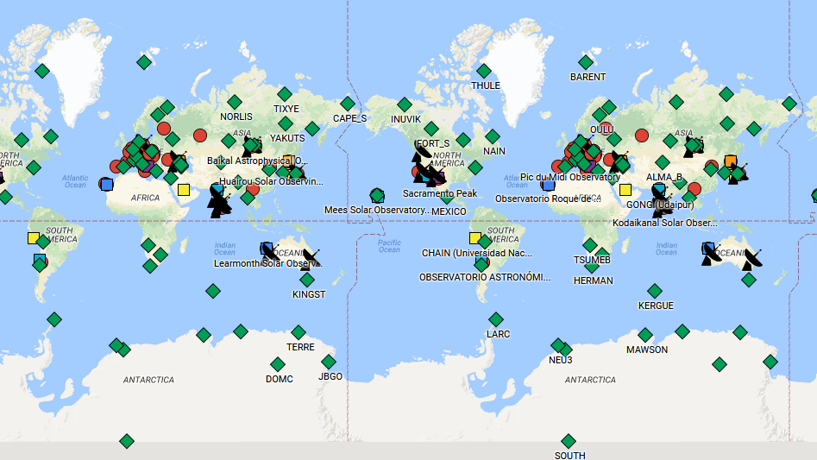


Inter-Division B-E WG on “Coordination of Synoptic Observations of the Sun” - Functional
Co-Chairs:
Frederic Clette (ROB, Belgium)
Alexei A. Pevtsov (NSO, USA)
Background: goo.gl/LRVhVk

Slide 2
History of WG and its present
2009 – IAU GA (Rio De Janeiro, Brazil) – decision about creating the WG under Div II/C12
Late-2011 – WG is formally created (Chair – Alexei Pevtsov)
2013 – vice-Chair: Frederic Clette
Late-2015 – Inter-Division B-E working group (two Co-Chairs).
2016 – Functional
Currently, the WG has 55 members from 19 countries
https://www.iau.org/science/scientific_bodies/working_groups/255/
http://www-dev.nso.edu/IAU-Com12 (direct link to WG group page, will change!)

Slide 3
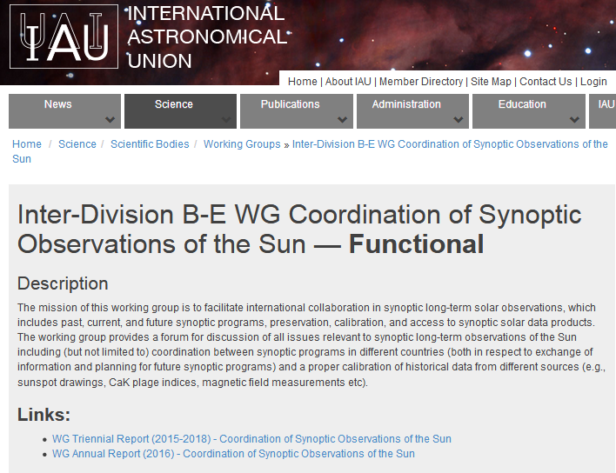
https://www.iau.org/science/scientific_bodies/working_groups/255/
The mission of this working group is to facilitate international collaboration in synoptic long-term solar observations, which includes past, current, and future synoptic programs, preservation, calibration, and access to synoptic solar data products.
The working group provides a forum for discussion of all issues relevant to synoptic long-term observations of the Sun including (but not limited to):
coordination between synoptic programs in different countries (both in respect to exchange of information and planning for future synoptic programs)
a proper calibration of historical data from different sources (e.g., sunspot drawings, CaK plage indices, magnetic field measurements, etc).

Slide 4
Major Activities by Members of WG:
Support for continuation of synoptic programs threatened by budget cuts and promoting the broadening of international participation in WG activities
Preservation and digitization of records of past solar activity
Verification of existing sunspot number time series and developing jointly-validated sunspot time series
Improving access to modern and historical data

Slide 5
1. Support for continuation of synoptic programs
Raised concerns about declining funding levels, which threaten the long-term continuation of synoptic solar
Provided letters of support for continuing operation and for proposals on historical data preservation and exploration.
IAU letter signed by IAU Secretary General and by two IAU Division Presidents in support of digitization of historical data.
Letters of support for IAU symposia and focus topics at IAU GA.
Opinion article on long-term synoptic programs:
Pevtsov, A. A., and Clette, F.: 2017, "To understand future solar activity, one has to know the past", Eos, 98, DOI: 10.1029/2017EO083277

Slide 6
1. Support for continuation of synoptic programs
Initiated a discussion of the long-term sustainability of synoptic programs with the international community: 2 splinter meetings
Oct. 16, 2017, Gottingen, Germany http://science-media.org/conferencePage.php?v=26
18-24 Feb., 2018, Jaipur, India (plans for communicating with the Office of Astronomy for Development, OAD).
WG maintains a list of astronomical observatories (optical and radio) engaged in solar observations, instrument networks and neutron monitors.
Different facilities are shown as separate layers on a Google map, which is available via goo.gl/LRVhVk (send updates to apevtsov@nso.edu)

Slide 7
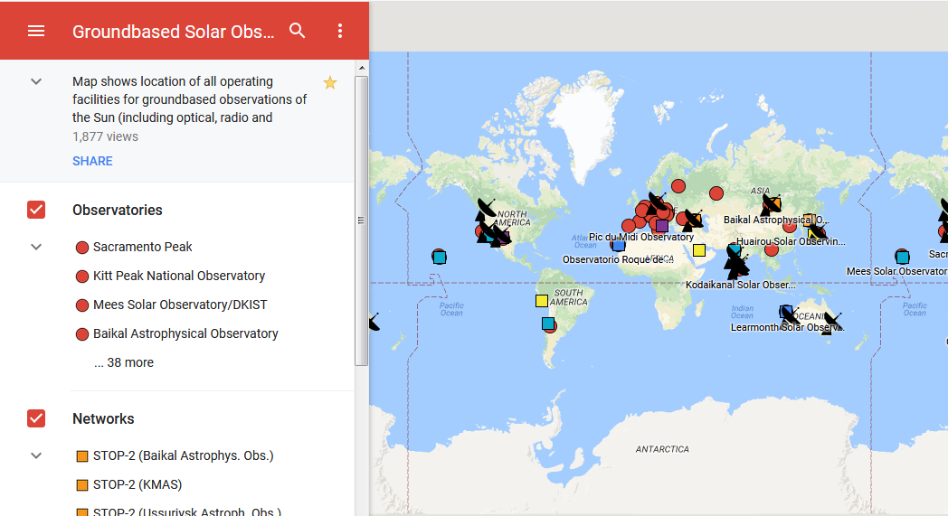
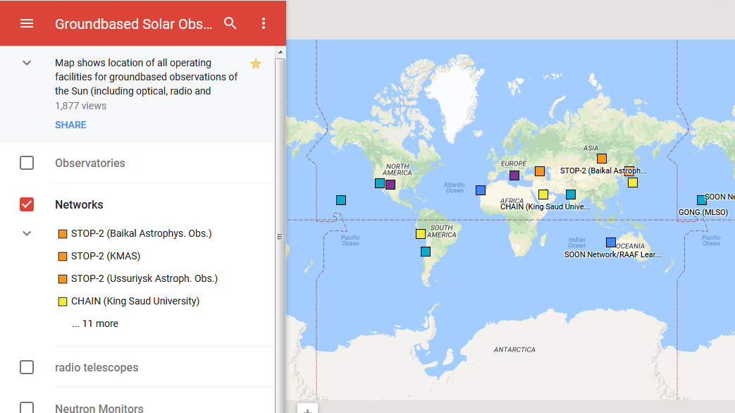
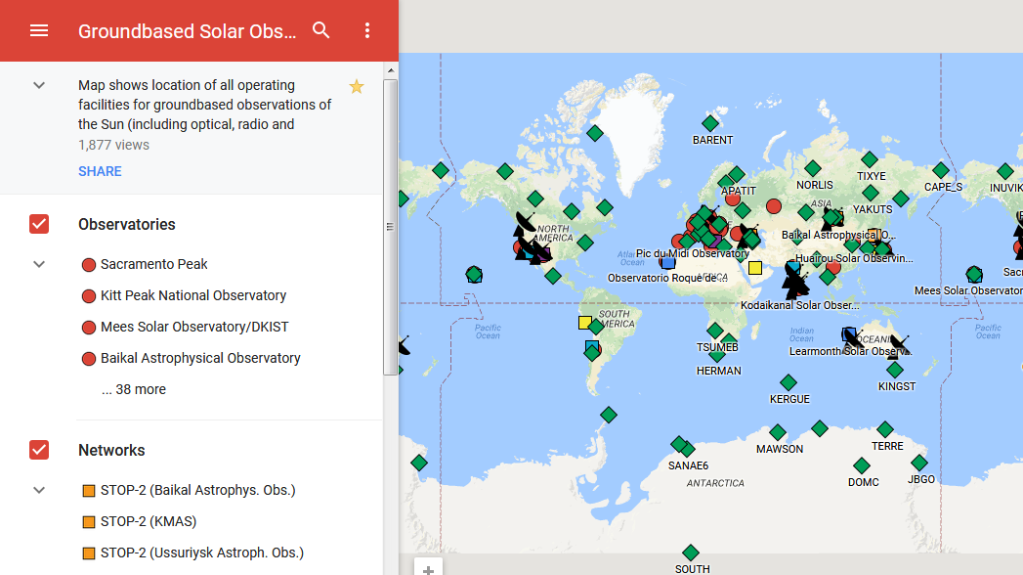
goo.gl/LRVhVk

Slide 8
2. Preservation and digitization of records of past solar activity
Worked with community on discovering new archives of sunspot drawings and other historical data worth preservation:
Taipei Astronomical Museum, TAM, 1941-present. TAM drawings were made public via Historical Archive of Sunspot Observations (HASO, http://haso.unex.es).
Ulugh Beg Astronomical Institute, Tashkent, Uzbekistan, 1884-1927.
WG Proposed Resolution B3: on the preservation, digitization and scientific exploration of historical astronomical data.
Plans for promoting astronomy data preservation as international activity via UN/SCOSTEP and global scientific data organizations (ICSU, CODATA, RDA).

Slide 9
3. Verification of existing sunspot number time series and developing a unified sunspot time series 4. Improving access to modern and historical data
Discussion of issues related to developing a consensus sunspot time series, and developing procedures and policies on future updates once such a time series is developed.
New ISSI Working Team (Lead: M.Owens, F.Clette; Bern, Jan. 2018)
Discussions on improving discoverability of historical data and their accessibility by the broad international community (e.g., a centralized repository, a distributed data archives with pointers via Virtual Solar Observatory, VSO).
Long-term maintenance/preservation of archives after retirement of projects PIs.
Initiation of a Survey of historical astronomy data: (https://goo.gl/forms/lphoIfquXRtvSfrm2)

Slide 10
Closing remarks
Over the last reporting period, the WG concentrated on
supporting continuation of long-term programs
promoting stronger international collaboration in synoptic observations of the Sun.
Work also continued on preservation of historical data and developing a consensus sunspot number time series.
The work of the WG includes sun-as-a-star observations, and thus, the WG is open to questions related to synoptic observations of other stars (e.g., stellar activity cycles).
We invite all astronomers interested in long-term synoptic observations and preservation of historical data to join the discussion.
https://www.iau.org/science/scientific_bodies/working_groups/255/

