Slide 1
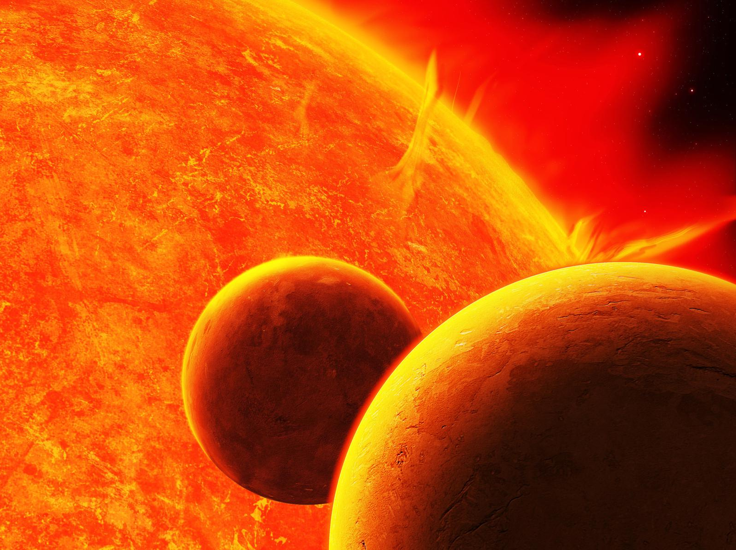
IAU Division E Business Meeting, Vienna, 27 August 2018
Impact of Magnetic Activity on Solar-Stellar Environments
An IAU Division E Working Group
Dibyendu Nandi (WG Chair)
http://www.iau.org/science/scientific_bodies/working_groups/196/

Slide 2
Aims and Scope
Coordinate among theorists, modellers and observers in the field of Solar, Stellar and Planetary Physics and facilitate the interdisciplinary science related to understanding the impact of stellar magnetic activity on their space environments and planetary atmospheres
OC Members
Sacha Brun Allan, Cliver Edward, Cremades Fernández, María. Gibson, Sarah, Güdel, Manuel, Haberreiter Margit, Işık Emre, Korhonen Heidi, Kusano Kanya, Mackay Duncan, Mandrini Cristina, Marsden, Stephen, Montes David,
Nandi Dibyendu, Petit Pascal, Riley Pete. Usoskin Ilya.
Vidotto Aline. Webb David

Slide 3
Functional Goals
Organization of Symposium and Meetings around the world
Publications of reviews and reports highlighting important advances
Maintain a WG webpage, with eventual goal for disseminating useful
information relevant for this topic, including collection of publications

Slide 4
Activity Report (2016-2018)
Meetings
IAUS 328: Living around Active Stars, Brazil, 2016
—Solar & Stellar Activity
—Heliospheric & Astrospheric Environments
—Coupled Star-Planet Evolution
—Exoplanets, Habitability & Life
SCOSTEP VarSITI Meeting, Bulgaria, 2016
—Session: Solar Evolution and Extrema
European Week of Astronomy and Space Science, Greece, 2016
—Session: Effect of solar and stellar magnetic activity on planets
IAUS 340: Long-Term Datasets for Solar-Stellar Activity, India, 2018
BCool Meeting, Ireland, 2018
IAUS 345: Origins, Austria, 2018
Supported Meetings
—FM9-IAU: Solar Irradiance – Physics Based Advances, Austria, 2018

Slide 5
Activity Report (2016-2018)
Major Publications
Living around Active Stars: Proceedings of the IAUS 328, Eds: Nandy,
D., Valio, A and Petit, P. 2017, Cambridge University Press
Chapter contribution on understanding the impact of stellar winds on
exoplanets in the Handbook on Exoplanets, Vidotto, A. 2018, Springer

Slide 6
Future
Bridging the disciplines of solar-stellar astrophysics, planetary
physics and climate sciences will bring about transformative progress
in understanding how astrophysical environments determine the origins and sustainability of life and habitabilty. With major space- and
ground-based instrumentation development and missions in the
offing, and concurrent progress in modeling star-planet interactions,
our community is poised for major advances in this interdisciplinary field. The continued efforts of this WG are therefore both
desirable and necessary.
Passing the Baton
Dibyendu Nandi (Chair: 2012—2018)
Heidi Korhonen (Chair: 2018— )
Expect new ideas, new activities in these exciting times…

Slide 7
Special Thanks
Sarah Gibson (USA), Lidia van Driel-Gesztelyi (EU) and
Cristina Mandrini (Argentina)
Adriana Valio (Brazil)
Heidi Korhonen (Denmark)

