Slide 1
SOFTWARE ENGINEERING proposal PROJECT
LOTTERY MACHINE APPLICATION

Slide 2
GROUP NAME:SCIENCE
GROUP MEMBERS :
-FABRICE IRAZI (F17040123) -RIDITA ISLAM (F17040106) -ELIZABETH LISA MONDOL (F17040114) -WALLACE BRUCE NAA KOSHIE (F17040122)

Slide 3
The old process of lottery

Slide 4
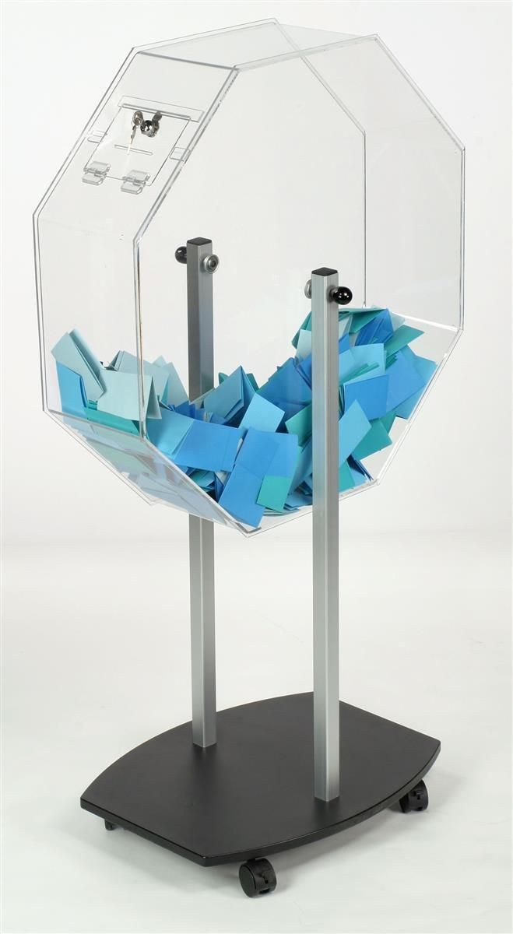
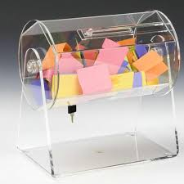


Slide 5
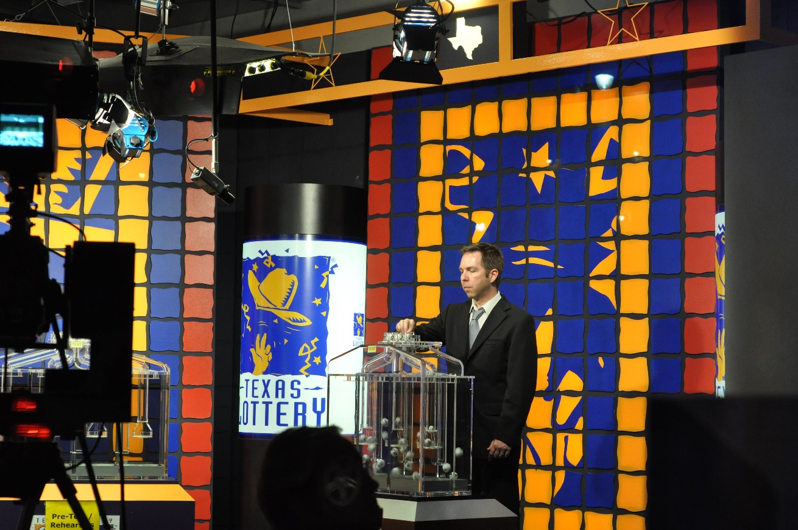
The old process is too lengthy, the papers might get missing and sometimes the decision might be partial.

Slide 6
Our vision
After getting the problems from the old process of lottery, our vision is to make a lottery machine software which is - Easy to use - real-time computing - faithful and reliable

Slide 7
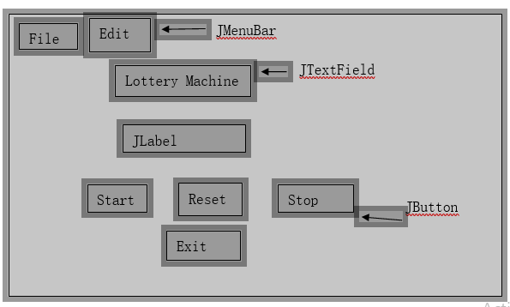
Structure of our project

Slide 8
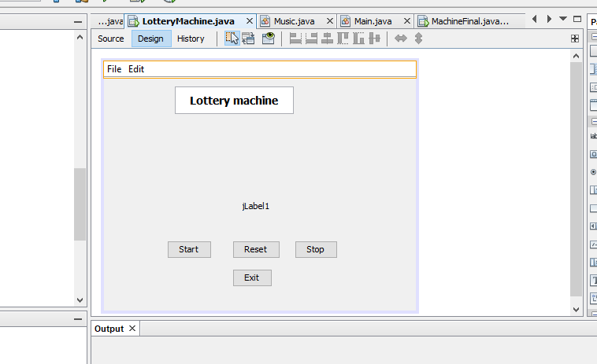
PROCESSING……..

Slide 9


Slide 10
MATERIALS:
We will use these materials for creating our software: 1. JAVA 2. Netbeans (IDE) 3. ICO converter

Slide 11
OUR PROSPECTS
Improving our skills on what we learnt in previous courses as in C++ programming, Java. Developing our group work skills Learn to exchange ideas with each other Utilizing our knowledge in future to build more new and interesting projects

Slide 12
THANKS TO OUR HONOURABLE TEACHER FOR GIVING US AN OPPORTUNITY TO SHARE OUR IDEA WITH EVERYONE AND THANKS TO THE AUDIENCE FOR LISTENTING TO US……………….

