Slide 1
SOFTWARE DESIGN SPECIFICATIONS
SYSTEM ARCHITECTURE AND DIAGRAMS

Slide 2
Group name : Science Group members: Fabrice Irazi( F17040123) Elizabeth Lisa mondol( F17040114) Ridita Islam (F17040106) Naa koshie Wallace bruce(F17040122) Mukhriddin ziyodullaev(F17040110)

Slide 3
PROBLEMS
The old process of lottery is too lengthy, the papers might get missing and sometimes the decision might be partial.

Slide 4
OUR GOALS
After getting the problems from the old process of lottery, our vision is to make a lottery machine software which is - Easy to use - real-time computing - faithful and reliable

Slide 5
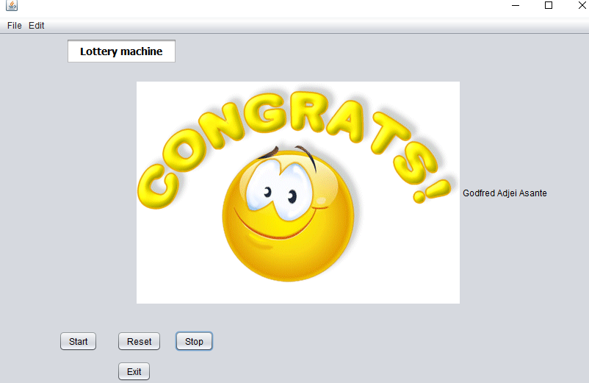
INTERFACE:

Slide 6
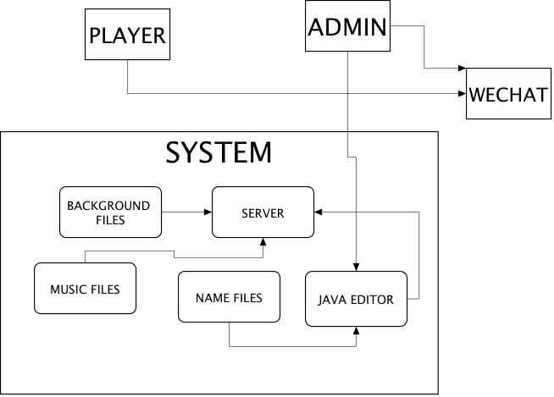
SYSTEM ARCHITECTURE OUR SYSTEM ARCHITECTURE HAS SOME MODULES SUCH AS WECHAT AND JAVA EDITOR. WeChat is used for providing some information. The player scan the QR code and get his id through WeChat. The administrator collect the information as in player's name through wechat.java editor is used for database. We store the name, the id, the information of the player in java editor.

Slide 7
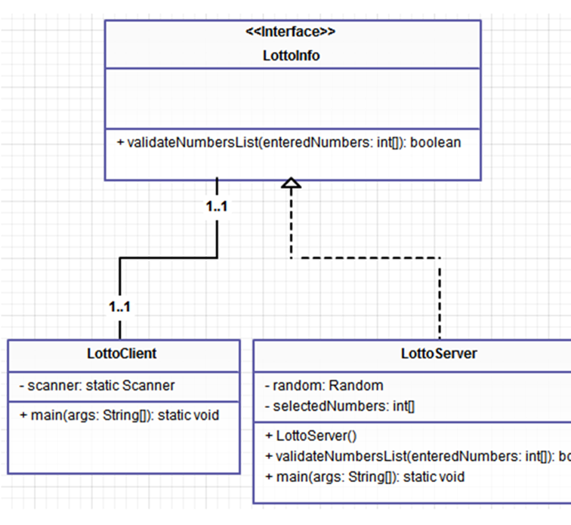
Class DIAGRAM our class diagram is focused on some classes such as Lotto Client, Lotto Server and LottoInfo.those classes have relationships between them. For example a client will be the one and only one to have a particular info. As well a particular info is for only one client. By the way the server can store many info.

Slide 8
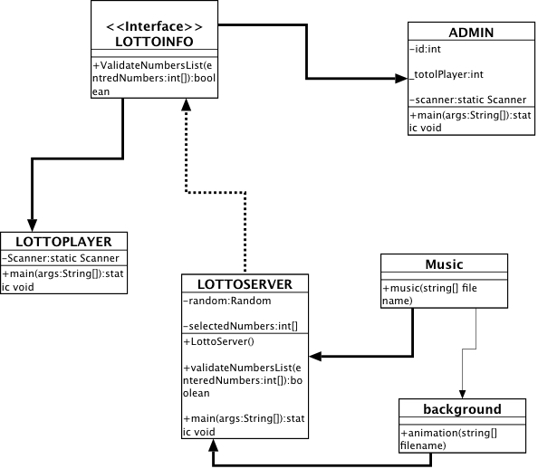

Slide 9
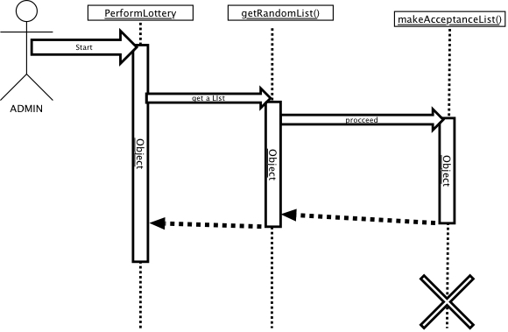
First sequence diagram our first UML sequence diagram shows the interaction between the administrator and the system. Here the administrator is the one to start the procedure of lottery. First of all he need to get a random list of players. Then proceed to do verifications.

Slide 10
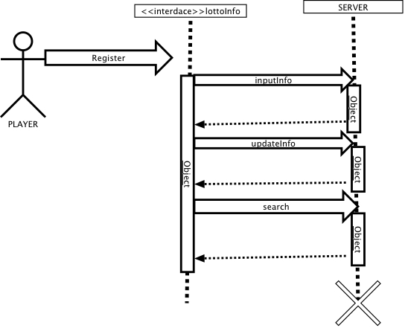
Second sequence diagram for the second UML sequence diagram, it shows the interaction between the player and the system. The player has to scan a qr code and by scanning it he will get some information about lottery as a message to provide his name etc. then after inputting his name he’ll get an id.

