Slide 1
SOFTWARE ENGINEERING.
NJUPT, OVERSEAS COLLEGE,
COMPUTER SCIENCE DEPARTMENT.
PROJECT PROPOSAL.
PROJECT: ANDROID SCHEDULING APPPLICATION.
Team members:
F15040112 (EMMANUEL KORANTENG)
F15040111 (ISAAC MOUKASSA)
F15040103 (M A MARUF HOSSAIN)

Slide 2


OUR PURPOSE:
Time as we all know is very essential to human life
and for that reason if its managed well could be of a
great help and make each day we live successful.
Our reason for choosing to work on time scheduling
application are as follows;

Slide 3


THE STUDENTS.
Is it this student thats fed
up with the sound of the
alarm so ignores it
when it rings?
Or this one that forgot he
had class at 8am on
Tuesday due to not
planning ahead?
WELL, WE THINK TECHNOLOGY CAN SAVE STUDENTS LIKE THESS AND OUR
IDEA CAN BE ONE SOLUTION.
* HELPING STUDENTS KEEP TRACK ON THEIR WEEKLY SCHEDULE.
* GIVEN THEM THE ENCOURAGEMENT NEED TO BE ABLE TO
GET UP FROM BED WHEN IT FEEL SO HARD.

Slide 4

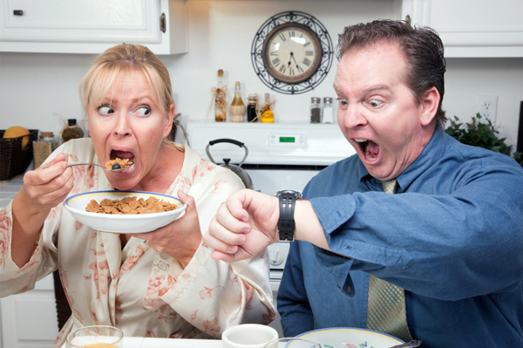
THE WORKER
How about this worker that
missed her appointment
Or this one that has limited
time for breakfast.
WELL, WE ARE NOT JUST BRINGING A SCHEDULE APP OR AN ALARM BUT
ALSO ACOMPANION.
* HELPING WORKERS KEEP TRACK ON THEIR APPOINTMENTS.
* SUGGESTION IDEAS AND HELP MAKE BASIC QUICK DECISIONS.

Slide 5
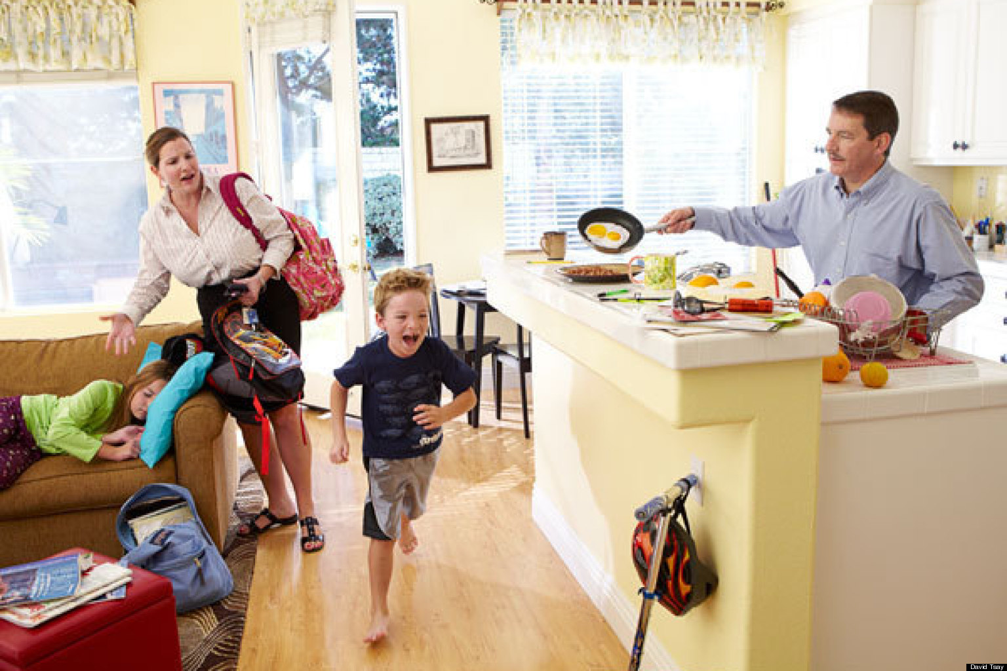

PARENTS
Talk about this parent that
finds it hard to plan what
kids should do at a
particular time
Or this parent that forgets the
doctors appointment for
the kids every month
WELL, WE ARE BRINGING YOU A THIRD PARENT TO YOUR HOME.
* HELPING PARENTS MANAGE HOME CHORES.
* KIDS APPOINTMENTS AND ACTIVITIES.

Slide 6
OUR OBJECTIVE
WE AIM TO ARCHIEVE A WORKING ANDROID BASED APPLICATION WITH THE ABILITY TO;
PLAN OR SCHEDULE WEEKLY TASKS WITH NOTIFICATION

Slide 7
THAT SUGGESTS IDEAS THAT A SPECIFIC USER COULD DO ON A SPECIFIC DAY OR TIME.
ALLOW USERS TO SET A MOTIVATIONAL SPEECH THAT PLAYS BEFORE EACH TASK TO HELP FIGHT LAZINESS.
REMINDS USERS MINUTES BEFORE A SPECIFIC SET TIME.
ALLOWS USER TO ACCEPT OR DECLINE WHETHER A SPECIFIC TASK COULD BE ACCOMPLISHED
HAVE A RECORD OF ACCOMPLISHED TASKS.

Slide 8
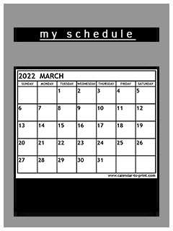
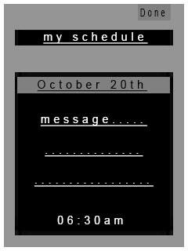
BASIC INTERFACE

