Slide 1
高阶拓扑绝缘体中的纠缠熵

Slide 2
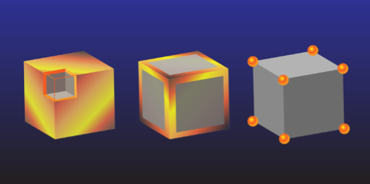
什么是高阶拓扑绝缘体？
(常规)拓扑绝缘体中的体边对应: d-1维gapless表面
高阶拓扑绝缘体(Higher-order topological insulators[HOTI]): d-n(n>1) 维gapless表面
Benalcazar, Bernevig & Hughes, Science, 2017; PRB, 2017;
Song, Fang & Fang, PRL, 2017;
Schindler et al., arXiv, 2017;
Ezawa, PRL, 2017;
Langbehn et al., PRL, 2017; PRB, 2018;
…
Parameswaran & Wan, 2017

Slide 3
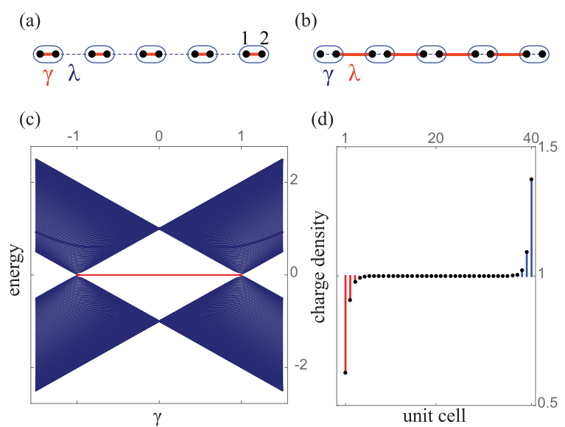
SSH model
Benalcazar, Bernevig & Hughes, PRB, 2017;

Slide 4
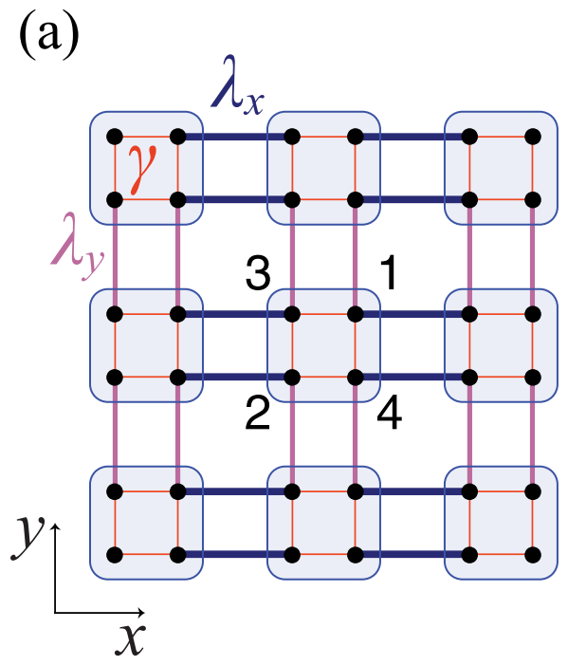
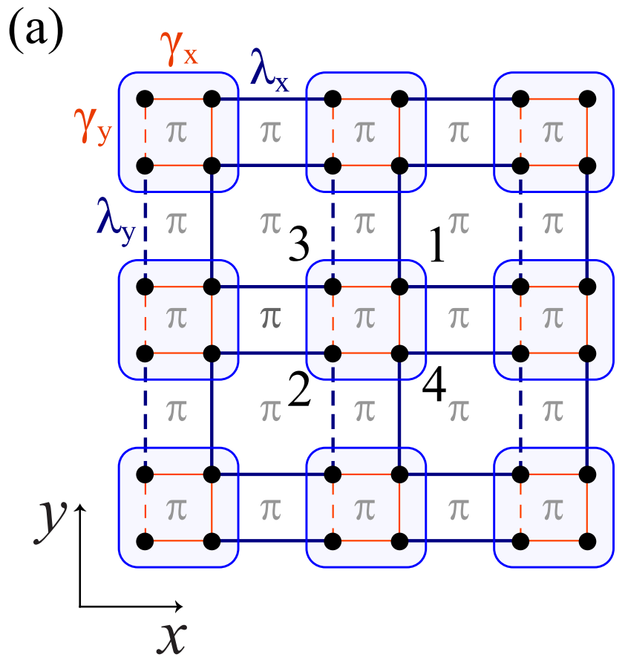
2d generalized SSH model
Benalcazar, Bernevig & Hughes, PRB, 2017;

Slide 5
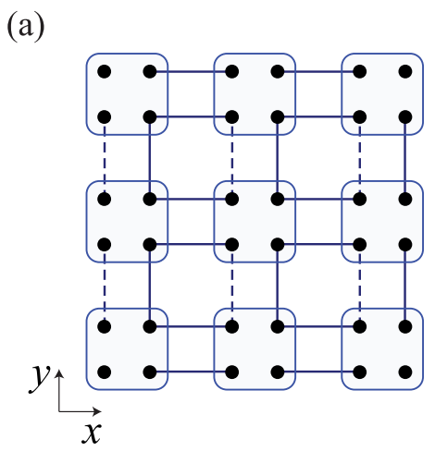
2d generalized SSH model
Benalcazar, Bernevig & Hughes, PRB, 2017;

Slide 6
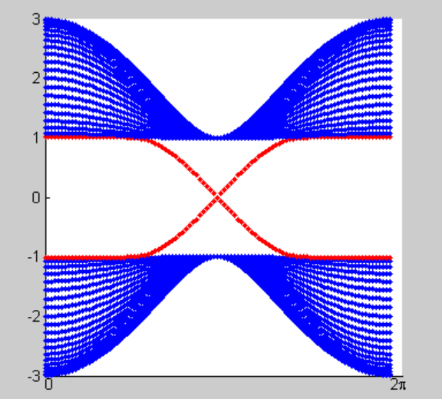



From TI to HOTI
m=t=λ=1,Lx=20
$$k_{y}$$
Qi, PRB, 2008
i=x，y
当 ， 可以 形成拓扑相

Slide 7
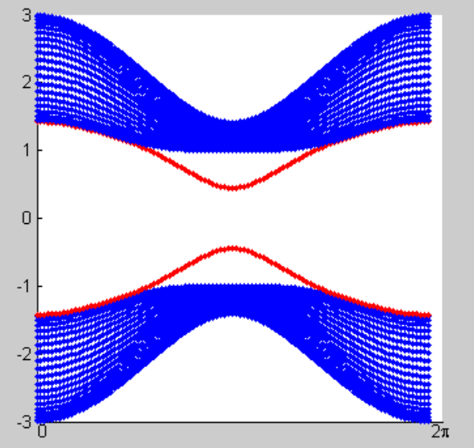



From TI to HOTI
m=t=λ=1,Lx=20
$$k_{y}$$
Qi, PRB, 2008
i=x，y
当 ， 可以 形成拓扑相
加入
$$Δ=0.5$$
会形成二阶拓扑绝缘体
$$k_{y}$$
Schindler et al., arXiv, 2017; Eazawa, PRB, 2018

Slide 8
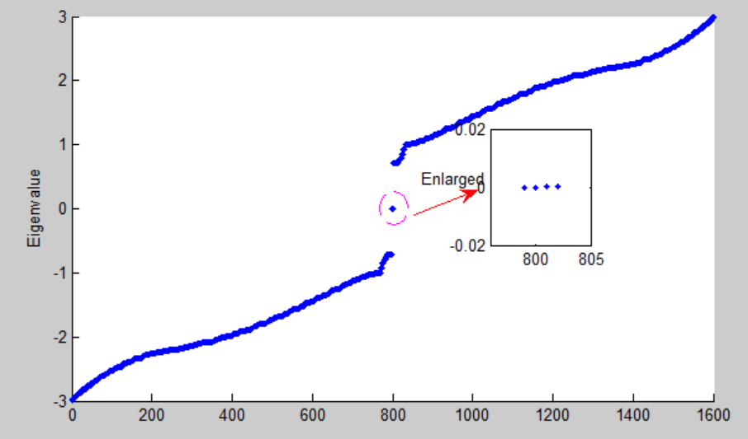
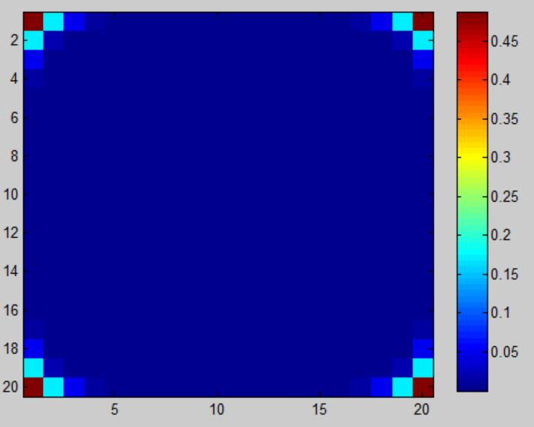
From TI to HOTI

Slide 9

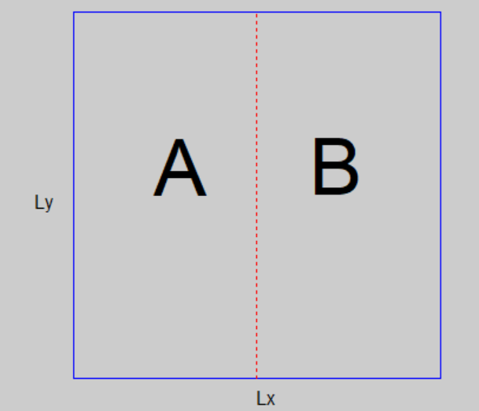
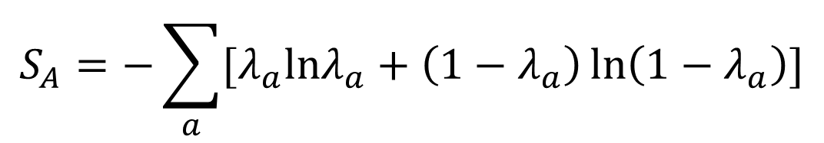
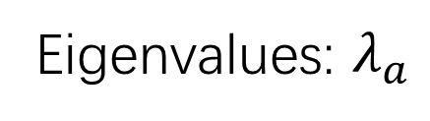
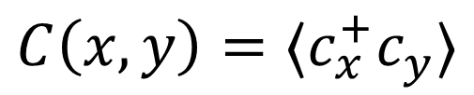
Entanglement entropy
$$C\left(x,y\right)=〈c_{x}^{+}c_{y}〉$$
Eigenvalues: $λ_{a}$
$$S_{A}=−\sum_{a}{[λ_{a}lnλ_{a}+\left(1−λ_{a}\right)\ln\left(1−λ_{a}\right)]}$$
Peschel, J. Phys. A: Math. Gen. 36, L205 (2003);
Cheong and Henley, Phys. Rev. B 69, 075111 (2004).
Ryu, Hatsugai, PRB, 2006

Slide 10
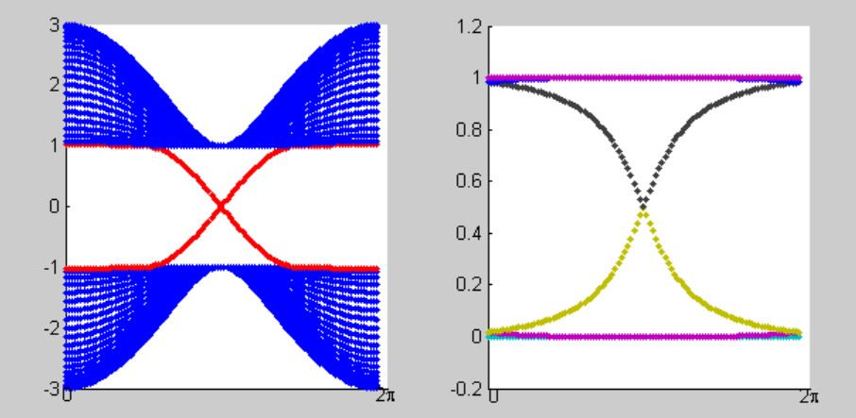


Entanglement entropy
纠缠谱图也可以描述拓扑绝缘体，和它的能谱图类似
$$k_{y}$$
$$k_{y}$$
Ryu & Hatsugai, 2006; Fidkowski, 2010

Slide 11
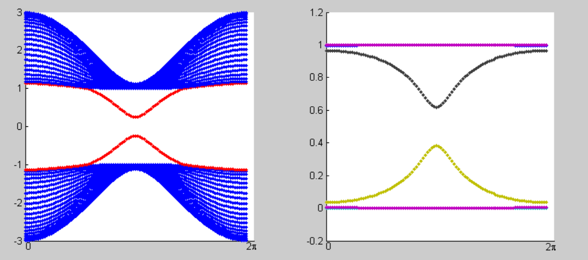
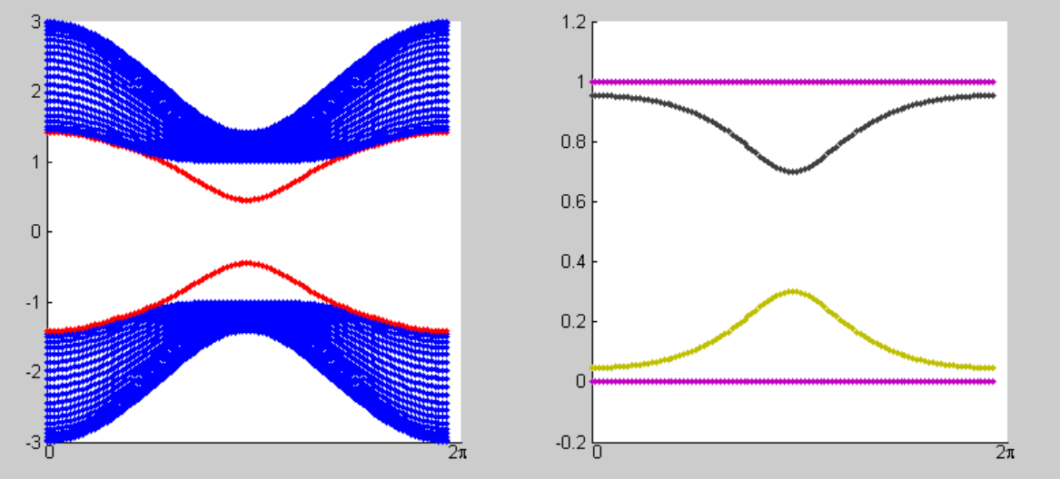
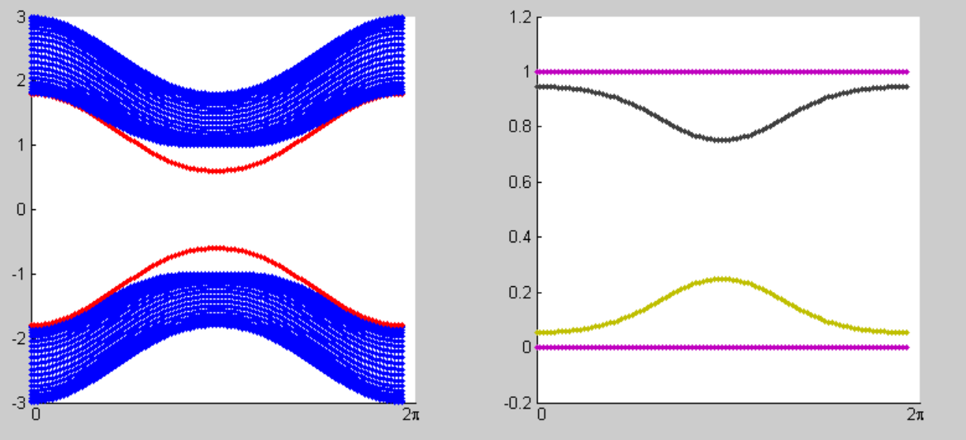
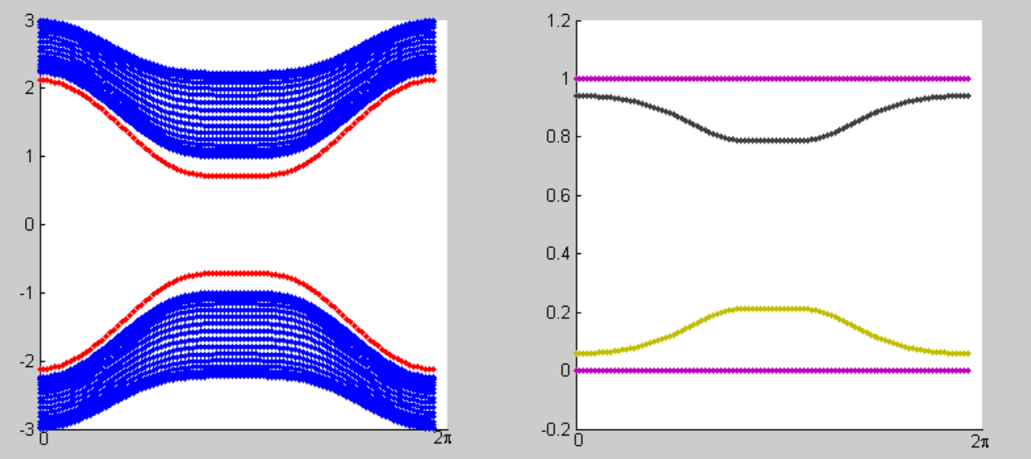


Entanglement entropy
$$k_{y}$$
$$k_{y}$$

Slide 12
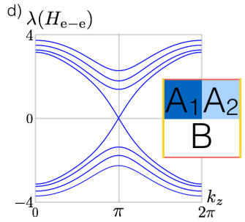
Nested entanglement spectrum
在2d二阶拓扑绝缘体中没有kz
Schindler et al., 2017

Slide 13
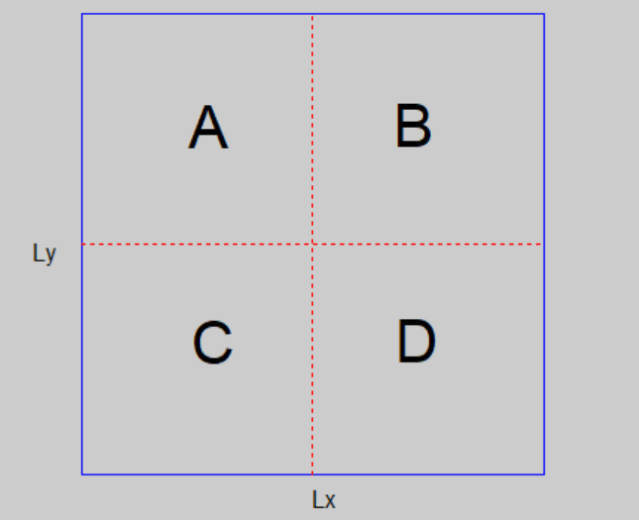
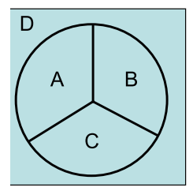
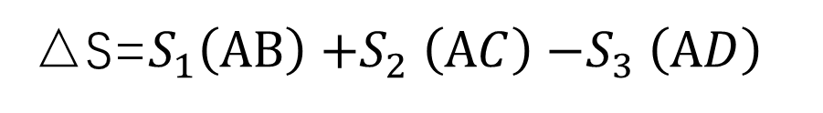

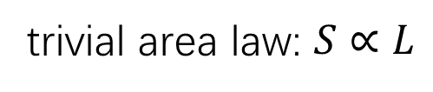
trivial area law: $S∝L$
Multi-partite entanglement entropy
Kitaev & Preskill, 2006
△S=$S_{1}\left(AB\right){+S}_{2}\left(AC\right){−S}_{3}\left(AD\right)$
$$S=αL+ΔS$$

Slide 14
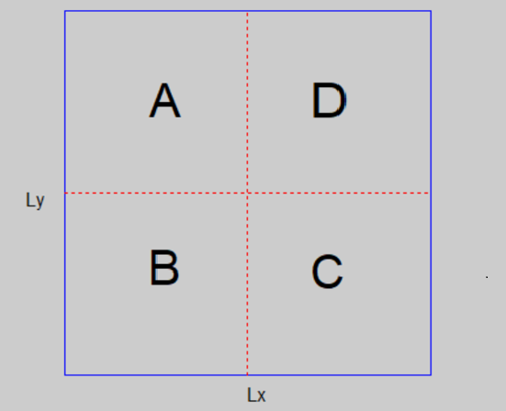
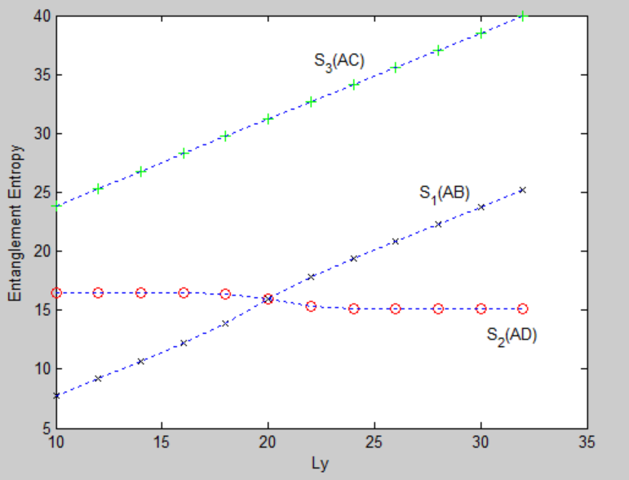
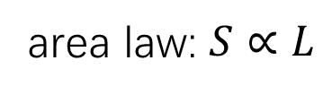
Multi-partite entanglement entropy
Lx=20
area law: $S∝L$

Slide 15
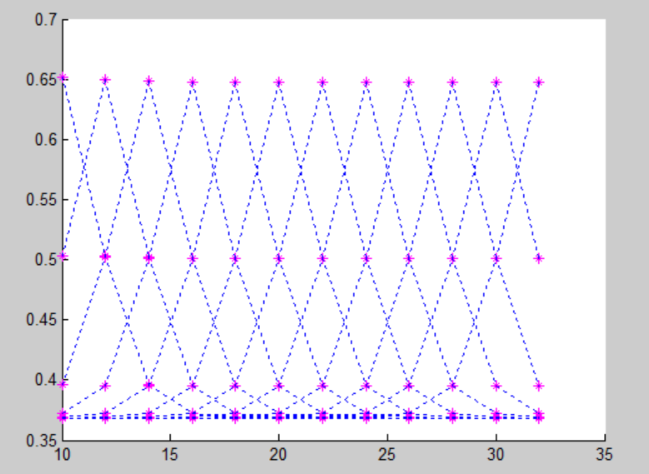
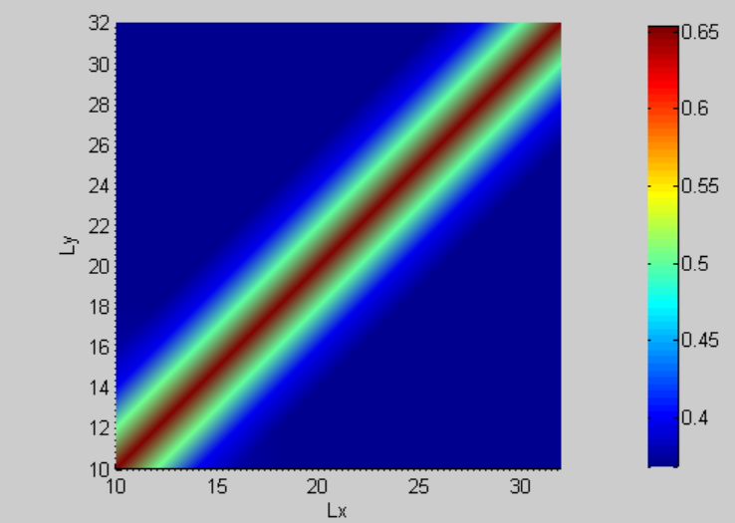
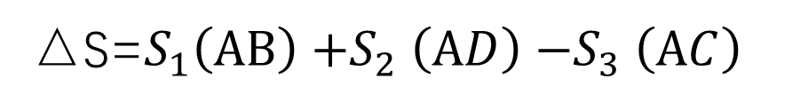
Multi-partite entanglement entropy
△S=$S_{1}\left(AB\right){+S}_{2}\left(AD\right){−S}_{3}\left(AC\right)$
Universal value 0.2797

Slide 16
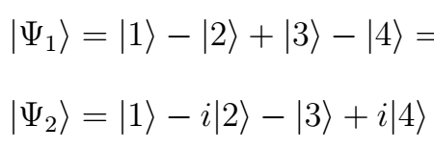

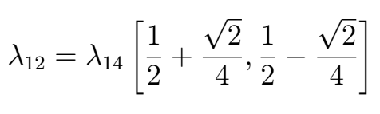
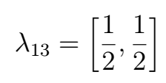

Toy model: 4-sites
4
3
1
2
$$ΔS=0.2797$$

Slide 17

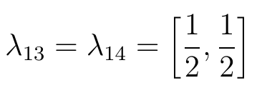


Toy model: 4-sites
4
3
1
2
$$ΔS=0$$

Slide 18

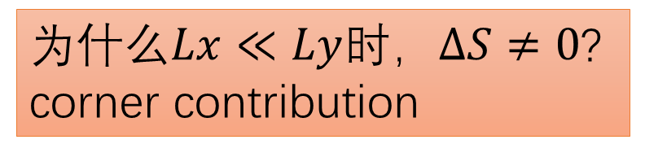
Toy model: 4-sites
4
3
1
2
为什么$Lx≪Ly$时，$ΔS≠0$? corner contribution
$$≠$$
$$ΔS=0$$

Slide 19
Summary
Calculate multi-partite entanglement entropy of a 2d topological insulator.
A universal value is obtained, which is obtained by a toy model.

