Slide 1
Parsing complex constructs for function-based screening
INDEPENDENT RESEARCH PROJECT / WORKING RECORD / 25 OCTOBER 2026
Can decomposing a synthetic DNA construct restore a foundation model's ability to say what is in it?
AUTHOR
EVIDENCE BASE
MEASURED ON
CUT-LINE
Nishit Kalani
29 modules, 64 scripts, 1,065 tests
4 tiers, 18 catalogues
25 Oct 2026
Every figure in this deck carries the catalogue it was measured on and the holdout it was measured at. Those two qualifiers are load-bearing, and the deck states them rather than rounding them away.
Notes:
Working record, not a polished pitch. The deck is built to be read offline by a reviewer who knows code and mathematics and does not need to know biology.

Slide 2
Six measured results, one method contribution, and three refutations of my own proposals
EXECUTIVE SUMMARY
1
THE CENTRAL CLAIM
2
THE DOSE-RESPONSE
3
THE METHOD
A pooled embedding cannot find a payload it is handed
The cost of not decomposing is a dose, not a threshold
The decomposition step needs no labels
Hand mean-pooled ESM-2 the answer, unmasked, inside a 40,750-protein catalogue. On the competing-filler tier it returns the payload at mean rank 6,140, with 35 of 144 constructs past rank 10,000. The clean span returns it at 1.46.
The dose is payload fraction f, the share of the queried reading frame that is actually the payload. It is computable before any retrieval runs, so it stratifies every table here.
Iterative best-hit segmentation uses no motif catalogue and no answer. On the powered tier it moves recall at depth 10 from 35.3% to 94.5%, against a perfect-decomposition ceiling of 94.1%.
4
REAL CONSTRUCTS
5
THE MECHANISM
6
THE DISCIPLINE
Measured on 43 real deposited plasmids, not only on synthetic ones
Change only the filler and the sign reverses between scorers
Three of my own proposals were refuted by the project's own rules
Route B was built because the public corpus is 86% undiluted and cannot test the claim. On it, whole against perfect decomposition is mean rank 81.19 to 7.81 at f below 0.50.
Same payloads, same dilution, same catalogue, same holdout. Random filler is invisible to alignment and fatal to ESM-2: 0.0% recall at depth 10 of 40,750. Decompose first and the reversal is gone, 0 better and 144 equal and 0 worse: it is a property of the query.
A triage gate, a claimed derivation, and a routing recommendation. Each is in the record with the measurement that killed it, because that is what makes the rest credible.
Notes:
The order is deliberate: the negative result about pooling comes first because the whole project exists to measure it, and the self-refutations come last because they are the reason to trust the first five.

Slide 3
Why anyone should care about the format of a DNA order
PART ONE
Gene synthesis screening is one of the few places where a dangerous sequence can be stopped before it becomes a physical molecule. It is also the place where the current method is visibly running out.

Slide 4
Before a sequence becomes a molecule, the provider can check what it encodes
THE CHOKEPOINT
A customer sends a synthesis provider a string of DNA and asks for the physical molecule back. That request is the last moment at which anything can be checked, because once the molecule exists the check has no leverage. So providers screen the string: they compare it against curated databases of sequences of concern, and the question the screen asks is whether some stretch of the order is a best match to an entry on a list of organisms under regulatory control.
Alignment asks a narrow question. It asks whether this string looks like a string we already have. It is fast, it is interpretable, and it is exactly as good as the similarity between the order and the reference. When a sequence is deliberately redesigned, that similarity is what goes away first.
THE ALTERNATIVE
Ask what the sequence does, not what it resembles
A function-based screen compares representations from a protein language model rather than letters. The models already exist and are already used to design proteins, so defence would run on the same advances as design instead of lagging them.
23,760
39.6 to 88.3%
0.5 to 0.8
variants still unflagged by the strongest patched tool in Wittmann et al. 2025, after patching, out of 74,967
of designed variants per protein remain often unflagged, depending on which screening tool is measured
Matthews correlation on 50-nucleotide fragments across four tools, from the 2026 follow-up
Patching helps and does not close the gap. That residual is the opening a function-based method would have to fill.

Slide 5
What is actually inside one synthesis order
READER GUIDE, FOR A REVIEWER WHO READS CODE AND NOT BIOLOGY
A plasmid is a circular DNA molecule, typically a few thousand to twenty thousand letters long, used to carry engineered genes into cells. Think of it as a circular byte string with a header, several payload records, and a lot of machinery that exists only so the string can be copied and selected for. The parts below are concatenated with no delimiters and no manifest.
1
THE THING YOU CARE ABOUT
2
ATTACHED TO THE PAYLOAD
3
REQUIRED MACHINERY
4
THE CONTAINER
Payload, or coding sequence
Tags and linkers
Promoters, terminators, markers
Vector backbone
A stretch of DNA that is translated into one protein. This is the only part a screen cares about. A plasmid may carry one, or several, or a fusion of two joined end to end.
Short extra sequences fused onto the payload so it can be purified, located under a microscope, or cut free later. They are part of the same reading frame, so they dilute it.
Control elements and antibiotic-resistance genes. They are real genes with real sequence, and they are not what the order is for, so they are noise with structure.
The rest of the circle: replication origins and assembly scars. In public annotation this is usually the best-labelled part of the file, which is the first finding in this deck.
WHY THIS IS A COMPUTER SCIENCE PROBLEM
A foundation model expects one complete unit. A real order is a concatenation of many.
A protein language model is trained on single complete proteins, so its representation of an input is a representation of the whole input. Mean-pooling makes that explicit: the model emits one vector per residue and the pipeline averages them into one vector per sequence. Average a payload together with a tag, a marker and a backbone fragment, and the payload's contribution is diluted in proportion to how little of the string it occupies. That proportion is the variable this project calls f, and the entire thesis is that it predicts the failure.

Slide 6
Two papers define the problem, and the second one hedges more than the brief does
WHERE THE GAP IS DOCUMENTED
WITTMANN ET AL., SCIENCE, 2025
FRONTIERS IN BIOENG. AND BIOTECH., 2026
AI-redesigned proteins evade sequence screening
Fragmentation collapses flagging, and the conclusion is hedged
Open-source protein design software generated variants of proteins of concern, and the authors identify a vulnerability where AI-redesigned sequences could not be detected reliably by current tools. They worked with four synthesis providers on patches. Read the figure carefully: four providers, but patched results are reported for three tools, and one carries an asterisk with n = 0.
The follow-up fragments those designs and shows flagging rates fall as the shared subsequence shortens. Its conclusion is this project's starting point: direct prediction of sequence function may be necessary, though how feasible that would be remains unclear. The brief renders may be as becomes. Quoting the hedge is the right foot to start on.
THE FACT THAT SHAPED HOW THIS WORK IS WRITTEN
Kevin Flyangolts, who wrote the project description, is a co-author of the second paper
So the work is answering a gap its own author identified, and a reviewer will recognise the paper immediately. That ruled out explaining the problem back to the person who posed it, and it is why this deck spends its length on measurement and on what failed rather than on motivation.
Both citations were checked against the primary sources rather than taken from the brief. That check changed three things, which is the next slide.

Slide 7
Three claims in the brief and in my own notes did not survive reading the sources
VERIFICATION, 14 TO 17 OCTOBER
Claim as received | What the source actually says | Consequence here
Embedding comparison already beats alignment at low identity | Pantolini et al. reach 0.92 Spearman with EBA, which is per-residue embeddings plus dynamic-programming alignment. The averaged-embedding baseline is 0.46 for ESM. HH-align is 0.82. | The honest comparator for a mean-pooled pipeline is 0.46, not 0.92. This strengthens the case rather than weakening it.
Over 98% of Addgene plasmids contain a leftover gene fragment | pLannotate reports over 98% contain at least one predicted feature fragment, and the median plasmid has 1.7% of its sequence in them. | Write at least one predicted fragment, typically a small one. Reviewers in this field know the paper.
Spicer et al. extend the method | There is no author named Spicer. The paper is Johnson, Peshwa and Sun, eLife 2024, and their one-byte result is a predicted 20-letter structural alphabet, not a quantised embedding. | Cited correctly, and the terminology point was raised by their own peer reviewer.
WHY THIS SLIDE IS IN A DECK ABOUT RESULTS
The project's own thesis is already in the literature, and pretending otherwise would have been caught
Johnson et al. credit Bileschi et al. 2022 with the observation that embedding-based methods struggle to discriminate individual domains of multi-domain proteins. That is the decomposition claim. The contribution here is therefore not the observation. It is the measured dose-response on real constructs and a decomposition step that uses no labels.
The project description is kept in the repository root so that every claim about the original proposal can be checked against the source rather than against a paraphrase of it.

Slide 8
Does decomposing a construct into model-ready units restore a foundation model's ability to say what is in it?
THE QUESTION, IN ONE SENTENCE
Stated this way the question is falsifiable in both directions, and both directions have now been measured. Scoped as integration and evaluation: no new model is trained, and no proprietary or customer data is used.
1
What is the unit?
2
How do you cut without the answer?
3
How do you know it worked?
4
What would falsify it?
A complete protein-coding sequence, as the model expects. Finding it inside a concatenated circular string is the problem.
A screen does not know the payload. Any split must come from the catalogue and the sequence alone, never from a label.
Rank of the correct payload family in a retrieval against a protein catalogue, stratified by how diluted the query was.
A tier where undiluted queries already win, or a decomposition that costs more than it rescues. Both were found and both are reported.
The fourth column is the habit that produced most of this deck. Before trusting a result from a subset, name the case that would falsify it and check whether that subset could have produced the case.

Slide 9
The object, the operator, and a limit that is derived rather than chosen
PART TWO
Three definitions carry the whole project. Stating them precisely is what makes the later tables comparable, and it is where a reviewer should check whether the measurement answers the question it claims to.

Slide 10
The object under study is a circular string with no delimiters
DEFINITION ONE OF THREE
FORMALLY
THE VARIABLE EVERYTHING IS STRATIFIED BY
A construct is a string S over the alphabet {A, C, G, T} with circular indexing, so position i means i mod |S|. Six-frame translation yields candidate open reading frames: three forward frames, three reverse-complement frames, each cut at stop codons. One of those frames contains the payload.
The payload itself is a contiguous substring of the translated frame. Write the frame as q and the payload span as p, a subinterval of q. The project's single moderating variable is their length ratio.
f = |p| / |q|
Payload fraction: the share of the queried reading frame that is actually the payload. f = 1.000 means the frame is the payload and nothing else. f = 0.20 means four fifths of what the model sees is something else.
f uses the label, so it can describe a benchmark item and can never be part of a screening rule. It is computed before any retrieval runs, which is exactly why it is a legitimate stratifier and not a method step.
A ONE-LINE BUG THAT INVALIDATED A WHOLE DISTRIBUTION
f must use the payload-bearing frame, not the longest frame in the plasmid
On 17 October a guard tested for a field name that does not exist, so f was computed against the longest reading frame instead. The tier totals could not have caught it, because both versions produce a plausible distribution. It is recorded as an erratum and the correct quantity is len(arms.orf_seq).
Circularity is not a detail. A feature that crosses the origin is two intervals, internal coordinates are zero-based half-open, and every exported CSV is one-based. Mixing those conventions has produced an off-by-one across an entire tier once already.

Slide 11
The measurable claim is about a decomposition operator and how its output is aggregated
DEFINITION TWO OF THREE
A decomposition operator D maps one queried frame to a set of subintervals, and retrieval returns a rank for the correct payload family. Two things can be varied: how the frame is cut, and how the resulting hit lists are combined. Conflating them cost a wrong headline once, so they are separate arms.
Arm | What D emits | How ranks are formed
whole | One segment, the entire frame q | A single query. The baseline a screen runs today.
auto | Segments from a curated motif catalogue of tags and linkers | Pooled: take the best score per target across segments, then rank once.
auto_per_segment | Same segments as auto | Per segment: rank each query, then take the best rank. One of the two headline arms.
bhs | Segments from iterative best-hit segmentation, label-free | Pooled.
bhs_per_segment | Same segments as bhs | Per segment. The method contribution, and the other headline arm.
oracle | One segment, the true payload span p | The ceiling. Uses the label, so it is a diagnostic and never a deployable arm.
oracle_selected | All bhs segments, but the best one is chosen using the label | Separates finding the right piece from choosing among pieces.
THE AGGREGATION CHOICE IS NOT FREE
Max-pooling across segments costs 345 rank points on a genuinely diluted tier, and 31 on the corpus
Pooling compares one target's best segment score against another target's best segment score, which lets a strong spurious hit on a short segment outrank a moderate correct hit on a long one. The pooled arms are kept only so that the earlier sections of the record stay readable. They are never quoted as the arm's result, and the names auto and bhs are frozen to mean the pooled quantity: add an arm, never redefine one.

Slide 12
Where a decomposition stops is derived from alignment statistics, not chosen
DEFINITION THREE OF THREE
KARLIN AND ALTSCHUL, INVERTED
THE SEGMENTER, IN SIX LINES
S >= ( ln(K m N) + ln(1/E) ) / lambda
Iterative best-hit segmentation
1. Score the frame against the catalogue.
2. Take the highest-scoring hit. If it does not clear the floor, stop.
3. Claim the interval that hit aligned to as a segment.
4. Mask those residues.
5. Repeat from step 1 on what is left.
6. Emit the segments. Their count is k.
Nothing in that loop consults a label, a motif catalogue, or the payload. It consults the catalogue a screen already has, which is what makes it deployable.
The expected number of alignments scoring at least S by chance is E = K m N exp(-lambda S), where m is query length, N is database size, and K and lambda are properties of the scoring system. Fix the query and the database and there is no free variable but S.
So a significance requirement of E <= 1e-3 is exactly a score floor. Measured across this project's 173 payloads that floor is 99.5 to 116.1 in BLOSUM62 units. Select every subject at or above it and truncation becomes structurally impossible: the count above the floor is a number to report, not a limit to defend.
WHY DERIVING THE LIMIT MATTERED MORE THAN CHOOSING IT WELL
The same trick fails honestly on the other two gates, and that failure is informative
Inverting an identity gate or a coverage gate gives a score floor below zero, which excludes nothing, because those gates admit alignments of negative expected score. A fraction-of-length gate also applies wildly different stringency across a 70-fold length range: at 41 residues a 0.40 coverage gate asks for 16 aligned columns, so 40.7% of a 40,750-protein catalogue qualifies as that payload's homolog. Building a holdout mask by identity alone would have held out 41,317 chance alignments, deleting non-relatives from the catalogue and making retrieval look harder than specified.

Slide 13
What the system actually does, in the order it does it
READER GUIDE
1
Parse
2
Call frames
3
Build arms
Read the GenBank record. Treat it as untrusted data: parse it, never execute anything inside it. Recover the depositor's stated insert as ground truth where it exists.
Six-frame circular scan for open reading frames, with origin-crossing features handled as two intervals.
One pass builds whole, auto, bhs and oracle segment sets for the same frame, so every experiment scores identical sequences and no arm gets a different input by accident.
4
Decompose
5
Retrieve
6
Report
Run the segmenter against the catalogue with the derived score floor. Record k, the segment count, and which residues each segment claimed.
Score every segment against the protein catalogue with the chosen scorer, and record the rank of the correct payload family.
Stratify by f, print micro and macro averages, and print a binding count for every limit the run touched whether or not it bound.
Step 6 is the one that found most of the bugs in this deck. A limit nobody reaches is free and can be forgotten; a limit anything reaches is a silent truncation, and it always truncates the remote tail.

Slide 14
What each scorer is, and what it is for
THE FOUR SCORERS
Scorer | What it computes | What it is for here
align | Exact Smith-Waterman local alignment, BLOSUM62, affine gaps, via parasail | The control, and the standard a screen runs today. Local by construction, so it needs no decomposition to find a buried match.
kmer | Hashed 3-mer frequency vector, L2 normalised, compared by cosine | A cheap mean-pooled baseline that runs on a CPU. It knows nothing about homology beyond shared 3-mers, so it sits below the published averaged-embedding comparator.
esm2 | ESM-2 650M per-residue embeddings, mean-pooled to one vector, compared by cosine | The arm the thesis is about. Pooling is the mechanism under test, not an implementation shortcut.
eba | Affine-gap Smith-Waterman over a cosine substitution matrix built from per-residue embeddings | The proposed fix: keep the alignment, replace the letters with embeddings. This is the published method that reaches 0.92 Spearman.
WHY THE EMBEDDING ARM IS THE HARD ONE
THE HYBRID THAT MAKES THE COMPARISON FAIR
Mean-pooling is a deliberate, published, widely used choice
Segment with alignment, retrieve with embeddings
The segmenter's stopping floor is in BLOSUM62 units. Hand it an embedding scorer and every construct stops at k = 0, because a cosine never reaches a floor of 99.5. So a flag was added to let segmentation stay on exact alignment while retrieval runs under the embedding model. Its acceptance test is a no-op: with both set to alignment it must reproduce the alignment run cell for cell.
Most retrieval pipelines built on protein language models reduce a sequence to a single vector, because then a search is a nearest-neighbour lookup and scales to millions of entries. That reduction is exactly what destroys a multi-part construct. The honest published comparator for it is 0.46 Spearman against structure, where embeddings plus alignment reach 0.92 on the same data.

Slide 15
Each tier covers the others' weakness, and they are never pooled into one number
FOUR TIERS OF EVIDENCE
Tier | n | Ground truth | What it is for, and what it cannot do
Hand-audited | 23 | The depositor's stated insert | Realism, and the anchor every rule is validated against first. Too small for power.
NCBI corpus | 410 | Alignment, gated, 80% validated | Breadth and statistical power. Median f is 1.000 and only 5.2% sits below f = 0.70, so it cannot test dilution at all.
Synthetic | 336 | Exact by construction | The architectures the corpus lacks, with dilution as an independent variable. Median f 0.600, 64.3% below 0.70. Constructed, so it bounds rather than measures.
Route B | 43 | Swiss-Prot payload, identity 0.856 floor | Real deposited plasmids chosen to be diluted. Median f 0.590, 63.0% below 0.70. The only tier that is both real and inside the regime.
138
0
18
distinct payloads carry the corpus's 410 constructs, and one payload appears in 37 of them. So constructs are not independent trials, and every table reports micro and macro.
2A peptides in the corpus, against 33 tagged fusions. The corpus cannot test the architectures the project is about, which is why the synthetic tier exists.
constructs over 14 distinct payloads is the project's effective sample for its central claim on measured data. That number is quoted beside any result drawn from f below 0.70.
Route B exists because of the second fact. A corpus null is a measurement of the sampling frame until it is stratified by f, and no aggregate statistic will show an effect in a population dominated by items the effect cannot act on.

Slide 16
One variable decides whether the effect can appear at all, and it is computable before any retrieval runs
THE METRIC DECISION, 17 OCTOBER
The decision was taken by the project owner rather than by me, and it governs every table from that date. It exists because a pooled headline hid a real effect behind a saturated population: pooled recall at depth 10 moved by 1.0% while the f below 0.50 stratum moved by 40.0 points.
1
Mean rank and MRR, stratified by f
2
recall@10 as the operational secondary
Strata 0.50, 0.70, 0.95. These are the only figures that move monotonically with dilution and do not saturate.
It reads as an analyst reviewing ten hits sees it. Depth 10 was measured against 1, 5, 10 and 25, and 10 and 25 give the identical winner set, so the preference for 10 is a stated assumption about review practice and not a derivation.
3
Top-1 is a column, never a headline
4
No pooled scalar across strata, ever
It is blind to the two largest gains in the corpus, both of which score zero, and it credits a four-residue trim that broke a near-tie.
There is no depth at which this result survives pooling. For an embedding arm, mean rank is additionally quoted only beside its count of rank >= 10,000 failures, because the distribution is bimodal.

Slide 17
What was measured, with the catalogue and the holdout attached to every number
PART THREE
The findings are ordered by how much work it took to make them trustworthy, not by how impressive they sound. Two of them are negative and one of those is the most useful thing in the deck.

Slide 18
What decomposition recovers is close to linear in how diluted the query was
FINDING ONE, THE QUANTITATIVE CORE
Dilution band | n | Whole | Oracle | Recovered
0.0 to 0.1 | 11 | 0.912 | 0.918 | +0.006
0.1 to 0.3 | 4 | 0.856 | 0.916 | +0.060
0.3 to 0.6 | 2 | 0.728 | 0.861 | +0.133
0.6 to 1.0 | 3 | 0.570 | 0.711 | +0.140
THE EXCLUSION THAT KEEPS THE FIT HONEST
One point is excluded, and it was excluded in writing before the run
Construct 171782's reference protein is a 3,054-residue polyprotein, so cosine against it tracks query length rather than identity. That was recorded in the manifest before the run rather than after seeing the result.
With the point included the fit is slope 0.24, r = 0.65. Both are plotted and both are reported. An exclusion decided after seeing a fit is a different operation from one decided before, and only the second is a measurement.
Dilution is one minus f: the fraction of the queried frame that is not the payload. The quantity recovered is the cosine similarity to the correct payload that decomposition gives back.
Fitted across 19 plasmids: cosine recovered = 0.35 x dilution, r = 0.98.
WHY A DOSE-RESPONSE AND NOT A THRESHOLD
A threshold would mean decomposition matters below some dilution and not above it. It does not work that way.
The effect is continuous and monotone in dilution, which is a far stronger claim than a cut point, because it predicts the size of the effect on a construct nobody has measured yet. It is also why every later table is stratified rather than averaged: an average over a population that is mostly undiluted reports the sampling frame, not the effect.

Slide 19
Two constructs at the same dilution, opposite outcomes, and the difference is a motif
FINDING TWO, THE SINGLE BEST EXHIBIT
CONSTRUCT 73037, DILUTION 0.744
CONSTRUCT 108653, DILUTION 0.735
Motif rules solve it completely
Motif rules are blind to it
Nluc joined to copGFP joined to PuroR by two 2A peptides. Cutting at the two motifs is the whole of the fix. Payload rank 50 to 1, cosine 0.512 to 0.725 to 0.761 at the oracle.
The other two segments correctly find their own best matches rather than the payload, which is the behaviour you want: each piece retrieves what it actually is.
The PicchuEV biosensor is a direct multi-domain fusion with no motif anywhere. Payload rank 21, unchanged at 21 after motif decomposition, and 1 at the oracle. Cosine 0.568, unchanged, then 0.862.
The boundary is real and the rules cannot see it, because there is no linker to see. Same dilution as the construct on the left, opposite result.
WHAT THE PAIR ESTABLISHES, STATED AS A MEASURED GAP
Motif rules recover 6 of the 8 audited fusions and are blind to the 2 that carry no motif
This is the argument for a decomposition step that is learned from sequence rather than written down as rules, and it is an argument from a measurement rather than from an assertion. A test exists specifically to fail if anyone later papers over construct 17551, the milder version of the same failure, with a heuristic that guesses at boundaries.
The label-free segmenter introduced later in this deck is the answer to this slide: it finds the boundary in 108653 from the catalogue rather than from a motif, which is why it is the method contribution and the motif arm is not.

Slide 20
Hand a pooled embedding the answer, unmasked, and it still cannot find it
FINDING THREE, THE SHARPEST MEASUREMENT IN THE PROJECT
This is a 100% holdout, which means nothing is hidden: the correct payload protein is sitting in the catalogue, unmasked, and the query is the whole reading frame that contains it. There is no remoteness in this measurement at all. Only dilution.
6,140
1.46
6 of 144
mean rank of the correct payload under mean-pooled ESM-2, querying the whole frame, on the competing-filler tier: 144 constructs, 35 of them past rank 10,000 of 40,750
mean rank of the same payload when the query is the clean payload span instead of the whole frame, on the same 144
is all the whole frame recovers at depth ten, against 144 of 144 for the clean span. The representation is not degraded, it is uninformative
WHY THIS IS THE LOAD-BEARING RESULT
AND THE CONTROL THAT TURNED INTO THE NEXT SLIDE
It separates dilution from remoteness completely
The filler is not incidental here, it is the variable
Every other result in the field can be explained by the match being faint. This one cannot: the match is exact and present. The only thing wrong with the query is that the payload is a minority of it. That makes dilution a sufficient cause of failure on its own.
The obvious control is to replace the non-payload material with random sequence and check the effect survives. It does not merely survive. It changes sign between scorers, which is the sharpest thing in the project and is the next slide.

Slide 21
Hold everything fixed and change only the filler: the sign reverses on exactly one scorer
FINDING THREE B, MEASURED 20 OCTOBER
The synthetic tier was built twice over the same 336 constructs: same payloads, same payload and frame lengths residue for residue, same catalogue, same holdout. Only the non-payload residues differ, random sequence against real Swiss-Prot protein. Dilution is matched exactly, so the filler is the only variable.
Scorer, whole-frame query | Random filler | Real protein filler | Paired, random vs real
Exact Smith-Waterman | 100.0% | 86.8% | 63 / 81 / 0 worse
Mean-pooled 3-mer composition | 50.0% | 44.4% | 103 / 27 / 14
Mean-pooled ESM-2 | 0.0% | 4.2% | 16 / 0 / 128 worse
Recall at depth 10, holdout 1.00, f below 0.50: 144 constructs over 24 payloads at exactly 6 each, so micro and macro are identical. The clean-span control is 144 of 144 in all six cells and identical construct by construct, which is what makes this a measurement.
ALIGNMENT
ESM-2
Random filler is literally invisible
Random filler is chance
The whole-frame query is bit-identical to the clean-span query on all 336 constructs, every f, same rank. Sequence that produces no alignment contributes nothing at all. The 19 constructs alignment does lose are lost to real protein competing for the rank.
Median rank 19,170 against a chance median of 20,375, with 109 of 144 past rank 10,000. Mean and median agree, so this arm has collapsed uniformly rather than splitting into two modes, and the mean is describing the centre.
Pooling depth does not order these three. The 3-mer arm pools just as hard as the language model and moves with alignment. What separates ESM-2 is that it is the only contextual representation of the three: a payload residue's embedding depends on its neighbours before any pooling happens.
Notes:
This is the result that turns the thesis from a claim about averaging into a claim about contextuality. It also says the worst case is scorer-dependent: competing real protein for alignment, random sequence for an embedding arm. Both are benign sequence, which is how the robustness question gets answered without red-teaming.

Slide 22
Decompose first and the reversal is not reduced, it is gone
FINDING THREE C, MEASURED 21 OCTOBER
Same 144 constructs, same 24 payloads, same catalogue, same 100% holdout, same two tiers. The only change is that the query is the segments the label-free arm claims rather than the whole frame.
Arm and scorer | Random filler | Real protein filler | Paired, random vs real
Whole frame, Smith-Waterman | 100.0% | 86.8% | 63 / 81 / 0 worse
Whole frame, mean-pooled ESM-2 | 0.0% | 4.2% | 16 / 0 / 128 worse
Per segment, Smith-Waterman | 100.0% | 100.0% | 0 / 144 equal / 0
Per segment, mean-pooled ESM-2 | 100.0% | 100.0% | 0 / 144 equal / 0
NOT A SMALLER GAP
STATED AS AN INVARIANCE
No gap at all, construct by construct
Does a payload's rank vary across its own 14 constructs?
The embedding arm goes from recall at depth ten of 0.0% to 100%, and the 1,831,284-point sign reversal goes to exactly zero. So the filler effect is a property of the whole-frame query and not of the representation. A mean-pooled embedding is catastrophically sensitive to what a payload is embedded with. It is not insensitive to the payload.
Whole frame with real protein filler: alignment varies on 15 of 24 payloads at the 100% holdout and 23 of 24 at the 70% one. With random filler, 0 of 24 at both. The language model varies on 24 of 24 under either filler. Per segment it is 0 of 24, both scorers, both fillers.
So local alignment is sensitive only to filler that scores, and a pooled embedding to filler that is merely there. Both are properties of the query. Limits, because this is the deck's most load-bearing robustness claim: one synthetic tier, 24 payloads, payloads that are contiguous blocks with exact boundaries, and it does not hold at the 25% holdout, where the filler still moves 4 constructs of 336.
Notes:
This is the cell the 20 October window was missing and it inverts how the previous slide should be read. The previous slide says the worst case is scorer-dependent; this one says both worst cases are whole-frame phenomena, so a pipeline that decomposes before it queries has nothing left to attack on this tier at five of six holdouts. That is the benign robustness claim red-teaming would have bought, measured, with the payload and the dilution held fixed and only the filler swapped.

Slide 23
What a pooled embedding is sensitive to is the dilution of the query, not of the construct
FINDING THREE D, AND IT MOVES THE THESIS
One decomposition does not remove the filler. The motif split, which cuts at cleavage sites, tags and linkers rather than at catalogue hits, still carries the effect. Tracing which splits is what turned the result above into a mechanism, and it refuted my own first explanation: splits that leave up to 9.6% filler inside a queried segment carry exactly zero effect. What carries it is the absence of a split.
Purity of the query | n | Payload fraction | Recall at ten, rnd / real | Net rank points
0.20 | 24 | 0.20 | 0.000 / 0.000 | -305,780
0.40 | 24 | 0.40 | 0.000 / 0.042 | -352,053
0.60 | 24 | 0.60 | 0.083 / 0.667 | -159,487
0.80 | 24 | 0.80 | 0.708 / 0.833 | -231
0.90 and above | 240 | 0.20 to 1.00 | 0.967 / 0.967 | exactly 0
AND PAYLOAD FRACTION IS CONTROLLED
A fourfold change in dilution moves the decomposed arm not at all
On the undecomposed architecture purity equals payload fraction, so that subset alone cannot separate the two. The multi-gene cassettes span the same four payload fractions at a purity that barely moves: recall at depth ten of 0.917 at every one of the four, net exactly zero at every one. Over the same range the undecomposed arm runs 0.000 to 0.708.
Mean-pooled ESM-2, motif decomposition queried per segment, 100% holdout, 40,750-protein catalogue, random filler against real protein. Purity is payload residues divided by residues handed to the scorer. Mean rank is not quoted: an embedding mean is admissible only beside its count of rank 10,000 failures.
WHAT THIS CHANGES ABOUT THE CLAIM
The quantity that predicts failure is one a pipeline controls
The brief, and this deck until now, states the problem as a property of the construct: it is too diluted for the model to recognise what is in it. It is not. It is a property of the sequence handed to the model, and a decomposition step changes that without touching the construct. Which is why the honest claim is a segmentation that isolates the payload helps, and not decomposition helps.
Notes:
Four measured points and a floor, not a located threshold: the tier's purity distribution is empty between 0.842 and 0.904, so nothing here says where in that gap the effect ends. One synthetic tier, five architectures, 24 payloads. It transfers to the real corpus only as a hypothesis, because 86 per cent of that corpus sits at payload fraction 0.95 and above, where purity and payload fraction are both near one and none of this would be visible. The architecture carrying the whole residue is the one built with no cleavage site, no tag and no linker for the motif catalogue to cut at.

Slide 24
A whole-construct query hides genes the construct actually contains
FINDING FOUR, NOT ANTICIPATED
Construct | Segment | Protein | Whole rank | Segment rank
63155 | 1415 to 1656 | GFP | 186 | 1
85400 | 1668 to 1909 | GFP | 438 | 1
CORRECTED 14 OCTOBER, AND THE CORRECTION MATTERS
This is a statement about embeddings, not about screening in general
A coding sequence carried downstream of a 2A peptide inside a long fusion frame gets its own query only after decomposition. Before it, the pooled embedding averages it away: cosine 0.583 against 0.969 for the same protein.
So decomposition is not only accuracy for the declared payload. It is coverage for sequence that the declared payload hides.
The alignment arm finds the same hidden genes in the whole frame at rank 2 to 3 with no decomposition at all, because Smith-Waterman is local and a 242-residue GFP aligns just as well inside a 1,909-residue chain.
Stated correctly the finding is stronger, because it attaches the problem to the method the project is building rather than to screening at large.
THE SAME CORRECTION, APPLIED AGAIN ON 17 OCTOBER
Alignment is not immune to dilution either. It is immune to the dilution the corpus happens to contain.
On the corpus at 0.50 <= f < 0.70, local alignment goes 21.4% macro top-1 for the whole frame against 71.4% for the clean span, and mean rank 44.00 against 2.20. The claim that alignment finds co-encoded genes without help holds at high payload fraction and not in general, and the condition is now stated every time the claim is.
Both payloads here are benign fluorescent reporters, and the project works only on benign constructs: reporters, common tags, standard enzymes, standard vectors. Nothing pathogen-derived or toxin-derived is fetched, built or analysed.

Slide 25
The cost of not decomposing is zero at high identity and six plasmids wide in the twilight zone
FINDING FIVE, THE CENTRAL CLAIM
Under exact Smith-Waterman, with the holdout swept from 100% to 25% identity, the clean span and the called frame are level where the match is exact and six plasmids apart where it is faint. Faint is where screening operates, and the figure is never quoted without its catalogue and its gate.
Catalogue | Gate | Gap at 25% holdout | What the qualifier changes
8,337 proteins | ungated, top-400 | +6 of 19 | The headline figure. Both limits in this row were later found to bind.
34,159 proteins | ungated | +4 of 19 | A larger catalogue makes the task harder for both arms, so the gap narrows.
40,750 proteins | E <= 1e-3 score floor | +4 of 15 | Under the derived floor the paired comparison shows the drop is five removed constructs, not one changed rank.
THE PAIRED TEST IS THE STRONG FORM
EIGHTEEN CATALOGUES ARE IN PLAY
Zero rank changes among the 15 constructs scorable under both conditions
Every count carries the reference set it came from
The first comparison measured whole against oracle across two different construct sets, which sums a sample change and an effect change into one number. Re-run paired, on only the constructs present in both, the gate changes nothing at all. That is a stronger claim than the one originally made, and it was only visible because the subset question was asked.
A denominator has been silently carried between catalogues more than once in this project, which is the same class of error as computing the two sides of a ratio differently. The register is explicit: add a row rather than reuse a number. Catalogues here range from 1,000 to 100,685 proteins, and two of them are family-structured rather than random.

Slide 26
A sixteenfold size sweep, with a control for who else is in the catalogue
WHAT THE GAP ACTUALLY DEPENDS ON
The obvious confound for any retrieval result is catalogue size: a bigger haystack makes every method look worse, and it would be easy to report a size effect as a method effect. So size was swept from 10,286 to 160,000 proteins, and the structure of the decoys was controlled separately.
THE SIZE SWEEP
THE CONTROL THAT CHANGED AN INTERPRETATION
The gap grows with catalogue size, and sublinearly
Family structure is worth about 1.6 times the size
Across 10,286, 20,000, 40,000, 80,000 and 160,000 proteins the whole-frame arm degrades faster than the clean-span arm, so the quantity the project reports grows rather than shrinks as the catalogue approaches a realistic size. That direction matters: it means the measurement is conservative at the sizes used here.
A catalogue grown from the payloads' own homolog families is roughly 1.6 times size-equivalent harder than a random catalogue of the same size. Two catalogues here are built that way, and before the control existed that difficulty was being read as a size effect.
THE GENERAL LESSON, WHICH RECURS FOUR TIMES IN THIS DECK
Derive the limit against the condition that actually matters, and report how many items hit it
Fifteen limits in this project have silently truncated a measurement: a length window that bound on 3 of 173 payloads, a hit cap that bound on the remote tail which is all the hardest holdout sees, a coverage denominator computed differently on each side of a ratio, a model length cap that truncated Cas9 to 74.7% while Cas9 carried 2 of the 6 headline rescues. Every one was reasonable when chosen, bound on a small minority, was invisible in every output, and bit at the remote end where the measurement operates. One line of reporting at construction time would have caught the entire class.

Slide 27
The decomposition step can be label-free, and that is the part that is new
PART FOUR
An oracle that uses the answer measures a ceiling. It is not a method. The question that decides whether any of this is deployable is whether a screen can find the boundary without being told where it is.

Slide 28
Iterative best-hit segmentation reaches the perfect-decomposition ceiling without using any label
FINDING SIX, THE METHOD CONTRIBUTION
Tier and condition | n | Whole | Label-free | Oracle ceiling | Paired test
synth_competing, depth 10 | 238 | 35.3% | 94.5% | 94.1% | 141 to 0, p = 7.2e-43
synth_competing, top-1 | 238 | 18.5% | 88.7%
synth_competing, mean rank | 238 | 375.7 | 3.41
at f below 0.50 |  | 7.8% | 94.1%
WHAT LABEL-FREE MEANS PRECISELY
REACHING THE CEILING IS THE SURPRISING PART
The segmenter consults the catalogue, never the answer
94.5% against the oracle's 94.1%
It takes the best remaining hit above the derived score floor, claims the residues that hit aligned to, masks them, and repeats until nothing clears the floor. A screening provider has the catalogue and the floor. It does not have the payload. So every input to the loop is something the deployment actually has, which is what separates this from the oracle.
The label-free arm is not merely close to perfect decomposition on this tier, it is level with it. That does not mean the segmentation is identical to the truth. It means the places where it differs do not cost retrieval anything, because a segment that contains the payload retrieves the payload whether or not its boundaries are exact.
Reported from the per-segment arm, never the pooled one. The pooled version of the same segments is worse by 345 rank points on this tier, and the two were separate arms from the day that was measured.

Slide 29
Decomposition does not improve an average. It removes a variable.
FINDING SEVEN, AND IT IS THE STRONGEST ONE
336 synthetic constructs over 24 payloads, 14 each, so micro and macro are identical and the effective sample is 24 payloads. Within a payload only the architecture and the dilution change. So the question is not what the average rank is, but whether the rank depends on what the payload was embedded in at all.
Holdout | Arm | Payloads whose rank varies across their own 14 constructs, alignment | Language model
100% | Whole frame | 15 of 24 | 24 of 24
100% | Label-free, per segment | 0 of 24 | 0 of 24
70% | Whole frame | 23 of 24 | 24 of 24
70% | Label-free, per segment | 0 of 24 | 0 of 24
25% | Whole frame | 17 of 24 | 17 of 24
25% | Label-free, per segment | 1 of 24 | 4 of 24
WHAT THAT MEANS, STATED CAREFULLY
AND THE OPERATIONAL NUMBER BESIDE IT
At the two looser holdouts the architecture and the dilution have no effect whatever on the rank
At a 100% holdout the answer is in the catalogue at full identity
Five architectures, dilution from 0.00 to 0.80, and once the construct is decomposed the rank becomes a property of the payload, the catalogue and the holdout alone. This deck stratifies by payload fraction because payload fraction moderates the effect. After decomposition it moderates nothing, and an invariance is a stronger claim than any mean.
Nothing is held out, so neither the holdout nor the segmenter is in the causal path and dilution is the only variable. The mean-pooled embedding of the whole frame still misses the top ten on 189 of 336 constructs, 147 of 336 found against the label-free arm's 336 of 336. Alignment loses 19 and recovers those too.
Synthetic tier only: the payload is a contiguous block with exact boundaries, and the corpus has a median payload fraction of 1.000, so there is nothing in it to decompose. One further observation, a motivation and never a result: at the 25% holdout this arm exceeds the labelled oracle, by 1 construct under alignment and 15 under the language model, because a sub-span can beat the whole payload at 25% identity. In sample, one tier, so it argues for building a sub-segment reference database, not about one.

Slide 30
A holdout threshold is an upper bound on what is available, not a description of it
THE ONE FAILURE LEFT, AND WHAT IT TURNED OUT TO BE
At the 70% holdout the label-free arm under the language model is short by exactly one payload, on all 14 of its constructs, at a constant rank of 591 against alignment's rank 1. A rank identical across five architectures and five dilution levels cannot be a dilution effect.
WHAT IT ACTUALLY IS
AND THE SEPARATION IS CLEAN
P09751's homolog family has a hole in it
The single failure is the single most remote payload
Its gated homolog identities run 1.000, 0.989, 0.952, 0.893, 0.871, and then nothing until 0.268. So a holdout that masks everything above 0.70 leaves this payload a 27% relative, while it leaves the other 23 payloads something between 0.34 and 0.70. It is a 25% holdout wearing a 70% label.
Ordered by the best identity the holdout actually leaves, this payload is first of 24 at 0.268, the next is at 0.340, and the remaining 22 sit between 0.47 and 0.70. Every one of the 23 above 0.34 is found; the one below it is missed. That sub-count was 21 until the quantity was computed rather than described, which is 1 + 1 + 21 = 23 for a set of 24.
THE TWENTY-THIRD BINDING LIMIT, AND THE FIRST TO BIND ON THE HOLDOUT ITSELF
Report the best identity a holdout leaves, per payload, beside the holdout
Holdout 0.70 means nothing above 0.70, not something near it, and which it means is a per-payload property no output here printed. It is now a computed column rather than a recommendation, and run on these 24 payloads it reports a class rather than an anecdote: the 70% label overstates by a full step of this sweep on 3 of them and the 90% label on 4.
So the two failure modes separate on the holdout, and only the first is what decomposing is for: it removes dilution completely and does not remove remoteness. This ordering explains nothing at the 25% holdout, where available identity is pinned against the threshold, and claiming it for both ends would repeat this deck's own refuted mechanism.

Slide 31
One label-free signal is a usable triage rule, in one direction only
FINDING SIX B, THE DEPLOYABLE PART
THE SAFE DIRECTION
THE UNSAFE DIRECTION, STATED EVERY TIME
High best-hit coverage rules dilution out
Low coverage does not rule dilution in
best_hit_cov is the fraction of the called frame claimed by the single top-scoring catalogue hit. At or above 0.65 it rules dilution out with negative predictive value 0.996, 1.000 and 1.000 across the corpus, the hand tier and the hardest synthetic condition. A provider could use it to skip decomposition on the constructs that do not need it, which is most of them.
Specificity falls from 0.903 in sample to 0.583 on real constructs, and every false positive has the same shape: a long multi-domain payload whose remote homolog matches one domain. The signal is reported as a one-directional rule, and the slide that tried to use it in the other direction is later in this deck, under refutations.
DEPLOYABILITY IS NOT FREE EVEN WHERE THE METHOD WORKS
The per-segment arm issues one query per segment, 2.28 per construct on real data and up to 7
A provider reviewing hit lists sees k of them rather than one, so the precision cost is real and is stated rather than hidden. The decomposition removes catastrophic failures; it does not make screening cheaper. The honest framing is that it buys recall at the cost of review volume, and the triage rule above is what keeps that volume down on the undiluted majority.
The 0.65 threshold was chosen on the same data it was then evaluated on, and the record says so in those words. That is the same error as tuning a threshold, wearing the other hat.

Slide 32
Both dose-responses, drawn from the committed measurement files
THE SAME SHAPE, TWO TIERS, TWO QUANTITIES
Left: what decomposition recovers on the hand tier, as cosine similarity to the correct payload. Right: what it recovers on 43 real deposited plasmids, as mean rank in a 25,402-protein catalogue. Different tiers, different quantities, the same monotone relationship in payload fraction.
HAND TIER, COSINE TO THE CORRECT PAYLOAD
ROUTE B, MEAN RANK AT THE 25 PER CENT HOLDOUT
TWO THINGS TO READ OFF THE RIGHT-HAND CHART BEFORE BELIEVING IT
The last pair is a control with no gap by construction, and the n values differ from the gate table
At f 0.95 and above the clean span is the called frame, so the two bars are identical at 19.33 rather than close: that pair is a control and it reads as one. And this chart is drawn over 46 scored pairs including three second payloads, where the decomposition-gate table earlier in this deck uses the 43 primary rows, one per file. That is why 0.50 to 0.70 reads 28.62 here and 28.20 there. Same measurement, two row sets, and the denominator is stated rather than reconciled silently.

Slide 33
The gap grows with catalogue size, and a family-structured catalogue sits above a random one
THE OBVIOUS CONFOUND, MEASURED
Plotted: whole-frame mean rank minus clean-span mean rank at the 25 per cent holdout. A bigger haystack makes every method look worse, so the question is whether this is a method effect or a size effect. It grows with size, so the figures quoted here are conservative.
WHAT THE SECOND SERIES CONTROLS FOR
WHY THE GAPS ARE MISSING IN PLACES
Family structure is worth roughly 1.6 times the catalogue size
The two series are different catalogues, not one swept twice
A catalogue grown from the payloads' own homolog families is harder than a random catalogue of the same size, because the decoys are relatives. Before this control existed, that difficulty was being read as a size effect.
The random-decoy series is a deliberate sixteenfold sweep. The clustered series is four real catalogues that happen to differ in size, so neither series has a value at the other's sizes.

Slide 34
The label-free arm closes the whole gap on every tier that has one, and the control has none to close
THE METHOD CONTRIBUTION, DRAWN
Recall at depth ten, exact Smith-Waterman. The third group is the one that makes the other three worth reading: a synthetic tier built with random filler, where there is no gap for the method to close and the method manufactures none.
READ THE FOURTH GROUP AGAINST THE THIRD
On competing filler the label-free arm is one construct above the ceiling. On random filler it is exactly level with the whole frame.
That pair is the mechanism test. If decomposition were manufacturing gains out of the act of cutting, the random-filler tier would show a gain too, and it shows none at any stratum. The hand and corpus tiers close their gaps as well, but they are 2 to 0 and 3 to 0 paired and therefore underpowered; the competing-filler tier is 141 to 0 at p = 7.2e-43.

Slide 35
Recall at depth ten on real deposited constructs, which is what an analyst reviewing ten hits sees
THE OPERATIONAL METRIC, DRAWN
WHY THIS CHART IS THE OPERATIONAL ONE
AND WHERE IT SATURATES
Mean rank moves by a factor of ten. Recall at depth ten moves by nineteen points.
At f 0.70 and above both arms reach 100 per cent
Both are true and they answer different questions. Mean rank says how far down the list the answer sits on average, and one catastrophic construct moves it a long way. Recall at depth ten says how often an analyst who reviews ten hits would see the answer at all, which is the question a provider actually faces.
Which is exactly why the project forbids a pooled headline across strata. Average these four groups together and the effect disappears into two saturated strata, and the number that comes out describes the sampling frame rather than the method.

Slide 36
The figures the runs actually wrote
PART THREE C
Nothing on the next twelve slides was drawn for this deck. These are the PNGs the measurement scripts emit, cropped and downsampled and otherwise untouched, including the caveats each figure prints about itself. Where a figure and a slide disagree, the figure is right.

Slide 37
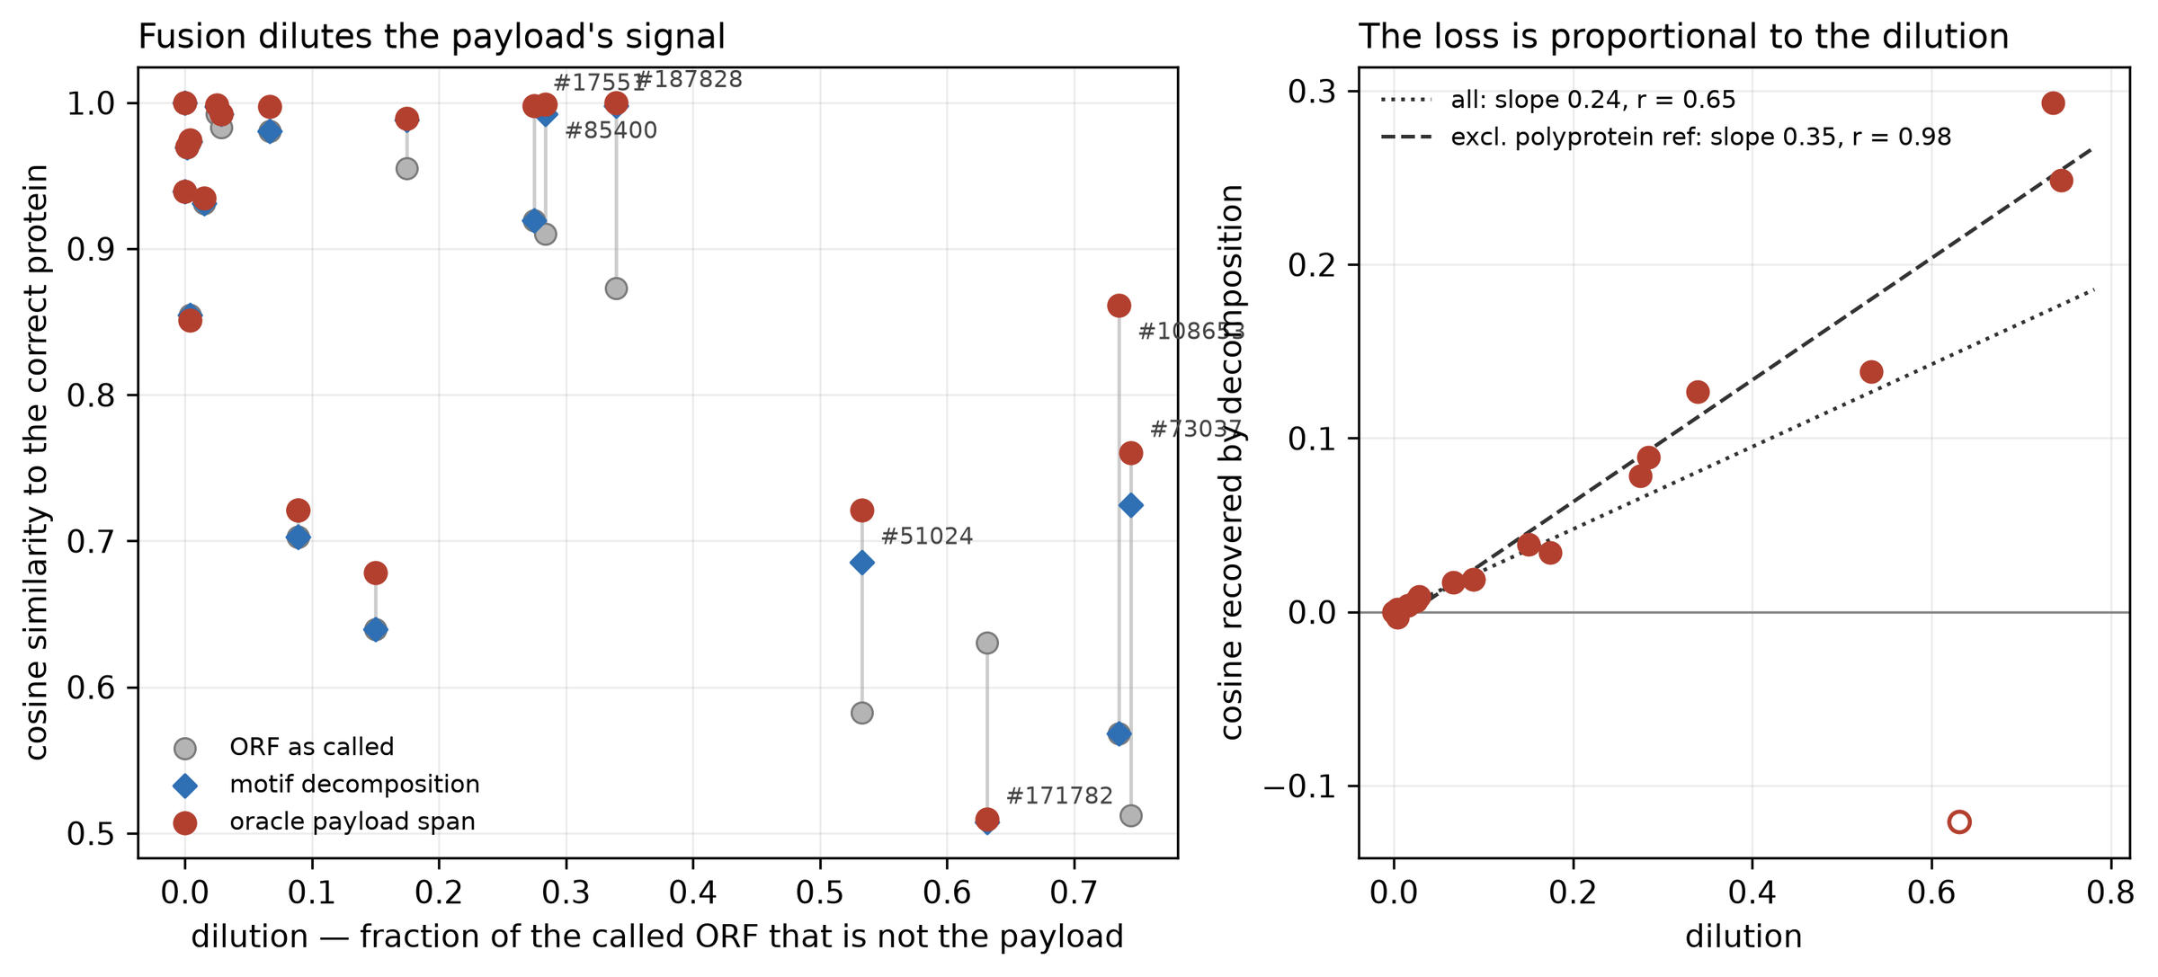
Dilution costs signal, and the loss is proportional to the dilution
WHERE THE PROJECT STARTED
WHAT THE TWO PANELS ARE
Left: every hand-audited construct, twice. Right: the difference, against how diluted it was.
Each vertical pair on the left is one plasmid queried two ways: the open reading frame as a gene caller returns it, and the clean payload span the depositor describes. The vertical distance is what the surrounding sequence costs. The right panel plots exactly that distance against dilution, the fraction of the queried frame that is not the payload. It is a line through the origin: at zero dilution there is nothing to recover and the method recovers nothing. Excluding one polyprotein reference, where the correct answer legitimately is the whole frame, the slope is 0.35 at r = 0.98. That is a dose-response rather than a difference of means, and it is the reason the rest of the project exists.
Figure as the run wrote it: results/baseline2/figures/fig_d1_dilution_doseresponse.png. Emitted by scripts/07_figures.py.

Slide 38
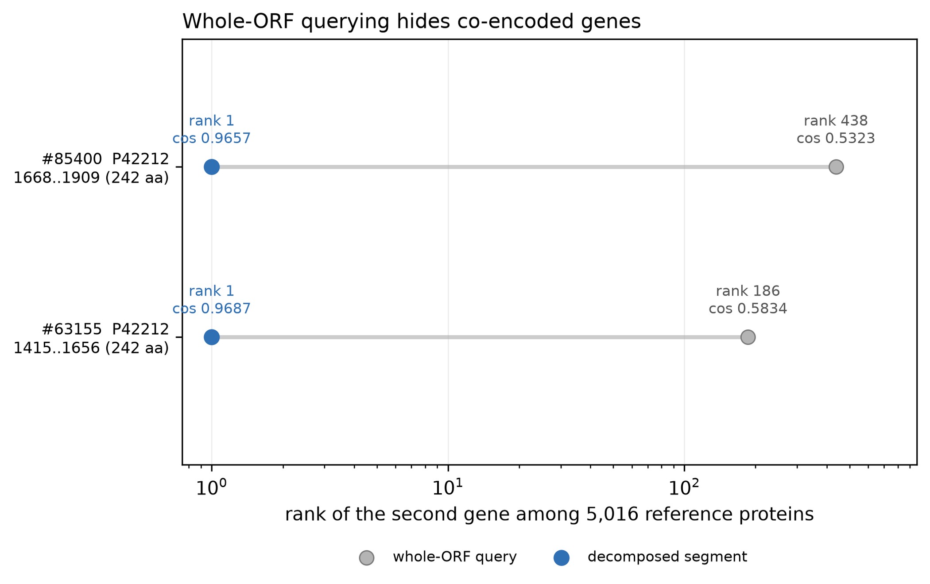
A gene that is present, is identical, and is invisible to the whole-frame query
THE CLEAREST SINGLE EXHIBIT
READ THE AXIS: IT IS LOGARITHMIC
Rank 438 to rank 1, and rank 186 to rank 1, among 5,016 reference proteins.
Both constructs carry the same second gene, P42212, the jellyfish fluorescent protein used as a marker in thousands of deposits. It is present at full identity. Queried as the whole called frame it ranks 438th and 186th, far below any depth a human would review. Queried as the segment that actually contains it, it ranks first both times, and the cosine similarity moves from about 0.53 to about 0.97. Nothing about the sequence changed between the two points. Only the span handed to the model changed, which is the whole claim in one picture.
Figure as the run wrote it: results/baseline2/figures/fig_d3_second_gene_masking.png. Emitted by scripts/07_figures.py.

Slide 39
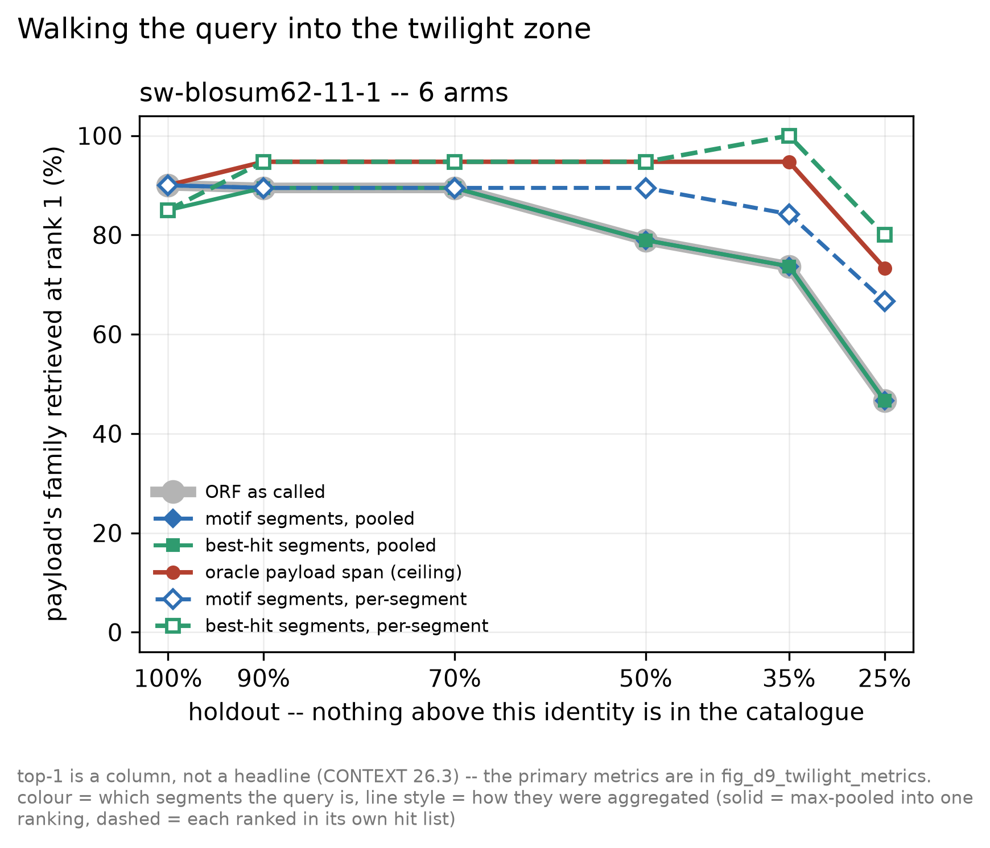
Walking the query into the twilight zone, six arms at once
THE EXPERIMENT THAT DEFINES THE REGIME
THE X AXIS IS AN ADVERSARY, NOT A DATASET
At each step, every protein above that identity to the right answer is deleted from the catalogue.
At 100 per cent the payload's own entry is present and every arm is near perfect, which is the control. At 25 per cent nothing closer than a remote relative survives, which is where real screening sits and where the arms separate. Colour says which residues the query is drawn from and line style says how the hits were aggregated, so the gap between a solid and a dashed line of one colour is purely the aggregation effect. The figure prints its own warning: this panel is top-1, which this project treats as a column and never a headline, and the primary metrics are the next figure.
Figure as the run wrote it: results/figures_postr10/fig_d4_twilight_curve.png. Emitted by scripts/07_figures.py.

Slide 40
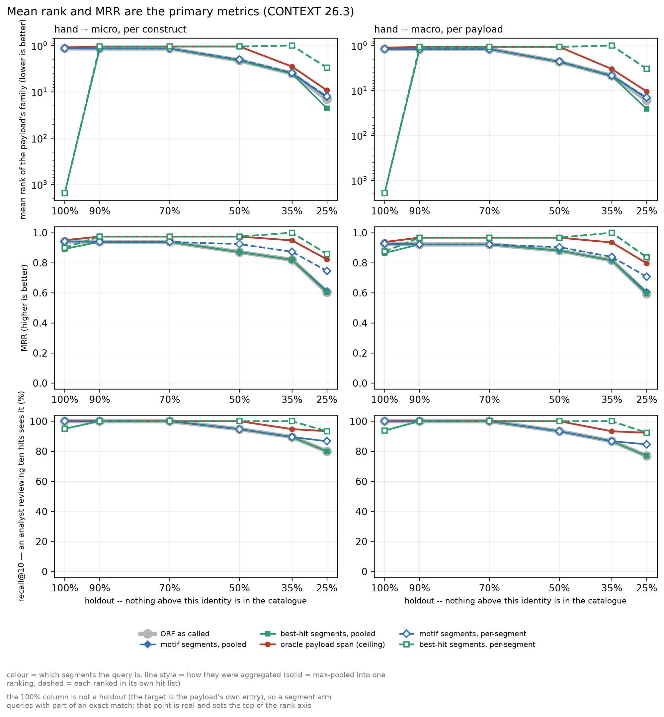
The same walk in the three quantities the project actually reports
THE METRICS THAT GOVERN
THREE ROWS, TWO COLUMNS, ONE DECISION
Mean rank, MRR and recall at depth ten, each shown micro and macro.
Micro averages over constructs, macro over distinct payloads. They are kept side by side because the corpus is not a set of independent trials: 410 constructs carry 138 distinct payloads and one payload appears in 37 of them, so a micro average quietly weights that payload 37 times. Where the two columns disagree, the macro one governs.
WHY THE TOP ROW USES A LOG SCALE
Under mean-pooling the rank distribution is bimodal, so the mean stops describing the centre.
A corpus whole-frame mean rank of 1,088 is really a median rank of 1 plus fifteen constructs carrying one payload sitting near 29,699 of 40,750. That is why the metric rule for an embedding arm makes recall and MRR primary and allows a mean rank only beside its count of rank 10,000 or worse failures. On alignment arms the mean is a genuine shift and needs no such caveat. The log axis is what makes both cases legible on one pair of panels.
Figure as the run wrote it: results/figures_postr10/fig_d9_twilight_metrics.png. Emitted by scripts/07_figures.py.

Slide 41
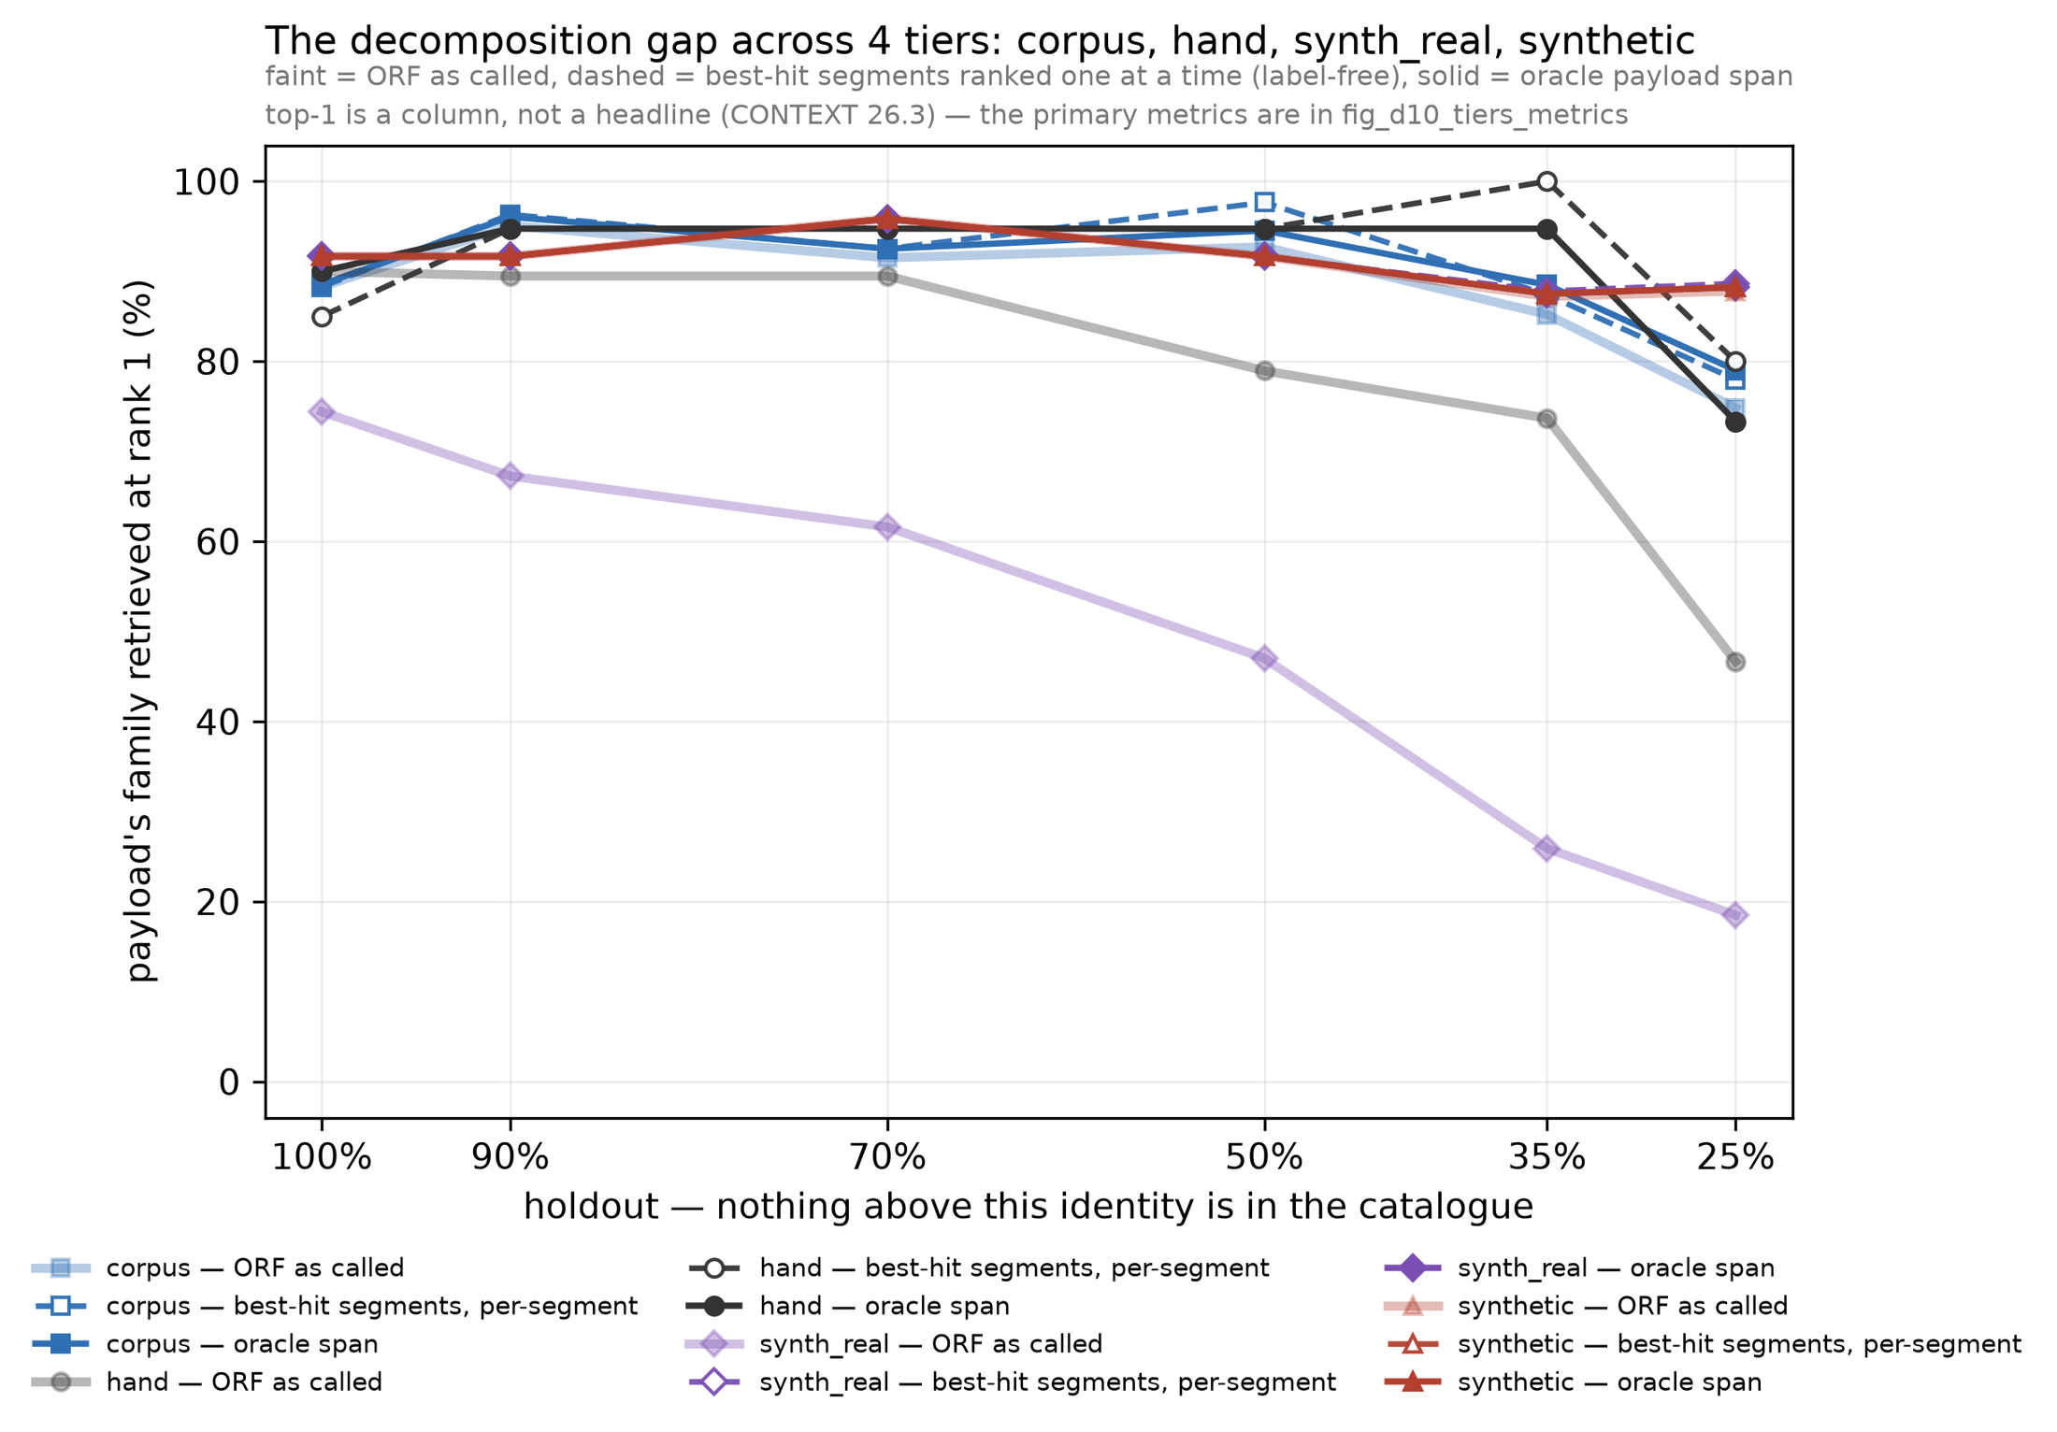
Each tier covers what the others cannot, and the four are never pooled into one line
FOUR TIERS ON ONE AXIS
FOLLOW THE PALE LINE THAT FALLS
synth_real is the tier built inside the regime, and it is the one that falls.
The corpus is a set of single genes in vectors: its median payload fraction is 1.000, so for most of it the frame already is the payload and there is nothing to decompose. The hand tier is realistic but small. synth_real is real payloads placed inside constructed context, so dilution is an independent variable with exact boundaries, and its whole-frame line drops from 75 per cent to 19 per cent while its decomposed line holds near 78. The four tiers are shown together and summed never, because an effect that only acts on diluted constructs cannot survive an average dominated by undiluted ones.
Figure as the run wrote it: results/figures_postr10/fig_d5_tiers.png. Emitted by scripts/17_compare_tiers.py.

Slide 42
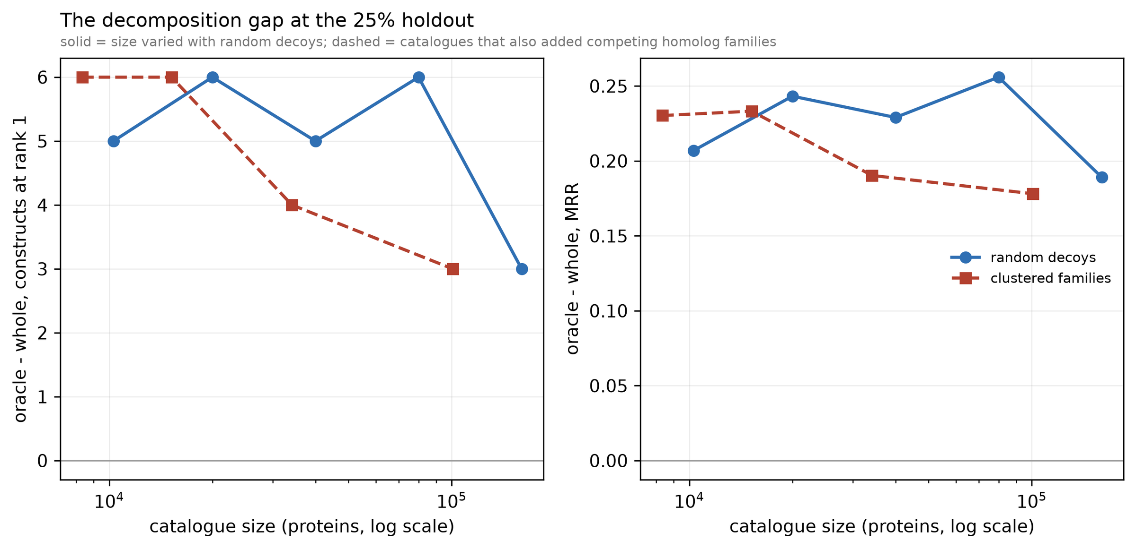
Is this a method effect, or just a bigger haystack?
THE CONFOUND A REVIEWER WOULD RAISE FIRST
TWO SERIES, AND THE SECOND IS THE REAL CONTROL
The gap does not shrink as the catalogue grows, and a family-structured catalogue is harder than a random one of the same size.
The solid series varies catalogue size with random decoys across a sixteenfold sweep. The dashed series is built from the payloads' own homolog families, so its decoys are relatives rather than strangers. At matched size the clustered catalogue is roughly 1.6 times harder, and before this control existed that difficulty was being read as a size effect. Both series are drawn at the 25 per cent holdout. The practical consequence is that every gap quoted elsewhere in this deck is conservative with respect to catalogue size.
Figure as the run wrote it: results/figures/fig_d8_gap_vs_size.png. Emitted by scripts/23_size_curve.py.

Slide 43
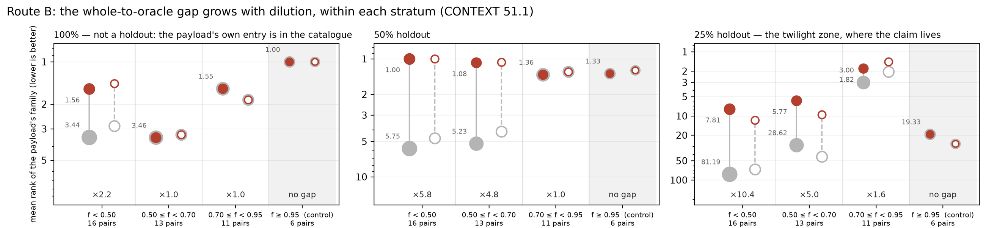
Mean rank on 43 real deposited plasmids, at three holdouts, stratified by dilution
ROUTE B, THE TOP ROW ENLARGED
Figure as the run wrote it: results/route_b_figures_postr10/fig_d11_route_b_dose_response.png, cropped to the top 28 per cent. Emitted by scripts/46_route_b_dose_response.py.
READ LEFT TO RIGHT, THEN INSIDE EACH PANEL
THE RIGHTMOST SLOT IN EACH PANEL IS A CONTROL
The same ordering appears at every holdout, and only the size of it changes.
At f of 0.95 and above the clean span is the called frame, so a zero gap there is arithmetic, not evidence.
Each slot holds one dilution stratum: the pale marker is the frame as called, the dark marker is the clean payload span, and the number beside each is its mean rank, lower being better. In the 100 per cent panel the payload's own entry is in the catalogue and the ratios are 2.2, 1.0 and 1.0. At 25 per cent, where only remote relatives survive, the same three slots read 10.4, 5.0 and 1.6 times. The effect is not present at every dilution and not absent at any holdout: it scales with both, together.
Three of those six pairs sit at f exactly 1.000 and the rest at 0.976 or above, so the two arms are issuing the same query or within a few per cent of it. A method that produced a gap in that slot would be producing it out of the act of cutting. It produces none: 19.33 against 19.33 at the 25 per cent holdout. Shading that slot in the figure rather than dropping it is deliberate, because a control is only useful if the reader can watch it pass.

Slide 44
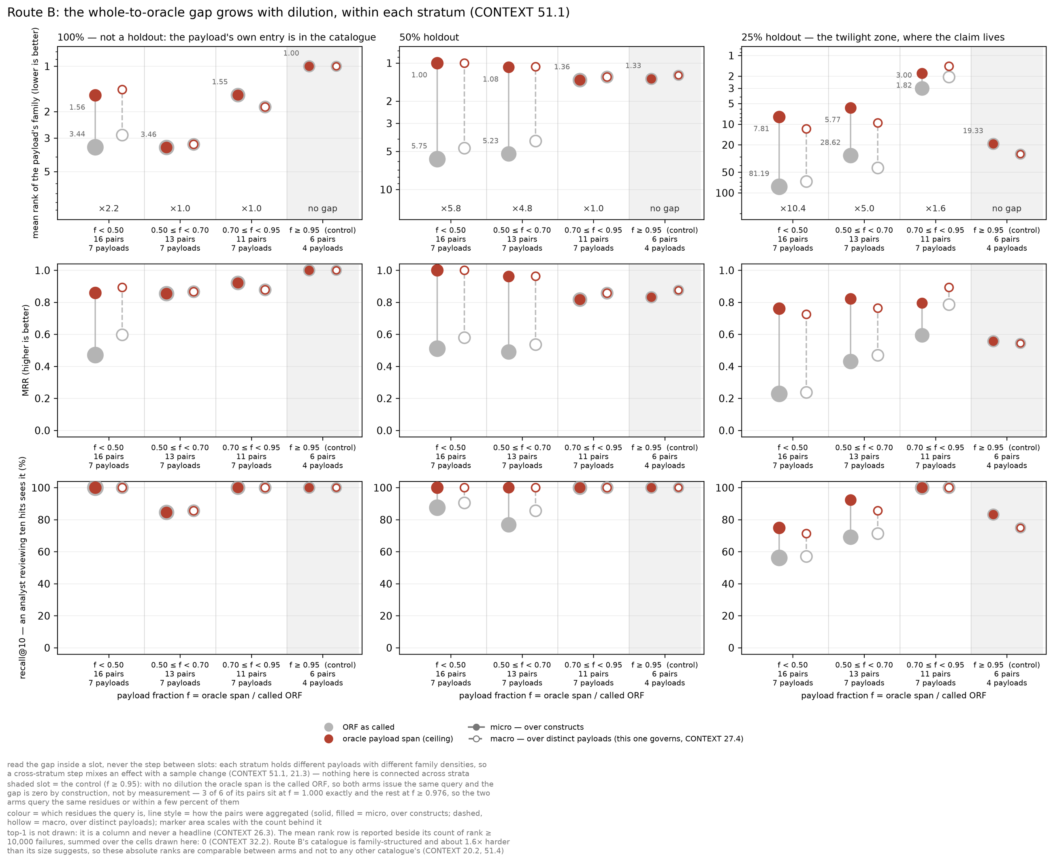
Three metrics, three holdouts, and the caveats the figure prints about itself
ROUTE B, THE WHOLE FIGURE
NINE PANELS, ONE GRID
Columns are holdouts, rows are mean rank, MRR and recall at depth ten.
Marker area scales with the number of pairs behind the point, filled markers are micro over constructs and hollow ones macro over distinct payloads. The counts are printed under every slot: 16, 13, 11 and 6 pairs over 7, 7, 7 and 4 payloads. Nothing is connected across strata, because a step between slots would mix an effect with a change of sample.
THE PARAGRAPH UNDER THE LEGEND
The figure ships with its own objections, printed at the bottom of the file.
It states that the shaded slot is a control with a zero gap by construction, that top-1 is deliberately not drawn, that the mean rank row carries a count of rank 10,000 or worse failures and that count is zero here, and that this catalogue is family-structured and about 1.6 times harder than its size suggests, so these absolute ranks compare between arms and to no other catalogue. Those sentences are inside the PNG because a figure that travels without them can be quoted wrongly.
Figure as the run wrote it: results/route_b_figures_postr10/fig_d11_route_b_dose_response.png. Emitted by scripts/46_route_b_dose_response.py.

Slide 45
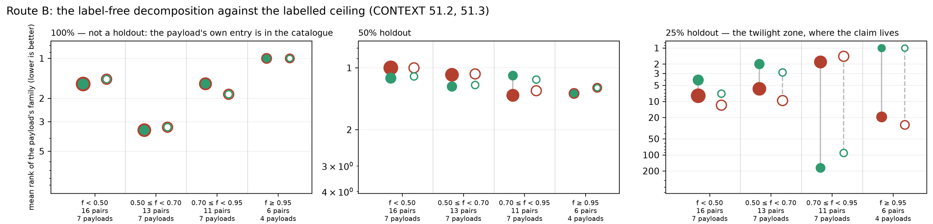
The same grid, with a deployable method in place of the oracle
THE LABEL-FREE ARM AGAINST THE CEILING
Figure as the run wrote it: results/route_b_figures_postr10/fig_d12_route_b_ceiling.png, cropped to the top 29 per cent. Emitted by scripts/46_route_b_dose_response.py.
WHAT CHANGED BETWEEN THIS FIGURE AND THE LAST
WHERE IT COSTS RATHER THAN PAYS
The whole-frame arm is gone. Both markers here are methods, and one of them is allowed to cheat.
At f between 0.70 and 0.95 the label-free arm sits well below the ceiling, and the figure does not hide it.
The dark marker is the labelled payload span, which knows the answer and is therefore a ceiling rather than a competitor. The other is the label-free arm: segment the frame by its own best alignment hits, rank every segment separately, keep the best. It uses no label of any kind and could be run on a sequence nobody has annotated, which is the only version of this that a screening provider could actually deploy.
That drop is concentrated rather than diffuse: the segmenter claimed one 54-residue window on three deposits of a single payload and never queried the other 254 residues. Three constructs of one payload is a small, nameable failure rather than a broad weakness, which is why it is reported as a named case and not averaged into a stratum summary. It is also the case that reverses sign under a different scorer, which the refutations section takes up.

Slide 46
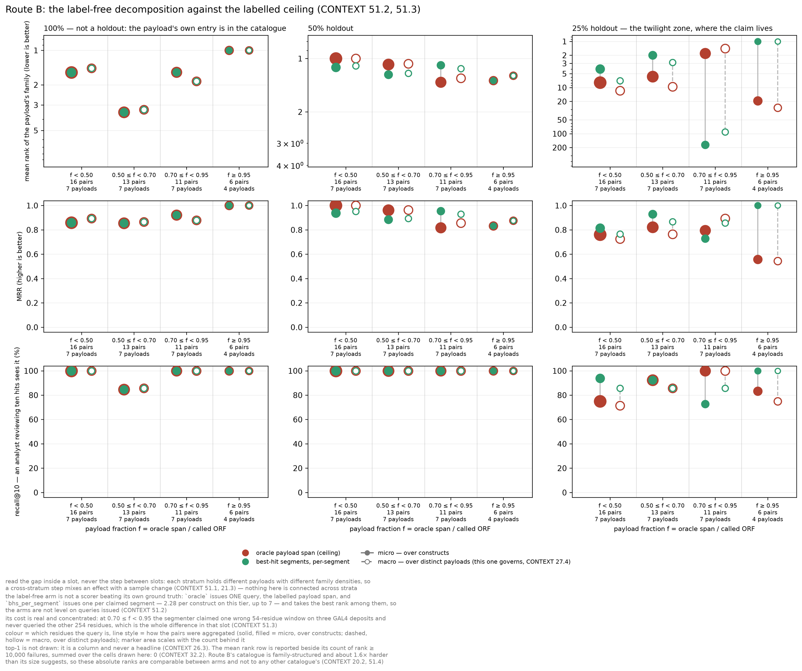
How close a method with no labels gets to a method with perfect labels
THE CEILING FIGURE, WHOLE
THE COMPARISON THIS PROJECT CARES ABOUT
An oracle says how much is there. A label-free arm says how much of it you can have.
The previous figure measured the size of the problem by handing one arm the answer. This one measures how much of that is recoverable without it. On the bottom row, recall at depth ten, the two arms are close to level at every stratum, which is the result that makes the method a proposal rather than an observation.
WHAT THESE TWO FIGURES DO NOT SETTLE
Every point here is exact Smith-Waterman, and the thesis is about embeddings.
Alignment is the control that shows the decomposition step is doing something real and measurable. The claim the project is actually built on is that a mean-pooled embedding needs that step in a way alignment does not, and the arm that proves it on this tier, an ESM-2 run over the same 25,402-protein catalogue, has since run and cleared the admission condition written down for it in advance. The figures are honest about which of the two they are.
Figure as the run wrote it: results/route_b_figures_postr10/fig_d12_route_b_ceiling.png. Emitted by scripts/46_route_b_dose_response.py.

Slide 47
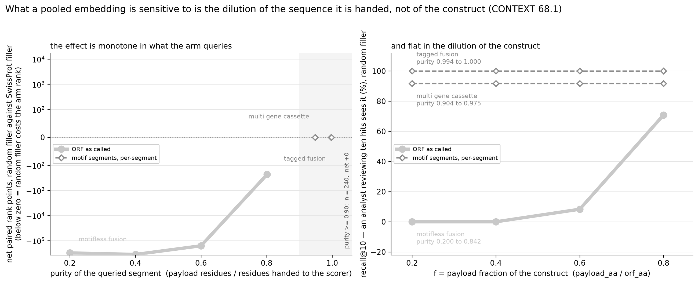
The effect is monotone in what the arm queries, and flat in the construct
THE NEWEST FIGURE, 21 OCTOBER
Figure as the run wrote it: results/figures_purity/fig_d13_purity_doseresponse_mono_nocap.png. Emitted by scripts/57_purity_doseresponse.py --mono.
HOW TO READ THE TWO PANELS
Left, the dose-response: purity is payload residues over residues handed to the scorer, and the pale series is the architecture the motif rules cannot cut, so its only query is the whole frame. Right, the control, without which the left panel proves nothing: there purity simply is payload fraction, while the per-segment series span the same four payload fractions at near-constant purity and do not move.
Notes:
This is the one figure in the deck drawn in the greyscale arm palette rather than the colour one. The palette is in src/pilot/figstyle.py and preserves the encoding rather than abandoning it: grey value replaces hue as the channel saying which segments a line is drawn from, line style still says how they were aggregated, and hollow markers still mark the per-segment arms. The colour version exists and is the one in the written report. Four measured points and a floor, not a located threshold: the tier's purity distribution is empty between 0.842 and 0.904.

Slide 48
Colour, line style and marker area each carry exactly one thing
ONE ENCODING ACROSS EVERY FIGURE
The figure scripts do not name an arm as a literal anywhere. Arm names, colours and metric labels live in one module, src/pilot/figstyle.py, which every figure script reads, so two figures cannot disagree about what a line means and renaming an arm cannot leave a stale legend behind.
1
COLOUR
2
LINE STYLE
3
MARKER AREA
Which residues the query was drawn from
How the hits from those pieces were aggregated
How many measurements sit behind the point
The frame as called, the motif segments, the best-hit segments, or the labelled payload span.
Solid is max-pooled into one ranking, dashed is each segment ranked in its own hit list. So the gap between a solid and a dashed line of one colour is the aggregation effect by itself.
A small marker is a small stratum and is meant to look like one. Filled is micro over constructs, hollow is macro over distinct payloads.
ONE THING THESE FIGURES ARE NOT
They are in colour, and the rest of this deck is not.
Every other mark in this deck is grey, because a monochrome deck survives being printed, photocopied, and read by someone who cannot separate red from green. These figures break that rule for one reason: the alternative was redrawing them for the deck, and a figure redrawn for a slide is no longer the figure the run produced. Their palette, and the typographic dashes in their own axis text, are the measurement code's output rather than this deck's typography. Making the figure scripts emit a greyscale palette that preserves the encoding above is a real and small piece of work, and it is written down as an open item rather than done inside a deliverable build.

Slide 49
Real deposited constructs, inside the regime, for the first time
PART FIVE, 19 OCTOBER
Everything up to here was measured either on 23 hand-audited plasmids, on a corpus that is 86% undiluted, or on constructs the project built itself. Route B is 43 real deposited plasmids selected to be diluted, and it is the tier that both confirmed the thesis and priced its cost.

Slide 50
The corpus cannot test the claim, and the synthetic tier can only bound it
WHY A FOURTH TIER WAS NECESSARY
THE PROBLEM
THE HALF-ANSWER
ROUTE B
A corpus null measures the sampling frame
A constructed tier bounds rather than measures
Real, deposited, and diluted
43 plasmids from public deposits, selected for carrying a Swiss-Prot payload that is a minority of its frame. Median f 0.590, with 29 of 46 scored pairs below 0.70. Real provenance and the right regime at the same time.
180 of the corpus's 286 scorable constructs sit at f exactly 1.000, and only 5.2% fall below 0.70. In the corpus the frame is the payload. No aggregate statistic can show an effect in a population dominated by items the effect cannot act on, and that is a general rule rather than a complaint about this corpus.
The synthetic tier puts dilution under direct control with exact boundaries, median f 0.600 and 64.3% below 0.70. But its hardest condition overstates by construction, so it brackets the real case rather than measuring it. Tuning it until it agreed with reality would have destroyed the thing that made it evidence.
THE SELECTION RULE, AND THE FLOOR THAT MAKES IT A MEASUREMENT
A payload counts as present only above 0.856 identity, and that floor was measured rather than chosen
0.856 is the lowest identity among 20 known-true payload matches on the hand tier, so it is the empirical floor at which a real payload is distinguishable from a near miss. It is why four engineered-variant pairs were excluded from the tier on the project owner's decision: all four sit at identity 0.779 to 0.822, below that floor, and admitting them would have put the floor's only purpose in the hands of a judgement rather than a measurement. A flag exists to reverse that decision in one argument, and a test pins the default so it cannot drift back silently.

Slide 51
The dose-response reproduces on real constructs, and the label-free arm tracks it
THE RESULT, AT THE 25% HOLDOUT
f stratum | n | Whole frame | Per segment | Gated at k >= 2 | Oracle router
below 0.50 | 16 | 81.19 | 3.94 | 3.94 | 3.94
0.50 to 0.70 | 10 | 28.20 | 2.30 | 2.30 | 2.30
0.70 to 0.95 | 11 | 3.00 | 174.18 | 1.82 | 1.82
0.95 and above | 6 | 19.33 | 1.00 | 1.00 | 1.00
Mean rank, exact Smith-Waterman, 25,402-protein catalogue grown from route B's own homolog families. Against the clean payload span the same f below 0.50 contrast is 81.19 to 7.81, a factor of 10.4.
It compounds with remoteness rather than replacing it: at the 100% holdout the same contrast is 3.44 to 1.56.
THE FALSIFIER THAT DID NOT FIRE
The picks were chosen for moderate homolog family size, so whole might have won anyway
It does not. At f below 0.50 the whole-frame query finds the payload family at rank 1 on only 2 of 16 constructs. The tier was not accidentally easy.
Read at the 25% holdout, the one column of six the next slide's defect could not reach, because there the segmentation and scoring masks are the same mask. The re-run confirms it: every cell here is bit-identical before and after the fix, the other five columns moved, and nothing in this deck is a lower bound any more.
THE ONE NUMBER THAT LOOKS TOO GOOD, AND THE SENTENCE THAT GOES WITH IT
The label-free arm beats the oracle at low f, and it is not a scorer beating its own ground truth
3.94 against the oracle span's 7.81 happens because the oracle issues one query and the label-free arm issues 2.28 per construct, taking the best rank. Not like for like, and both are always stated together.

Slide 52
Decomposition has a cost, it is real at the hardest holdout, and most of what I had priced was my own harness
THE PART I DID NOT EXPECT
Look again at the 0.70 to 0.95 row: per segment reads 174.18 where the whole frame reads 3.00. That is not noise and it is not spread across the stratum, it is three deposits of one protein. On 19 October this deck quoted the same cost at every holdout. On 20 October that turned out to be two findings, not one.
WHAT SURVIVES, AND WHERE
WHAT DID NOT SURVIVE, AND IT WAS MINE
At the 25% holdout the cost is real and the mechanism is measured
The same 174.18 at every looser holdout was a defect in the measurement script
The segmenter's best hit covered a 54-residue window, it masked those residues, found nothing else above the floor, and never queried the remaining 254. The piece it kept was not the payload, so the payload was never asked about. That is a genuine cost of decomposing, and it belongs to the most remote holdout specifically: the regime where there are no relatives left to find, so a domain gets claimed instead of a protein.
The script built the segmenter's holdout mask once, at the strictest threshold in the sweep, and reused it at every looser one. So a payload whose whole family is masked at the strictest setting could not be claimed at all, and the loop stopped holding whatever else was in the frame. Re-measured with the mask built per holdout, that stratum reads 1.00 at four of six holdouts and the three constructs are at rank 1. The full re-run finished on 21 October.
1.00
0.727 to 1.000
14,717 to 6
mean rank of the per-segment arm in that stratum once the mask is built per holdout, against a reported 174.18
recall at depth 10 in the same stratum, across the whole sweep, after the fix
manufactured loss against manufactured gain on the corpus tier, so the choice was conservative in neither direction
The comment above that line described the reuse as deliberately conservative at looser holdouts. It was not conservative in either direction, and my own first correction of it made the same mistake the other way. When a choice is documented as conservative, ask conservative for which direction, and measure both.

Slide 53
Fixed, validated against the depositors, checked against an independent implementation, then re-run in full
WHAT WAS DONE ABOUT IT, WITHIN THE DAY
Step | Result | What it establishes
Fix, with the old path kept | Reproduces the recorded files bit for bit | The affected sections stay replayable rather than merely caveated, so nothing already published becomes unverifiable
Validate on the hand-audited 23 | Fraction of each payload claimed: 0.70 to 0.91 | Scored against the depositors' own stated inserts, not against alignment. All 10 rank changes are improvements
Check against the reference implementation | 43 of 43 constructs agree | At the holdout where only the reference implementation had been right, where 11 of 43 had differed before
Re-run all three quoted tiers | Done, 21 October | 9,593.5 s of alignment on the processors and 1,918.5 s of language-model replay on the card beside it. No cell in this deck is a lower bound on this account
The control that makes it checkable | 0 of 144 cells | The whole-frame and oracle arms query a fixed span against a mask that was always per threshold, so the defect provably cannot reach them. That was an argument until this measured it, under both scorers
THE CHEAP CHECK, WHICH BOUGHT ALMOST NOTHING
WHAT THE RE-RUN MOVED, AND IN WHICH DIRECTION
An independent implementation covered 1 of the 40 affected cells
Nine cells got worse, and that is the part worth keeping
Before spending the window, the obvious move is to ask how much of the answer already exists. Every run of the reference implementation in this repository is at the one holdout the production script was never wrong at, and there is no embedding run of it at all. Asking cost nothing and the answer was one cell. That is still the right order to do it in.
The segmented arms moved on 50 of 288 cells under alignment, all upward, and on 80 of 288 under the language model, where 71 went up and nine went down. So the defect is not one-signed, and this slide's earlier claim that a reported gain was very nearly a lower bound was an inference rather than a count, for the third time in this row's history.
This slide exists rather than a quiet re-run before anyone noticed, and the fix kept a flag that reproduces the old numbers bit for bit. The re-run's baseline is published beside the original rather than over it, and each file states which one it is: replacing a published benchmark row is a release decision, not a measurement script's.

Slide 54
The gate I pre-registered to fix that failure is refuted, and not by its threshold
REFUTATION ONE, OF MY OWN PROPOSAL
I proposed using the triage signal to decide whether to decompose, and I wrote down the falsifier first: the gate works if it leaves the GAL4 constructs on the whole frame and costs nothing in the f below 0.50 stratum. It fired on the first clause.
Threshold swept | 0.20 to 0.90 | At 0.65 | What changes
GAL4 best_hit_cov | 0.175 | 0.175 | below every threshold
Tier median | 0.354 | 0.354 | GAL4 sits under it
f 0.70-0.95 mean rank | 174.18 | 174.18 | identical at all seven
WHY NO THRESHOLD CAN WORK
The ordering is wrong, not the cut point
GAL4 sits below the diluted population it would have to be separated from, so any threshold low enough to keep it whole keeps nearly the whole tier whole and gives up every rescue. A test asserts this, so a future re-tuning cannot quietly reopen it.
THE MECHANISM, MEASURED RATHER THAN ARGUED
The signal is stable and wrong, not decaying into wrongness, and the first version of this card was the artefact
This card used to say the signal decays from 0.896 to 0.175 between the 100% and 25% holdouts. The 0.896 was my own reference implementation handing the segmenter the payload's own entry. With that closed the three constructs read 0.1753 at 100% and 0.175 at 25%: same hit, same span, same value. The refutation stands with one fewer moving part.
The error was mine and it was a reasoning error, not a measurement one. I argued that choosing whether to decompose is a negative-direction use of a signal that is only sound negatively. Declining to decompose is the negative direction. Deciding to decompose is the positive one, and a gate has to do both.

Slide 55
Segment count does the job, and it is stable under exactly the thing that broke coverage
THE REPLACEMENT, AND WHAT IT IS WORTH
THE RULE
WHY IT SURVIVES WHAT COVERAGE DID NOT
Decompose only when the segmenter claimed two or more segments
Not because k is stable. That reason was measured through the same leak.
k is free: the segmenter already counts its own segments. It is equally label-free. And it matches the labelled oracle router in every stratum, 3.94 / 2.30 / 1.82 / 1.00, with recall at depth 10 of 1.000 where the coverage gate gives 0.727.
With the leak closed GAL4 reads k = 2 at the 100% holdout and k = 1 at 25%, and more masking gives fewer segments, which is the opposite of the intuition I had. Tier-wide k moves on 3 of 43. What survives is that the gate reads k at 0.25, where GAL4 is k = 1 and is correctly left whole, and nothing at 0.25 moved. The rule keeps its sweep and loses a mechanism story it never needed.
REFUTATION TWO, OF MY OWN JUSTIFICATION FOR IT
I claimed 2 was a definition rather than a threshold. That argument is dead.
The claim was that at k = 1 the segmenter found one thing, so decomposing and querying the whole frame are the same claim about the sequence. The premise is true and the inference is false: the residues the segmenter discards are the ones competing for the rank, so a single claimed window can beat the frame it was cut from. Six cases in 476 synthetic constructs, the largest moving rank 66 to 1. What survives is weaker and is all the deck claims: of the three candidate settings, 1 is decomposing unconditionally and loses the 0.70 to 0.95 stratum, 3 breaks two other strata, and 2 is the interior winner whose neighbours fail in different places. That is a swept parameter with its failure modes named, in sample, and not a derivation.

Slide 56
A validation set that cannot produce the failure will certify the rule that fails
THE SHARPEST METHODOLOGICAL FINDING IN THE PROJECT
The project's own rule is that any rule bound for new data is scored against the 23 hand-audited constructs first. The coverage gate was. It passed. Here is what that passing was worth.
Hand tier, k = 1 cases | n | Whole equals per segment | Routing changes
All k = 1 constructs | 9 | 9 | 0
Of which non-trivial rank | 1 | both at rank 28 | 0
THE CONSEQUENCE
Run on the 23, the refuted gate also matches the oracle router in all four strata
Every hand construct with k = 1 has the two arms returning the identical rank, so no routing decision can change any number. The validation set passes the rule that route B refutes.
WHY THIS IS WORTH A SLIDE OF ITS OWN
The lesson had already been learned twice, in measurements. This is it arriving inside the validation step.
The question to ask of a subset is not whether it is representative. It is what would have to be true for the conclusion to be wrong, and whether this sample could have shown it. Applied to a measurement that question has caught a hit cap that bound on 5 of 16 payloads and a comparison that summed a sample change with an effect change. Applied to a validation set it says: a validation that cannot produce the failure mode is not evidence about the failure mode, however green it comes back. That is why the coverage gate looked reasonable for a day.

Slide 57
Under mean-pooling the k = 1 case reverses, exactly as the mechanism said it would
THE PRE-REGISTERED PREDICTION, AND IT CAME BACK CONFIRMED
Written down before the run: if an embedding arm runs on this tier, expect more k = 1 falsifiers and not fewer, because a pooled vector mixes the whole frame and so discarding the competing residues should help more, not less. The arm ran the same evening on a CPU.
Scorer, k = 1 cases | n | Tie | Whole wins | Per segment wins
Exact Smith-Waterman | 13 | 10 | 3 | 0
Mean-pooled k-mer | 13 | 0 | 4 | 9
AND THE GAL4 CASE REVERSES
Whole 1,860 against per segment 992
The three constructs the gate exists to protect are now ones the gate costs 266 to 882 rank points on. The k = 1 branch's net value moves from minus 1,896 rank points to plus 7,395.
THREE REASONS THIS IS NOT A FLIP, ALL OF THEM STATED IN THE RECORD
The evidence that moved is the weakest evidence in the register
First, it is a hashed 3-mer cosine and not the language model the thesis is about, so it tests mean-pooling and not ESM-2. Second, the reversal is holdout-specific: at the 100% holdout those same constructs fail under mean-pooling too, and worse, at rank 16,748 of 25,402. Third, at the 25% holdout this arm's recall at depth 10 is 0.000 in every stratum, so the nine falsifiers are rank movements deep in a tail where nothing is being found at all, and nine of them are substantially the alignment arm's ten ties breaking. The direction is the result. The count is inflated.
One standing claim did not survive the change of scorer: zero counterexamples in 225 constructs for the k >= 2 branch becomes 5 of 30 under mean-pooling, costing 384 rank points against the branch's 53,074. The branch's value holds and its unanimity was a property of the rule and the scoring system together.

Slide 58
I proposed a scorer-conditional rule. It was the worse answer, and the simpler one was kept.
REFUTATION THREE, OF MY OWN RECOMMENDATION
WHAT I RECOMMENDED
WHAT WAS DECIDED
Two branches: gate under alignment, do not gate under mean-pooling
Keep the single rule
Conditioning a rule on the newest and weakest measurement in the register is the error this project's rules warn about, not the cure for it. The decision was the project owner's, and it is recorded with the reasoning and with the condition that would change it.
It fits the data on the table. It also builds a more complex rule on one k-mer arm, three constructs of one payload, one holdout, and a stratum where the primary metric for an embedding arm reads zero. Against that, the single rule rests on 225 constructs across three tiers with one of its two directions confirmed out of sample.
THE CONDITION FOR REVISITING, WRITTEN DOWN BEFORE IT CAN BE ARGUED ABOUT
The ESM-2 arm on route B, at both holdouts, with recall at depth 10 non-zero
That is the comparison between two methods that are both actually screening, rather than between two orderings of a tail. If the GAL4 reversal survives it, the rule changes. If it does not, the k-mer result stands as a measurement about 3-mer vectors and nothing more. Nothing short of that run reopens the question, and saying so in advance is what stops the next piece of weak evidence from being read as decisive.

Slide 59
A pre-registered condition is only worth something if you go back to it when it is met
THE CONDITION FIRED, 20 OCTOBER
The ESM-2 arm ran on route B and cleared its admission threshold: recall at depth 10 of 0.545 over 11 pairs in the stratum in question, 0.571 averaged over payloads, nothing past rank 10,000. So the arbiter exists and its numbers are readable under the project's own metric rule.
4 / 6 / 3
Confirmed
Unchanged
of the 13 single-segment pairs: per segment better, tied, worse, at the strictest holdout. Net plus 95 rank points
the refutation in the previous slides, on the one piece of evidence reserved for deciding it
the rule itself. The arbiter supported the simpler version rather than the scorer-conditional one I had proposed
AND THE QUESTION DISSOLVED RATHER THAN BEING ANSWERED
WHY THIS SLIDE IS THE POINT OF THE THREE BEFORE IT
The protein behind all three motivating constructs is one this representation cannot retrieve at all
The value of writing the condition down is that it can come back against you, or for you, and either way you have to look
Its own labelled span, queried alone, with the protein present in the catalogue and nothing held out, ranks between 1,912 and 2,337 of 25,402. An arm that cannot find a protein when handed it cleanly cannot measure what dilution does to it, so the nine reversals that prompted my recommendation were movements inside a failure. That protein is now off the candidate list for extending this tier.
Had the condition not been stated in advance, this arm's numbers would have been read in whichever direction suited the rule already in place. Stated in advance, it was a test. It happened to support the decision that was taken, which is the less interesting of the two outcomes and the one worth reporting carefully for exactly that reason.

Slide 60
The fix the literature points to, and a negative result with a useful half
PART SIX
If pooling is the problem, the fix is to stop pooling: keep the alignment and replace the letters with per-residue embeddings. That is the published method that reaches 0.92 Spearman. Building it took four days and it does not work yet, for a reason worth more than the build would have been.

Slide 61
Smith-Waterman, unchanged, over a substitution matrix made of cosines
WHAT THE ARM IS
THE CONSTRUCTION
THE ONE FREE PARAMETER
Replace the 20 by 20 scoring table with a computed one
The shift, and it decides whether the method has statistics at all
Embed each residue of the query and of the subject, build the matrix of pairwise cosines, subtract a shift so that unrelated pairs score negative, scale to integers, and run the identical affine-gap local alignment. Everything downstream is unchanged, which is the point: the arm sits behind the same scorer interface, so it runs anywhere the alignment control runs.
Local alignment statistics require the expected score of a random residue pair to be negative. That is why an optimal local alignment terminates. Get it wrong and the score measures length, the score distribution is Gaussian rather than Gumbel, and no E-value exists to invert.
THE SHARPEST SETBACK IN THE PROJECT, AND IT WAS A DERIVATION THAT WAS RIGHT ABOUT THE WRONG THING
The shift was derived from a cosine null, which is where unrelated pairs sit. It needed to be derived from where the expected pair score crosses zero.
Those two conditions are almost the same number and that is what made it dangerous: the derived value of 0.2710 lands within 0.0007 of the crossing point, which is to say exactly on the boundary of the regime where the mathematics works. Measured at shift 0.25 the expected pair score is plus 0.0197, so alignments never terminate. It cost 2 hours 45 minutes of calibration before the cause was found, and the check that would have caught it runs in under a second with no dynamic programming at all.

Slide 62
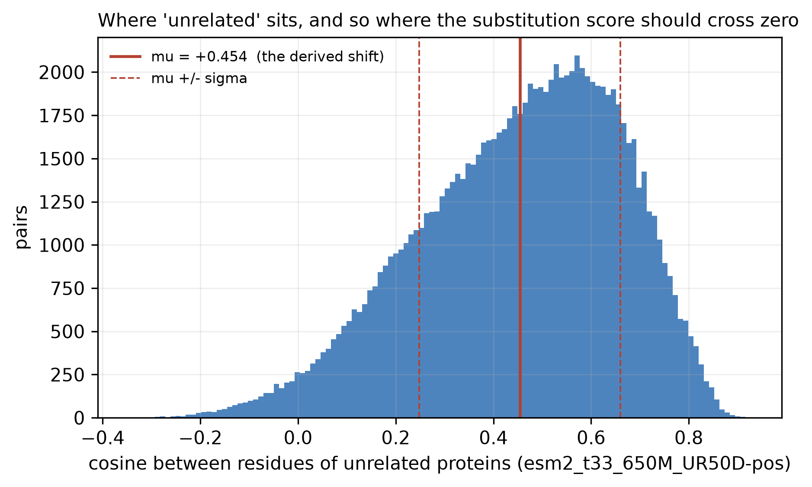
Where unrelated residues sit, measured over a hundred thousand pairs
THE FIGURE THE WRONG DERIVATION CAME FROM
A CORRECT MEASUREMENT OF THE WRONG QUANTITY
The histogram is right. The solid line is the mistake.
Every bar is a cosine between two residues of unrelated proteins under ESM-2, so the distribution is where the model places strangers. The solid line is its mean at plus 0.454, which was taken as the shift because subtracting it puts the average unrelated pair at zero. That reasoning is intuitive and it is wrong. What local alignment needs is not that the average unrelated pair score zero, but that the expected score of a random pair be strictly negative, with the pair frequencies of real sequences weighting it. Those two conditions sit within 0.0007 of each other for this embedder, which is exactly why the error survived review: the derivation was careful, the arithmetic was right, and the condition was the neighbouring one. The repair is a function that takes a second and is now run before any work on this arm, on every embedder, because the number belongs to the embedder and not to the catalogue.
Figure as the run wrote it: results/baseline2/figures/fig_d7_cosine_facebook_esm2_t33_650M_UR50D.png. Emitted by scripts/20_eba_scale.py.

Slide 63
Negative is necessary and not sufficient, and the rest costs nothing either
THE CHECKS THAT ARE FREE
Check | What it is | What it rejected here
Expected pair score < 0 | The regime condition for local alignment statistics to exist at all | Shift 0.25, measured at plus 0.0197. Four weeks of planned work, avoided in one second.
Ungapped lambda bound | Solve the ungapped equation on the pair-score distribution. It reproduces the published BLOSUM62 value to 0.002 and is an upper bound on any gapped lambda, because gaps can only raise a score. | A 27-minute calibration its own goodness-of-fit rule had passed. A fitted lambda above the bound is not a noisy estimate, it is evidence that what was fitted is not lambda.
Gumbel onset | The ungapped lambda times the standard deviation of the pair score. Below roughly 0.3, expect the fitted lambda to depend on query length, which lambda cannot. | Shift 0.3025, at 0.173. The fitted value drifted 2.2 times across three length bins where a planted Gumbel at the same sample size drifts 10%.
K at most 1 | For E = K m N exp(-lambda S) to be a probability statement, K must be of order 1 or smaller. BLAST's gapped BLOSUM62 value is about 0.041. | Three calibrations that cost 88 minutes each to reject on goodness of fit, rejectable in zero seconds from numbers already printed.
THE DIAGNOSTIC THAT WAS PRINTED ON EVERY RUN AND READ ON NONE
Across the five-shift sweep K moved from 1.56e+15 to 0.816, fifteen orders of magnitude
Over the same sweep the goodness-of-fit statistic that the promotion rule actually tested moved by 7.5%, from 0.890 to 0.957. So the quantity that carried the information was on screen for four runs and the quantity being watched was nearly flat. A fitted K of ten to the fifteenth is not a noisy intercept: it says the fitted slope and intercept are mutually inconsistent with an exponential tail over the range fitted. Screening on its order of magnitude is a different operation from quoting its value, which remains an extrapolated intercept and is still not independently interpretable.

Slide 64
Five shifts across the admissible range, and not one gives a promotable calibration
A NEGATIVE RESULT, AND IT IS CLOSED RATHER THAN ABANDONED
The admissible range for this embedder was measured, not guessed: background cosine 0.2697 on the 40,750-protein catalogue gives a viable shift range of 0.2897 to 0.5197. Five shifts were calibrated across it. Every one fails the per-bin goodness-of-fit rule on the longest query length.
WHY IT IS A MEASUREMENT AND NOT A SHRUG
SO THE CONCLUSION IS BOUNDED
The fifth run was a pre-registered falsifier at the top of the range by construction
No admissible shift for this embedder yields a promotable calibration
At 0.5197 the expected pair score is minus 0.2500 exactly, with the regime condition as the hard limit above it. It came back at 0.95687 against the 0.962 that the four-point line predicted, a residual of minus 0.003 where those four points scatter by plus or minus 0.007, and it fails at every bin count from 2 to 6.
Do not go looking for a sixth shift. Five across a defined range is a closed measurement, not an extrapolation from four points. A second embedder closes the same way on four shifts, every fit rejected by the same rule. What is still open is different gap costs or longer calibration queries.
AND THEN THE USEFUL PART, WHICH IS THE REASON THIS SLIDE IS HERE
The same unpromotable floor reproduces exact alignment's segmentation on 18 and 19 of 20 hand-audited constructs
It does so identically across a 2.1 to 2.5 fold band of floors, because the segmenter only asks whether the best remaining hit clears the floor, and a lambda wrong by 30% answers that the same way. Before abandoning a quantity that fails its own goodness test, check what consumes it: a threshold crossing tolerates error a reported number does not. The write-up quotes the floor as a band, shows the verdict surviving it, and names the one construct that moves.

Slide 65
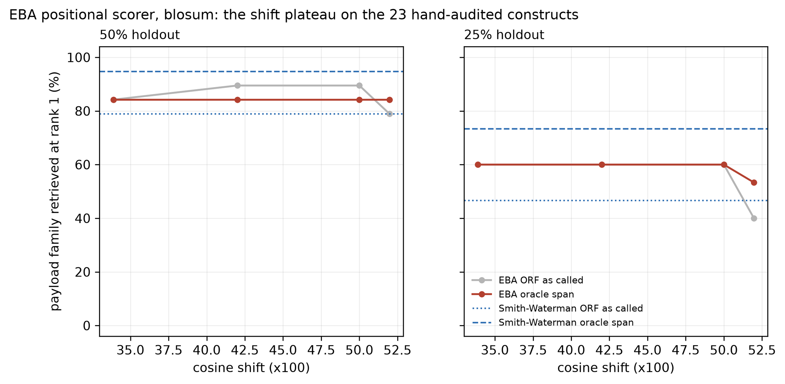
Five shifts, two holdouts, against the exact alignment control on the same catalogue
THE SWEEP, AS THE RUN PLOTTED IT
WHAT A PLATEAU IS WORTH HERE
The flat stretch is the finding, and the horizontal lines are the bar it has to clear.
The two dotted and dashed horizontals are exact Smith-Waterman on the same reduced catalogue, run as the control: one for the frame as called, one for the labelled payload span. The embedding scorer's own points sit between them at the 50 per cent holdout and below both at 25 per cent, so behind that shortlist the positional arm does not beat the letters it replaced. Re-run exhaustively it does: level at the 50 per cent holdout, eighteen rank points behind over nineteen constructs, and still behind at 25 per cent. The deficit was the shortlist. Both ends have since been re-run on the full catalogue, where the shift no longer separates the scorers. What is useful is the shape rather than the height. The arm is flat across a wide band of shifts and then falls at the top of the range, which is a plateau rather than a peak, and a result that holds across a band is one a reviewer can trust without trusting a tuned value.
Figure as the run wrote it: results/eba_regime_sweep/figures/fig_d6_eba_sweep_blosum.png. Emitted by scripts/18_eba_sweep.py.

Slide 66
Every rule is scored against 23 known answers before it is trusted anywhere else
PART SEVEN
This is the habit that found every real bug in the project, and the one time it was skipped is the most expensive mistake in the record.

Slide 67
Validate against the known answers, not against a weaker version of the same tool
THE VALIDATION HABIT, AND WHAT SKIPPING IT COST ONCE
Rule | Scored | Against
Payload assignment from alignment | 16 of 20 | the depositor's stated insert
Archetype calling from sequence | 19 of 23 | the depositor's stated insert
Motif false-split rate | 0.36% | a specificity run after any catalogue change
Segmentation under the embedding floor | 18 to 19 of 20 | exact Smith-Waterman on the same constructs
THE ONE THAT WAS SKIPPED
A sensitivity setting validated against a weaker version of itself
The homolog search was validated against the same tool at default sensitivity rather than against exact alignment. It loses half the sub-25% homologs on the hand tier: 858 homolog rows against exact alignment's 1,705.
WHAT THIS HABIT HAS CAUGHT, NONE OF IT VISIBLE BY INSPECTION
Three bugs no amount of code review would have found
An uncharacterised protein chosen as the payload of four unrelated constructs. Twelve orthologues of one gene counted as a twelve-gene cassette. A synthetic tier silently off by one for every tagged construct. All three survive review because the code is correct and the labels are wrong, or the convention is mixed. Only scoring the rule against known answers surfaces that class.
THE RULE THAT SEPARATES TWO FAILURES NEEDING OPPOSITE RESPONSES
A rule failing and a label encoding a judgement the rule cannot see are different problems
If the rule is wrong, fix the rule. If the label encodes something the rule has no access to, the rule is working and the benchmark item is the thing to document. Collapsing those two is how a project tunes itself into agreeing with its own labels.

Slide 68
Twenty-seven limits have silently truncated a measurement, and every one was visible at construction time
THE RECURRING FAILURE, AND THE REGISTER OF IT
The limit | What bound it | Where it bit
Database length window, 50 to 2,000 residues | 3 of 173 payloads | Those payloads unretrievable at any holdout, in a benchmark about retrieval
Hit cap on the homolog search | 3 of 173 payloads | The remote tail, which is all the hardest holdout sees. Thought saturated from a 3-payload sample that could not have shown otherwise
Coverage denominator | Every payload shorter than its hit | Up to five times per payload, in both directions. Both sides of a ratio must be computed the same way
ESM-2 length cap of 1,022 | 3,889 of 40,750 proteins | Cas9 truncated to 74.7%, and Cas9 carries 2 of the 6 headline rescues
ESM-2 length cap of 2,048 | 504 entries, 7.43% of all residues | Unrecorded for four weeks. 70 to 80% of the entries it bites were already diluted references
The record dedupe rule | 2 of 52 GenBank records | Both were the complete record of their deposit, so one gene was measured on a partial file and reported absent from a construct carrying it at identity 0.998
A free-text tier label | Which of two tiers a number belongs to | Two tiers under four labels, with nothing tying a label to its input. Which was which had to be established by hashing the file, and the difference between them reverses the sign of the headline result
A length cap counted in residues when the model counts tokens | The limit's own reported count | A cap of n admits n minus 2 residues, so the two-residue band just over the cap was reported as untruncated, and the last per-residue row of every truncated sequence was a sentinel token's embedding returned as a residue
The segmenter's holdout mask, built once at the strictest threshold | The decomposition arm's reported cost at every looser holdout | The next slide. The only row here that binds at the loose end rather than the remote one, and the only one that inflates a cost rather than a gain. Fixed and fully re-run on 21 October
The nominal holdout threshold, read as a remoteness | Which regime a stratified row describes | A holdout is an upper bound on what is available, not a description of it. One synthetic payload gets a 27% relative from a 70% holdout where 22 others get 0.47 to 0.70, and it is the language model's only failure in that tier at that holdout. The first row here to bind on the holdout itself rather than on a gate. Now a computed column, which found 3 payloads overstated at that holdout and 4 at the next one up
A construct identifier as a benchmark item's only key | 336 of 1,102 items | The two synthetic tiers are the same constructs differing only in their filler, so they share every identifier, and the identifier is what an item is addressed by. Adding the second tier to the benchmark deleted the first, with nothing raised. The only row here caught before it shipped, and the only one found by trying an extension rather than auditing a finished one
THE SHARED SIGNATURE
AND ONE ROW BREAKS THE SIGNATURE
Reasonable when chosen, binding on a small minority, invisible in every output, biting at the remote end
The last one binds at the loose end, where nothing in this list points
A cap that binds is not a neutral setting: the kept hits are the top-scoring ones, so what is discarded is always the remote tail. The rule now is to raise a binding limit past the point of binding rather than nudging it, and to report the new count to show it is clear.
Every habit above looks at the remote tail: the hardest holdout, the smallest minority, the most truncated entry. That row inflates a reported cost at the easy end instead, and it carried a comment stating its own direction of bias which was wrong, as was my first correction of it.

Slide 69
Fourteen corrections, each with the thing that caught it, kept in the record on purpose
THE ERRATUM TRAIL
What was wrong | What caught it | What it changed
A pooled-embedding number attributed to the un-aligned ablation | Reading the primary source instead of the brief | The comparator moved from 0.56 to 0.46 for ESM, and the argument got stronger
Payload fraction computed on the longest frame | A guard testing a field name that does not exist | A whole tier's f distribution, which the tier totals could not have caught
A gene reported absent from a construct carrying it | Re-fetching the deposit and finding a second, longer record | Identity 0.998 present, not absent. The dedupe rule was the real defect
A claimed derivation of a segment-count boundary | A falsifier run on purpose on the synthetic tier | Six counterexamples in 476. The claim is now a swept parameter
A triage gate used in its unsafe direction | Pre-registering the falsifier before running it | The gate is refuted and replaced, and the replacement is weaker than first claimed
A runtime estimate wrong by a factor of ten | Running the thing instead of extrapolating | 772.4 seconds against two to three hours predicted from a probe sharing two cores
A comment claiming a choice was conservative | Measuring both directions instead of reasoning about one | It was conservative in neither: 14,717 manufactured rank points of loss against 6 of gain. My own correction then missed the 6
A derived fragment-length floor | Measuring real fragments against it | It was a median, not a floor. The floor is 8 residues, and 37 fragments beat the prediction because composition varies
A length cap counted in the wrong unit | A test written to reproduce the tokenizer rather than approximate it | A sentinel token's embedding had been returned as a residue for every truncated sequence: 504 of 40,750 entries
A comment above the pooling step | Reading it against the line beneath it | It asserted the opposite of the code, for every retrieval vector in the project. Worth a median 0.00046 of cosine, which had to be measured to be called small
A signal reported as decaying across a holdout sweep | Closing a label leak that had moved no rank at all, then re-reading the columns beside the ranks | It reads the same value to three decimals at both ends. There was one measurement and one artefact, and two readings at the ends of a sweep never established the trend between them
A stability claim about the replacement gate | The same leak, closed | Half of it had been measured through the leak. The gate survives because it is read where nothing moved, not because the signal is stable
WHY THE TRAIL IS KEPT RATHER THAN TIDIED
A measured negative result beats an unmeasured positive one, and the trail is the evidence that the rest is measured
Every number in this deck is only as good as the chance that something like the fourteen above is still hiding in it. A record that shows fourteen found, each with the mechanism that surfaced it, is a stronger statement about the remaining risk than a clean document would be. It also makes the project auditable by someone who was not there, which is the actual test of a research record. Eight of the fourteen were found on one day, which is a rate rather than a tally and is reported as one.
Two of these are hypotheses of mine that the project's own rules killed before they were built on: a triage gate used positively, and a derivation that turned out to be an inference. The last two are a category of their own and the sharper lesson: a defect can be invisible in the column a script is validated on and decisive in the column a section argues from. That script's rankings were right throughout, which is why no cross-check it served as arbiter for was ever affected.

Slide 70
Two cores, a borrowed graphics card, and the surprise about which one mattered
PART EIGHT
The hardware shaped what could be measured and in what order, so it belongs in the record rather than in an acknowledgements line.

Slide 71
A laptop with two physical cores, and a graphics card borrowed from my brother
WHAT THE WORK ACTUALLY RAN ON
THE MACHINE THAT DOES THE WORK
THE MACHINE THAT WAS BORROWED
ThinkPad: 2 physical cores, 4 logical, integrated graphics, CPU-only PyTorch
An Omen with an RTX 5050, 8 GB of video memory, available in windows
Every alignment measurement in this deck ran here. Exact Smith-Waterman is CPU work and parallelises across four threads, so the control arm was never the bottleneck. The integrated graphics cannot run a protein language model at all, which is the entire reason the schedule is shaped the way it is.
It belongs to my brother, so access came in afternoons and late evenings rather than on demand. Three windows produced every embedding number in this deck. Work was queued against those windows in advance, because an idle window is the most expensive thing in a project with a cut-line.
Run | Measured cost | What the cost forced
One embedding-alignment calibration shift | 5,665.5 s, 94.4 min | Four shifts is 6.3 hours, so the sweep ran overnight and the fifth shift had to be worth its own night
Route B alignment retrieval, 43 constructs by 6 arms by 6 holdouts | 772.4 s | Nothing. My own estimate of two to three hours was wrong by a factor of ten
Fragment probe, 497 queries | 1 h 38 min | A whole evening, for a confirmation that changed no reported number and bounded a knob
Route B k-mer embedding arm, end to end | 487.3 s | Nothing, and that is the finding on the next slide
An embedding arm replayed over a finished segmentation | 499 s against its parent's 7,045 s | Nothing, and it reordered every job since: segment once on the processors, then replay on the card
Re-segmenting one tier per holdout rather than once | 2.89x and 2.96x wall clock, on two tiers | The price of the newest fix, and the reason the outstanding re-run is one window rather than a week
The ten-times error has a cause worth stating: I extrapolated from a probe that had been sharing two physical cores with another session. On a two-core machine, contention is not a small correction to a runtime estimate. It is the dominant term.

Slide 72
One blocker was real and is now cleared, one was assumed, and the third window was won by scheduling rather than hardware
WHAT THE CONSTRAINT COST, AND WHAT IT DID NOT
THE REAL BLOCKER, CLEARED 20 OCTOBER
THE ASSUMED BLOCKER
Route B needed its own 25,402-row reference matrix, and the third window produced it
The same pipeline ran on the laptop in eight minutes
None of route B's 21 payloads is a payload entry in the catalogue every other run uses, so the tier could not borrow a cached matrix, and it tested the alignment claim only. A day before this deck was revised that was described here as the single largest open item in the project. The arm has now run and cleared the admission condition written down for it in advance, which is the slide three before this one.
Substituting a k-mer embedder for the language model: 57.5 seconds to build the 25,402-row matrix against a 70.5-second upper-bound projection, then 396.5 and 33.3 seconds for the two passes. It is not the ESM-2 number and cannot stand in for it. But it proved the whole path end to end, so the GPU window is now a one-flag substitution rather than a build.
THE LESSON FROM THE THIRD WINDOW, WHICH IS ABOUT SCHEDULING AND NOT ABOUT HARDWARE
One borrowed machine is two lanes, not one queue
That machine has 16 logical processors as well as the card, and exact Smith-Waterman touches no video memory at all, so an alignment job and an embedding job run side by side on it with no contention for anything. Treating it as two lanes is what made one window produce two complete experiments. Combined with the replay finding above, the remaining work was ordered the same way and has since run: the processors re-segmented three tiers in 9,593.5 seconds while the card replayed the finished segmentations beside them in 1,918.5 seconds, so the card's share hid entirely inside the processors'. The quarter described at the time as lowest-value, the random-filler tier, is the one that produced finding three C.

Slide 73
How far the work has come, and how close it is to what the proposal asked for
PART NINE
Eleven days of measurement, 82 numbered sections of record, and one deliberate decision to keep every wrong turn in the document. This part scores the work against the original brief rather than against itself.

Slide 74
Each phase was opened by a result from the one before it, not by a plan written in advance
HOW THE WORK DEVELOPED
1
14 TO 15 OCTOBER
2
15 TO 16 OCTOBER
3
17 OCTOBER
Verify the brief, then build step one
The first dose-response, and the tier that could not test it
The metric decision, and two arms split into four
Every citation checked against the primary source. Three claims did not survive, including one in my own notes. The parser, the circular frame scanner and the scoring harness were built around 23 hand-audited plasmids where the depositor states the answer.
Cosine recovered is linear in dilution at r = 0.98 on 19 plasmids. Then the 410-construct corpus came in and turned out to be 86% undiluted, so it could not test the claim at all. That is what forced a constructed tier and, later, route B.
Stratify by payload fraction, never pool across strata, top-1 is never a headline. On the same day the pooled and per-segment arms were separated, which exposed that max-pooling across segments costs 345 rank points.
4
18 OCTOBER
5
19 OCTOBER, MORNING
6
19 OCTOBER, EVENING
The embedding arm, and the sharpest single number
The embedding-alignment arm closed as a bounded negative
Route B, the cost of decomposition, and three refutations
Mean-pooled ESM-2 at a 100% holdout returns a payload it has been handed at mean rank 6,140 of 40,750 on the competing-filler tier, 35 of 144 past rank 10,000. A flag was added so segmentation can stay on exact alignment while retrieval runs under the model.
Five shifts across a measured admissible range, none promotable, the fifth one a pre-registered falsifier at the top of the range. The unpromotable floor then turned out to be reusable as a decision, which is the useful half.
A real diluted tier, the dose-response reproduced on deposited constructs, decomposition's first measured price, a pre-registered gate refuted, its replacement weakened, and a CPU embedding arm that ran in eight minutes.

Slide 75
The proposal's minimum viable product had four asks. All four are now met, and one carries a stated bound.
SCORED AGAINST THE ORIGINAL BRIEF
What the proposal asked for | Status | Evidence, and what is missing
An approach, plus pre-processing tools, to decompose arbitrary constructs into model-ready units | Met | Four decomposition rules behind one interface, including a label-free one that reaches the perfect-decomposition ceiling. 29 modules, 64 scripts, 1,065 tests.
A test set of a few hundred public synthetic constructs spanning four archetypes | Met | 812 constructs across four tiers. The corpus contributes breadth, the synthetic tier contributes the architectures the corpus lacks entirely, including 2A cassettes, of which the corpus has zero.
Measure whether the approach restores a foundation model's ability to say what is in the construct | Met | Measured under exact alignment on all four tiers and under mean-pooled ESM-2 on all four. The harness defect found on 20 October is fixed and the re-run it implied finished overnight on 21 October across all three quoted tiers and both scorers, so nothing here is a lower bound on that account. On the tier built for it, decomposition turns out to remove dilution as a variable rather than to improve an average.
Integration and evaluation only: no new model, no training, no proprietary or customer data | Held | Nothing was trained. Every sequence is from a public deposit or generated by the project itself, and the hard rules in the repository forbid pathogen-derived and toxin-derived material outright.
THE HONEST HEADLINE
THE SCOPE NOTE THE BRIEF ITSELF RAISED
Both questions are answered, on all four tiers and under both scorers.
The brief asked for a few hundred constructs and worried about it
The last thing outstanding was a re-run of work already done correctly in code, and it ran overnight on 21 October. It did more than close the cells: on the tier built for it, decomposition turns out to remove dilution as a variable rather than to improve an average, which is a stronger claim than the one it was correcting.
812 is past that, but the number that governs the central claim is smaller and is quoted every time: 18 constructs over 14 distinct payloads on measured data, because that is how much of the collection sits in the regime where the effect can act.

Slide 76
Six places where the project now says something stronger, or more careful, than the proposal did, and one of them moves the claim
WHERE THE WORK WENT PAST ITS OWN BRIEF
1
It corrected the brief's central citation
2
It moved the claim from the construct to the query
3
It found a decomposition that needs no labels
The brief says embedding methods already outperform alignment at low identity. They do not: the published figure belongs to embeddings plus alignment, and the pooled baseline is 0.46 for ESM. The project's framing is now more accurate than the document that commissioned it.
The brief asks whether decomposition restores performance, which one number would answer. A dose-response predicts the effect on constructs nobody has measured. And the dose turns out to be the purity of the sequence handed to the model, not the dilution of the construct, which is a quantity a pipeline controls.
The brief asks for pre-processing tools. An oracle would have satisfied the letter of that and been undeployable. The label-free segmenter reaches the oracle ceiling using only the catalogue a provider already has.
4
It priced the cost of decomposing, then caught itself over-pricing it
5
It derives its limits instead of choosing them
6
It located its own contribution honestly
The brief never asks what decomposition loses. It does lose, at the hardest holdout, on one real payload. Most of what was first priced turned out to be a defect in my own harness, measured in both directions and corrected inside a day. A one-sided result in either direction would have been easier to present.
The stopping floor is a significance requirement inverted through Karlin and Altschul, so the count above it is a reported measurement rather than a defended setting. The same move fails honestly on the identity and coverage gates, and the project says why.
The observation that embeddings struggle on multi-domain proteins is already in the literature and credited to work from 2022. So the contribution is not the observation. It is the measured dose-response on real constructs and the label-free step.

Slide 77
The things most likely to overturn something in this deck, in order of how much they would cost
WHAT COULD STILL BE WRONG
Risk | Why it is live | What would settle it
A result read as dilution that is really remoteness | A nominal holdout is an upper bound on what a run can see, not a description of what it saw, and the difference is a per-payload property no output printed. One synthetic payload gets a 27% relative out of a 70% holdout | Report it, per payload, beside the holdout. Now computed rather than recommended, and it finds a class rather than one case: 3 of 24 payloads overstated at the 70% holdout, 4 at the 90%. Untested on any other tier
Effective sample size where the effect lives | 18 constructs over 14 payloads on measured data for the central claim, and the decomposition-cost finding rests on 3 constructs of one payload | More route B deposits, which is harvesting work rather than method work
The synthetic tier overstates by construction | Its hardest condition is a bound, not a measurement, and it is the only tier with real power | It is already reported as a bracket with real data between the conditions, which is the mitigation rather than the fix
A twenty-eighth binding limit | Twenty-seven have been found, several after weeks. One bound at the loose end of the sweep where every habit here pointed away, one was invisible in the column its script is validated on, one was a check whose success branch could pass having compared nothing, and the newest is a derived admissibility range that turned out to bind on the best answer inside it | Nothing settles this. It is why every limit prints a binding count whether or not it binds, and why the newest tests refuse an input they cannot place rather than guessing
One threshold is still in sample | The 0.65 triage threshold was chosen on the data it is evaluated on, and the record says so in those words | A held-out tier for that one signal, or reporting it only in the direction where its predictive value is 0.996 and above
THE TWO THAT CAME OFF THE LIST
Whether decomposition helps at all, and whether it helps under a language model on real constructs
The first has been measured on four tiers, two scorers, eighteen catalogues and six holdout depths, with a paired test at p = 7.2e-43 on the powered tier and the mechanism isolated at a 100% holdout where nothing is hidden. The second was the first row of this table a day ago and has since been measured. What remains uncertain is the size of the effect on real data, the models it transfers to, and what it costs. Not its existence.
None of these is a reason to discount the deck. They are the list a reviewer would otherwise have to reconstruct, and reconstructing it is slower than reading it.

Slide 78
Four still open and one closed since this deck was last built, each with the thing that would close it
STILL OPEN, AND NOT QUOTED AS SETTLED
1
OPEN, AND THE AUTHOR'S TO DO
2
CLOSED 23 OCTOBER, AFTER TWO CONTROLS
3
OPEN METHOD QUESTION
Nothing is published yet
The scorer decides it, and a control retracted the mechanism
A per-residue index at catalogue scale
The benchmark, its licence and its citation file are all written and all sit in a private repository, which licenses nothing and publishes nothing. The baseline question this card used to carry was decided on 22 October: the re-measured pair is canonical.
Under alignment the prior does not reach the rank. Under pooling the sign reverses, but a tail knowing nothing about the fragment is worse than appending nothing. 16 payloads better against 8, p = 0.15.
It now runs at full catalogue scale over BLOSUM62 rows, level with exact Smith-Waterman at the 50% holdout. Unmeasured is the same scorer over per-residue model embeddings, which needs a cheap prefilter: a build, not a measurement.
4
OPEN AND BOUNDED
5
ADMINISTRATIVE
A different scoring system for the embedding alignment
The submission page is unverified
No admissible shift calibrates either embedder. Four shifts on the second are all rejected and the curve is monotone in the shift, so that one is an extrapolation rather than a closed sweep.
Flagged in the record rather than assumed. It must be checked before the write-up window closes, and it is not a research risk but it is a deadline risk.
Measurement stops on 25 October. Write-up runs to 1 November, with 2 November as buffer.
Anything not measured by then is reported as open rather than rushed, which protects every number above. One ready job is deliberately left past the cut-line: raising the model's length cap would rebuild the cache every current number depends on, so it buys one figure and costs their comparability.

Slide 79
A portfolio deliverable, a request for review, and a benchmark that could outlive both
WHAT THIS BECOMES, AND FOR WHOM
PRIMARY
SECONDARY
THE EXTENSION WORTH MOST
MIT Maker Portfolio
An unofficial request for review
A public benchmark
Technical documentation as a PDF, written responses, figures, and up to 120 seconds of video. The prompts ask about process, setbacks and what was learned, which is why the erratum trail is an asset here rather than an embarrassment.
An email to the researcher who wrote the project description, asking him to look at the work. The call was unofficial, so there is nothing to submit a proposal to. Asking the person who identified the gap to review an attempt at it is the useful version of that.
Packaged and baselined: 1,102 items over four tiers, the rules as executable code, a scorer, 576 baseline rows per scorer, and a cross-check finding 120 of 120 cells identical against the measurement script. The fourth tier went in on 22 October and caught two defects: a tier that deleted another tier silently, and four published checksums describing bytes no clone receives. This deck ships inside the published tree.
ONE PROPOSED EXTENSION IS DELIBERATELY NOT BEING DONE
Red-teaming the pipeline against obfuscated constructs is out of scope here, by rule and not by omission
The repository's hard rules forbid creating sequences designed to evade screening: obfuscated, fragmented to evade, or redesigned. The proposal lists red-teaming as a logical next step, and it is, but it needs an information-hazard review and a programme to run it inside. Declining it in a document otherwise arguing for the method is the correct answer, and saying why is part of it.
The fragment extension is what has been done instead, and all three halves are now closed, the third on 22 October. Retrieval is measured at full eligibility, 166 of 173 payloads and 27,888 queries under each of two scorers. Completion was first measured on the 35 million parameter checkpoint, which produced an empty answer at every length and a flat curve across a 37-fold range of context. The 650 million parameter checkpoint was named there as the falsifying case, and it refuted the mechanism while confirming the conclusion: the same axis runs 0.080 to 0.247 rather than flat, so the earlier flatness was a model sitting on its floor rather than an inert input, and a flat dose-response says nothing about a variable when the response is on the floor. The prior it does carry above 33 residues then does not reach the rank: appending a completion to a 33 to 66 residue fragment is 9 payloads better against 10, and 32 cells against 36 when compared with a shuffle of the model's own output. That reads as a null only because appending the real continuation is 63 better against 21, so the instrument could have seen the effect.

Slide 80
A measured claim, a deployable step, and a record of what went wrong
IN SUMMARY
The question was whether decomposing a messy construct restores a foundation model's ability to say what is in it. On four tiers it does, the effect is a dose-response rather than a threshold, the decomposition needs no labels, and the dose turns out to be the dilution of the query rather than of the construct.
6,140 to 1.46
35.3% to 94.5%
0.0% to 100%
0 of 24 payloads
mean rank for a payload handed to a pooled embedding unmasked, whole frame against clean span, on the competing-filler tier at n = 144 with 35 past rank 10,000. Dilution alone is sufficient to cause the failure
recall at depth 10 from the label-free step on the powered tier, against a perfect-decomposition ceiling of 94.1%, paired 141 to 0
recall at depth 10 for the payloads random filler destroys, recovered by decomposing before querying. The filler reversal is a property of the whole-frame query, not of the representation
vary in rank across their own 14 constructs once decomposed, against 24 of 24 undecomposed. Decomposition removes dilution as a variable rather than improving a mean
Nishit Kalani / 25 October 2026 / measurement cut-line 25 October / 3 refutations of my own proposals and 18 errata, each with the measurement that ended it / every figure carries its catalogue and its holdout, and says so when it is a bound
Notes:
Close on the refutations. The four results are only worth as much as the discipline that produced them, and the discipline is the part that generalises to the next project.

