Slide 1
CPEN 211: Introduction to Microcomputers Lab 5 Introduction
Prof. Tor Aamodt
Notes:
1

Slide 2
General Advice for Lab 5
Start early!
Watch the debugging video: https://youtu.be/2c3CZouKJKs
Learn a revision control system such as “git”. E.g.,
https://try.github.io/levels/1/challenges/1
https://www.atlassian.com/git/tutorials
Sign up to a free site allowing private repositories: E.g., https://education.github.com or https://bitbucket.org
Learning to use git will pay for itself in time and frustration saved on Labs 5 through 8.
Create self-checking testbenches and use them for “regression testing” (see Lab 5 handout).

Slide 3
Consider the following line of “C” code:
f = (g + h) – (i + j);
Question: How does a computer take this line and actually compute “f” given values for “g”, “h”, “i”, and “j” using digital logic?

Slide 4
Example (Lab 5)
Convert this program (in C or Java) into ARM:
f = (g + h) – (i + j);
Solution:
ADD t0, g, h // t0 contains g + h
ADD t1, i, j // t1 contains i + j
SUB f, t0, t1 // f gets t0 – t1,
// which is (g + h) – (i + j)

Slide 5
Suppose: g = 5, h = 7, i = 10, j = 2
How might the computer remember these values?

Slide 6
Register with Load Enable
7
5
5
0
5
1
7
5
1
0
5

Slide 7
Register with Load Enable
module vDFFE(clk, en, in, out) ;
parameter n = 1; // width
input clk, en ;
input [n-1:0] in ;
output [n-1:0] out ;
reg [n-1:0] out ;
wire [n-1:0] next_out ;
assign next_out = en ? in : out;
always @(posedge clk)
out = next_out;
endmodule

Slide 8
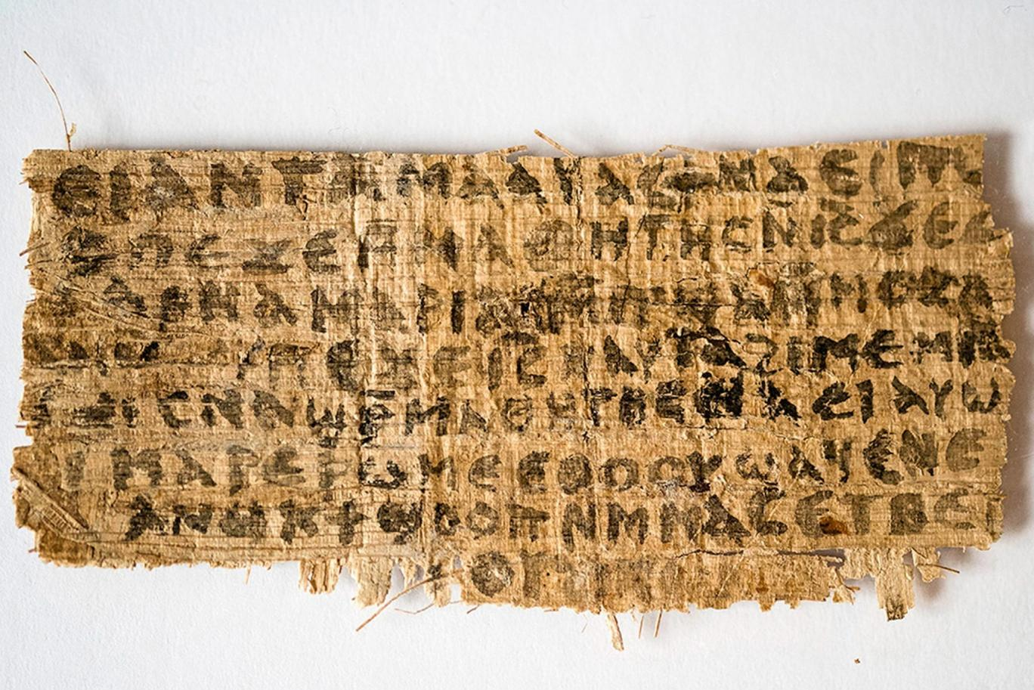

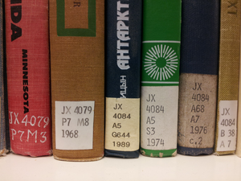
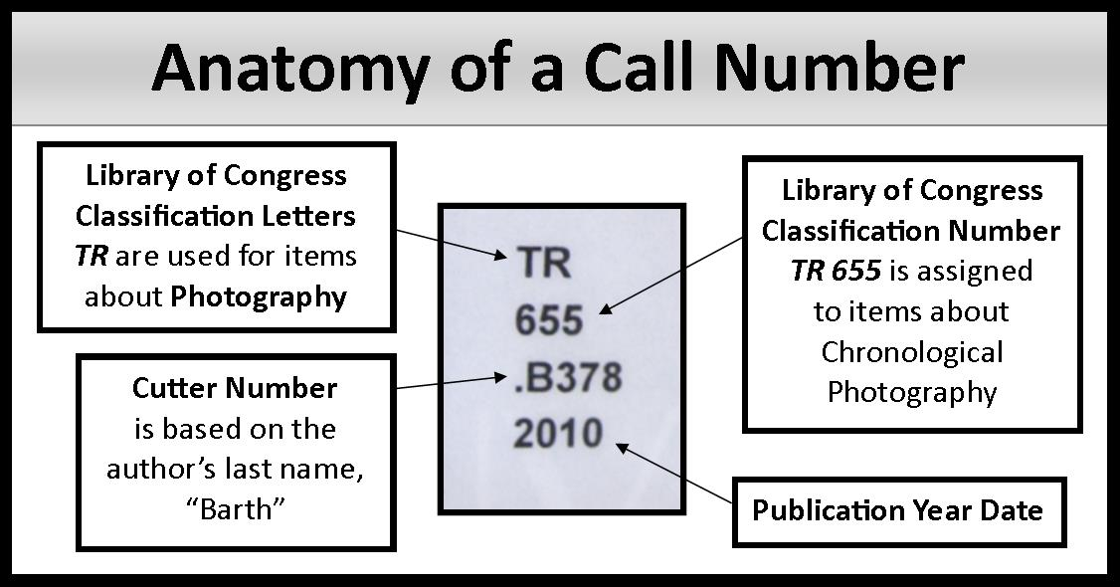
Remembering More Than One Thing…
[source: http://www.independent.co.uk]
[source: http://www.trinity.ox.ac.uk/]
[http://wiki.ubc.ca/images/thumb/d/d2/Book_spines.png/300px-Book_spines.png]
[source: https://dcadlibrary.wordpress.com/2013/05/20/anatomy-of-a-call-number/]
Notes:
Consider first how we organize large amounts of written information.
One approach is to store the writing in books and store the books on shelves.
To find a book in a library …
… you first look up the call number of that book.

Slide 9


Notes:
Once you know the call number …
… you can find the book by going to the appropriate section of the library.
Then, you sign out the book …
… and you can take it home …
… to read.
Now let’s consider how a computer stores larger amounts of information than be in the register file at once.

Slide 10

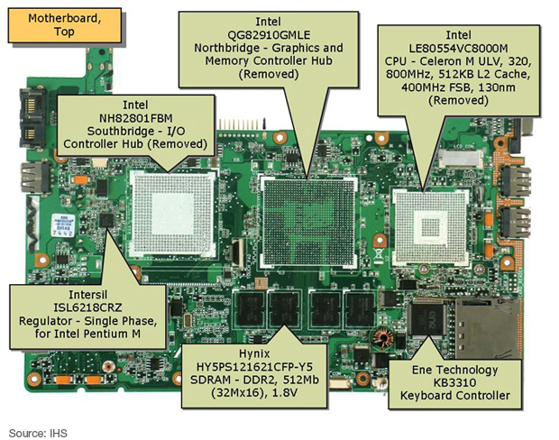



Memory has locations and things stored in those locations; locations are numbers; things are numbers.
JX 4084 A68 A7,
JX 4084 A5 S3,
…
[Source: http://electronics360.globalspec.com/article/3610/asus-eeepc-2gsurf-bk-notebook-computer-teardown]
Notes:
Let’s look inside this laptop computer.
The image on the right is a photo of the motherboard found inside this laptop computer.
This highlighted portion is where the computer’s microprocessor chip is inserted.
This second highlighted portion is the computer’s main memory. The main memory on today’s computers can typically store several gigabytes of data. How does the processor access data from memory? The answer is much like you find a book in the library.
To find the book you are interested in you start with its call number. We will see that a computer uses a special number called an address instead of a call number.
Next you walk to the section of the library containing books with that call number. Inside the computer the equivalent is to send the address to main memory over an address bus.
Next you find the book you were looking for. Inside a computer the address is used to find the data the program is looking for.
Next you sign out and bring the books home.
Inside a computer the process is a bit different in that only an electronic copy of the data in main memory is made and the original copy remains in main memory.

Slide 11
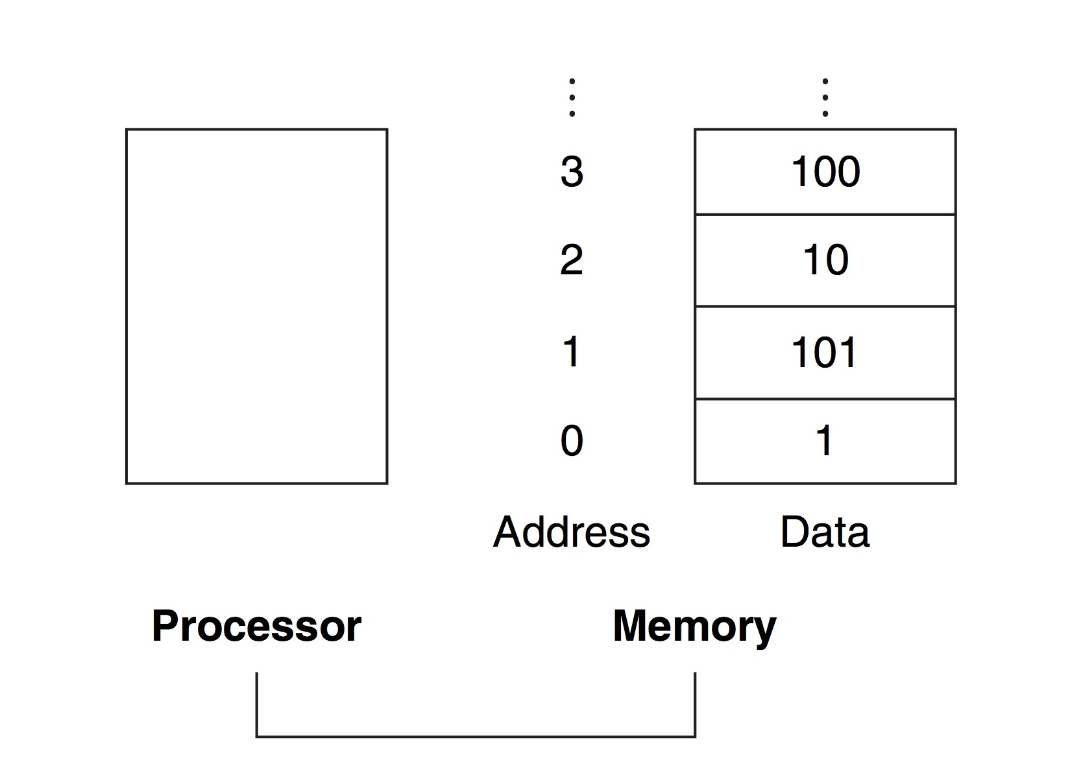
Memory
Notes:
This figure shows an abstracted view of main memory in a computer. The main memory is on the right and is connected to the processor on the left…
… using a bus…

Slide 12
Register File

Slide 13
Register File
Contains eight 16-bit registers
To read a register:
Put the register number on the readnum control signal (3 bits)
The value in the selected register will be driven on the output bus
(not aligned to the clock at all)

Slide 14
Register File
Writing to the register file?

Slide 15
Register File
Writing to the register file…
When? Write data into the register file on rising edge of clk.

Slide 16
Register File
Writing to the register file…
Where? Data to be written into the register supplied on “data_in”

Slide 17
Register File
Writing to the register file…
How? Enable only one register using decoder and AND gates:

Slide 18
Register File
Writing to the register file:
Put the data you want to write on the input bus (data_in)
Put the register number on writenum (NOTE: only 3 bits!)
When clk goes high, the data is written

Slide 19
Example: Writing 5 into R0
3’b000
1’b1
16’d5
5
Writing a value into the register file is clock edge sensitive!

Slide 20
Example: Writing 7 into R1
3’b001
1’b1
16’d7
5
7

Slide 21
Register File: Reading R0
5
7
3’b000
8’b00000001
Reading a value out of register file is purely combinational – no clock!
5

Slide 22
Why only 8 Registers?
Smaller is faster
Reason: delay increases with length of wires
(Generally, all others things being equal, prefer computers to be faster.)
For arithmetic instructions in the Simple RISC Machine ISA all “operands” must be in the register file.
Other ISAs do not make same choice (x86).

Slide 23
Example w/ Registers
The variables f, g, h, i, and j are assigned to the registers r0, r1, r2, r3, and r4, respectively. What is the compiled ARM code for the following C?
f = (g + h) – (i + j);
Solution:
ADD R5,R1,R2 // register R5 contains g + h
ADD R6,R3,R4 // register R6 contains i + j
SUB R0,R5,R6 // R4 gets R5 – R6,
// which is (g + h) – (i + j)

Slide 24
Simple RISC Machine Datapath

Slide 25
Datapath Control Inputs

Slide 26
Each instruction takes between 1 and 4 cycles to execute: Each cycle, certain control signals are asserted to perform the required operations
Which control signals are asserted depends on which instruction is being executed. A decoder and state machine drives the signals at the right time. You’ll design that part in Lab 6.

Slide 27
Multiplexers: Purely combinational logic: you could design these blocks with your eyes closed.

Slide 28
Arithmetic Logic Unit (ALU): Does the actual computing. E.g., adding, subtracting numbers and performing logical operations (AND, NOT, etc…)
ALUop | Operation
00 | Ain + Bin
01 | Ain - Bin
10 | Ain & Bin
11 | ~ Bin
1 if result of ALU
operation is 0
and 0 otherwise

Slide 29
Addition/Subtraction in Verilog
wire [7:0] X, Y, Z;
reg [7:0] W;
assign Z = X + Y; // works with “-” as well
always @*
W = X - Y; // works with “+” as well

Slide 30
Shifter unit: Useful to multiply one ALU
operand by 2 (or divide by 2). We can do
this by shifting 1-bit left or right.

Slide 31
How to shift?
wire [3:0] X, Y, Z;
assign Y = {X[2:0], 1’b0}; // shift X left 1-bit
assign Z = X << 1; // also shifts X left 1-bit

Slide 32
Datapath Operation
MOV R3, #42 // register R3 contains 42
MOV R5,#13 // register R5 contains 13
ADD R2,R5,R3 // R2 gets 42 + 13 = 55
MOV R7,R3 // register R7 contains 42

Slide 33
Suppose we want to load the
actual value “42” into Register 3.
We can do this in one cycle!
Call this “MOV R3, #42”
42
3
1
1

Slide 34
Suppose we want to load the
actual value “13” into Register 5.
(i.e., “MOV R5, #13”)
13
5
1
1

Slide 35
Suppose we want to add the value in
R3 to the value in R5, and store the
result in R2 (“ADD R2, R5, R3”)
42
1
3
Cycle 1: readnum=3, loadb=1
Value in Register 3 is stored in B

Slide 36
Suppose we want to add the value in
R3 to the value in R5, and store the
result in R2 (“ADD R2, R5, R3”)
13
1
5
Cycle 1: readnum=3, loadb=1
Value in Register 3 is stored in B
Cycle 2: readnum=5, loada=1
Value in Register 5 is stored in A

Slide 37
Suppose we want to add the value in
R3 to the value in R5, and store the
result in R2 (“ADD R2, R5, R3”)
13
42
2’b00
Cycle 1: readnum=3, loadb=1
Value in Register 3 is stored in B
0
0
Cycle 2: readnum=5, loada=1
Value in Register 5 is stored in A
Cycle 3: shift=00, asel=0, bsel=0
ALUop=00, loadc=1
Sum of R3 and R5 loaded in C.
2’b00
55
1

Slide 38
Suppose we want to add the value in
R3 to the value in R5, and store the
result in R2 (“ADD R2, R5, R3”)
55
2
1
0
Cycle 1: readnum=3, loadb=1
Value in Register 3 is stored in B
Cycle 2: readnum=5, loada=1
Value in Register 5 is stored in A
Cycle 3: shift=00, asel=0, bsel=0
ALUop=00, loadc=1
Sum of R3 and R5 loaded in C.
Cycle 4: writenum=2, write=1,
Vsel=0; Sum of R3 and R5 written to R2.

Slide 39
Suppose we want to copy the contents
of R3 to R7 (“MOV R7, R3”)
42
1
3
Cycle 1: readnum=3, loadb=1
Value in Register 3 is stored in B

Slide 40
Suppose we want to copy the contents
of R3 to R7 (“MOV R7, R3”)
42
2’b00
0
Cycle 1: readnum=3, loadb=1
Value in Register 3 is stored in B
0
1
Cycle 2: shift=00, asel=1, bsel=0
ALUop=00, loadc=1,status=1
Sum of 0 and R3 loaded in C.
2’b00
42
1

Slide 41
Suppose we want to copy the contents
of R3 to R7 (“MOV R7, R3”)
42
7
1
0
Cycle 1: readnum=3, loadb=1
Value in Register 3 is stored in B
Cycle 2: shift=00, asel=1, bsel=0
ALUop=00, loadc=1,status=1
Sum of 0 and R3 loaded in C.
Cycle 3: writenum=2, write=1,
Vsel=0; Sum of R3 and R5 written to R2.

