Slide 1
CPEN 211: Introduction to Microcomputers Lab 6 Introduction
Prof. Tor Aamodt
Notes:
1

Slide 2
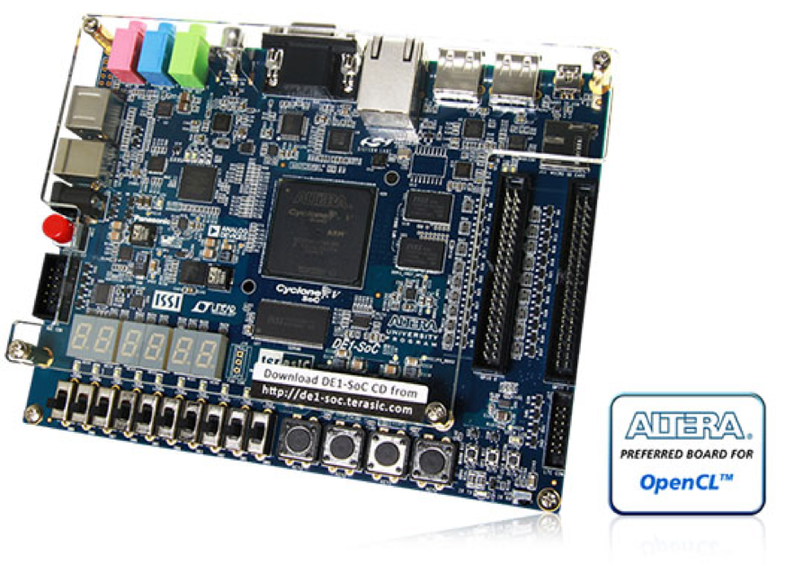
Automating Instruction Execution
In Lab 5 you built a datapath for a computer…

Slide 3
Recall from Lab 5…
Suppose we want to add the value in
R3 to the value in R5, and store the
result in R2 (“ADD R2, R5, R3”)
13
1
5
Cycle 1: readnum=5, loada=1
Value in Register 5 is stored in A

Slide 4
Recall from Lab 5…
Suppose we want to add the value in
R3 to the value in R5, and store the
result in R2 (“ADD R2, R5, R3”)
42
1
3
Cycle 1: readnum=5, loada=1
Value in Register 5 is stored in A
Cycle 2: readnum=3, loadb=1
Value in Register 3 is stored in B

Slide 5
Recall from Lab 5…
Suppose we want to add the value in
R3 to the value in R5, and store the
result in R2 (“ADD R2, R5, R3”)
13
42
2’b00
Cycle 1: readnum=5, loada=1
Value in Register 5 is stored in A
0
0
Cycle 2: readnum=3, loadb=1
Value in Register 3 is stored in B
2’b00
Cycle 3: shift=00, asel=0, bsel=0
ALUop=00, loadc=1
Sum of R3 and R5 loaded in C.
55
1

Slide 6
Recall from Lab 5…
Suppose we want to add the value in
R3 to the value in R5, and store the
result in R2 (“ADD R2, R5, R3”)
55
2
1
0
Cycle 1: readnum=5, loada=1
Value in Register 5 is stored in A
Cycle 2: readnum=3, loadb=1
Value in Register 3 is stored in B
Cycle 3: shift=00, asel=0, bsel=0
ALUop=00, loadc=1
Sum of R3 and R5 loaded in C.
Cycle 4: writenum=2, write=1,
Vsel=0; Sum of R3 and R5 written to R2.

Slide 7
Automating Instruction Execution
Lab 6: Add a “Controller” to automate setting control signals

Slide 8
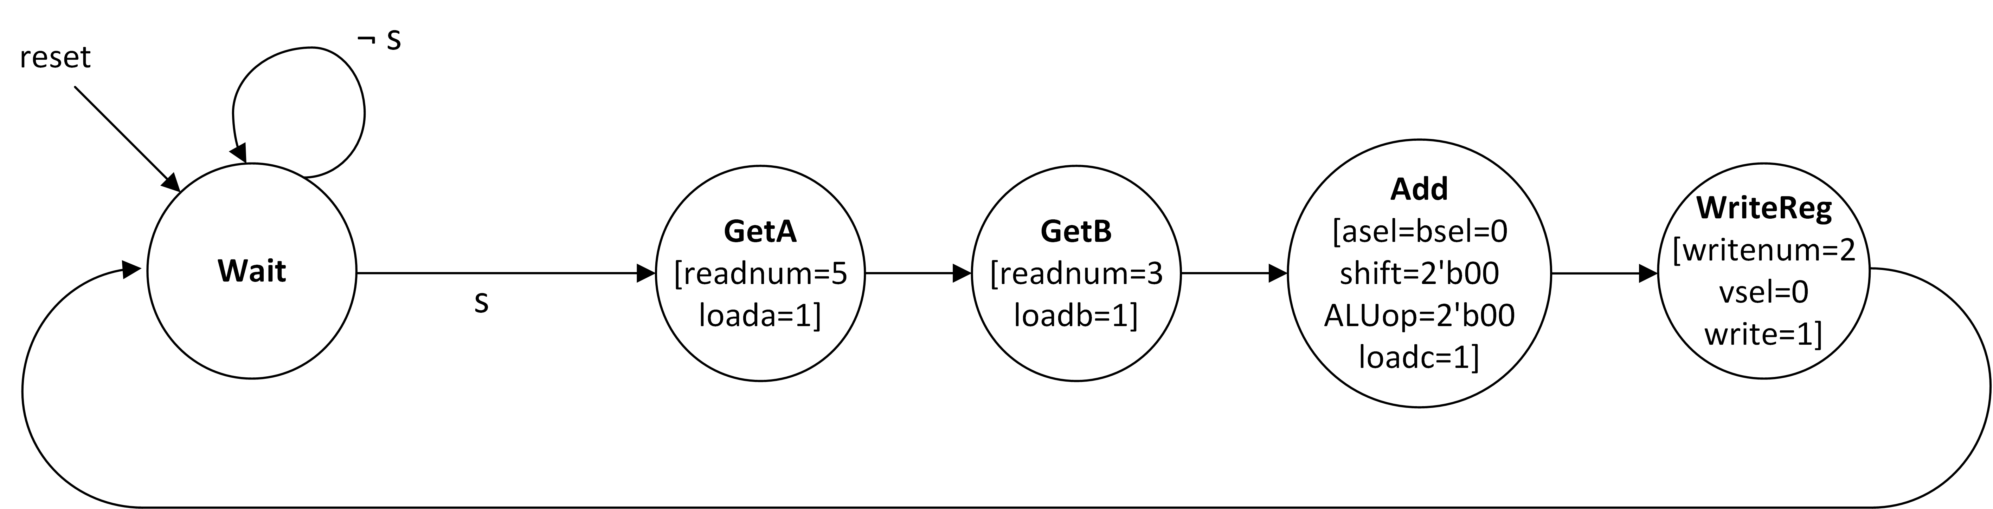
How to design this controller?
1st : Imagine just supporting “ADD R2, R5, R3”…

Slide 9
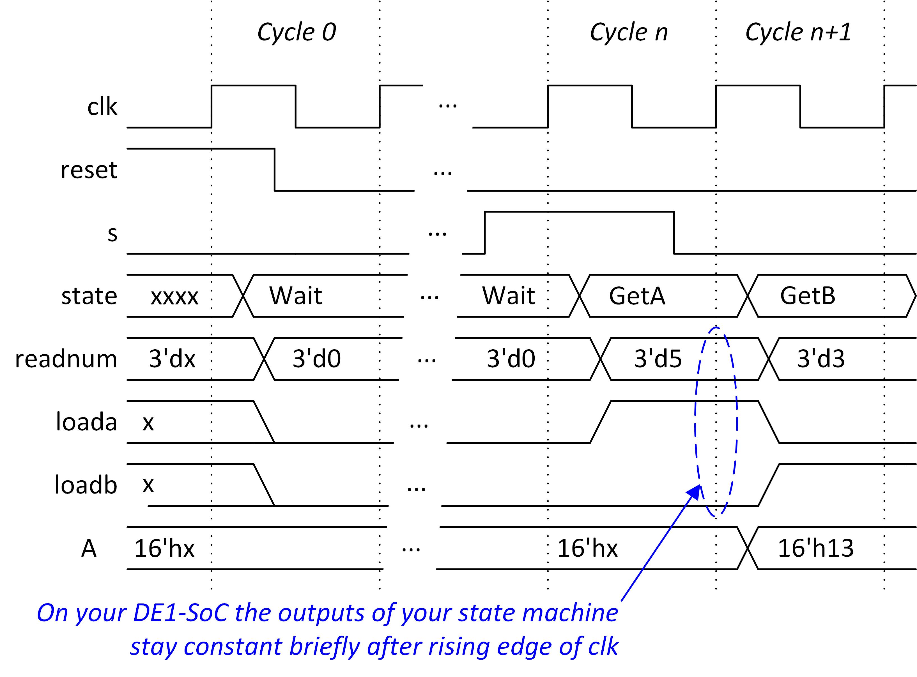
1st : Imagine just supporting “ADD R2, R5, R3”…
13
1
5

Slide 10
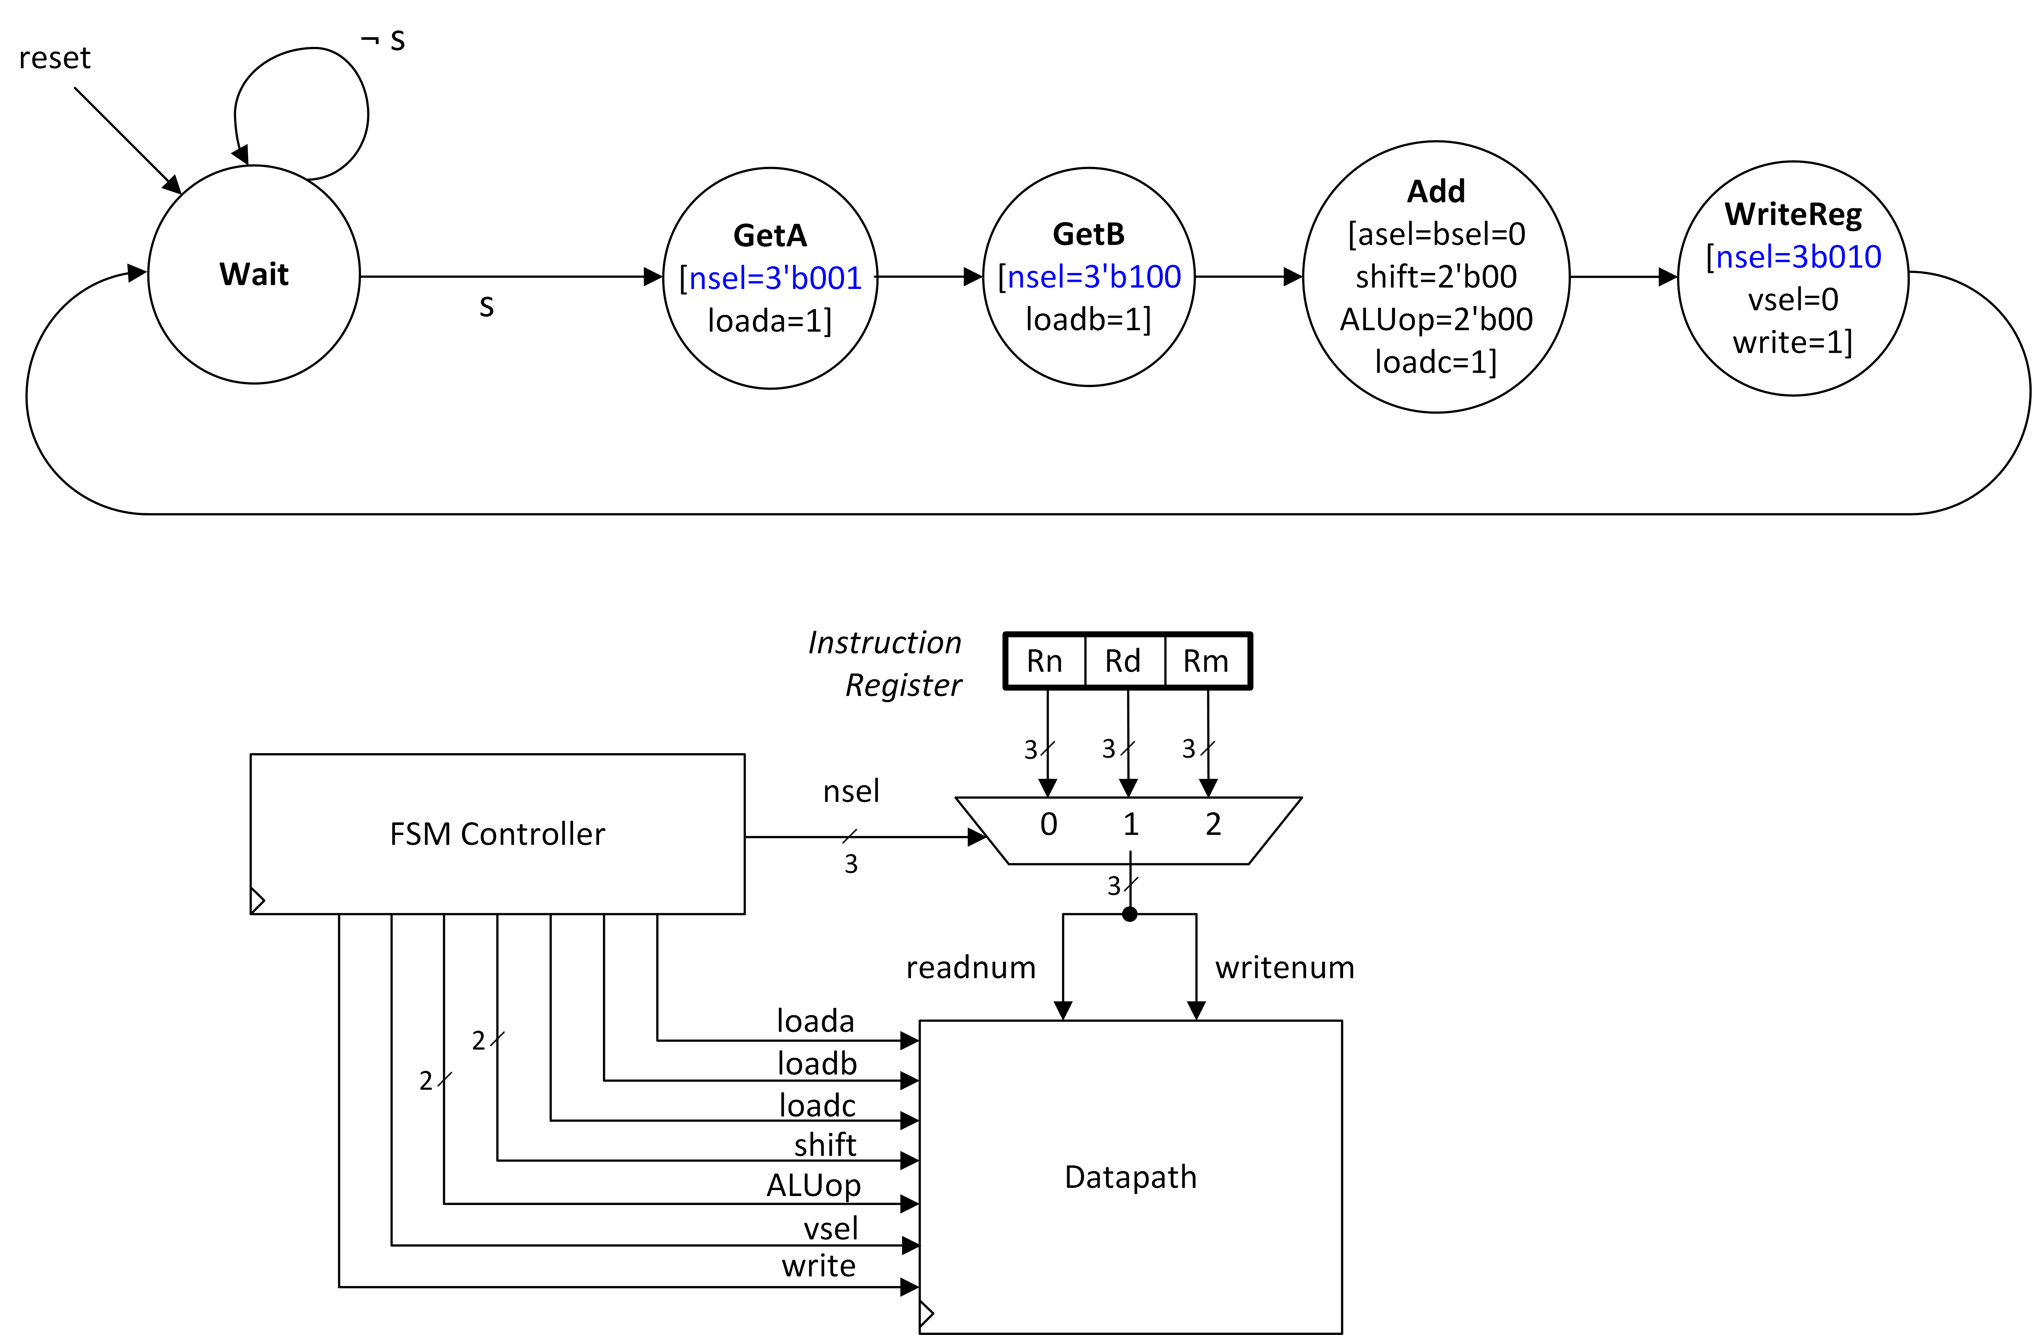
More than one instruction?
Adding “Instruction Register” enables support for ADD Rd, Rn, Rm
Rm and Rn indicate which two of the eight registers in ”regfile” should be added together
Rd is the register in “regfile” where we will put the result into.

Slide 11
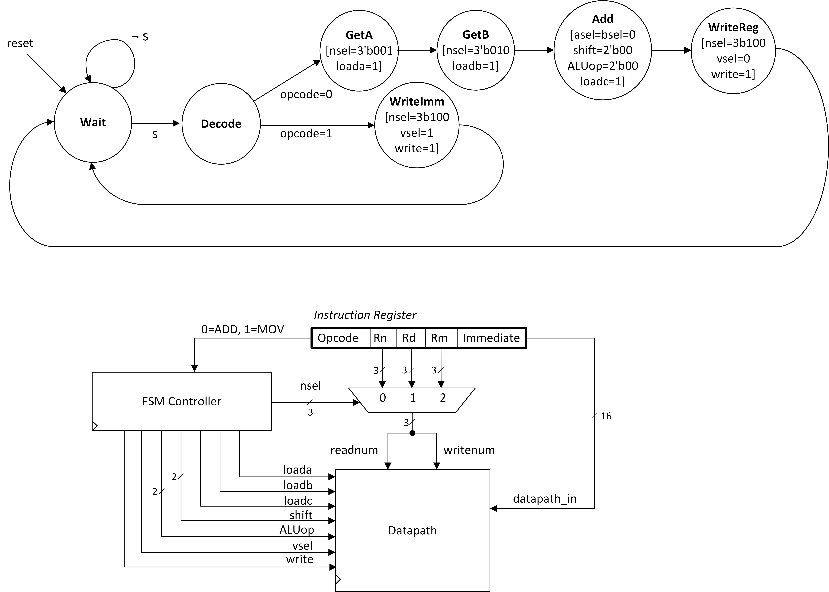
Two instructions…
Use “Opcode” to enable “MOV Rn,#<im8>” and ADD “Rd, Rn, Rm”

Slide 12
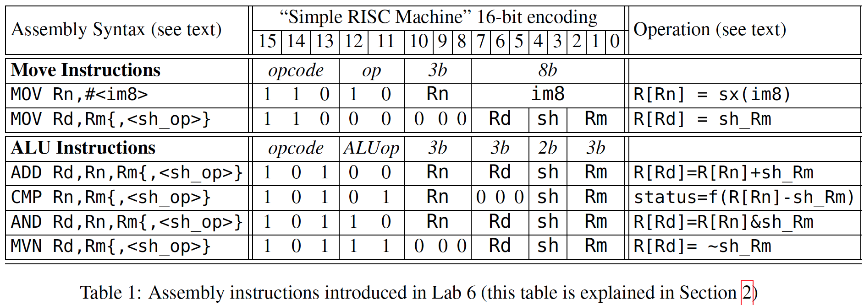
Lab 6: Design Requirements
Design state machine to support following instructions…

Slide 13
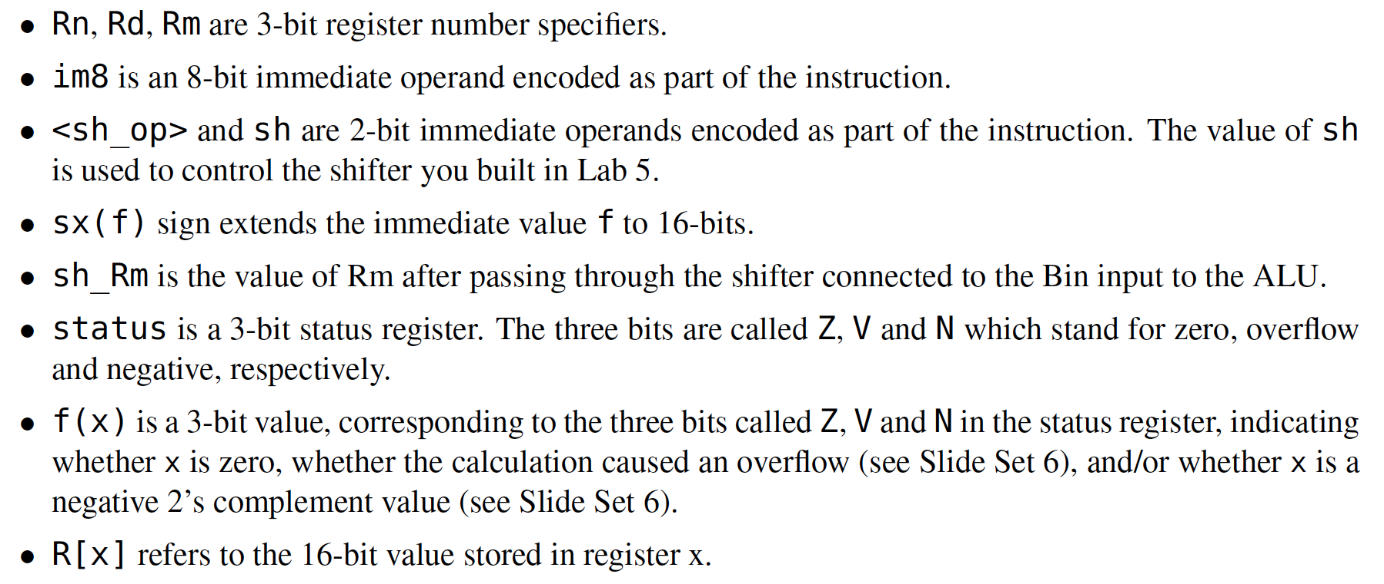
Definitions used in prior table

Slide 14
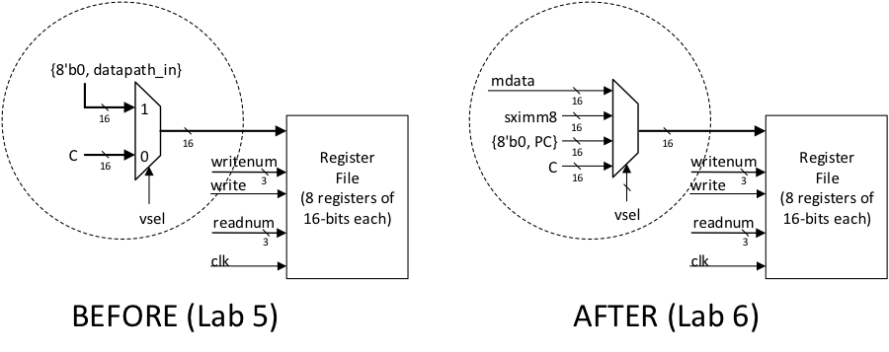
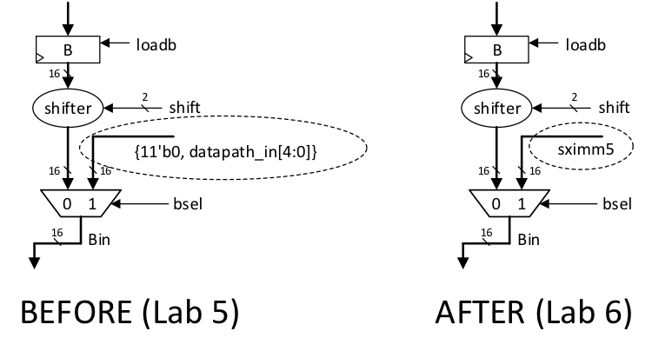
Lab Procedure
Datapath changes…

Slide 15
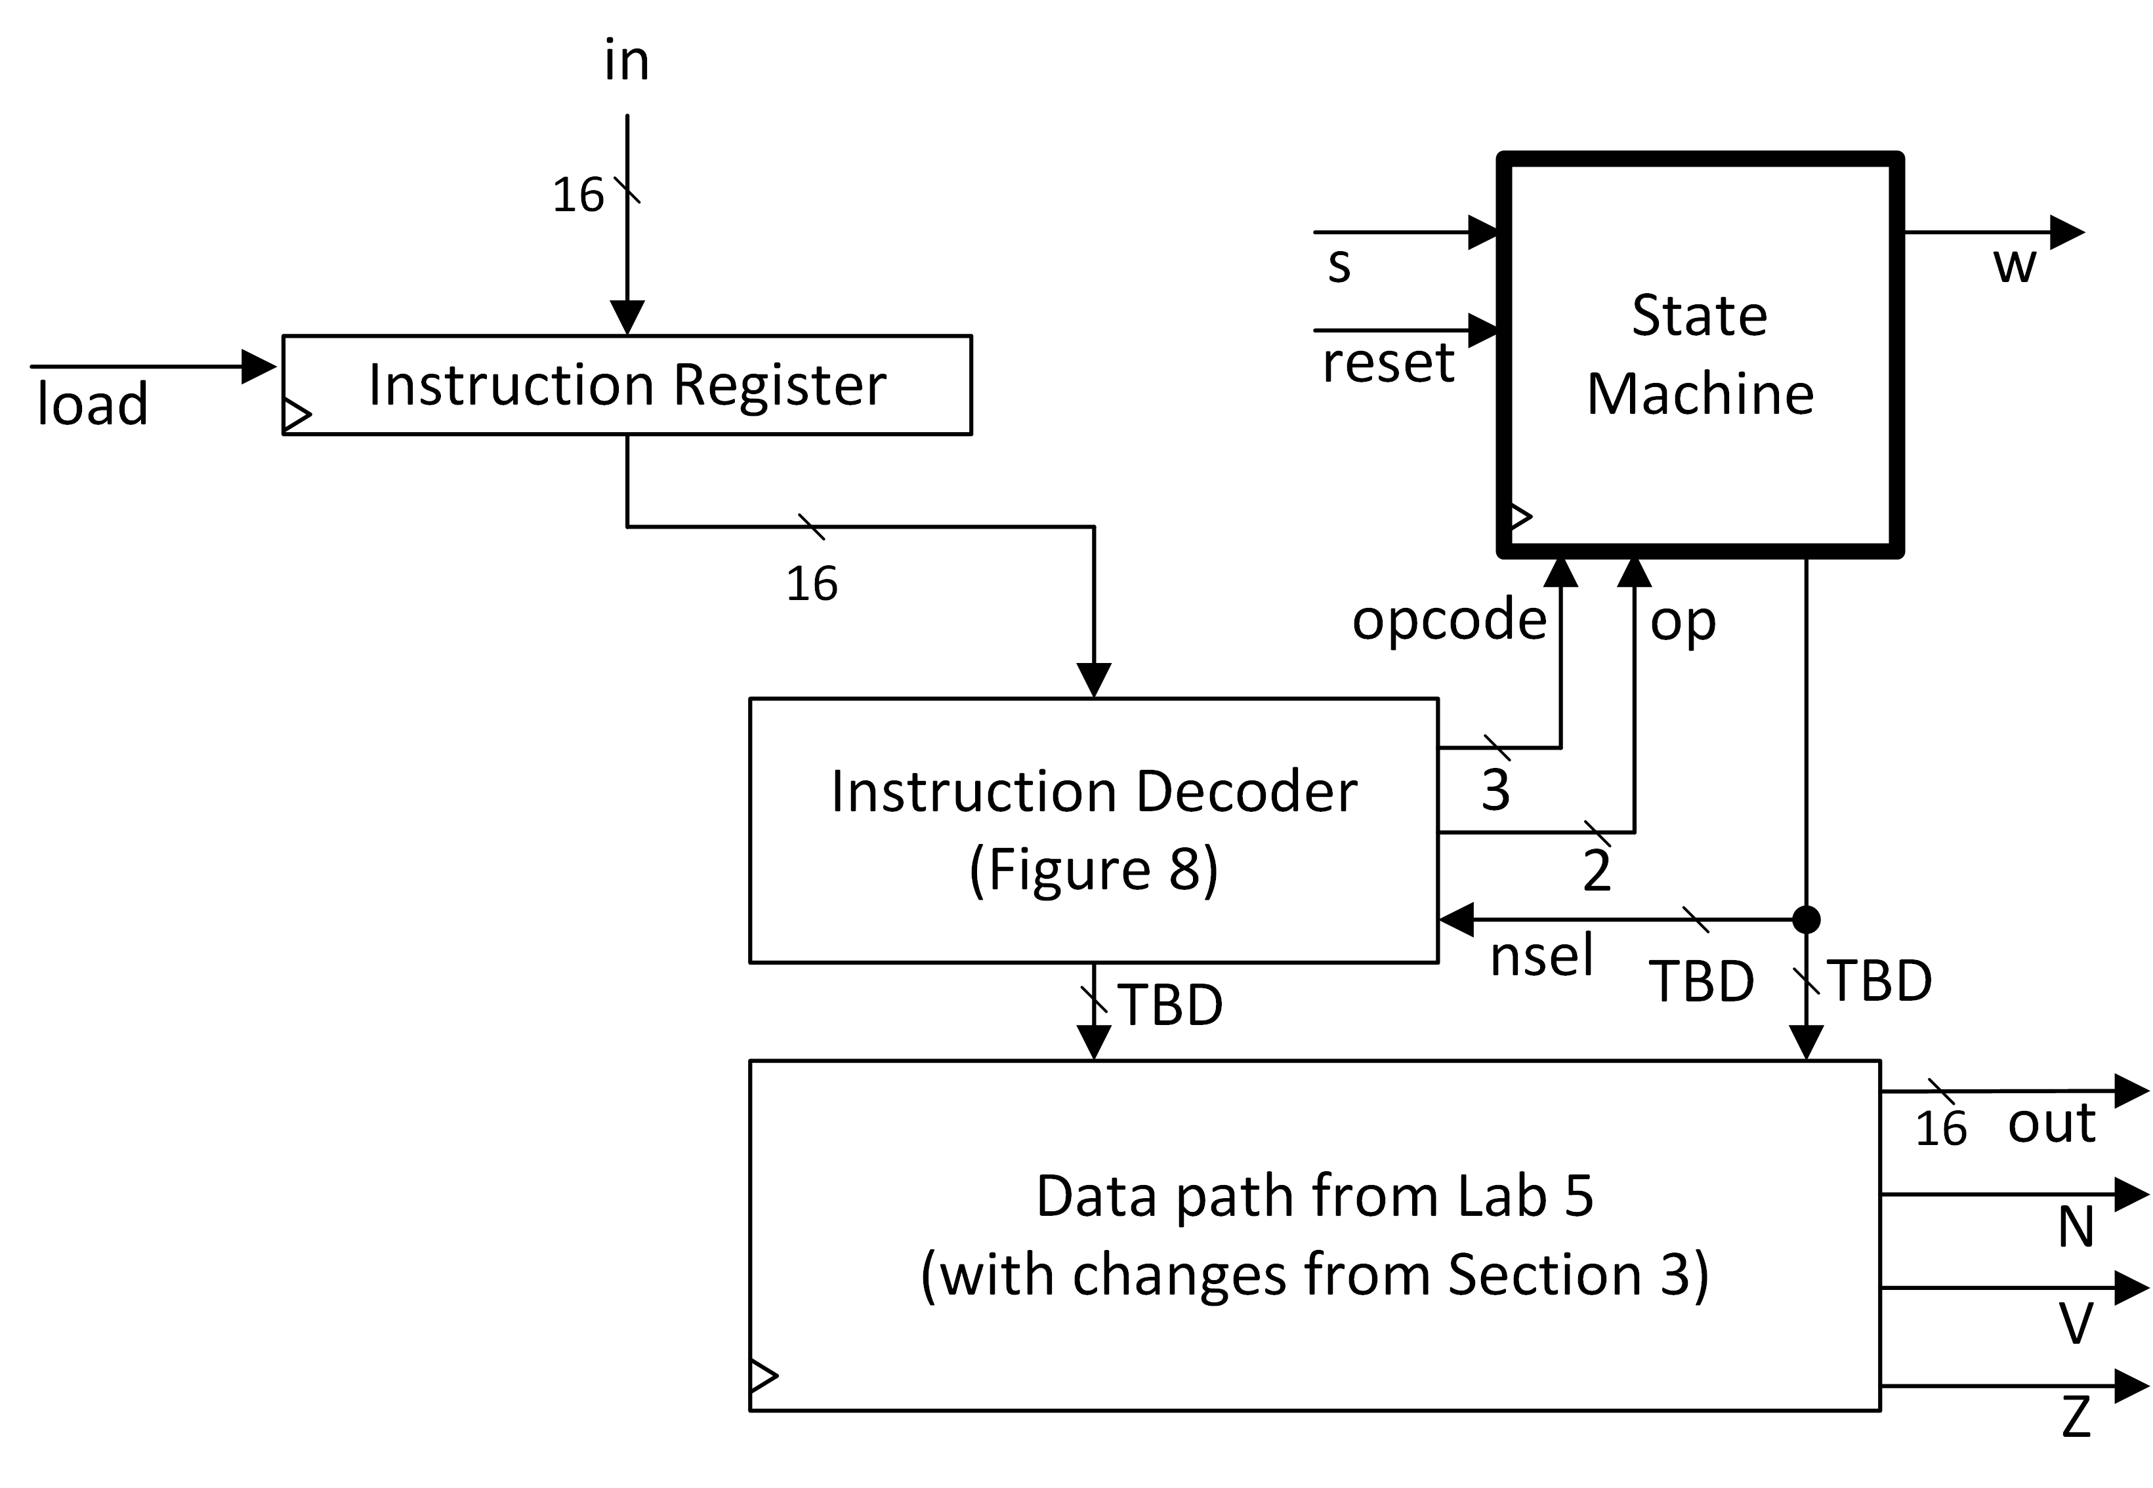
Instruction Decoder and Controller
FSM requires both opcode and op as inputs.
Instruction decoder in Figure 8 is a suggestion (could be made part of FSM).
Input from FSM to Decoder is nsel, but FSM can also send other outputs besides “nsel” to datapath.

Slide 16
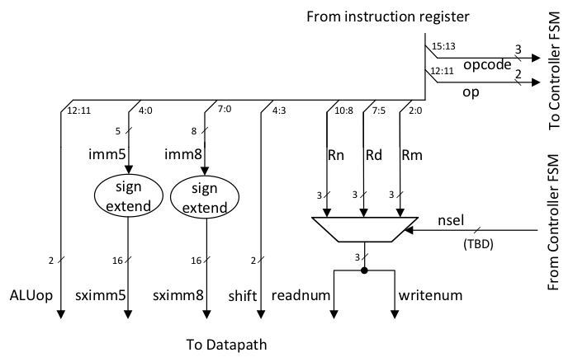
Instruction Decoder
Just a suggestion…

Slide 17
Autograder checker
Reminder: Simulate lab6_autograder_check.v in ModelSim to make sure your Verilog is compatible with the autograder.

