Slide 1

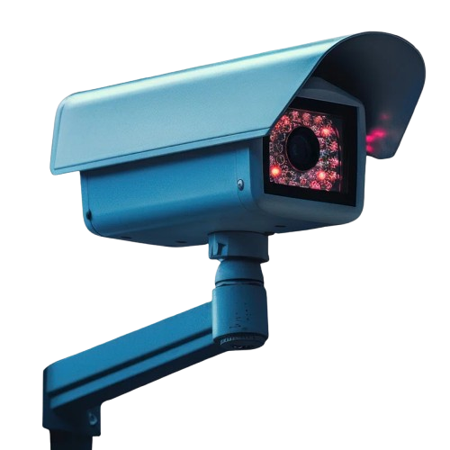










False
• Location of Crime
• Crime Footage
• 6 Nearest CCTV Footage
START
CMIL (Contrastive Multiple Instance Learning) Model
Data Input Stream
O/P
Crime detected?
True
CCTV Live Rendering
UCF Crime Dataset for Training
Decentralized Evidence Logging
& Access Control
[Edu-Chain - Layer 2 EVM Network]
Crime Prediction Model
Alert
Database
Florence 2 as VLM for Transcription of Video-To-Text
Frame level captioning with timestamp for cctv clip
Query (E.g. Any white car spotted between 1 - 3 PM)
ZenSafe Police Dashboard
VLM for Text Extraction from Video
RAG (Retrieval Augmented Generation) Model
RAG
Text/Document Database
Response (E.g. Yes, at 2:15 PM)

Slide 2
