Slide 1



ZENSAFE
Practical AI and Blockchain In Empowering CCTV Surveillance For Woman’s and Public Safety
Team Matrix
Sri Manakula Vinayagar Engineering College
Pavan K
(Leader, AI/ML, Blockchain)
Divakar E
(Web & API Developer)
Sachin G.P
(DevOps
Engineer)
Nidhin S
(UI/UX
Designer)

Slide 2
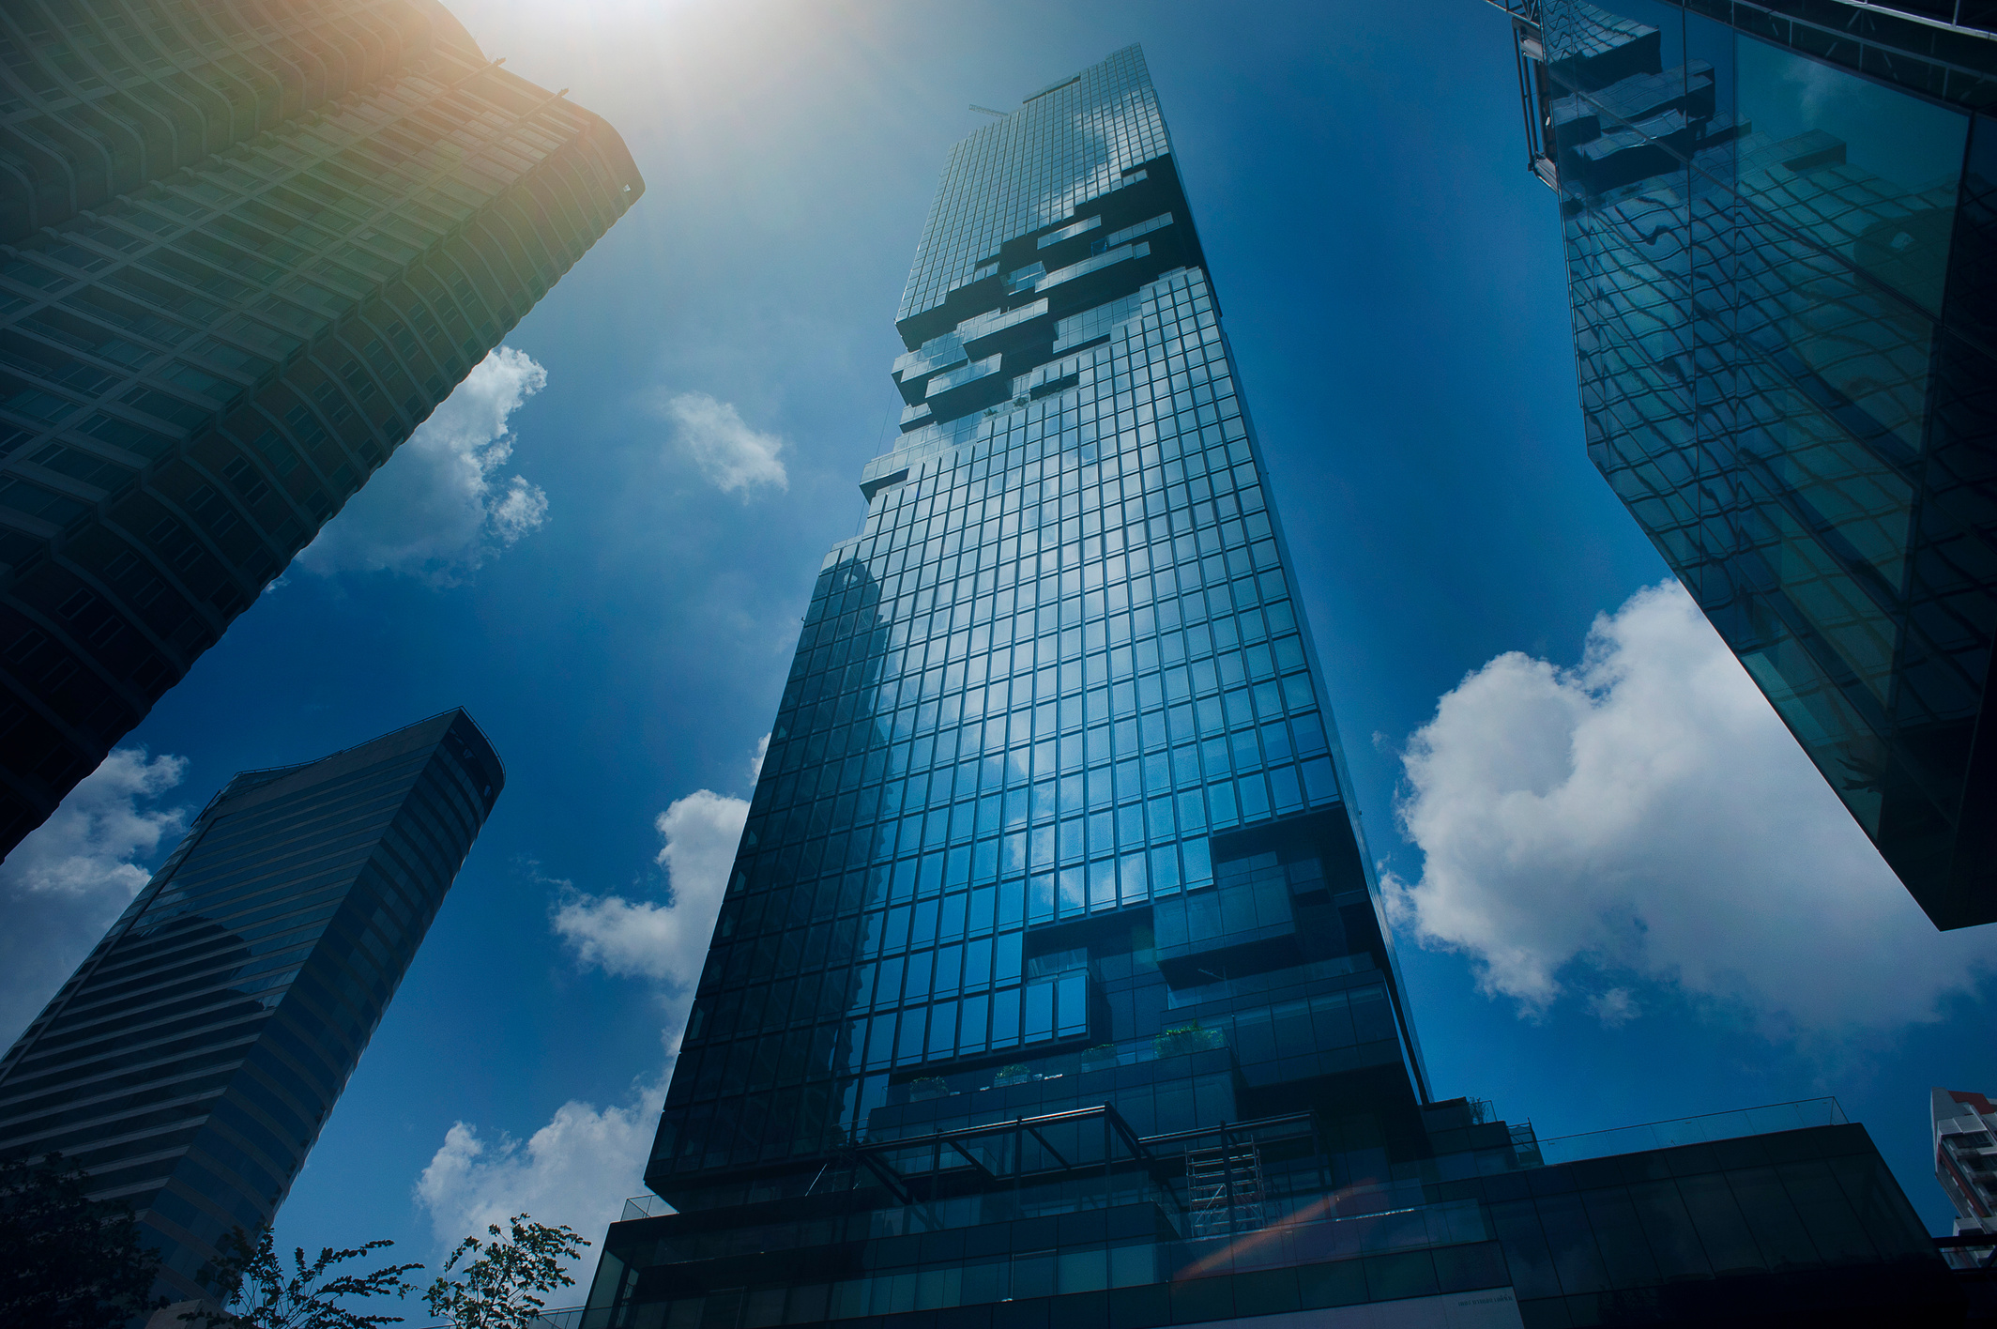
1
2
3
Problem Statement
Proposed Solution
Market Analysis
AGENDA
4
5
6
System Architecture
Existing System vs Zensafe
Computation & Deployment
7
8
9
Revenue & Cost Analysis
Impacts & Benefits
Conclusion

Slide 3





1
Problem Statement
“When crimes go unseen and fear takes the lead, The cries for justice are lost in the bleed.
Justice delayed is justice denied - Silence becomes the place where truth has died.”
Underreporting and Delay
Tampering and Bias In Evidence
Crimes often go unnoticed or unreported due to public fear or apathy. Lack of real-time monitoring results in delayed responses and increased threats to life and safety.
Crucial digital evidence can be altered or suppressed. Political or financial influence often compromises the integrity of investigations, leading to unjust outcomes.
CCTV Analysis Bottleneck
Delayed Justice Loop
Manual footage analysis during investigations is slow and resource-heavy, delaying evidence retrieval and impacting the speed and effectiveness of case resolution.
Time-consuming investigations and inefficient systems delay justice. This erodes public trust and burdens law enforcement with extended case cycles and mounting unresolved evidence.

Slide 4




2
Proposed Solution
Real-Time Crime Detection
Trustless Crime Archiving
AI-powered surveillance identifies crimes instantly, reducing response time. Prevents delays by analyzing live CCTV feeds for suspicious activity.
Uses dual-layer hashing of video and ID, stores footage on IPFS, and records final hash with metadata on blockchain for tamper-proof evidence.
Natural Language CCTV Querying
Tactical Monitoring Grid
Allows investigators to search CCTV footage using simple text queries. Speeds up evidence retrieval by describing events instead of manually searching.
Intelligently auto-retrieves nearby CCTV feeds, shares verified crime footage, geotags incidents, and alerts police for rapid response.

Slide 5





3
Market Analysis
In 2024, the global public safety market was valued at $520.8 billion and is expected to grow to $878.2 billion by 2030 at a CAGR of 11.0%
Government & Municipalities
Police & Law Enforcement
Target Audience
Private Sectors
Global Public Safety Market Growth Projection (2024-2030)

Slide 6
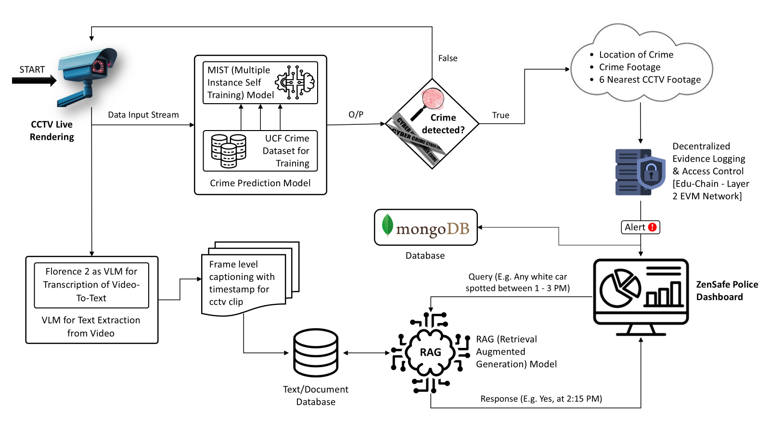

4
System Architecture

Slide 7

5
Existing System vs Zensafe
Feature | Existing System | Zensafe
Incident Reporting | Requires the public to manually report crimes, often delayed or skipped. | AI-powered CCTV auto-reports incidents with location, crime clip and nearby camera feeds.
Real-time Crime Detection | Performs video-level crime classification, unsuitable for live CCTV streams. | Frame-level predictions enable true real-time crime detection and response.
CCTV Footage Analysis | Manual review of hours of footage; consumes time and manpower. | Natural language querying cut down effort by 80-90%, enabling rapid investigation.
Evidence Integrity | Lacks standardization; footage can be tampered or lost, especially under influence. | Hybrid hash of video, timestamp and location are logged immutably on blockchain for security.
Access & Transparency | Data access often opaque, prone to internal delays and manipulation. | Role-based access with on-chain audit logs ensures transparency and traceability in every action.

Slide 8
6
Computation & Deployment
Task | Performance
Crime Detection Inferencing | ~ 2.5 frames/sec
Caption Generation | ~ 4 sec/frame
Caption Embedding | ~ 2 ms/token
Vector Store Updation/Retrieval | ~ 700 ms/minute footage
We perform edge computing using the NVIDIA A100 GPU, leveraging its exceptional parallel processing to handle real-time surveillance workloads efficiently.
A single A100 can handle 80-120 CCTV cameras at ~1 FPS, enabling scalable, zonal deployment across urban clusters.
Running key tasks like AI inferencing and generation locally reduces latency and ensures quicker response.
This architecture minimizes cloud dependency, cutting bandwidth costs and ensuring uninterrupted processing even in low-connectivity areas.
Note: Performance estimations are based on RTX 3050-controlled testing environments and projected scalability of A100 GPU.

Slide 9

7
Revenue & Cost Analysis
The Indian government has invested over ₹1,47,000 crore in Smart City projects across 100 cities. ZenSafe aligns perfectly with this push for AI-driven urban infrastructure.
With SaaS-based models, smart surveillance systems generate up to 60–70% of their lifetime value through recurring revenue - maintenance, licensing, and analytics subscriptions.
Edge processing can cut cloud expenses by 30–60%, while reducing latency and bandwidth use - making ZenSafe highly scalable and profitable over time.
The AI surveillance market is expected to reach $12.46 billion by 2030. With limited end-to-end tamper-proof systems, ZenSafe is poised for niche dominance.
$20K- 30K per
Cluster
Investment Pie Chart per Cluster

Slide 10
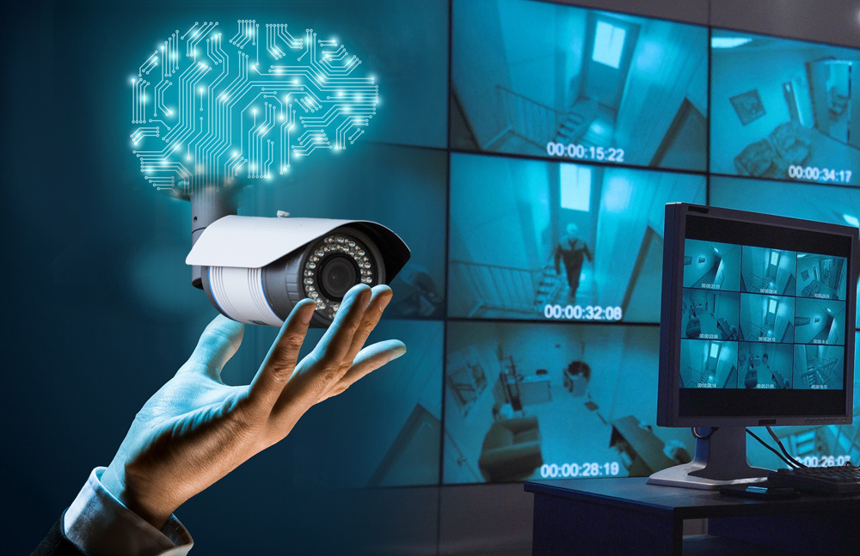
8
Impacts & Benefits
1
Establishes a proactive and responsive crime monitoring framework, leading to safer communities and faster interventions.
2
Reduces delays, bias, and evidentiary gaps - helping ensure fair, timely, and transparent legal outcomes.
3
Automates surveillance and analysis, allowing officials to act swiftly and focus on high-priority threats.
4
Promotes confidence & bolsters trust among citizens by ensuring accountability, security and visible action against crime.

Slide 11
9
Conclusion
ZenSafe stands at the intersection of technology, justice, and public safety. By addressing long-standing challenges in surveillance, evidence integrity, and response time, it redefines how cities can proactively protect their citizens. With scalable infrastructure, AI-driven intelligence, and trusted digital records, ZenSafe is not just a tool - it’s a step toward a safer, smarter society. It’s not about watching anymore - it’s about acting faster, smarter, and fairer.
“When crimes go unseen and justice is late,
Fear takes root and trust meets its fate.
But with eyes that watch and minds that learn,
A safer world is what we earn.”

Slide 12
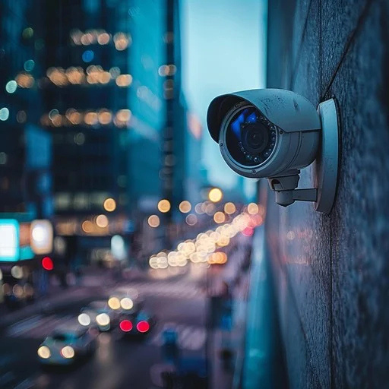
THANK YOU

