Slide 1

AtilQ Hospitality Analysis
Data Analysis using PowerBi
Presented By
Nikita Jagtap

Slide 2
About Project
Project Title | AtliQ Hospitality Analysis
Technology | Data Analytics
Domain | Travel and Tourism
Project Difficulty Level | Advanced
Tool used | MS PowerBI
AtliQ Grands owns multiple five-star hotels across India. They have been in the hospitality industry for the past 20 years. Due to strategic moves from other competitors and ineffective decision-making in management, AtliQ Grands are losing its market share and revenue in the luxury/business hotels category. AtliQ Hotels have their properties in the cities of Mumbai, Delhi, Bangalore & Hyderabad. There properties are further categorized as Atliq Bay, Atliq Blu, Atliq City, Atliq Exotica, Atliq Grands, Atliq Palace & Atliq Seasons.
Mumbai
Bangalore
Hyderabad
Delhi
Atliq Bay
Atliq Blu
Atliq City
Atliq Exotica
Atliq Grands
Atliq Palace
Atliq Seasons
Atliq Bay
Atliq Blu
Atliq City
Atliq Exotica
Atliq Grands
Atliq Palace
Atliq Bay
Atliq Blu
Atliq City
Atliq Exotica
Atliq Grands
Atliq Palace
Atliq Bay
Atliq Blu
Atliq City
Atliq Grands
Atliq Palace

Slide 3
Problem Statement
AtliQ Grands are losing its market share and revenue in the luxury/business hotels category.
As a strategic move, the managing director of AtliQ Grands wanted to incorporate “Business and Data Intelligence” to regain their market share and revenue.
Provide Insights to the Revenue team by utilizing the given data.

Slide 4
About the Dataset
This file contains all the meta information regarding the columns described in the CSV files. we have provided 5 CSV files: 1. dim_date 2. dim_hotels 3. dim_rooms 4. fact_aggregated_bookings 5. fact_bookings
Column Description for dim_date:
1. date: This column represents the dates present in May, June and July. 2. mmm yy: This column represents the date in the format of mmm yy (monthname year). 3. week no: This column represents the unique week number for that particular date. 4. day_type: This column represents whether the given day is Weekend or Weekeday.
Column Description for dim_hotels:
1. property_id: This column represents the Unique ID for each of the hotels. 2. property_name: This column represents the name of each hotel. 3. category: This column determines which class[Luxury, Business] a particular hotel/property belongs to. 4. city: This column represents where the particular hotel/property resides in.
Column Description for dim_rooms:
1. room_id: This column represents the type of room[RT1, RT2, RT3, RT4] in a hotel. 2. room_class: This column represents to which class[Standard, Elite, Premium, Presidential] particular room type belongs.
Column Description for fact_aggregated_bookings:
1. property_id: This column represents the Unique ID for each of the hotels. 2. check_in_date: This column represents all the check_in_dates of the customers. 3. room_category: This column represents the type of room[RT1, RT2, RT3, RT4] in a hotel. 4. successful_bookings: This column represents all the successful room bookings that happen for a particular room type in that hotel on that particular date. 5. capacity: This column represents the maximum count of rooms available for a particular room type in that hotel on that particular date.

Slide 5
Column Description for fact_bookings:
booking_id: This column represents the Unique Booking ID for each customer when they booked their rooms. 2. property_id: This column represents the Unique ID for each of the hotels 3. booking_date: This column represents the date on which the customer booked their rooms. 4. check_in_date: This column represents the date on which the customer check-in(entered) at the hotel. 5. check_out_date: This column represents the date on which the customer check-out(left) of the hotel. 6. no_guests: This column represents the number of guests who stayed in a particular room in that hotel. 7. room_category: This column represents the type of room[RT1, RT2, RT3, RT4] in a hotel. 8. booking_platform: This column represents in which way the customer booked his room. 9. ratings_given: This column represents the ratings given by the customer for hotel services. 10. booking_status: This column represents whether the customer cancelled his booking[Cancelled], successfully stayed in the hotel[Checked Out] or booked his room but not stayed in the hotel[No show]. 11. revenue_generated: This column represents the amount of money generated by the hotel from a particular customer. 12. revenue_realized: This column represents the final amount of money that goes to the hotel based on booking status. If the booking status is cancelled, then 40% of the revenue generated is deducted and the remaining is refunded to the customer. If the booking status is Checked Out/No show, then full revenue generated will goes to hotels.

Slide 6
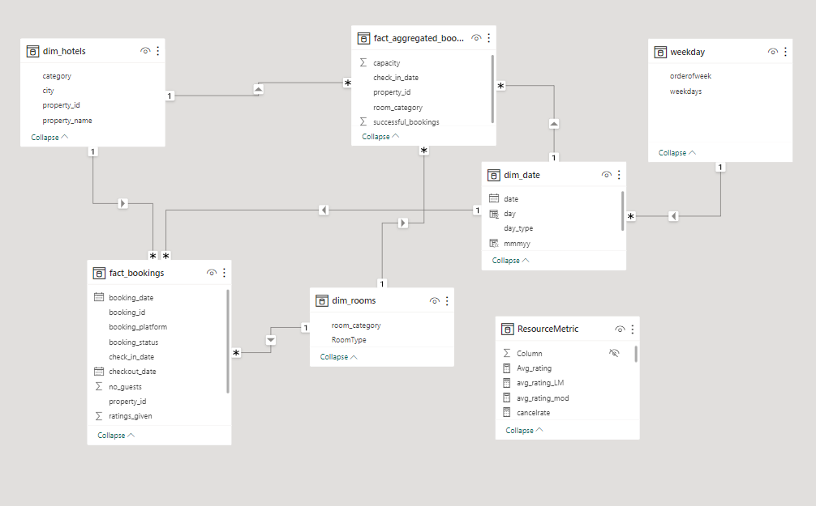
Data Modelling

Slide 7
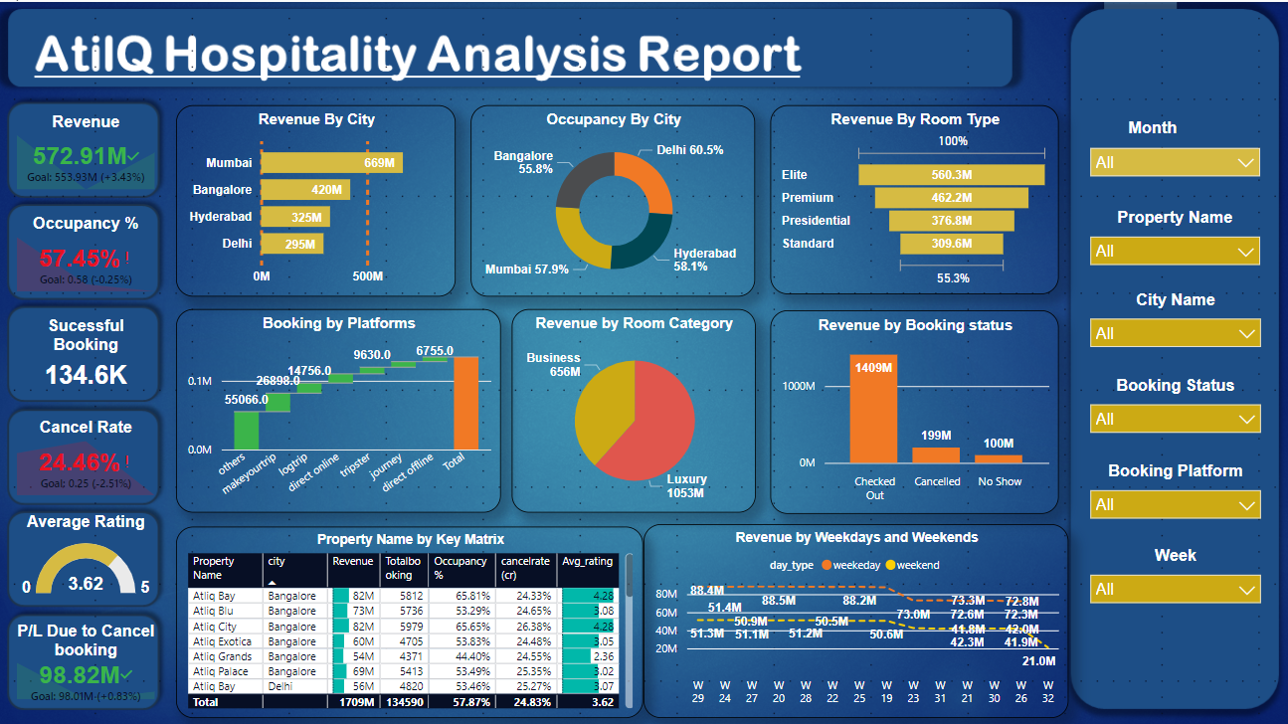
Dashboard

Slide 8
Insights
Revenue Overview
Total Revenue: The total revenue generated is 1708.8M.
Revenue by City: Mumbai leads in revenue generation with 669M, followed by Bangalore (420M), Hyderabad (325M), and Delhi
(295M).
Revenue by Room Type: The highest revenue is generated from Elite rooms (560.3M), followed by Premium (462.2M),
Presidential (376.8M), and Standard rooms (309.6M).
Revenue by Room Category: Luxury rooms contribute the most to revenue (1053M), while Business rooms generate 656M.
Revenue by Booking Status: Checked-out bookings contribute the most to revenue (1409M), while canceled bookings and
no-shows account for 199M and 100M, respectively.
Revenue by Weekdays and Weekends: Revenue is generally higher on weekdays (88.2M) compared to weekends
(51.3M), with a noticeable peak in week 28.
Occupancy & Booking Metrics
Occupancy Rate: The overall occupancy rate is 57.9%. Delhi has the highest occupancy rate (60.5%), followed by Hyderabad
(58.1%), and Mumbai (57.9%).
Successful Bookings: There are 134.6K successful bookings.
Booking by Platforms: Most bookings come from the "others" category (55,066), followed by makemytrip, and various direct
and indirect online channels.
Cancel Rate: The overall cancelation rate is 24.8%, which seems significant.
Average Rating: The properties have an average rating of 3.62 out of 5, indicating moderate customer satisfaction.

Slide 9
Property-Level Insights:
The report includes a table of properties with their respective revenue, total bookings, occupancy rate, cancelation rate, and average rating. For example:
AtilQ Bay in Mumbai generated 58M revenue with an occupancy rate of 65.81% and an average rating of 4.28.
AtilQ Grands in Bangalore has a lower occupancy rate (55.29%) and a cancelation rate of 25.35%.
Overall Insights
Mumbai is the leading city in terms of revenue generation, but Delhi has the highest occupancy rate.
Elite and Luxury rooms are the most profitable in terms of revenue.
Checked-out bookings are the primary contributors to revenue, indicating successful service delivery.
Weekdays generate higher revenue than weekends, possibly due to business travelers.
The cancelation rate is relatively high, which may need to be addressed to optimize revenue.
The average rating suggests there's room for improvement in customer satisfaction across the properties.\
20% of bookings comes from makeyourtrip.com.
Elite room class generates the highest revenue followed by Premium and Presidential.

