Slide 1
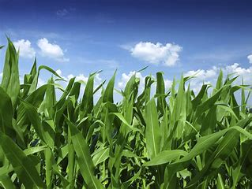
Crop Production Analysis of India
Data Analysis using Python
Presented By :Nikita Jagtap

Slide 2
Project Overview
Project Title | Crop Production Analysis of India
Technology | Data Analytics
Domain | Agriculture
Project Difficulty level | Advance
Programming Language Used | Python
Tool used | Juypter Notebook,
Over the past few weeks, I have conducted an in-depth analysis of crop production data in India, covering the period from 1997 to 2015 of 246091 records in dataset, using Python (Pandas, Matplotlib, Seaborn). The objective of this analysis was to uncover trends, patterns, and insights into crop production across various states and districts. By utilizing Python, I efficiently extracted and processed large datasets, ensuring accurate and comprehensive data preparation. Python’s powerful libraries enabled me to visualize this data effectively, resulting in a series of detailed and informative charts.
The analysis highlights key metrics such as total production, area under cultivation, and the distribution of different crop categories across states and seasons. It identifies top and bottom-performing states and districts, offering valuable insights into regional disparities and potential areas for agricultural improvement. Seasonal and category-specific analyses reveal significant variations in production, which can inform strategic planning for future agricultural policies. Overall, this project not only sheds light on historical crop production trends but also provides crucial insights for optimizing agricultural productivity and decision-making in India.

Slide 3
Dataset Overview
Records – 246091 rows
Columns – 8 columns
Columns Name – a. State Name
b. District Name
c. Crop Year
e. Season
f. Crop
g. Area
h. Production
i. Crop Category

Slide 4
Problem Statement
Categorization of Crops: The dataset includes a wide variety of crops that need to be categorized into meaningful groups (e.g., Cereals, Pulses, Fruits, Vegetables) for better analysis.
State-wise Crop Production Analysis:
Determine the total crop production across different states in India.
Identify top-performing and low-performing states based on crop production.
Crop Production Trends Over Time:
Identify trends in crop production, such as increases, decreases, or stability in production levels.
Seasonal Impact on Crop Production: Examine how different seasons affect crop production in various states.
Area-Wise Production Analysis: Investigate the relationship between the area cultivated and the production output.
District-Level Crop Production Analysis: Identify the top 5 and bottom 5 districts in terms of crop production.
Production Distribution Across Crop Categories: Examine the distribution of crop production across different categories and states.
Impact of Crop Category and Season on Production: Analyze how different crop categories perform across various seasons.

Slide 5
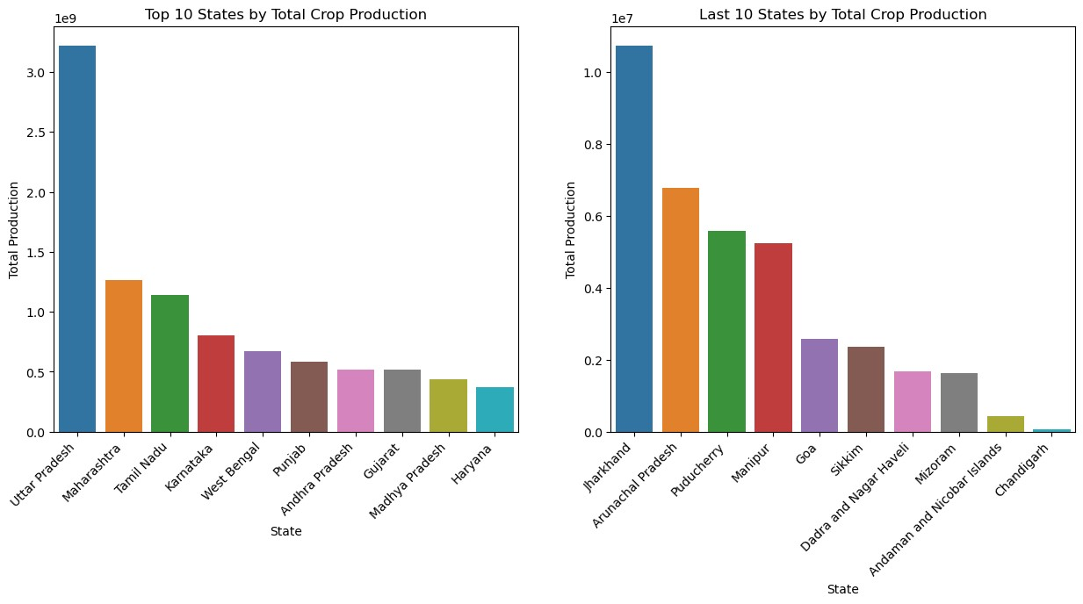
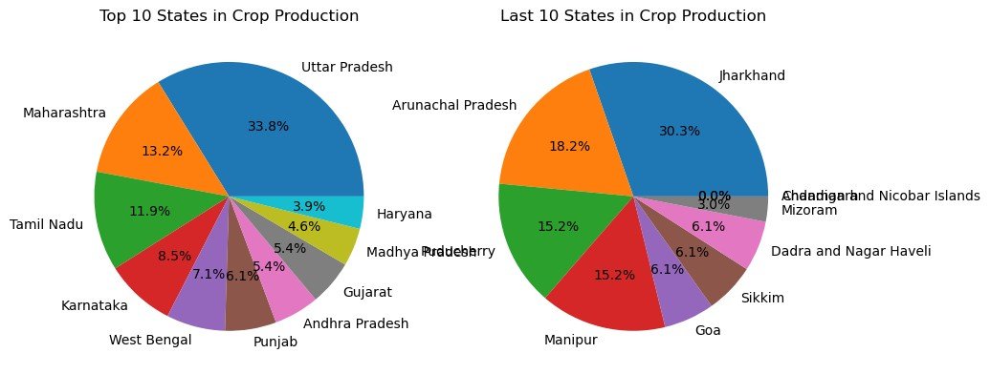
Top and Last States in Total Production
The top three states in terms of crop production are:
Uttar Pradesh: 33.8%
Maharashtra: 13.2%
Tamil Nadu: 11.9%
The last three states in terms of crop production are:
Chandigarh
Andaman and Nicobar
Mizoram

Slide 6
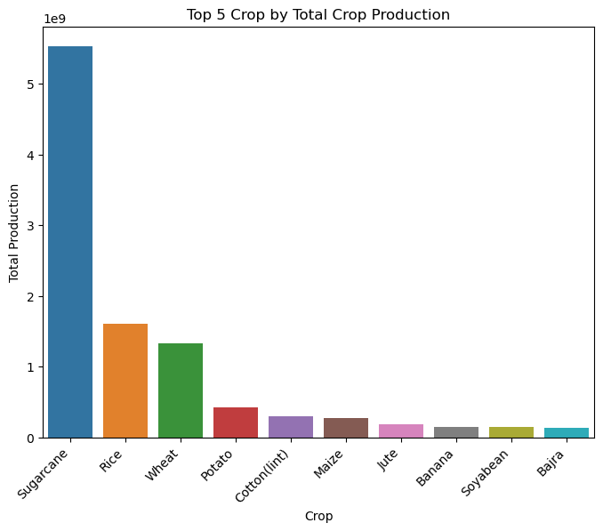
Top 10 Crop in overall Year
Sugarcane is by far the most produced crop, accounting for about 49% of the total production.
The top 5 crops sugarcane, rice, wheat, potato and cotton.

Slide 7
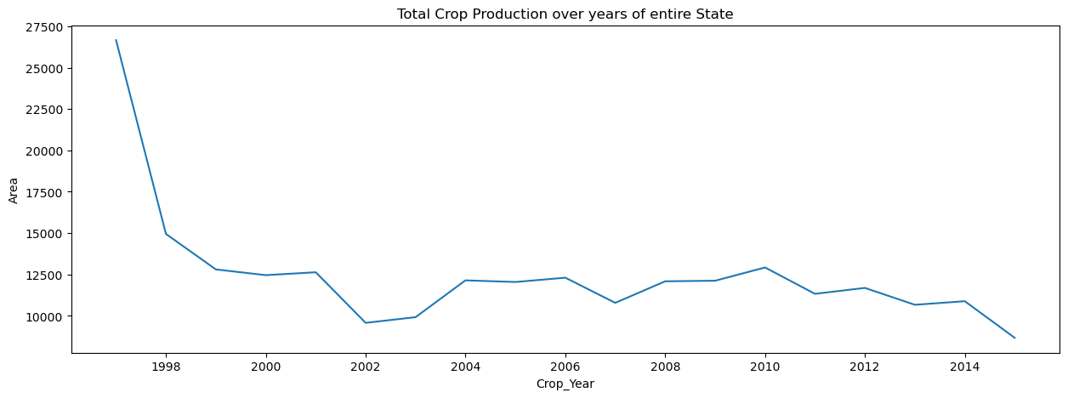
Total crop production changed over the years for the entire state
Between 1997 and 2001, there is a sharp decline in the area used for crop production.
From 2001 to 2015, the area shows fluctuations with periods of both increase and decrease, but the overall trend remains downward.

Slide 8
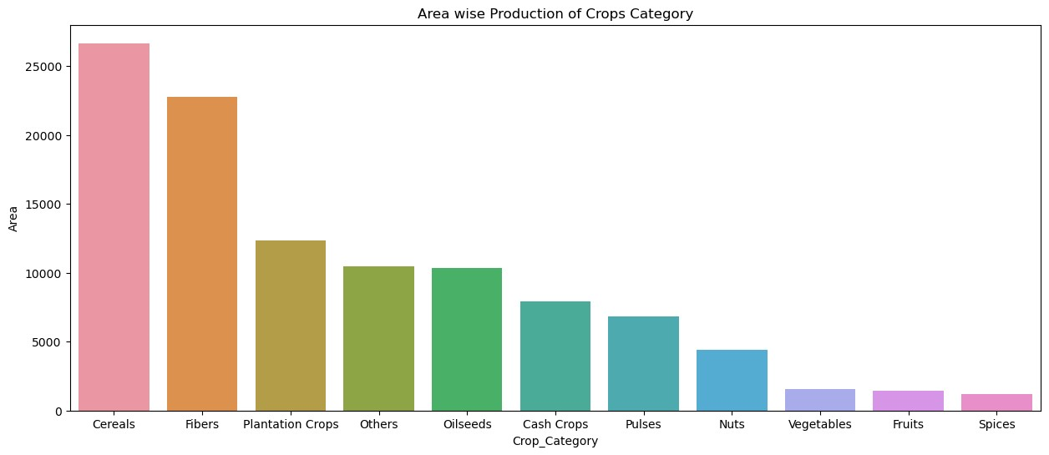
Area wise Production of Crops Category
Cereals have the highest production area, significantly higher than any other crop category.

Slide 9
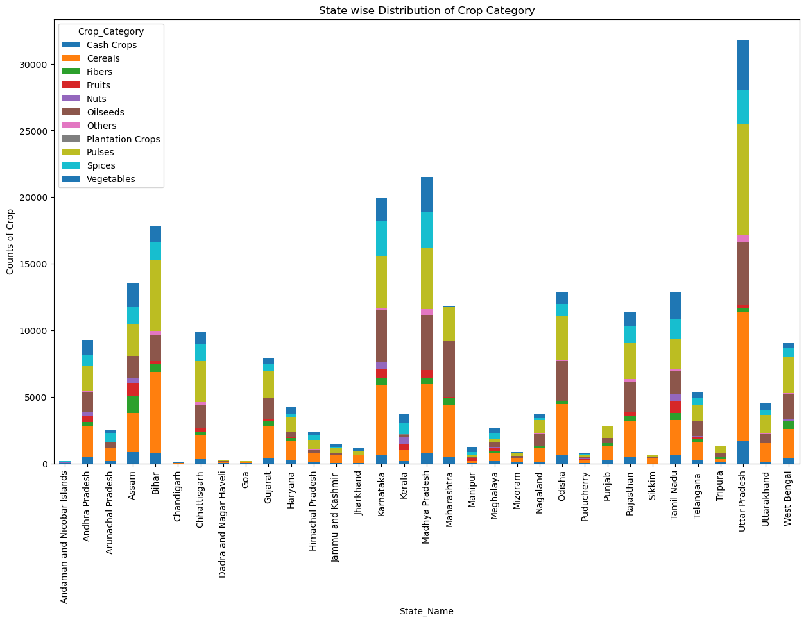
State Wise Distribution of Crop Category
Uttar Pradesh has the highest overall crop production area, followed by states like Madhya Pradesh and Karnataka.
Cereals are a major crop in most states, especially in states like Uttar Pradesh, West Bengal, and Madhya Pradesh.
Dadra and Nagar Haveli, Goa, and Chandigarh have relatively lower overall crop production areas.

Slide 10
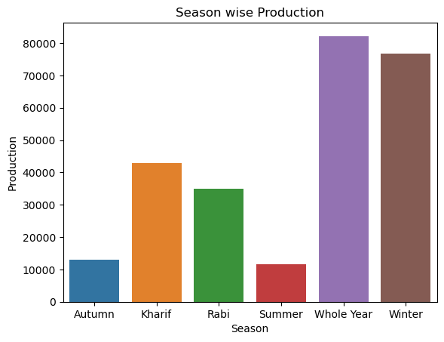
Season wise Production
Whole Year season have the highest Average production, significantly higher than any other Season.

Slide 11
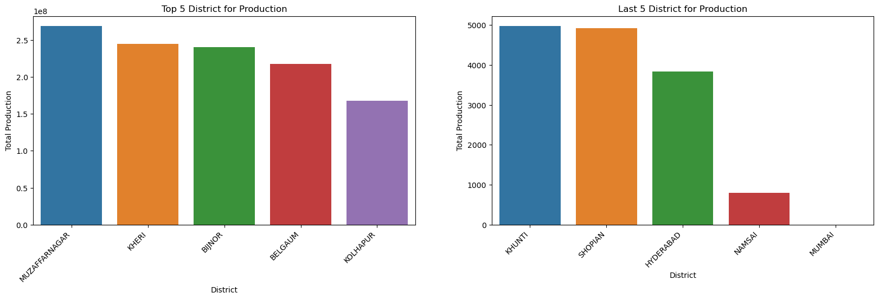
Top and Last 5 District in Production
Muzaffarnagar district is the most prominent in crop production and Mumbai is last district for crop production.

Slide 12
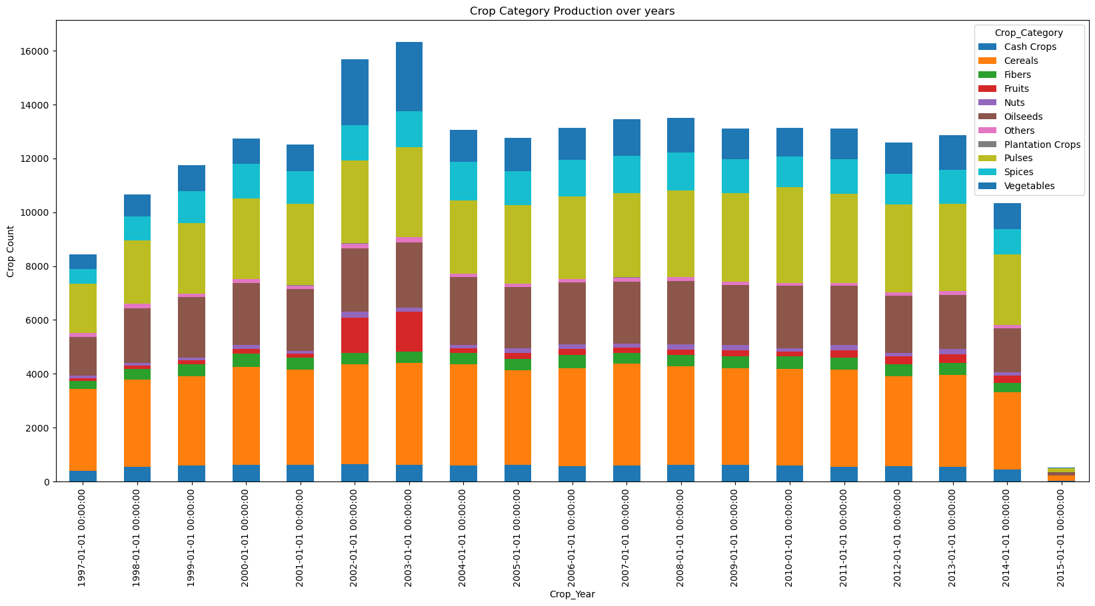
Crop Category Production over years
Crop production increased from 1997 to around 2003, remained relatively high and stable until around 201, and then dropped sharply in 2015.
Cereals, Pulses and Vegetables are consistently contribute a significant portion of the total crop production each year.
Categories like Spices, Fibers, Nuts, Oilseeds have much smaller contributions to the total production.

Slide 13
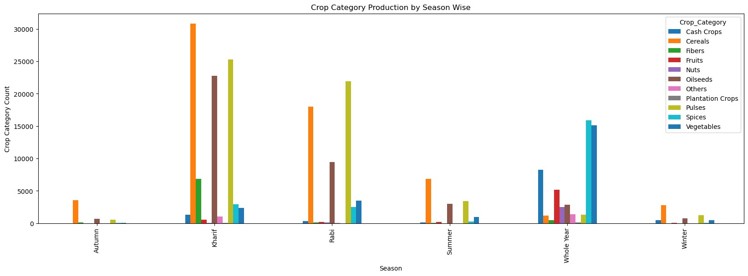
Crop Category Production by Season wise
In Autumn season Production of Cereals is more and Nuts and Plantation crops are almost zero production.
In Kharif season Production of Cereals and Pulses are most Produced compared other seasons. Least Production is Plantation crop
In Rabi season Pulses production is more than Cereals and followed by Oilseed.
In Summer Season Cereals production is low compared to Kharif and Rabi season.
In Whole Year Vegetables and Spices are produced consistently throughout the year.
In Winter There is very noticeable production of Cereals and Pulses.

Slide 14
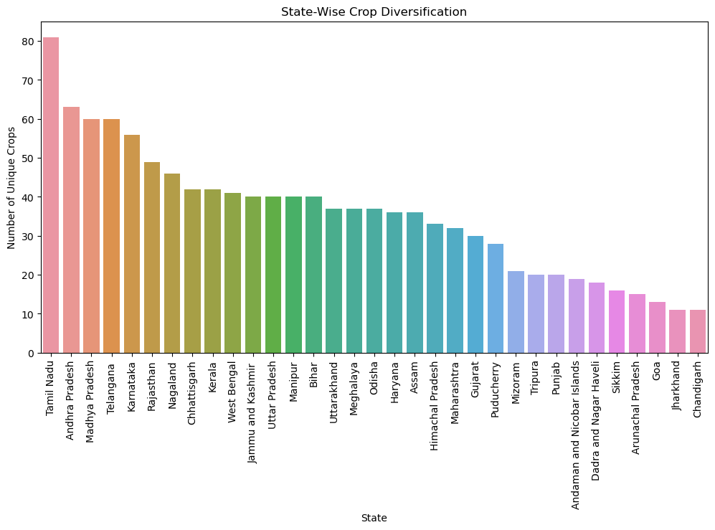
State wise Crop Diversification
Tamil Nadu is highest in producing unique crop of around 80 unique crops followed by Andhra Pradesh and Madhya Pradesh.
States like Goa, Chandigarh, and Jharkhand are at the lower end.

Slide 15
Overall Insights
Top Crop Producing States- Uttar Pradesh, Maharashtra and Tamil Nadu are the top three states in terms of total crop production and Chandigarh, Andaman and Nicobar and Mizoram are among the states with the lowest crop production.
Significant Crop Categories: Cereals and Fibers are occupy the largest production area.
Dominant Crops: Sugarcane is by far the most produced crop, accounting for about 49% of the total production followed by Rice, wheat, potato and cotton.
Trends Over the Years: The analysis reveals a sharp decline in the area used for crop production between 1997 and 2001, followed by fluctuations from 2001 to 2015.
Seasonal Crop Production:Whole Year season has the average highest crop production, while Winter and Kharif seasons also contribute significantly to the total production, particularly in cereals and pulses.
State-Wise Crop Diversification:Tamil Nadu leads in crop diversification with over 80 unique crops and Goa, Chandigarh, and Jharkhand show lower diversification, with fewer than 20 unique crops.
Area-Wise Production: Uttar Pradesh, Madhya Pradesh and Karnataka are among the states with the highest overall crop production area and Dadra and Nagar Haveli, Goa, and Chandigarh are the states with lowest crop production.
Top Districts for Crop Production: Muzaffarnagar is the leading district in crop production, while Mumbai ranks last.
Impact of Crop Categories Over the Years: Crop production for categories like Cereals, Pulses, and Vegetables has remained consistent over the years and Production of categories like Spices, Fibers, Nuts, and Oilseeds is comparatively lower but still plays an essential role in the agricultural landscape.

