Slide 1

Knowledge Based Churn Prediction In Telecom Networks
Presented By
RCC INSTITUTE OF INFORMATION TECHNOLOGY
Name | Class Roll Number | University Roll Number
Rashida Jahan | CSE2016/006 | 11700116058
Nitish Prasad Khushwaha | CSE2016/013 | 11700116067
Shailza Kumari | CSE2016/015 | 11700116047
Anisha Annu | CSE2016/043 | 11700116102

Slide 2
NEED
A “churn” with respect to the Telecom industry, is defined as the percentage of subscribers moving from a specific service or a service provider to another in a given period of time.
Churn prediction is the technique by which we can easily find out who is likely to churn in given time period.

Slide 3
OUR AIM
Find a optimal uncorrelated and diversified set of features able to correctly determine the cause of churn.
To develop a predictive model using a classifier to predict the occurrence of churn given the feature vector.

Slide 4
Related Work Done
SI NO. | AUTHOR NAME | PAPER NAME | CONTRIBUTION | CHALLENGES
1 | Nabgha Hashmi, Naveed Anwer Butt and Dr.Muddesar Iqbal | Customer Churn Prediction in Telecommunication : A Decade Review and Classification | Research made a contribution in the field of customer churn predictive modeling in telecommunication. Thus the paper draws a sketch line for the researchers for reviewing and accumulation of the trends about data mining applications in the field of telecommunication. | The classification techniques are good for analyzing qualitative and continuous data and afterwards interpreting results but these techniques do not guarantee the appropriable accuracy of prediction model for large enough, highly dimensional, non linear or time series datasets.
2 | IRFAN ULLAH , BASIT RAZA , AHMAD KAMRAN MALIK , MUHAMMAD IMRAN , SAIF UL ISLAM , AND SUNG WON KIM | A Churn Prediction Model Using Random Forest: Analysis of Machine Learning Techniques for Churn Prediction and Factor Identification in Telecom Sector | A customer churn model is provided for data analytics and validated through standard evaluation metrics. The obtained results show that our proposed churn model performed better by using machine learning techniques | The study can be further extended to explore the changing behavior patterns of churn customers by applying Artificial Intelligence techniques for predictions and trend analysis.

Slide 5
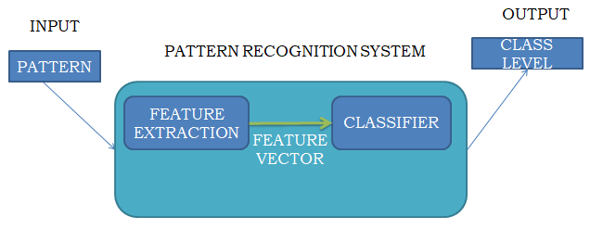
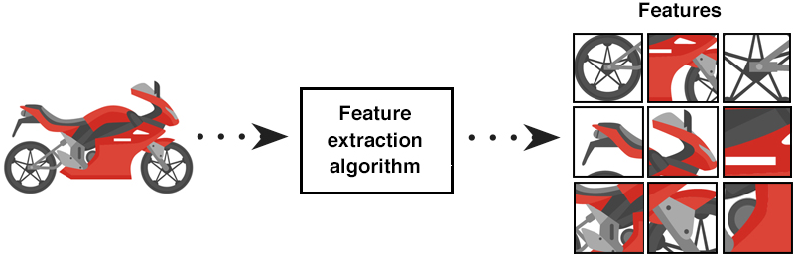
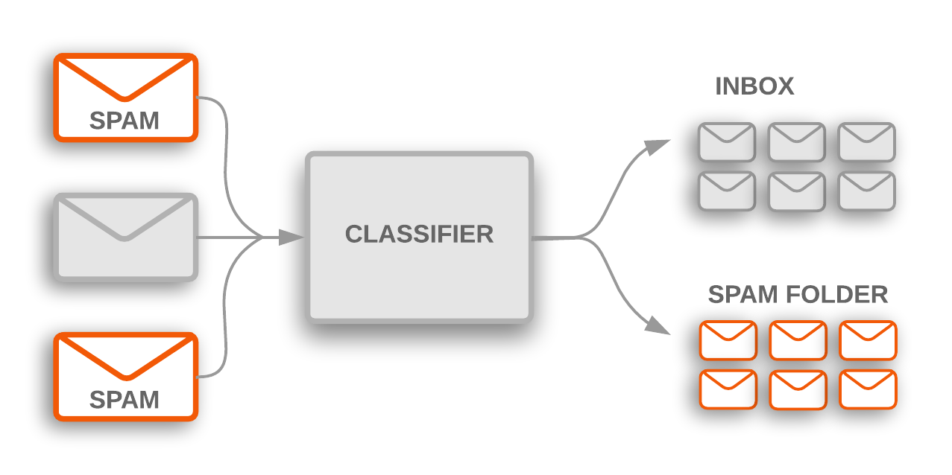
PATTERN RECOGNITION PROCESS
FEATURE EXTRACTION
CLASSIFICATION

Slide 6
OUR APPROACH
FEATURE EXTRACTION: DECISION TREE METHOD
Decision trees are in the proposed method used to calculate and order the features based on the information gain of each feature. During the method validation they are used for failure classification to show the influence of different features on the classification performance

Slide 7
OUR APPROACH
DATA CLASSIFICATION: NAIVE BAYESIAN CLASSIFIER
Naive Bayes classifiers are a family of simple "probabilistic classifiers" based on applying Bayes' theorem with strong (naïve) independence assumptions between the features. They are among the simplest Bayesian network models.

Slide 8
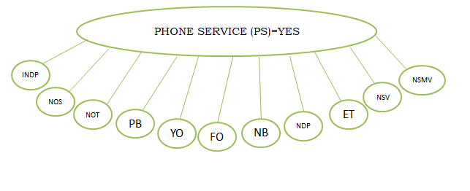
FEATURE SELECTION: EFFECTIVE FEATURE ORDER DETERMINATION
LEVEL-0: FEATURE CAUSING MOST CHURN
ROOT OF FEATURE TREE [DATA]
PHONE SERVICE
YES
NO
90%
10%

Slide 9
FEATURE SELECTION: EFFECTIVE FEATURE ORDER DETERMINATION CONT..
LEVEL-1: PHONE SERVICE IS “YES” AND CAUSING MAXIMUM CHURN.
NEXT ROOT SELECTION [DATA]
PS=YES
TENURE
<=50
>=50
81%
19%

Slide 10
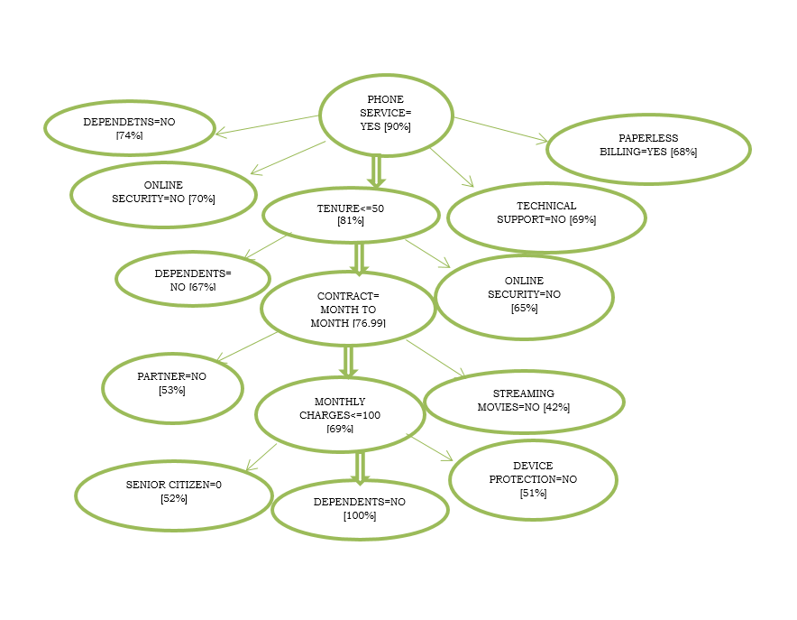
OUR FEATURE TREE

Slide 11
IMPLEMENTATION OF CLASSIFIER
After making the decision tree we know the favourable attributes ,
Now we will give some random positive constraints and use the favourable attributes of the customer and we will check the results.
Here we ask the user to enter each attribute values as they want and then our classifier will calculate the probability of the churn rate.
Here we have use a=38, b=28,c=17,d=12,e=5;

Slide 12

RESULT ANALYSIS
churn_column_wise.xlsx
graph_rep_of_churn.docx
Decision tree is shown in this file
decision_tree.docx
Churn rate probability for various inputs
final_result.docx

Slide 13
PERFORMANCE ANALYSIS
Since we have used probability based classifier we are getting the result predicted using the formula we have designed using naïve based classifier.
It is giving using correct probability of churn rate in many cases however it may fail in the
some rare cases.

Slide 14
CONCLUSION
In this project we have used decision tree and naïve bayes classifier to predict the desired output e.g to prediction the probability of the churn rate of a customer.

Slide 15
REFERENCES
http://www.ise.bgu.ac.il/faculty/liorr/hbchap1.pdf
http://www2.cs.uregina.ca/~dbd/cs831/notes/kdd/1_kdd.html
https://pdfs.semanticscholar.org/b666/3d699e3f93a096209a2c29e9c6c85049c56a.pdf
https://ieeexplore.ieee.org/stamp/stamp.jsp?arnumber=8706988
https://www.r-project.org/about.html
https://www.researchgate.net/publication/311484488_Customer_Churn_Prediction_in_Telecommunication_Sector_using_Rough_Set_Approach

Slide 16


