Slide 1
ESOP Synthesis
R09921049
黃禹靖

Slide 2
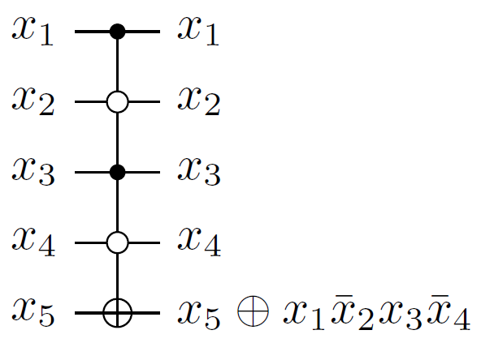
ESOP Synthesis
Exclusive Sum of Product
ESOP are advantageous for quantum circuits because of their natural relation to Toffoli gates.
Toffoli gate is one of the primitives in reversible logic.

Slide 3
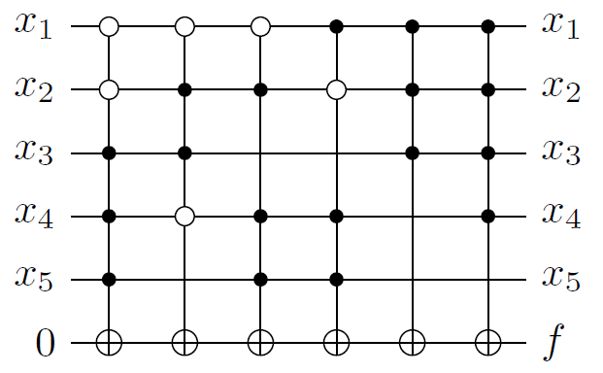
ESOP Synthesis
By concatenating Toffoli gates on the same target line, we can build up an ESOP expression.

Slide 4
ESOP Synthesis
The Toffoli gates are mapped into quantum gate library (Clifford+T gate set).
A heuristic to reduce the cost of mapped quantum circuits: minimize
Number of Toffoli gates → Number of cubes
Number of control lines → Number of literals

Slide 5
ESOP Synthesis
It is necessary to convert a Boolean network into minimum two-level ESOP expressions.
Two state-of-the-art techniques
AIG extract
BDD extract

Slide 6
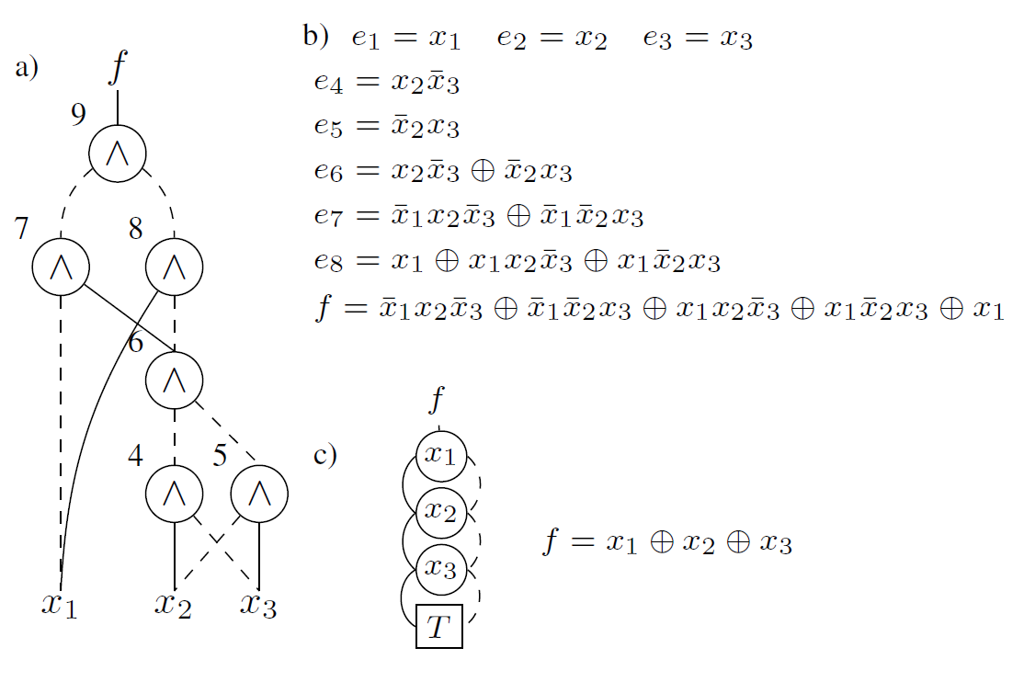
AIG BDD Extract
AIG method suffers from size explosion of resulting ESOP expressions.
BDD method suffers from memory explosion in BDD construction process.

Slide 7

Divide and Conquer Method
Lemma Any Boolean function f can be written as if
Selection of a set P Limit our choices to $p_{i}$ is single-cube cofactor. ${f∧p}_{i}=f_{p_{i}}∧p_{i}$

Slide 8
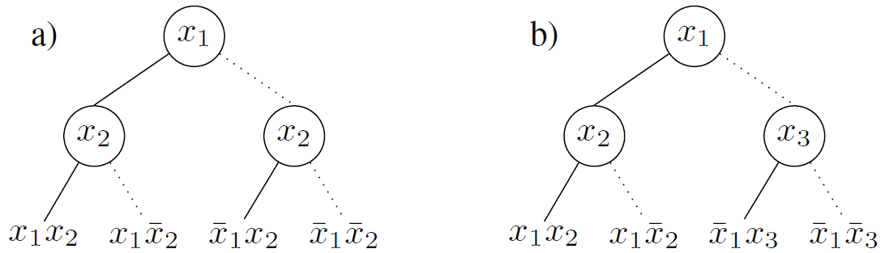
Selection Heuristic
Fixed variable selection
Free variable selection
Support threshold

Slide 9
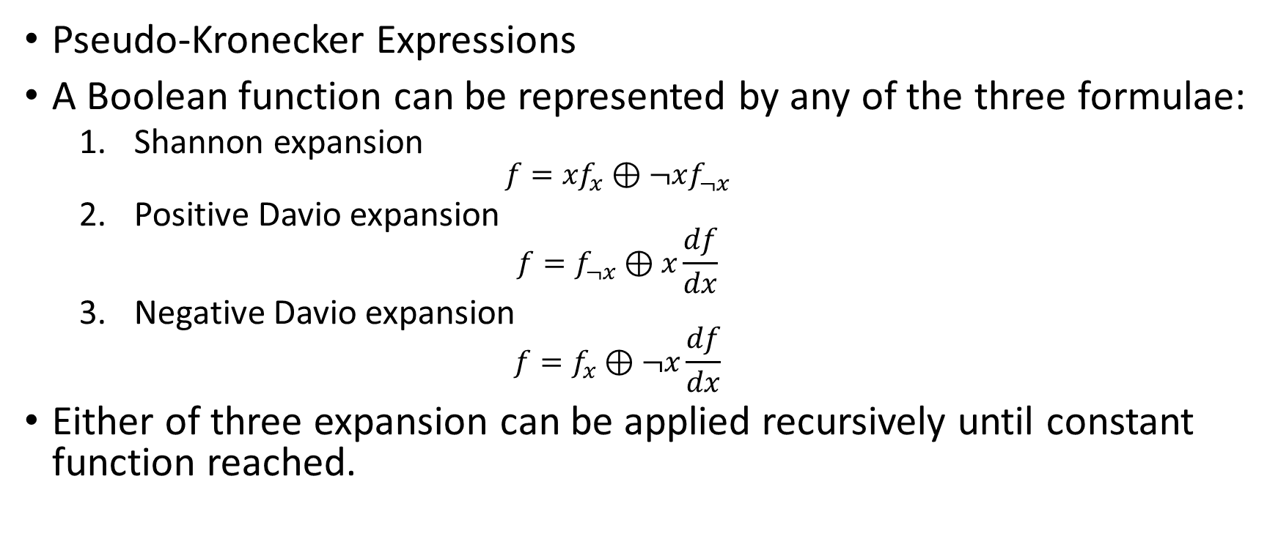
BDD Extract
Pseudo-Kronecker Expressions
A Boolean function can be represented by any of the three formulae:
Shannon expansion $f={xf}_{x}⊕¬xf_{¬x}$
Positive Davio expansion $f=f_{¬x}⊕x\frac{df}{dx}$
Negative Davio expansion $f=f_{x}⊕¬x\frac{df}{dx}$
Either of three expansion can be applied recursively until constant function reached.

Slide 10

BDD Extract
$$f\left(x_{1},x_{2}, x_{3}\right)=x_{1}+x_{2}x_{3}$$
Shannon $f=¬x_{1}(x_{2}x_{3})⊕x_{1}(1)$
Negative Davio $f=¬x_{1}(x_{3}⊕{¬x}_{2}(x_{3}))⊕x_{1}(1)$
Multiply out $f=¬x_{1}x_{3}⊕{¬x_{1}¬x}_{2}x_{3}⊕x_{1}$

Slide 11
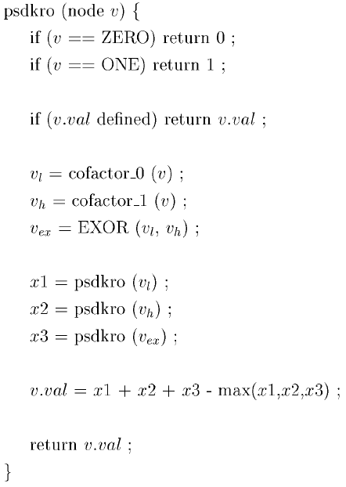
BDD Extract
Find the expansion that minimize total cube number

Slide 12
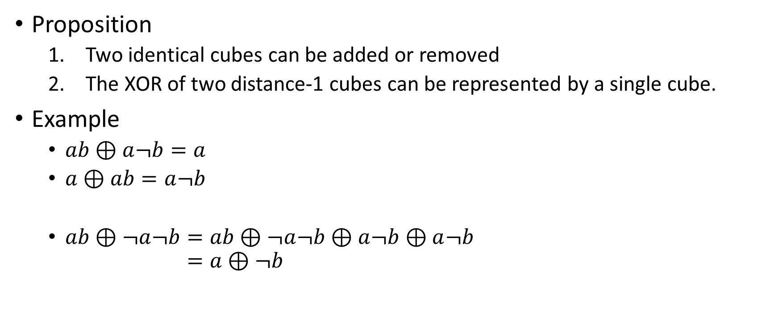
ESOP simplify
Proposition
Two identical cubes can be added or removed
The XOR of two distance-1 cubes can be represented by a single cube.
Example
$ab⊕a¬b=a$
$a⊕ab=a¬b$
$ab⊕¬a¬b=ab⊕¬a¬b⊕a¬b⊕a¬b$ $=a⊕¬b$

Slide 13
Experimental Results
16-adder |  |  |  | simplified
PO | Support # | Cube # | Literal # | Cube # | Literal # | time (s)
cout | 33 | 244607 | 7506370 | 244607 | 7506370 | 4630.2
s15 | 33 | 82332 | 2438338 | 82268 | 2437378 | 694.42
s14 | 31 | 41164 | 1136834 | 41132 | 1136418 | 211.99
s13 | 29 | 20580 | 527250 | 20564 | 527074 | 70.62
s12 | 27 | 10288 | 243042 | 10280 | 242970 | 28.63
s11 | 25 | 5142 | 111230 | 5138 | 111202 | 17.08
s10 | 23 | 2569 | 50470 | 2567 | 50460 | 5.28
c432 |  |  |  | simplified
PO | Support # | Cube # | Literal # | Cube # | Literal # | time (s)
G223gat | 18 | 512 | 4609 | 511 | 4608 | 0.12
G329gat | 27 | 5448 | 79378 | 3952 | 60855 | 7.05
G370gat | 36 | 110176 | 2267008 | 85739 | 1811954 | 773.83
G421gat | 36 | 31414 | 685194 | 25831 | 578819 | 127.39
G430gat | 36 | 91969 | 1910788 | 69089 | 1468765 | 544.47
G431gat | 36 | 84303 | 1748731 | 65682 | 1382563 | 470.6
G432gat | 36 | 76912 | 1565663 | 59103 | 1235378 | 400.34

Slide 14
Experimental Results
Support Threshold = 20
c432 |  |  |  | simplified
PO | Support # | Cube # | Literal # | Cube # | Literal # | time (s)
G223gat | 18 | 512 | 4609 | 511 | 4608 | 0.12
G329gat | 27 | 5448 | 79378 | 3952 | 60855 | 7.05
G370gat | 36 | 110176 | 2267008 | 85739 | 1811954 | 773.83
G421gat | 36 | 31414 | 685194 | 25831 | 578819 | 127.39
G430gat | 36 | 91969 | 1910788 | 69089 | 1468765 | 544.47
G431gat | 36 | 84303 | 1748731 | 65682 | 1382563 | 470.6
G432gat | 36 | 76912 | 1565663 | 59103 | 1235378 | 400.34
Support Threshold = Inifinity
c432 |  |  |  | simplified
PO | Support # | Cube # | Literal # | Cube # | Literal # | time (s)
G223gat | 18 | 512 | 4609 | 511 | 4608 | 0.12
G329gat | 27 | 2816 | 39203 | 2055 | 29955 | 124.49
G370gat | 36 | - | - | - | - | -
G421gat | 36 | - | - | - | - | -
G430gat | 36 | - | - | - | - | -
G431gat | 36 | - | - | - | - | -
G432gat | 36 | - | - | - | - | -

Slide 15
Thank you!

