Slide 1
The final project – DevOps Academy 2022 (June)
Nina Rojanek

Slide 2
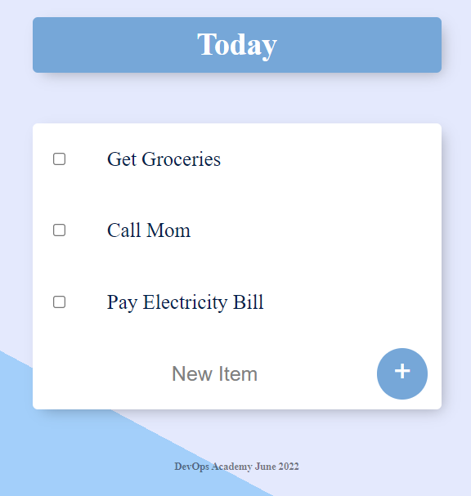
DevOps Academy thesis project overview:
- Main tasks and assumptions:
a) The CI/CD pipeline for a web application fully hosted on AWS cloud
b) All underlying infrastructure should be provisioned as IaC and its code is kept in the Git repository
- Cloud Provider: AWS
The application: Simple CRUD WebApp build from scratch in Node.js with MongoDB-based database
Notes:
My application is simple Todo List web application which was build using Javascript and Node.js. It is supported by MongoDB NoSQL database and it working on CRUD functionalities with it.
NoSQL - database provides a mechanism for storage of data that is closed in models.
I did this app because I was working with MongoDB few years ago and I wanted to understood how it is working correctly with application.
It is simple app just to have item to create CI/CD pipelines for this project.

Slide 3





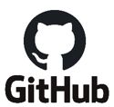
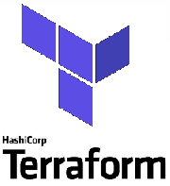
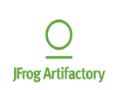

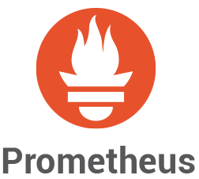

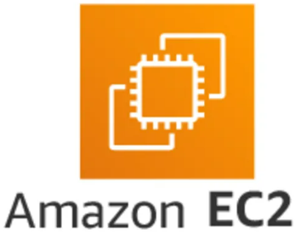
Initial setup of production and staging infrastructures
pipelines in the selected Build System provision two completely separate infrastructure instances (for dev and for prod environments)
Terraform backend (the state file) is located in AWS S3 storage, so it can be shared among later CI/CD stages tasks
Networking + VPN security
Role and access management
SMTP server
State file
SCM
Jenkins
Build
System
/pipelines
IaC
Image registry + documentation repository
Monitoring and alerting
WebApp server + MongoDB
Notes:
Initial setup of production and staging infrastructures
pipelines in the selected Build System provision two completely separate infrastructure instances (for dev and for prod environments)
Selected – because I created this slide some times ago and now I was wondering about Zuul-CI solution, I am during installation it in my EC2 instance to integrate it with other elements from project.
About ZUUL: I know some theory about this tool. I saw few tutorials on youtube and read documentation. For example I know
During DevOps academy we had courses about Jenkins so I see there are some differences between those tools, for example
Zuul is purpose built to be a gating continuous integration and deployment system.
Jenkins is a generic automation tool that can be used to perform CI and CD.
What is Jenkins? An extendable open source continuous integration server. Built with Java, it provides over 300 plugins to support building and testing virtually any project.
What is Zuul CI? A program that drives continuous integration, delivery, and deployment systems with a focus on project gating and interrelated projects. It is an open source CI/CD platform specializing in gating changes across multiple systems and applications before landing a single patch.
Jenkins and Zuul CI can be primarily classified as "Continuous Integration" tools.
Some of the features offered by Jenkins are:
Easy installation
Easy configuration
Change set support
On the other hand, Zuul CI provides the following key features:
Project Gating: for example: testing changes in parallel, creating “stock” of tasks and they are performing in paraller way
CI/CD with Ansible
Cross-Project Dependencies
Terraform backend (the state file and config files) is located in AWS S3 storage, so it can be shared among later CI/CD stages tasks.
I am using some AWS services:
VPC for Networking and VPN security of project.
IAM for role and access management, so also security
SES as SMTP server for sending notification about monitoring statuses
S3 for storage of State file
And EC2 as WebApp server with MongoDB on its localhost right now. I know there are other services and right now this solution is self-hosted and may be problematic in prod, but it is only academy project and I have limited time to perform it so I focused on the simplest way for me. I know there are AWS DynamoDB and AWS DocumentDB services which I could use here, and it could be AWS managed then. I tired both ways but I am newbie in AWS yet and had some troubles with implementation those services. For example they needed changes in source code and it could be time eating for me. I haven’t got time for this, maybe if I will finish the core solution of CICD then I will come back for that.
Outside the AWS I will use Jfrog Artifactory as image registry and documentation repository. I know I could use ECR or ECS for that but I wanted to learn about Artifactory which. Also it was topic of my seminary presentation about 2 weeks ago during DevOps academy. I heard is popular in our customers scope
And for monitoing purposes I plan to use Grafana and Prometheus, already I participated in courses about those tools. Also heard they are popular solutions.

Slide 4
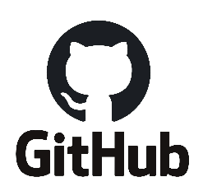
Branching strategy
v0
v0
v0.1
v2
main branch
hotfix branch
D
D-A
D-AB
D-ABC
dev branch
feature1 branch
feature2 branch
feature3 branch
Notes:
My Source Control Management is GitHub repository.
Source code management (SCM) is used to track modifications to a source code repository. SCM tracks a running history of changes to a code base and helps resolve conflicts when merging updates from multiple contributors. SCM is also synonymous with Version control.
I choose GitHub becase first it is popular tool, second I worked on this before and wanted to stabilize my skills in this tool. I worked also on BitBucket during studies few years ago but I find GitHub as more intuitive for me.
During academy we had presentation about source tree tool, the old Git GUI for Mac and Windows. But it looks old and totally non intuitive ☺
GIT:
Rebase
https://git-scm.com/docs/git-rebase
Git checkout hotfix
Git rebase main - Reapply commits on top of another base tip. Rebasing essentially takes a set of commits, "copies" them, and plops them down somewhere else.
While this sounds confusing, the advantage of rebasing is that it can be used to make a nice linear sequence of commits. The commit log / history of the repository will be a lot cleaner if only rebasing is allowed.
Cherry-pick - The next concept we're going to cover is "moving work around" -- in other words, it's a way for developers to say "I want this work here and that work there" in precise, eloquent, flexible ways.
git cherry-pick <Commit1> <Commit2> <...>
It's a very straightforward way of saying that you would like to copy a series of commits below your current location (HEAD).
Fetch - Download objects and refs from another repository
git fetch [<options>] [<repository> [<refspec>…​]]
git fetch [<options>] <group>
git fetch --multiple [<options>] [(<repository> | <group>)…​]
git fetch --all [<options>]
git fetch --prune - download all referencies from remote branches, update referencies. the best utility for cleaning outdated branches
Git Fetch is the command that tells the local repository that there are changes available in the remote repository without bringing the changes into the local repository.
Git Pull on the other hand brings the copy of the remote directory changes into the local repository.

Slide 5






Development -
Developer
feature branch
manual
Notes:
Source code should be according to the coding guides which will allow to create Automated doc.
Feature branch it should have a template name for example I am using “feature/T123-short-desc”, which could help other developers in using this repository and find changes.
I know it can also be automated with Bug tracking tool like Jira and for example show status of branch via automated connecting with it there. But I am not sure how it is work, so I will skip this topic.

Slide 6

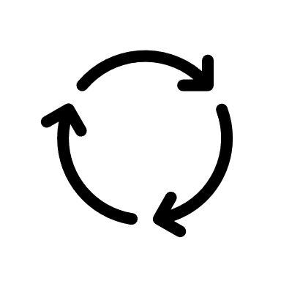



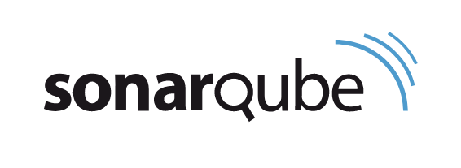


Integration -
Build system
PULL REQUEST
triggered
Integration tests
feature branch
dev branch
Unit tests
report
Reviewer
REVIEW
automated
Static code
analysis
Report with results
Gradle
Developer

Slide 7
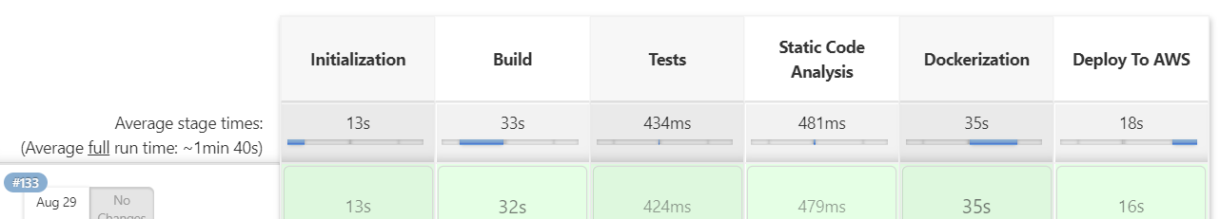
CI/CD Pipelines proposition
DEV (Feature pipeline)
Trigger: PR to Dev Branch.
Delivery to Dev | Build | Type of Conducted Tests | Static Code Analysis | Deploy to AWS | Documentation generation
PR in GitHub, Review result, git merge to dev branch | Building Node.js webapp, create artifacts, artifacts storing | Integration tests in Gradle, *OpenSource test | In Sonarcube /Sonarcloud | Terraform based IaC from dev branch | Fully automatic using Doxygen (Release notes)
Notes:
Here is proposition of pipeline which I want to use for development environment. I divided those environments to be sure releases are proceed successfully and prod is working correctly for customers.
OPENSOURCE : in prod syste I would go with opensource tests here to be sure if source code is legal.
jak cos sie pojawi bazujace na licencji openource to aplikacja musi byc tez open source
przyklad: GNU - tylko do domowego uzytku
trzeba zmieniac np. na BSD - darmowy kod, ale nie opensource. Wymaganie: w kodzie musi znalezc sie informacja ze kod bazuje w takim wymiarze na licencji BSD.

Slide 8
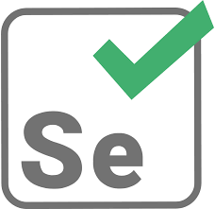
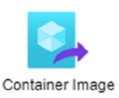





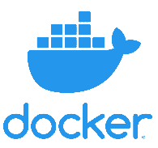
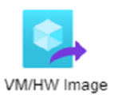
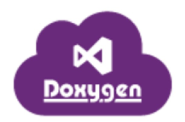

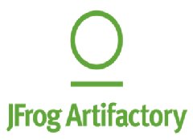
Delivery -
Selenium tests
outside the project
PULL REQUEST
merge
Smoke
Tests
on binaries
Approver (or release gate)
release criteria
dev branch
main branch
Vagrant
Opensource
tests
Automated
Documentation
Creation
(image registry
&
repository of documentation)
Notes:
Release criteria – like for example counter of tickets accepted and approved, or time (for example each week), or manager acceptance.
Build will perform in docker and create container which is much smaller and easier to implement than VM. I had implemented this step using Dockerfile but I had to uninstall DockerDesktop because of security reasons just today morning and I have to reinstall docker right now. I learnt about docker also during DevOps academy, for example how to build app in docker, how to run the containers, show them, show logs of container. Also stop and remove them after their work.
Next step – smoke tests – here should be used some QA tools, like Selenium or stress/performance tests could be also implemented. In my project I will focus on simply curl test checking if web app is running correctly on EC2 instance. Maybe I will extend them to REST API tests if there will be time for that.
Then next step is upload images and docs to Jfrog Artifactory. As I said I will use it for image registry and repository of documentation. Artifactory can be also used as Artifacts repository in wider perspective.
[ Single Source of Truth - The practice of structuring information models and associated data schemas such that every data element is mastered (or edited) only in one place, providing data normalization to a canonical form. It provides multiple advantages:
greater efficiency/productivity,
easy prevention of mistaken inconsistencies (such as a duplicate value/copy somewhere being forgotten)
greatly simplified version control.
Artifact as single source of truth - A software artifact is an item that is produced during the development process. This can be a data model, a prototype, workflow diagram, a design document, or a setup script. In fact, there are specific artifacts that are required during a development cycle – and these need to be stored in an accessible manner.]

Slide 9
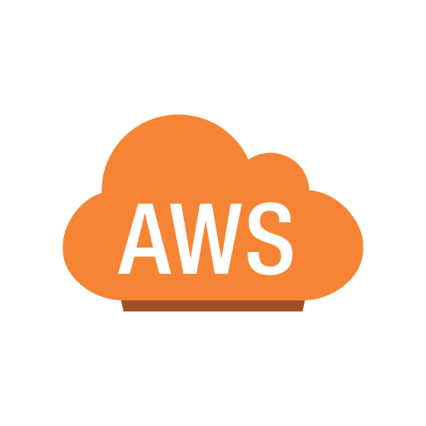

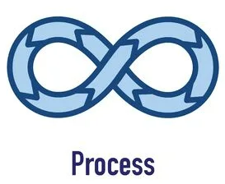
Deployment -
IaC
services
Build
system
Smoke
tests
Selenium tests
outside the project
Notes:
In my case Deployment is fully automated . In prod system it could be manual trigerred by developer or some process in GitHub for example.
I am just taking stable images from Artifactory and deploy them using pipeline and terraform as IaC. I am building AWS services and setup WebApp to the customers.

Slide 10






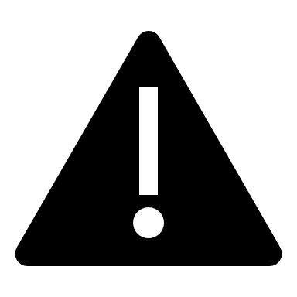

Monitoring
Developer
Manager
Open ticket
Assign to Developer
Email notification
Developer
Notes:
And the last part of my project will be creation of Monitoring system. It should have a dashboard easy to read, so I choose Grafana. Prometheus will check if app is up and if performance is fine on it, if server is not closed ect. It will use AWS SES service to send email notification about result of monitoring.
If there will be time I would like to check CloudWatch also using my free trial on AWS services, because I am interested how it will look like.

Slide 11
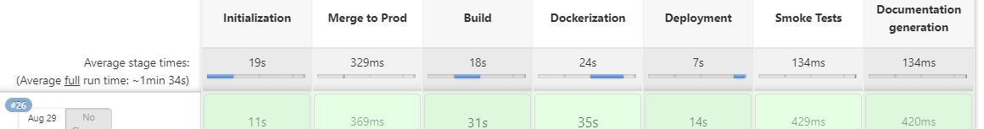
CI/CD Pipelines proposition
PROD (Release Pipeline)
Trigger: accepted release criteria
Delivery to Prod | Build | Type of Conducted Tests | Deploy to AWS | Documentation generation | Generate monitoring report
PR in GitHub,, git merge to prod branch | Building Node.js webapp, create and store artifacts in Artifactory | Smoke Tests on Prod | Terraform based IaC from prod branch | Fully automatic using Doxygen (Release notes) | Use SES and notify about monitoring results

Slide 12
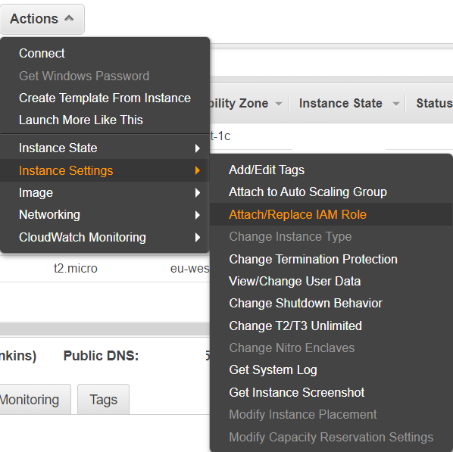
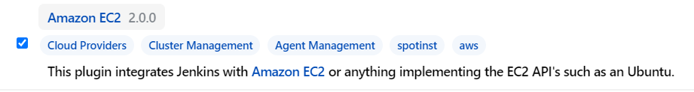
Jenkins Agents
Created IAM role “Jenkins-ec2-role” with permission: AmazonEC2FullAccess
Add role to EC2 instance with Jenkins installed
Create AWS security group for Jenkins Agent with open ssh connection from security group used by Jenkins server
Install Jenkins plugin: Amazon EC2
Configuration of plugin in Jenkins System
Configuration of Jenkins Agent creation
Helpful link: https://www.youtube.com/watch?v=dAa3u39RYpM

Slide 13
DEMO

Slide 14
THANK YOU

