Slide 1

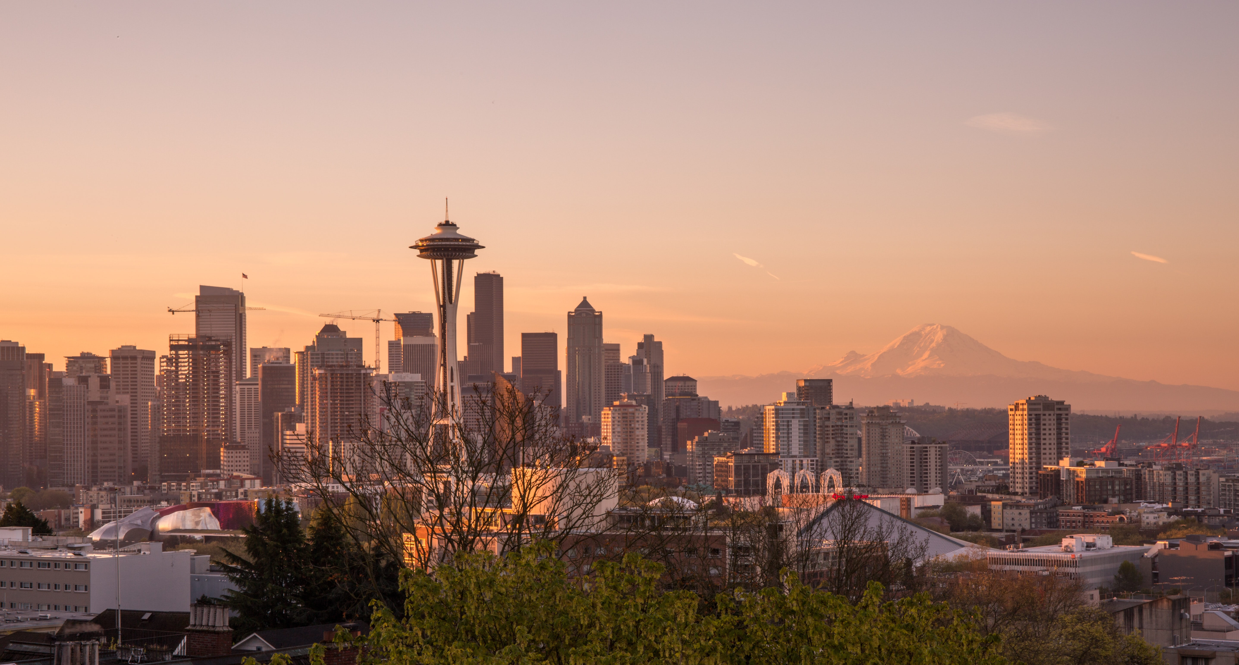
Battle of the Neighborhoods - Seattle

Slide 2
Problem Statement
About 4 million residents in the Seattle Metropolitan
Expanding neighborhoods outside of the Seattle area
Identify popular local venues
Home values and ease of transport

Slide 3

Analysis

Slide 4
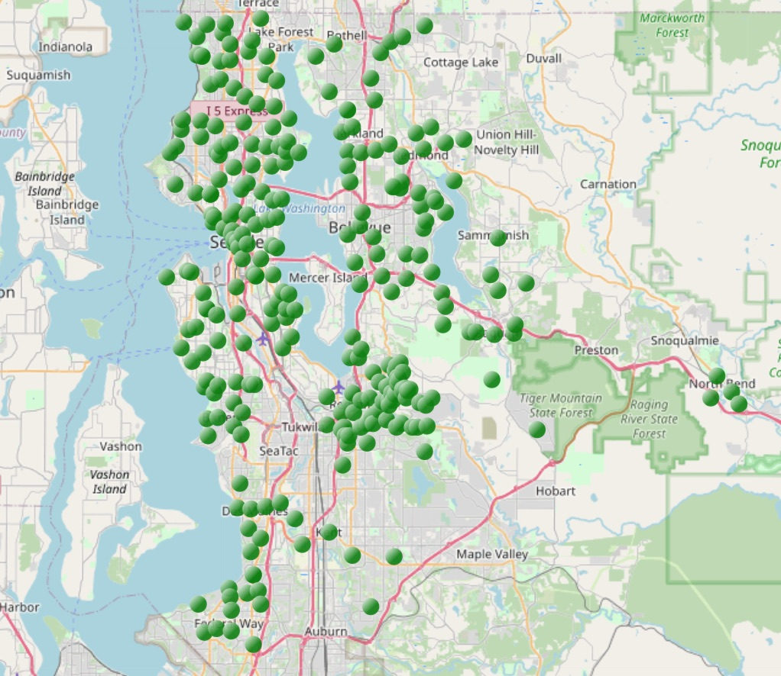
Neighborhoods in Seattle represented by the green bubbles

Slide 5

Distribution of home value from 2016-2020
Largest value in the distribution over $1 million
Lowest value in the distribution around $ 300k
Large outliers present with highest values over $3 million

Slide 6
Neighborhoods with bottom and top 30 homes values on average

Slide 7
Results

Slide 8
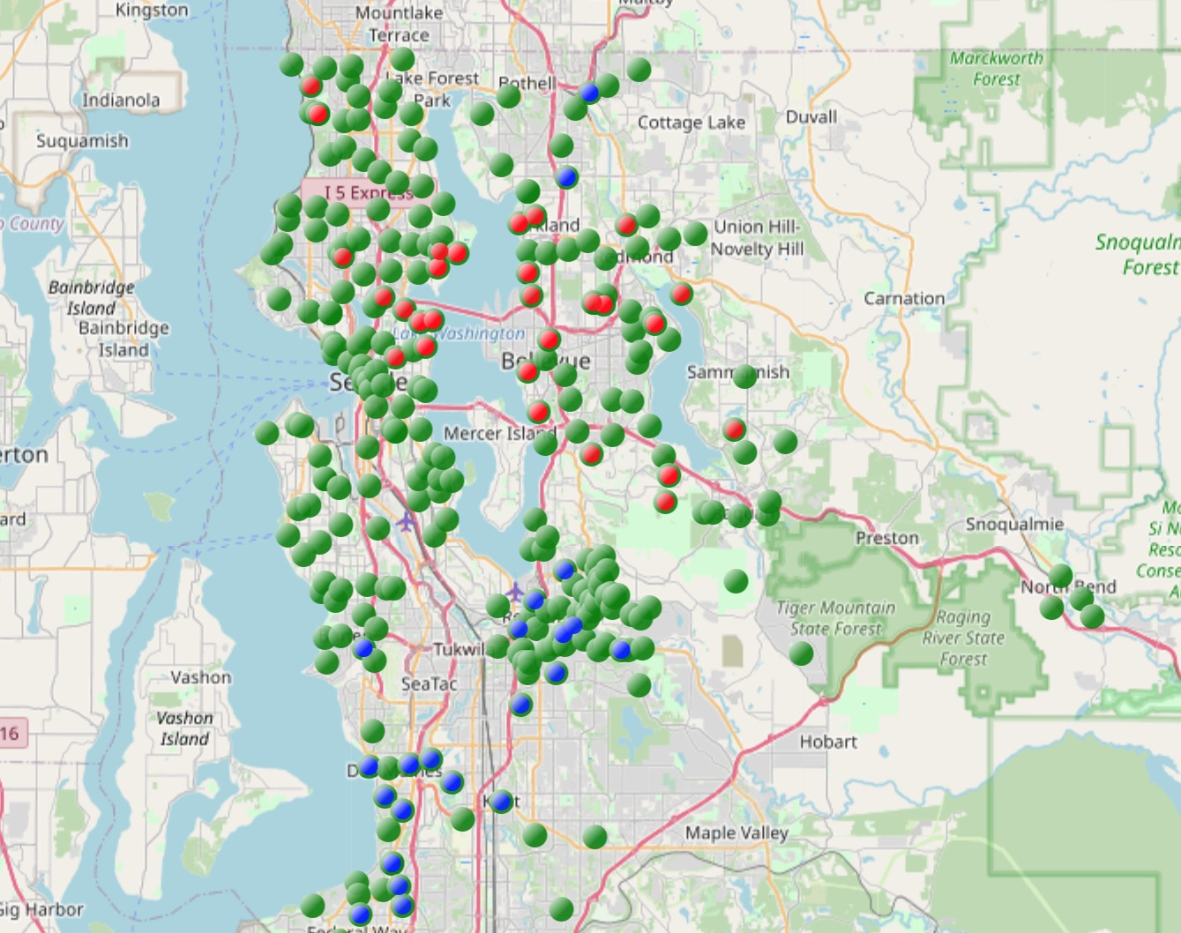
Red neighborhoods with home values over $ 1 million Blue neighborhoods with home values > $400k

Slide 9
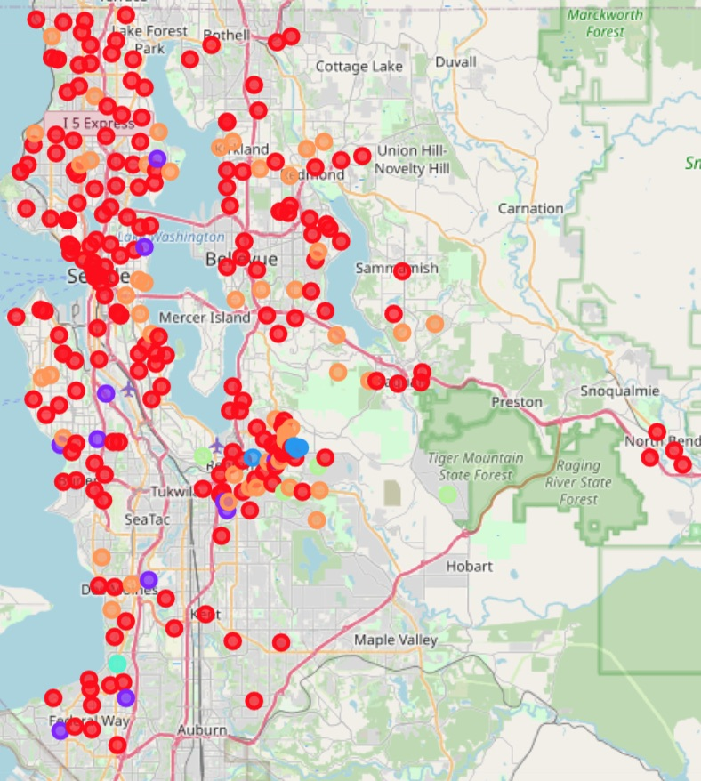
Clustering of the neighborhoods based on top venues from FourSquare API Most neighborhood seem to fall under one cluster (red)

Slide 10
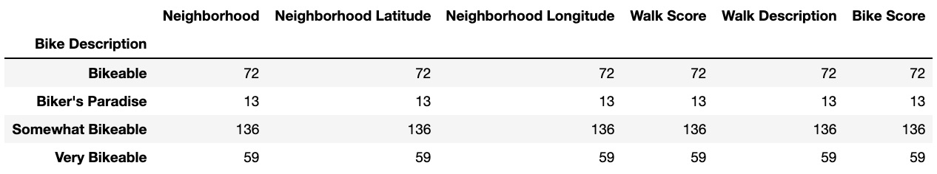
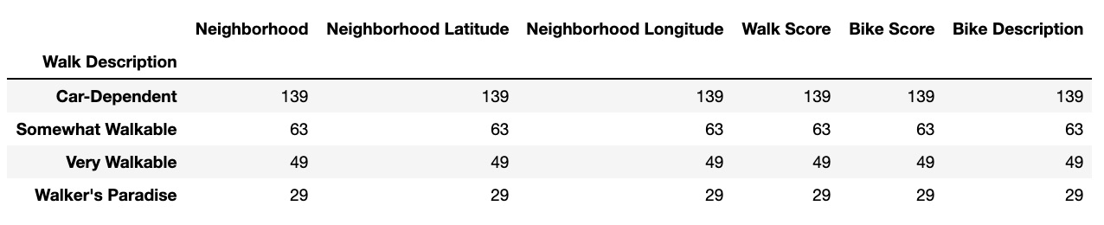
Walk and Bike Score from WalkScore API About 30% of neighborhoods walk and bike friendly

Slide 11

Conclusion
Large variation in the home value based on location
North and north—east of Seattle show high home values
South of Seattle cheaper than the rest
Top attractions are similar in majority of the neighborhoods
Seattle Metro is not quite bike and walk friendly with only 30% of neighborhoods have business conveniently located for resident
Area near Renton, WA could be most suitable for the average residents looking to settle in the Seattle metro

