Slide 1

BLOOD DONATION DATABASE PROJECT
Nour Kahile
Database systems
Database Name: FINAL52

Slide 2
Enterprise Statement:
For my final project, I worked on implementing a database to help and assist in the blood donation process in schools, to go further with the project and to put the database to use I implemented a program in java that will interact with the database.

Slide 3
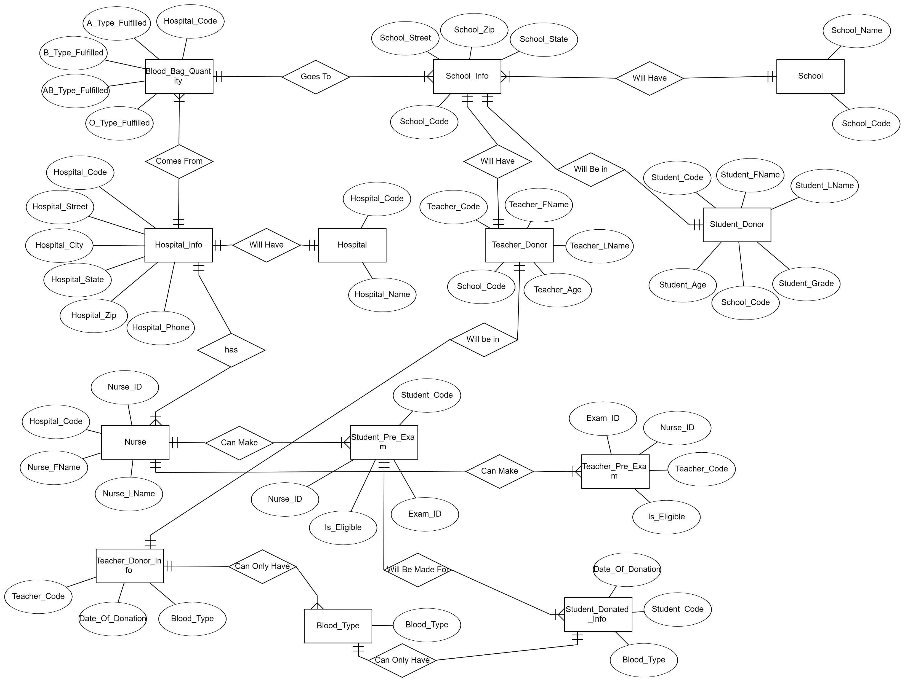
Fixed and Updated ERD
Will Have

Slide 4
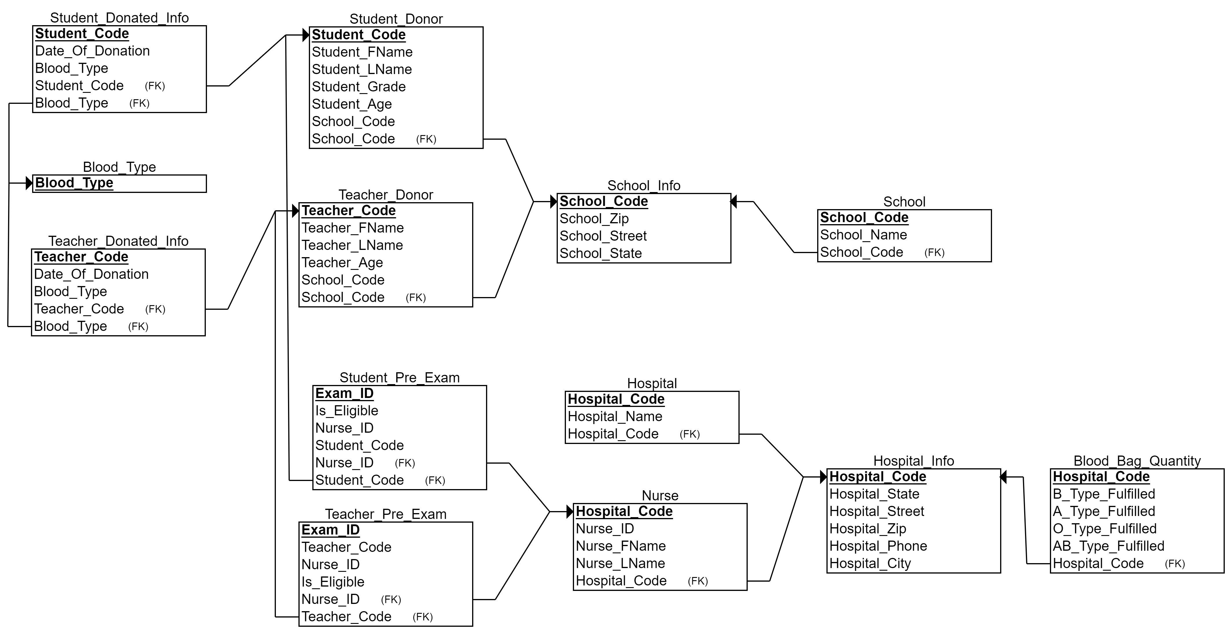
Relational Schema &Dependency Diagrams

Slide 5
Database Implemented in 3NF
-The whole database is implemented in the third normal form(3NF) by reducing the complexity of tables and reducing the redundancy of data, For example let’s look at the Student_Pre_Exam table and Teacher_Pre_Exam table, Both could be combined In on table but that will result in repeating data and a high chance in repeating ID’s

Slide 6
Function Of The Most Relevant Entities
*The tables with Donated Individuals and School Students will have an auto increment so whenever we insert new data it will increment the previous inserted row ID by one.
Student_Donor: Will hold student information.
Teacher_Donor: Will hold teacher information.
School_Info: Will hold all school information.
School: School unique code and the name of the school.
Hospital_Info: Will hold hospital information.
- Nurse: Will have all the Nurses information.

Slide 7
Function Of The Most Relevant Entities
Student_Pre_Exam: Will have the student code, nurse code, and whether the student is eligible to donate.
Teacher_Pre_Exam: Will have the student code, nurse code, and whether the teacher is eligible to donate.
Blood_Bag_Quantity: This table will have the quantity needed for each blood type
Blood Type: Will have all the blood types(A,B,AB,O)
Student_Donated_Info: Will have all the information about the students that
have successfully donated
- Teacher_Donated_Info: Will have all the information about the teachers that have successfully donated

Slide 8
Operations On The Database
- Student_Update_Quantity Trigger: This trigger will execute after insert on the Student_Donated_Info Table, it will check what blood type has been inserted, then it will update the Blood_Bag_Quantity, and decrease the required blood type quantity by one, here’s a screenshot for better explanation

Slide 9
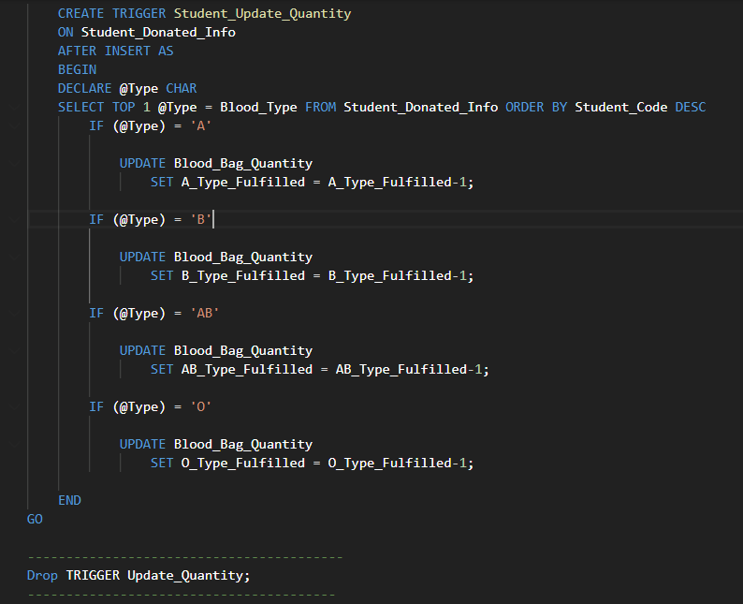

Slide 10
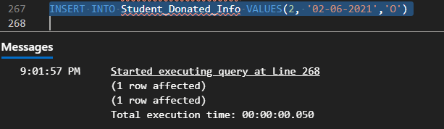
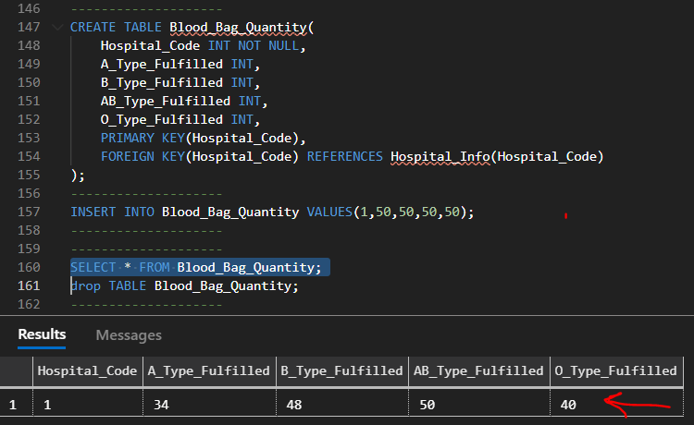

Slide 11
Operations On The Database
-Teacher_Update_Quantity: This trigger similar to the previous on but for Teachers, It will execute after insert on Teacher_Donated_Info Table, it will check what blood type has been inserted, then it will update the Blood_Bag_Quantity, and decrease the required blood type quantity by one, here’s a screenshot for better exlaination

Slide 12
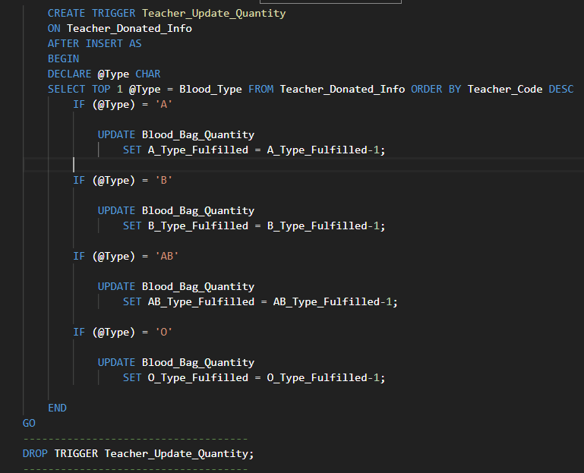

Slide 13
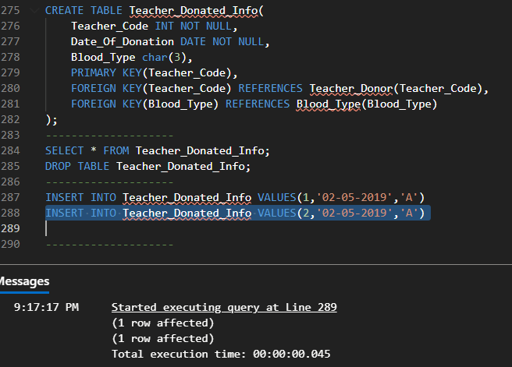

Slide 14
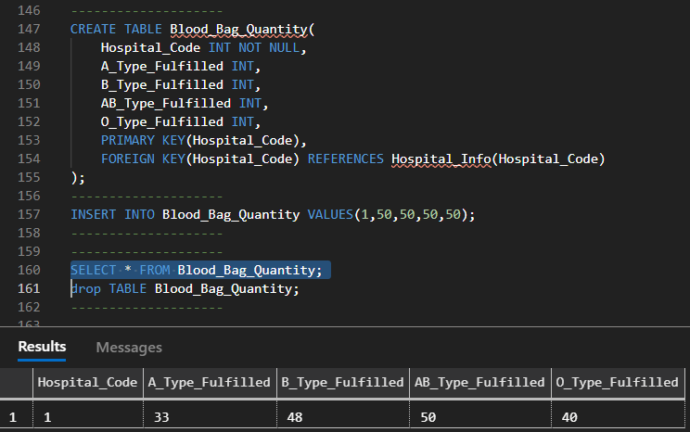

Slide 15
Operations On The Database
Donated_Students Stored Procedure: It be executed whenever we need to know the first and last name of the donated students and the name of the school they are in.
Donated_Teachers Stored Procedure: It be executed whenever we need to know the first and last name of the donated Teachers and the name of the school they are in.

Slide 16
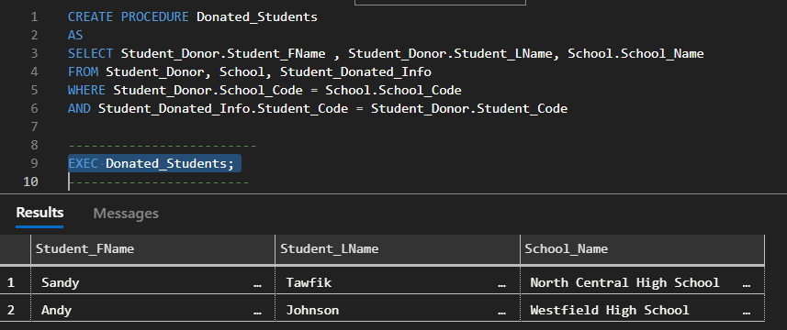

Slide 17
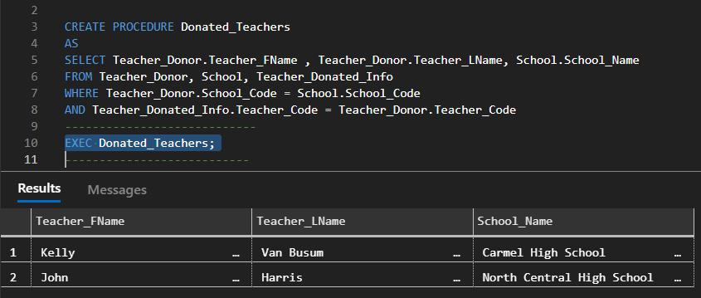

Slide 18
Java
Connection.java: Will have a public static Connection getConnection() function to make the connection between the database and java.
- It will also have a public static void runQuery(Connection conn, String query) that will take the Query and execute it and display its contents on the console

Slide 19
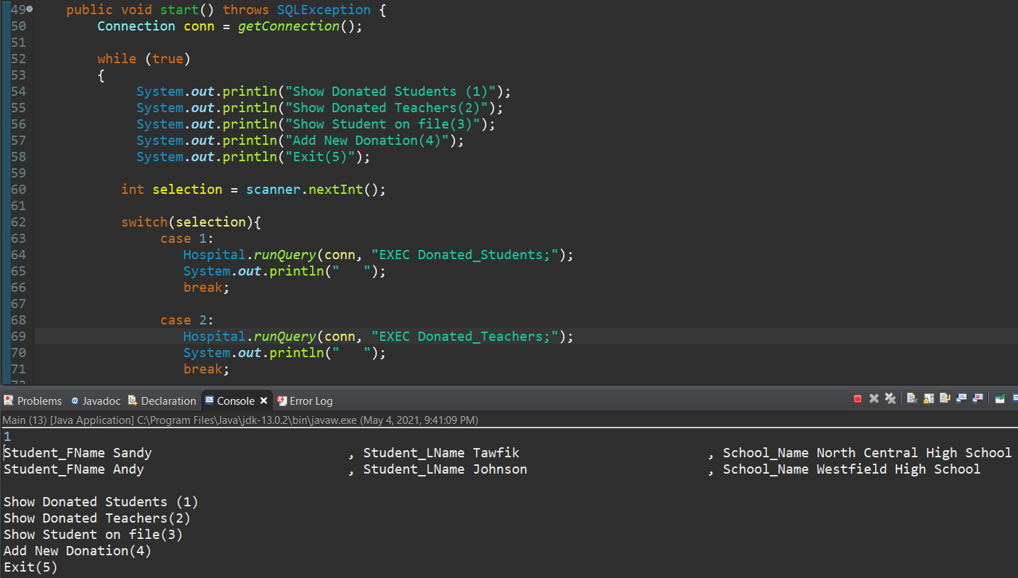
Stored Procedure used to extract data

Slide 20
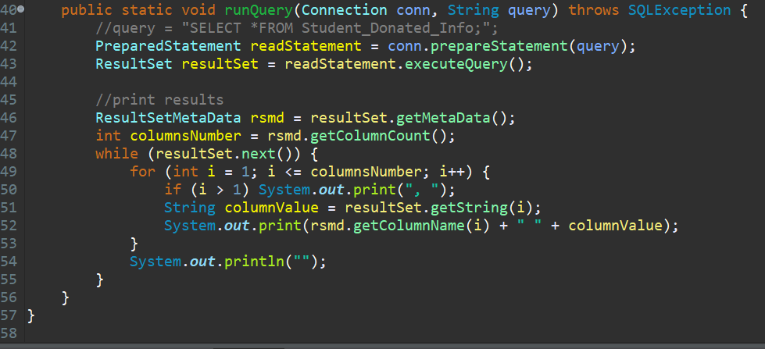

Slide 21
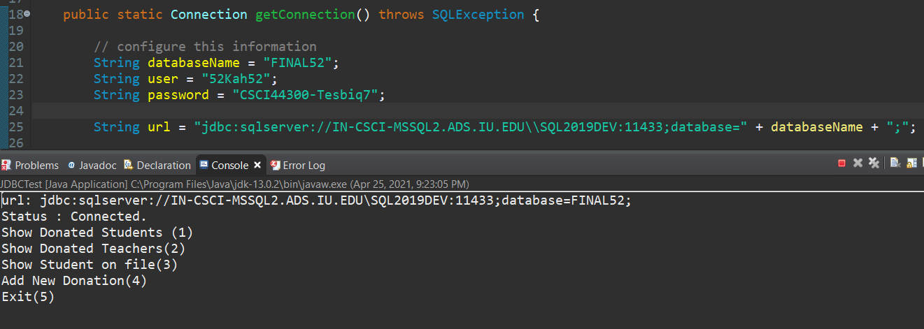

Slide 22
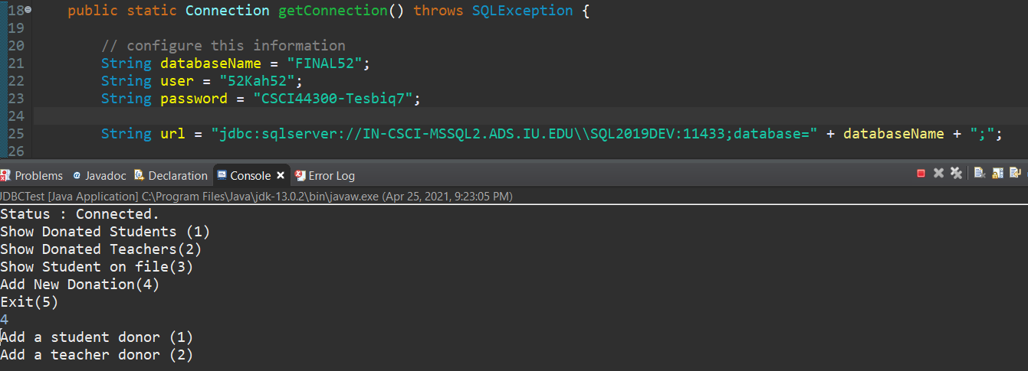

Slide 23
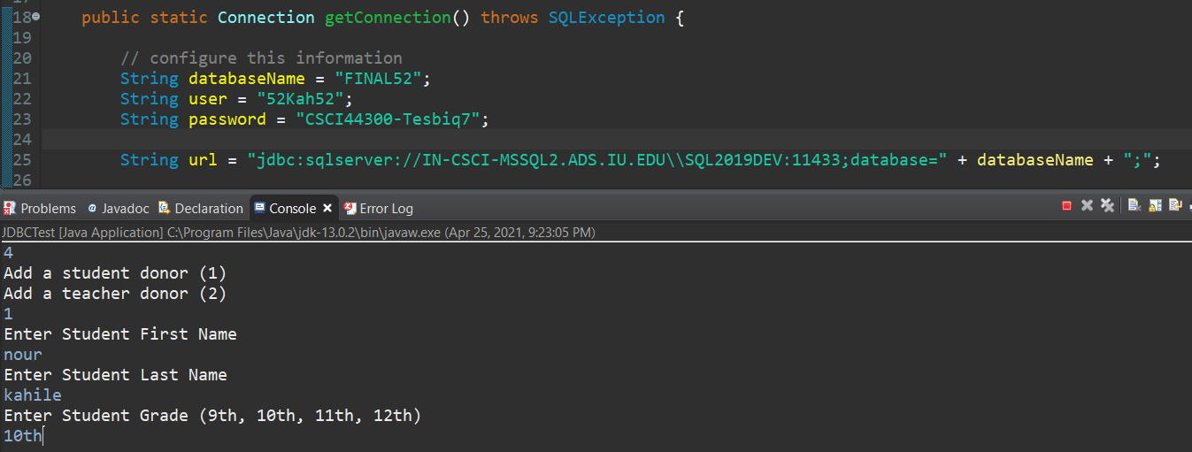

Slide 24
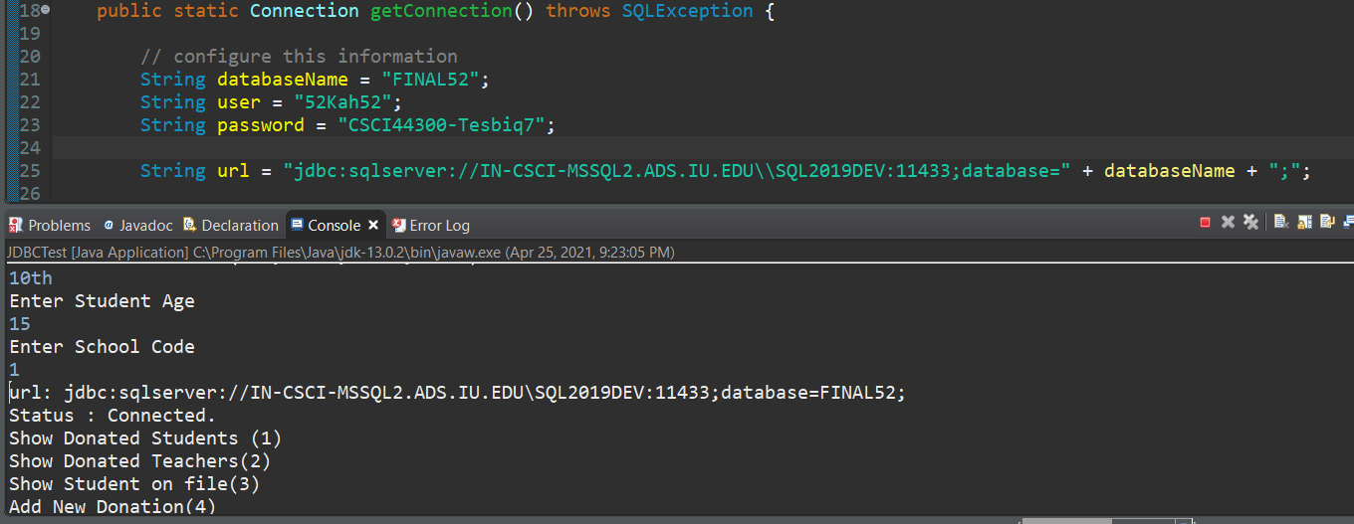

Slide 25
