Slide 1
Focal loss for contrastive learning
Advanced topics in Deep Learning
Natan Kaminsky
Noam Rotstein

Slide 2
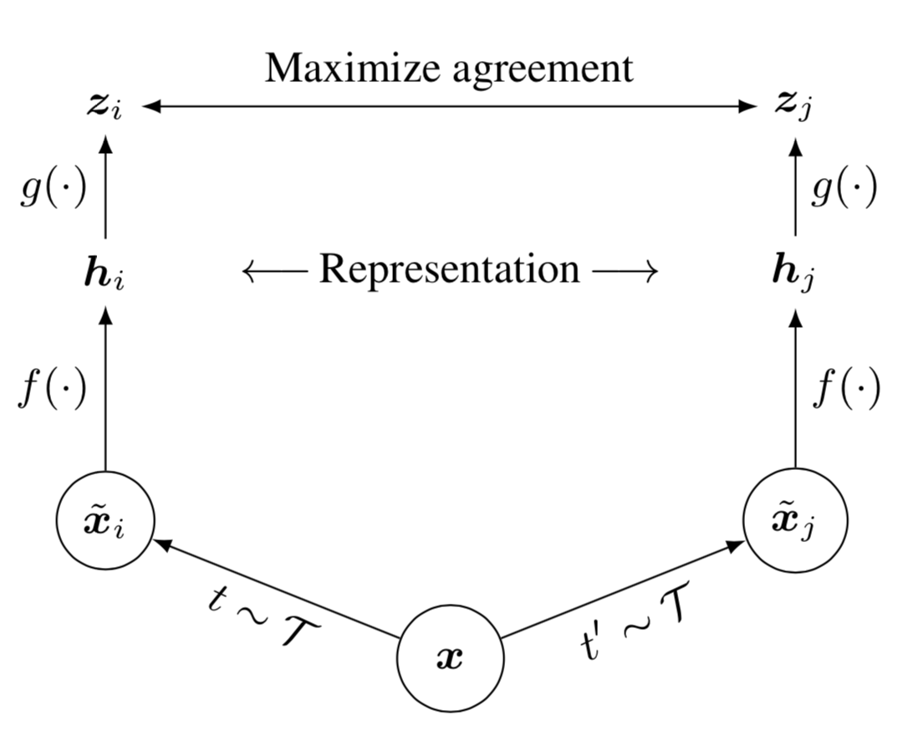
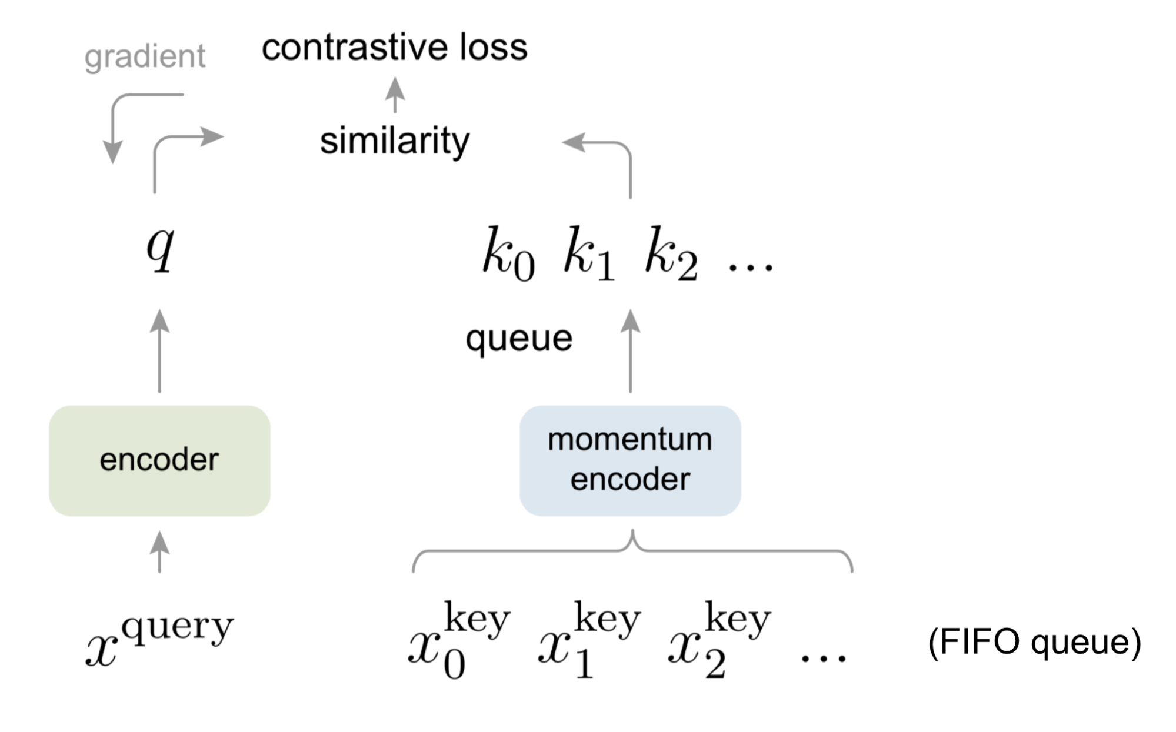
Costrastive learning
Learn such an embedding space in which
Similar sample pairs stay close to each other
Dissimilar ones are far apart
SimCLR
MoCo

Slide 3
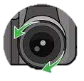
Focal loss
Easy samples- Samples correctly classified as positive/negative examples
Hard samples- Samples misclassified as negative/positive examples
Class imbalance bias (from detection)

Slide 4




Focal loss
Training becomes inefficient as most of the samples are easy negatives
Cumulative easy negatives loss overwhelms the total loss
Modify classical cross entropy loss:
$$L\left(p\right)=CE\left(p\right)=−\log\left(p\right)$$
$$L_{focal}\left(p\right)=FL\left(p\right)=−{\left(1−p\right)}^{γ}\log\left(p\right)$$
$${\left(1− \right)}^{γ}$$

Slide 5
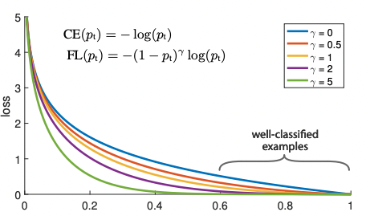
Focal loss

Slide 6
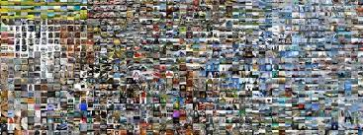
Datasets and models
Imagenette
Due to computational constraints we will use the data set from the hw assignment
MoCo v2

Slide 7
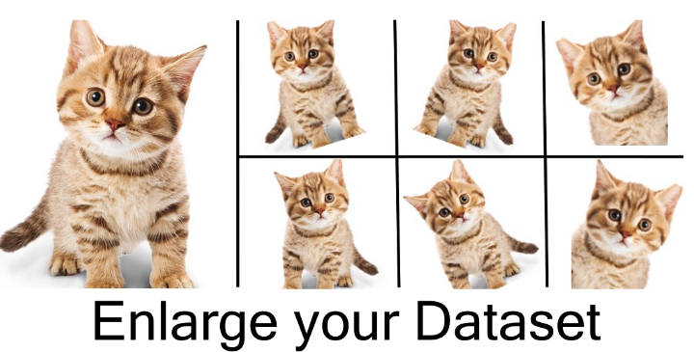
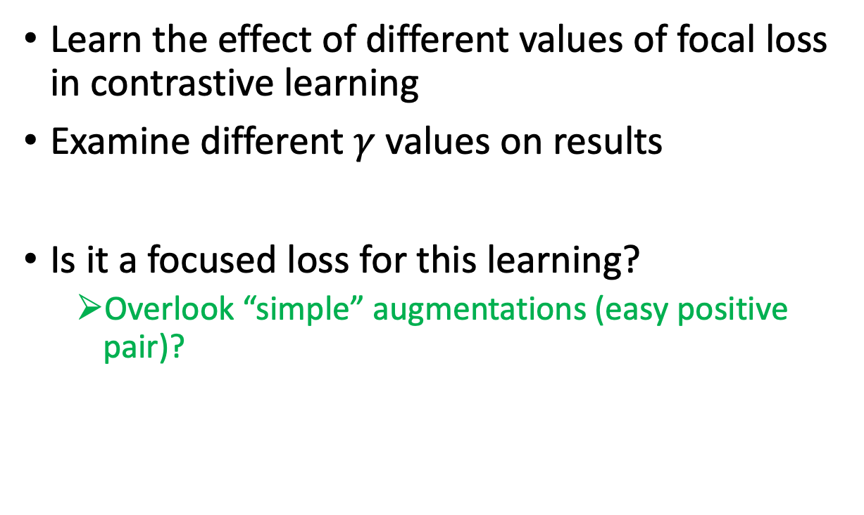
Experiments
Learn the effect of different values of focal loss in contrastive learning
Examine different $γ$ values on results
Is it a focused loss for this learning?
Overlook “simple” augmentations (easy positive pair)?

Slide 8
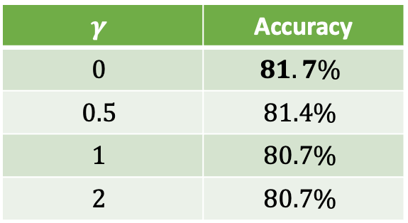

Experiment 1- Naive
Learn the effect of different values of $γ$ focal loss in contrastive learning
Examine different $γ$ values on results
$$γ$$ | Accuracy
$$0$$ | $$81.7\%$$
$$0.5$$ | $$81.4\%$$
$$1$$ | $$80.7\%$$
$$2$$ | $$80.7\%$$

Slide 9
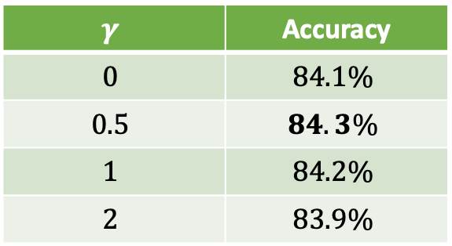

Experiment 2 – Post Training
Pre-Train with $γ=0$
Post-Train with different $γ$ values
$$γ$$ | Accuracy
$$0$$ | $$84.1\%$$
$$0.5$$ | $$84.3\%$$
$$1$$ | $$84.2\%$$
$$2$$ | $$83.9\%$$

Slide 10
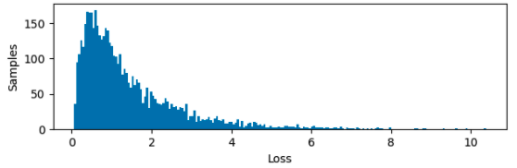


Loss Distribution
Focal loss designed for biased loss distribution
Analyze it for our trained model $(γ=0)$
$$Loss Distribution$$

Slide 11

Loss Distribution – Clustered
Even if queue samples belong to the same class, contrastive approach still tries to reduce their similarity
Apply k-means to queue
Mark all cluster of current sample as positive examples

Slide 12

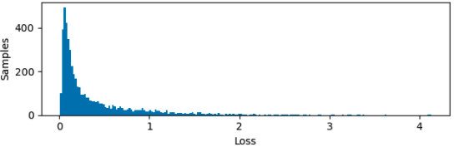

Loss Distribution – Clustered
$$Clustered Loss Distribution$$

Slide 13
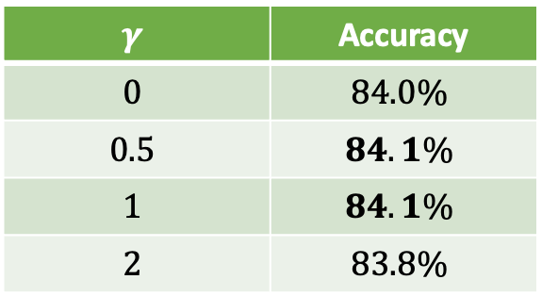

Experiment 3– Clustered
Pre-Train with $γ=0$
Post-Train with different $γ$ values and clustered loss
$$γ$$ | Accuracy
$$0$$ | $$84.0\%$$
$$0.5$$ | $$84.1\%$$
$$1$$ | $$84.1\%$$
$$2$$ | $$83.8\%$$

Slide 14
Loss Distribution – Filtered
Clustered too dependent on k-means classification?
Increased similarity
Filtered loss- Remove all samples belonging to the same cluster from the queue
Only avoid decreased similarity

Slide 15

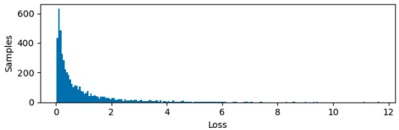

Loss Distribution – Filtered
$$Filtered Loss Distribution$$

Slide 16
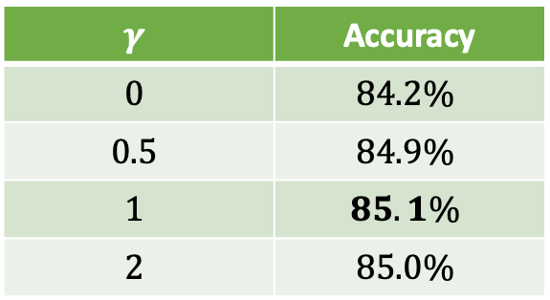

Experiment 4– Filtered
Pre-Train with $γ=0$
Post-Train with different $γ$ values and filtered loss
$$γ$$ | Accuracy
$$0$$ | $$84.2\%$$
$$0.5$$ | $$84.9\%$$
$$1$$ | $$85.1\%$$
$$2$$ | $$85.0\%$$

Slide 17
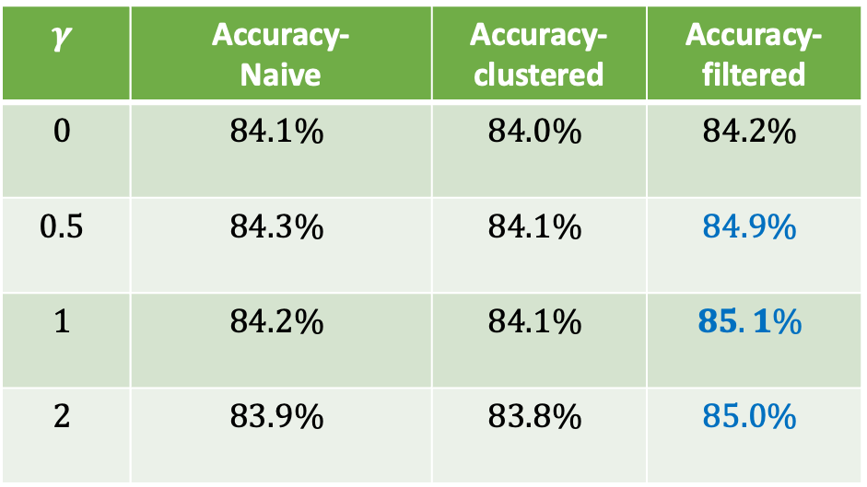
Results Sum-Up
$$γ$$ | Accuracy- Naive | Accuracy- clustered | Accuracy- filtered
$$0$$ | $$84.1\%$$ | $$84.0\%$$ | $$84.2\%$$
$$0.5$$ | $$84.3\%$$ | $$84.1\%$$ | $$84.9\%$$
$$1$$ | $$84.2\%$$ | $$84.1\%$$ | $$85.1\%$$
$$2$$ | $$83.9\%$$ | $$83.8\%$$ | $$85.0\%$$

Slide 18
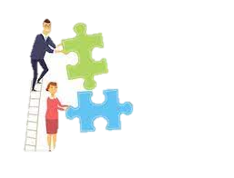
Conclusions
Naive focal loss does not improve contrastive learning
Clustering and filtering do not either
Combining filtered + focal loss leads to better model accuracy
Easily used with different back bones and contrastive loss functions.

Slide 19
Future Work
Other K values
Other unsupervised clustering algorithms
“Smart” augmentations

Slide 20
THANK YOU!

