Slide 1
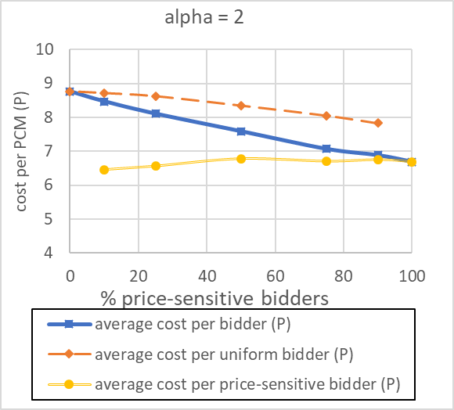
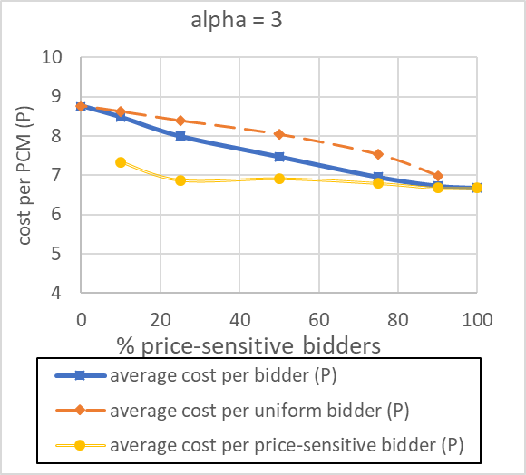
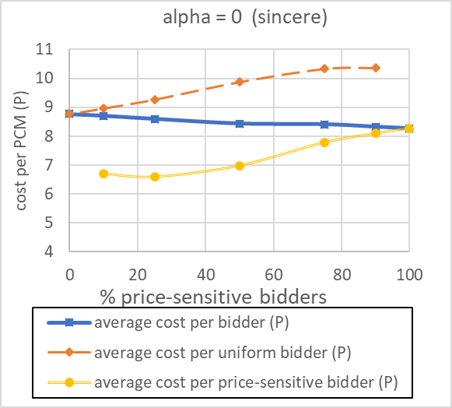
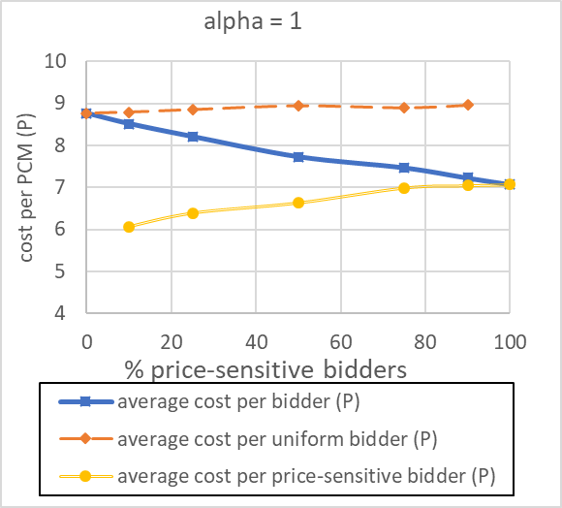
greedy_(alpha)_m52_n24.

Slide 2

Greedy_2_(fb)_m52_n24.json

Slide 3

greedy_2_(fb)_m442_n161.json

Slide 4

json/greedy_2_(fb)_m54_n31.json

Slide 5
Selective behavior

Slide 6
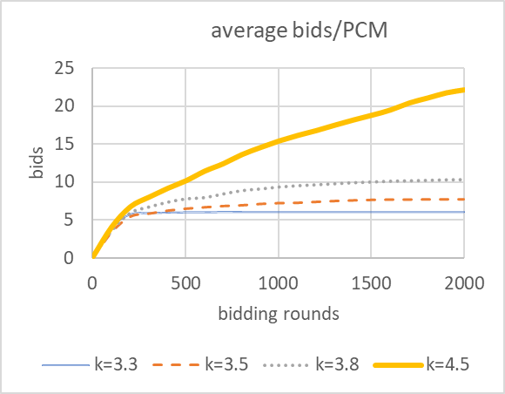
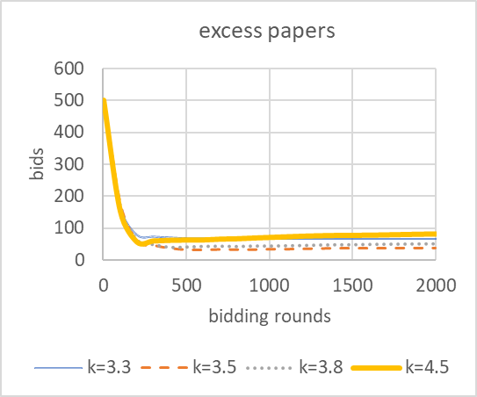
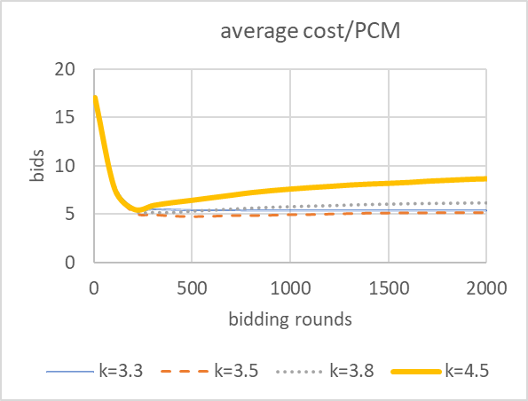
Bidding rounds
papers
cost
2n
2n
2n

