Slide 1
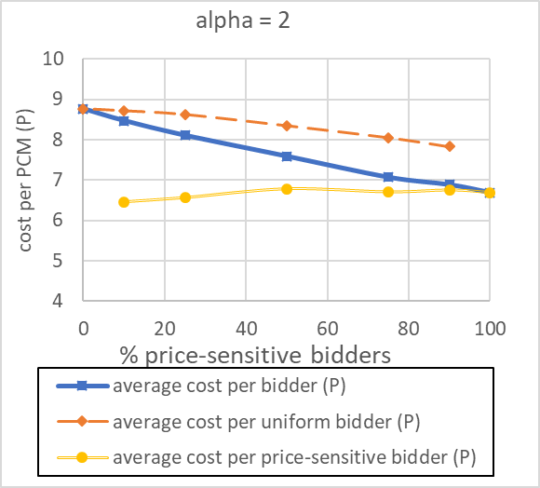
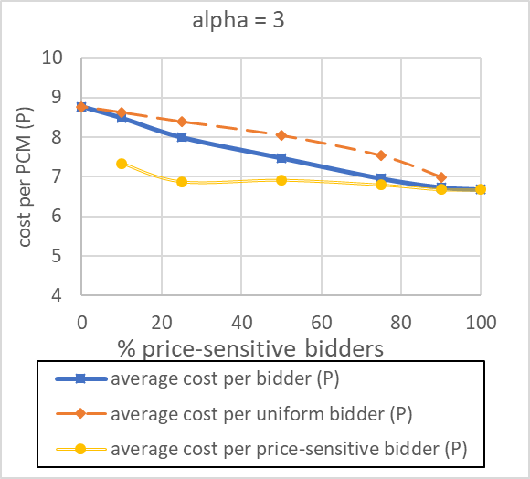
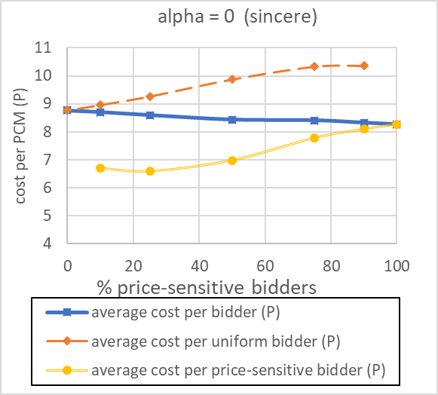
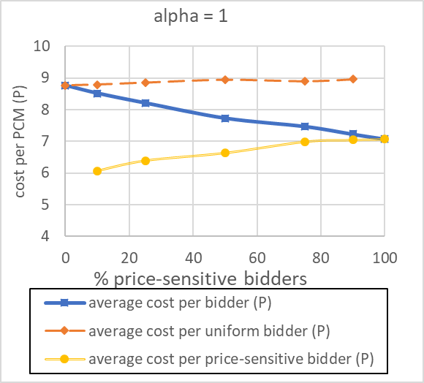
greedy_(alpha)_m52_n24.

Slide 2

Greedy_2_(fb)_m52_n24.json

Slide 3

greedy_2_(fb)_m442_n161.json

Slide 4

json/greedy_2_(fb)_m54_n31.json

Slide 5

json/greedy_2_(fb)_m176_n146.json

Slide 6

json/greedy_2_(fb)_m176_n146_2lvl.json
For the original bids: 8.9 bids per PCM, 0.31 excess papers, 7.4 cost per PCM

Slide 7
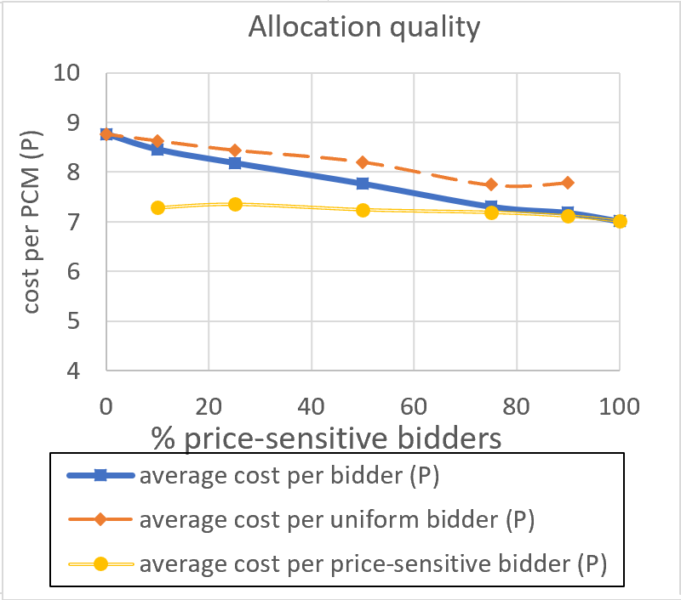
Sequential bids (T=n)
m52_n24

Slide 8
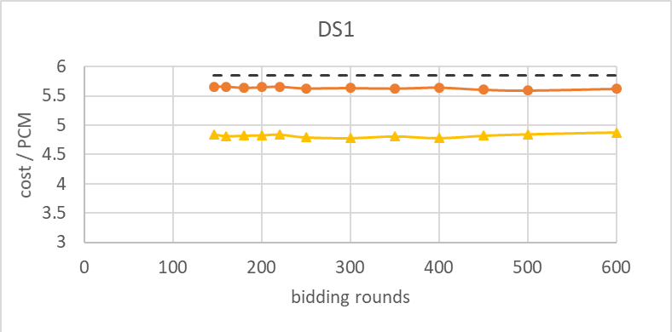
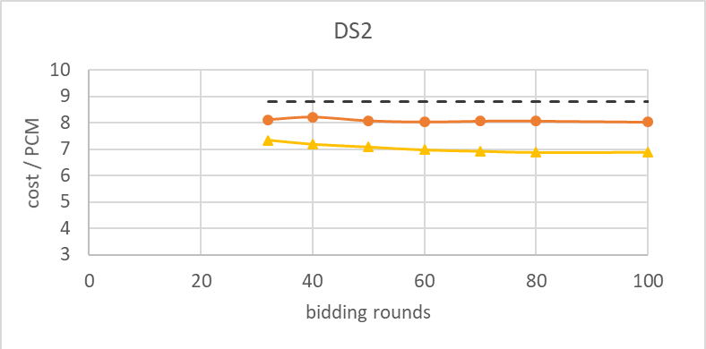
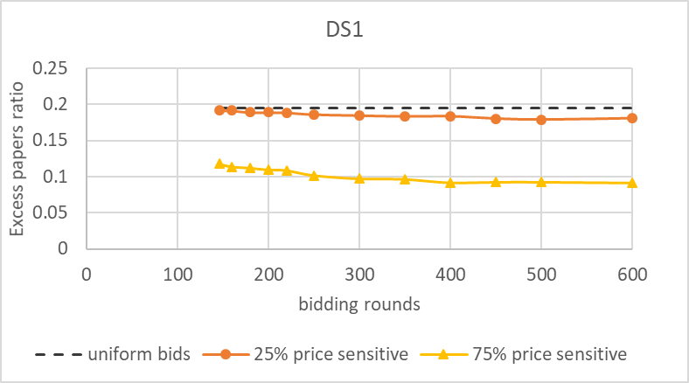
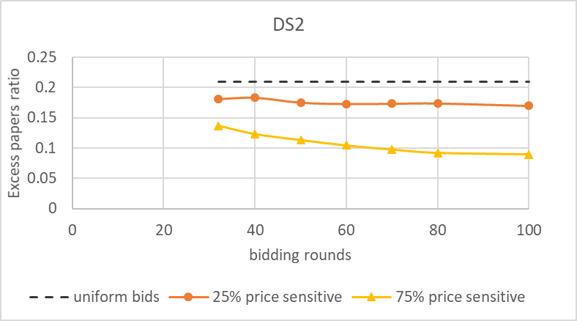
n
2n
n
2n

Slide 9
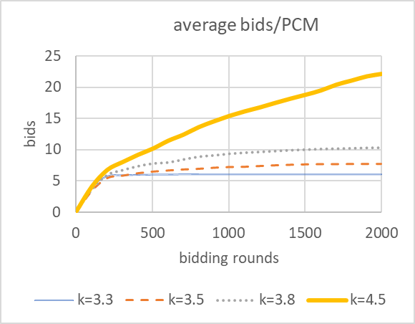
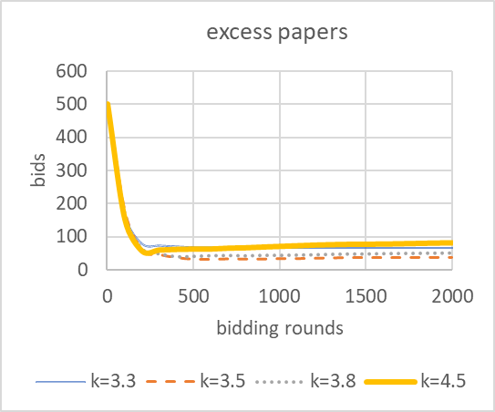
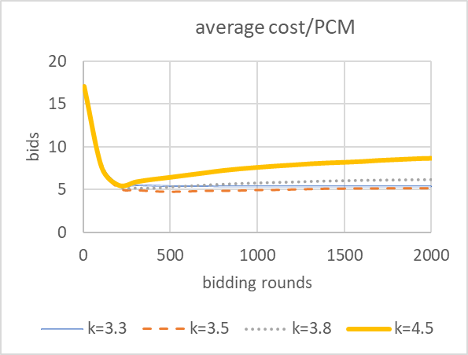
Bidding rounds
papers
cost
2n
2n
2n

Slide 10
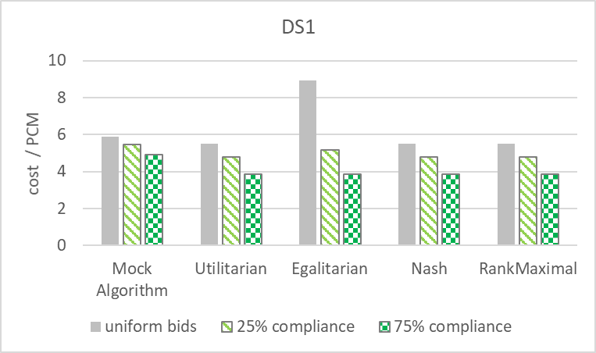
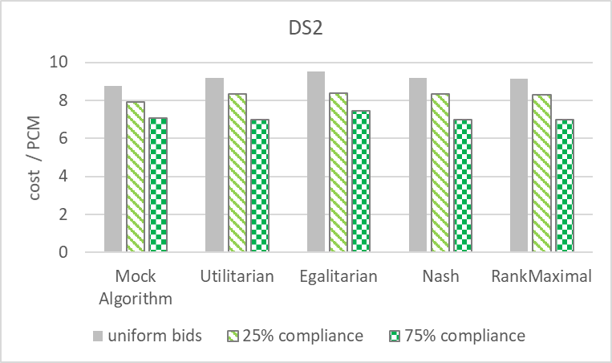
All algorithms

Slide 11
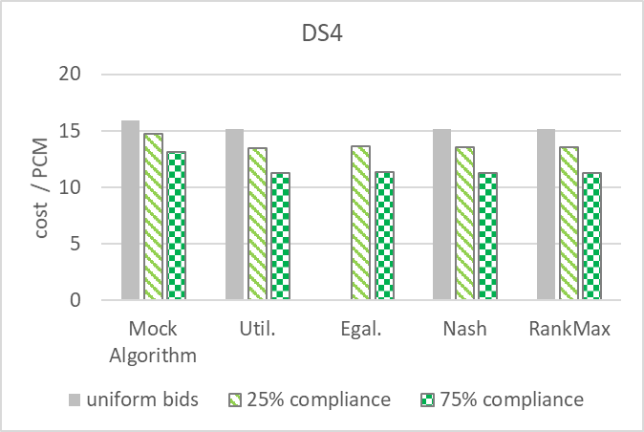
x

