Slide 1
A Machine Learning Primer with examples

Slide 2
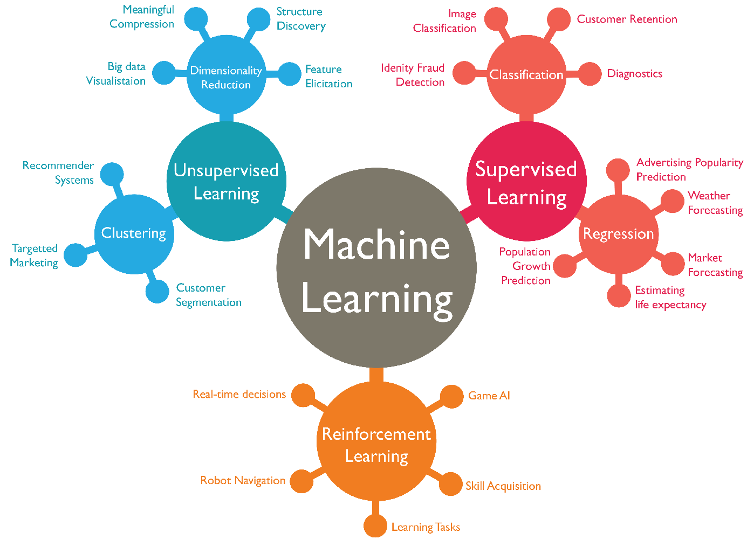
What is today’s session about?
Give you an intuition about ML that you can get started on your ML journey.
Enough intuition so you can understand the workshop.
What’s it not about?
Advanced discussion of LLM/DL architectures, GenAI hype/slop/trash

Slide 3

What is Machine Learning?
BORING!
Machine learning (ML) is a field of study in artificial intelligence concerned with the development and study of statistical algorithms that can learn from data and generalise to unseen data, and thus perform tasks without explicit instructions.

Slide 4

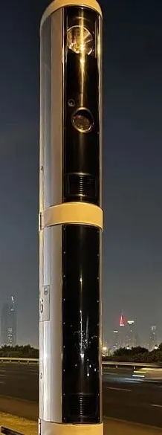

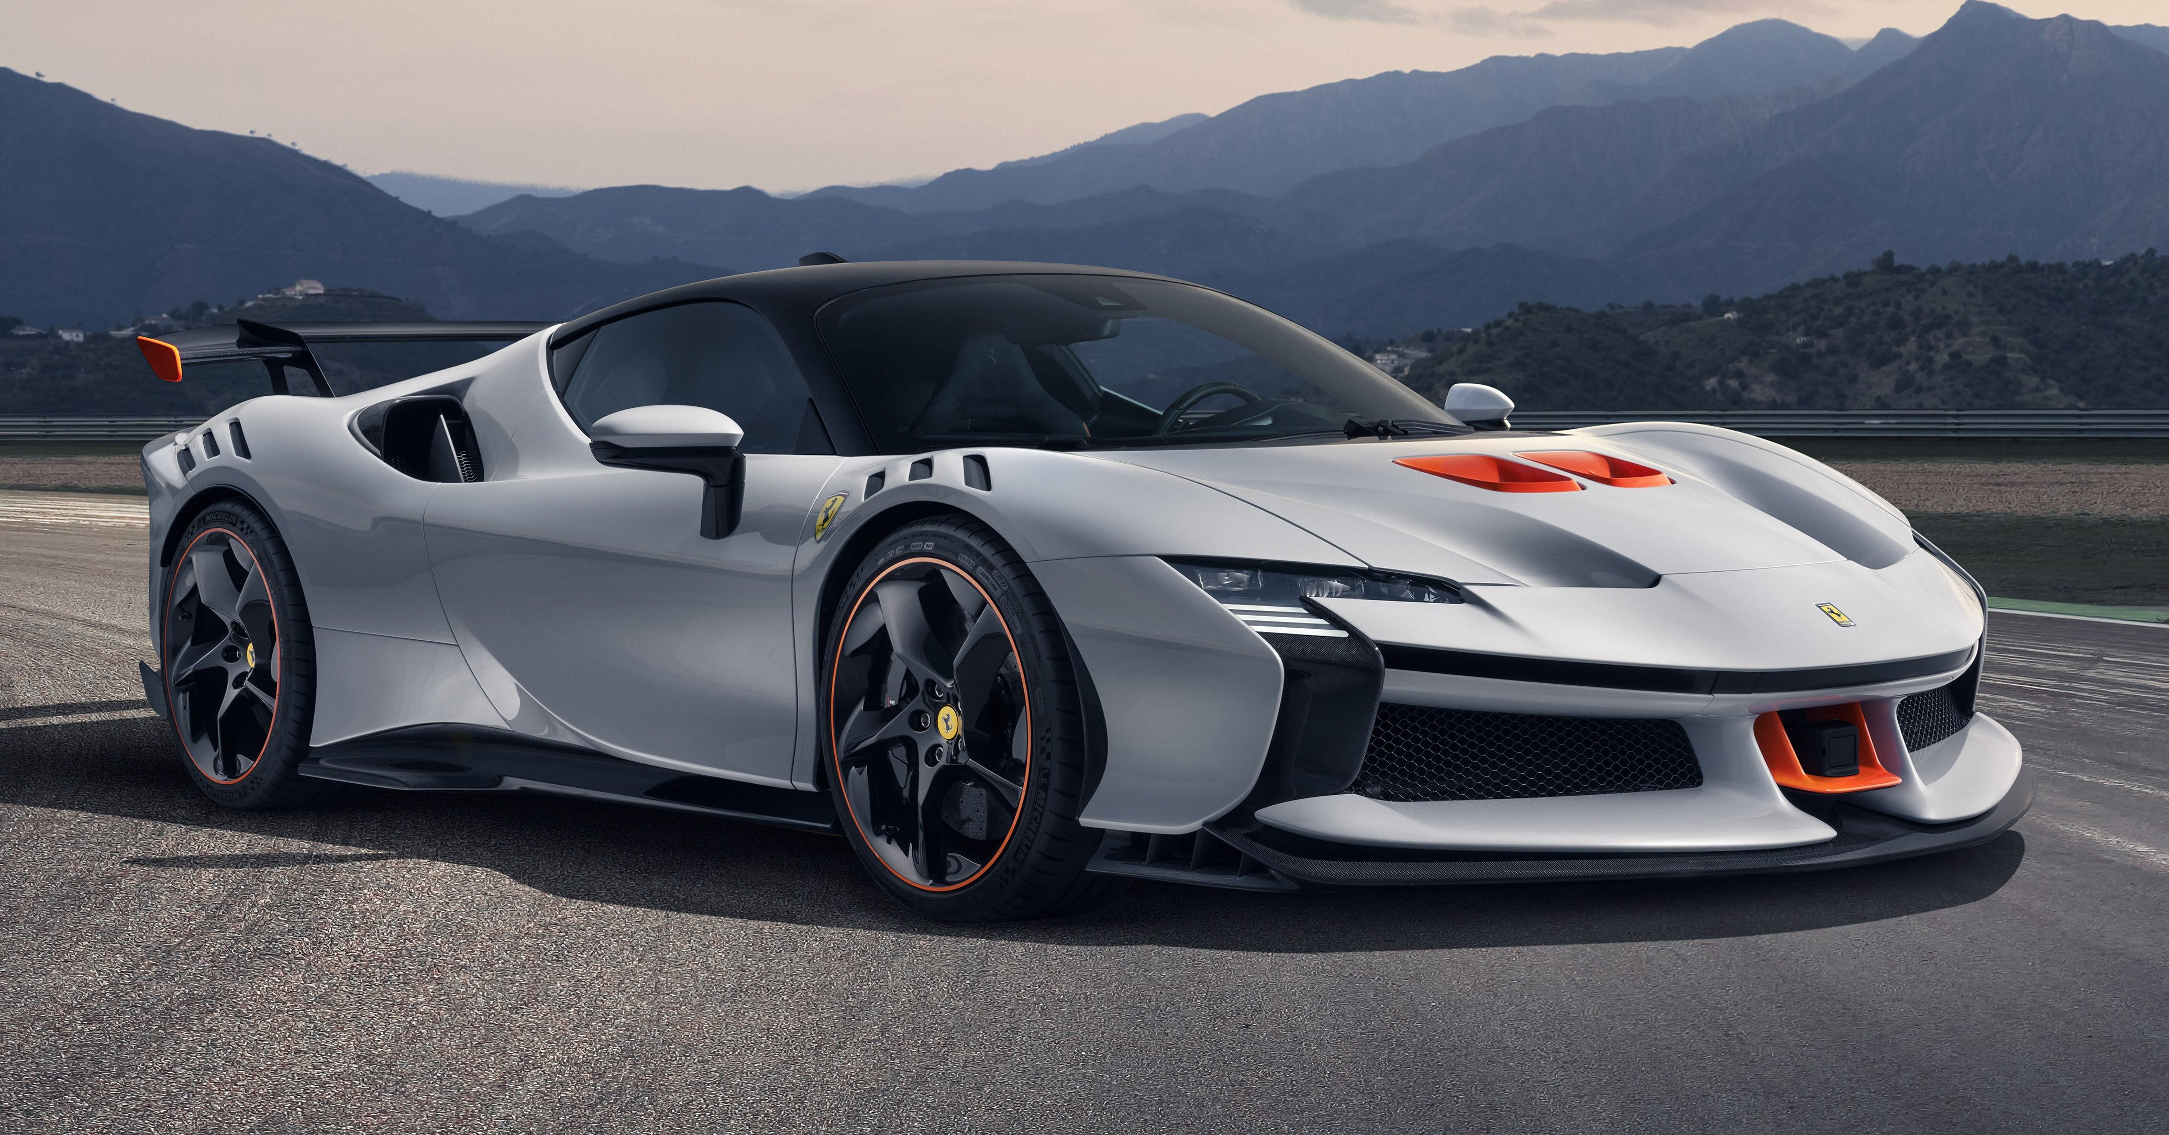
What is Machine Learning? An example
NAUGHTY BOY TAKE FINE~!
VROOOMMM

Slide 5
OK so you think you can keep up, human?
NAUGHTY BOY TAKE FINE~!
Checking if you’re on your phone (scrolling brainrot on Instagram)
Checking if you don’t have a seat belt on?
Checking if your license plate has expired?

Slide 6
OK so you think you can keep up, human?
Machine learning algorithm
.....
.....
=
.....

Slide 7
What is Supervised Learning?
Machine learning (ML) is a field of study in artificial intelligence concerned with the development and study of statistical algorithms that can learn from data and generalise to unseen data, and thus perform tasks without explicit instructions.

Slide 8
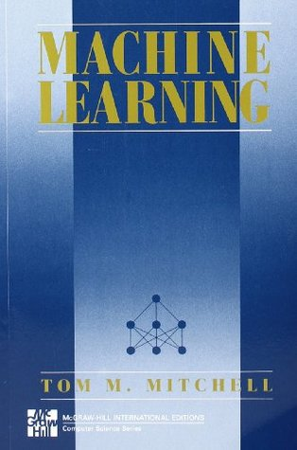
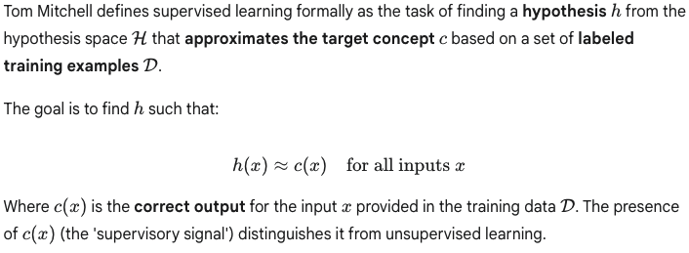
More formally!
HOLD ON TO THIS A BIT!
We shall understand this soon

Slide 9
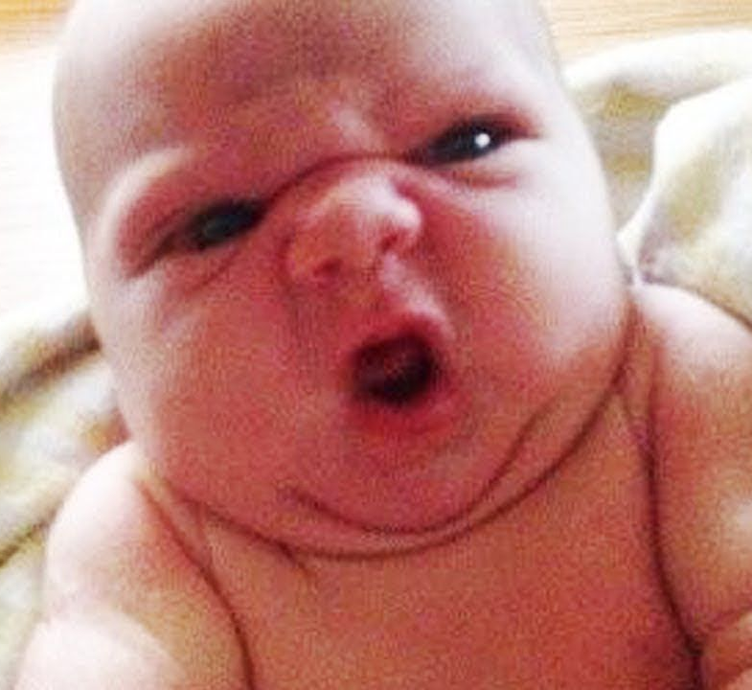
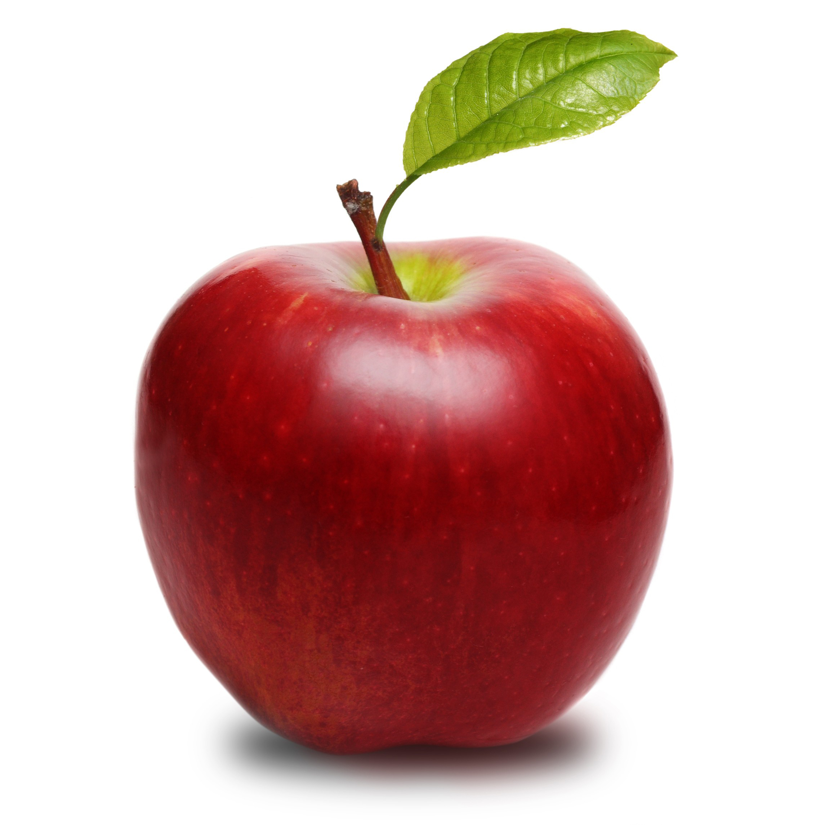
An open question
HANGRY?!
How do babies learn about Apples?

Slide 10
The features!
HANGRY?!
Taste...? Shape...? Color...? Stem...?

Slide 11
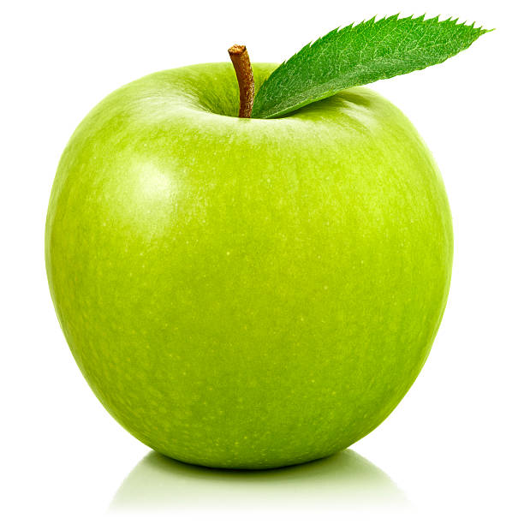
What happens when it’s a Green Apple?
HANGRY?!
Does the baby’s mental model of an Apple fail entirely here?

Slide 12
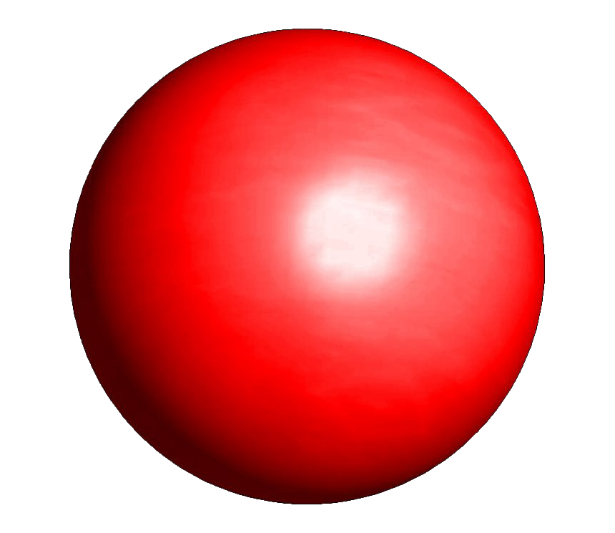
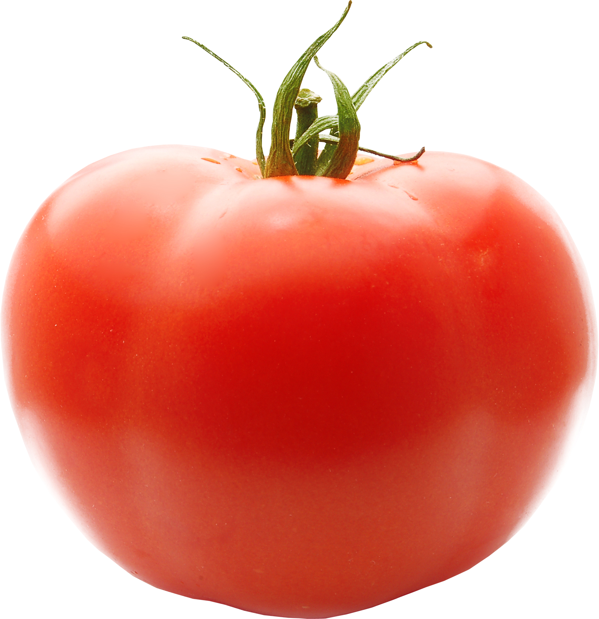
Or Perhaps?
IM STILL
HANGRY?!!!
Is this an Apple?
What about this?

Slide 13
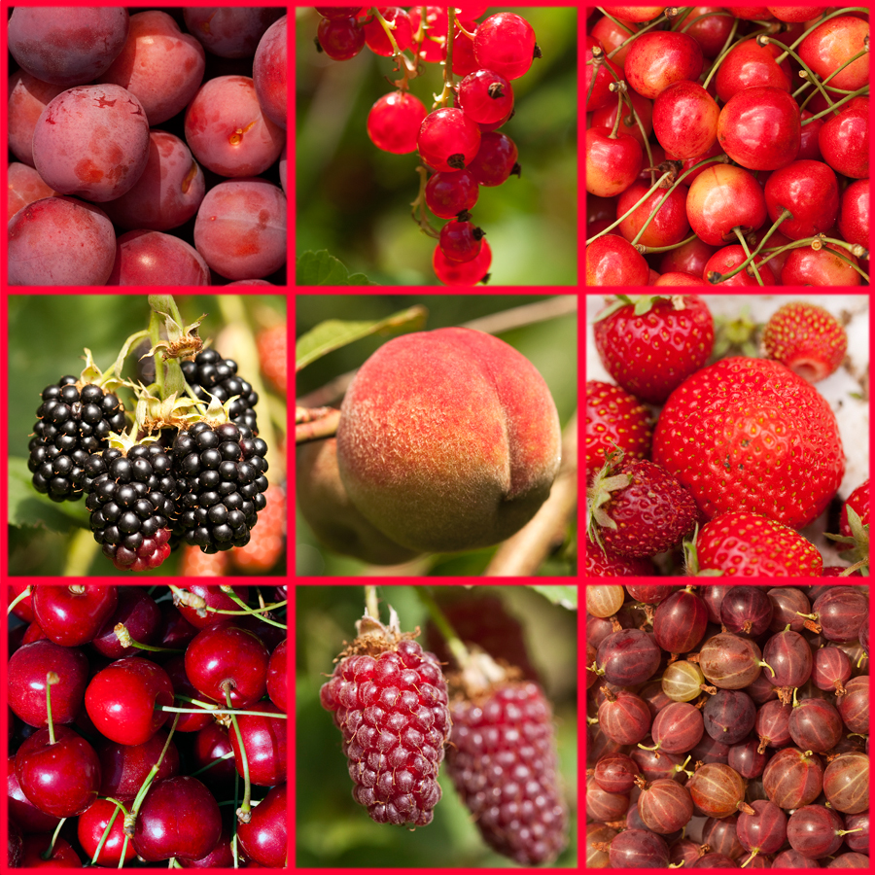
How do we ingrain this concept? collect the data
Image in question | Taste | Shape | Color | Has a Stem?
Red Apple | Sweet | Round | Red | Yes
Green Apple | Sweet | Round | Green | Yes
Red Ball | PLASTIC | Perfect Sphere | Red | No
Tomato | You Decide | ??? | Red | Yes
Cherries | Sweet | Round | Red | Yes
Apricot | Sweet | Round | Yellowish Red | No
... | ... | ... | ... | ...

Slide 14
Our Data for ML
FEATURES
Image in question | Taste | Shape | Color | Has a Stem?
Red Apple | Sweet | Round | Red | Yes
Green Apple | Sweet | Round | Green | Yes
Red Ball | PLASTIC | Perfect Sphere | Red | No
Tomato | You Decide | ??? | Red | Yes
Cherries | Sweet | Round | Red | Yes
Apricot | Sweet | Round | Yellowish Red | No
... | ... | ... | ... | ...
EXAMPLES

Slide 15
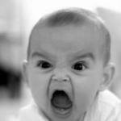
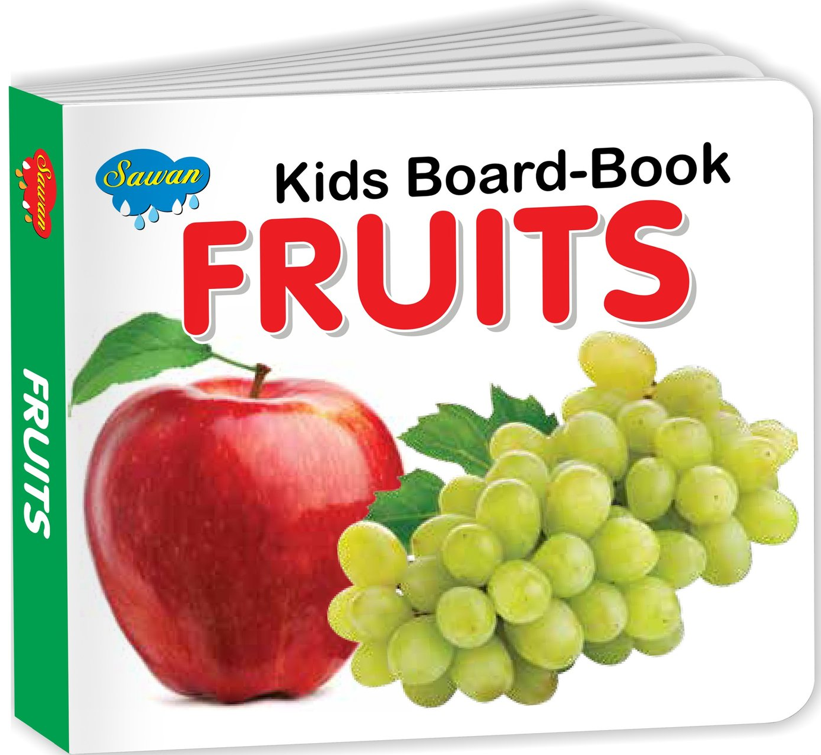
Well, what is this similar to? :)
Image in question | Taste | Shape | Color | Has a Stem?
Red Apple | Sweet | Round | Red | Yes
Green Apple | Sweet | Round | Green | Yes
Red Ball | PLASTIC | Perfect Sphere | Red | No
Tomato | You Decide | ??? | Red | Yes
Cherries | Sweet | Round | Red | Yes
Apricot | Sweet | Round | Yellowish Red | No
... | ... | ... | ... | ...
==

Slide 16
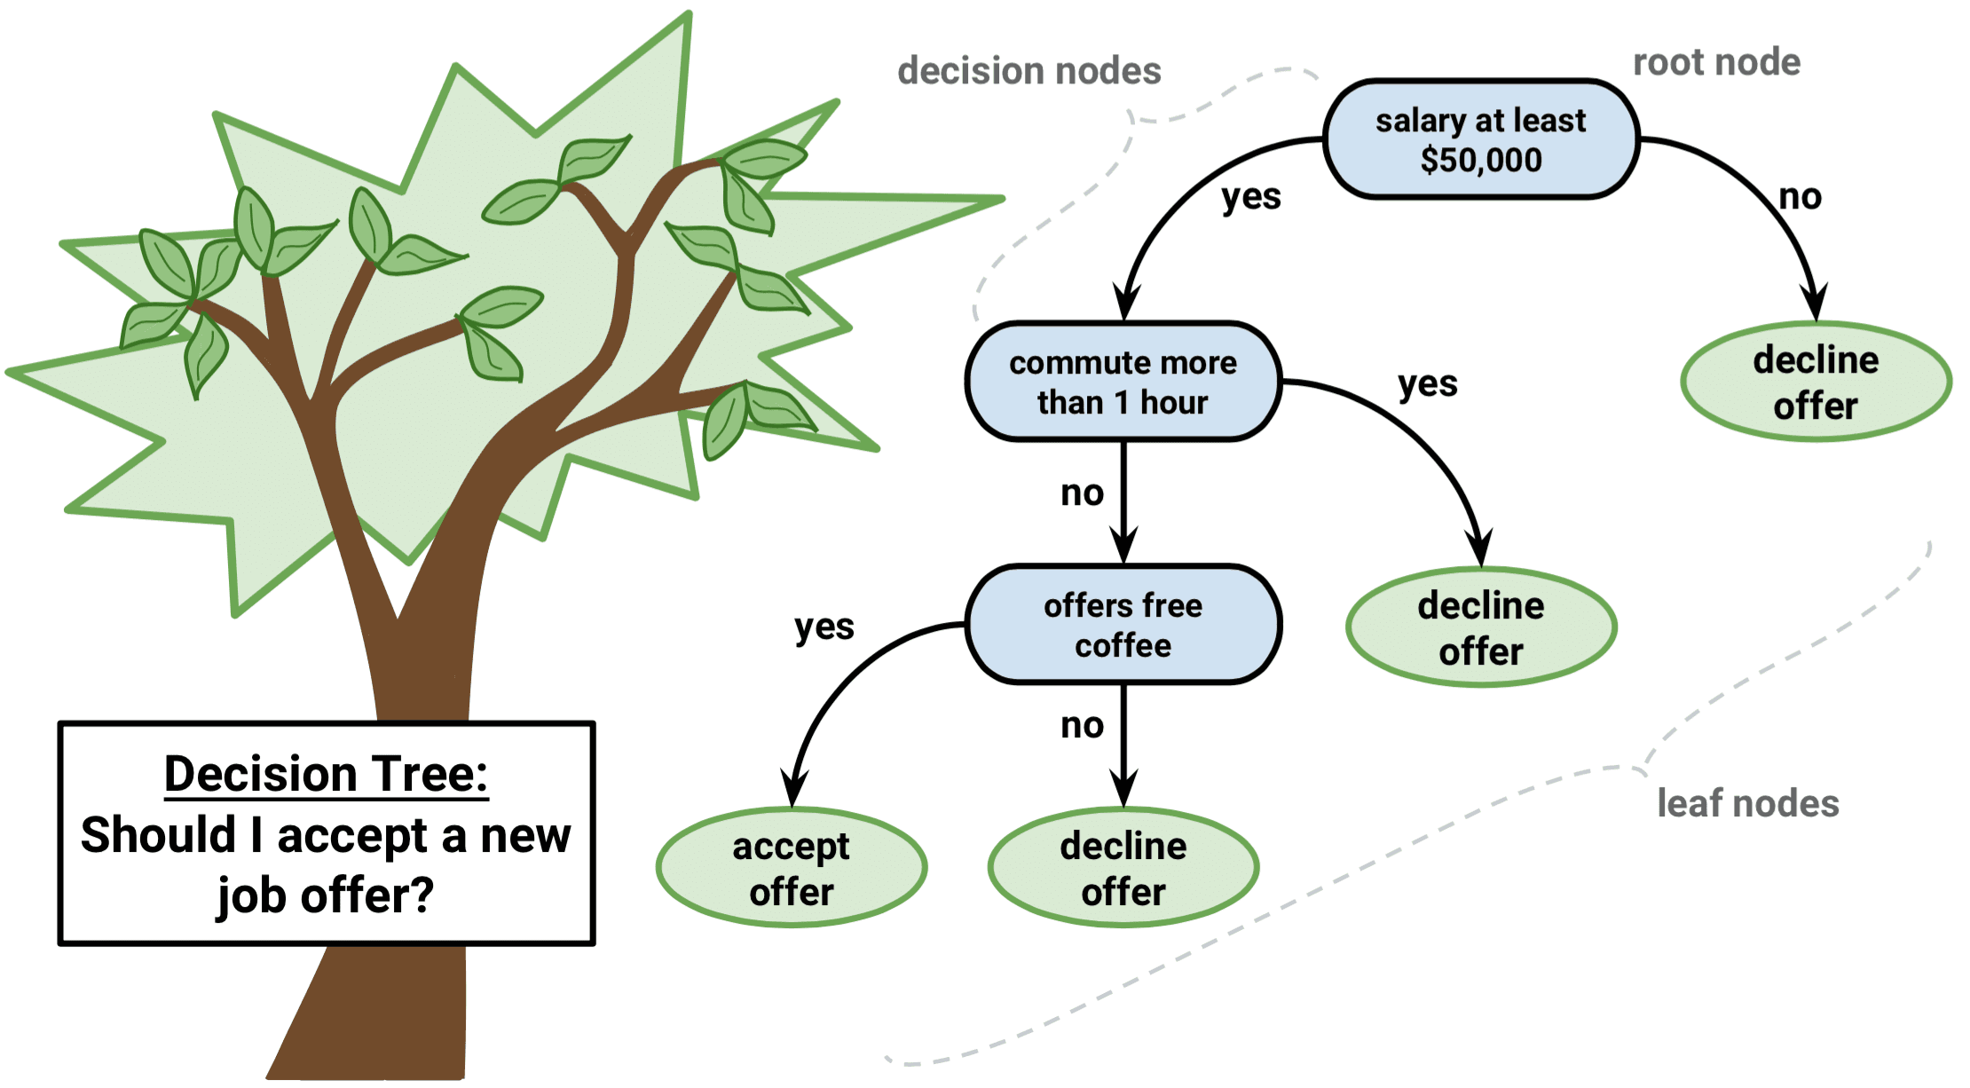
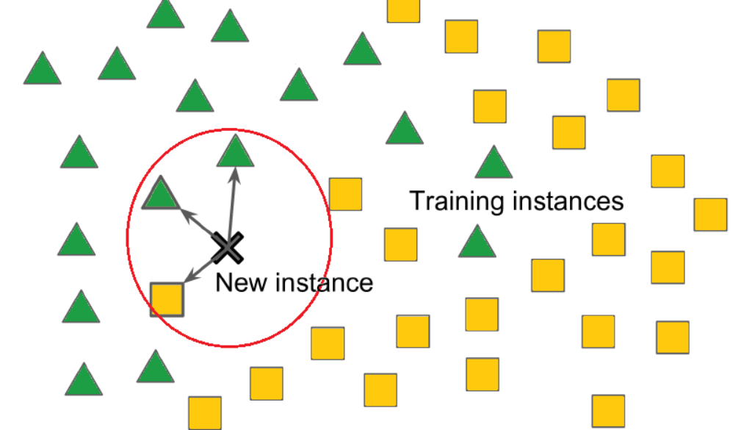
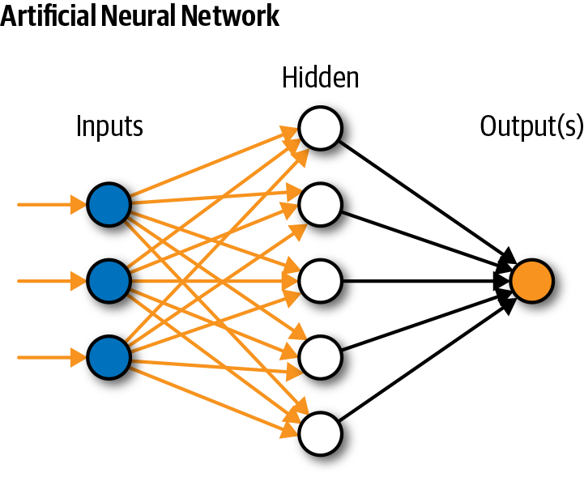
The algorithms we will cover only 3, don’t want to scare you.
Decision Trees
Neural Networks
K Nearest Neighbors

Slide 17
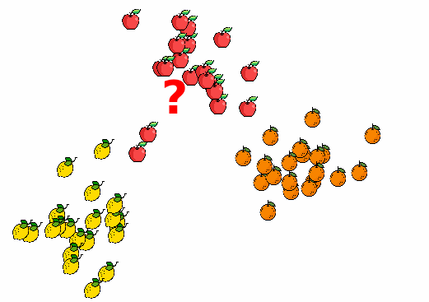
K Nearest Neighbors (KNN) Algorithm the algorithm
? = red, round, sweet.... I wonder what it is.. aaaaaaaaa

Slide 18
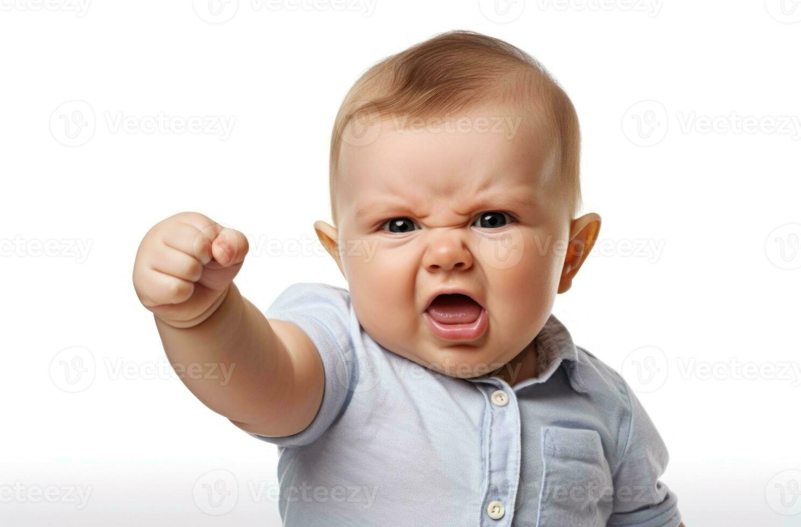
K Nearest Neighbors (KNN) Algorithm shortcomings...
I ONLY KNOW RED BALLS! THIS “?” IS RED BALL MOM!
Bias: Data dependence

Slide 19
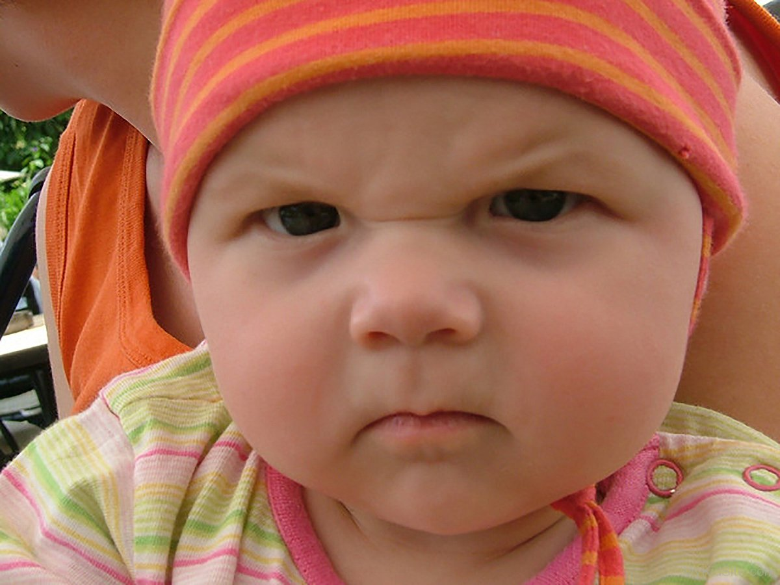
Decision Tree Algorithm the algorithm
Is it red?
Others..
Yes
No
Is it green?
Is it round?
Yes
No
Yes
No
Does it fit into my different mental models at hand?
APPLE!
APPLE!
Bias: Excels in dataset with many categories

Slide 20
Neural networks! the algorithm
a
taste
b
shape
apple or not?
c
color
has stem
Umm I know Apples are round and have sweet taste so I give more weightage to that!
d
a*taste + b*shape + c*color + d*has_stem = apple or not
Bias: Extremely flexible can lead to over dependence on some features over others!

Slide 21
Data-algorithm interplay the algorithm
Garbage in, garbage out
If you teach a baby concept of Apple using Tomatoes, it will misrepresent the concept. DATA IS KING!
So, better features, better perf!
Choose right algorithm for data
Choosing right algorithm for data is important! What the baby learns depends on how it is taught the concept. Based on categories? Based on weighting? Based on looking at neighbors?
TEACH ME WELL!

Slide 22
Remember me? Math is just English, don’t worry
the diff algos: NN, KNN, Decision Tree
the concept
apple, pear, tomato, red ball
apple
finding which algorithm (h) out of H = {NN, KNN, DT} can best explain concept of apple (c(x)) for all inputs

Slide 23
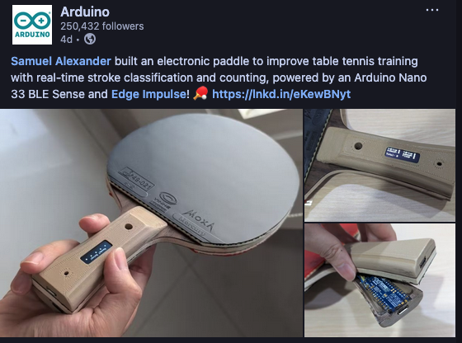
Other usecases of Supervised Learning
y u forget apple
Instead of Apples, we’re just classifying what the current incoming ball is!
https://www.linkedin.com/posts/arduino_samuel-alexander-built-an-electronic-paddle-activity-7391276338155778048-mYGe

Slide 24
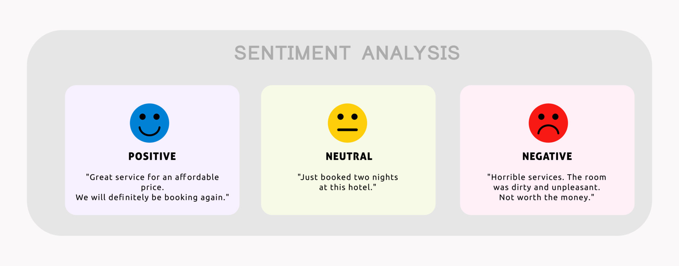
Other usecases of Supervised Learning
y u forget apple
Instead of Apples, we’re just classifying if review is positive or not.

Slide 25
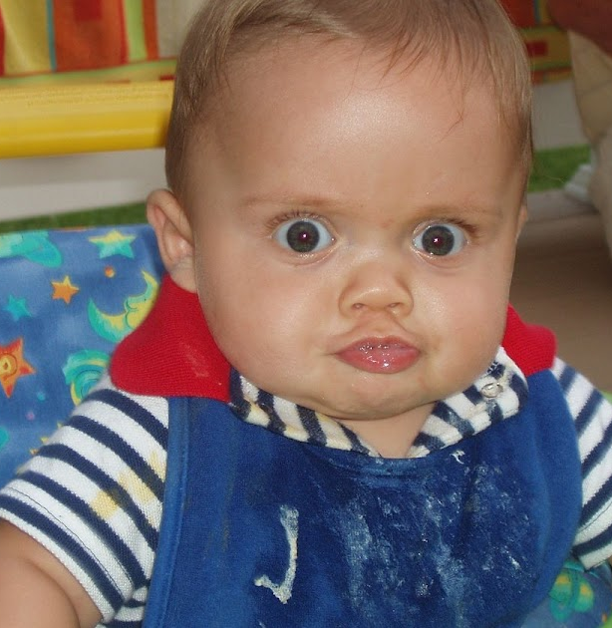
You’re all set to be a LLM expert! let me prove it to you
You were classifying whether fruit was Apple or not... guess what LLMs are?
A multiclassification task of what will be the next word given current word.. ofc it’s Apples!
I LOVE APPLES

Slide 26
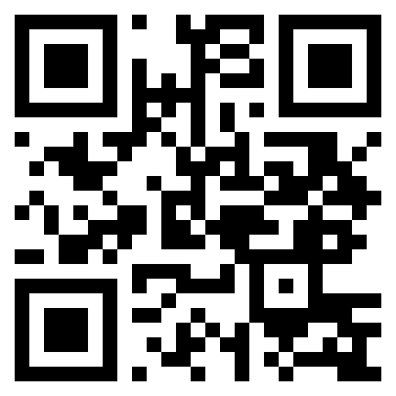
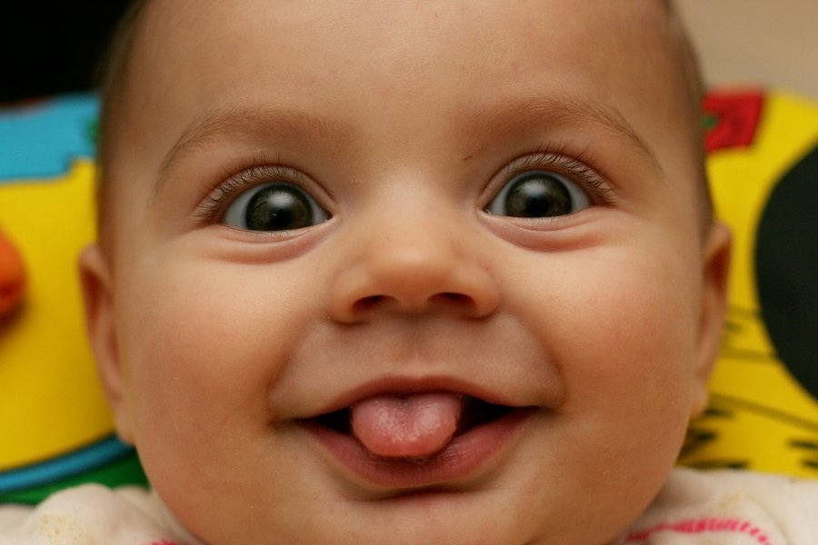
Thank you Hope you were not bored!!
It’s an Apple Break!
Get in touch
Enjoy the workshop

