Slide 1
GSA_v1 vs GSA_v2 vs GSA_v3
09/11/2020
Darina Czamara

Slide 2
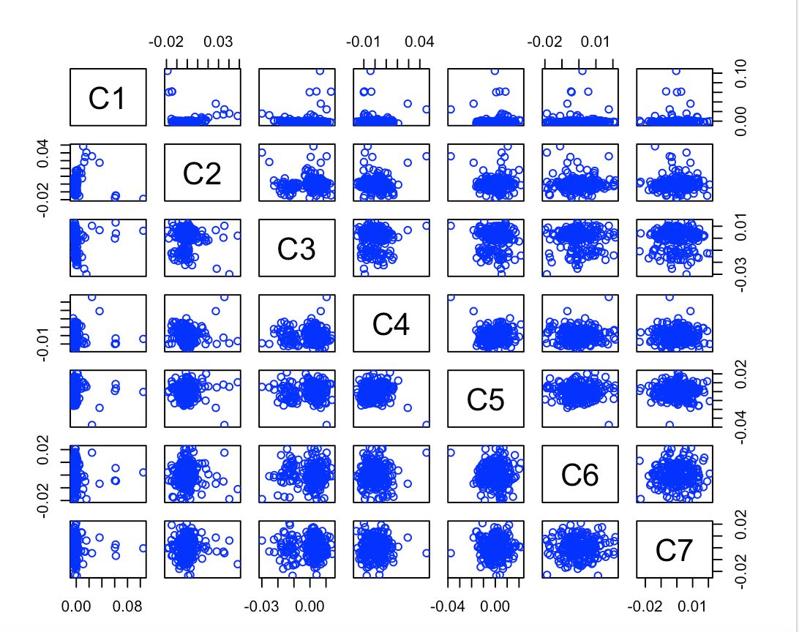
GSA version 1
after QC (before outlier detection): 234 BeCome samples, 463,209 SNPs

Slide 3
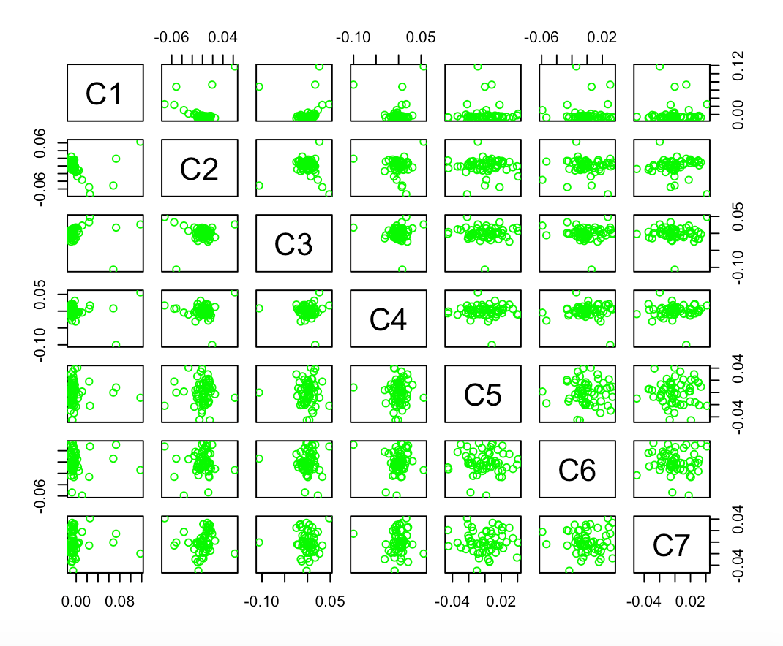
GSA version 2
after QC (before outlier detection): 60 BeCome samples, 459,945 SNPs

Slide 4
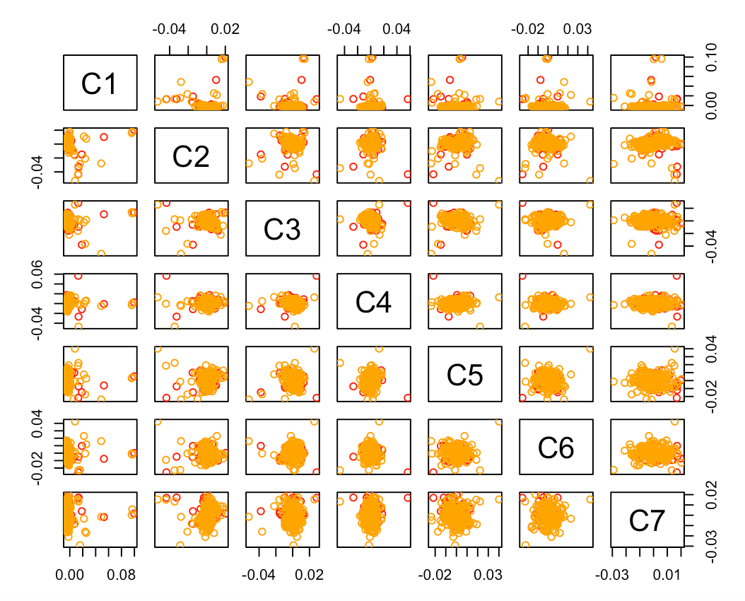
GSA version 3
after QC (before outlier detection): 56 BeCome samples (red), 176 Optima samples (orange), 474,758 SNPs

Slide 5
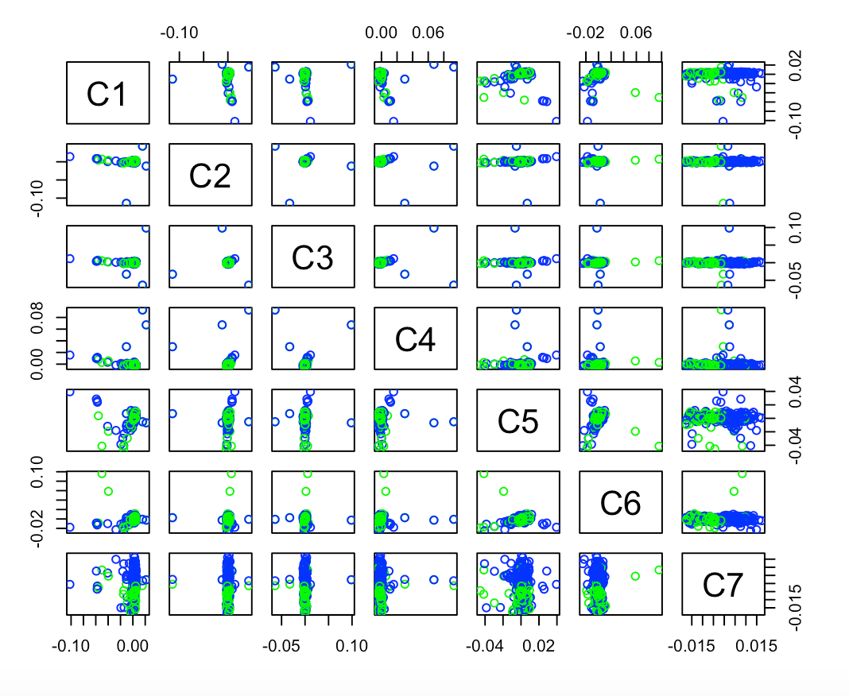
GSA version 1 versus version 2
after QC (before outlier detection): 293 BeCome samples (3 overlapped), 412,668 SNPs

Slide 6
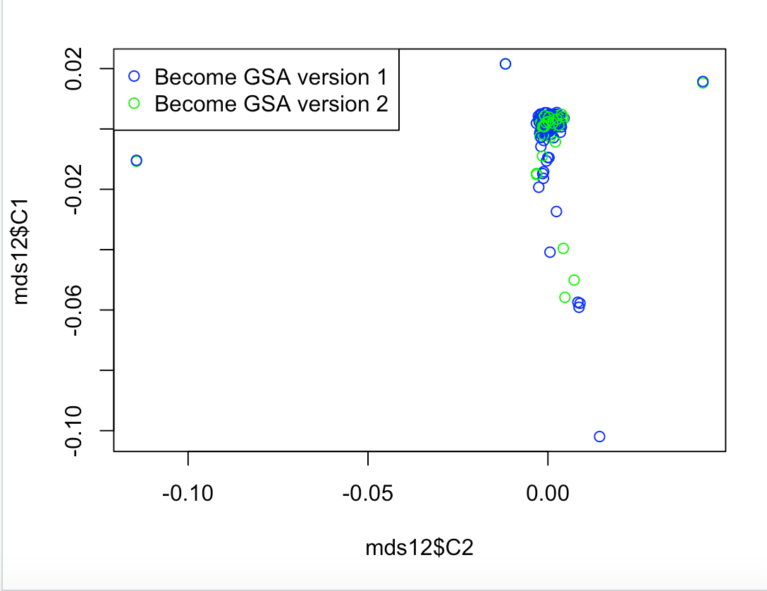
GSA version 1 versus version 2
after QC (before outlier detection): 293 BeCome samples (3 overlapped), 412,668 SNPs

Slide 7
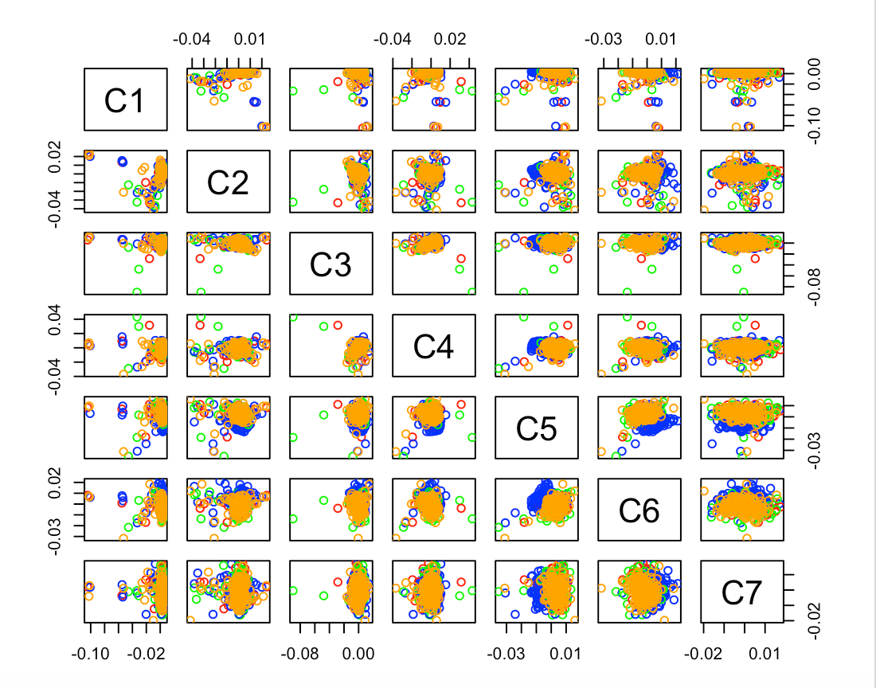
GSA version 1 versus version 2 versus version 3
after QC (before outlier detection): 344 BeCome samples (blue/green/red, 6 overlapped), 175 Optima samples (orange), 388,007 SNPs

Slide 8
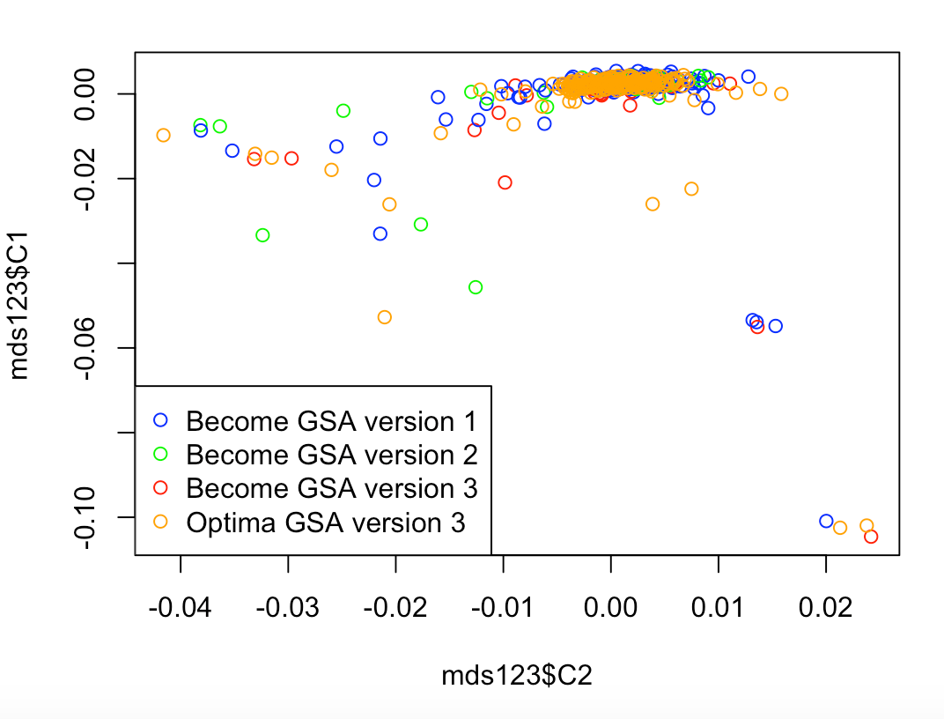
GSA version 1 versus version 2 versus version 3
after QC (before outlier detection): 344 BeCome samples (blue/green/red, 6 overlapped), 175 Optima samples (orange), 388,007 SNPs

Slide 9
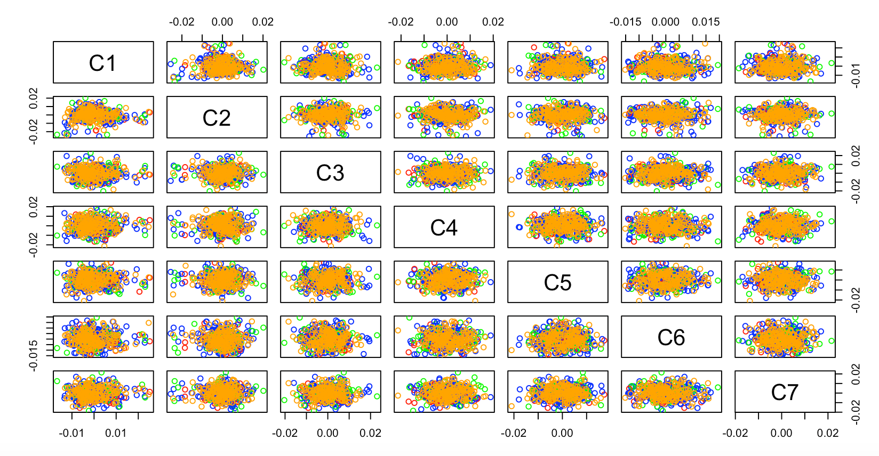
GSA version 1 versus version 2 versus version 3
after QC/MDS outlier detection): 319 BeCome samples (blue/green/red), 164 Optima samples (orange), 388,007 SNPs

Slide 10
GSA version 1 versus version 2 versus version 3
after QC/MDS outlier detection): 319 BeCome samples (blue/green/red), 164 Optima samples (orange), 388,007 SNPs

