Slide 1
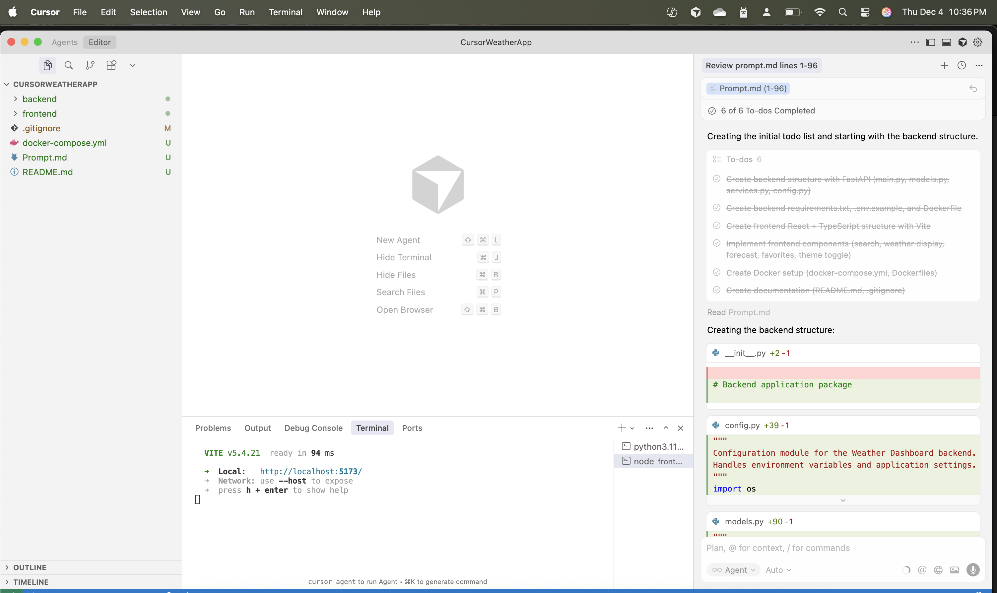

Slide 2
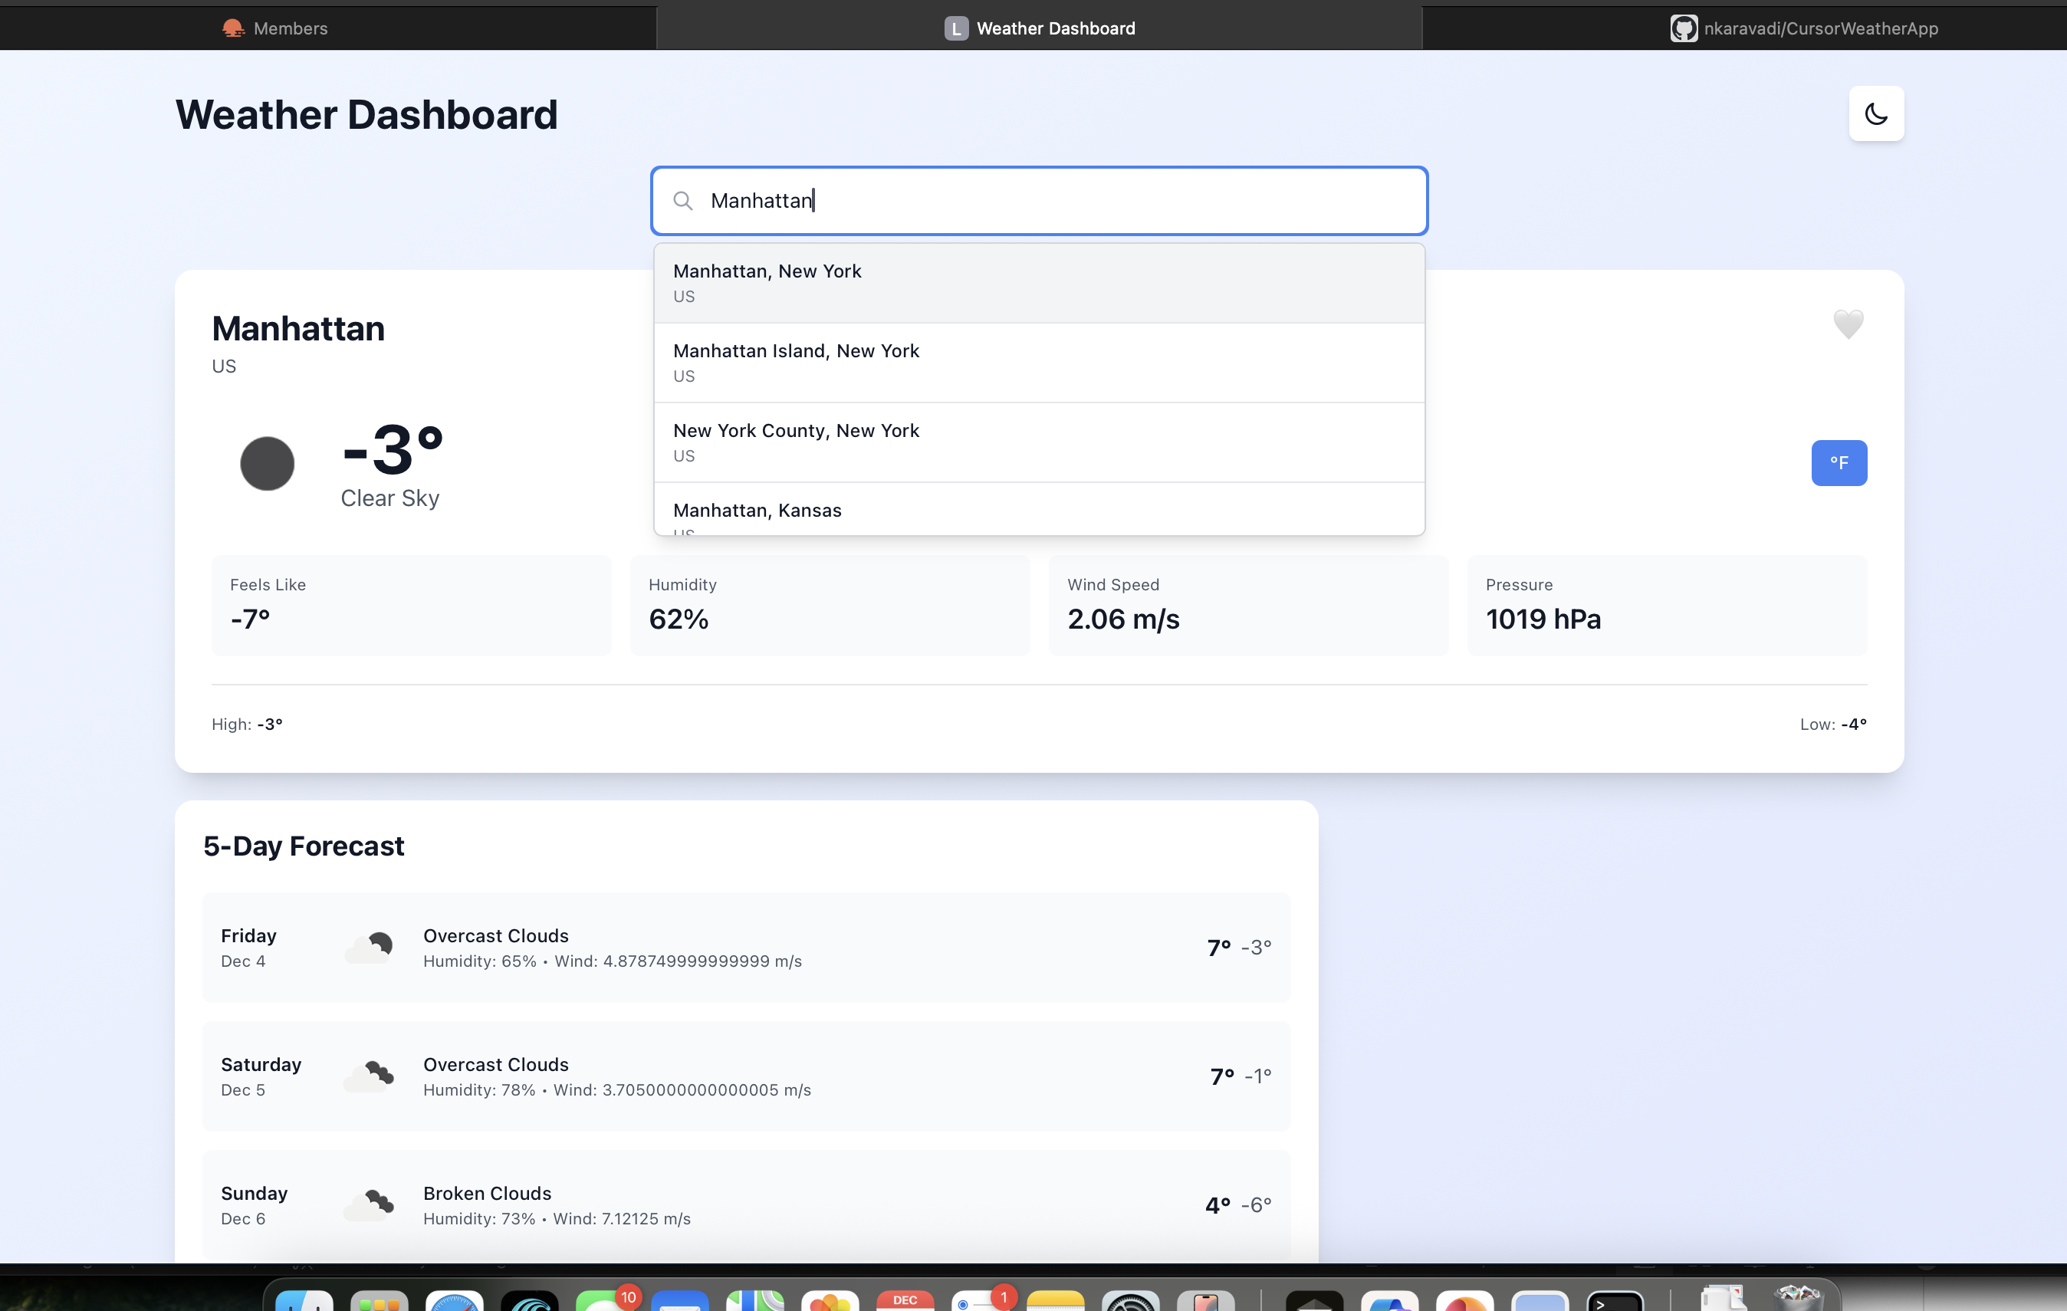

Slide 3
Create a complete Weather Dashboard application with the following specifications:
### Backend (Python/FastAPI)
- Create a FastAPI backend server with the following endpoints:
- `GET /api/weather/{city}` - Get current weather for a city
- `GET /api/weather/{city}/forecast` - Get 5-day weather forecast
- `GET /api/cities/search?q={query}` - Search for cities by name
- `GET /api/health` - Health check endpoint
- Use the OpenWeatherMap API (use a free API key - I'll provide it in environment variables)
- Implement proper error handling with meaningful error messages
- Add CORS middleware to allow frontend connections
- Create a requirements.txt with all dependencies
- Include environment variable support for API keys (use python-dotenv)
- Add input validation using Pydantic models
- Structure the code with separate modules: `main.py`, `models.py`, `services.py`, `config.py`
- Include proper logging
- Add rate limiting to prevent API abuse
### Frontend (React + TypeScript)
- Create a modern React application with TypeScript
- Use Vite as the build tool for fast development
- Implement a beautiful, responsive UI with:
- A search bar to find cities
- Current weather display with:
- City name and country
- Temperature (with unit toggle: Celsius/Fahrenheit)
- Weather condition with icon
- Humidity, wind speed, pressure
- "Feels like" temperature
- 5-day forecast cards showing:
- Day of week
- High/low temperatures
- Weather condition icon
- Brief description
- Loading states and error messages
- Smooth animations and transitions
- Use Tailwind CSS for styling
- Implement proper TypeScript interfaces for all API responses
- Add error boundaries for graceful error handling
- Include a favorites feature (store in localStorage)
- Make it fully responsive (mobile, tablet, desktop)
- Add a dark/light theme toggle
### Additional Features
- Create a comprehensive README.md with:
- Setup instructions for both frontend and backend
- Environment variable configuration
- How to get an OpenWeatherMap API key
- How to run the application
- Project structure overview
- Add a .gitignore file for both Python and Node.js
- Include example .env files (.env.example)
- Create a Docker setup:
- Dockerfile for backend
- Dockerfile for frontend
- docker-compose.yml to run both services
### Code Quality
- Follow best practices and coding standards
- Add helpful comments where necessary
- Use async/await properly
- Implement proper error handling throughout
- Make the code production-ready (not just a prototype)
### Project Structure
```
weather-dashboard/
├── backend/
│ ├── app/
│ │ ├── __init__.py
│ │ ├── main.py
│ │ ├── models.py
│ │ ├── services.py
│ │ └── config.py
│ ├── requirements.txt
│ ├── .env.example
│ └── Dockerfile
├── frontend/
│ ├── src/
│ │ ├── components/
│ │ ├── services/
│ │ ├── types/
│ │ ├── hooks/
│ │ └── App.tsx
│ ├── package.json
│ ├── vite.config.ts
│ ├── tsconfig.json
│ └── Dockerfile
├── docker-compose.yml
├── README.md
└── .gitignore
```
Start by creating the backend, then the frontend, and ensure they work together seamlessly.

Slide 4
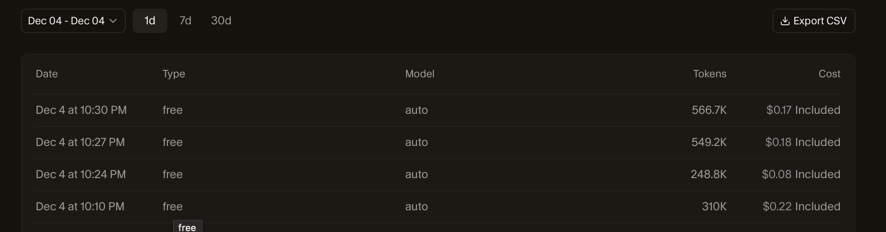
Results
Task | Time
Cursor : Initial code build out | ~ 7 mins
Human: Tasks to run and find issue | ~ 10 mins (run test, collect error logs)
Cursor: Repair issues by itself | ~ 3 mins

Slide 5
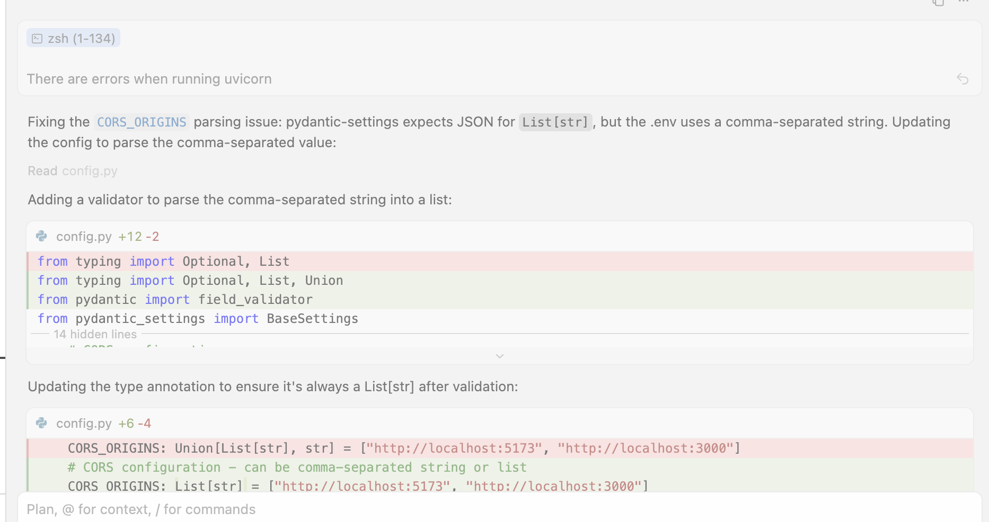
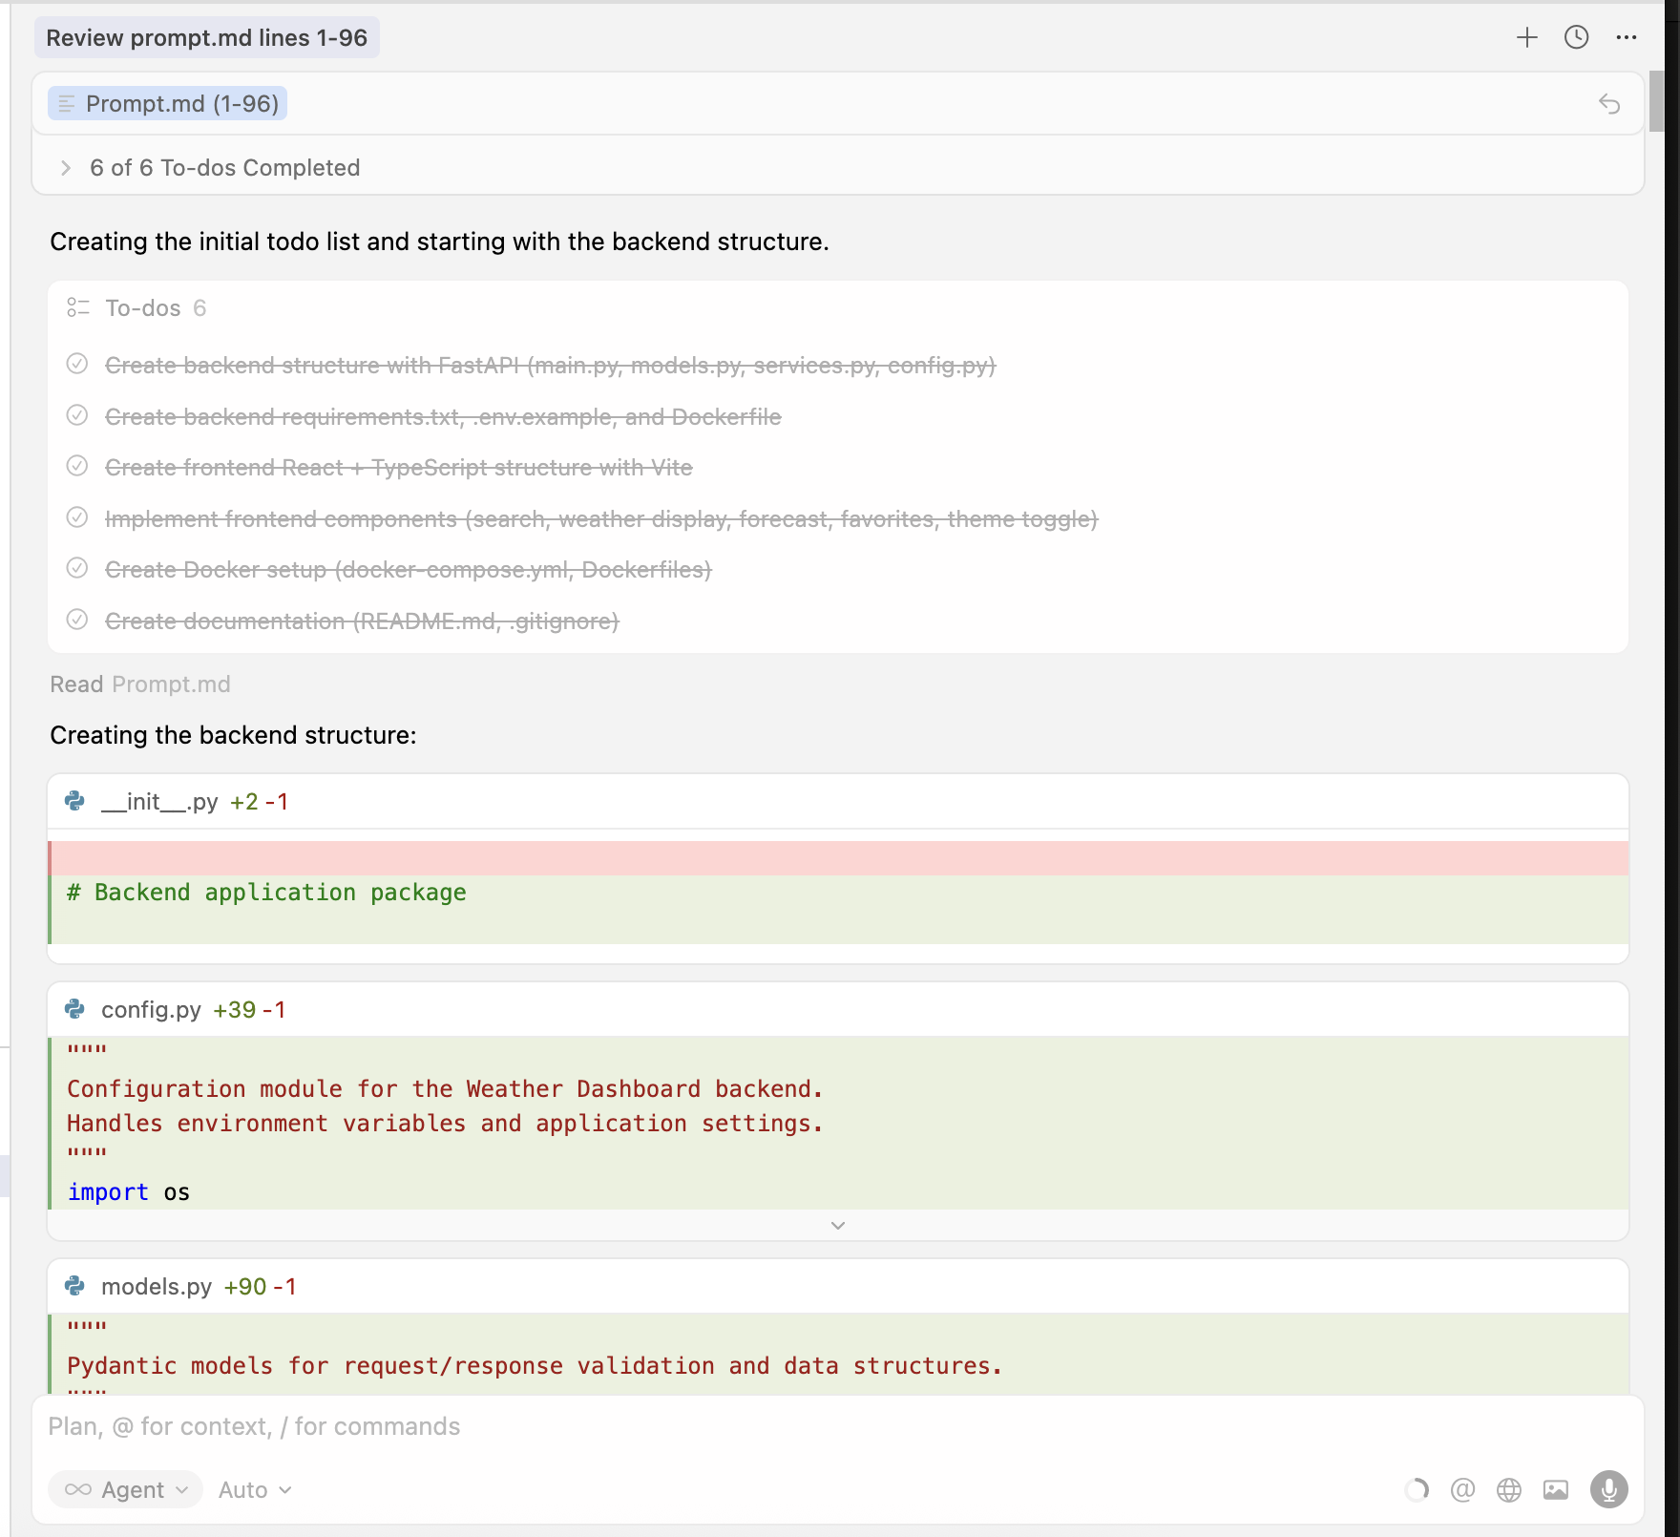
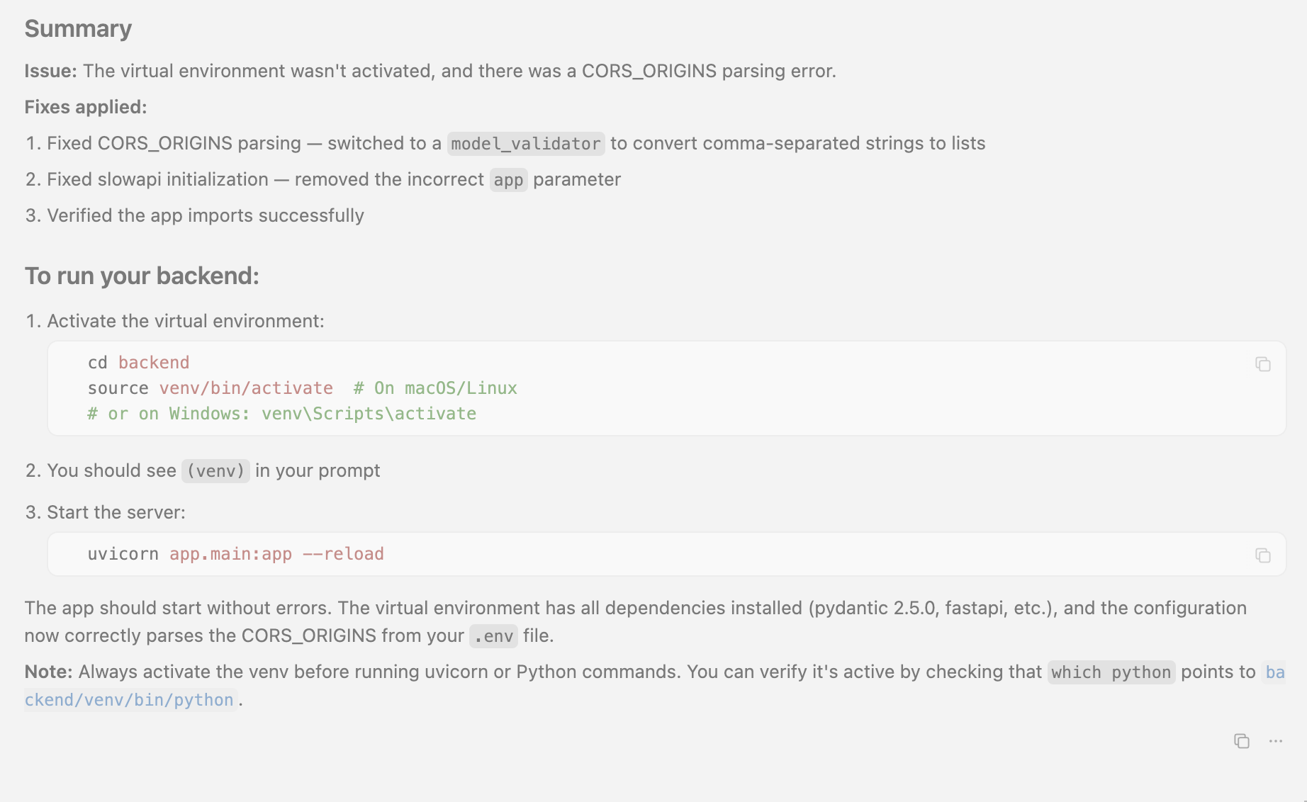

Slide 6
