Slide 1
Introduction to MPI
Aravind Sukumaran Rajam

Slide 2
Objective:
Introduction to distributed computing using MPI

Slide 3
Shared memory
CPU
Memory
Shared Memory
CPU
GPU
Memory
CPU
GPU
Shared Memory

Slide 4
Distributed system
Consists of a set of nodes
Each node has its own private memory
Each task on a node can only operate on local data
Communication is required to access remote data

Slide 5
Parallel computer architectures
CPU
GPU
Memory
CPU
GPU
Shared Memory
node 1
node 2
node 3
node 4
Network
Node 5
Node 6
Node 7
Distributed Memory

Slide 6
Shared Memory vs Message passing
Shared Memory
read/
write
Send
Receive
thread 0
thread 1
Process 0
Process 1
Shared memory
Message passing

Slide 7
Motivation for distributed computing
The performance of a single node is limited
Bigger problems can be solved using multiple nodes
Access to more resources such as memory

Slide 8
MPI
MPI: Message Passing Interface
A standard specification of interface for message passing
Supported on C/C++, Python, Fortran etc.
Implemented as a library
Note: MPI is a message passing specification (Not an implementation)

Slide 9
MPI Vendors
MPICH : Argonne National Laboratory
MVAPICH : Ohio State University
OpenMPI : OpenMPI consortium.
Intel MPI : Intel Corporation

Slide 10
Message Passing (Cooperative)
A co-operative mode of data exchange
Data transfer requires explicit send and receive
Process 0
Process 1
Any change in receivers memory is only possible with explicit participation of the receiver
Communication and synchronization are combined
send(data)
recv(data)

Slide 11
Message Passing (one sided)
Remote reads and writes
Explicit participation on only one node is required
Process 0
Process 1
Communication and synchronization are decoupled
Part of MPI 2 (MPI_Get, MPI_Put)
Put(data)
(memory)
(memory)
Get(data)

Slide 12
Common MPI functions
Function | Description
int MPI_Init() | Initialize MPI
int MPI_Comm_size() | Number of processes associated with a communicator
int MPI_Comm_rank() | Processor rank within a communicator
int MPI_Finalize() | Terminate MPI
int MPI_Send () | Send data
int MPI_Recv () | Receive data

Slide 13
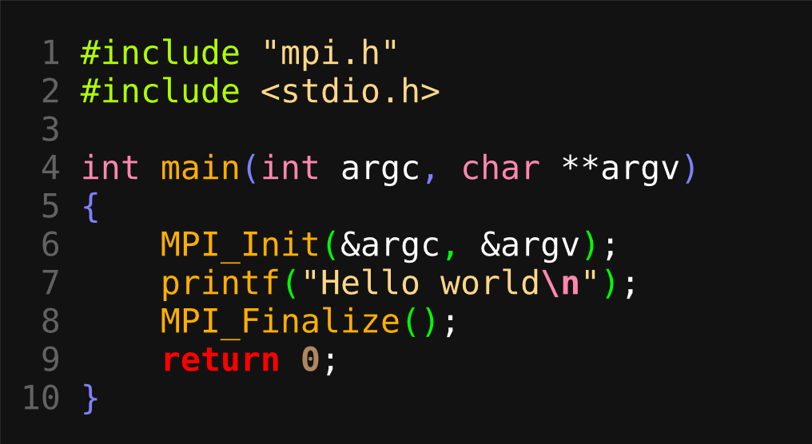
Hello world
MPI initialization
MPI finalization
MPI_Init(): Should be called before any other MPI routine

Slide 14
Hello world
MPI initialization
MPI finalization
int MPI_Init( int *argc, char ***argv )
returns: MPI_SUCCESS (no error)
MPI_ERR_OTHER (on error returns error code)

Slide 15
Hello world
MPI initialization
MPI finalization
int MPI_Finalize( int *argc, char ***argv )
returns: MPI_SUCCESS (no error)
MPI_ERR_OTHER (on error returns error code)

Slide 16
Compiling MPI program
Compile: mpicc -O3 hello.c -o hello
run1: mpirun -np 1 hello
output:
Hello world
run2: mpirun -np 3 hello
output:
Hello world
Hello world
Hello world

Slide 17
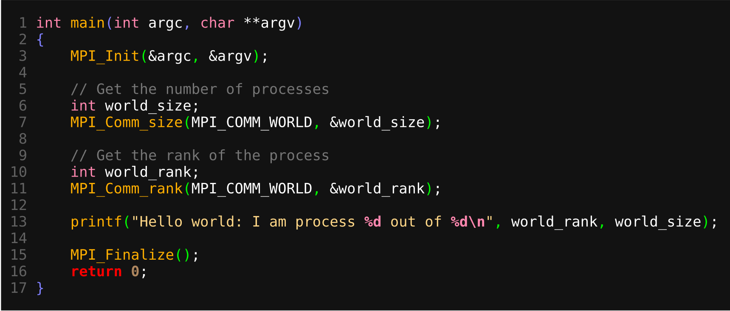
Hello world 2
int MPI_Comm_rank(MPI_Comm comm, int *rank)
MPI_Comm : communicator

Slide 18
Hello world 2
int MPI_Comm_size(MPI_Comm comm, int *size)
MPI_Comm : communicator

Slide 19
Hello world 2
Compile: mpicc -O3 hello2.c -o hello2

Slide 20

Compiling MPI program
run: mpirun -np 4 hello2
output:
Hello world: I am process 3 out of 4
Hello world: I am process 0 out of 4
Hello world: I am process 1 out of 4
Hello world: I am process 2 out of 4
We specified to run 4 ‘hello2’ processes
Where did these processes run?
Same node?
Different nodes?
Depends?
How do we control this?

Slide 21
Host specification
Host file
mpirun -np 4 -hostfile <filename> ./hello2
export MPI_HOSTS= <filename>
Host switch(argument)
mpirun -np 4 -host node1,node2,node3,node4 ./hello2
Depending on job scheduler (slurm, pbs etc) the hosts may be inferred.
Sample Host File
cat myhost.txt
192.168.1.4
192.168.1.5
gpu_node_198
gpu_node_260

Slide 22
MPI send/receive
Function | Description
int MPI_Init() | Initialize MPI
int MPI_Comm_size() | Number of processes associated with a communicator
int MPI_Comm_rank() | Processor rank within a communicator
int MPI_Finalize() | Terminate MPI
int MPI_Send () | Send data
int MPI_Recv () | Receive data

Slide 23
send/recv
int MPI_Send(void *data_to_send, int send_count, MPI_Datatype send_type, int dest_ID, int tag, MPI_Comm comm);
int MPI_Recv(void *data_to_recv, int recv_count, MPI_Datatype recv_type, int src_ID, int tag, MPI_Comm comm, MPI_Status *status);
data_to_(send/recv): address of element(s)
(send/recv)_count: number of elements
MPI_Datatype: datatype (MPI_INT, MPI_FLOAT, MPI_DOUBLE)
(src/dest)_ID: process Id (to recv/send)
tag: message tag
MPI_Status: status struct

Slide 24
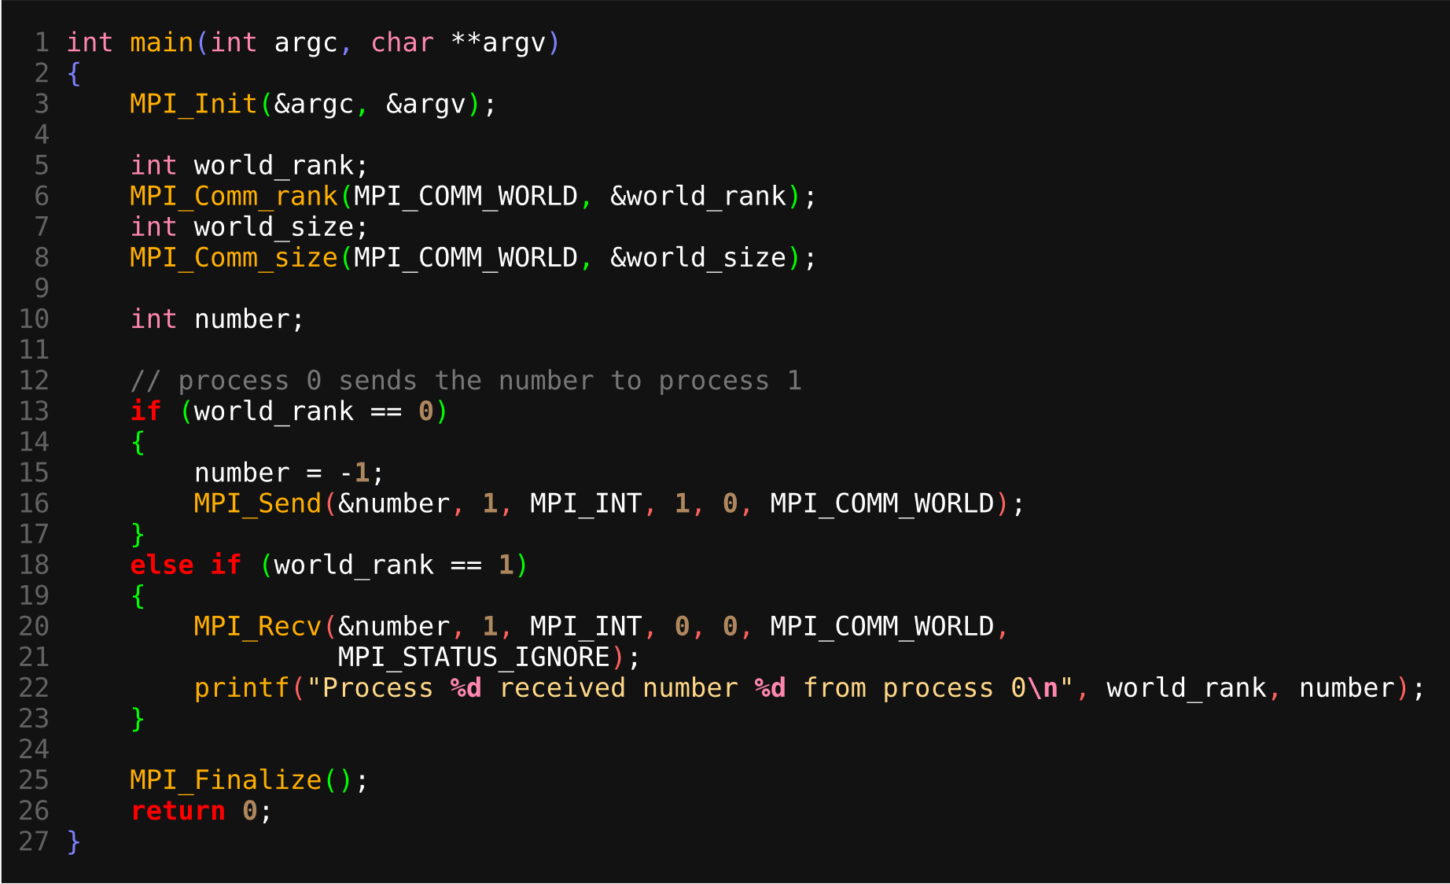
send/recv
int MPI_Send(void *data_to_send, int send_count, MPI_Datatype send_type,
int dest_ID, int tag, MPI_Comm comm);

Slide 25
send/recv
int MPI_Recv(void *data_to_recv, int recv_count, MPI_Datatype recv_type,
int src_ID, int tag, MPI_Comm comm, MPI_Status *status);

Slide 26
send/recv
run: mpirun -np 2 send_recv
output:
Process 1 received number -1 from process 0
run2: mpirun -np 1 send_recv
output:
[bluegene:14322] *** An error occurred in MPI_Send
[bluegene:14322] *** reported by process [2800353281,0]
[bluegene:14322] *** on communicator MPI_COMM_WORLD
[bluegene:14322] *** MPI_ERR_RANK: invalid rank
[bluegene:14322] *** MPI_ERRORS_ARE_FATAL (processes in this
communicator will now abort,
[bluegene:14322] *** and potentially your MPI job)

Slide 27
send/recv
Where did the error occur for np = 1?
What will happen if we run this with np = 4?

Slide 28
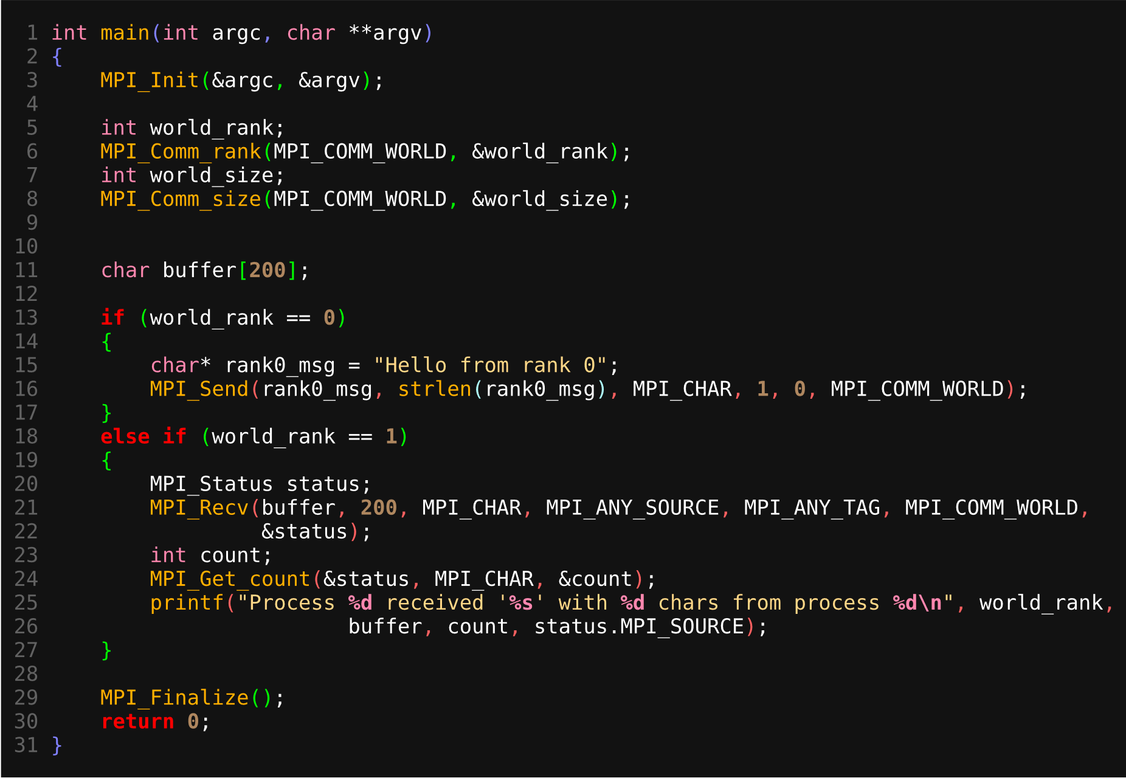
send/recv(2)

Slide 29
send/recv(2)
int MPI_Get_count(MPI_Status *status, MPI_Datatype type, int* count);
run: mpirun -np 2 send_msg
output:
Process 1 received 'Hello from rank 0' with 17 chars
from process 0

Slide 30
MPI_send/recv
MPI_send/recv is blocking
Return from MPI_send does not guarantee that the receiver has received the data
Depending on implementation and amount of data transferred, it MPI_send may internally buffer the data
MPI_Isend and MPI_Irecv are non-blocking versions or MPI_send and MPI_recv

Slide 31
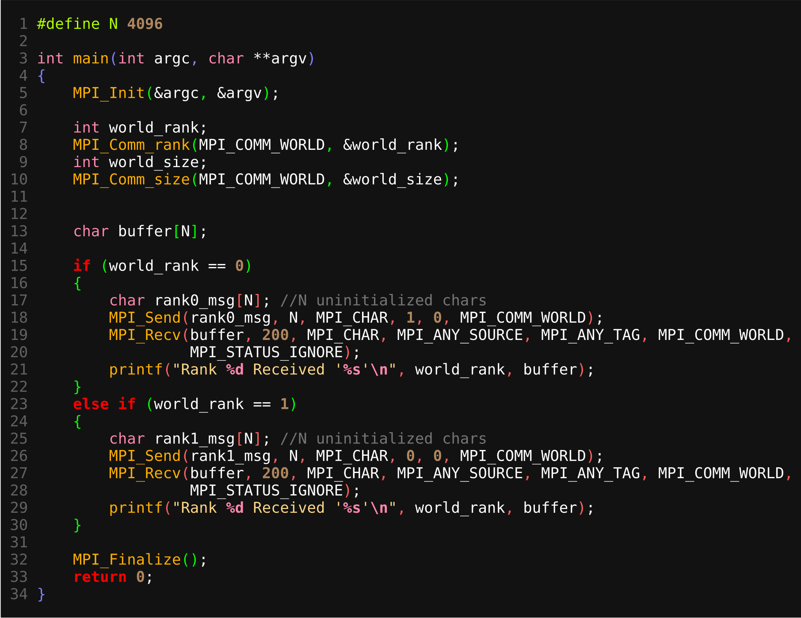
Find the bug
Hint: reducing N *may* to help to hide the bug

Slide 32
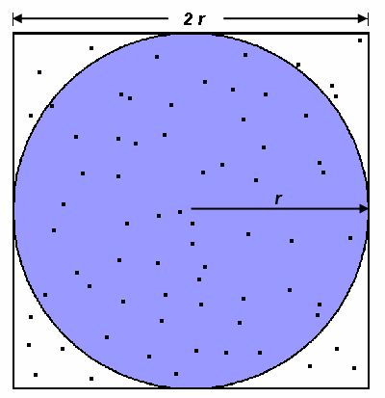
Computing PI
Monte Carlo method of approximating PI:
Inscribe a circle with radius r in a square with side length of 2r
The area of the circle is πr² and the area of the square is 4r²
The ratio of the area of the circle to the area of the square is:
πr² / 4r² = π / 4
Randomly generate N points inside the square,
Approximately N * π / 4 of those points (M) should fall inside the circle
π is then approximated as:
N * π / 4 = M
π / 4 = M / N
π = 4 * M / N
Note that increasing the number of points generated improves the approximation
Source: https://computing.llnl.gov/tutorials/parallel_comp/

Slide 33
Computing PI
Monte Carlo method of approximating PI:
npoints = 10000
circle_count = 0
do j = 1,npoints
generate 2 random numbers between 0 and 1
xcoordinate = random1
ycoordinate = random2
if (xcoordinate, ycoordinate) inside circle
then circle_count = circle_count + 1
end do
PI = 4.0*circle_count/npoints
Source: https://computing.llnl.gov/tutorials/parallel_comp/

Slide 34
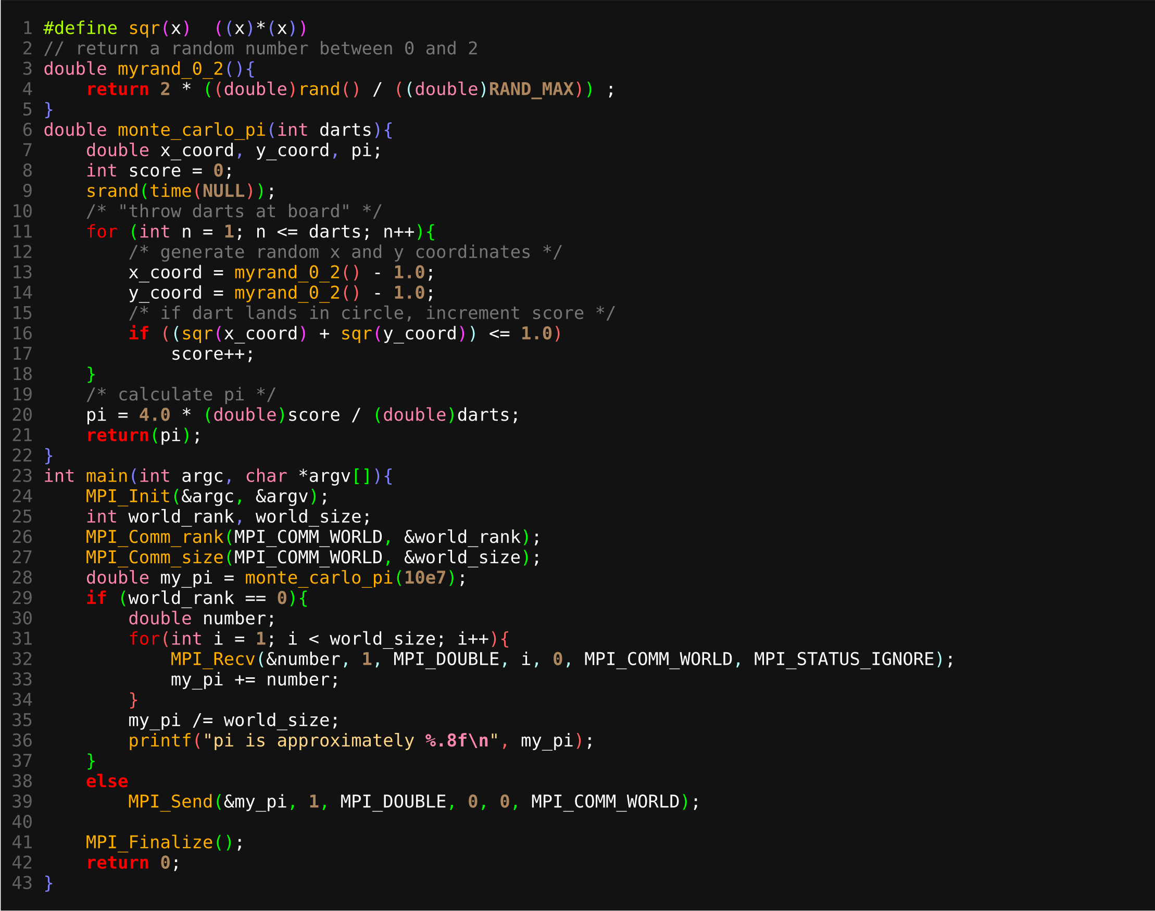
Computing PI

Slide 35
MPI_reduce
int MPI_Reduce(void *send_data, void *recv_data,
int count, MPI_Datatype type,
MPI_op count, int root, MPI_Comm comm);
root
rank 0
val: 4
rank 1
val: 2
rank 2
val: 3
rank 3
val: 1
rank 4
val: 4
+
val: 14

Slide 36
MPI_reduce
int MPI_Reduce(void *send_data, void *recv_data,
int count, MPI_Datatype type,
MPI_op count, int root, MPI_Comm comm);
MPI_MAX - Returns the maximum element.
MPI_MIN - Returns the minimum element.
MPI_SUM - Sums the elements.
MPI_PROD - Multiplies all elements.
MPI_LAND - Performs a logical and across the elements.
MPI_LOR - Performs a logical or across the elements.
MPI_BAND - Performs a bitwise and across the bits of the elements.
MPI_BOR - Performs a bitwise or across the bits of the elements.
MPI_MAXLOC - Returns the maximum value and the rank of the process that owns it.
MPI_MINLOC - Returns the minimum value and the rank of the process that owns it.

Slide 37
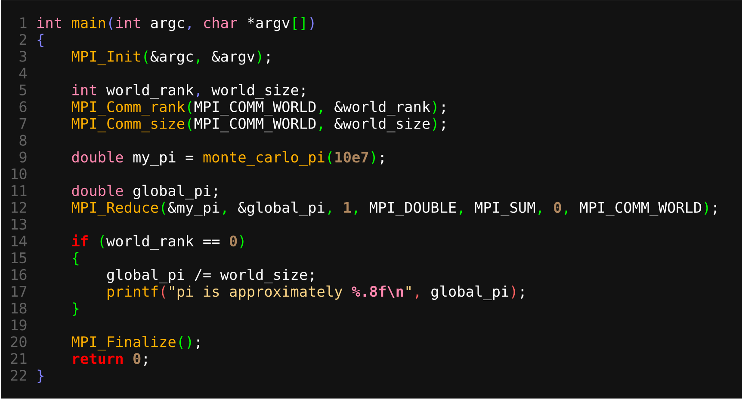
Computing Pi - reduction

Slide 38
Summary
Overview of Distributed Computing
Introduction to MPI
Sending and receiving data using MPI
This is not the last slide :)

Slide 39

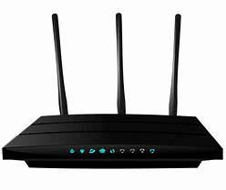
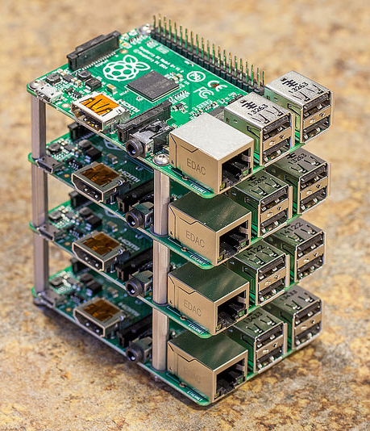
DIY
Build your own cluster
connect two laptops directly using lan
connect multiple laptops directly using a router
Build your own cluster using low power & low cost devices such as Raspberry Pi

Slide 40
Exercise
Game of life
A cell is alive if
if the cell value is 1 and sum of neighbors
is at least 2
if the cell value is 0 and sum of neighbors is
at least 4

Slide 41
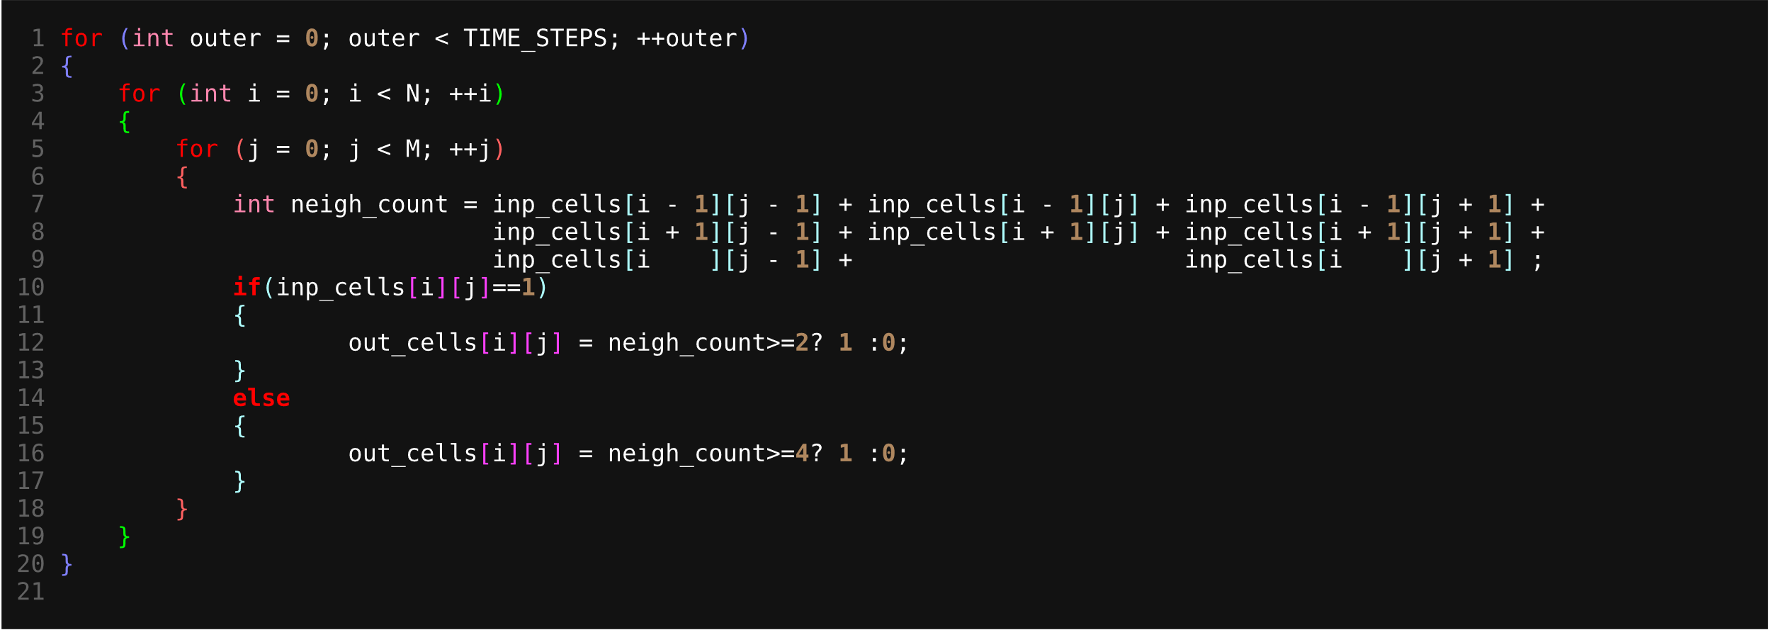
Exercise
Game of life
Given an M * N matrix
Find which cells are alive in the T_{th} time step

Slide 42
Exercise
Game of life
How to parallelize this problem
How would you use MPI to solve this problem

Slide 43
Exercise

Slide 44
Exercise
rank 0
rank 1
rank 2
rank 3

