Slide 1
INTERCITY BUS RESERVATION SYSTEM
Team No:17
Student Name: KARTHIK REDDY Roll No: 2620090027
Student Name : VARSHITH REDDY Roll No:2620080100
Student Name: BHUVANESH Roll No: 2620090075

Slide 2
Abstract
The Intercity Bus Reservation System is a basic Java console application that helps a user view bus routes between cities and reserve a seat.
The program accepts input from the user, displays available route details, and uses simple conditions and loops to guide the booking process. Arrays can be used to represent seat availability, while methods divide the program into smaller tasks.
The project demonstrates Java fundamentals from the syllabus. It is an educational prototype, not a commercial booking platform.

Slide 3
Understanding Problem Statement
Problem:
Manual bus booking can make it difficult to check route information and track which seats have been reserved.
Objective:
Create a simple Java program that displays selected intercity routes, accepts a source and destination, shows basic bus information, and allows a user to choose a seat.
Basic workflow:
1. Display the menu and available routes.
2. Read the user's source and destination.
3. Check the route using conditional statements.
4. Display bus details and seat options.
5. Confirm the booking and display a message.
Scope: This is a beginner-level console project. Online payment, live bus tracking, login, and real-time database connectivity are outside the current scope.

Slide 4
CO 1 Topics — Java Foundations
Syllabus topics applied:
• Problem solving and computational thinking
• Java program structure and main() method
• Variables, data types, constants and identifiers
• Operators and expressions
• Console input/output using Scanner and System.out.println()
How they are used:
Variables store the source city, destination city, bus name, seat number, and booking choice. Scanner reads the user's choices, while print statements display routes and booking details. Operators and simple expressions support menu and seat-related calculations.

Slide 5
CO 2 Topics — Control Flow
Syllabus topics applied:
• if, if-else and else-if statements
• switch statements (if used for the menu)
• for and while loops
• break and menu repetition
How they are used:
Conditional statements check whether the selected source and destination match a supported route. Loops display the menu again or repeat seat selection. A loop can also show a list of routes or seats. The program uses these controls to guide the user through the booking steps.

Slide 6
CO 3 Topics — Methods and Arrays
Syllabus topics applied:
• Methods: definition, invocation and parameters
• Return values (where required)
• One-dimensional arrays
• Array traversal and searching
How they are used:
The program can be divided into methods such as displayMenu(), showRoutes(), and bookSeat(). Parameters pass the selected route or seat number to a method. An array can store seat status, for example 0 for available and 1 for booked. A loop searches the array and displays seat availability. Only the basic array concepts needed for this project are used.

Slide 7
CO 4 Topics — OOP and Exception Handling
Syllabus topics applied:
• Classes and objects
• Fields and methods
• Constructors
How they are used:
A Bus class can represent a bus using fields such as busName, source, destination, and time. An object stores the details of one bus. Methods display or use those details. A constructor can initialize the bus fields. Basic exception handling can prevent the program from stopping when the user enters invalid numeric input. These concepts should be described as used only if they are present in the submitted code.

Slide 8
CO 5 Topics — Strings and File I/O
Syllabus topics that may be used in the basic version:
• String variables and common String operations
• equals() for comparing city names
• Case conversion or trimming to make input checks more reliable
How they relate to the project:
City names and bus names are stored as Strings. Use equals() rather than == to compare their contents. If file handling is included, booking details can be written to and read from a text file. If the current code does not save files, present file I/O as a possible improvement—not as an implemented feature.

Slide 9
CO 6 Topics — Collections and Streams
Syllabus topics:
• List, Set and Map collections
• Adding, removing and retrieving items
• Iterating through a collection
• Streams and operations such as filter() and forEach()
Connection to this project:
The current beginner version can manage routes and seats with arrays, so Collections and Streams are not essential to its basic functionality. As a small extension, an ArrayList could store bus routes and a for-each loop could display them. Stream operations are an optional future extension and should not be claimed as implemented unless they appear in the actual Java code.

Slide 10
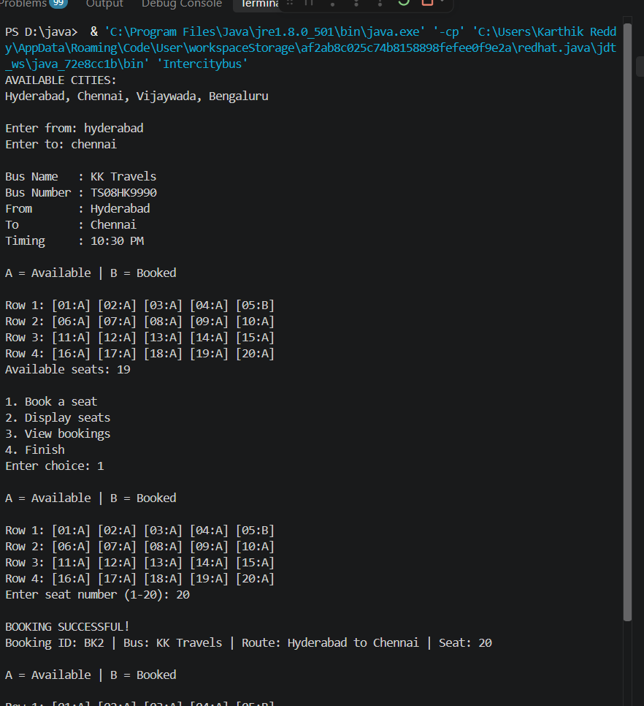
Screenshot :

Slide 11
Conclusion
The Intercity Bus Reservation System applies core Java concepts to a familiar real-life problem. It demonstrates user input/output, variables, conditional statements, loops, methods, and arrays for a simple booking workflow. Basic classes, String handling, exception handling, or file storage can be included where they are present in the implementation.
The project helped connect syllabus concepts with practical program design and improve logical thinking. More advanced features can be added later, but the current objective is to build and explain a clear beginner-level reservation system.

