Slide 1


Building Efficient and Reliable Software-Defined Networks
FPO Talk
Naga Katta
Jennifer Rexford (Advisor)
Readers: Mike Freedman, David Walker
Examiners: Nick Feamster, Aarti Gupta

Slide 2
Traditional Networking

Slide 3
Traditional Networking
Distributed Network Protocols

Slide 4
Traditional Networking
Distributed Network Protocols
Reliable routing
Inflexible network control

Slide 5
Software-Defined Networking
Controller

Slide 6
Software-Defined Networking
Controller

Slide 7
SDN: A Clean Abstraction
Application
Controller

Slide 8
SDN Promises
Application
Flexibility
Controller
Efficiency

Slide 9
SDN Meets Reality
Application
Flexibility
Controller
Efficiency
Too slow for routing

Slide 10
SDN Meets Reality
Application
Flexibility
Controller
Efficiency
Limited TCAM space

Slide 11
SDN Meets Reality
Application
Flexibility
Controller
Efficiency
Single point of failure
Reliability

Slide 12
My Research
Application
Flexibility
Controller
Efficiency
Reliability

Slide 13

Research Contribution
HULA (SOSR 16)
An efficient non-blocking switch
CacheFlow (SOSR 16)
A logical switch with infinite policy space
Ravana (SOSR 15)
Reliable logically centralized controller
Efficiency
Flexibility
Best Paper
Reliability

Slide 14
Research Contribution
HULA (SOSR 16)
An efficient non-blocking switch
CacheFlow (SOSR 16)
A logical switch with infinite policy space
Ravana (SOSR 15)
Reliable logically centralized controller
Efficiency
Flexibility
Best Paper
Reliability

Slide 15
HULA: Scalable Load Balancing Using Programmable Data Planes
Naga Katta¹
Mukesh Hira², Changhoon Kim³, Anirudh Sivaraman⁴,
Jennifer Rexford¹
1.Princeton 2.VMware 3.Barefoot Networks 4.MIT

Slide 16

Load Balancing Today
Equal Cost Multi-Path (ECMP) – hashing
Spine Switches
Leaf Switches
. . . . . .
…
…
…
Servers

Slide 17

Alternatives Proposed
Central Controller
HyperV
HyperV
Slow reaction time

Slide 18
Congestion-Aware Fabric
HyperV
HyperV
Congestion-aware Load Balancing
CONGA – Cisco
Designed for 2-tier topologies

Slide 19
Programmable Dataplanes
Advanced switch architectures (P4 model)
Programmable packet headers
Stateful packet processing
Applications
In-band Network Telemetry (INT)
HULA load balancer
Examples
Barefoot RMT, Intel Flexpipe, etc.

Slide 20
Programmable Switches - Capabilities
P4 Program
Compile
Memory
Memory
Memory
Memory
M | A
m1 | a1
M | A
m1 | a1
M | A
m1 | a1
M | A
m1 | a1
Ingress Parser
Queue Buffer
Egress Deparser

Slide 21
Programmable Switches - Capabilities
P4 Program
Programmable Parsing
Compile
Memory
Memory
Memory
Memory
M | A
m1 | a1
M | A
m1 | a1
M | A
m1 | a1
M | A
m1 | a1
Ingress Parser
Queue Buffer
Egress Deparser

Slide 22
Programmable Switches - Capabilities
P4 Program
Programmable Parsing
Stateful Memory
Compile
Memory
Memory
Memory
Memory
M | A
m1 | a1
M | A
m1 | a1
M | A
m1 | a1
M | A
m1 | a1
Ingress Parser
Queue Buffer
Egress Deparser

Slide 23
Programmable Switches - Capabilities
P4 Program
Programmable Parsing
Stateful
Memory
Compile
Memory
Memory
Memory
Memory
M | A
m1 | a1
M | A
m1 | a1
M | A
m1 | a1
M | A
m1 | a1
Ingress Parser
Queue Buffer
Egress Deparser
Switch
Metadata

Slide 24
Hop-by-hop Utilization-aware Load-balancing Architecture
HULA probes propagate path utilization
Congestion-aware switches
Each switch remembers best next hop
Scalable and topology-oblivious
Split elephants to mice flows (flowlets)
Fine-grained load balancing

Slide 25
1. Probes carry path utilization
Spines
Probe replicates
Aggregate
Probe originates
ToR
Notes:
Let’s dig a little deeper. In HULA, the probes originate at the ToRs (through the servers or the ToRs themselves) and then are replicated on multiple paths as they travel the network. We make sure that each switch replicates only the necessary set of probes to the others so that the probe overhead is minimal.

Slide 26
1. Probes carry path utilization
P4 primitives
New header format
Programmable Parsing
Switch metadata
Spines
Probe replicates
Aggregate
Probe originates
ToR
Notes:
Let’s dig a little deeper. In HULA, the probes originate at the ToRs (through the servers or the ToRs themselves) and then are replicated on multiple paths as they travel the network. We make sure that each switch replicates only the necessary set of probes to the others so that the probe overhead is minimal.

Slide 27
1. Probes carry path utilization
ToR ID = 10 Max_util = 80%
S2
ToR ID = 10 Max_util = 60%
ToR 10
ToR 1
S1
S3
Probe
S4
ToR ID = 10 Max_util = 50%

Slide 28
2. Switch identifies best downstream path
ToR ID = 10 Max_util = 50%
S2
ToR 10
ToR 1
S1
S3
Probe
Dst | Best hop | Path util
ToR 10 | S4 | 50%
ToR 1 | S2 | 10%
… | …
S4
Best hop table
Notes:
Then the switch takes the minimum from among the probe given utilization and stores it in the local routing table. The switch S1 then sends its view of the best path to the upstream switches. And the upstream switches process these probes and update their neighbours. This leads to a distance vector-style propagation of information about network utilization to all the switches. But at the same time, each switch only needs to keep track of the best next hop towards a destination.

Slide 29
2. Switch identifies best downstream path
ToR ID = 10 Max_util = 40%
S2
ToR 10
ToR 1
S1
S3
Probe
Dst | Best hop | Path util
ToR 10 | S4 S3 | 50% 40%
ToR 1 | S2 | 10%
… | …
S4
Best hop table
Notes:
Then the switch takes the minimum from among the probe given utilization and stores it in the local routing table. The switch S1 then sends its view of the best path to the upstream switches. And the upstream switches process these probes and update their neighbours. This leads to a distance vector-style propagation of information about network utilization to all the switches. But at the same time, each switch only needs to keep track of the best next hop towards a destination.

Slide 30
3. Switches load balance flowlets
S2
ToR 10
ToR 1
Data
S1
S3
Dest | Best hop | Path util
ToR 10 | S4 | 50%
ToR 1 | S2 | 10%
… | …
S4
Best hop table
Notes:
The switches then route data packets in the opposite direction by spitting flows into smaller groups of packets called flowlets. Flowlets basically are subsequences of packets in a flow separated by a large enough inter-packet gap so that when different flowlets are sent on different paths, the destination does not see packet reordering with high probability.

Slide 31
3. Switches load balance flowlets
Flowlet table
Hash flow
Dest | Timestamp | Next hop
ToR 10 | 1 | S4
 | … | …
 | … | …
S2
ToR 10
ToR 1
Data
S1
S3
Dest | Best hop | Path util
ToR 10 | S4 | 50%
ToR 1 | S2 | 10%
… | …
S4
Best hop table
Notes:
The switches then route data packets in the opposite direction by spitting flows into smaller groups of packets called flowlets. Flowlets basically are subsequences of packets in a flow separated by a large enough inter-packet gap so that when different flowlets are sent on different paths, the destination does not see packet reordering with high probability.

Slide 32
3. Switches load balance flowlets
P4 primitives
RW access to stateful memory
Comparison/arithmetic operators
Flowlet table
Dest | Timestamp | Next hop
ToR 10 | 1 | S4
 | … | …
 | … | …
S2
ToR 10
ToR 1
Data
S1
S3
Dest | Best hop | Path util
ToR 10 | S4 | 50%
ToR 1 | S2 | 10%
… | …
S4
Best hop table
Notes:
The switches then route data packets in the opposite direction by spitting flows into smaller groups of packets called flowlets. Flowlets basically are subsequences of packets in a flow separated by a large enough inter-packet gap so that when different flowlets are sent on different paths, the destination does not see packet reordering with high probability.

Slide 33
Evaluated Topology
S1
S2
Link Failure
40Gbps
A1
A2
A3
A4
40Gbps
L1
L2
L3
L4
10Gbps
8 servers
per leaf

Slide 34
Evaluation Setup
NS2 packet-level simulator
RPC-based workload generator
Empirical flow size distributions
Websearch and Datamining
End-to-end metric
Average Flow Completion Time (FCT)

Slide 35
Compared with
ECMP
Flow level hashing at each switch
CONGA’
CONGA within each leaf-spine pod
ECMP on flowlets for traffic across pods¹
1. Based on communication with the authors

Slide 36
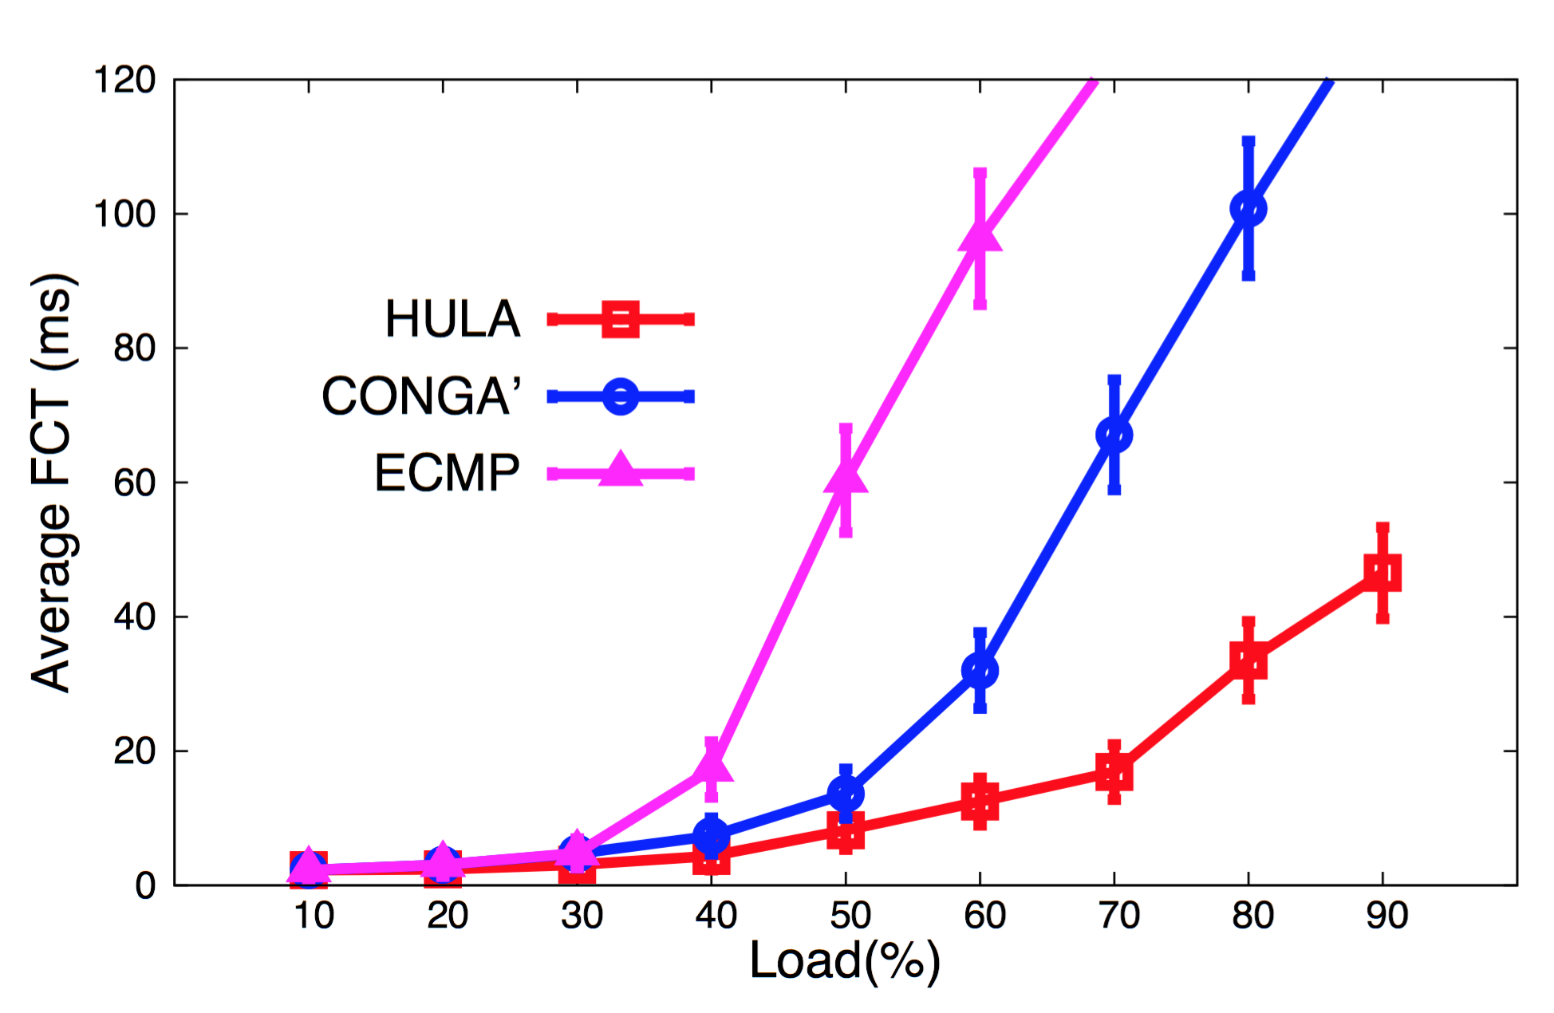
HULA handles high load much better
~ 9x improvement

Slide 37
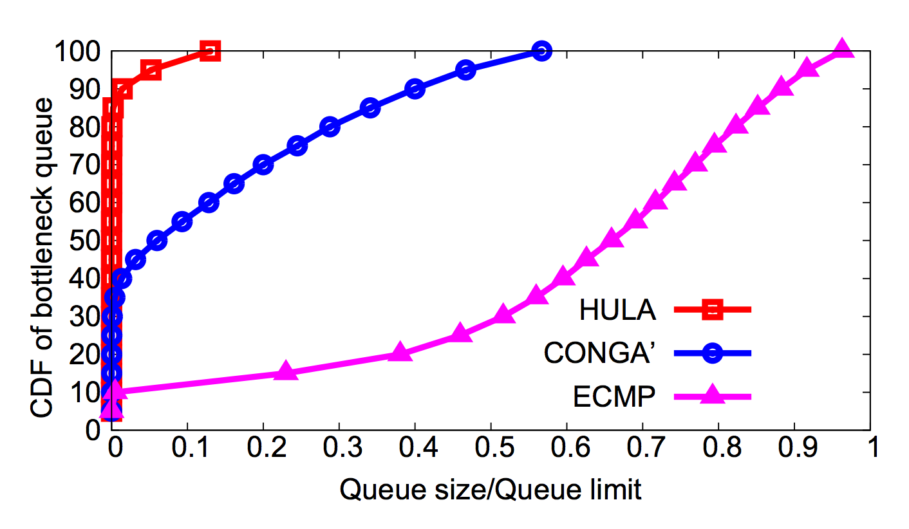
HULA keeps queue occupancy low

Slide 38
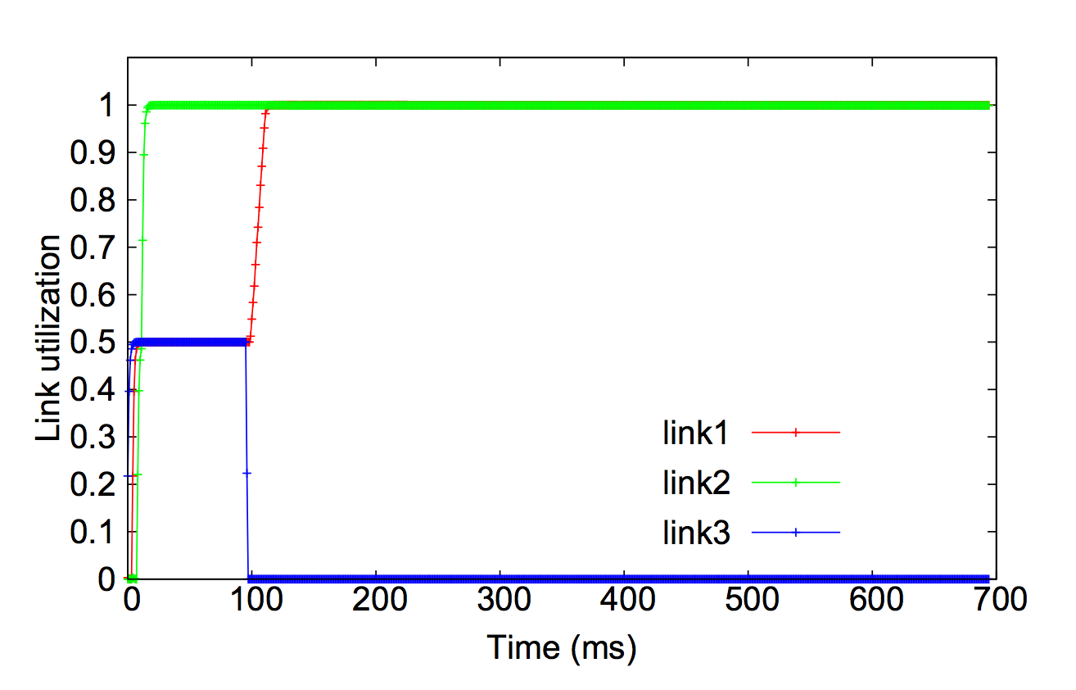
HULA is stable on link failure

Slide 39
HULA: An Efficient Non-Blocking Switch
Scalable to large topologies
Adaptive to network congestion
Reliable in the face of failures
Bonus: Programmable in P4!
Notes:
This leads to a design that is topology oblivious (it makes no assumptions about symmetry or number of hops in the network)
The distribution of only the relevant utilization state to network switches mitigates concentration of a huge amount of state at the sender.
Since each switch makes the routing decision based on the INT info, there is no separate source routing mechanism necessary.
And most interesting thing is that all this logic is programmable in P4. I can discuss the details offline if you are interested.

Slide 40
Research Contribution
HULA (SOSR 16)
One big efficient non-blocking switch
CacheFlow (SOSR 16)
A logical switch with infinite policy space
Ravana (SOSR 15)
Reliable logically centralized controller
Efficiency
Flexibility
Best Paper
Reliability

Slide 41
2. CacheFlow: Dependency-Aware Rule-Caching for Software-Defined Networks
Flexibility
Naga Katta
Omid Alipourfard, Jennifer Rexford, David Walker
Princeton University

Slide 42
SDN Promises Flexible Policies
Lot of fine-grained rules
Controller
Switch
TCAM

Slide 43
SDN Promises Flexible Policies
Lot of fine-grained rules
What now?
Controller
Limited rule space!

Slide 44
State of the Art
 | Hardware Switch | Software Switch
Rule Capacity | Low (~2K-4K) | High
Lookup Throughput | High (>400Gbps) | Low (~40Gbps)
Port Density | High | Low
Cost | Expensive | Relatively cheap
Notes:
We can categorize switches available today into two broad categories – hardware switches that have TCAM based ASIC and software switches that run on generic x86 architectures. While hardware switches have high throughput and high port density, software switches have practically infinite rule space and are relatively cheaper.

Slide 45
TCAM as cache
High throughput + high rule space
Controller
CacheFlow
<5% rules cached
S₁
S₂
TCAM

Slide 46
Caching Ternary Rules
Rule | Match | Action | Priority | Traffic
R1 | 11* | Fwd 1 | 3 | 10
R2 | 1*0 | Fwd 2 | 2 | 60
R3 | 10* | Fwd 3 | 1 | 30
Partial Overlaps!
Greedy strategy breaks rule-table semantics

Slide 47
The dependency graph
For a given rule R
Find all the rules that its packets may hit if R is removed
R
R1
R2
R3
R4
R’ ∧ R3 != φ

Slide 48
Splice Dependents for Efficiency
Dependent-Set
Cover-Set
Rule Space Cost
Notes:
In general, a cover-set is formed by the immediate dependents of a heavy-hitter rule while the dependent set is formed by all the dependent rules. This is why the cover-set algorithm which splices long dependency chains utilizes the TCAM space more efficiently compared to the dependent set.

Slide 49
CacheFlow: Enforcing Flexible Policies
A switch with logically infinite policy space
Dependency analysis for correctness
Splicing dependency chains for Efficiency
Transparent design
Notes:
To conclude, we describe a rule-caching solution for Software-Defined Networking that implements large rule tables correctly and efficiently. Our system also preserves the semantics of Openflow so that it can work with unmodified control applications.

Slide 50
Research Contribution
HULA (SOSR 16)
One big efficient non-blocking switch
CacheFlow (SOSR 16)
A logical switch with infinite policy space
Ravana (SOSR 15)
Reliable logically centralized controller
Efficiency
Flexibility
Best Paper
Reliability

Slide 51

3. Ravana: Controller Fault-Tolerance in Software-Defined Networking
Reliability
Naga Katta
Haoyu Zhang, Michael Freedman, Jennifer Rexford
Notes:
Today, I am going to talk about how to design a logically centralized fault-tolerant controller.

Slide 52
SDN controller: single point of failure
Application
Controller
event
cmd
S1
S2
S3
End-host
pkt
pkt
pkt
Failure leads to
- Service disruption
- Incorrect network behavior
Notes:
In SDN, the controller reacts to various events in the network by orchestrating the switches through various commands. However, the controller can be a single point of failure and that is scary – It can make the network unresponsive to network failures, it may not implement the security policy correctly and in the worst case, can lead to a complete breakdown of connectivity. So how do we make the SDN fault-tolerant to controller failure?

Slide 53
Replicate Controller State?
Master
Slave
h1
S1
S3
h2
S2
Notes:
Here is a problem: Supposing the controller fails. And while the failover is taking place, a network failure happens and the switches send that event to the controller. Then who is going to take care of this event? It’s not just that, supposing the master received it and is trying to replicate it and process it, but while doing that, it fails. Then that event is pretty much lost.

Slide 54
State External to Controllers: Events
Master
Slave
h1
S1
S3
h2
S2
During master failover…
Linkdown event is generated
→ event loss!
Notes:
Here is a problem: Supposing the controller fails. And while the failover is taking place, a network failure happens and the switches send that event to the controller. Then who is going to take care of this event? It’s not just that, supposing the master received it and is trying to replicate it and process it, but while doing that, it fails. Then that event is pretty much lost.

Slide 55
State External to Controllers: Commands
Master
Slave
Master
h1
S1
S3
h2
cmd 1
cmd 3
cmd 1
S2
cmd 2
cmd 2
Master crashes while sending commands…
New master will process and send commands again
→ repeated commands!
Notes:
Here is another issue: If the master crashes while sending some commands, then the new master either “undo”s the commands (which is not possible in the case of switch state) or it simply reexecutes the commands from the beginning because it is not sure which ones were sent by the old master and which were not. And repeated commands also cause an issue. In the paper we discuss a concrete example with a set of flowmods that actually violate the security policy during failues because the flowmods were repeated during a controller failure. The intuition here is that the effect of flowmods on a prioritized rule table depends on the initial state of the table. If you send some commands, the state of the table has changed and repeating the commands can drive the switch state through undesirable transition states. So no repeated commands.

Slide 56
Ravana: A Fault-Tolerant Control Protocol
Goal: Ordered Event Transactions
Exactly-once events
Totally ordered events
Exactly once commands
Two stage replication protocol
Enhances RSM
Acknowledgements, Retransmission, Filtering
Notes:
What we should aim for is that the entire control loop for processing events should be executed exactly once. Because this is what an ideal fault-free centralized controller would do. This would mean we need to do three things: We need to make sure that all events (which are the inputs in this case) are reliably replicated to all controllers. Then we need to make sure that all the replicas process the input in the same order – that means we need an ordering on events. Then we need to make sure that the commands output from the processing of events are executed exactly once. Our solution is the Ravana protocol that aims to achieve these goals in two stages. We basically enhance the replicated state machine approach with well known mechanisms to ensure events and commands are not lost or repeated. The challenge lies in making sure all the mechanisms work together to ensure correctness with minimal overhead.

Slide 57
Exactly Once Event Processing
4
event log
Application
Application
e1
e1p
Master
Slave
2
7
1
3
5
6
5
6
runtime
runtime
S1
S2
End-host
c1
c2
Notes:
In the second stage, the received events are processed in the log order by the replicas. For example, the master runtime sends the logged event e1 to the application and sends the resulting commands to the switches. The switch runtime then acknowledges that the commands were indeed received by them – this is to make sure that the master does not tell the replicas that the commands were sent while they are still stuck in the controller network stack. Once all the acknowledgements are received, the master puts an event processed message “e1p” in the log so that the replicas know of the event process pointer in the shared log. This way, on a failure, the newly elected master knows exactly where to start processing the events from.

Slide 58
Conclusion
Reliable control plane
Efficient runtime
Transparent programming abstraction
Notes:
To conclude, we present a two-stage replication protocol that aims to achieve a logically centralized controller. It does this by ensuring that the entire event control loop is processed exactly once and in order in the network even during failures. Our runtime is designed in such a way that it works transparently with programs written for a single controller and has reasonable performance overhead. Thank you.

Slide 59
Research Contribution
HULA (SOSR 16)
One big efficient non-blocking switch
CacheFlow (SOSR 16)
A logical switch with infinite policy space
Ravana (SOSR 15)
Reliable logically centralized controller
Efficiency
Flexibility
Best Paper
Reliability

Slide 60
Other Work
Flog: Logic Programming for Controllers
XLDI 2012
Incremental Consistent Updates
HotSDN 2014
In-band Network Telemetry
SIGCOMM Demo 2015
Edge-Based Load-Balancing
To appear in HotNets 2016
Control plane
Middle layer
Data plane
Data plane

Slide 61
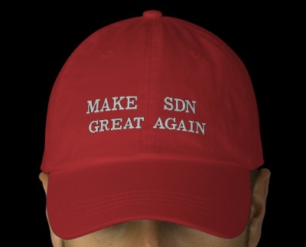
Thesis: Summary

Slide 62
Thesis: Summary
HULA: an efficient non-blocking switch
Efficiency

Slide 63
Thesis: Summary
CacheFlow: logically infinite memory
Flexibility

Slide 64
Thesis: Summary
Ravana: logically centralized controller
Controller
Reliability
Controller
Controller
Controller

Slide 65
A Desirable SDN
Application
Simple programming abstraction
Controller
Reliability
Controller
Controller
Controller
Flexibility
Efficiency
Notes:
The challenge was to implement these abstractions efficiently and at the appropriate timescales without compromising the simplicity of the abstractions from the programmer’s perspective.

Slide 66
Thank You!

Slide 67
Backup slides

Slide 68
Transport Layer (MPTCP)
Leaf Switch
HyperV
OS
TCP1
TCP2
TCPn
Multipath TCP
Socket
APP
Guest VM Changes

Slide 69
HULA: Scalable, Adaptable, Programmable
LB Scheme | Congestion aware | Application agnostic | Dataplane timescale | Scalable | Programmable dataplanes
ECMP
SWAN, B4
MPTCP
CONGA
HULA

Slide 70
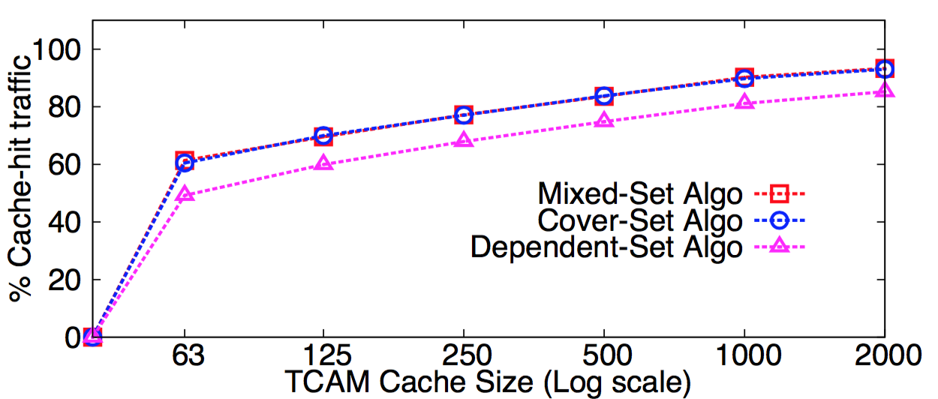
Dependency Chains – Clear Gain
CAIDA packet trace
3% rules
85% traffic
Notes:
To demonstrate the effectiveness of our caching algorithms, we ran our prototype on a CAIDA packet trace taken from the equinox datacenter in Chicago. The packet trace had a total of 610 million packets sent over 30 minutes. Since CAIDA does not publish the corresponding policy, we created a routing policy that matches this traffic and then composed it with a small ACL policy of depth 5. This resulted in 70K OF rules. The mixed-set and cover-set algorithms have sim- ilar cache-hit rates and do much better than the dependent- set algorithm consistently because they splice every single dependency chain in the policy. But more importantly, all three algorithms achieve at least an 85% cache-hit rate at 2000 rules (3% of the rule table) which is the capacity of the Pica8 switch used here.

Slide 71
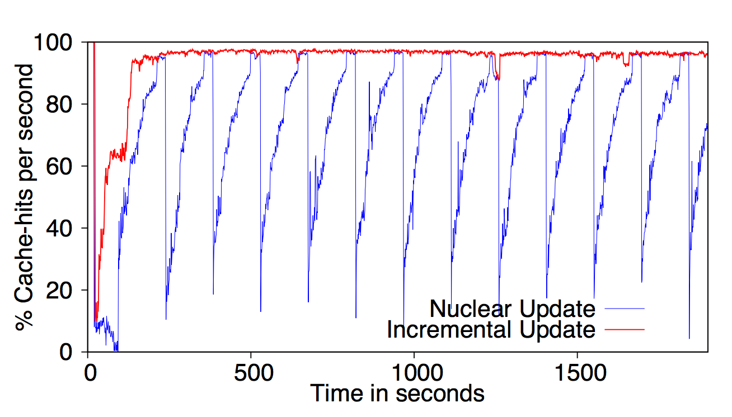
Incremental update is more stable
Notes:
To demonstrate this difference, we ran our prototype on a Classbench generated ACL which contained rules that form long dependency chains with a maximum depth of 10. In our simulation, when we cache 5% of the total rule table in the hardware switch, we running the cover-set algorithm obtains a cache-hit ratio of 90% for 5% of the rules cached in the hardware switch while dependent-set algorithm achieves a cache-hit rate of just 32%. We have also done experiments on rule-tables with shallow dependency chains where the gains are comparatively less as expected.

Slide 72
What causes the overhead?
8.4%
7.8%
5.3%
9.7%
Factor analysis: overhead for each component
Notes:
But in the paper, we also discuss the breakup of this overhead into the various components of the protocol to give a sense of whee the overhead lies. Broadly speaking, the components that contribute the most have to do with event replication and command acknowledgement. Because each one of these require a couple of network RTTs to ensure correctness. It is an interesting question to ask if we can disable the expensive parts of the protoco lfor certain applications – say, can we disable the constraint on total ordering if the order in which the events are being processed is not important etc.

Slide 73
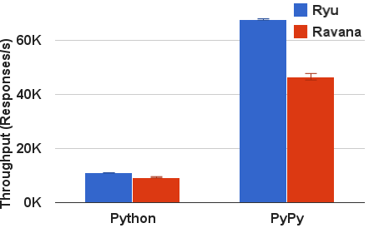
Ravana Throughput Overhead
Measured with cbench test suite
Event-processing throughput: 31.4% overhead
Notes:
If you look at the strongest consistency/correcntess guarantees that the protocol provides, Ravana incurs a 34% overhead compared to the vanilla Ryu platform which has no replications whatsoever. This is the maximum overhead you would have to pay for ensuring strict correctness during failures.

Slide 74
Controller Failover Time
Failure Detection
Role Req
Proc Old Events
0ms
40ms
50ms
75ms
Notes:
In terms of the failover time, our system takes around 40ms to detect failure and elect a new leader (with the help of ZooKeeper), around 10ms to register the new role on the switch and around 25ms to catch up with the old master, a total of 75 ms.

