Slide 1
Capstone Project - The Battle of Neighborhoods
Submitted by : N. Kaviyarasan
07th July 2019

Slide 2
Recommendation Program : Selection of New Food & Beverage Outlet in a Specific Area
United States
New York – Landmarks
Any Specific Park

Slide 3
Business Problem
Business Problem
The client has an established restaurant chain in U.S. successfully running in several parts and the client would like to venture into any of the Parks area in New York city.
The following details are requested by the Client:-
Pickup any park for an example whichever park is in a central area
What are the Nearby attractions
What are the Food & beverage outlets near the location around 1000 meters radius
What type of Outlets (Fast food, Coffee shop, etc)
What type of Cuisines are served in the Outlets

Slide 4
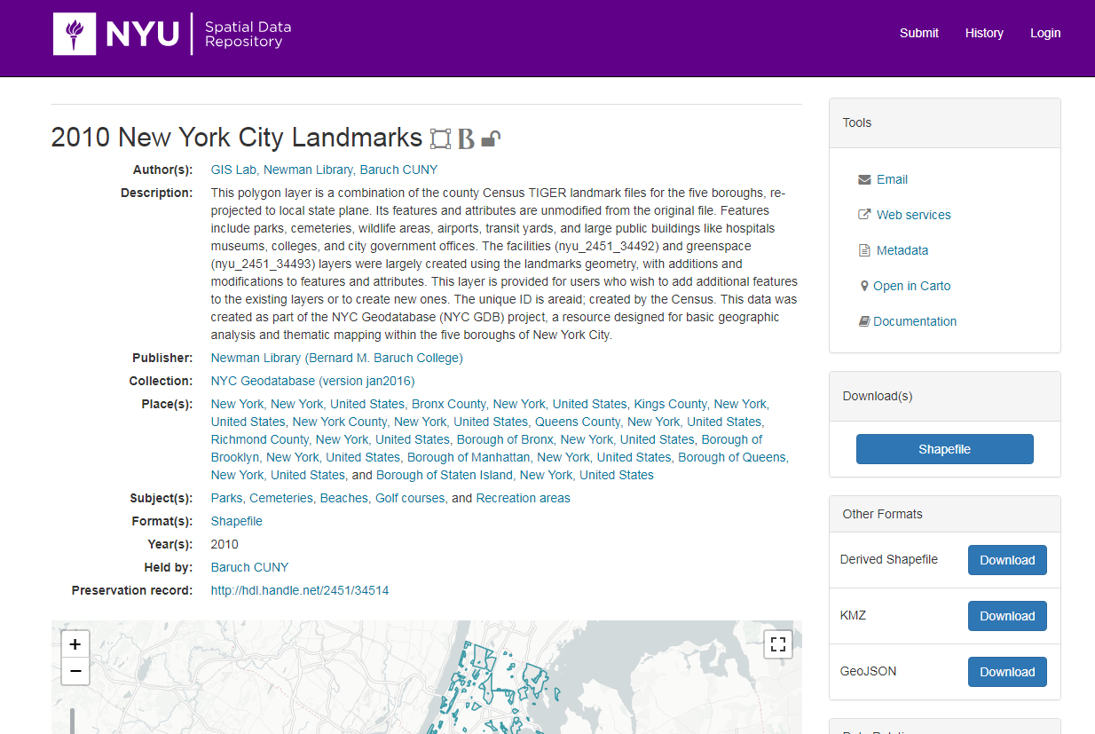
Data Source

Slide 5
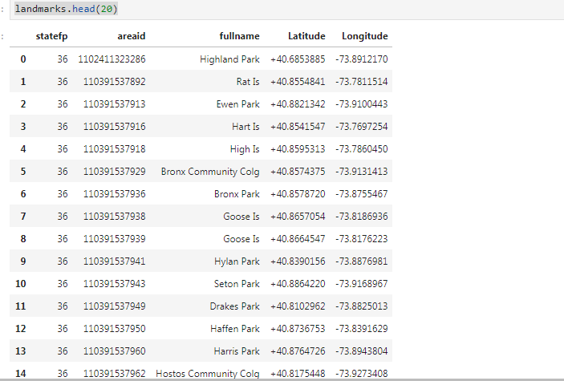
Data Source

Slide 6
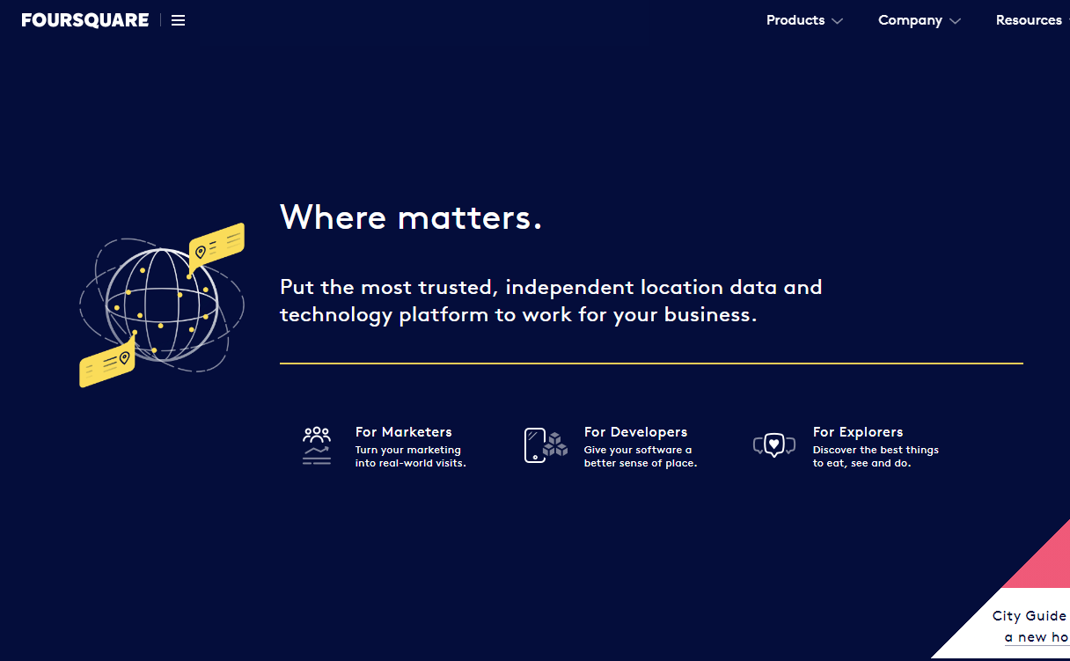
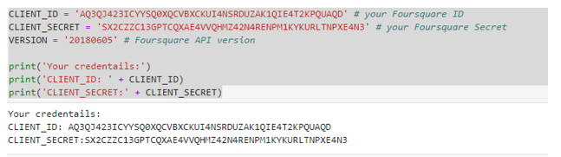
API : Foursquare.com

Slide 7
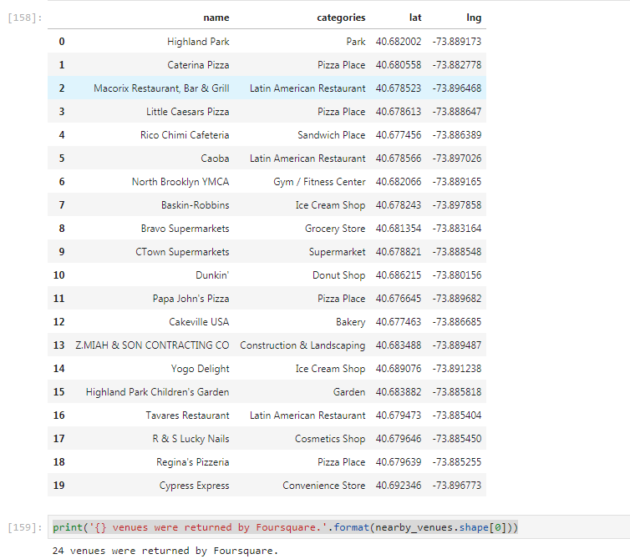
Results

Slide 8
Conclusion
“ Highland Park” has food and beverage outlets of
Ice Cream Shops - 2
Pizza Outlets – 4
Sandwich Shops – 1
Bakery – 1
Latin American Restaurants – 3
Donut Shop – 1
The Client can make a decision as already there are 4 outlets of Pizza shops and the client may introduce new cuisines in the area.
The client can use the test data as any other Park in the above test data to check for any other location or Park.

Slide 9
References
https://foursquare.com/
https://geo.nyu.edu/catalog/nyu-2451-34514

