Slide 1

Text-mining Approach for Transforming Nursing Narrative Data into Quantifiable Data: An Automated Extraction Tool
Mikyoung Angela Lee, PhD, RN
Associate Professor

Slide 2
Background
It is crucial that nurses clearly verify the values of nursing interventions for the improvement of patient outcomes.
However,
For nurse scientists
Ability (data resources, readiness, capacity, etc.) to electronically obtain valid and comparable nursing data?

Slide 3
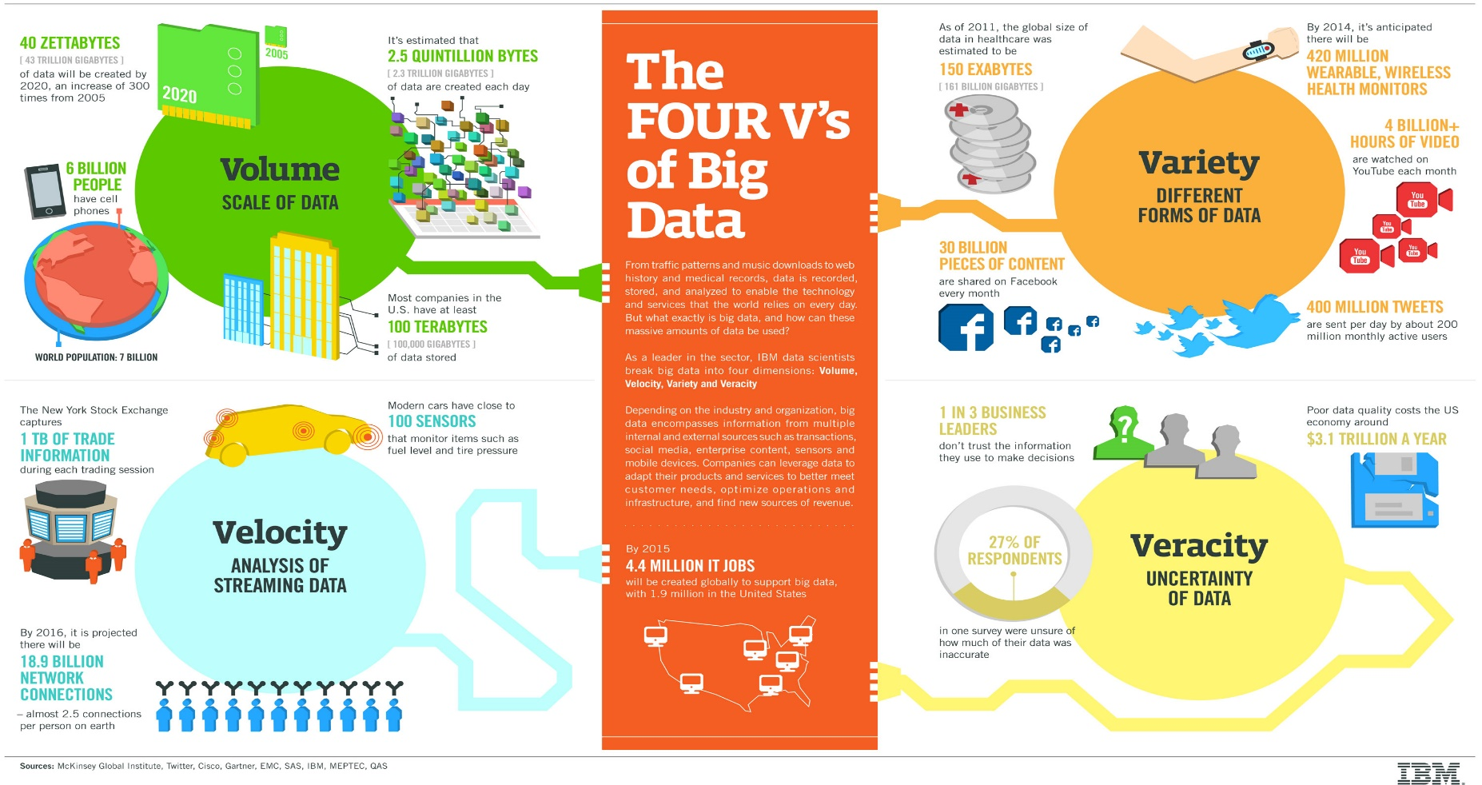
Background
Big Data Characteristics in Nursing

Slide 4
Background
The importance of “computable” nursing data and databases have been long recognized and led to the development of standardized nursing terminologies (SNTs) to represent nursing interventions and outcomes.
Nurses’ free-text records to document care processes and patient outcomes.
Free-text records, which may produce rich information on nursing phenomena yet incomputable, have been of limited use for generating nursing information and knowledge.

Slide 5
Purpose
Develop and test an automated extraction tool to extract and transform the narrative nursing notes to quantifiable data in SNTs.

Slide 6
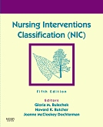
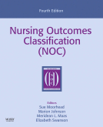
Methodology
The nursing narrative notes were collected from a retrospective nursing record review of patients admitted to a community hospital with the diagnosis of Septicemia.
SNTs used for mapping
    Nursing Interventions Classification (NIC) is a comprehensive, standardized classification of nursing interventions. It includes a list of independent and collaborative interventions, as well as direct and indirect interventions. The fifth edition of NIC comprises 7 domains, 30 classes, 542 interventions, and thousands of nursing activities.
    Nursing Outcomes Classification (NOC) is a comprehensive standardized classification of patient outcomes that can be used to evaluate the results of nursing interventions. The NOC is composed of 385 nursing-sensitive outcomes labels and over 5000 indicators grouped into 31 classes and 7 domains.

Slide 7
Methodology
Automated Nursing Information Extraction System (ANGIES) was developed using natural language processing
    The GUI - NetBeans IDE and Perl programming language.
    Tokenizing each sentence to identify single word term candidates, stemming them, lexical collocations to coordinate the words into meaningful information (phrases/sentences), and mapping them into labels and indicators of SNTs were accomplished by using Regular Expressions.
    The validation of the tool was completed by comparing the result from the use of the tool with the result from the manual mapping by 2 nursing experts, which was considered as the gold standard.

Slide 8
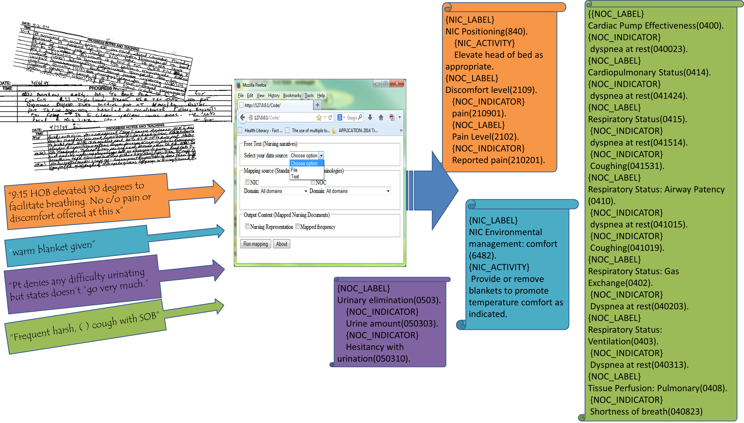
Features

Slide 9
Results
A total of 25588 words from nursing narrative records of 14 patients were used.
On average 52 parsed phrases or sentences per nursing record were mapped.
In total, 768 labels of NIC and 4733 indicators of NOC were mapped, including the duplicates.
Compared with the manually mapped terms (the gold standard), the automated mapping tool showed the accuracy rates ((True positive + True negative)/The Overall mapped), 80.6% with NIC and 74.8% with NOC.

Slide 10
Results
The most frequently mapped descriptors of NIC:
  ‘Report changes in patient status’ under the label of ‘Physician Support (7710).’
The most commonly mapped indicators of NOC:
  ‘Coughing (041019)’ under the label of ‘Respiratory Status: Airway Patency.’
Nurses were likely to document their observations of patient status than what nursing interventions were provided.

Slide 11
Conclusion/Implications
The Automated Nursing Information Extraction System (ANGIES) showed high performance at the initial stage.
The validation of the tool will be continuously tested with more nursing narratives data.
It is expected that the tool will be useful for transforming nursing information with SNTs into quantifiable and comparable data, which consequently can be used for nursing effectiveness research.
It can be used for outcomes analyses, regulatory quality report generation, and text analysis for finding appropriate nursing literature and capturing nursing concepts in qualitative research.
The study findings can also contribute to the development and refinement of SNTs to more accurately represent nursing practice.

Slide 12

Thank You!
Contact:
  Mikyoung Angela Lee, PhD, RN (MikyoungLee@twu.edu)

