Slide 1


A New Approach to Estimate Event Occurrences in Large Longitudinal Incomplete Clinical Data
Lisiane Pruinelli, PhD, MS, RN
OptumLabs Visiting Fellow
School of Nursing
University of Minnesota
Minneapolis, MN, US

Slide 2
Reference: 2019 IEEE International Conference on Health Informatics Proceedings.

Slide 3
Problem
Transplantation is the treatment of choice for severe end liver disease
30,352 procedures worldwide in 2016 (8,250 in the US-2018)
US expenditures around $4.9 billion in 2014 – forecast increase of 33% in 10 years
The most common measured outcome is survival (65% - 79.1%)
Scarcity of organs and uncertainty of prognosis
Heterogeneous clinical presentation
Emphasis on physiologic risk factors

Slide 4
Overall objective
To model predictors of the survival for patients receiving liver transplant, and compare how different groups have different and/or similar health outcomes according to their risk factor characteristics.

Slide 5
OptumLabs® Data Warehouse (OLDW) approach
UNIFIED - Claims and EHR data
EHR versus transplant registry
Single center versus OLDW

Slide 6
Estimating LT dates
1. The timeline is divided into non-overlapping two-week time periods
2. Logistic regression model
3. A change point detection procedure – Convolution of Signal
4. Additional rules to select a single date from the selected two-week period.
Evaluation: split 80-20 between training and test patients.
Notes:
A logistic regression model was constructed predicting whether the period is fully after the event of interest or not
A change point detection procedure from the field of signal processing to identify the period with the most likely point at which the event occurred

Slide 7
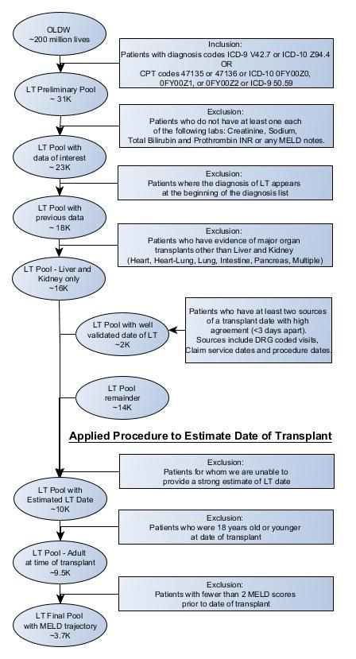
Preliminary Results
Cohort identification

Slide 8
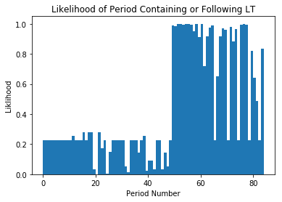
Logistic Model Results
 | Coefficient | SE | p-value
Intercept | -1.22 | 0.05 | <0.001
LT diagnosisª | 15.16 | 1.62 | <0.001
After care diagnosis | 2.78 | 0.20 | <0.001
Awaiting organ diagnosis | -0.46 | 0.06 | <0.001
LT complication diagnosis | 0.67 | 0.14 | <0.001
Pre-procedure examination diagnosis | -0.16 | 0.03 | <0.001
Anesthesia procedure | 0.18 | 0.04 | <0.001
Immunosuppressor use | 1.12 | 0.29 | <0.001
Notes:
(a) the number of liver transplant diagnosis codes as a percent of the total number of diagnosis, (b) the number of diagnosis codes related to aftercare following organ transplant or change and removal or surgical wound dressing, (c) the number of diagnosis codes indicating that the individual is awaiting organ transplant, (d) the number of diagnosis codes indicating complications of liver transplant, (e) the number of diagnosis codes related to pre-operative examinations, (f) the number of procedure records relating to anesthesia, and (g) the number of procedure records relating to the administration of Tacrolimus, the most common used immunosuppressant for LT.

Slide 9
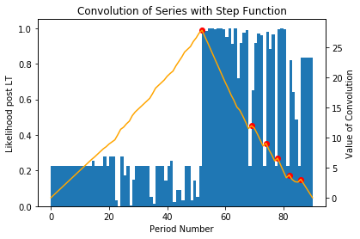
Convolution of Signal

Slide 10
Method Evaluation
Mean error = 18 days (median = 0).
The majority (84%) had an error less than one week
92% had the errors fall within two weeks of the true date
Notes:
The mean absolute error is 18 days and the median error is 0 days. On the vast majority of the data set (84%), the error (absolute difference between the predicted and true transplant dates in days) is less than one week and for almost the entire data set (92%), the errors fall within two weeks of the true date.

Slide 11
Conclusions
This is the first study to develop a method to estimate event occurrence in longitudinal clinical data
Incorporating probability likelihood derived from the GEE into the convolution of signals, we obtained a model that perform better than if the process is used alone
The approach provides parameters where we can identify what are the estimates that are not very accurate, and offer room to further validation
This is replicable to any other major events from large, incomplete, longitudinal data

Slide 12
Acknowledgments
Lisiane Pruinelli, University of Minnesota is a Visiting Fellow at OptumLabs. Data for this study was obtained from the OptumLabs Data Warehouse, a database of health claims, clinical, demographic and other data elements. Study data were accessed using techniques compliant with the Health Insurance Portability and Accountability Act of 1996 (HIPAA) and, because this study involved analysis of pre-existing, de-identified data, it was exempt from Institutional Review Board approval.
This study was funded by the University of Minnesota Grant-in-Aid of Research, Artistry and Scholarship (GIA) #212912.

