Slide 1
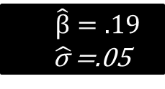
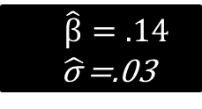
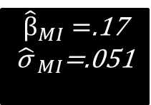
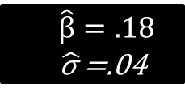
m=3 MI datasets
Regress Age on Weight
Analysis
Age | Weight | Height
24 | 170 | 70
28 | 160 | 68
20 | 155 | 65
⁞ | ⁞ | ⁞
$\hat{β}=.14$
$\hat{\text{σ} }$=.03
Pooled Result
Original data
Age | Weight | Height
24 | ? | 70
28 | 160 | ?
20 | 155 | 65
⁞ | ⁞ | ⁞
Age | Weight | Height
24 | 150 | 70
28 | 160 | 64
20 | 155 | 65
⁞ | ⁞ | ⁞
${\hat{β}}_{MI}=$.17
${\hat{\text{σ} }}_{MI}$=.051
$\hat{β}=.19$
$\hat{\text{σ} }$=.05
Age | Weight | Height
24 | 163 | 70
28 | 160 | 66
20 | 155 | 65
⁞ | ⁞ | ⁞
$\hat{β}=.18$
$\hat{\text{σ} }$=.04

Slide 2

M=3 MI datasets
Age | Weight | Height
24 | 170 | 70
28 | 160 | 68
20 | 155 | 65
⁞ | ⁞ | ⁞
24 | 150 | 70
28 | 160 | 64
20 | 155 | 65
⁞ | ⁞ | ⁞
24 | 163 | 70
28 | 160 | 66
20 | 155 | 65
⁞ | ⁞ | ⁞
Age | Weight | Height
24 | 170 | 70
28 | 160 | 68
20 | 155 | 65
⁞ | ⁞ | ⁞
Regress Age on Weight
Pooled Result
Original data
Age | Weight | Height
24 | 150 | 70
28 | 160 | 64
20 | 155 | 65
⁞ | ⁞ | ⁞
$${\hat{β}}_{stack}=$$
.17
Age | Weight | Height
24 | ? | 70
28 | 160 | ?
20 | 155 | 65
⁞ | ⁞ | ⁞
Age | Weight | Height
24 | 163 | 70
28 | 160 | 66
20 | 155 | 65
⁞ | ⁞ | ⁞

Slide 3
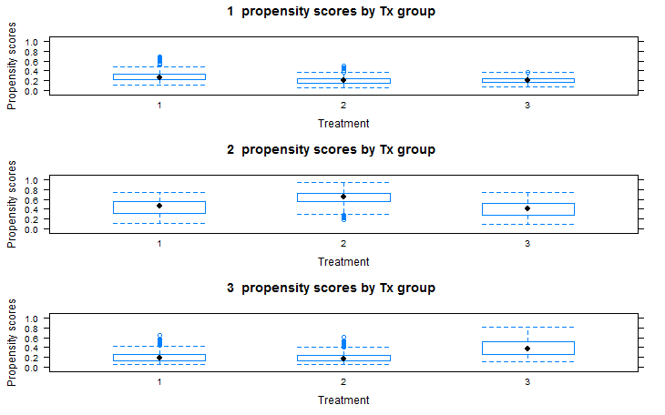
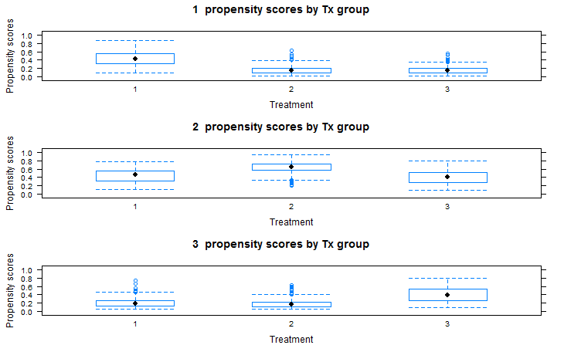

Slide 4
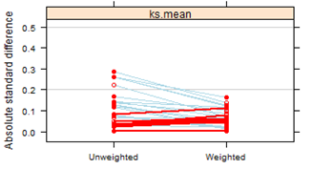
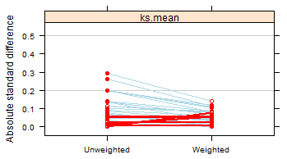
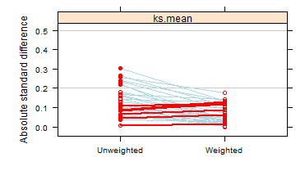
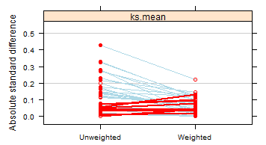
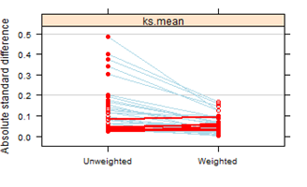
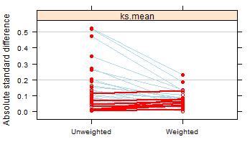
Cape. Vs. Other
Cape. Vs. Other
Cape. Vs. none
Cape. Vs. none
Other Vs. None
Other Vs. None

Slide 5



Drug: Observed
Survival
Time
No Drug: Counterfactual (unobserved)
Pretreatment
Post treatment

Slide 6
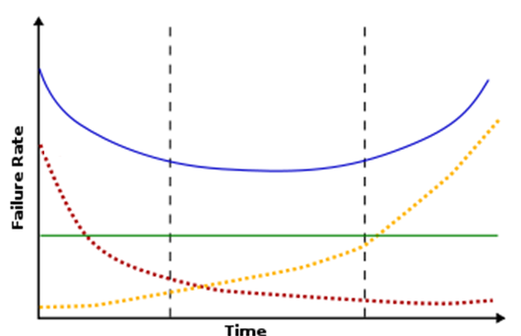
Bathtub
Hazard
Early
Late
Constant
Time

Slide 7
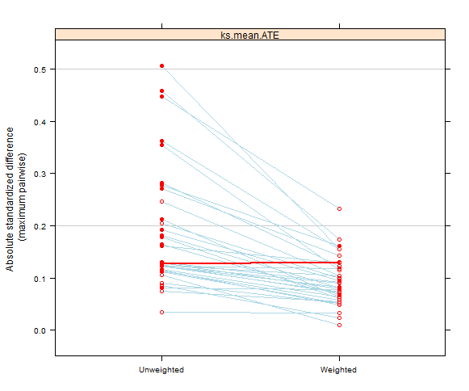
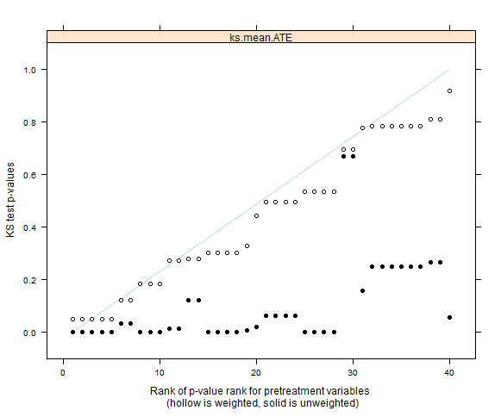
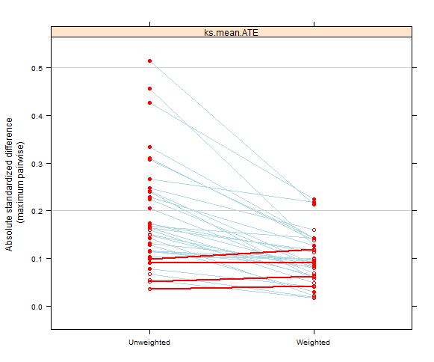
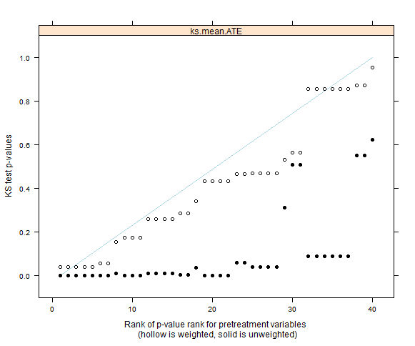

Slide 8
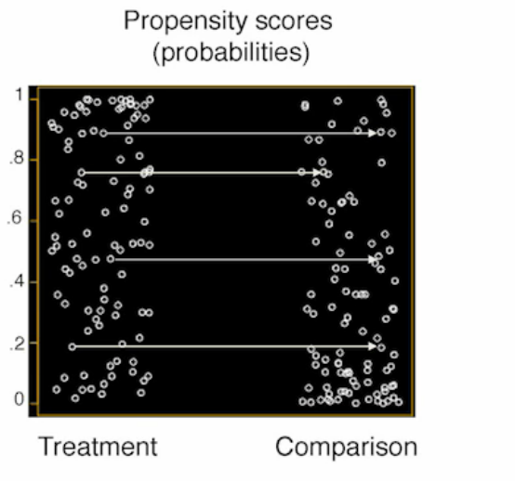
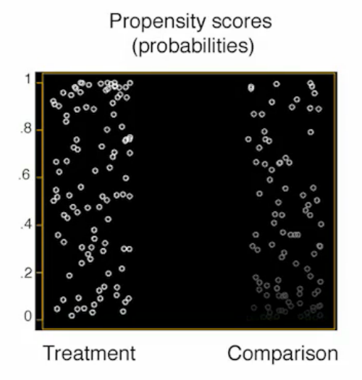

Slide 9
Data obtained from MDACC
Multiple Imputation:
m=50
40 iterations
Survival Analysis:
Kaplan-Meier
Log-Rank test
Cox model
Causal Analysis:
IPTW weighted Cox model

Slide 10
par(mfcol=c(2,2))
xydat=data.frame(x=rnorm(50),y=rnorm(50),col=rep(NA,50))
#mcar
xydat$col=sample(c("red","black"),50,replace=TRUE)
plot(xydat$x,xydat$y, col=xydat$col,xlab="Data with missingness",
ylab="Fully observed data",main="MCAR")
#mnar
xydat$col=ifelse(xydat$x<0,"red","black")
plot(xydat$x,xydat$y, col=xydat$col,xlab="Data with missingness",
ylab="Fully observed data",main="MNAR")
#MAR
xydat$col=ifelse(xydat$y<0,"red","black")
plot(xydat$x,xydat$y, col=xydat$col,xlab="",
ylab="Fully observed data",main="MAR")
#legend(1,1,c("Observed", "Missing"), pch = c(1), col = c("red","black"))
plot.new()
legend("top",c("Observed", "Missing"), pch = c(1), col = c("red","black"))
# par(oma = c(4, 1, 1, 1))
# par(fig = c(0, 1, 0, 1), oma = c(0, 0, 0, 0), mar = c(0, 0, 0, 0), new = TRUE)
# plot(0, 0, type = "n", bty = "n", xaxt = "n", yaxt = "n")
# legend("bottom", c("observed","missing"), xpd = TRUE, horiz = TRUE, inset = c(0, 0),
# bty = "n", pch = 1, col = c("red","black"), cex = 2)
# xpd = TRUE tells R that it is OK to plot outside the region horiz = TRUE
# tells R that I want a horizontal legend inset = c(x,y) tells R how to move
# the legend relative to the 'bottom' location bty = 'n' means that 'no' box
# will be drawn around it pch and col are the types and colors of points cex
# = 2 makes the legend twice as large as other fonts
Code for
Missingness
plots

Slide 11
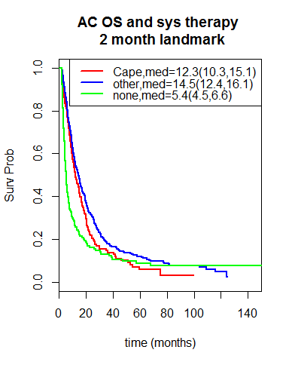
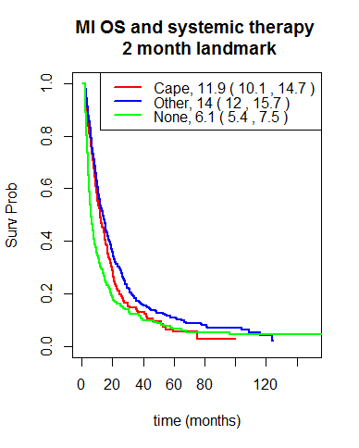

Slide 12

Propensity Score
Matching
Propensity Score
Weighting

Slide 13
plot(survfit(Surv(os,dead)~factor(ECOG01),data=data,subset=os>2),col=c("red","blue"),mark.time = FALSE,xlab="Months",ylab="Survival",main="Survival by ECOG Classification")
legend("topright",title="ECOG Score",
c("0,1",">2"), col=c("blue","red"),lty=1 )
abline(h=.5)

Slide 14
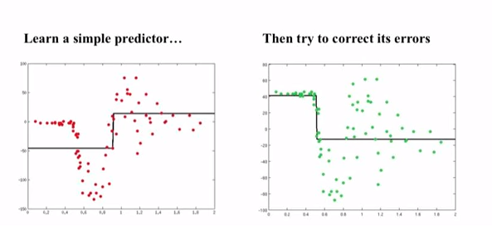
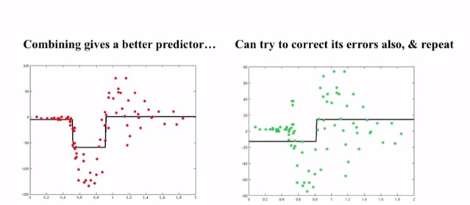
https://www.youtube.com/watch?v=sRktKszFmSk

