Slide 1
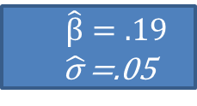
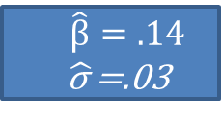
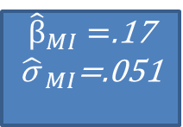
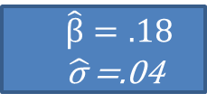
M=3 MI datasets
Regress Age on Weight
Analysis
Age | Weight | Height
24 | 170 | 70
28 | 160 | 68
20 | 155 | 65
⁞ | ⁞ | ⁞
$\hat{β}=.14$
$\hat{\text{σ} }$=.03
Pooled Result
Original data
Age | Weight | Height
24 | ? | 70
28 | 160 | ?
20 | 155 | 65
⁞ | ⁞ | ⁞
Age | Weight | Height
24 | 150 | 70
28 | 160 | 64
20 | 155 | 65
⁞ | ⁞ | ⁞
${\hat{β}}_{MI}=$.17
${\hat{\text{σ} }}_{MI}$=.051
$\hat{β}=.19$
$\hat{\text{σ} }$=.05
Age | Weight | Height
24 | 163 | 70
28 | 160 | 66
20 | 155 | 65
⁞ | ⁞ | ⁞
$\hat{β}=.18$
$\hat{\text{σ} }$=.04

Slide 2

M=3 MI datasets
Age | Weight | Height
24 | 170 | 70
28 | 160 | 68
20 | 155 | 65
⁞ | ⁞ | ⁞
24 | 150 | 70
28 | 160 | 64
20 | 155 | 65
⁞ | ⁞ | ⁞
24 | 163 | 70
28 | 160 | 66
20 | 155 | 65
⁞ | ⁞ | ⁞
Age | Weight | Height
24 | 170 | 70
28 | 160 | 68
20 | 155 | 65
⁞ | ⁞ | ⁞
Regress Age on Weight
Pooled Result
Original data
Age | Weight | Height
24 | 150 | 70
28 | 160 | 64
20 | 155 | 65
⁞ | ⁞ | ⁞
$${\hat{β}}_{stack}=$$
.17
Age | Weight | Height
24 | ? | 70
28 | 160 | ?
20 | 155 | 65
⁞ | ⁞ | ⁞
Age | Weight | Height
24 | 163 | 70
28 | 160 | 66
20 | 155 | 65
⁞ | ⁞ | ⁞

Slide 3
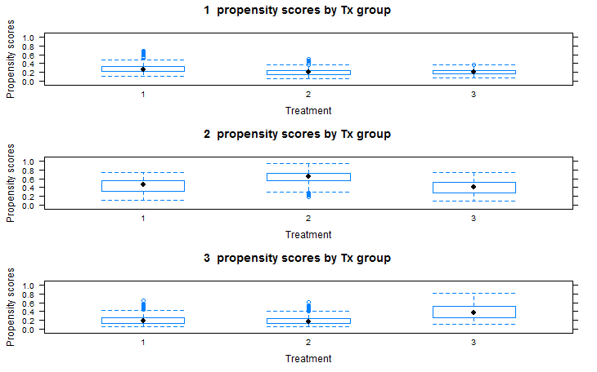
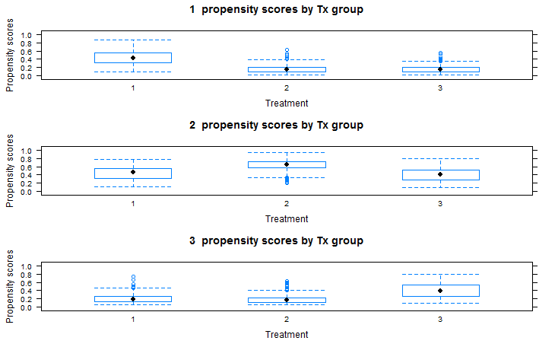

Slide 4
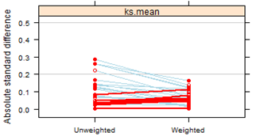
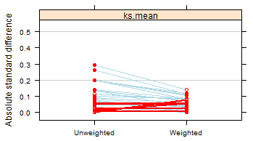
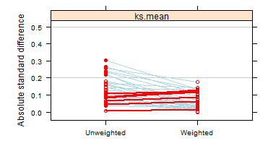
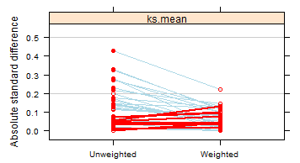
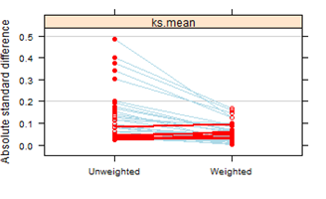
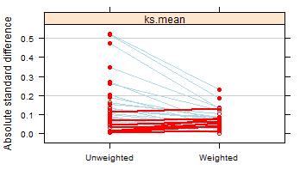
Cape. Vs. Other
Cape. Vs. Other
Cape. Vs. none
Cape. Vs. none
Other Vs. None
Other Vs. None

Slide 5



Placebo: Counterfactual (unobserved)
Weight
Drug: Observed
Pretreatment
Post treatment

Slide 6
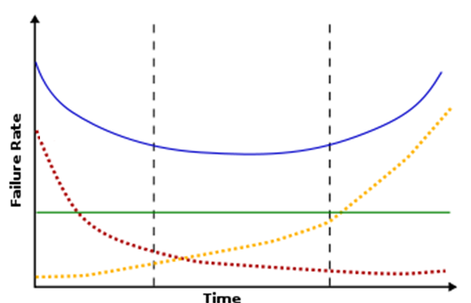
Bathtub
Hazard
Early
Late
Constant
Time

Slide 7
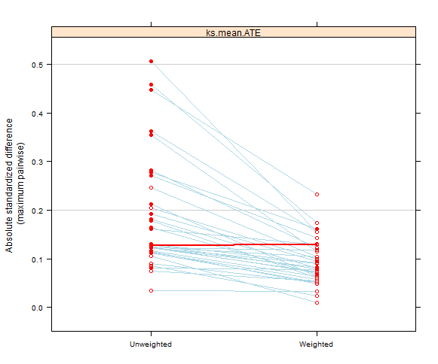
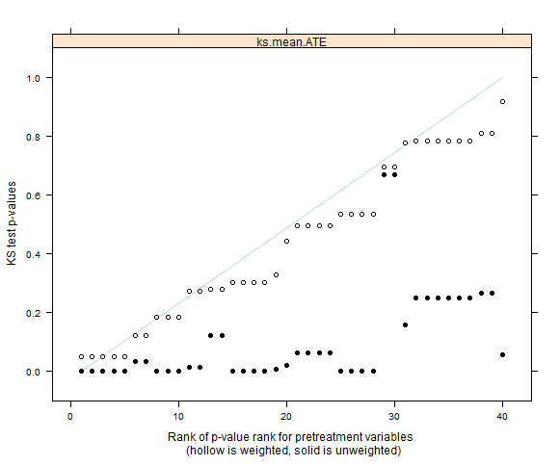
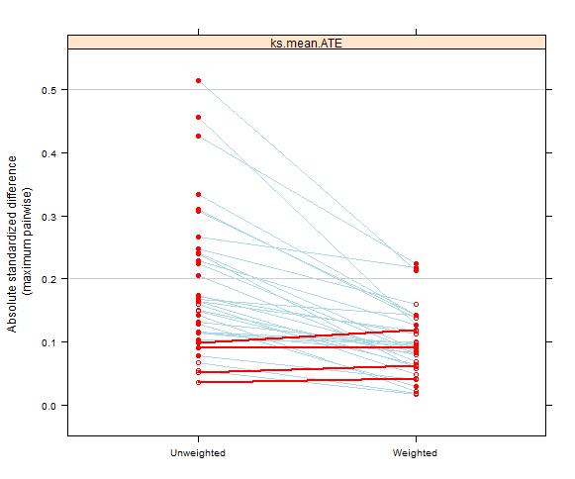
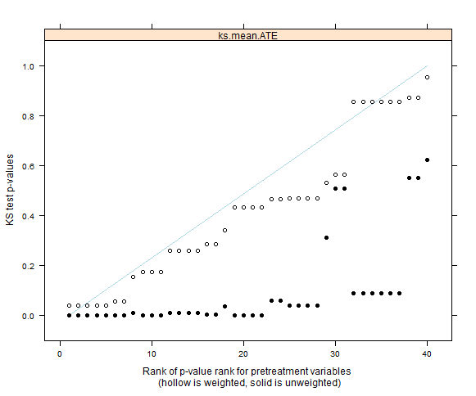

Slide 8
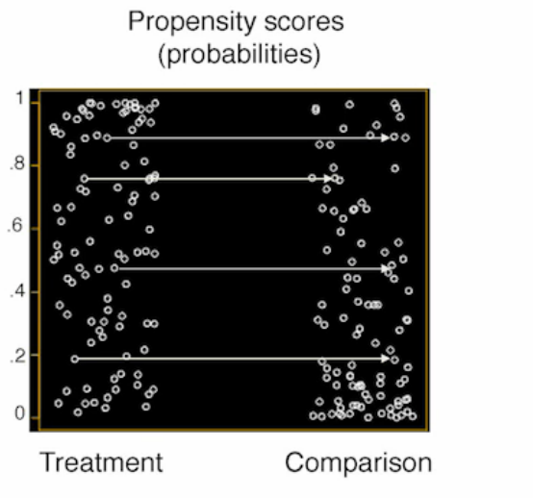
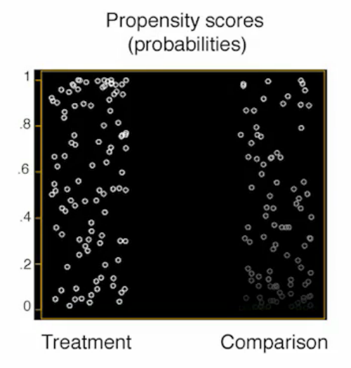

Slide 9
Data obtained from MDACC
MI via FCS
M=50
40 iterations
Kaplan-Meier
Log-Rank test
Cox model
IPTW weighted Cox model
Doubly robust IPTW Cox Model

Slide 10
par(mfcol=c(1,3))
#mcar
xydat$col=sample(c("red","blue"),50,replace=TRUE)
plot(xydat$x,xydat$y, col=xydat$col,xlab="Data with missingness",
ylab="Fully observed data",main="MCAR")
#mnar
xydat$col=ifelse(xydat$x<0,"red","blue")
plot(xydat$x,xydat$y, col=xydat$col,xlab="Data with missingness",
ylab="Fully observed data",main="MNAR")
#MAR
xydat$col=ifelse(xydat$y<0,"red","blue")
plot(xydat$x,xydat$y, col=xydat$col,xlab="Data with missingness",
ylab="Fully observed data",main="MAR")
legend(1,1,c("Observed", "Missing"), pch = c(1), col = c("red","blue"))
Code for
Missingness
plots

